Slide 1
Psychological First Aid in Radiation Disasters
Leeanna Allen, MPH, CHES
Oak Ridge Institute for Science and Education
March 21, 2011
National Center for Environmental Health
Division of Environmental Hazards and Health Effects

Slide 2
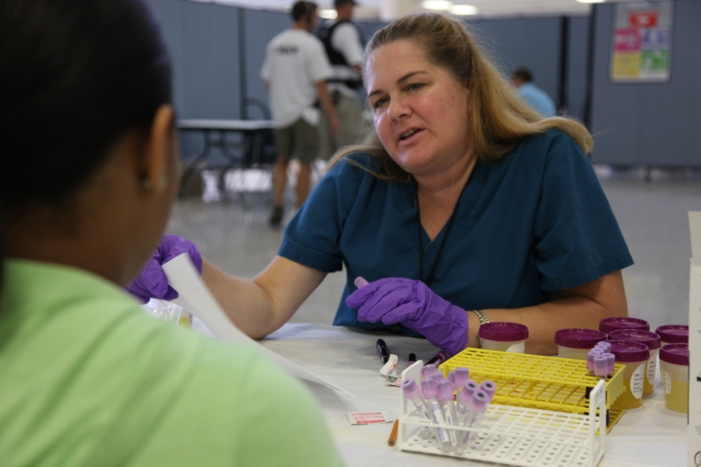
Objectives
Identify the unique psychological effects of radiation disasters
Define skills and techniques used when performing psychological first aid in radiation disasters

Slide 3
What is Psychological First Aid?
Psychological First Aid is a way to help reduce the initial distress caused by traumatic events
Designed to be:
Consistent with research evidence on risk and resilience following trauma
Applicable and practical in the field
Culturally informed and flexibly delivered

Slide 4
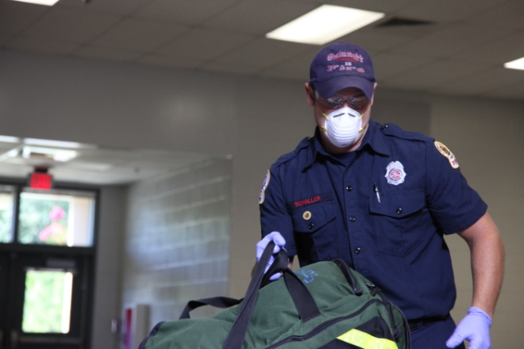
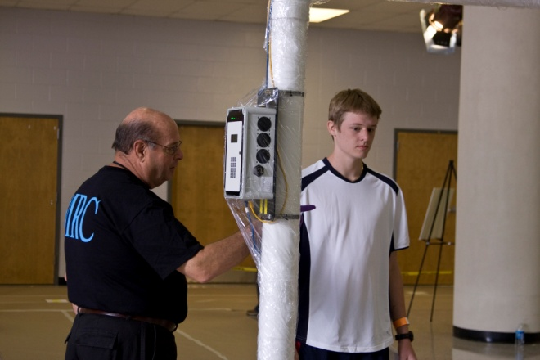
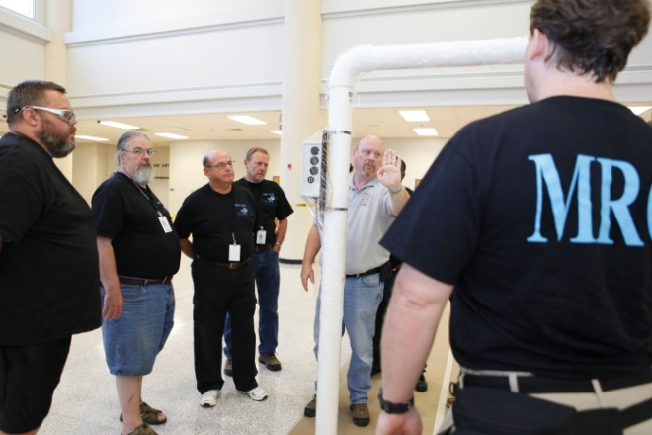
Example of Roles for the Public Health/Medical Community in a Radiation Disaster
Medical Triage and Treatment
Population Monitoring
Risk Communication and Public Information
Establishing Clinical Registries
Sheltering Displaced Populations

Slide 5
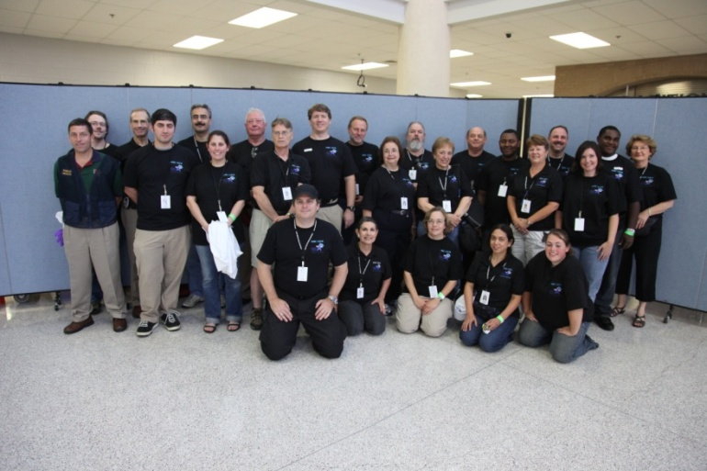
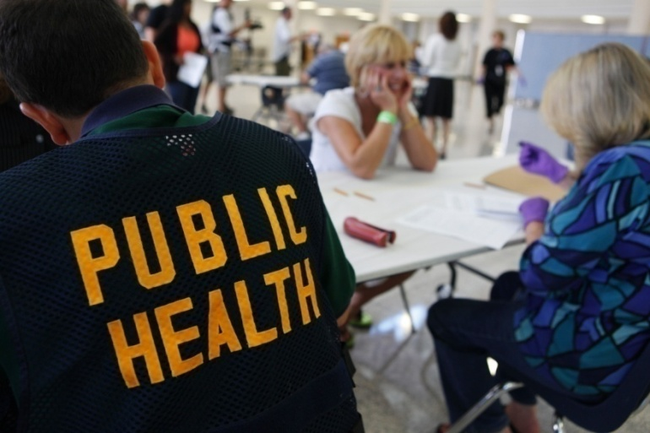
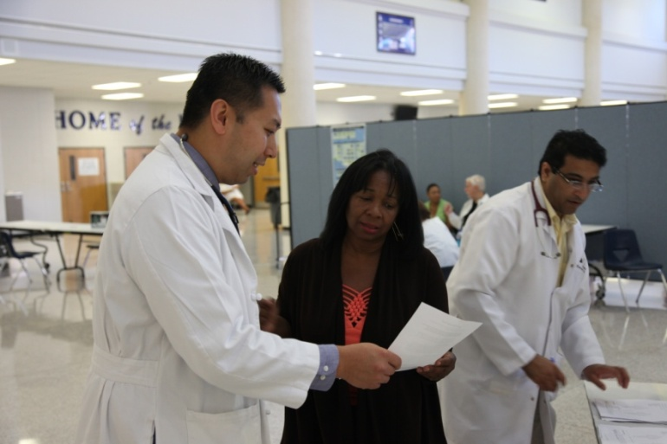
Who may need to administer Psychological First Aid?

Slide 6
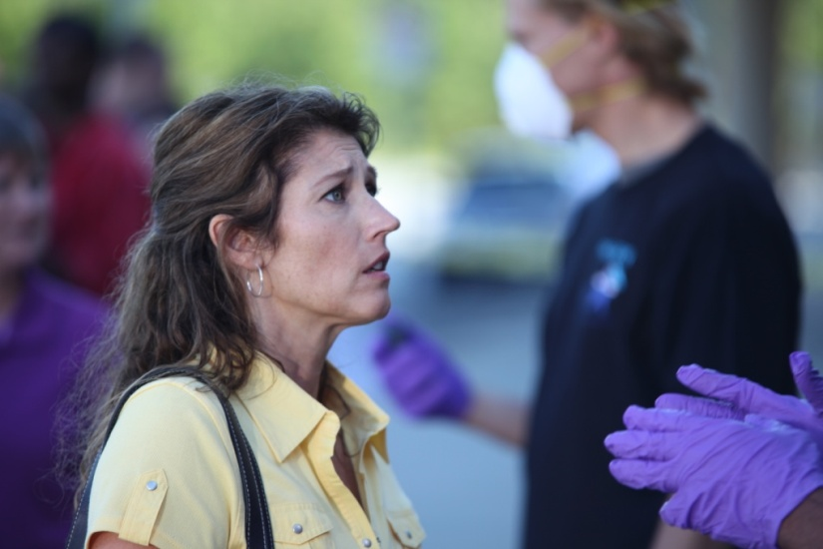
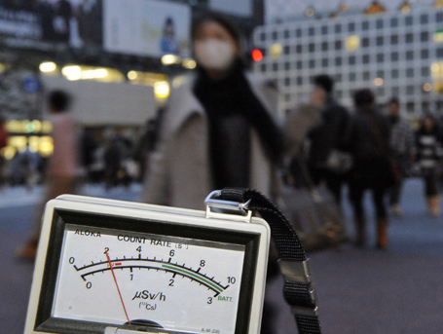
Radiation Disasters are Different
Radiation is:
Invisible
Silent
Odorless
Can only be detected with specialized equipment
Radiation concepts, terms, and risks are poorly understood by the public
Fear
Fatalism

Slide 7
Social Stigma
Can be experienced by those contaminated or potentially contaminated
People may choose not to assist victims of radiation disasters
Lack of social support hinders resilience and recovery efforts
Stigma can also be associated with receiving mental health services

Slide 8
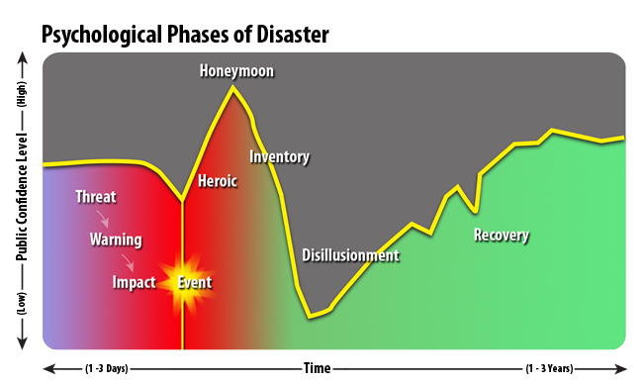

Slide 9
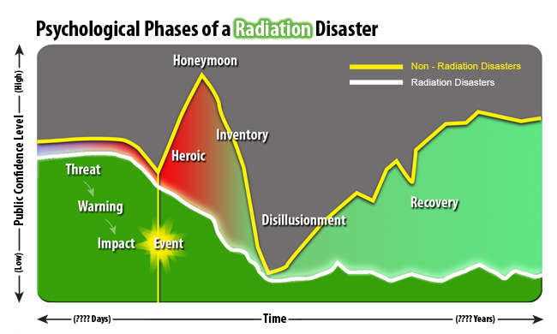

Slide 10
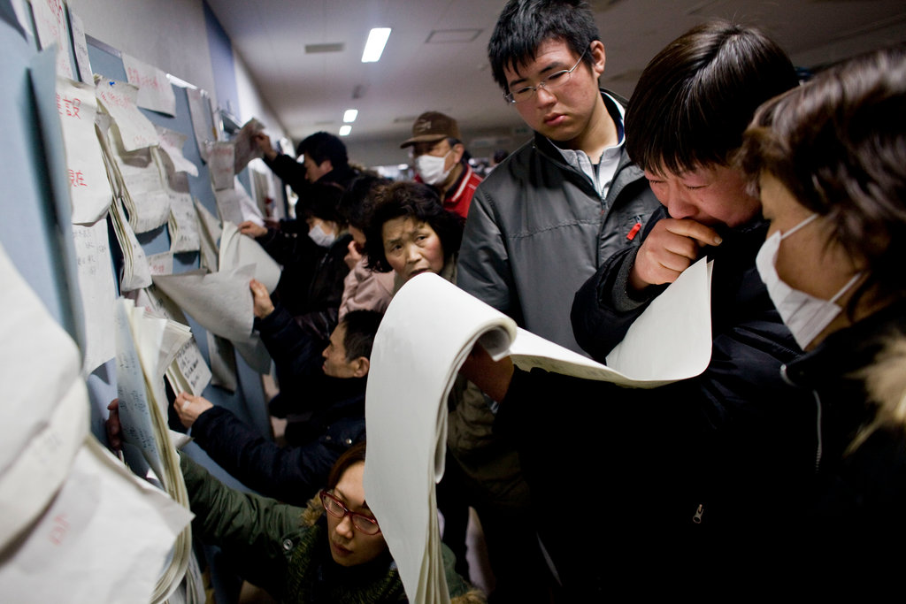
Psychological First Aid in Radiation Disasters
Do:
Don’t:
Actively engage
Provide accurate information
Listen
Use open posture
Use a soft tone of voice
Ask simple questions
Make referrals if necessary
Be respectful
Make promises you cannot keep
Force people to share their stories
Give simple reassurances
Criticize response or relief efforts

Slide 11
Use Psychological First Aid to Promote:
Safety
Provide repeated, simple, and accurate information on how to meet basic needs
Calm
Speak calmly and be compassionate and friendly
Connectedness
Keep families together
Self-Efficacy
Give practical suggestions to help empower survivors
Help
Direct people to available services

Slide 12
Psychological First Aid in Radiation Disaster Training
Multimedia training product (approx. 75 minutes)
Highlights the unique psychological effects of radiation disasters
CD-ROM or web training
Used as a supplement to existing psychological first aid training
Instructor materials available for trainers

Slide 13
Psychological First Aid in Radiation Disaster Training
Overview of Radiation Disasters
Interview with physicians who observed radiation disaster involving abandoned medical equipment in Goiânia, Brazil
Psychosocial Reactions to Radiation Disasters
Interviews with psychologist and his son, who lived near the Three Mile Island nuclear power reactor near Harrisburg, Pennsylvania
Psychological First Aid in Radiation Disasters
Call Center
Community Reception Center
Hospital

Slide 14
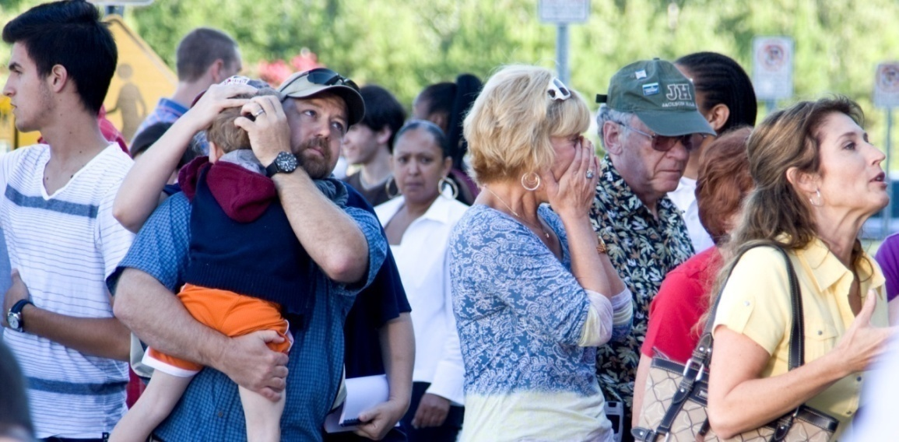
Summary
Population monitoring and addressing psychosocial issues will be major components of the response to a radiation or nuclear incident
Existing plans and protocols can be modified to address specific radiation concerns

Slide 15
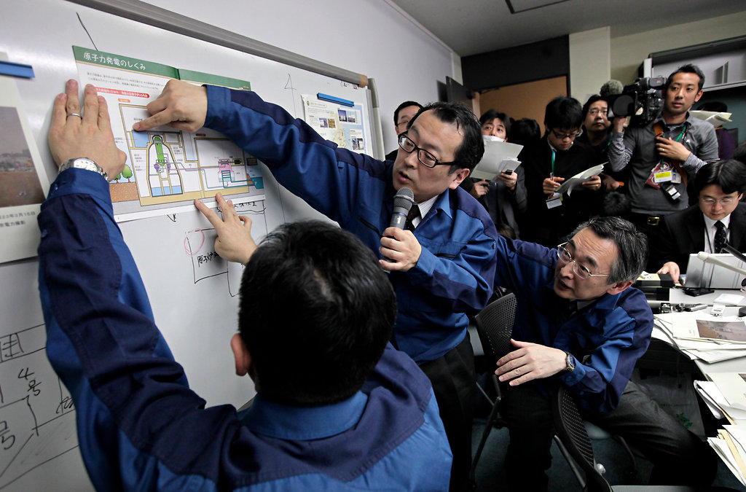
Communications and Public Information in Radiation Disasters
Leeanna Allen, MPH, CHES
Oak Ridge Institute for Science and Education
March 21, 2011
National Center for Environmental Health
Division of Environmental Hazards and Health Effects

Slide 16
Objectives
Identify unique communication issues in radiological emergencies
Describe “best practices” as defined by CDC communications research
Discuss recent message testing project for communications following an IND (Improvised Nuclear Device) event

Slide 17
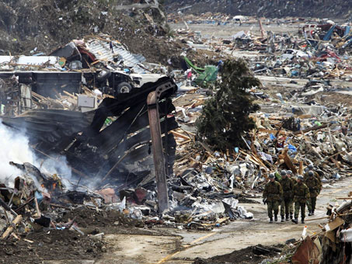
Communicating in a Crisis
People process information differently
Stress can reduce the ability to process information by 80%
Radiation concepts and terms are poorly understood by the public
In some cases, communications infrastructure could be disabled, or even destroyed

Slide 18
Recent Examples
"I still have no idea what the numbers they are giving about radiation levels mean. It's all so confusing. And I wonder if they aren't playing down the dangers to keep us from panicking. I don't know who to trust.“
Tsugumi Hasegawa, age 29, living with her young daughter in a shelter with 1,400 other people on the outskirts of Fukushima city, 80 miles (50 miles) away from the plant
From “Japan’s efforts to ease nuke crisis hit setback”, Mary Yamaguchi, AP 3/20/2011

Slide 19
Communication Goals
Effective communication in radiation emergencies can:
Decrease illness, injury, and death
Facilitate response and recovery efforts
Avoid misallocation of limited resources
Reduce rumors
Minimize medically unnecessary self-referrals to hospitals and other critical facilities

Slide 20
“The success of every communication, from providing technical expertise to political appointees to safety information to response teams depends on the ability to develop clear, consistent messaging and deliver those messages effectively.”
-Planning Guidance for Response to a Nuclear Detonation, second edition, June 2010

Slide 21
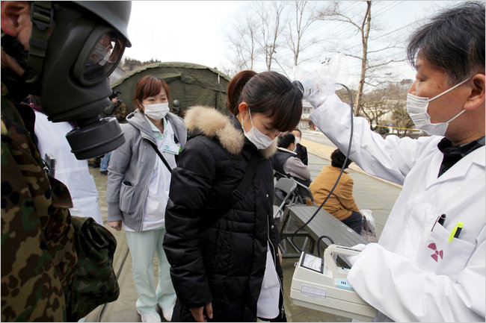
Key Communications Questions
Are we meeting audience needs for information?
How can we bridge the gap between technical information and risk perception?
How can we describe radiation in ways that promote responsible public action?

Slide 22
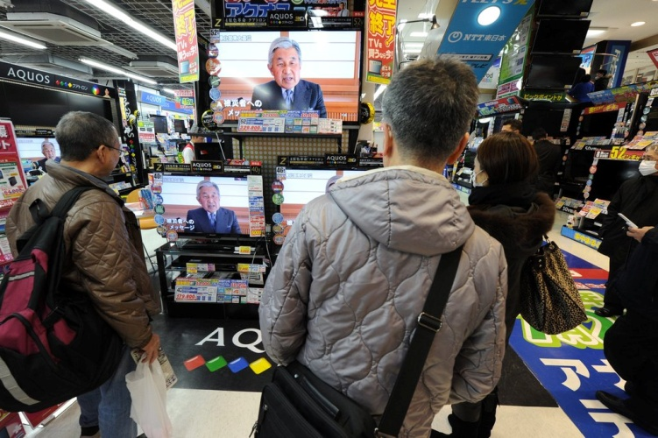
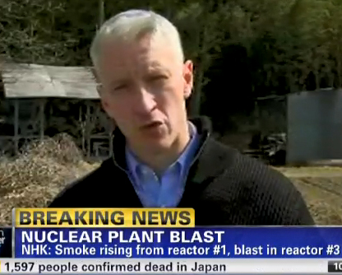
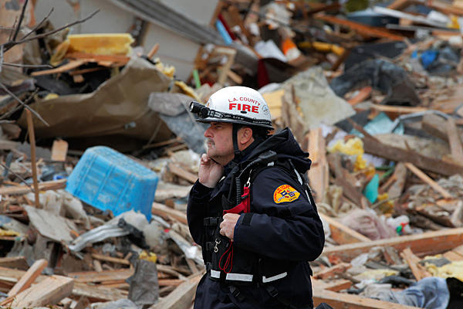
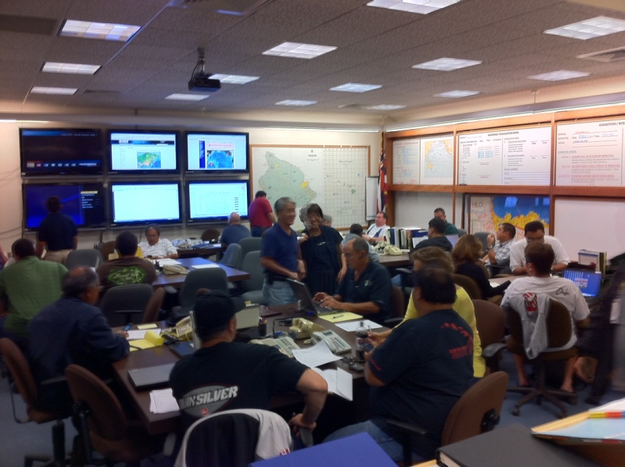
Key Target Audiences
Public
Impacted Area
Nationwide
Public Health Professionals
Emergency Services Clinicians

Slide 23
CDC Audience Research
Focus group testing of knowledge, abilities and beliefs (2002-2003)
Cognitive interview testing of messages (2008)
Secondary research (lit search) (2008)
Message testing with public health professionals (2008)
HealthStyles® survey of knowledge and abilities (2009)
Spanish message testing (2010)
Focus group testing of draft messages for a post-IND event (2011)

Slide 24
Testing selected messages from the draft Fact-Based Guide to Inform the Public in the First 72 Hours After a Nuclear Detonation

Slide 25
Methodology
90-minute focus groups of 7-8 people
New York City Washington, D.C.
Chicago Houston
Los Angeles
108 participants
“General public”
Diverse in age, education, race/ethnicity

Slide 26
Scenario and Sample Message

Slide 27
Self-Decontamination Feedback
Perceived main ideas:
Get contamination off of your body
Showering is best
Perceived Strengths:
Gave alternatives based on available resources
Prioritized actions
Provided relatively clear instructions
Perceived as do-able
Reassured respondents
“I liked the way they said ‘if you don’t have access to this, do this’.”
“This was simple…a 10 year old could get it. It’s what you need to do.”
“I can get 90% of the radiation off by doing something...calming.”

Slide 28
Self-Decontamination
Lack of integration with other messages:
Message assumes that water is safe
Directed to stay inside, go outside to dispose of clothes
If the house is contaminated, are clothes in the closet or drawers safe?
“What if the water isn’t good? Is the shower contaminated?”
“Is there water available? You’re better off at home.”
“Put clothes outside, but you’re not supposed to go outside.”

Slide 29
Confusion on Self-Decontamination Directives
How do I know if I am contaminated?
How long do I need to stay in the shower?
Why lukewarm water?
Why do I have to put clothes in a plastic bag?
What does “out-of-the-way place” mean?
“We need as many specifics as possible…1, 2, 3…a,b,c.”
“How do I know if I am contaminated?”
“What is an ‘out-of-the-way’ place?”

Slide 30
More Confusion on Self-Decontamination Directives
If I have water, why do I need to dust off my hair or clothing?
How do you treat wounds?
“Staying away from people” – isolate myself?
Should I only remove my outer layer of clothing or all my clothing?
“Cuts – clean with what?”
“How soon can I get around other people?”
“Do I need to remove all my clothing?”

Slide 31
What Should it Say?
Delete “it is best”, use more authoritative language
Help the public assess their risk of contamination
“I need instruction.”
“If you were inside, you would think you weren’t contaminated, but you would never know.”
“It would be nice to add how to minimize the contamination once you’ve taken a shower and are staying inside. Should I put on a long-sleeved shirt? Should I wear a mask?”

Slide 32
Sources of Information During an Emergency
Participants wanted a live voice, not a recording
Reassurance that others are alive and out there
Gave a sense of hope
If battery/crank radios are the only source of information many participants would be isolated from communications
“I felt a sense of relief because I heard a voice telling us what to do.”
“Acknowledge the desperate need for the knowledge of others.”
“It must be live, not a recording.”

Slide 33
Frames of Reference
When uncertain, participants often based intended actions on familiar situations, both real and fictional.
9/11
“People who stayed in on 9/11 died.”
Hiroshima, Nagasaki
Chernobyl
Blackout (New York)
Earthquake (Los Angeles)
Fires (Los Angeles)
Hurricane Katrina, Ike, Rita (Houston)
Cold War
Large weapons
Areas uninhabitable
Movies
Silkwood
The Sum of All Fears
28 Days
I Am Legend

Slide 34
Expressed Intent of Non-Compliance
Several participants expressed intent to evacuate or take other measures (i.e. retrieve children) contrary to directives
“The first thing I would want to do is grab my kids.”
“As a mother, your first thought is, ‘I’ve got to go get my kids’.”
“[I’d] gather my family.”

Slide 35
Information Updates
Participants wanted to know when to expect updated information
“Updates” were highly preferred over “instructions will change”
“We will instruct you to leave when it is in your best interest to do so” is counterproductive
“Be specific about when you’re going to give me an update. Give me some things to do.”
“As soon as possible is vague…how soon will I be hearing something?”

Slide 36
Commonly Misunderstood Terms
“Responders”
“Protective Measures”
“Protective Actions”
“Radioactive Material”
“Contamination/Contaminant”
“Risk of Exposure”
“Sheltering”
“In the path/Downwind”

Slide 37
Key Principles of Emergency Communication
Make messages short, concise, simple
Use active voice
Use personal pronouns
Give prioritized action items in each message
Do not use contradictory statements
Do not use words than convey uncertainty
“May”, “Might”, “Could”
Provide directive rather than suggestive messages
Tailor messages to:
Distance from the blast
Regional characteristics

Slide 38
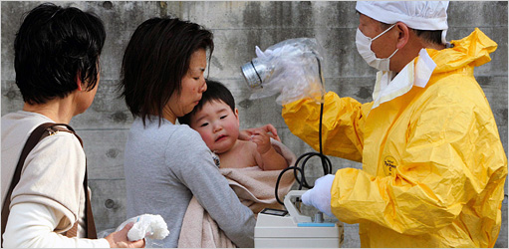
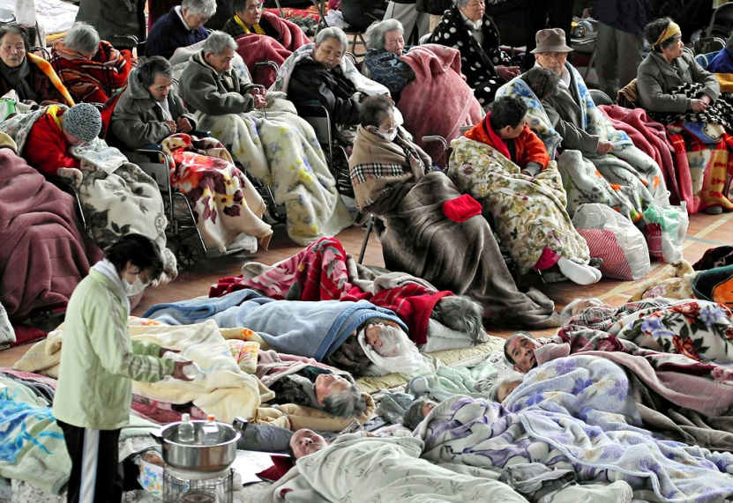
Message Development
Few differences in higher vs. lower education level
Professional responders will have the same concerns as members of the public
Non-English speakers and other special populations will have specific communication needs

Slide 39
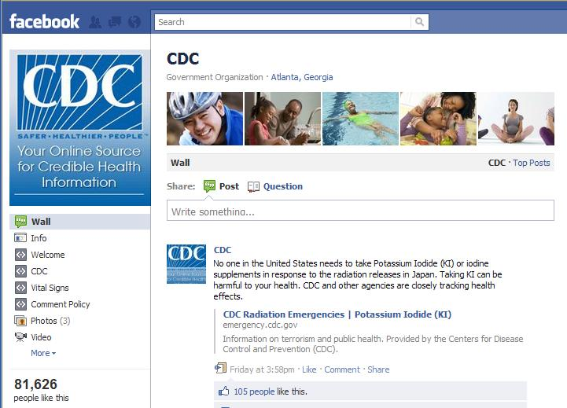
Message Delivery Methods
“High-Tech”
Radio
Television
Email alerts
Text messaging
Smartphone Applications
Social Media

Slide 40
Message Delivery Methods
“Low-Tech”
Loudspeakers
Megaphone
Leaflets
First Responders

Slide 41
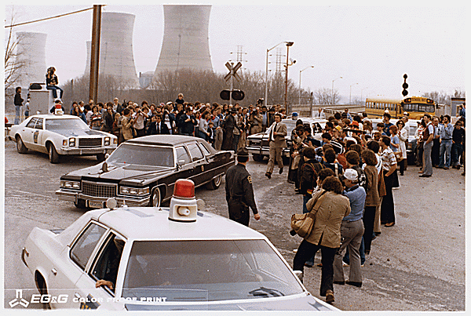
Communications Resources
CDC Radiation Emergency Website
Planning Guidance for Response to a Nuclear Detonation (second edition)
EPA booklet Communicating Radiation Risks: Crisis Communications for Emergency Responders
(CDC Public Health Toolkit)

Slide 42
Radiological Terrorism: A Toolkit for Emergency Services Clinicians
Resources for Clinicians:
JIT Training
Pocket Guides
Radiation Triage Chart
Fact Sheets
Webcasts
Self-study Training
Psych First Aid

Slide 43
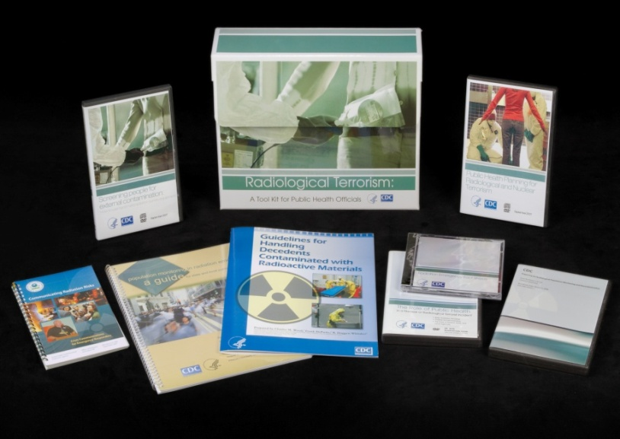
Radiological Terrorism: A Toolkit for Public Health Professionals
Resources for Public Health
vCRC
Population Monitoring Guide
EPA Risk Communication Guide
Contaminated Decedents Guide
Radiation Survey DVD
Webcasts
Fact Sheets
Self-study Training
Psychological First Aid Self-Study

Slide 44
To order complimentary toolkits:
Email: cdcinfo@cdc.gov or
Call: 1-800-CDC-INFO (1-800-232-4636);
TTY: (888) 232-6348
Selected material available online:
http://www.emergency.cdc.gov/radiation

Slide 45
Questions?
For more information please contact Radiation Studies Branch, CDC
The findings and conclusions in this report are those of the authors and do not necessarily represent the official position of the Centers for Disease Control and Prevention
National Center for Environmental Health
Division of Environmental Hazards and Health Effects

