Slide 1

Role of the Medical Reserve Corps in Radiation Emergencies

Slide 2
Volunteerism has been an integral part of our nation’s fabric from its inception through the present
The Minutemen
The first public health efforts
Civil Defense Corps (about 10 million volunteers!)
Nearly three-fourths of all firefighters in the U.S. today are volunteers

Slide 3
Some estimates place the number of active volunteers now in the U.S. at over 60 million.

Slide 4
Less than 1% of the U.S. population is an official emergency responder:
There’s 1 firefighter (including volunteers) for every 265 people
There’s 1 sworn law enforcement officer for every 334 people
There’s 1 EMT/paramedic for every 325 people

Slide 5
Not surprisingly, in 95% of all emergencies, bystanders or victims themselves are the first to provide emergency assistance or to perform a rescue.

Slide 6
ORIGIN OF THE MRC
Created by the President in response to the attacks of September 11, 2001.
Begun with Federal grant program.
Component of the Citizen Corps, which is part of the USA Freedom Corps.
Guided by the Office of the U.S. Surgeon General.
Notes:
This program emerges from a call to service President Bush issued during his 2002 State of the Union Address and is a component of the USA Freedom Corps. President Bush tasked the Department of Health and Human Services (DHHS), under Secretary Tommy Thompson, with developing and implementing the Medical Reserve Corps (MRC). In response, Secretary Thompson assigned the Office of the Surgeon General (OSG) lead responsibility within DHHS for developing a program that would promote and support the development of the MRC.

Slide 7
PURPOSE OF A LOCAL MRC UNIT
Recruit and credential volunteers before the time of crisis.
Strengthen communities by providing a ready reserve capacity to respond to emergencies.
Provides organized volunteer opportunities for local citizens.
Assist with ongoing public health needs by working to improve the overall health and well being of communities.
Notes:
After September 11, 2001, thousands upon thousands of volunteers responded to the national tragedy providing sorely needed resources in numerous ways. Many more Americans asked, "What can I do to help?" The Medical Reserve Corps brings volunteers - health professionals and others - together to supplement existing local emergency plans and resources in cities, towns, and counties throughout the United States. In order to be most effective during times of emergency, volunteers must be organized and trained to work in emergency situations. The Medical Reserve Corps is designed to provide that organizational structure and promote appropriate training of volunteers for communities.
Medical Reserve Corps are being assembled to assist the East Metro Public Health District, and local emergency response partners, in preparing for and responding to large-scale emergencies, such as an tornadoes, influenza epidemic, hazardous material spills, or act of terrorism. In addition, volunteers may work to improve the overall health and well being of their communities by engaging in public health initiatives such as community vaccination clinics, health education campaigns and health fairs throughout the year.

Slide 8
WHO SERVES IN AN MRC UNIT?
Volunteers who possess non-medical skills and diverse training backgrounds.
Volunteers who are licensed active, inactive, or retired health care professionals.
Public health professionals.
Anyone can join and make a difference!
Notes:
Medical Reserve Corps (MRC) units are comprised of non-medically trained volunteers as well as medically trained volunteers who desire to assist the East Metro Health District and local emergency response partners during emergencies and with ongoing public health needs.
Persons who do not have health training or experience may volunteer to provide basic support services such as: planning, data entry, fundraising, volunteer management, interpreting, counseling, transportation, communications, clerical and administrative assistance, and facilities management.
Licensed active, inactive or retired health care professionals who wish to volunteer may include: physicians of any specialty, dentists, dental assistants, mental health professionals, veterinarians, epidemiologists, pharmacists, physician assistants, public health experts, health educators, healthcare administrators, technicians, RNs, nurse practitioners, LPNs, nursing assistants, former military personnel with medical training, nutritionists, environmental health specialists, social workers, students in the health professions, etc.
Each MRC volunteer receives training, assistance, and supervision from the East Metro Health District’s MRC Program Coordinator and other District staff members.

Slide 9
Daniel Barnett et al of the Johns Hopkins Preparedness and Emergency
Response Research Center recently published a study "Gauging U.S.
Emergency Medical Services workers' willingness to respond to pandemic influenza..."

Slide 10
Conclusions:
If the workers:
understand the risks they face and how to protect themselves
understand the important, vital, critical role they play in the response
they are far more likely to participate in a response effort.

Slide 11
In addition, when dealing with volunteers, it is important to keep them engaged. Otherwise, they’re likely to find some other activity that provides them with more positive feedback.

Slide 12
Our MRC unit was fortunate enough to participate in two radiation emergency response training sessions and a Community Reception Center drill.

Slide 13
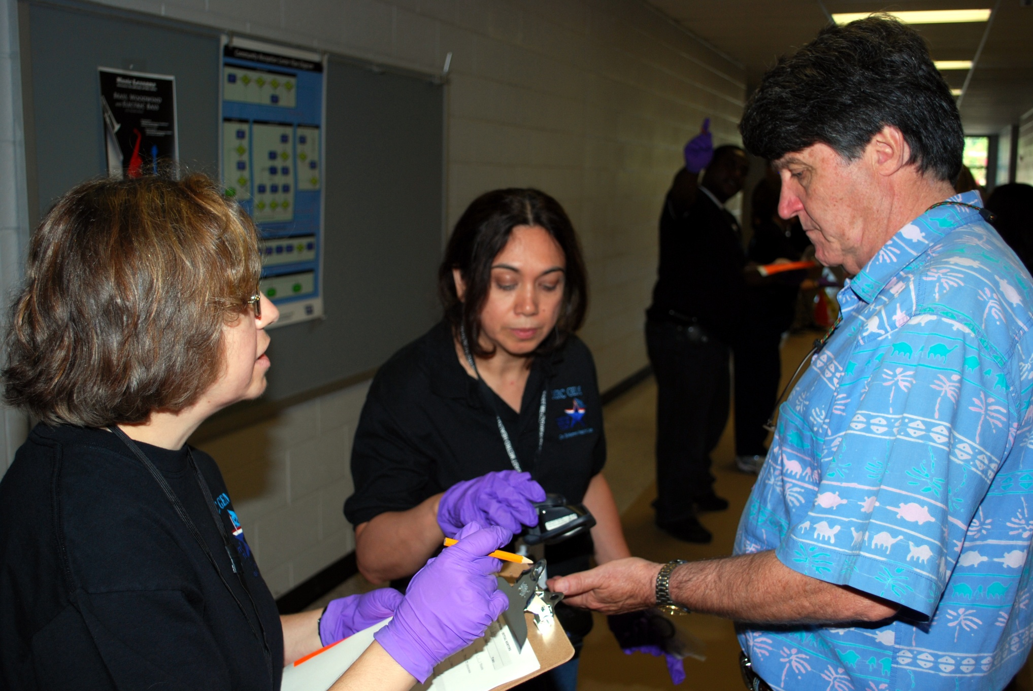

Slide 14
These training opportunities also attracted radiation professionals and health physicist to join our unit.

Slide 15
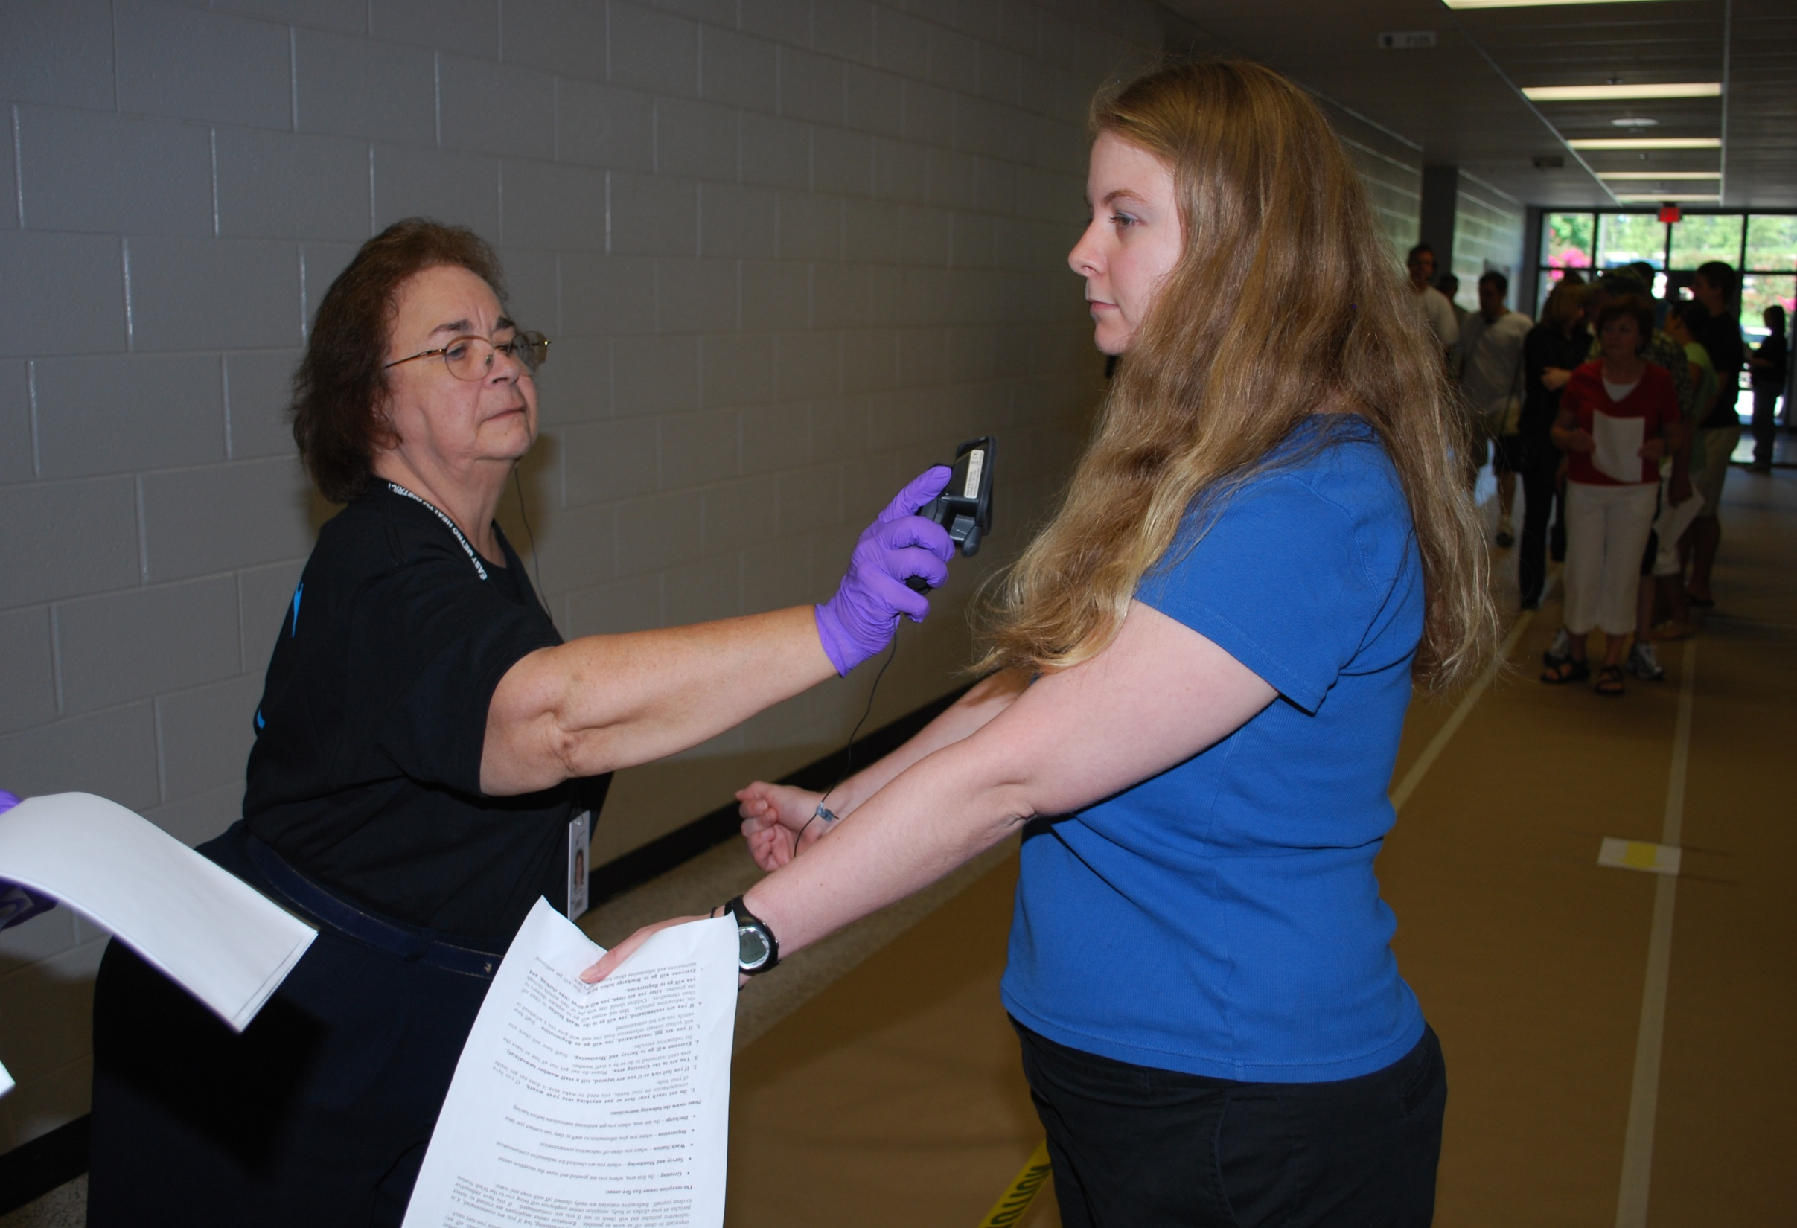

Slide 16
Not only would their participation be invaluable in responding to a radiation emergency, the Medical Reserve Corps gives them an opportunity to serve in other health emergencies should they wish to do so.

Slide 17
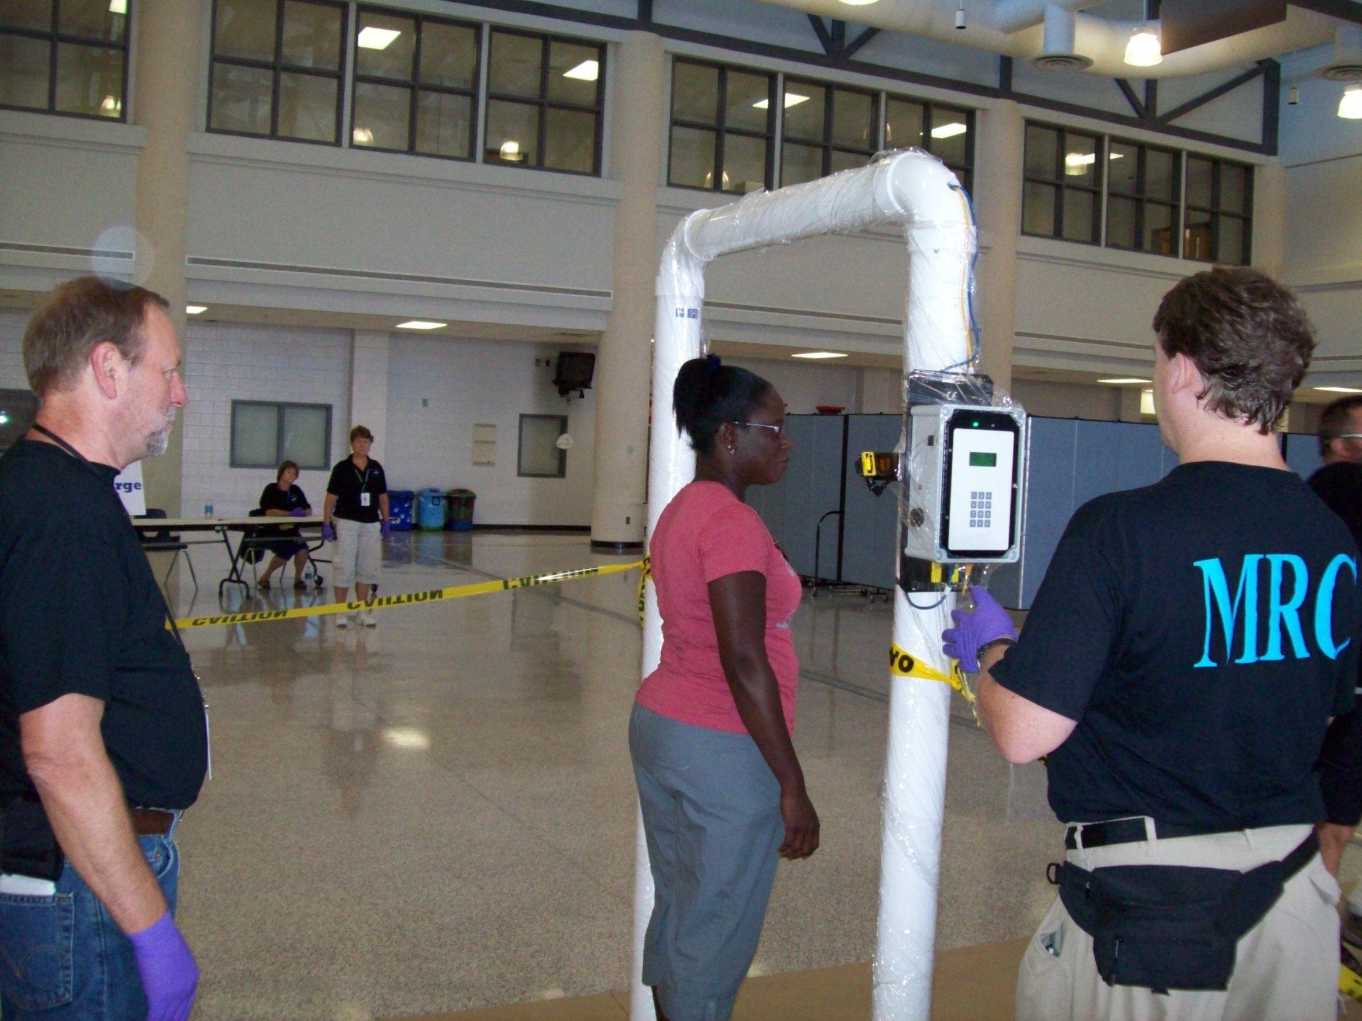

Slide 18
MRC GEM works with our local health district serving Gwinnett, Newton, and Rockdale counties.
We are a non-profit corporation working closely with local health departments, emergency managers, and homeland security.

Slide 19
We serve a population of about 1 million.
About 300 health department employees
About 225 MRC GEM volunteers

Slide 20
FOR MORE INFORMATION
National MRC Website:
http://www.medicalreservecorps.com
MRC GEM
http://www.mrcgem.com
Sherwin Levinson
director@mrcgem.com

