Slide 1
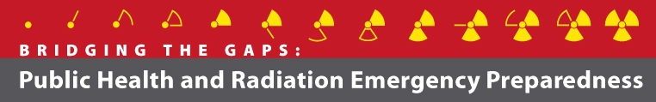
Welcome!
Radiation Basics 8:30 AM
National Center for Environmental Health

Slide 2
Morning Agenda
8:30 AM Radiation Basics (Armin Ansari)
10:00 AM ** BREAK **
10:30 AM Radiation Emergencies and Public Health (Armin Ansari)
11:30 AM Role of the Medical Reserve Corps
(Sherwin Levinson)
12:00 – 1:30 PM LUNCH (on our own)

Slide 3
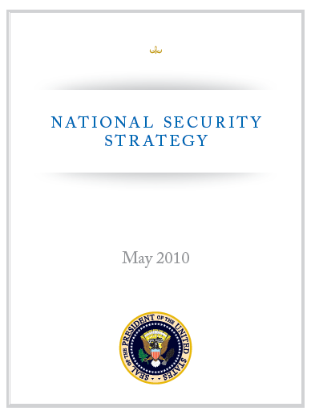
The Threat
“The American people face no greater or more urgent danger than a terrorist attack with a nuclear weapon.”
http://www.whitehouse.gov/sites/default/files/rss_viewer/national_security_strategy.pdf

Slide 4
A Radiation Primer
radiation … radioactive material
What are they?
exposure … contamination
Are they the same?
What’s a mrem or microSv?
What’s a uCi/cm² or Bq/m³?

Slide 5
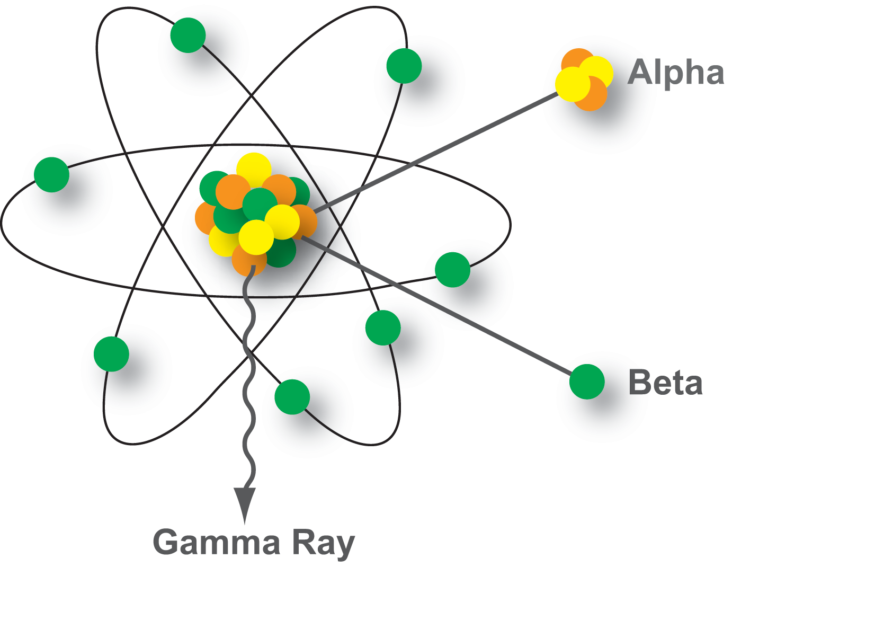
Radioactivity

Slide 6
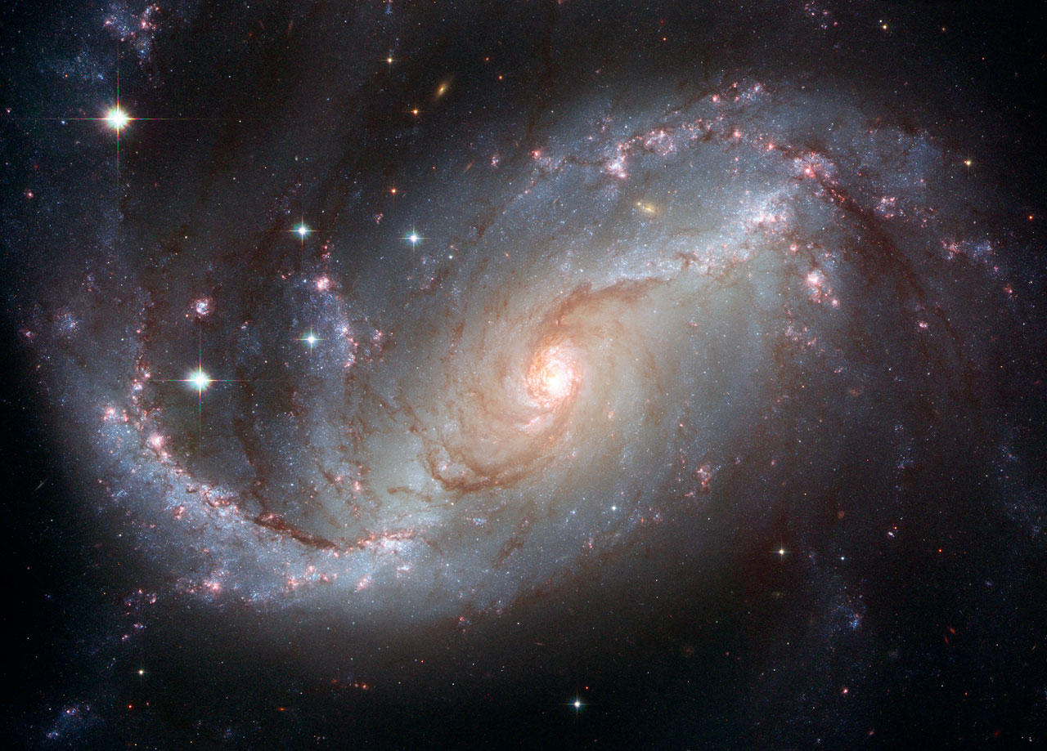
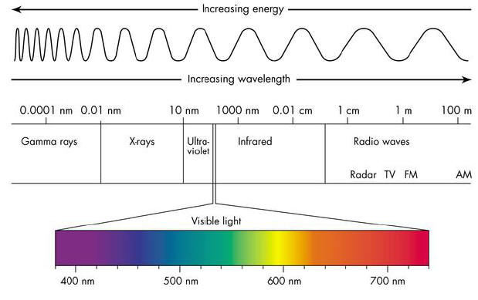
Electromagnetic Radiation
”energy with wave like behavior”
all travel at the speed of light

Slide 7
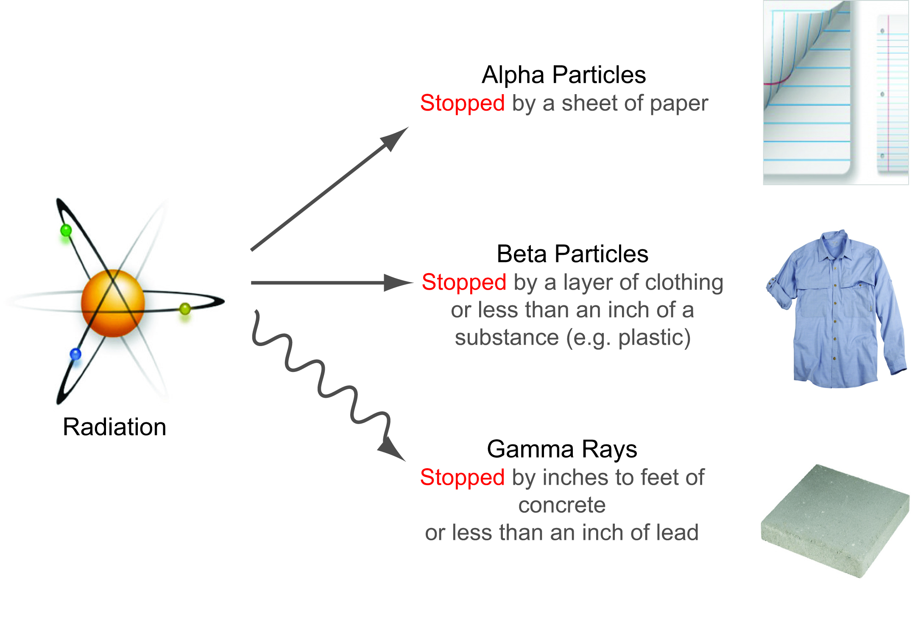
Penetration Abilities
Especially damaging to internal tissues if inhaled or swallowed
Damaging to internal tissues if inhaled or swallowed and can cause external skin burns
Damaging to tissues externally and internally
Notes:
The 3 major types of radiation have different abilities to penetrate matter.
[use pointer] Alpha particles about an inch in air andcan be stopped by a thin layer of paper or clothing, or the outer layer of skin. As a result, they are not considered an external hazard to people, but they can damage tissue if they get inside the body.
[use pointer] Beta particles can travel from inches to many feet in air. Beta emitting contaminants on the skin may cause skin injury, and beta particles may be harmful if they get inside the body.
[use pointer] Gamma rays travel many feet in air and many inches in human tissue. Thick layers of concrete or lead are needed to shield against gamma radiation.
Dr. Jones will be talking in more detail about the laboratory detection methods,

Slide 8
Common Radioactive Nuclides
Nuclear medicine: Iodine-131
Radiotherapy: cobalt-60
Satellite power: plutonium-238
Nuclear power: uranium-235
Our body: potassium-40
Our water: radium-226
Notes:
I-131, a beta emitter, is taken up almost exclusively in the in the thyroid gland.
Cobalt-60 is a high energy gamma emitter.
Plutonium-238 is primarily an alpha emitter.
Uranium-235 , is one of the unique radionuclides with the capability of fissioning or splitting when it captures a neutron.
Since the fission itself produces neutrons, the resulting chain reaction, when controlled, can produce power in a nuclear reactor. When uncontrolled, it is a nuclear weapon.
Potassium-40 is both a beta and gamma emitter, present at 0.01% of naturally occurring potassium. Potassium-39 is the most abundant potassium isotope (93%) and is stable: it does not emit radiation and therefore does not decay.

Slide 9
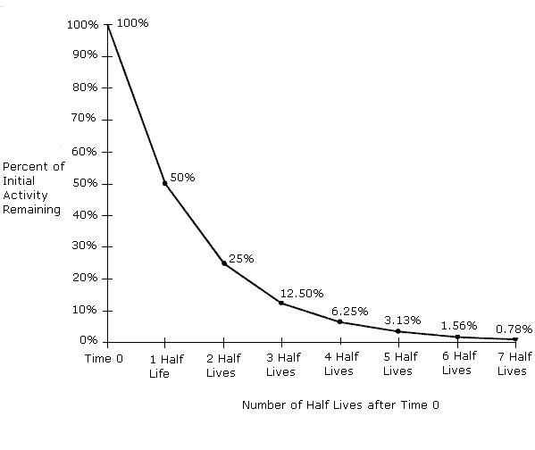
Decay Rate/Half-Life of Radionuclides
T_{1/2} can range from milliseconds to billions of years!

Slide 10
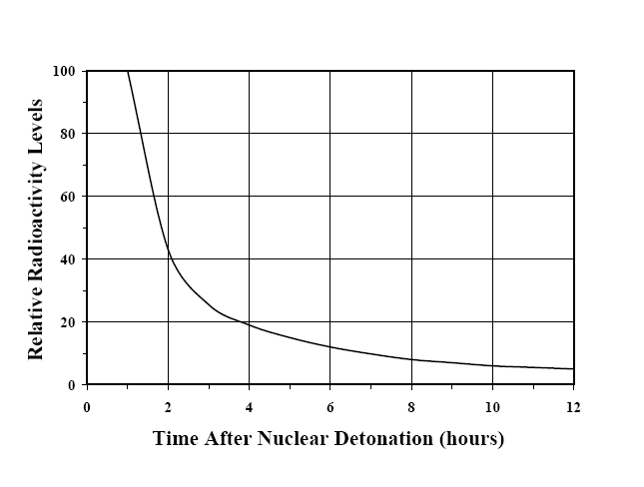
Shorter Half Life Works to Our Advantage
Source: A. Ansari, Radiation Threats and Your Safety, 2010, using data from Glasstone, 1977.
Notes:
From nuclear bombs to uses in medicine

Slide 11
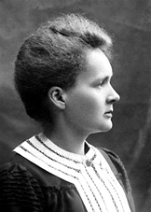
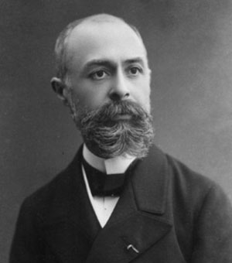
Radiation Units
Amount of radioactivity
  Curie (Ci), Becquerel (Bq)
Ambient radiation levels
  Roentgen (R) per hour, rem per hour, Sievert (Sv) per hour
Radiation dose
  Rad, rem, Gray (Gy), Sievert (Sv)
Unit prefixes from tera (10¹²) to pico (10⁻¹²)
milli (10⁻³) and micro (10⁻⁶) are most common

Slide 12


Radioactive Contamination
What if you ingested
  12 Bq (disintegrations per second)?
  5500 Bq?
The point is not to trivialize radioactivity, but to put it in perspective.
Notes:
Same with radiation dose

Slide 13
Unknown
Radioactive Substance
Contains:
  Cesium-137 (3.7 Bq/kg)
  Uranium-238 (50 Bq/kg)
  Thorium-232 (24 Bq/kg)
  Radium-226 (37 Bq/kg)

Slide 14
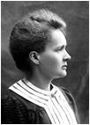
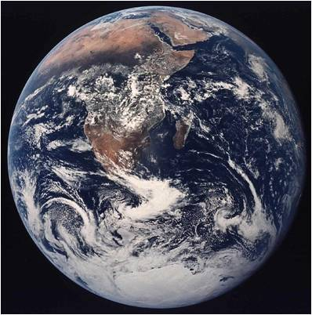
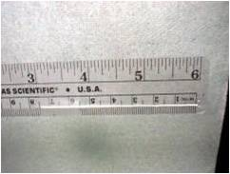

Comparing Units of Curie (Ci) and
Becquerel (Bq)
GBq
MBq
kBq
Bq
1 Bq = 1 dps
Ci
mCi
uCi
nCi
pCi
1 Ci = 37 billion dps

Slide 15
More Radiation Units
U.S.: rem, rad, Roentgen (R)
  International: Sievert (Sv) and Gray (Gy)
  Most common unit (U.S.) for health effect: rem
    1 rem = 0.01 Sv
    1 mrem = 10 μSv
    1 Sv = 100 rem
    1 mSv = 100 mrem
    1 μSv = 100 μrem
Notes:
When we speak of radiation effects, we must quantify how much radiation we are referring to. This is traditionally done in terms of radiation dose.
Radiation dose represents the amount of energy absorbed from the radiation per unit mass of tissue. (For example, 1 rad = 100 ergs of energy absorbed per gm to tissue.)
Radiation dose has a very different meaning than does dose in toxicology. There, dose or dosage, is commonly expressed as milligrams or micrograms of a toxin per kilogram of body weight.
Frequently you see rem or Sievert presented with Greek prefixes, e.g., millirem or microsievert.

Slide 16
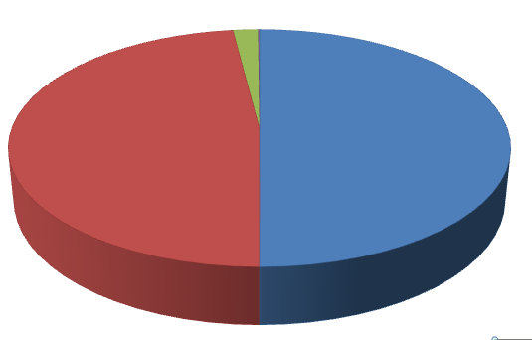
Average Annual Radiation Exposures:
6.2 mSv = 620 mrem
Consumer products, occupational
2%
Natural background
50%
Medical
48%
Source: NCRP Report No. 160, Ionizing Radiation Exposure of the Population of the United States (2009)

Slide 17
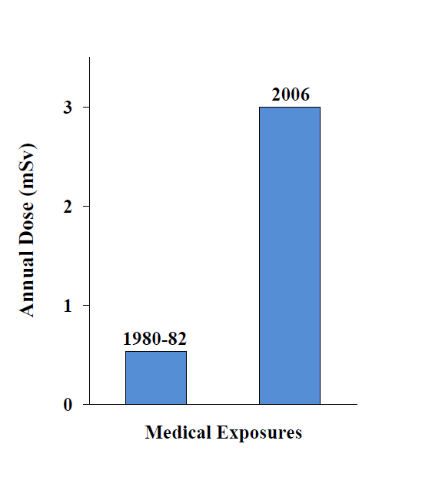
Average Annual
Medical Exposures (U.S.)
Data Source: NCRP Report No. 160, Ionizing Radiation Exposure of the Population of the United States (2009)

Slide 18


It’s all about dose
= 1 mrem
(10 μSv)

Slide 19
Typical Doses (mrem = )
Airport Screening 0.010
NY to London by air 5
Chest X-Ray 10
Natural bkgd. (annual) 300
CT Scan -Abdomen 1,000
Occupational annual limit 5,000
50% survival (whole body) 400,000
Radiotherapy (tumor) 8,000,000
1 mrem = 10 μSv
Notes:
“Rem” is the most common dose unit used in America (Note: this is changing; eventually it will likely be the “Sievert ‘as in the rest of the world.)
When we specify radiation dose in terms of a rem, we are taking account of the fact that different types of radiation can have varying biological effects.
In this table we get a feel for how big or small a rem is.
Note that the very large doses delivered in radiotherapy represent the dose to the tumor, not to the whole body. The objective is to kill all tumor cells while leaving the surrounding healthy tissue with little or no radiation dose.
In general, we would say that a chest x-ray delivers about 10 millirem of radiation dose.

Slide 20
Radiation Protection
Time
Distance
Shielding
Guiding principle for controlling exposures:
ALARA
As Low As Reasonably Achievable

Slide 21
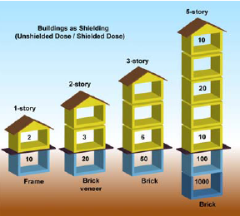
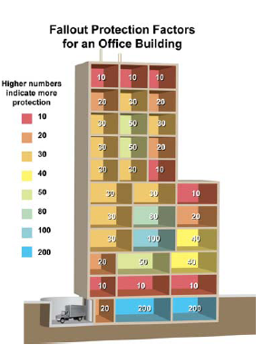
Shielding
Source: Planning Guidance for Response to a Nuclear detonation, 2010.
Notes:
21
Mention car
Lead, soil, sand
Which floor of a building, basement, top floor, middle floor, middle of the room.

Slide 22
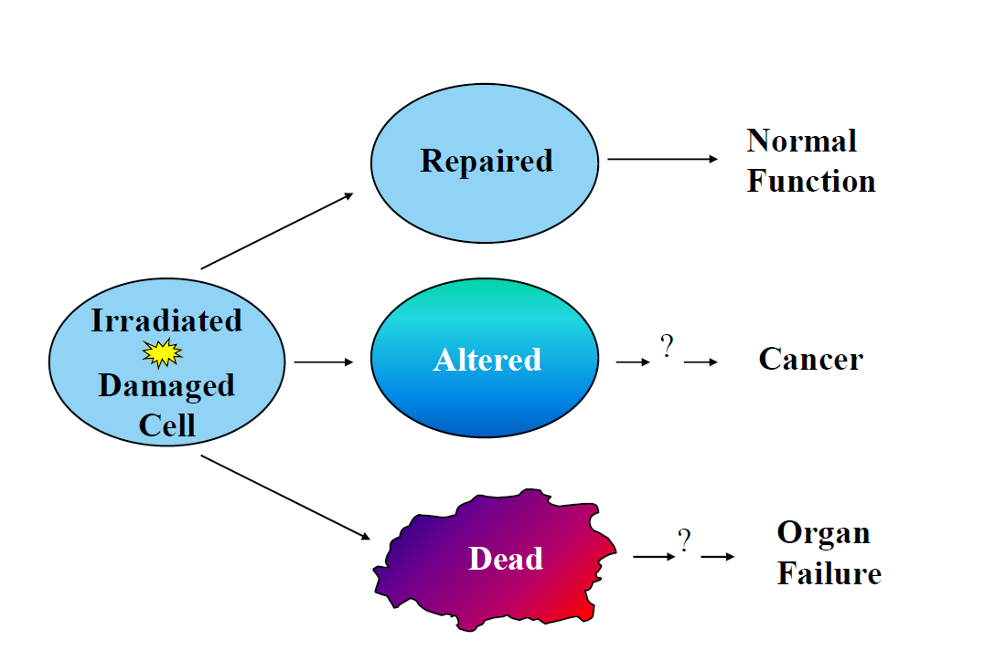

Health Effects
Source: A. Ansari, Radiation Threats and Your Safety, 2010.

Slide 23
Human Health Effects
Depending on radiation dose, dose rate, and other parameters (e.g., age):
Acute effects (acute radiation syndrome)
Late effects (cancer)
No observable effects
Notes:
Radiation exposure does not necessarily result in any observable or clinical effects. But keep in mind, it can increase one’s chance of getting a cancer, depending on the radiation dose.
As with toxicology, it is the “dose that makes the poison.”

Slide 24
Late Effects (cancer)
Most cancers can be induced by
radiation
Clear evidence for leukemia, breast,
thyroid, salivary glands, stomach, colon, lung (& others)
Young age at exposure increases risk
Risk persists throughout life
Notes:
First cancer attributed to ionizing radiation exposure was on the hand of radiologist in 1902
Leukemia was first associated with chronic exposure in studies of radiologists (1944)
There are no novel cancers induced by radiation exposure. The cancers induced are those we already know about.
Children exposed have greater risks due to higher cellular proliferation rates in many organs and to the fact that there are many more years available for a radiation-induced cancer to be expressed.
Once exposed, the risk of a radiation-induced cancer does not go away. (Compare with tobacco smoking: when one stops smoking, the risk of lung cancer declines as the years go by.)

Slide 25
Review Fundamentals
Difference between:
– Radioactive material
– Radiation
Difference between being:
– Contaminated
– Irradiated (exposed)
External &
Internal

Slide 26
Summary: Key Points
Radiation types: alpha, beta, gamma
Radiation and radioactivity are part of our natural environment
Radioactive contamination is not immediately life threatening.
Decontamination is relatively simple.

Slide 27
Summary: Key Points
Radiation can be readily detected.
Dose Units: rem (U.S.)
Radiation can kill in short term or cause cancer in long term.
It is all about the dose!

Slide 28
Quiz!

Slide 29
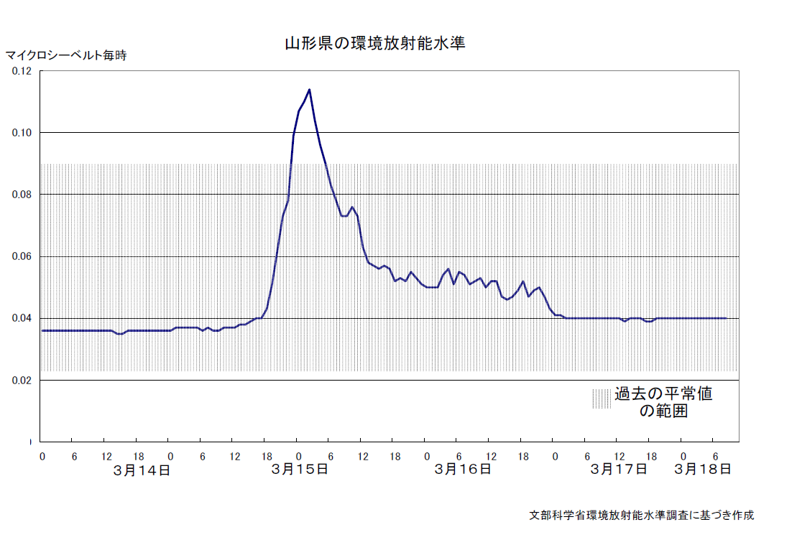
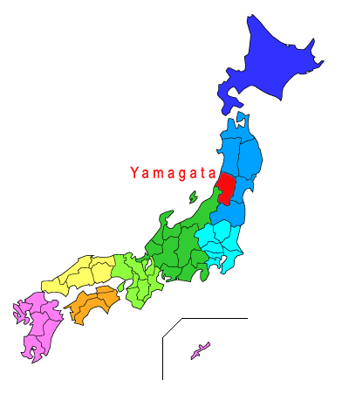
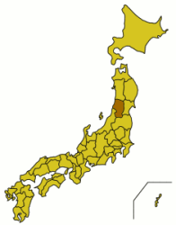
μSv/h
Yamagata Prefecture

Slide 30
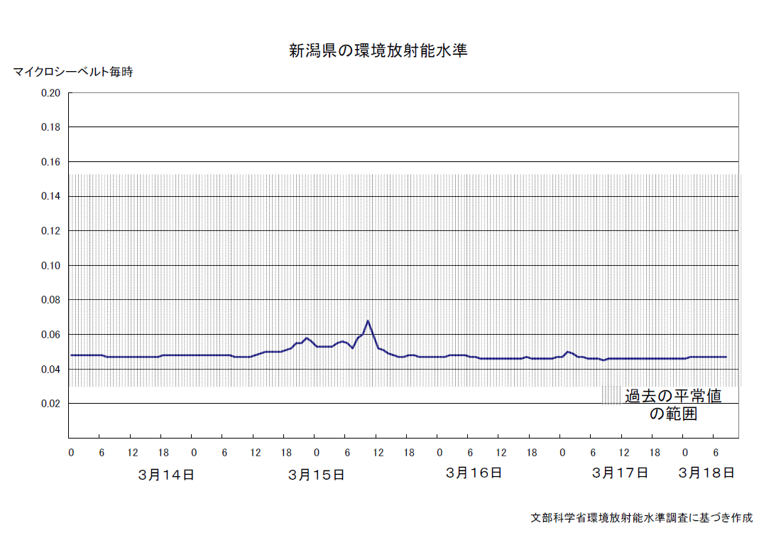
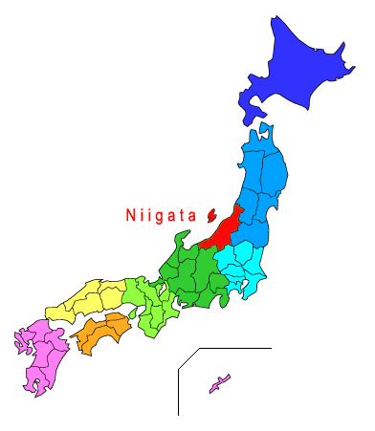
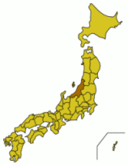
Niigata Prefecture
μSv/h

Slide 31
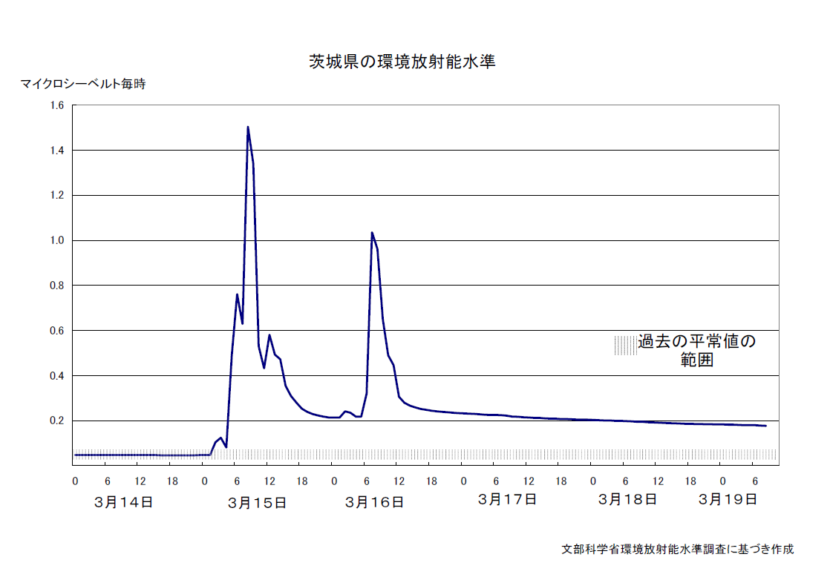

Ibaraki Prefecture
μSv/h

Slide 32
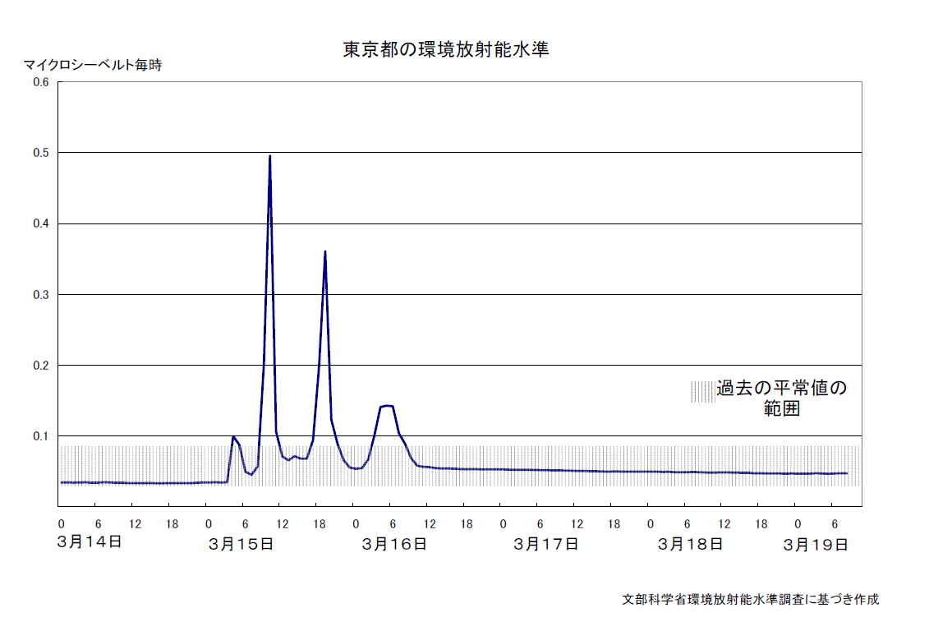

μSv/h
Tokyo Prefecture

Slide 33

Tochigi Prefecture

Slide 34
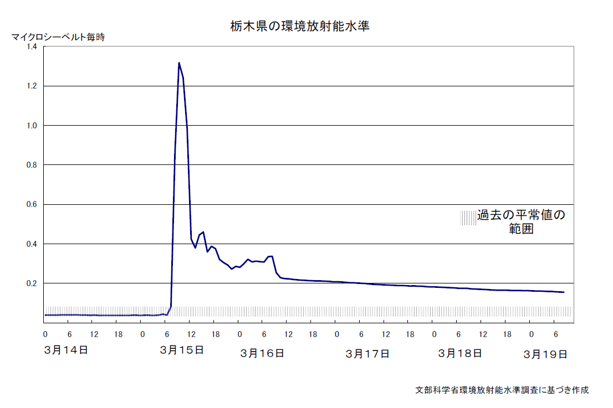
μSv/h
Tochigi Prefecture

Slide 35
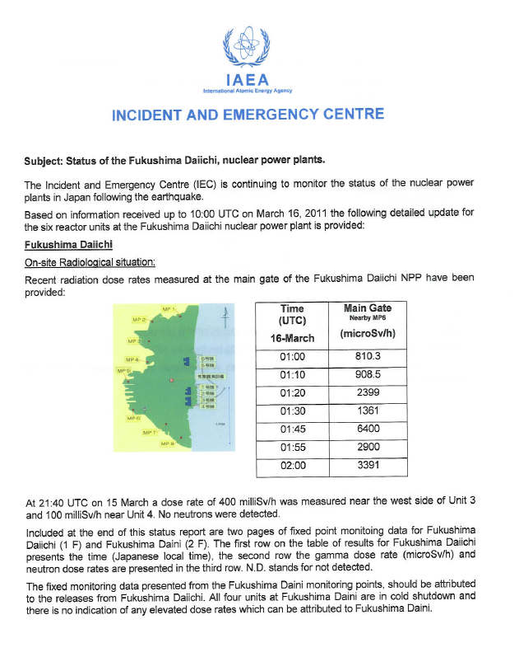
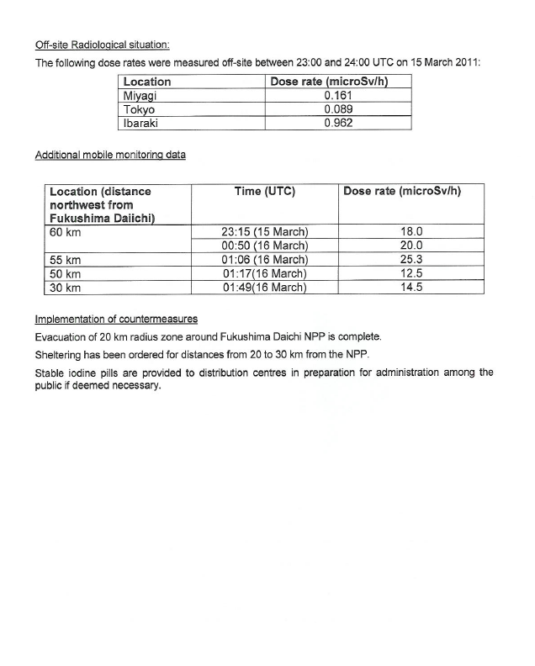

Slide 36
Radiation Emergencies and
Public Health Response
Armin Ansari, PhD, CHP
Radiation Studies Branch
AAnsari@cdc.gov
770-488-3654
National Center for Environmental Health
Division of Environmental Hazards and Health Effects

Slide 37
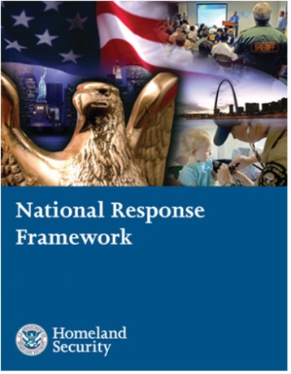
Emergency Support Functions
ESF #1 - Transportation
ESF #2 - Communications
ESF #3 - Public Works and Engineering
ESF #4 - Firefighting
ESF #5 - Emergency Management
ESF #6 - Mass Care, Emergency Assistance, Housing and Human Services
ESF #7 - Logistics Management and Resource Support
ESF #8 - Public Health and Medical Services
ESF #9 - Search and Rescue
ESF #10 - Oil and Hazardous Materials Response
ESF #11 - Agriculture and Natural Resources
ESF #12 - Energy
ESF #13 - Public Safety and Security
ESF #14 - Long-Term Community Recovery
ESF #15 - External Affairs
www.fema.gov/emergency/nrf/

Slide 38
Incident Annexes
Biological Incident
Catastrophic Incident
Cyber Incident
Food and Agriculture Incident
Mass Evacuation Incident
Nuclear/Radiological Incident
Terrorism Incident Law Enforcement and Investigation
http://www.fema.gov/emergency/nrf/

Slide 39
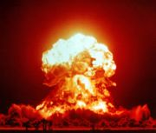
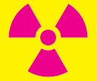
CBRNE
(Chemical, Biological, Radiological, Nuclear, Explosive)
A nuclear incident involves a nuclear detonation
A radiological incident does NOT involve a nuclear detonation

Slide 40
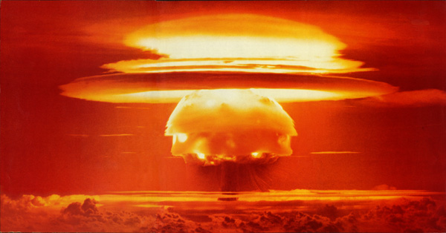
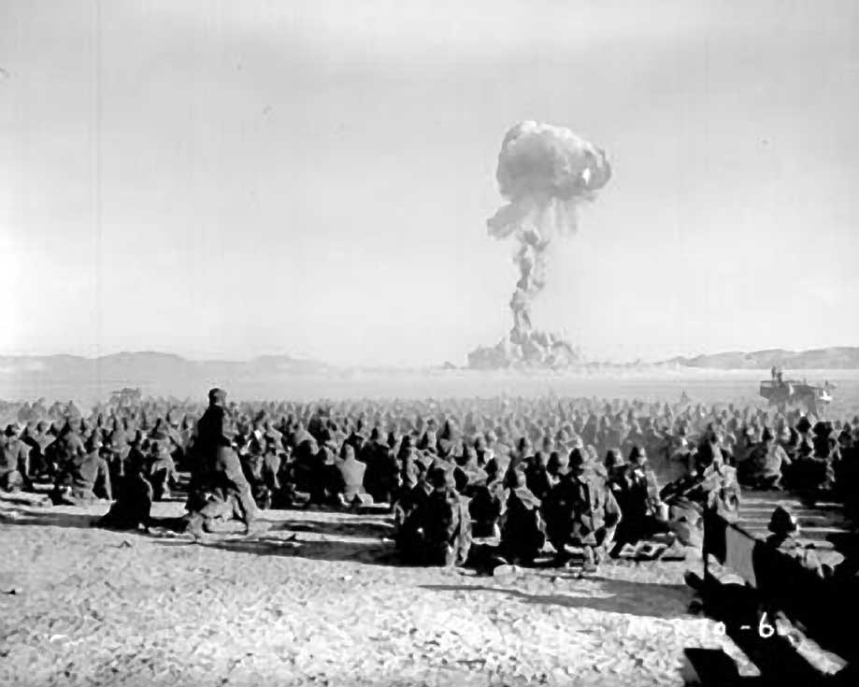
Examples of Nuclear Incidents
Strategic Nuclear Weapons
  Think Cold War (megaton range)
  Not considered a likely threat today
Improvised Nuclear Device (IND)
  Think Hiroshima “Little Boy”
  Low-yield kiloton range
  Possible tool of terrorism
  No warning!
  National Planning

Slide 41
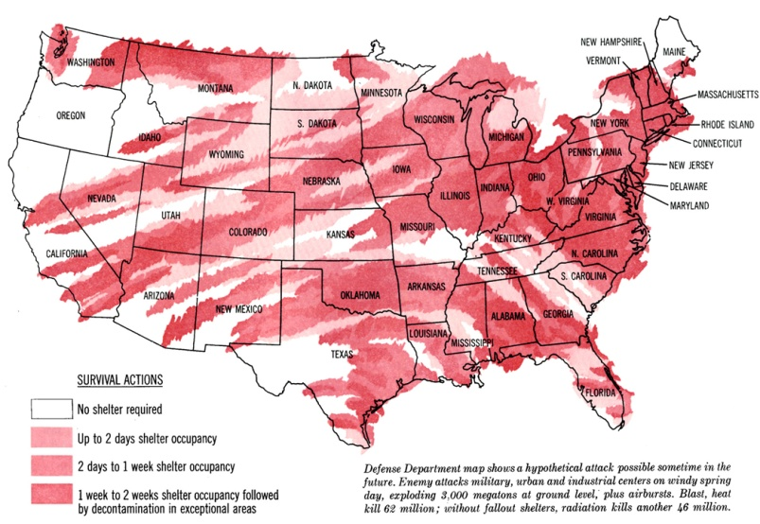
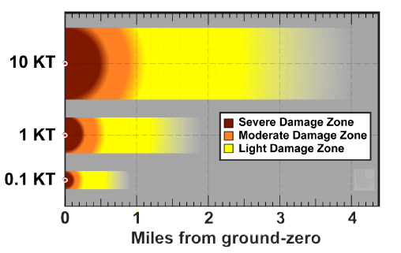
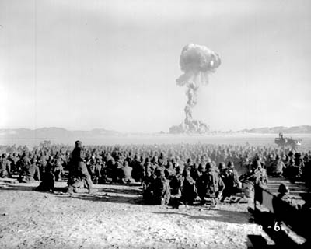
Survivability
Cold War Threat
IND
Notes:
EMS from neighboring communities responding
IND survivable, national response different than Cold War
The Office of Technology Assessment (1979) estimated the effects of a large-scale nuclear attack on U.S. military and economic targets. This scenario assumes a direct attack on 250 U.S. cities, with a total yield of 7,800 megatons. The most immediate effects would be the loss of millions of human lives, accompanied by similar incomprehensible levels of injuries, and the physical destruction of a high percentage of U.S. economic and industrial capacity. The full range of effects resulting from several thousand warheads - most having yields of a megaton or greater - impacting on or near U.S. cities can only be discussed in terms of uncertainty and speculation. It is estimated that 100 million to 165 million people would be killed.

Slide 42
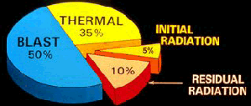
Immediate and massive destruction of by a nuclear bomb is NOT caused by radiation!

Slide 43
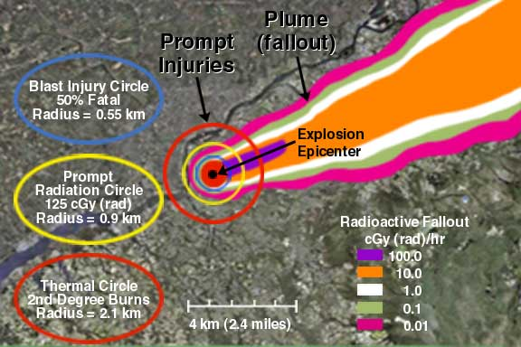
10 Kiloton Nuclear Detonation
http://www.remm.nlm.gov/plume.htm
Notes:
Dose rate at 4 hours in cGy(rad)/hr
Assumptions
Surface burst
10 mph wind from SW
Flat topography
10% of initial dose rate after 8 hours
1% of initial dose rate after 2 days
0.1% of initial dose rate after 2 weeks

Slide 44
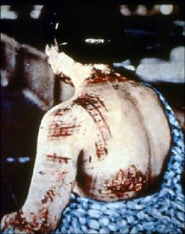
Nuclear Blast
Thermal skin burns are immediate

Slide 45
Examples of Radiological Incidents
Transportation accidents
Nuclear power plant accidents
Spent fuel storage leaks/spills
Space vehicle accidents
Gas explosion/fire at any licensed facility
Explosive RDD (dirty bomb) – National Planning Scenario #11
Non-explosive RDD (Cesium Chloride [CsCl] solution spray)
Radiation Exposure Device – (hidden source)

Slide 46
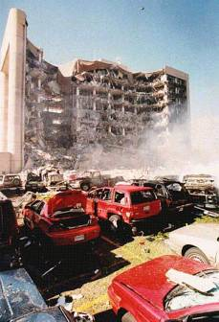


Radiological Dispersal Device (RDD)
A device that disperses radioactive material by conventional explosive (dirty bomb) or other mechanical means, such as a spray.
Notes:
Radiation from a radionuclide (or mix of radionuclides) can be spread in a variety of ways by terrorists.
By “dirty bomb,” we mean the dispersal of radioactive material explosively, using say TNT or another type of conventional explosive material.

Slide 47
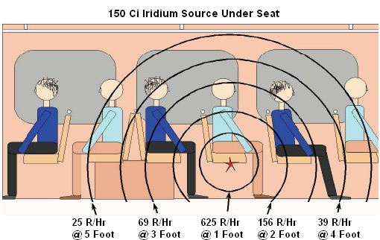
Radiological Exposure Device (RED)
A device whose purpose is to expose people to radiation, rather than to disperse radioactive material. “silent source”
Notes:
Radioactive sources exist that could be stolen for radiological terrorism. Such a device could be hidden in a public place, irradiating people without their knowledge and with lethal radiation doses.

Slide 48
Case Studies

Slide 49
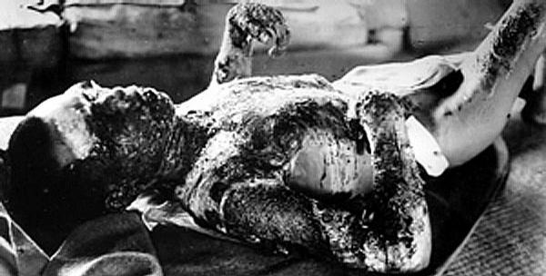
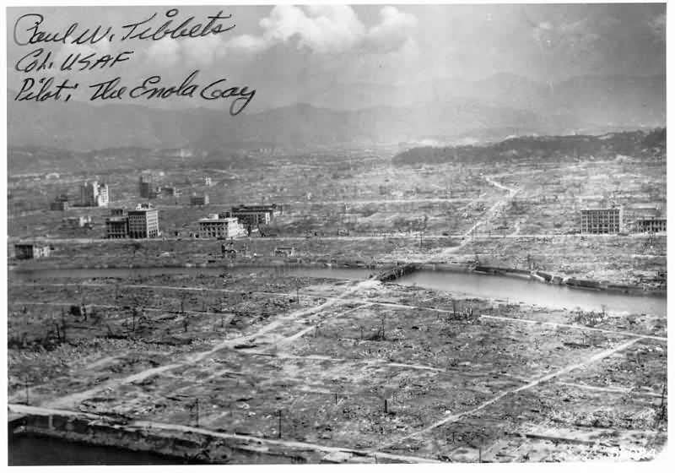
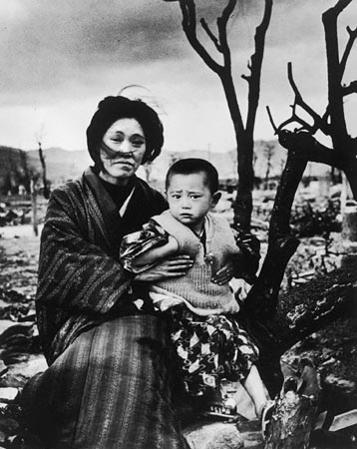
Hiroshima, August 1945
Detonation height – 600 meters (2,000 ft)
Blast yield equivalent to 15,000 tons of TNT
4.7 square miles (12 km²) of the city were destroyed
Notes:
Other deliberate acts have also exposed people to radiation
For example, on August 6, 1945, when a nuclear weapon was dropped on Hiroshima, Japan.
Almost five square miles of the city were destroyed.
This bomb used enriched uranium for its explosive power, and the design was NOT tested in advance. This was basically an Improvised Nuclear Device or IND.
This bomb was detonated at a height above ground to minimize environmental contamination. .

Slide 50
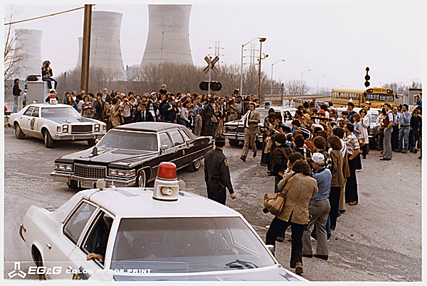
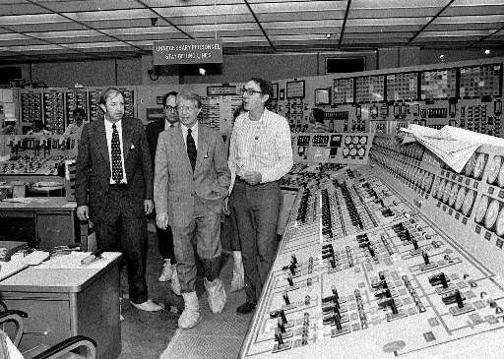
Three Mile Island, April 1979
No one was physically harmed!
Radiation doses were miniscule.
Tremendous social and economic impact!

Slide 51
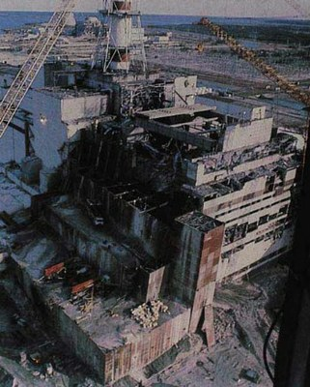
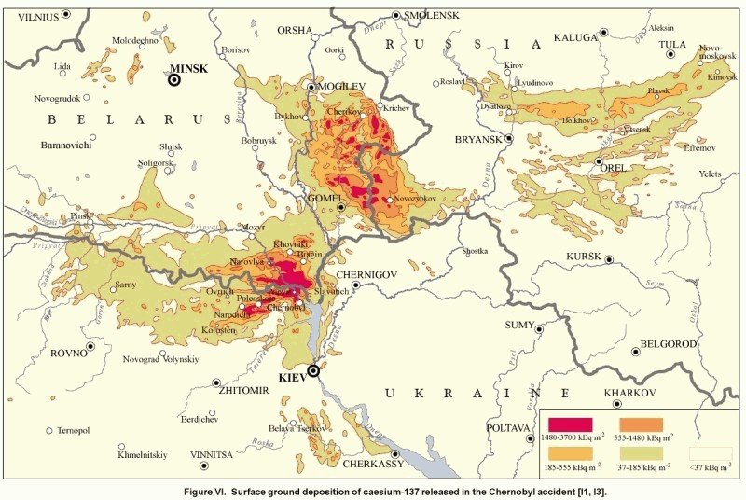
Chernobyl, April 1986
The world’s worst nuclear reactor disaster
10 km radius uninhabitable - indefinitely
30 km radius controlled entry – indefinitely
Impacting towns and large rural areas
Notes:
30 people died within 3 months from acute radiation exposure.
10 days of releases into the atmosphere under varying meteorological conditions.

Slide 52
Goiânia, September 1987
249 exposed; 54 hospitalized
Eight with ARS
Four people died
112,000 people monitored (>10% of total population)
  Over a 2-month period
Psychosocial Impact
Courtesy of Dr. Jose Rozental

Slide 53
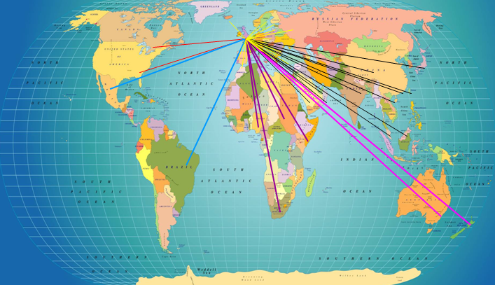

London, November 2006
Polonium-210 poisoning
November 2006 52 countries involved!
Notes:
Epi data really important . Where they were and when. What did they come in contact with.
Because it was an alpha emitter, no direct bioassay was available

Slide 54




Fukushima, 2011
Unfolding as we speak!
ARS likely; worker deaths likely
170,000 evacuated from the 20-km radius
450,000 people in 2600 evacuation centers
Significant environmental and agricultural impact
Psychosocial Impact

Slide 55
Summary
Incidents involving radiation cover a wide range of scenarios.
A nuclear detonation creates by far the greatest amount damage and loss of life.
Radiological incidents can involve exposure and/or contamination. They may be limited in scope or cover wide geographical areas.
Both present many public health challenges, even at communities far removed from the scene.
Notes:
Mention Tokyo, Jakarta, to California

Slide 56
Scenario ?
~ 1,500 fatalities
> 1 million people evacuated
  ~ 800,000 people displaced
  ~ 300,000 in evacuation centers
~ 100,000 people remained
  Civil unrest
  Health hazards
  Infrastructure failure

Slide 57

Example of a Displaced Population

Slide 58









New Orleans 2005

Slide 59







Haiti 2010

Slide 60

Public Health Functions After
Any Disaster
Rapid assessment of health and medical needs
Sheltering and housing, mass care safety
Injury and illness surveillance
Potable water, safe food, sanitation and hygiene
Vector control
Solid waste, waste water management
Hazardous material disposal
Registry
Handling of the deceased
Rumor control
Public service announcements
Notes:
60
Design, implementation, and interpretation of results from environmental field surveys, laboratory analyses.

Slide 61
In a radiation emergency:
Public health practitioners need to work closely with radiation safety professionals
Public
Health Physics

Slide 62

Example: Planning for Public Shelters after an IND
Public shelter locations
  20 miles from Ground Zero
  2000 miles from Ground Zero
  Places in between
Radiation screening staff and equipment
  Adequate
  Less than adequate or none!
Photo credit: Christian Science Monitor, Mario Villafuerte/PhotoLouisiana.com
Notes:
Evacuees from hurricane Gustav arrived at the Red Cross shelter in Shreveport, La., in 2008. (Mario Villafuerte/PhotoLouisiana.com)

Slide 63

Need for Shelter after a Radiation Emergency
Are we prepared?

Slide 64

Population Monitoring

Slide 65

National Response Framework
Nuclear/Radiological Incident Annex
Decontamination/Population Monitoring are:
“the responsibility of State, local, and tribal governments.”
www.fema.gov/emergency/nrf/
Notes:
YoYo-72 or longer

Slide 66



Decontamination as a Response Issue
Department of Defense supports transport of injured
  Current protocols: injured must be stable and decontaminated before they will be accepted for transport
American Red Cross supports public shelters
  Current protocols: Before entering a shelter, evacuees need to be free of radioactive contamination
Notes:
It’s not just EMS, everyone has decon issues
EMS can’t say patients must be decontaminated before giving life-saving care.

Slide 67






Default Thinking on Dealing with “Contaminated” Public

Slide 68




Decon Before MedEvac?!

Slide 69
Local Response
  Plan to receive a large population
  - Potential for contamination
  - Potential for injuries
  - Some may need immediate medical care
  - Most may need shelter/temporary housing
  - All would be stressed

Slide 70
Local Response
  People need to be screened and triaged, preferably at locations other than area hospitals (more on this later)
  Response and recovery from detection to site decontamination could extend for weeks, months, or years
  Biomonitoring might be performed for years

Slide 71



Radiation Medical Countermeasures
No drug can offer immunity against radiation!
Potassium Iodide (KI) tablets
Prussian Blue
Ca-DTPA, Zn-DTPA
Neupogen®
www.remm.nlm.gov
www.fda.gov/Drugs/EmergencyPreparedness/default.htm
Notes:
KI is no longer provided in the CDC Stockpile, but is left to the individual states to decide on how to store and distribute it if needed in a emergency.
Prussian Blue is used to treat people who have been internally contaminated with radioactive cesium (mainly Cs-137). Prussian blue helps to accelerate the elimination of cesium from the body.
DTPA (diethylenetriaminepentaacetate) comes in two forms: calcium (Ca-DTPA) and zinc (Zn-DTPA). Both forms work by tightly chelating (holding on to) plutonium, americium, and curium, allowing passage from the body into the urine.
A very high dose of radiation may destroy bone marrow, potentially resulting in bleeding and infection. Filgrastim (trade name Neupogen®), is a drug approved for use by the FDA for cancer patients with bone marrow damage due to chemotherapy or radiotherapy.

Slide 72


References
www.crcpd.org/RDD.htm
www.remm.nlm.gov/PlanningGuidanceNuclearDetonation.pdf

Slide 73

Important Contact!
Know name and contact information for your state radiation control program director. This person is vital in both planning for and responding to a nuclear or radiological incident.
www.crcpd.org/Map/map.html

Slide 74
Thank you!
Armin Ansari
770-488-3654
AAnsari@cdc.gov

