Slide 1
Community Reception Center Operations for Radiation Emergency Response:
Tools for Training and Planning
Kevin Caspary, MPH
Oak Ridge Institute for Science and Education
National Center for Environmental Health
Division of Environmental Hazards and Health Effects
Notes:
I’m Kevin Caspary. I’m a Health Education Specialist with Oak Ridge Institute for Science and Education working with the CDC Radiation Studies Branch in Atlanta.

Slide 2
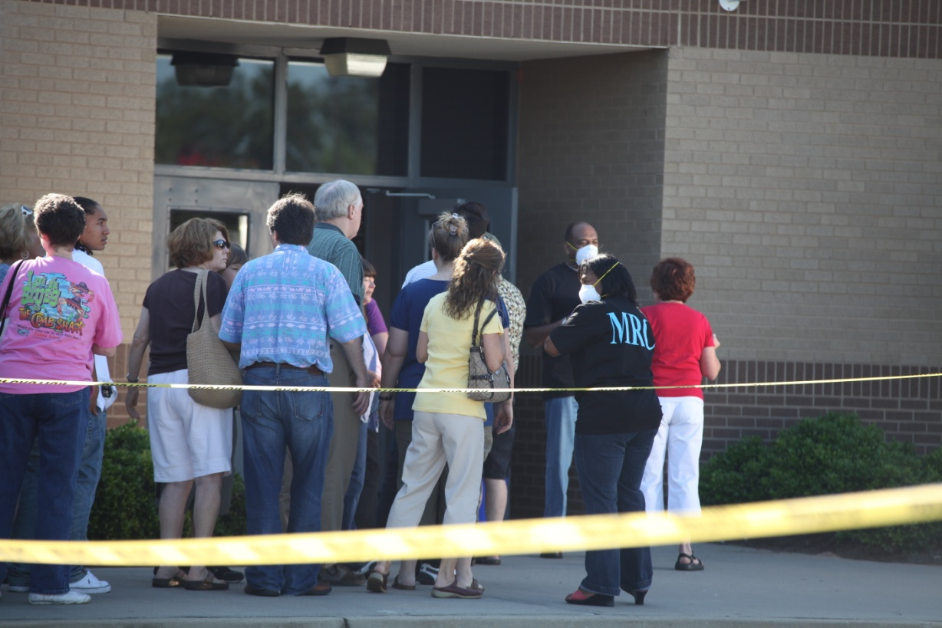
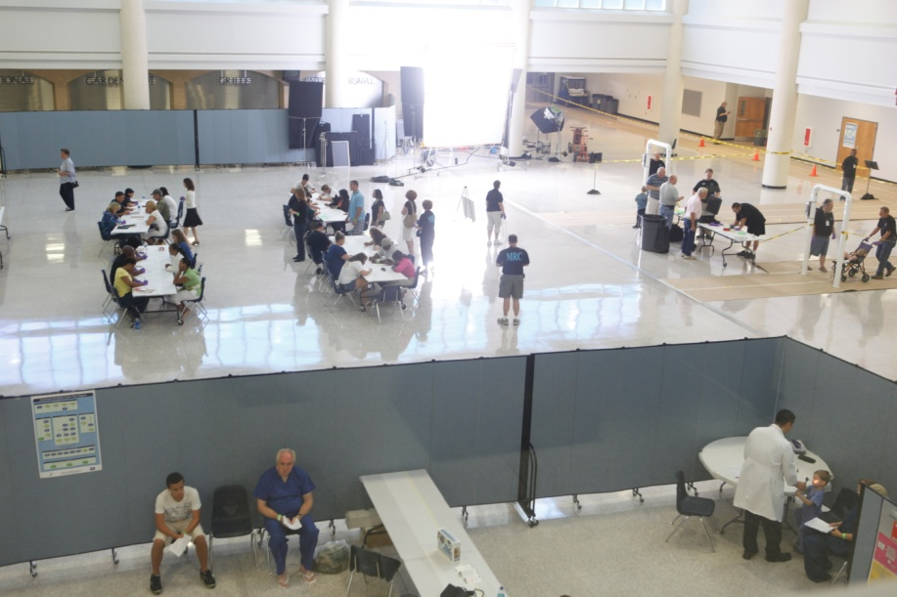
Objectives
Describe the process flow in a CRC
Demonstrate new training and planning tools for CRC operations
Notes:
In the next 20 Minutes or so I’m going to share the CDC’s community reception center model for radiation emergency response and demonstrate the Virtual Community Reception Center (vCRC), a new training program for public health planners, staff, response partners, and organized volunteers.
At the end of the presentation, you should be able to:
Describe the process flow in a CRC, and
Identify key stations in a CRC.
**Remind viewers about materials in “Handouts” – CRC Diagram Desk Reference, vCRC Flyer**

Slide 3
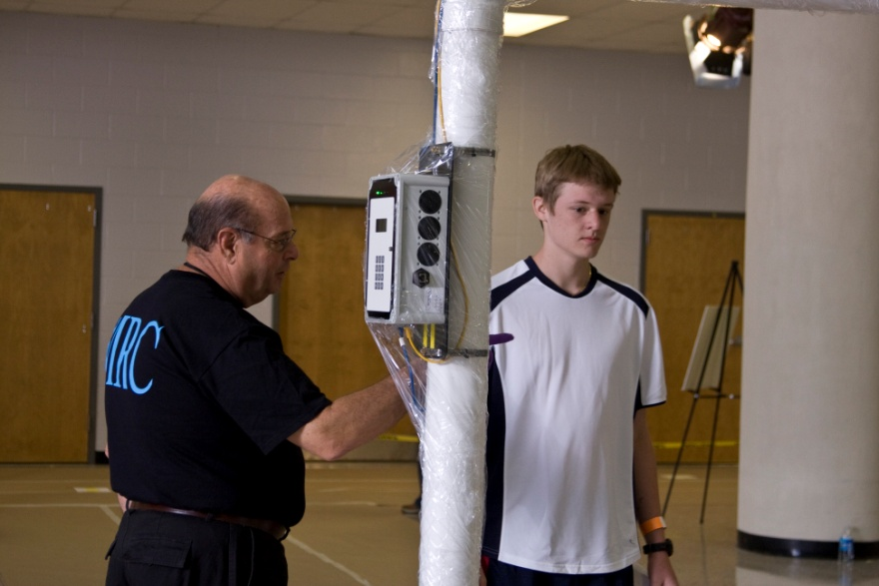
Community Reception Centers
Local response strategy for conducting population monitoring
  Multi-agency effort, public health lead
  Staffed by government officials and organized volunteers
  Opened 24-48 hours post event
  Located outside of hot zone
  Comparable to PODs, NEHCs
Notes:
CRCs are a local response strategy for conducting population monitoring that require a multi-agency effort, coordinated by state and local public health.
CRCs will be opened to receive evacuees 24-48 hours after a radiological or nuclear incident and will be located outside of the hot zone.
In terms of planning and staffing, CRCs are comparable to points-of-dispensing, neighborhood emergency help centers, or mass-vaccination clinics, like for H1N1.

Slide 4
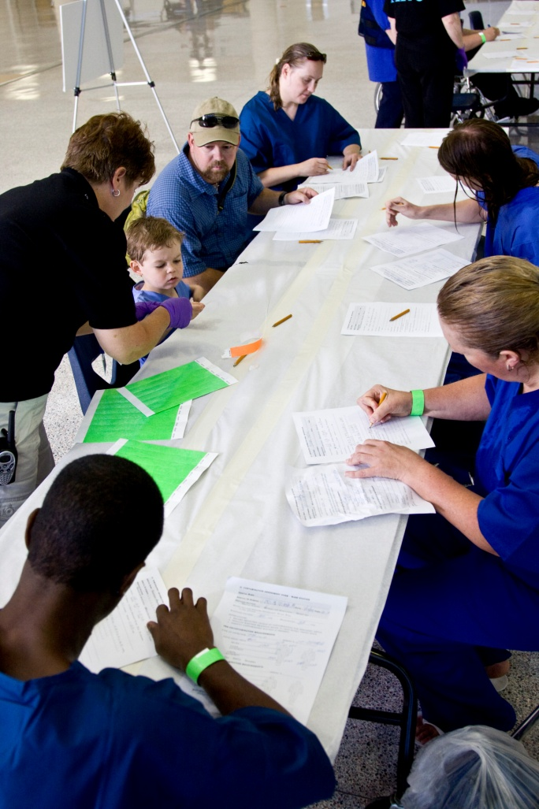
Community Reception Centers
Services include:
  Contamination screening
  Decontamination
  Limited medical care
Main purpose is to prioritize people for further care
  Ease burden on hospitals
  Manage scarce medical resources
Notes:
The main services offered at a CRC include:
Screening for external contamination
Decontamination, and
Some medical care
The main goal of a CRC operation is to prioritize people for further care. This can help ease the burden on hospitals and manage scarce medical resources, such as radiation countermeasures.

Slide 5
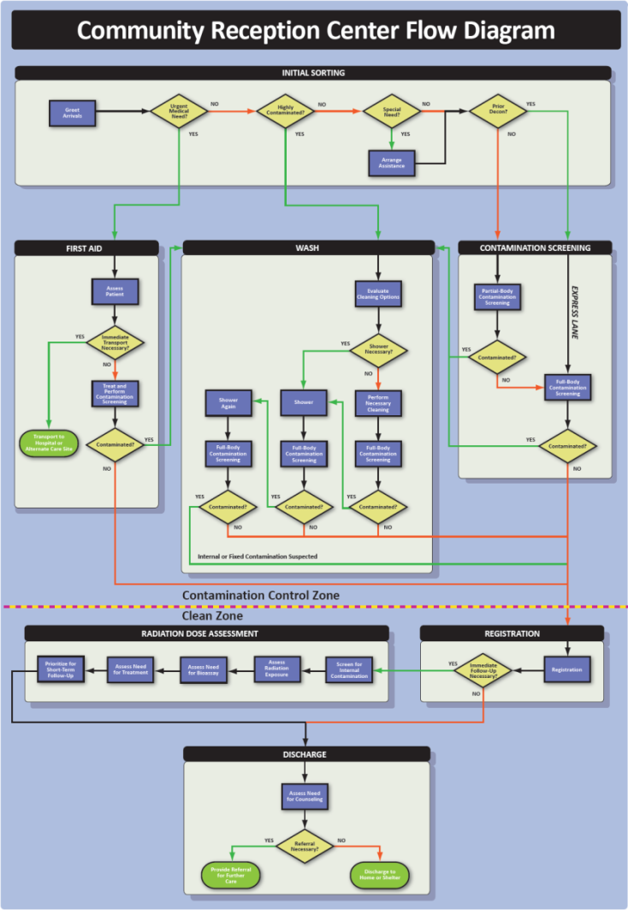
Origin
CRC
Endpoint
Home
Affected Area
Public Shelter
Surrounding Community
Hospital or Alternate Care Site
Notes:
This graphic shows how CRCs fit into the evacuation strategy after a radiation emergency.
People evacuating the affected area will be directed to the CRC, where they will be screened for contamination, decontaminated, and entered into a registry for follow-up purposes. We also anticipate some people in unaffected communities near the CRC showing up for contamination screening.
There are three possible endpoints for people at the CRC. They may be sent home, sent to a public shelter, or sent to a hospital or alternate care site for further care.
The CRC is an important precursor to these endpoints, because it provides an element of contamination control, medical prioritization, and patient tracking that will streamline efforts to provide additional care and follow-up services.

Slide 6

Community Reception Center
Process Flow
7 Stations:
  Initial Sorting
  First Aid
  Contamination Screening
  Wash
Contamination Control Zone
Clean Zone
  Registration
  Radiation Dose Assessment
  Discharge
Notes:
Now, let’s take a look at the CRC process flow.
A CRC has seven stations:
Initial Sorting,
First Aid,
Contamination Screening,
Wash,
Registration,
Radiation Dose Assessment, and
Discharge.
Some of these stations are located in a contamination control zone, and others are located in a clean zone.

Slide 7
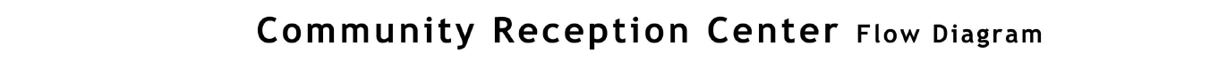
Initial Sorting
Initial Sorting Area
Emergency Medical Care or Transfer
Survey and Monitoring Area
Wash Station Area
Registration and Dose/Medical Assessment Area
General Registration Area
Discharge Area

Slide 8
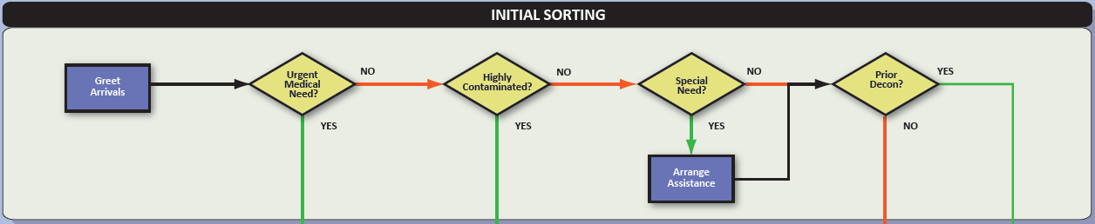
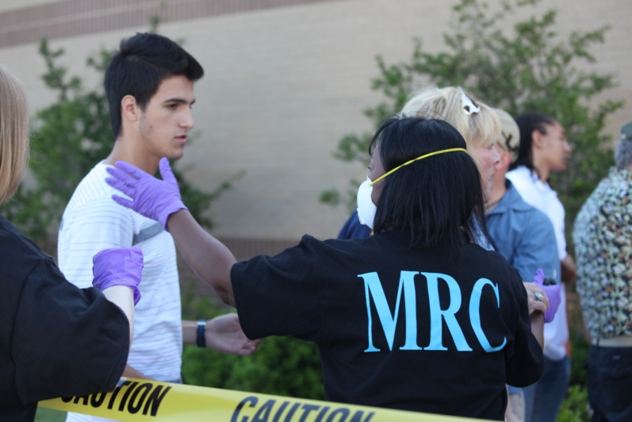
Initial Sorting
Staff identify people who have :
  Urgent medical needs
  High levels of contamination
  Special needs
  Decontaminated before coming to the CRC
Notes:
The Initial Sorting Station is where staff put people on the correct path through the CRC. Staff here identify people who have:
Urgent medical need,
High levels of contamination,
Special needs, or
Prior decontamination.

Slide 9
First Aid
Initial Sorting Area
Emergency Medical Care or Transfer
Survey and Monitoring Area
Wash Station Area
Registration and Dose/Medical Assessment Area
General Registration Area
Discharge Area

Slide 10
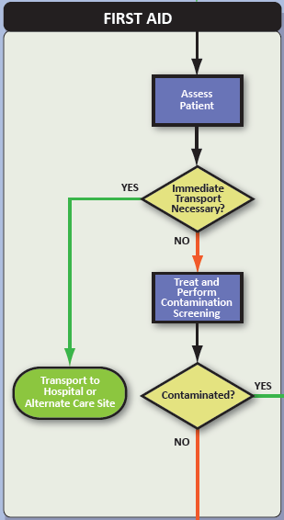
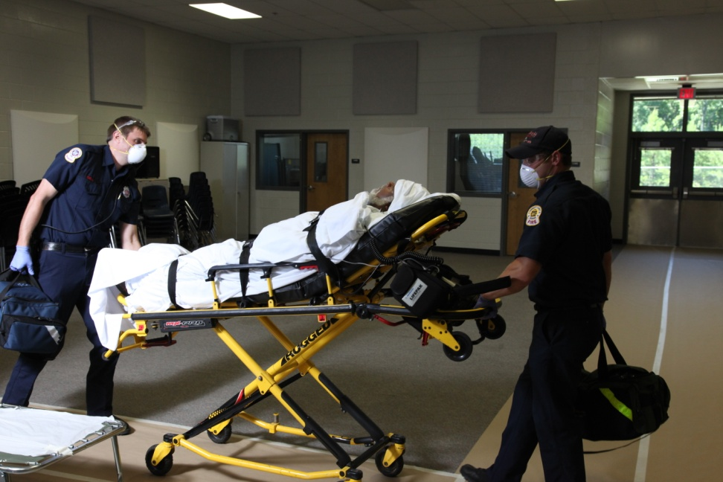
First Aid
Medical staff care for and/or transport patients with urgent medical needs
Life saving care takes priority!
  Do not delay transport for decontamination!
Notes:
People with urgent medical needs go to the First Aid Station for medical care and possible transport to a medical facility or alternate care site.
An urgent medical need is defined as any medical condition that requires immediate medical attention. This could include cardiac arrest, heat injuries, or open wounds that could potentially be contaminated or get contaminated in the CRC.
Life saving care should not be delayed for extensive decontamination – removing the outer layer of clothing is sufficient.

Slide 11
Contamination Screening
Initial Sorting Area
Emergency Medical Care or Transfer
Survey and Monitoring Area
Wash Station Area
Registration and Dose/Medical Assessment Area
General Registration Area
Discharge Area

Slide 12
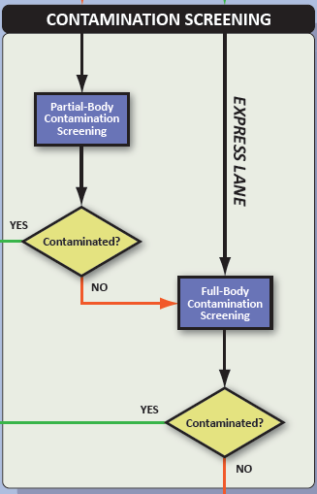
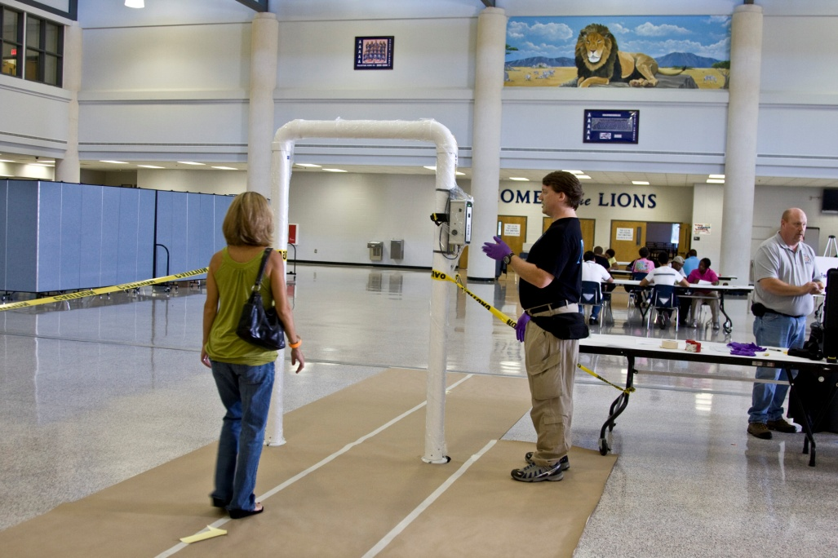
Contamination Screening
Staff screen people for external contamination
Radiation detection equipment
  Consult your state or local radiation control authority for assistance
Notes:
The Contamination Screening Station is where staff monitor people for external contamination.
Staff can use a combination of partial-body and full-body screenings, using either handheld detectors or portal monitors, to screen for contamination. Also, an express lane may be established for people who decontaminated before coming to the CRC.
People who are contaminated go to the Wash Station for decontamination. People who are not contaminated go to Registration.

Slide 13
Wash
Initial Sorting Area
Emergency Medical Care or Transfer
Survey and Monitoring Area
Wash Station Area
Registration and Dose/Medical Assessment Area
General Registration Area
Discharge Area

Slide 14
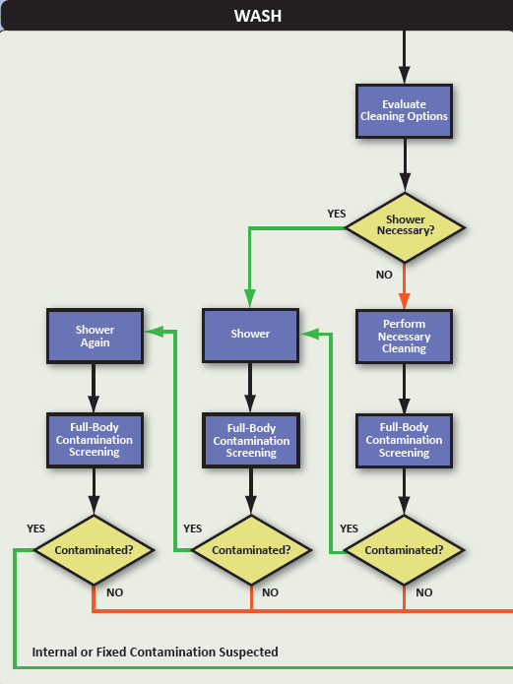
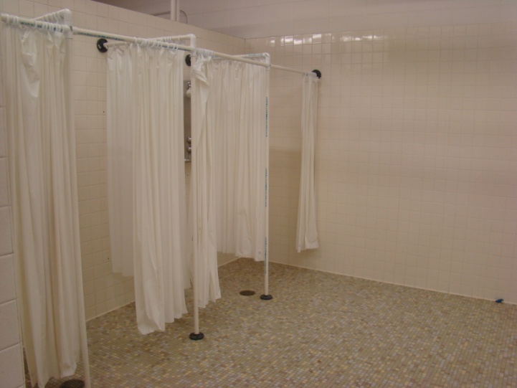
Wash
Staff monitor and facilitate showering
People wash themselves
  People with special needs may require additional assistance
Notes:
At the Wash Station, people clean themselves. Some people may need only minimal decontamination, such as washing their hands or removing the outer layer of their clothing.
Screening staff in the Wash Station will check people for contamination after they clean themselves. If contamination is still present after two showers, that person may be internally contaminated and will require additional screening at the Radiation Dose Assessment Station.

Slide 15
Registration
Initial Sorting Area
Emergency Medical Care or Transfer
Survey and Monitoring Area
Wash Station Area
Registration and Dose/Medical Assessment Area
General Registration Area
Discharge Area

Slide 16
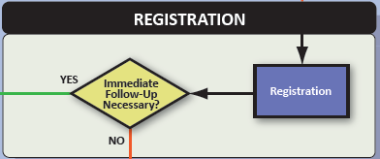
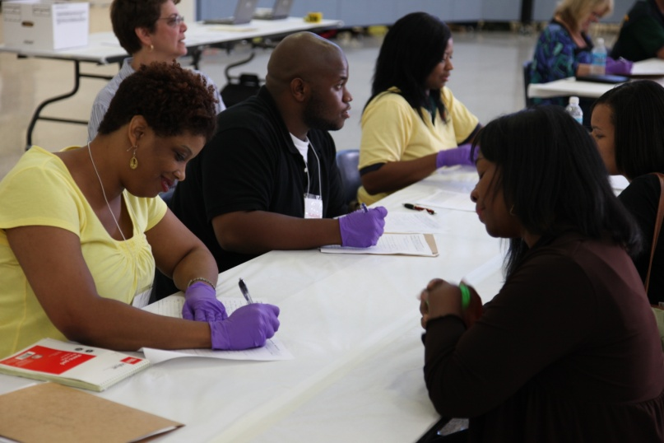
Registration
Staff collect information for registry and long-term follow-up:
  Patient name
  Contact information
  Destination
  Proximity to event
  Time in affected area
Notes:
After being screened for contamination or decontaminated at the Wash Station, people register with public health staff. Information collected at this station can be used to identify people who need immediate follow-up at the Radiation Dose Assessment Station. This information can also be used for long-term follow-up and tracking.

Slide 17
Radiation Dose Assessment
Initial Sorting Area
Emergency Medical Care or Transfer
Survey and Monitoring Area
Wash Station Area
Registration and Dose/Medical Assessment Area
General Registration Area
Discharge Area

Slide 18
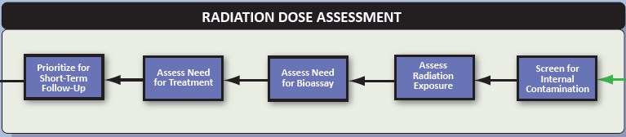
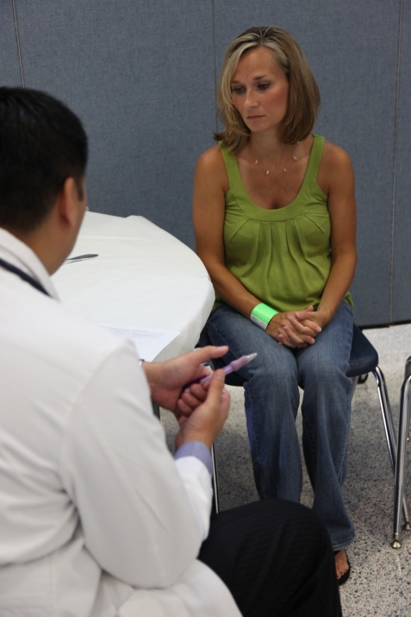
Radiation Dose Assessment
Clinical and health physics staff:
  Screen for internal contamination
  Assess radiation exposure
  Assess need for bioassay
  Assess need for treatment
  Prioritize for short-term follow-up
Notes:
Staff at the Radiation Dose Assessment Station :
Screen people for internal contamination
Assess radiation exposure,
Assess the need for bioassay,
Assess the need for treatment, and
Prioritize people for short-term follow-up.
Not everyone at the CRC will be evaluated at the Radiation Dose Assessment Station. For example, pregnant women, people showing signs of acute radiation sickness, people who are suspected to be internally contaminated, and people who were externally contaminated when they entered the CRC, may be the only people referred for Radiation Dose Assessment.

Slide 19
Discharge
Initial Sorting Area
Emergency Medical Care or Transfer
Survey and Monitoring Area
Wash Station Area
Registration and Dose/Medical Assessment Area
General Registration Area
Discharge Area

Slide 20
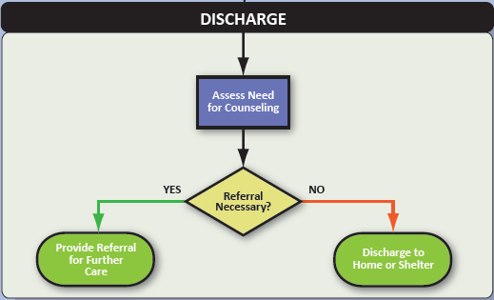
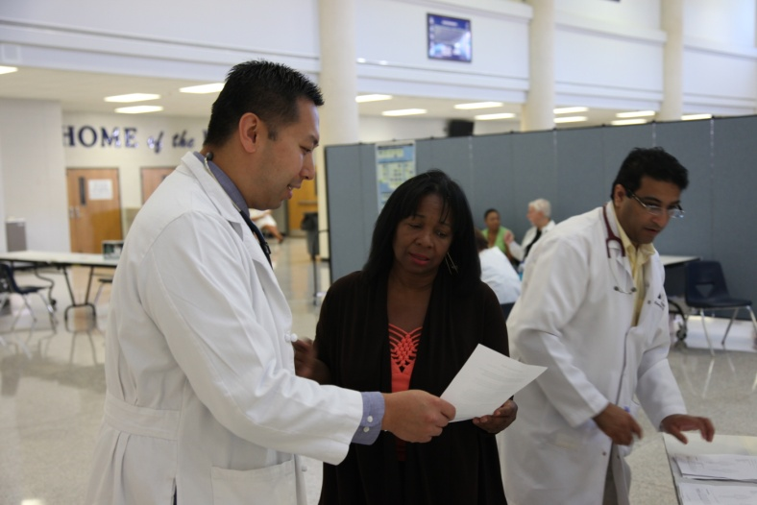
Discharge
Staff provide information for people discharged:
  Assess need for counseling
  Discharge to home or shelter
  Provide referral for further care
Notes:
Staff at the Discharge Station assess the need for counseling and provide referrals for further care. Staff here also provide information for people who are being discharged to their homes and facilitate placement in a public shelter.

Slide 21
Community Reception Center
Process Flow
Process can be adjusted to meet capabilities
  Instrumentation
  Personnel
Additional processes can be added as needed or as possible
  Pets
  Relocation services
Initial Sorting Area
Emergency Medical Care or Transfer
Survey and Monitoring Area
Wash Station Area
Registration and Dose/Medical Assessment Area
General Registration Area
Discharge Area
Notes:
This modular CRC process can be adjusted to meet the capabilities of your jurisdictions, in terms of instrumentation and personnel, and additional processes can be added as resources become available or to meet different demands.

Slide 22
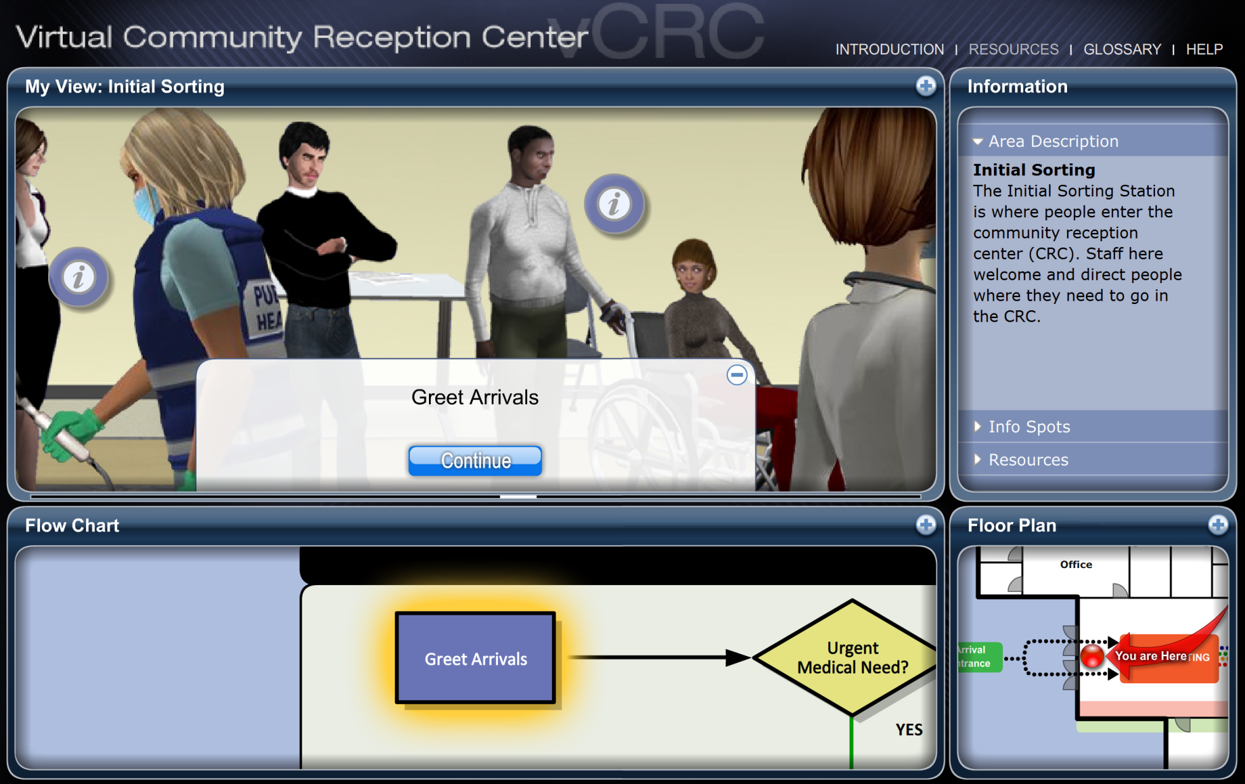
vCRC Demo
Notes:
Now that we’ve reviewed the CRC process, let’s take a look at the Virtual Community Reception Center (vCRC).
vCRC is a web-based training program for public health planners, staff, response partners, and organized volunteers. The program features an animated exploration area, an interactive flow diagram, embedded video segments, and supporting resources for CRC operations.
The default view of vCRC consist of four panels, the My View Panel, the Flow Chart Panel, The Floor Plan Panel, and the Information Panel. Panels that have a plus sign in the upper right corner can be expanded to a larger size to facilitate exploration and viewing.
To advance through the vCRC, you answer questions – using either the navigation panel or the flow chart – that correspond to the steps in the CRC flow diagram. There are no right or wrong answers in vCRC. The program is designed to be a free exploration of the virtual CRC. Once you reach an endpoint in vCRC, you can go back to the beginning and explore a different path through the center.
The icons in the My View Panel link to embedded video segments that provide additional information about that particular step in the CRC process.
Now, I’d like to demonstrate vCRC by following a couple different paths through the CRC.
1) Greet Arrivals → Urgent Medical (Y) → Transport Necessary (Y) → Transport to Hospital or Alternate Care Site (END)
2) Greet Arrivals → Urgent Medical (N) → Highly Contaminated (Y) → Shower → Contaminated (N) → Register/Immediate Follow-Up Necessary (Y) → Screen/Assess/Prioritize → Assess for Counseling/Referral Necessary (Y) → Provide Referral for Further Care (END)
3) Greet Arrivals → Urgent Medical (N) → Highly Contaminated (N) → Special Need (Y, Arrange Assistance) → Prior Decon (Y) → Full-Body/Contaminated (N) → Register/Immediate Follow-Up Necessary (N) → Assess for Counseling/Referral Necessary (N) → Discharge to Home or Shelter (END)

Slide 23
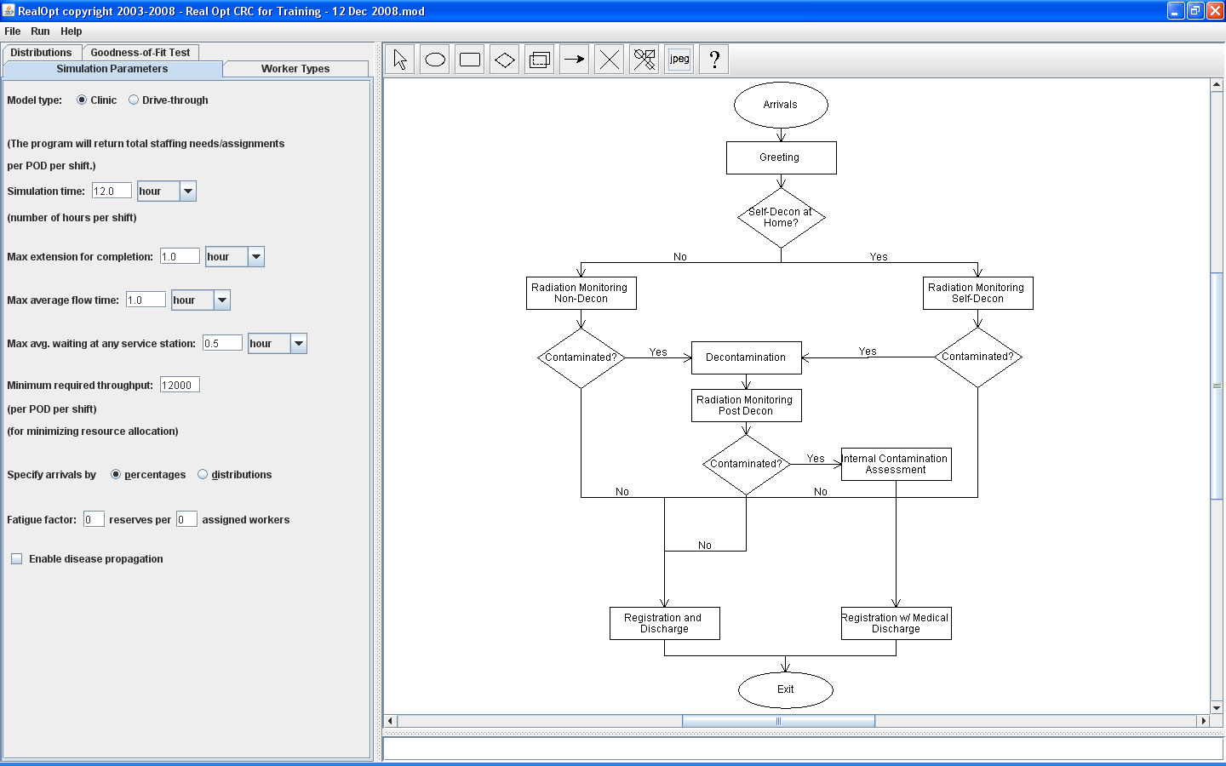
Additional Planning Tools…
CRC-STEP
RealOpt CRC
Notes:
Now that we’ve reviewed the CRC process, let’s take a look at the Virtual Community Reception Center (vCRC).
vCRC is a web-based training program for public health planners, staff, response partners, and organized volunteers. The program features an animated exploration area, an interactive flow diagram, embedded video segments, and supporting resources for CRC operations.
The default view of vCRC consist of four panels, the My View Panel, the Flow Chart Panel, The Floor Plan Panel, and the Information Panel. Panels that have a plus sign in the upper right corner can be expanded to a larger size to facilitate exploration and viewing.
To advance through the vCRC, you answer questions – using either the navigation panel or the flow chart – that correspond to the steps in the CRC flow diagram. There are no right or wrong answers in vCRC. The program is designed to be a free exploration of the virtual CRC. Once you reach an endpoint in vCRC, you can go back to the beginning and explore a different path through the center.
The icons in the My View Panel link to embedded video segments that provide additional information about that particular step in the CRC process.
Now, I’d like to demonstrate vCRC by following a couple different paths through the CRC.
1) Greet Arrivals → Urgent Medical (Y) → Transport Necessary (Y) → Transport to Hospital or Alternate Care Site (END)
2) Greet Arrivals → Urgent Medical (N) → Highly Contaminated (Y) → Shower → Contaminated (N) → Register/Immediate Follow-Up Necessary (Y) → Screen/Assess/Prioritize → Assess for Counseling/Referral Necessary (Y) → Provide Referral for Further Care (END)
3) Greet Arrivals → Urgent Medical (N) → Highly Contaminated (N) → Special Need (Y, Arrange Assistance) → Prior Decon (Y) → Full-Body/Contaminated (N) → Register/Immediate Follow-Up Necessary (N) → Assess for Counseling/Referral Necessary (N) → Discharge to Home or Shelter (END)

Slide 24
vCRC available online:
http://www.emergency.cdc.gov/radiation/crc/vcrc
Or to request a complimentary copy:
cdcinfo@cdc.gov or 800-CDC-INFO
National Center for Environmental Health
Division of Environmental Hazards and Health Effects

