Slide 1

Public Health Operations and Capabilities
State Perspective
Bridging the Gaps: Public Health and Radiation Emergency Preparedness
22 March 2011
Jim Craig
Director of Health Protection
Mississippi State Department of Health

Slide 2
“State health departments display substantial gaps in preparedness for a major radiation emergency, including acts of terrorism and unintentional releases of radiation,” according to survey results published in the journal Disaster Medicine and Public Health Preparedness.
Notes:
Many of us have read the recent report on State-Level Emergency Preparedness and Response Capabilities related to radiation emergencies.
The report showed that there are substantial gaps in preparedness for a major radiation emergency.
I would like to spend a few minutes to share with you my perspective, a state perspective on these gaps. Please recognize that in MS we are centralized public health meaning that all local public health departments work for and or employees of the state public health department. Further, our Radiological Health department is centralized in Public Health.

Slide 3
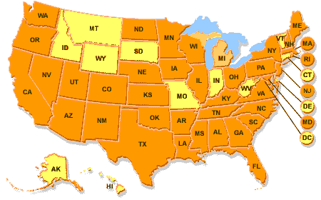
NRC Agreement States
(38 States)
Notes:
Mississippi is one of the 38 agreement states with NRC

Slide 4
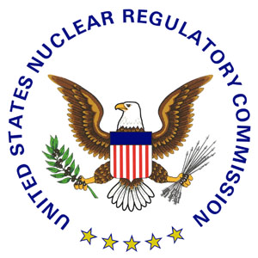
NRC Agreement States
State Radiation Control Programs
NRC relinquishes to the States portions of its regulatory authority
State Radiation Control Programs are regulatory in nature
Notes:
Under the agreement, NRC relinquishes to the States portions of its regulatory authority to license and regulate byproduct materials (radioisotopes); source materials (uranium and thorium); and certain quantities of special nuclear materials.
State Radiation Control Programs therefore are regulatory in nature and are designed to protect the health and safety of the citizens from the harmful effects of ionizing radiation. Many Radiation Control Programs are funded related to their regulatory function. In Mississippi most of our revenue is fee based for providing inspections. Many radiation control programs have limited to no funding for emergency planning and response.

Slide 5
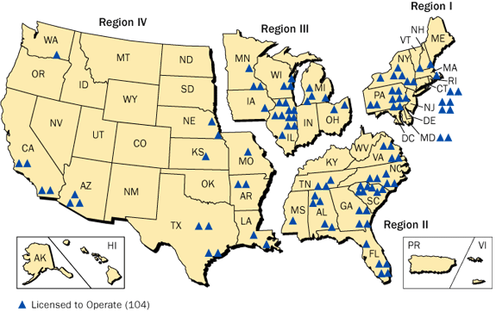
States with Nuclear Power Plants
(31 States)
Notes:
Mississippi is also a state with a nuclear power plant which means that local and state level plans for responding to incidents related to the plant have been developed and exercised as specified by FEMA.

Slide 6
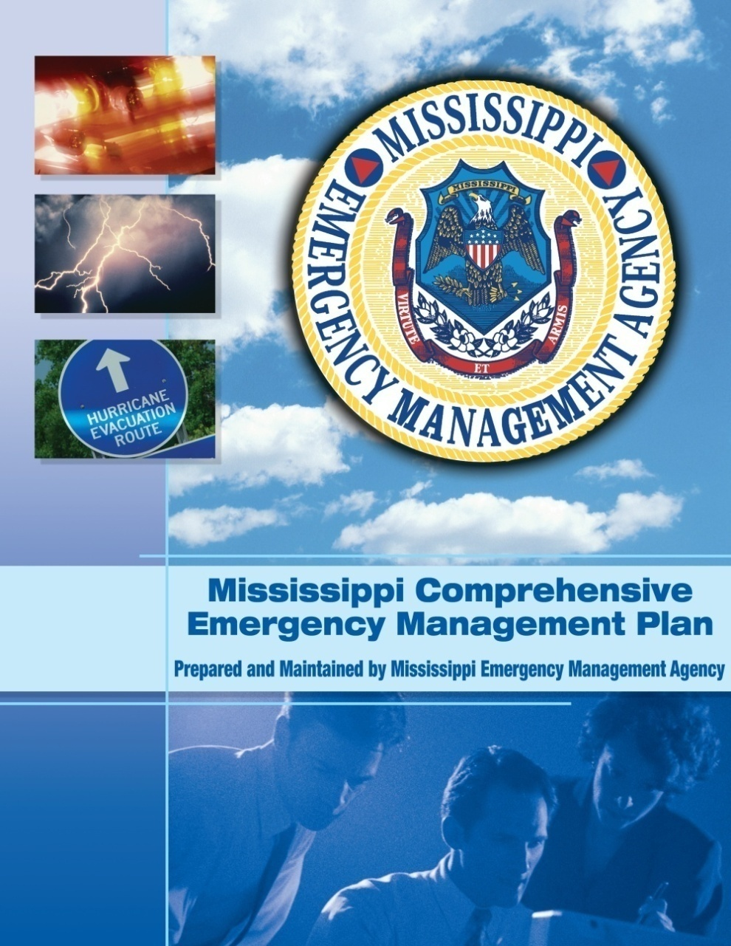
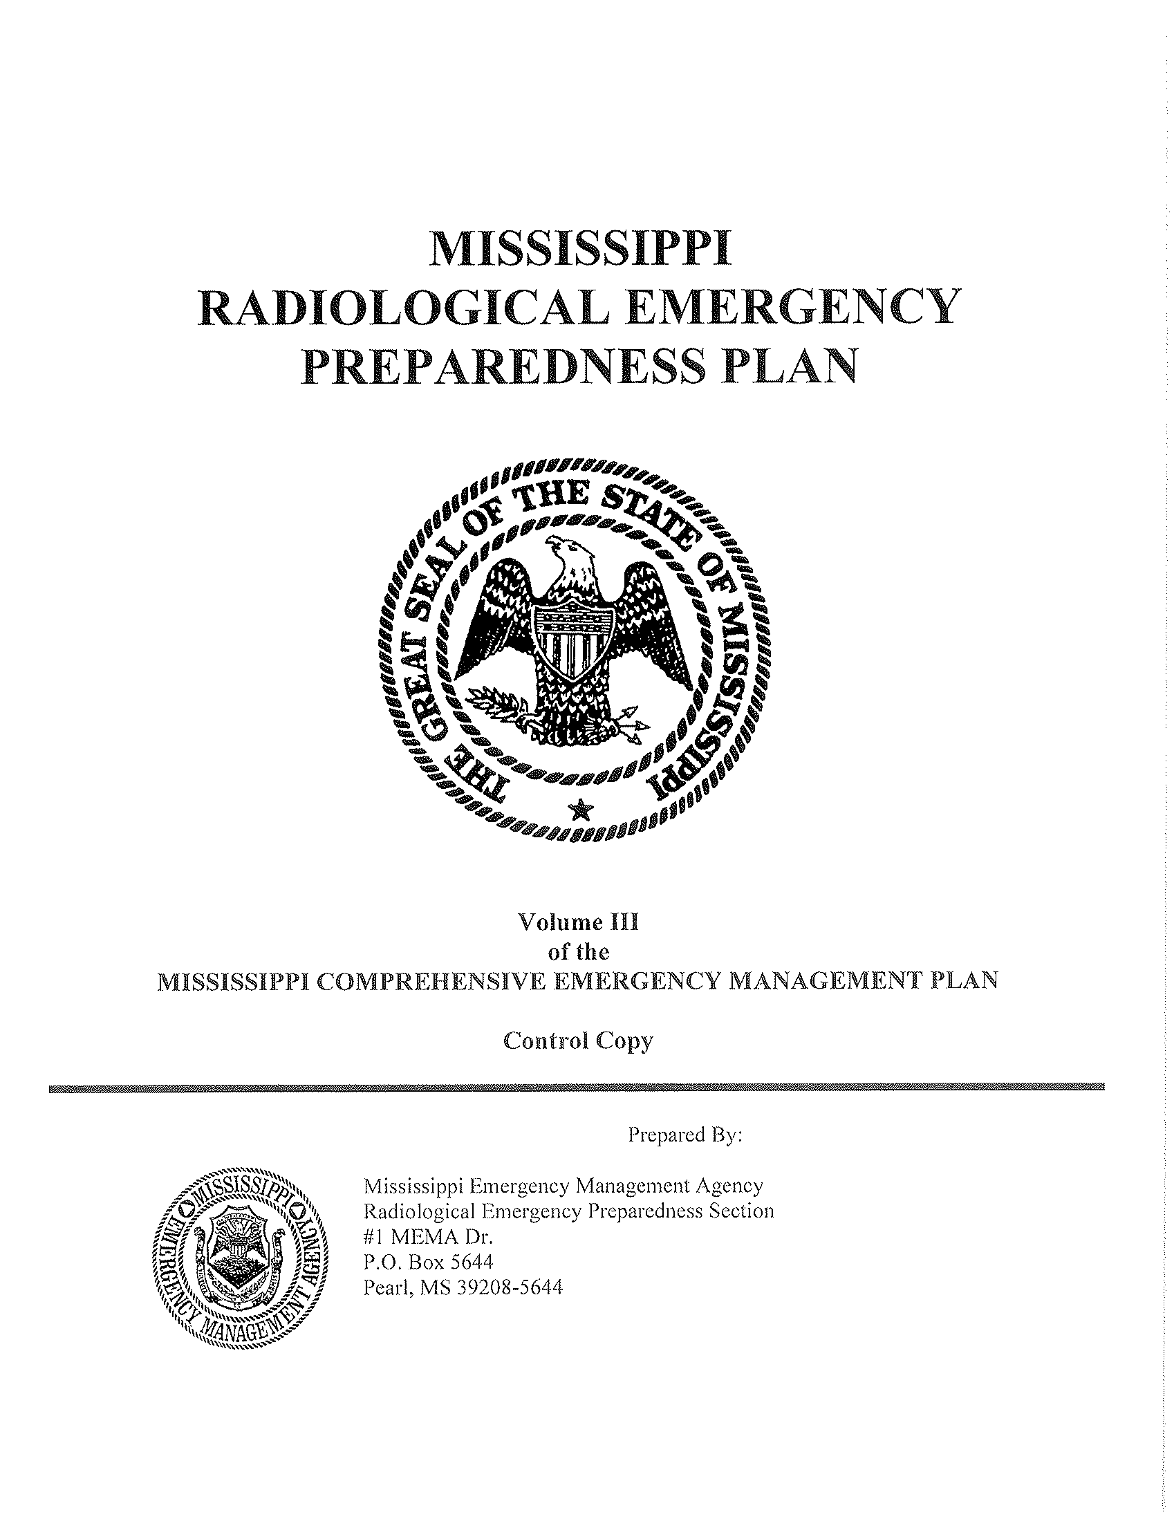
Planning in States Operating Nuclear Power Plants
Notes:
These Radiological Emergency Preparedness Plans or REP plans are very mature plans that have been extensively reviewed, trained on and exercised. Exercises for these plans are graded events.
In Mississippi our REP plan is part of the overall Mississippi Emergency Operations Plan, a plan which is designed to protect the health, safety and property of the citizens of Mississippi from all hazards.
Most REP plans include requirements related to population monitoring, and demonstrate well-established working relationships with planning partners in the state radiation control program, public health, state and local emergency management and federal partners in the Federal Emergency Management Agency (FEMA), Department of Homeland Security (DHS), and the Nuclear Regulatory Commission (NRC).
In most states with REP plans there are hospital plans that have been developed for receiving and treating patients as a result of a radiation incident.

Slide 7
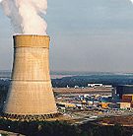
Shortfalls
Effective response to a radiological or nuclear terrorism incident requires a broader scope of planning
Plans need to account for the suddenness of an incident
Plans and expertise already developed are assets
Grand Gulf Nuclear Power Plant, Port Gibson, MS
Notes:
Sounds like states with REP Plans have all the plans needed right? Having a REP plan and the local, state and federal collaboration to create and exercise these plans is definitely a plus but there are a number of shortfalls as related to overall radioactive and nuclear emergency planning. Effective response to a radiological or nuclear terrorism incident requires a broader scope of planning and most likely a different mode of response than those described in plans for response to nuclear power plants.
These plans need to account for the suddenness of an incident (as opposed to a nuclear power plant failure, which would likely unfold over a 24- to 72-hour period); the likelihood that the incident would be larger in scale, involving a much larger urban population; and the unknown aspect of the radionuclide(s) involved.
However, the plans, collaborations and expertise already developed are assets in preparing for a radiological or nuclear terrorism incident with mass casualties.

Slide 8
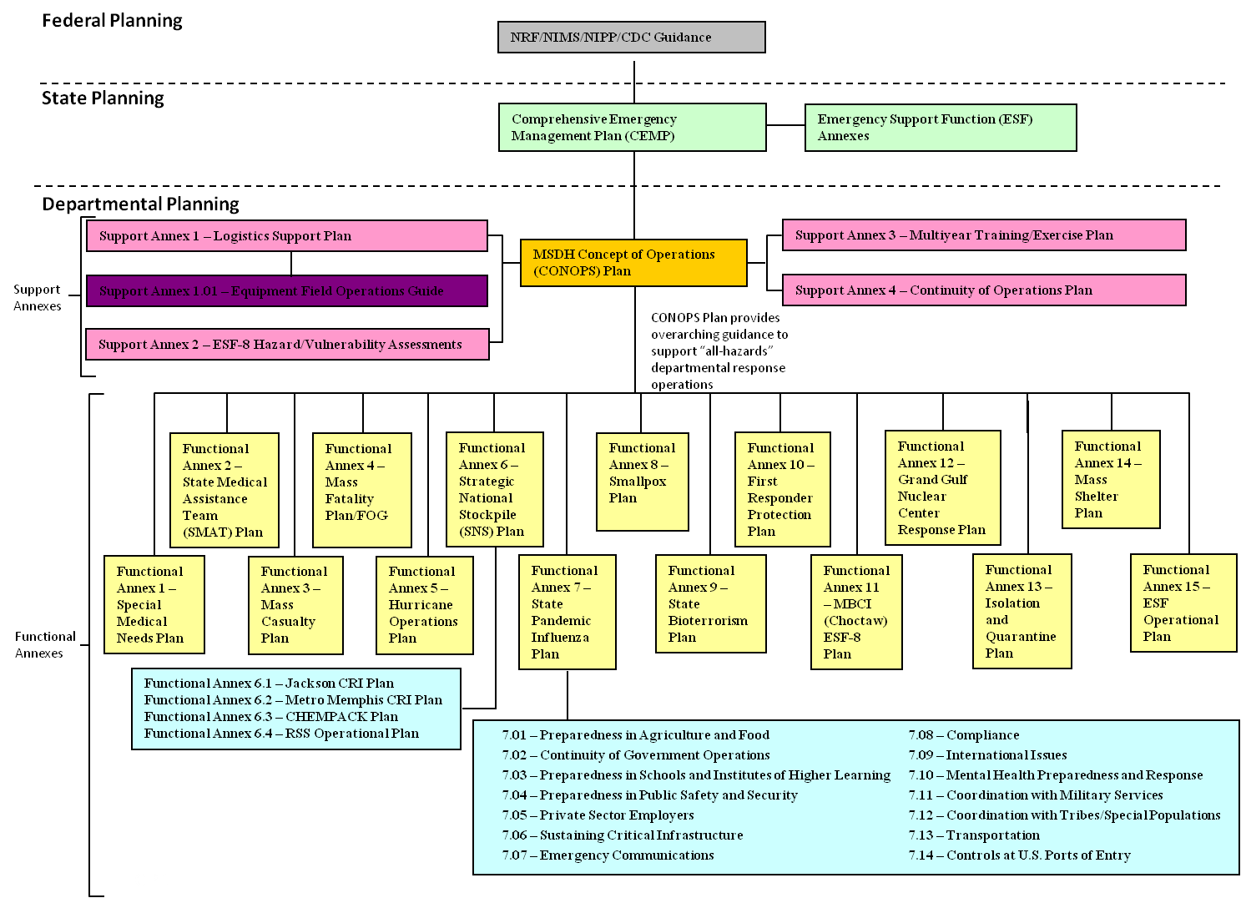
All Hazard Planning
Notes:
8
In most states, long after the development of REP plans, CDC invested in State and Local Public Health Emergency Preparedness through cooperative agreements that in part were designed to better prepare public health to respond to public health emergencies. Public Health Preparedness funding has produced much progress in developing All Hazard Plans. As you can see Mississippi has been able to develop a number of annexes to our Comprehensive Plan but emphasis has been placed on areas that were important in the cooperative agreement such as smallpox, strategic national stockpile, pandemic influenza etc. While most all states probably address CBRNE (Chemical, Biological, Radioactive, Nuclear and Explosive) in their all hazard plans, in most cases the radioactive and nuclear plans are not nearly as developed from a public health perspective as other plans. Further, many annexes do not provide nuclear or radioactive considerations. As an example, State medical assistance team plans do not contemplate a disaster patient who may have a radioactive exposure, special medical needs sheltering and other general population sheltering plans are distinct and separate from reception center plans that are part of the REP plans. Screening in shelter plans do not normally include staffing, equipment and processes for radiation screening. Mass fatality and mass casualty plans are not specific enough about radiation emergencies as well as many other plans do not include actions for radiation events. Cooperative agreements with federal funders help set the priority for planning and development of response capabilities. While nothing precludes a state from further developing radiation or nuclear emergency preparedness plans they have not been seen as the priority through guidance.

Slide 9
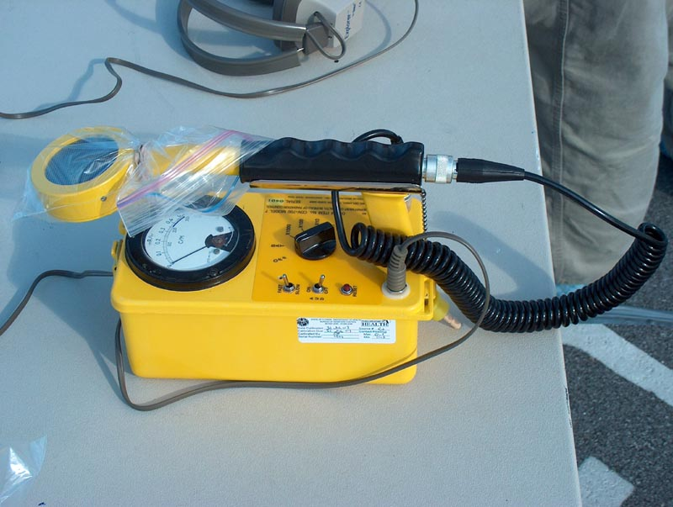
Shortfalls
Little to no planning for public health surveillance to assess potential human health impacts of a radiation event
Plans to address exposure assessments
Environmental sampling plans
Human specimen collection and analysis plans
Responder Health and Safety
Behavioral Health Plans
Notes:
In addition there are shortfalls in integrating public health surveillance to assess potential human health impacts of a radiation event
addressing exposure assessments, developing environmental sampling plans, human specimen collection and analyses plans, developing responder health and safety as well as behavioral health plans for radiation emergency conditions.

Slide 10
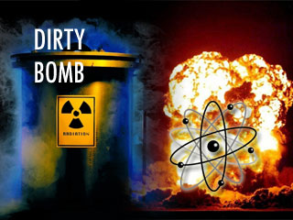
Shortfalls
Detailed plans for
  Radiologic contaminated dispersal devices (RDD’s or so called “dirty bombs”)
  Intentional Scenarios
Training in radiation emergency response
Exercise templates for non-nuclear power plant radiation releases
Notes:
Also in many states we lack detailed plans for
Radiologic contaminated dispersal devices (RDD’s or so called “dirty bombs”)
Intentional Scenarios
Training in radiation emergency response
Exercise templates for non-nuclear power plant radiation releases

Slide 11
Absent proper planning, states in which a radiation emergency occur are likely to have inefficient, ineffective, inappropriate or tardy responses that could result in (preventable) loss of life.
Notes:
This planning, integration and collaboration is paramount to our ability to be efficient, effective and timely in our responses.

Slide 12
There is insufficient capability to respond to a radiation incident.”
Notes:
While REP states probably have more radiologic staffing than other states there is just not enough staff to get it all done. Mississippi has 1 health physicists on staff for every 187000 persons in MS. He or she will be busy in a nuclear or radiologic emergency. Mississippi is working to develop a Radiological Medical Reserve Corps to provide additional surge capacity but there is very limited funding to develop these resources. As I stated earlier in many cases the radiation control program may not be in public health.

Slide 13
Health Protection
Health
Protection
Environmental
Health
Emergency Planning and Response
Licensure
Notes:
I have been fortunate in Mississippi to be successful in organizing the Office of Health Protection where the Director of Health Protection also serves as the Public Health Preparedness Director and has the various programs of Environmental Health – food safety, water, milk etc., Emergency Planning and Response and the state survey agency for health care facilities, child care and professional licensure.

Slide 14
Emergency Planning and Response
Emergency Planning and Response
Radiological Health
Planning
Emergency Medical Service
Logistics
Finance/Admin
Operations
CDC PHEP
ASPR HPP
Notes:
Mississippi is fortunate that our radiological health department is in the same organization as public health preparedness and hospital preparedness.
As such we can work together for better planning and coordination in radiological health and other public health functions.

Slide 15

Resource Shortages
Staff
  Health Physicists
  Epidemiologists
  Radiochemists
Resources to conduct population-based exposure monitoring
Resources to collect, process and ship samples for, and conduct radiation analyses
Monitoring equipment
Screening equipment
Laboratory equipment and supplies
Notes:
The shortage of resources are more than just health physicists. There are also shortages of epidemiologists, radiochemists and other laboratorians to plan, train and respond. These staff deficits relate to insufficient resources to conduct population based exposure monitoring, collect, process and ship samples for radiation analyses. Also as we watch news footage from Japan where radiation screening and or monitoring is being performed it is clear that Mississippi as well as most states do not have sufficient monitoring or screening equipment as well as laboratory equipment and supplies.

Slide 16


Regional Collaboration
(16 States/2 Territories)
Non-profit Organization
Southern Mutual Agreement for Mutual State Radiological Assistance
    The Southern Mutual Radiation Assistance Plan (SMRAP) provides a mechanism for coordinating radiological emergency assistance capabilities among participating states.
By-Laws for Southern Emergency Response Council
Activation Procedure
    Requesting State
    Responding State
    Radiation Control Program
Notes:
In many cases process is just as important as plans and contacts are critical to a response. Since it is clear there is not enough of anything other than need, it is important that we further develop regional collaborations. Mississippi is truly fortunate to be part of the Southern States Energy Board which provides a mechanism and process for coordinating radiological emergency assistance among its participants and

Slide 17
Region IV Unified Planning Coalition
Together we are better!
a state-lead interstate public health and medical (ESF-8) preparedness and response organization devoted to planning and the development of partnerships.
enhances the member states' abilities to prepare for public health and medical response to incidents/events.
support each other to prepare for and respond to incidents or events through the development of integrated, interoperable, and comprehensive all-hazards public health and medical emergency response systems.
Alabama – Florida – Georgia – Kentucky – Mississippi – North Carolina – South Carolina - Tennessee
Notes:
The Region IV Unified Planning Coalition that brings the eight southeastern states together to support each other in planning and response to public health and medical emergency response systems.

Slide 18
Many Opportunities
Do nothing – maintain status quo
Doing less with nothing
Doing more with less
Leveraging other funding
Be funded to be prepared

Slide 19
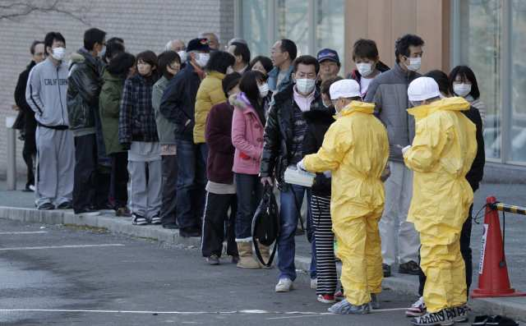
Are we ready?
Notes:
The Japan earthquake and subsequent radiation emergency has brought much for us all to think about.
Are we Ready?

