Slide 1

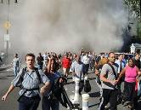

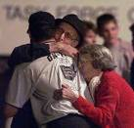

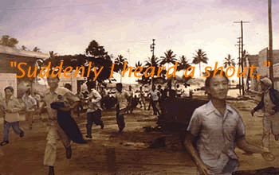
Planning for Psychosocial and Behavioral Health in a Radiological/Nuclear Event
Jack Herrmann, MSEd., NCC, LMHC
Senior Advisor, Public Health Preparedness
National Association of County and City Health Officials (NACCHO)
Bridging the Gaps: Public Health and Radiation Emergency Preparedness Summit· March, 22-24, 2011

Slide 2
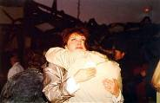
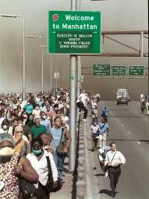

Objectives of the Panel
Brief overview of the range of reactions individuals experience in the aftermath of radiation disaster and planning challenges to address these reactions.
Understand the multiple disaster mental health strategies and “touch points” in helping community members and disaster responders plan and respond to a radiation event.
Identify the innovative programs to prepare hospitals and clinics for the psychological consequences of a radiation event or other incident.
Recognize the importance of Family Assistance Centers in helping to meet the mental health needs of families/survivors.

Slide 3
Panelists
Rob Yin, LISW
Manager, Disaster Mental Health
American Red Cross, National Headquarters
Sandra Stark Shields, LMFT, CTS
Sr. Disaster Services Analyst
LA County Department of Health Services
Emergency Medical Services Agency
Onora Lien
Health Systems Response Planner
King County Healthcare Coalition
Public Health - Seattle & King County

Slide 4
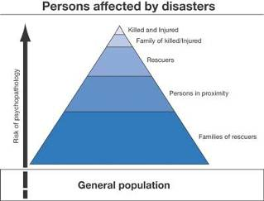
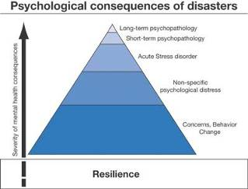
Key Principles
Most disaster survivors experience ‘expectable’ reactions and are generally capable of functioning effectively in the aftermath of a disaster.
The vast majority of survivors do not develop long term psychiatric disorders.
However, some will go on to develop both short and long term mental health problems.
(Galea, 2006)
(Galea, 2006)

Slide 5

Disaster Reactions Over Time
20-50% of individuals exposed to disasters experience psychological responses that are:
  Immediate (onset within one month of trauma)
  Mild (fewer symptoms than needed for full diagnosis)
  Transient (symptoms are less than 1 year in duration)
Majority recover fully from any psychological effects within 12-18 months
Maybe longer for human-caused disasters

Slide 6
Range of Reactions
Emotional
Cognitive
Behavioral
Physical
Spiritual

Slide 7
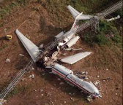
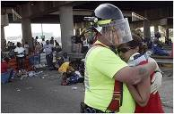

Factors Contributing to Psychological and Psychosocial Responses
Disaster Characteristics
Response Characteristics
Individual Characteristics

Slide 8
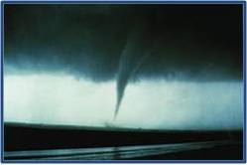
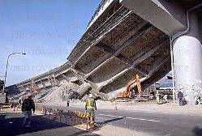
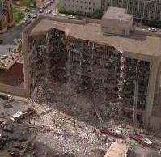
Disaster Characteristics
Natural vs. Human-Caused
Onset
Scope
Impact
Duration

Slide 9
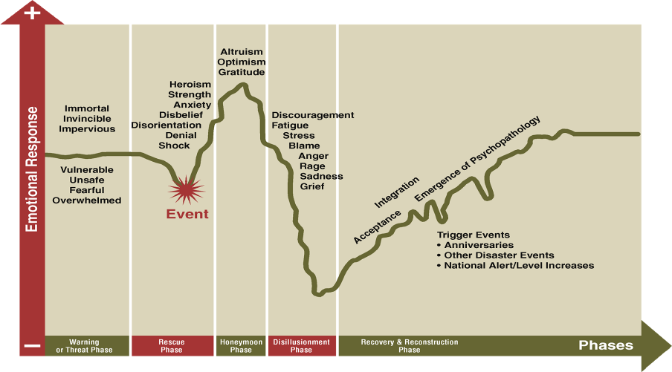
Response Characteristics
(Adapted from Zunin/Meyers)
Notes:
Replace with new diagram

Slide 10
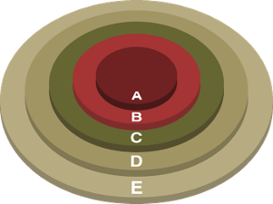
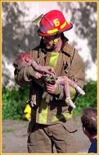
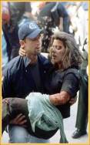
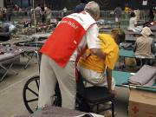
Individual Characteristics
Personal Exposure
Previous Disaster Functioning
Personality Characteristics
Disaster History
Age
Gender
Socioeconomic Status
Culture/Ethnicity
Family Factors
First Responders
Persons with Disabilities

Slide 11
Reactions Following Radiation Incidents
Radiation emergencies may cause psychological traumatic stress, with both short and long-term effects
Extend beyond the individuals directly affected.
Situations with a high degree of uncertainty, regarding potential future health effects, may be more psychologically traumatic than others.

Slide 12
Reactions Following Radiation Incidents
Medical Professionals and First Responders
Have limited experience in managing casualties from radiation events.
May experience fear, shock, anger, helplessness and worry
May be concerned about exposing family/friends
Psychological support services, education and training may mitigate potential staff shortages during these incidents

Slide 13
Learning From Past Events
Three Mile Island, Middletown, PA (1979)
Nuclear Reactor
  Mechanical problem & operator-induced error
  144,000 individuals within 15 mile radius evacuated
  Initial official communication was confusing
  Schools closed
  Public perceptions of term health effects
  Radiation exposure to public minimal
The only detectable effect was psychological stress during and shortly after the incident.
Pennsylvania DOH maintained registry of 30,000 individuals x18 years

Slide 14
Learning From Past Events
Goiana, Brazil (1987)
Discarded radioactive medical equipment
  249 individuals contaminated
  4 related deaths
  Public concern spread throughout the city and outlying regions
  Government screened about 125,000 persons for possible exposure.
  Of the first 60,000 screened, 5,000 individuals had psychosomatic symptoms that mimicked those of radiological exposure.
  None of them had actually been exposed to the radioactive materials
  112,000 sought medical evaluation (11% of population)

Slide 15
Planning Challenges in Response to Radiation Disasters
Public/Responder Reactions
Plan for how people will respond, not how you want them to respond!
Radiation effects are not clearly understood by the public
Concern, anxiety, fear and panic
Concerns about short and long term health effects
Concerns about contamination/contagion
Social stigma
Notes:
Radiation detection-invisible silent, odorless

Slide 16
Planning Challenges in Response to Radiation Disasters
Evacuation
Determining when, who, where, and how
Addressing special needs populations
Setting up evacuee receiving sites
Determining the services offered at these sites
Population monitoring (short/long term) and decontamination
Pets

Slide 17
Reactions Following Radiation Incidents
“When people are confused about their actual health risks, some will assume incorrectly that they have been exposed and will develop physical reactions.”
National Child Traumatic Stress Network (NCTSN) 2010

Slide 18
Planning Challenges in Response to Radiation Disasters
Surge on the Healthcare Sector
Medical “home” may or may not be available
Traditional places for seeking care (e.g. hospitals, clinics) may be overcrowded
Staffing shortages
Personnel Training
Mental health vs. physical health triage
Availability of prophylaxis or treatment medications
Alternate care system and standards of care

Slide 19
Planning Challenges in Response to Radiation Disasters
Communication with the Public
Information sharing-What? When? How?
Social media
Trusted informants
Messaging to special needs populations, risk groups
Communication with Workers and Responders

Slide 20
Thank You!!
Jack Herrmann, MSEd., NCC, LMHC
Senior Advisor, Public Health Preparedness
National Association of County and City Health Officials (NACCHO)
(202) 507-4228
jherrmann@naccho.org

