Slide 1


Planning and Response Tools for a Radiation Emergency
Ed Waller, PhD, PEng, CAIH, CHP
Professor
NSERC Industrial Research Chair in Health Physics and Environmental Safety
University of Ontario Institute of Technology
Presented at the Centers for Disease Control and Prevention, Atlanta, Georgia, 23 March 2011

Slide 2

“Security forces are taking "very seriously" the risk of a possible terrorist attack using radioactive agents.”
Jacqui Smith, British Home Secretary, 2007
A dirty bomb attack against a major Western city
is just a matter of time”
UK Security Service: MI5, Dame Elizabeth Manningham-Buller
“It’s not if a dirty bomb will go off; it’s when”
V.E. Anderson, California Dept of Public Health
“We cannot train everyone to a health physicist level”
Rob Ingram, FDNY Chief WMD
Individual dose assessment in the early phase of a terrorist attack is currently not possible.
US Department of Homeland Security

Slide 3
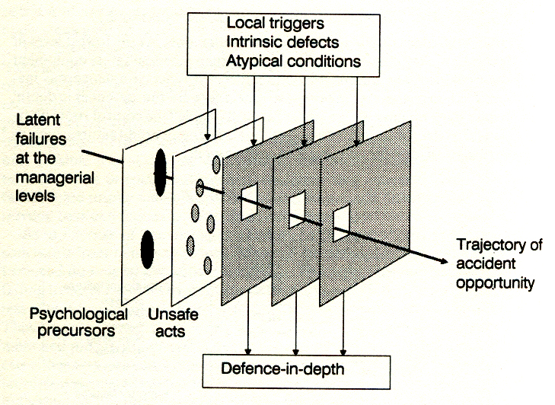
Anatomy of the RDD Event
“Evil
Plans”
System ‘holes’
Ineffective tools
Abnormal situations
nb: for a reactor accident, evil plans might be replaced by unsafe acts, inadequate training, etc
Latent failures at the managerial level
Realizable Damage to humans and/or infrastructure
Psychological precursors
Defence in Depth
Adapted from “Human Error”, James Reason, Cambridge, 1990

Slide 4
Need for Tools
In the same way that all emergencies are local emergencies, all medical management tools are by necessity local tools
Tool must be tailored to local conditions, populations and resources available
Although tools are local, they need to be consistent with state/federal/territorial guidance and directives

Slide 5
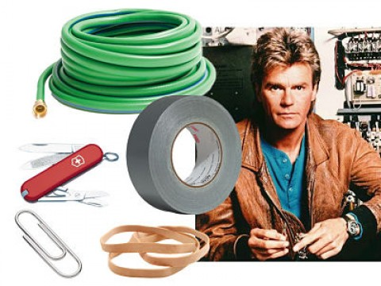

The Human Factor
Most people have never been in a mass casualty emergency, let alone a radiological emergency. Real experience is lacking.
Who do you need?
Theoretician
Problem Solver

Slide 6
What is a tool?
An implement used in the practice of a vocation
Entity that interfaces between two or more domains
Tools need to be simple and effective
for emergency response
Marshall McLuhan: “We shape our tools. And then our tools shape us”
Notes:
The medium is the message
The global village
Predicted the world wide web

Slide 7

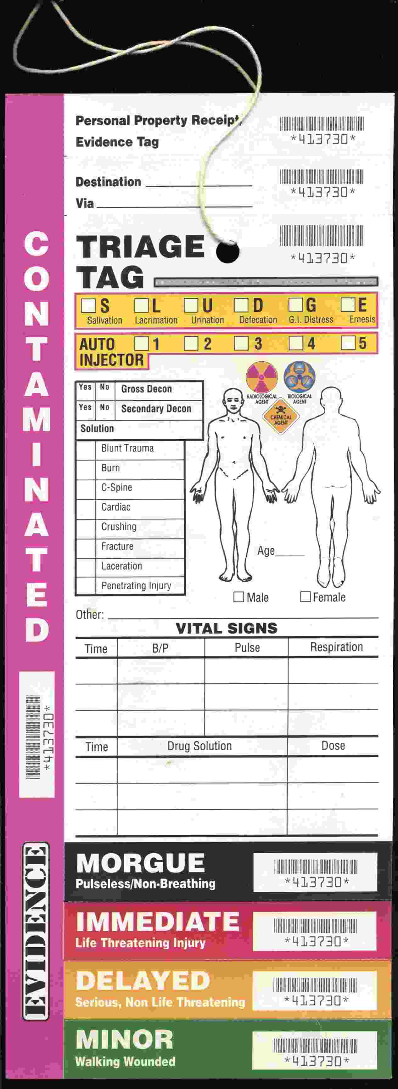
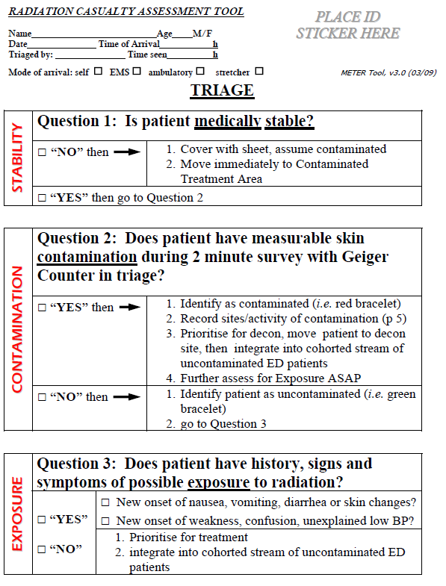
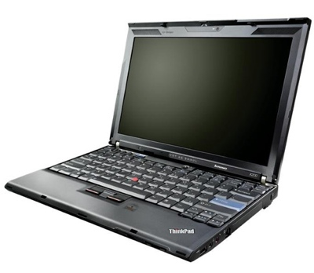
Tools
Post-itTM note
Tag
Piece of paper
Many sheets of paper
Software (desktop, laptop, mobile app)
WebWare
Integrated hardware/software

Slide 8
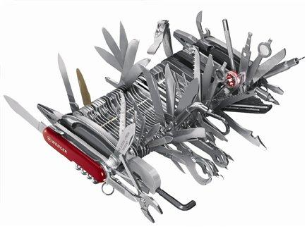
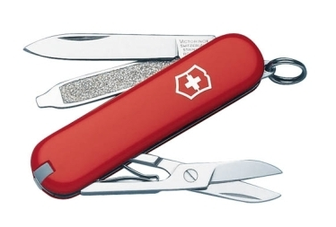
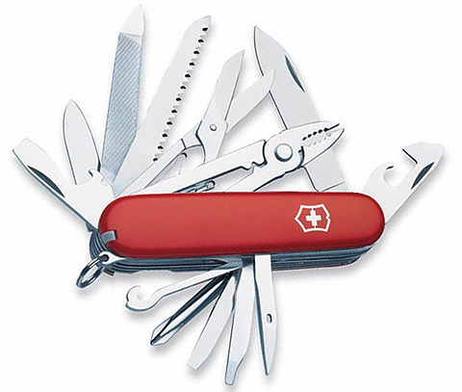
Conundrum
Tool designers want to put as much functionality into their tools as possible
End-users want simplicity and efficiency
Reality is in-between

Slide 9
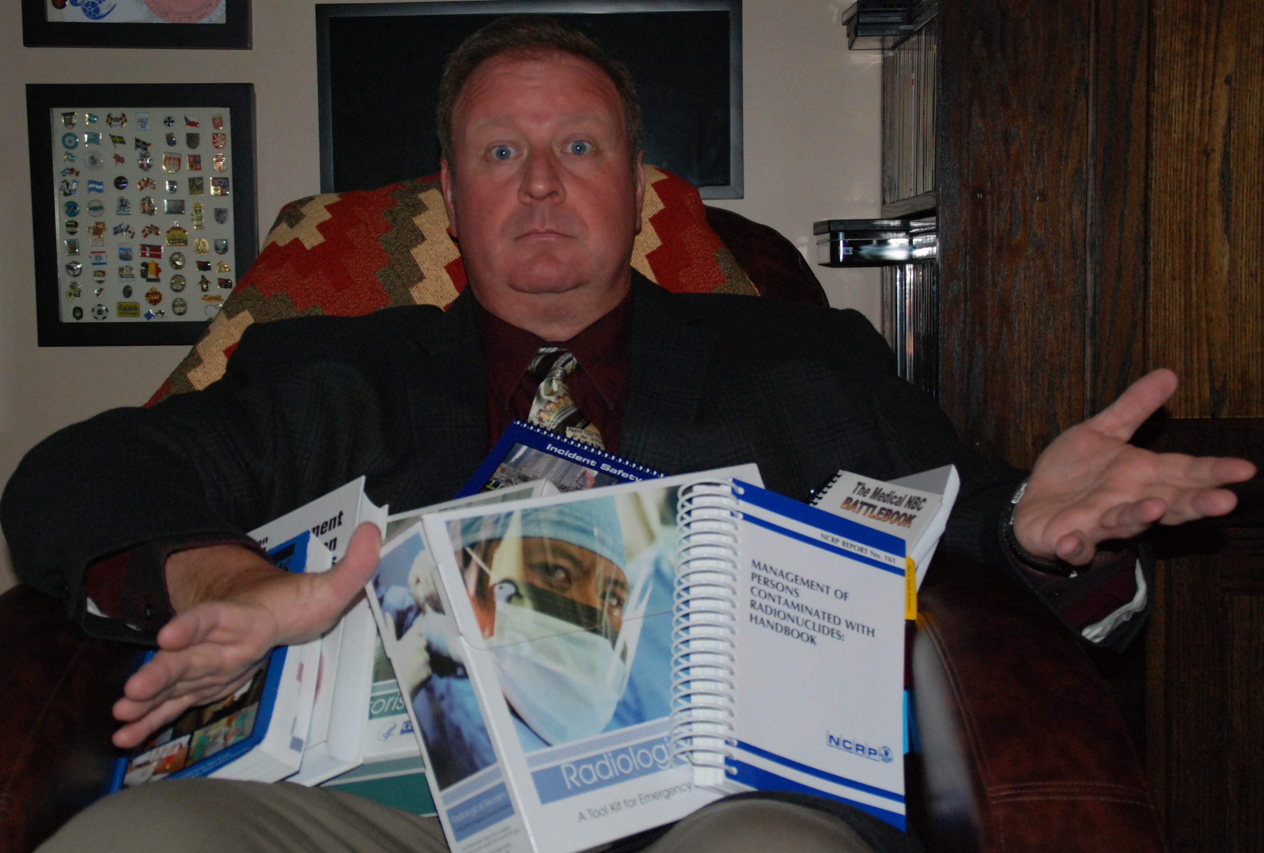
Where do I start?

Slide 10
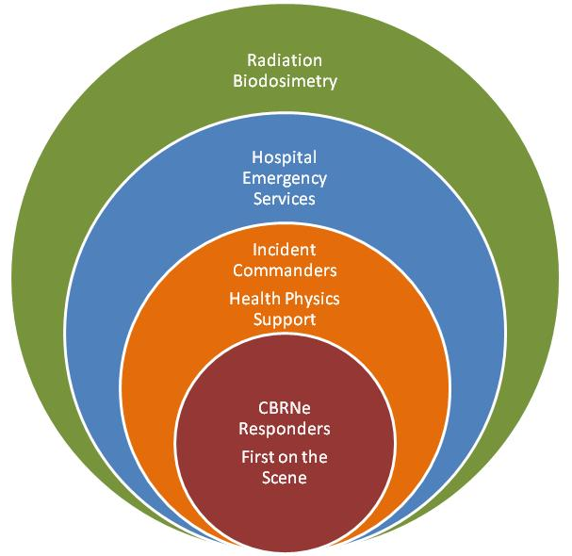

End-Users
First-on-the-Scene
CBRNe Responders
Incident Commanders
Health Physics Reach-Back
Hospital Emergency Services
Radiation Biodosimetry
Law Enforcement (forensic criminal investigation)
Forensics

Slide 11
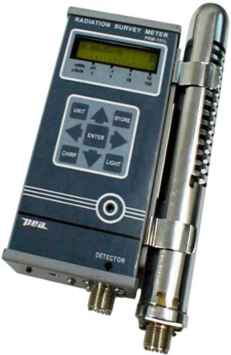
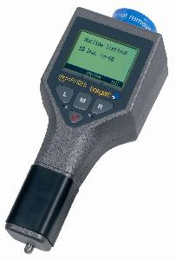

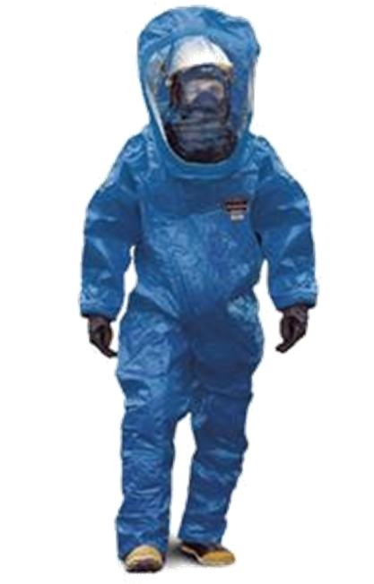
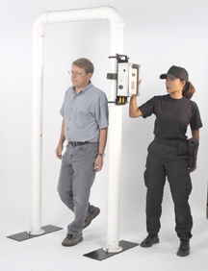
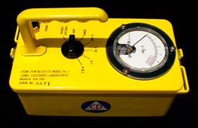
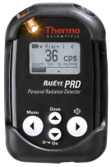
Hardware & Software
Hardware tools
  Detect radiation
  Quantify radiation exposure
  Quantify radiation dose
Software tools
  Extent of condition
  Triage decisions
  Treatment assistance
  Dose assessment
  Recording
  Forensics
Software Application Categories
  Medical Triage
  Medical Treatment
  Hazard Prediction
  Dosimetry
  Training

Slide 12
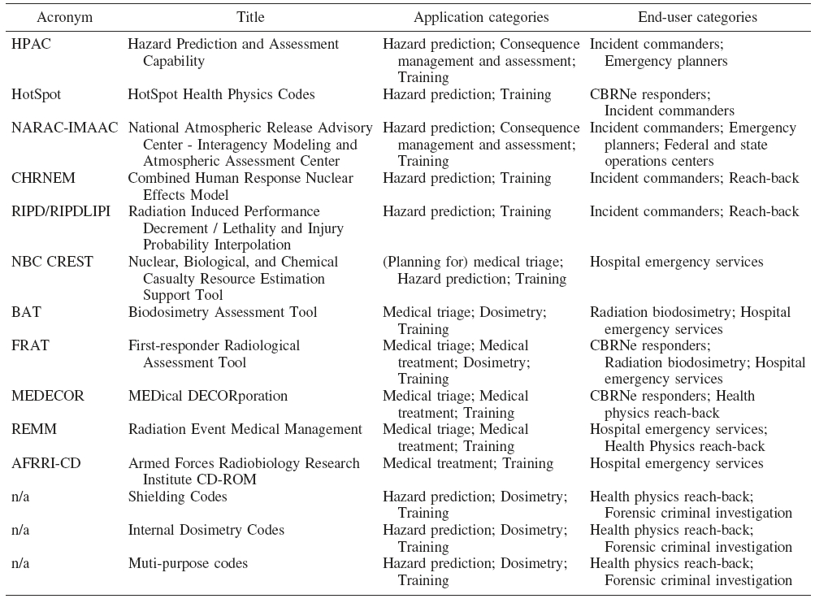
Select Software Tools
“Overview of Hazard Assessment and Emergency Planning Software of Use to RN First Responders”, Waller, E.J., Millage, Blakely, Ross, Mercier, Sandgren, Levine, Dickerson, Nemhauser, Nasstrom, Sugiyama, Homann, Buddemeier, Curling and Disraelly, Health Phys, Vol. 97, No. 2, pp. 145-156, 2009.

Slide 13
Medical Management

Slide 14
Of Importance to the
Medical Management
Is the person injured?
  Treat this first (without compromising position)
Is the person contaminated?
  External, internal or both?
If external, decontaminated and re-assess
  Dosimetry estimate
If internal, what is isotope & activity?
  Triage internal contamination
  Dosimetry assessment
  Long term care & risk assessment

Slide 15
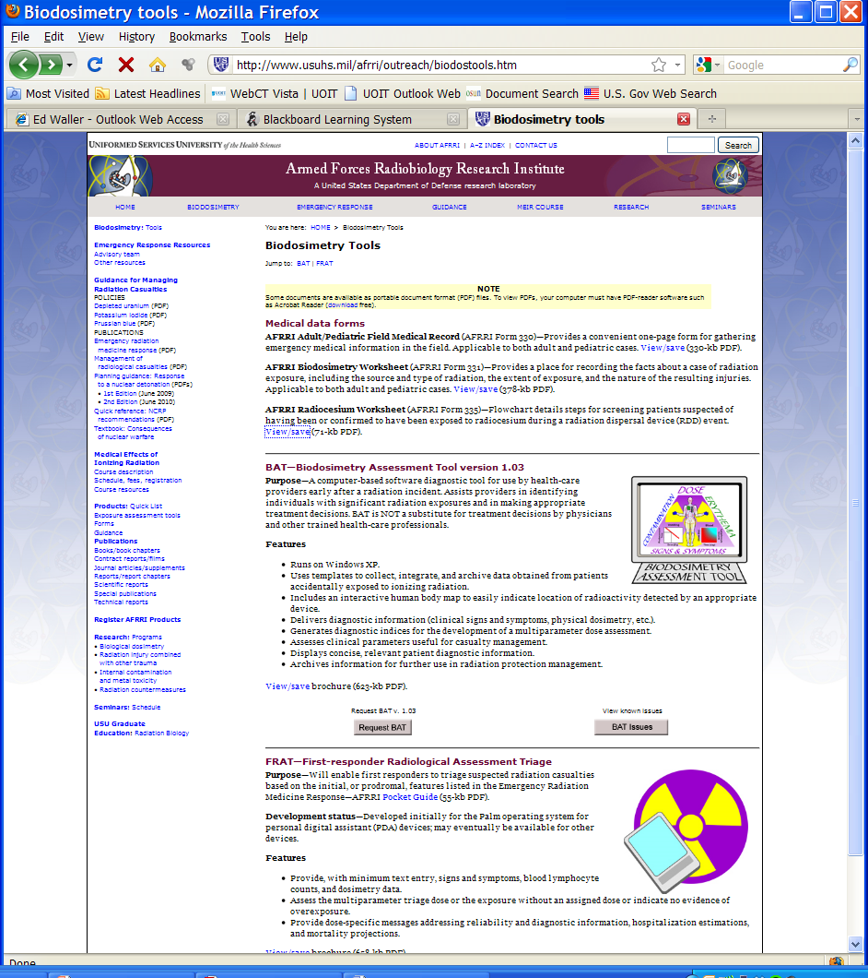
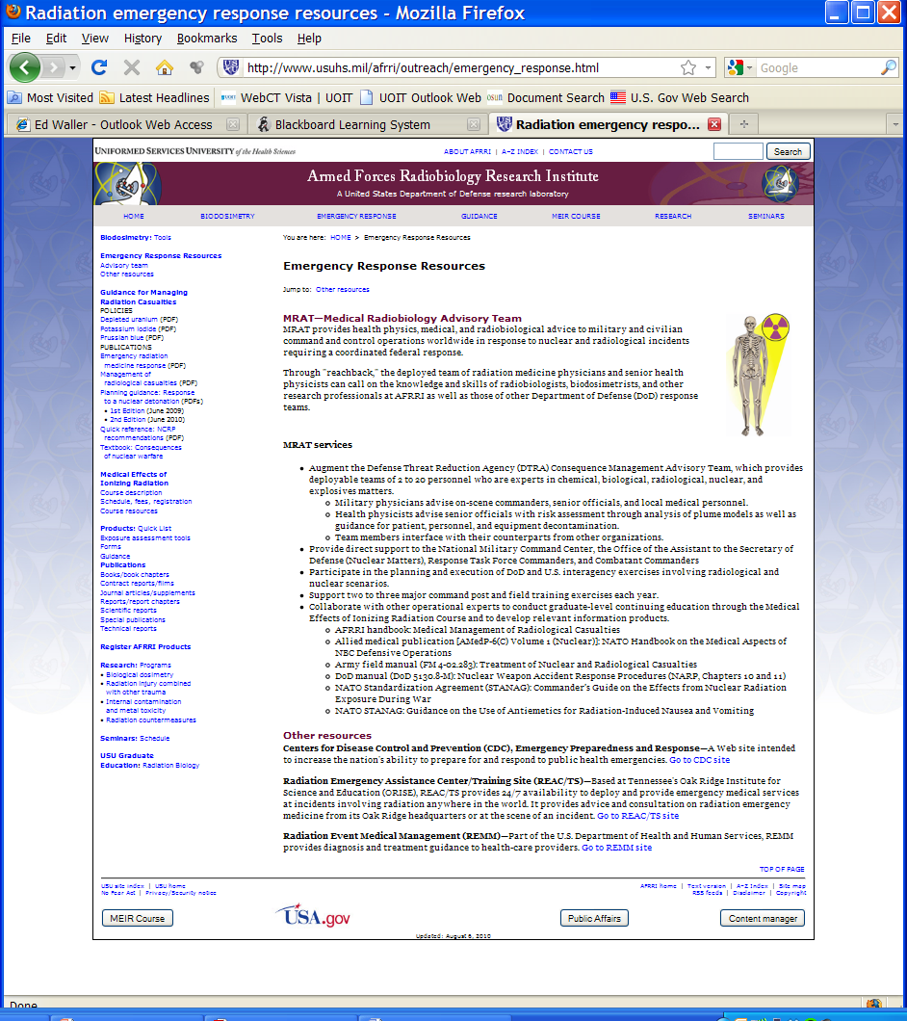
AFRRI Tools
AFRRI = Armed Forces Radiobiology Research Institute

Slide 16
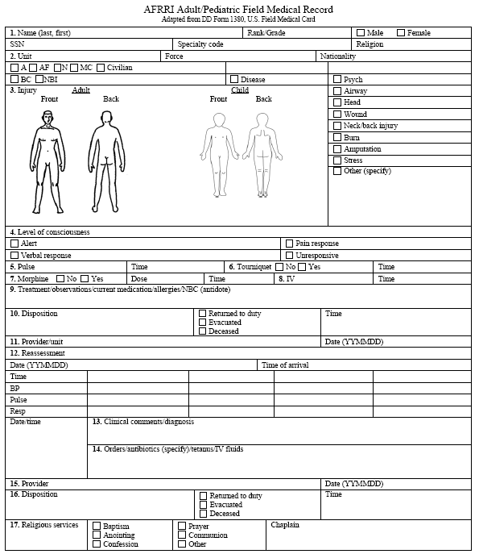
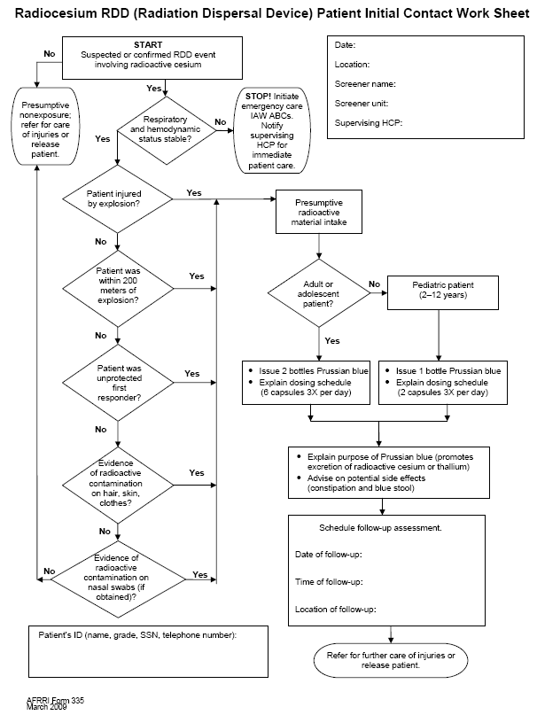
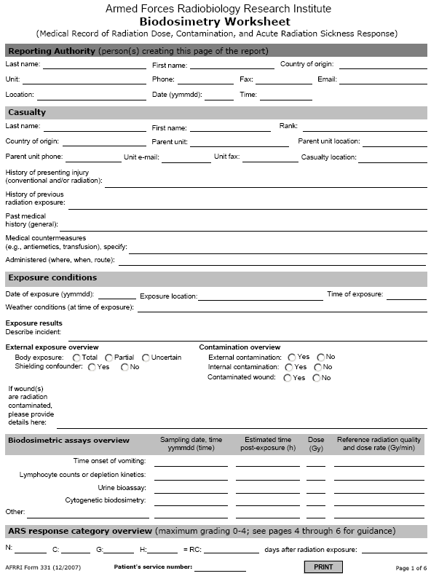
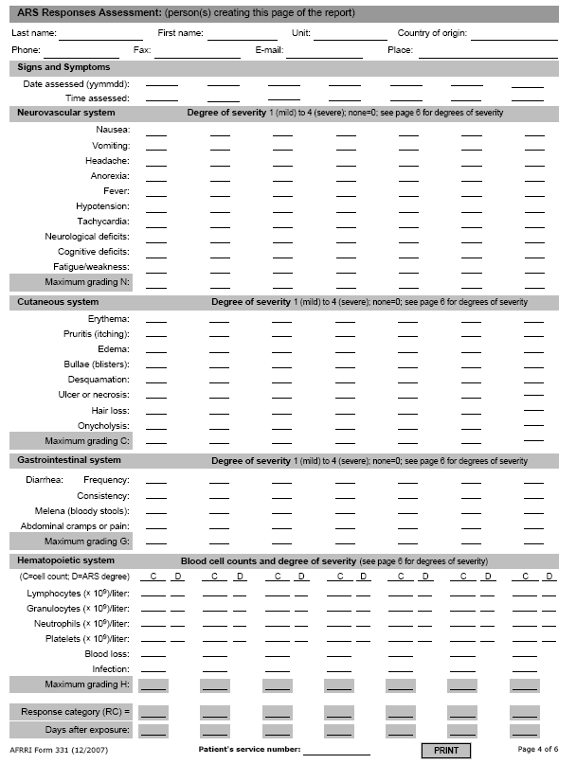
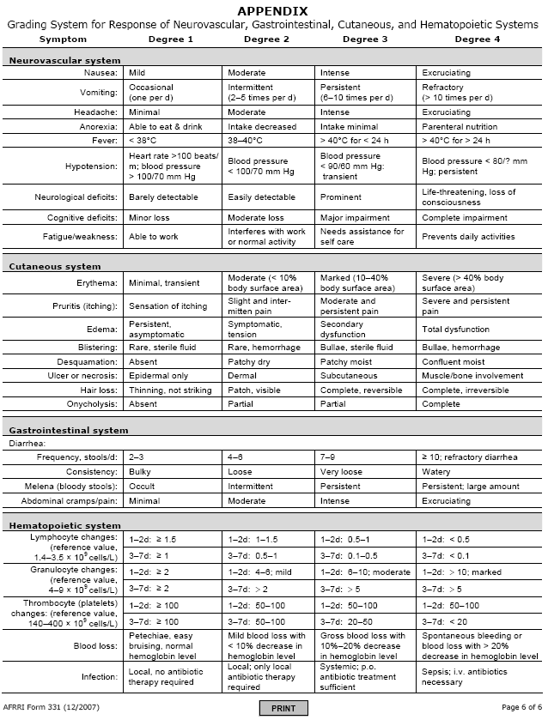
FRAT tool assists triage and treatment using multiparameter biodosimetry
BAT software tool assists radiation dose prediction using lymphocytes, lymphocyte depletion and on-set of emesis

Slide 17
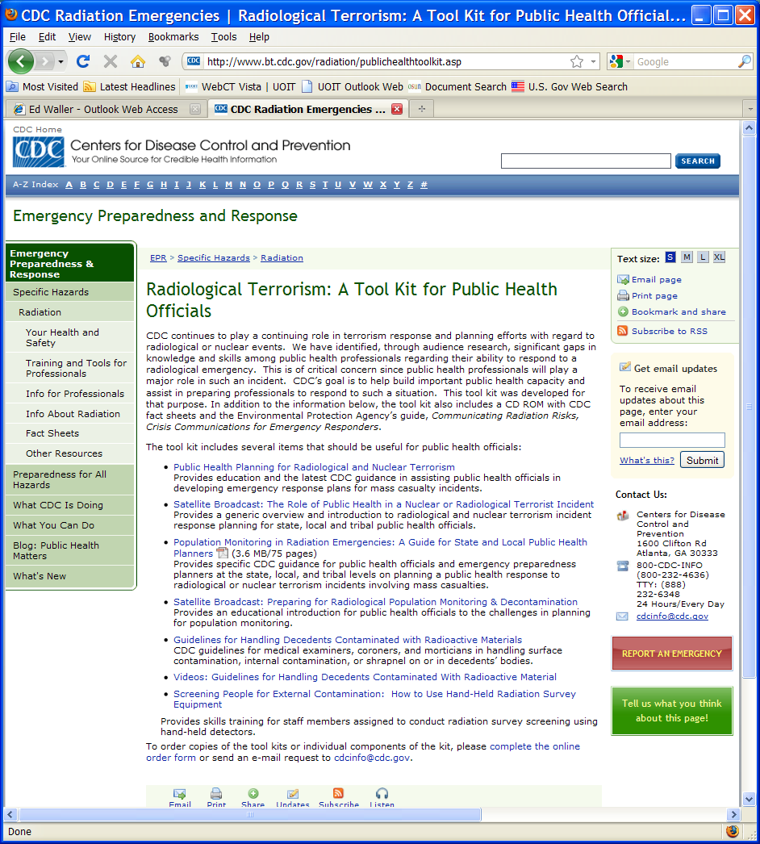
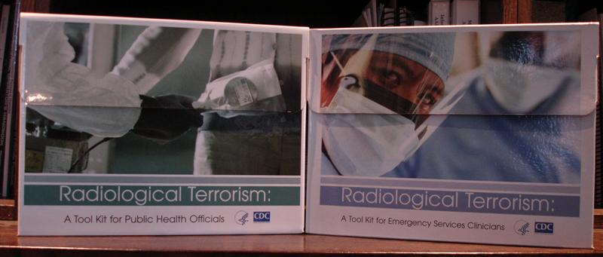
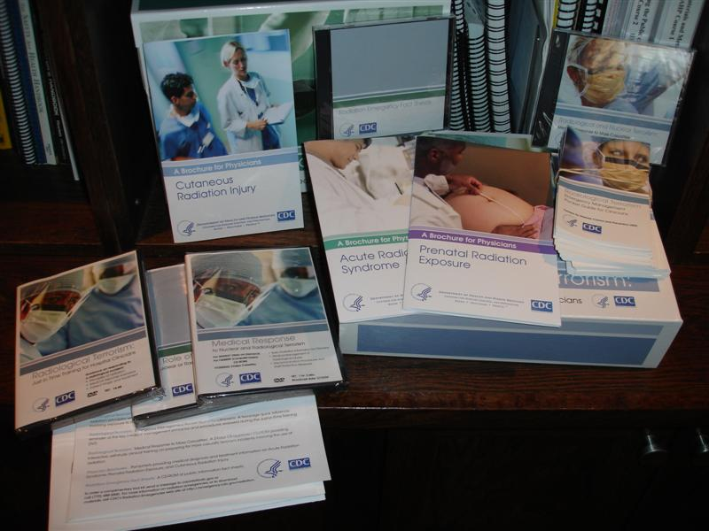
CDC Tools
CDC = Centers for Disease Control and Prevention

Slide 18
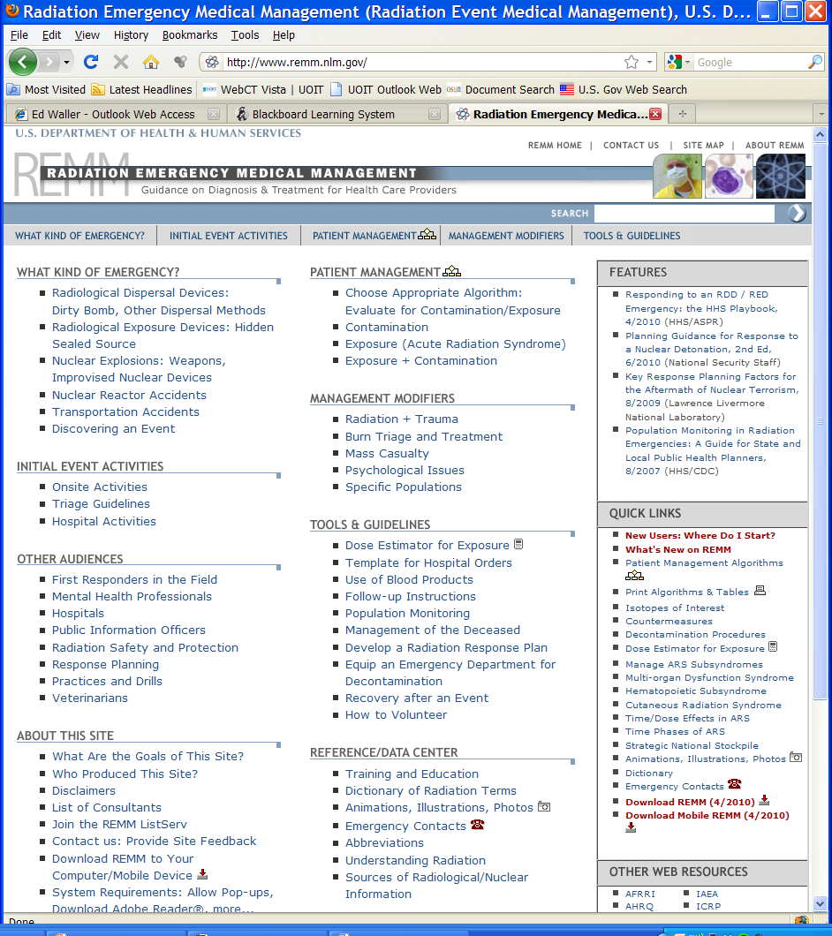
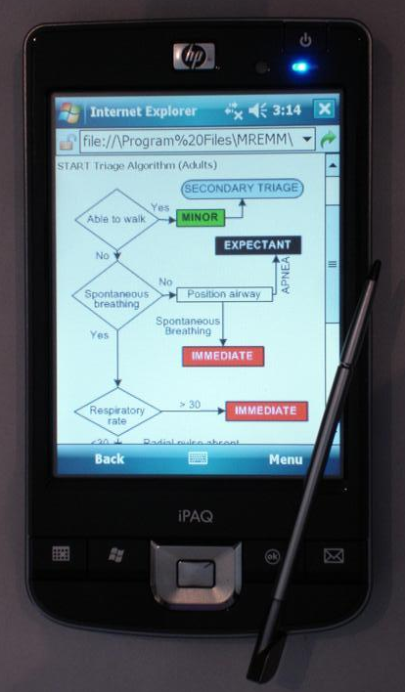
HHS Tools
HHS = US Department of Health and Human Services

Slide 19
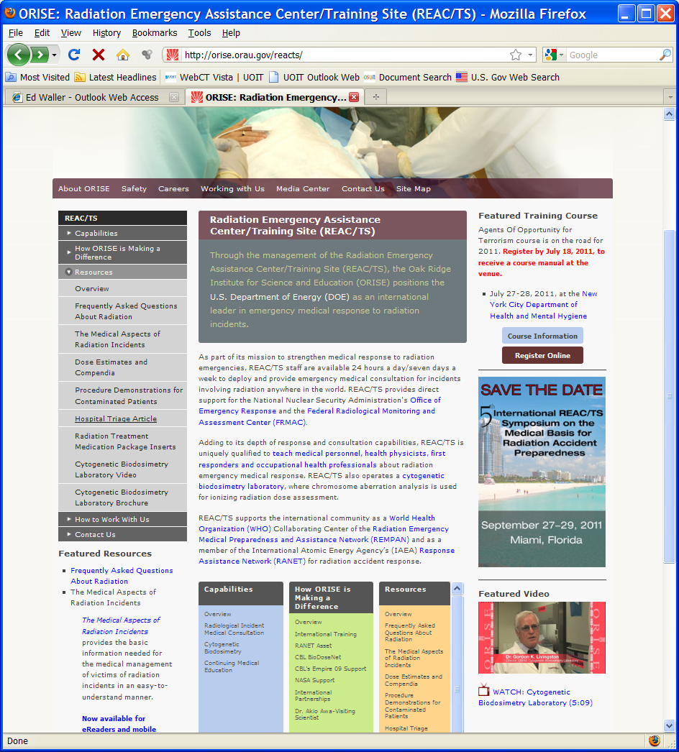
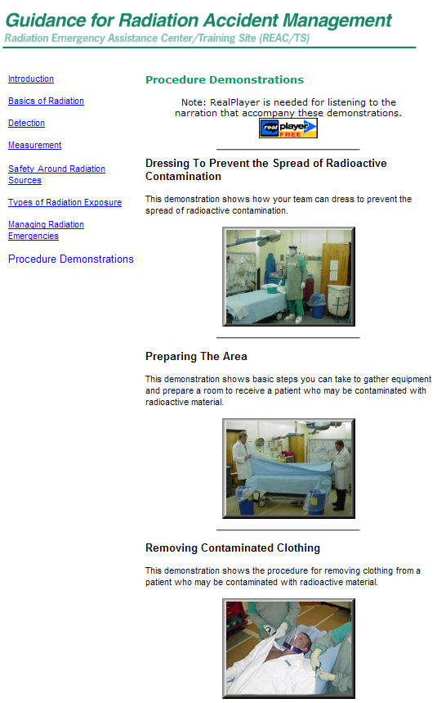
REAC/TS Tools
REAC/TS = Radiation Emergency Assistance Center/Training Site

Slide 20

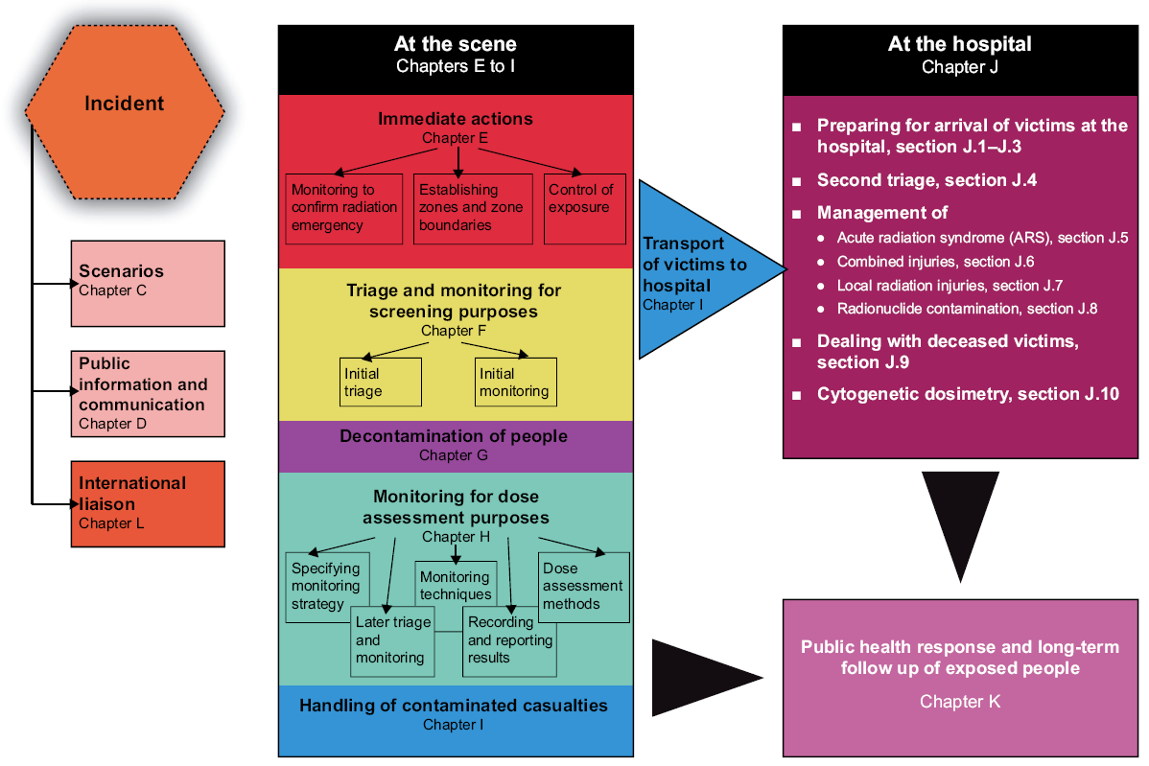
TMT Handbook

Slide 21
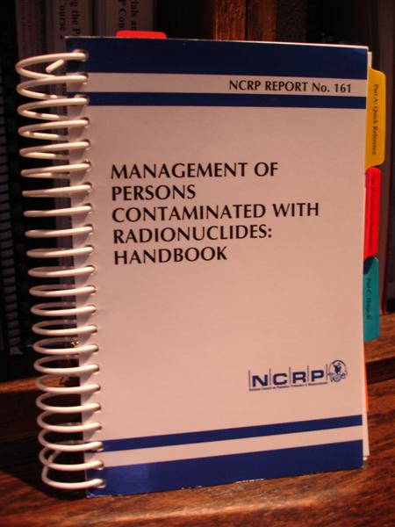
MEDECOR Software
MEDECOR (MEdical DECORporation)
PDA app developed for DRDC-Ottawa
Assist in Triage and Treatment plans for internally contaminated persons
First Revision tested at NATO exercise Peaceful Dragon in 2006
Beta Version of MEDECOR2 tested in Czech Republic in Fall 2010
Current testing within Canadian Forces
Guidance is consistent with NCRP161 (revision of NCRP65)

Slide 22
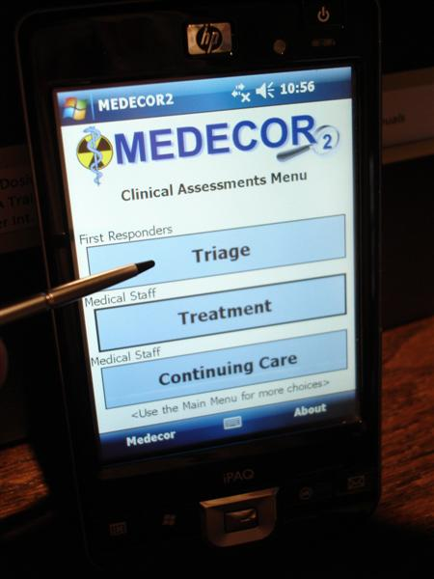
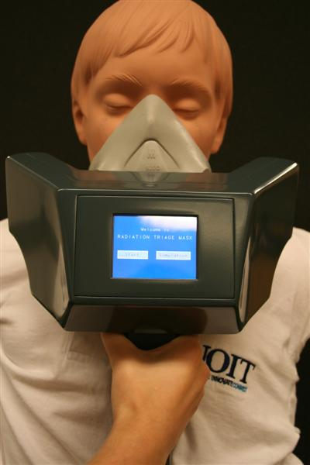
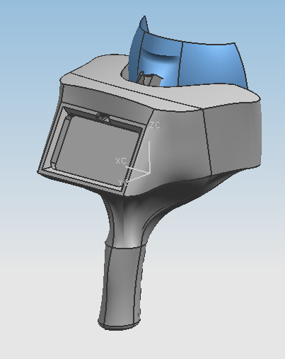
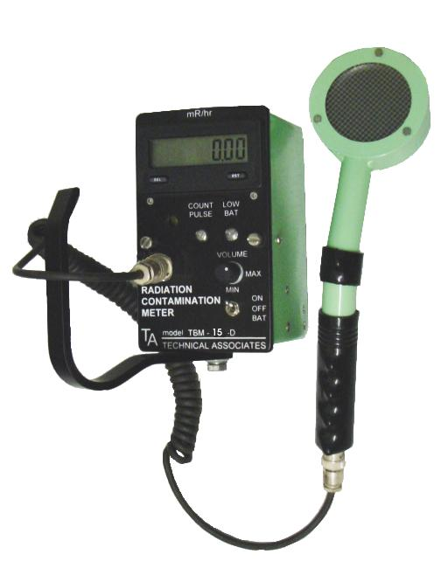
Combined Software and
Hardware Solution
MEDECOR and RTM (Radiation Triage Mask)
Or, alternately

Slide 23
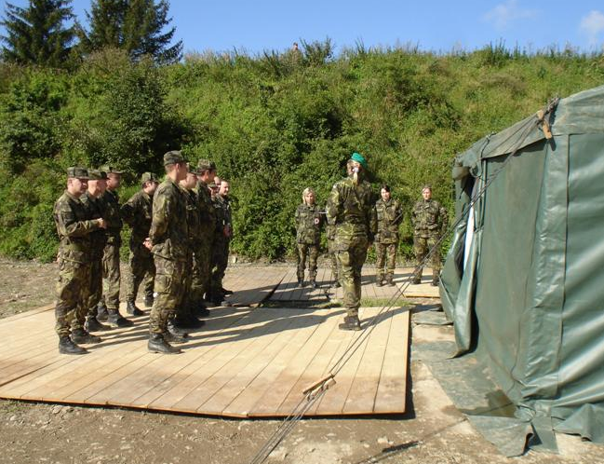
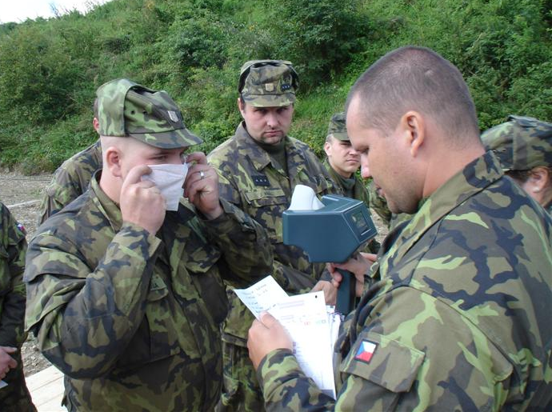
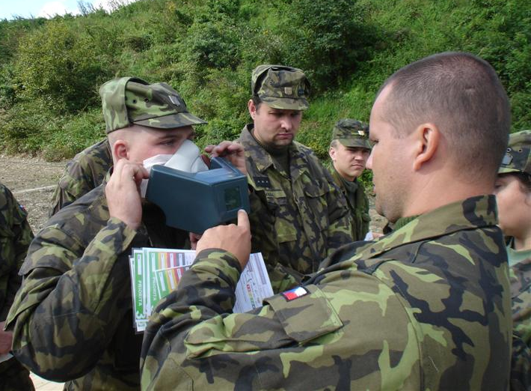
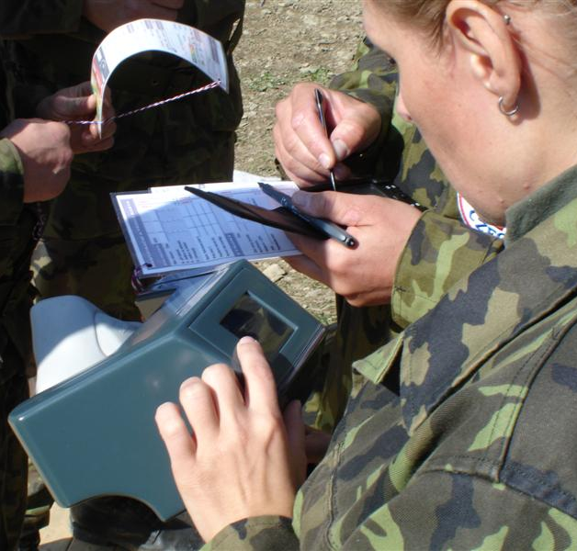
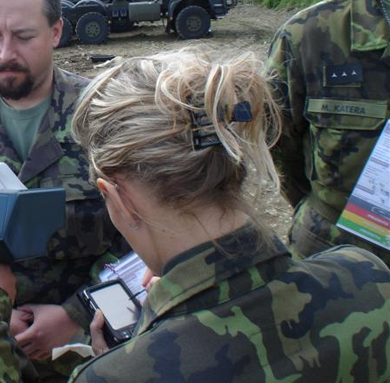
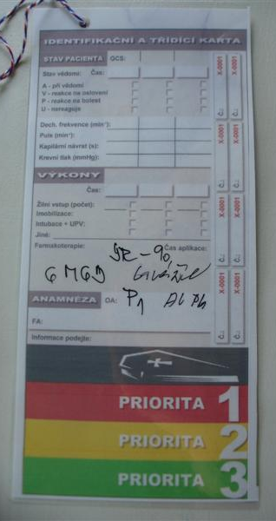
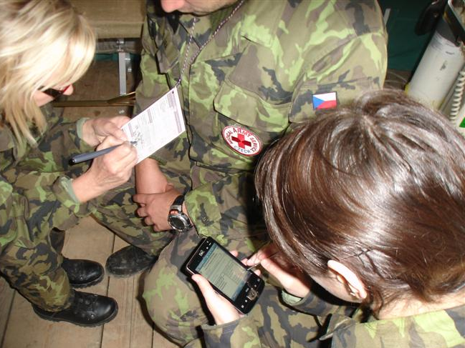
End-User Testing

Slide 24
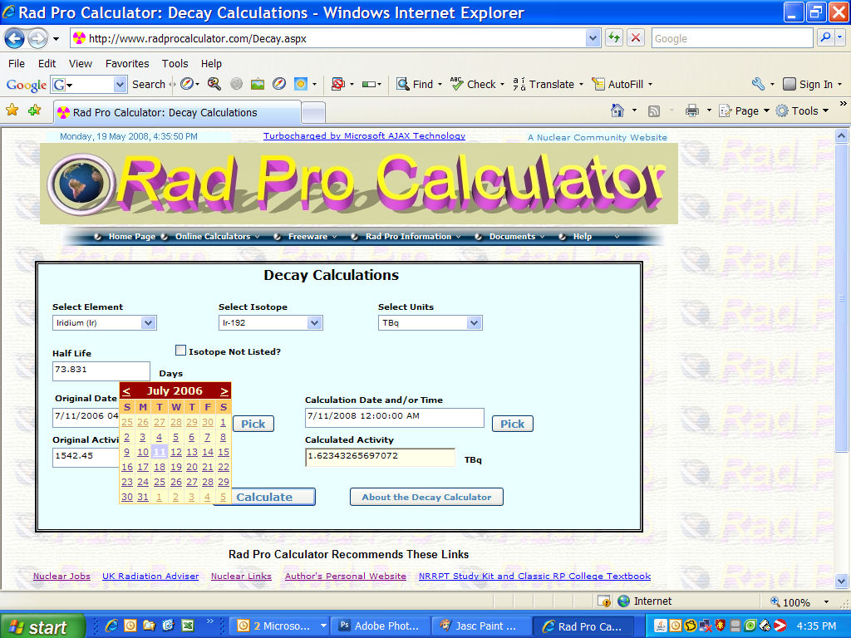
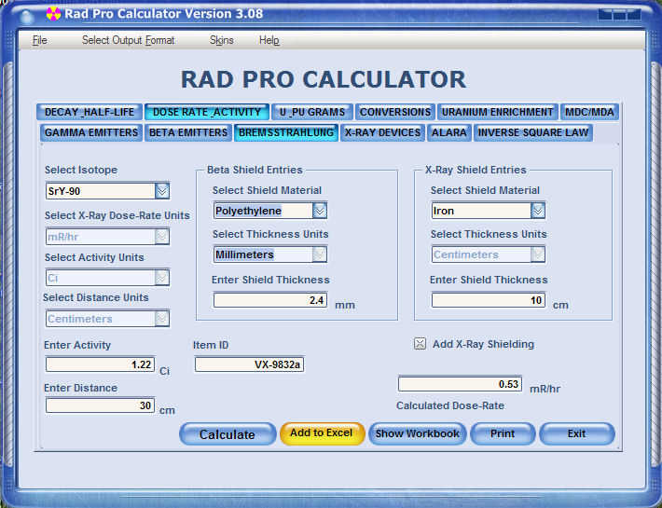
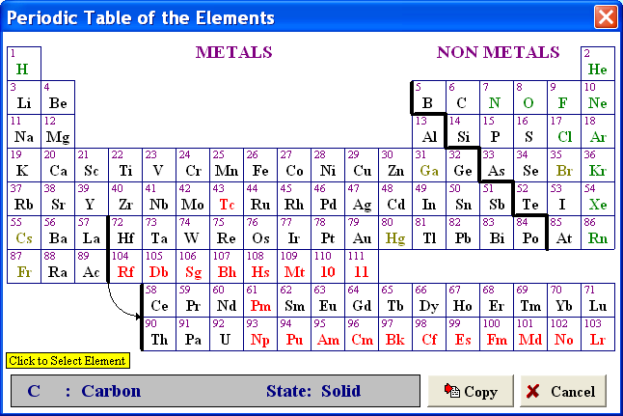
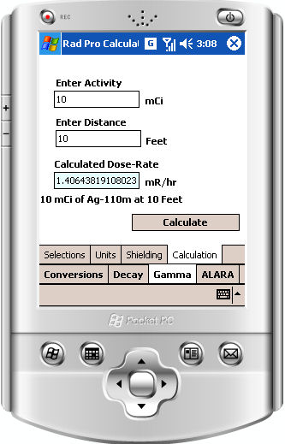
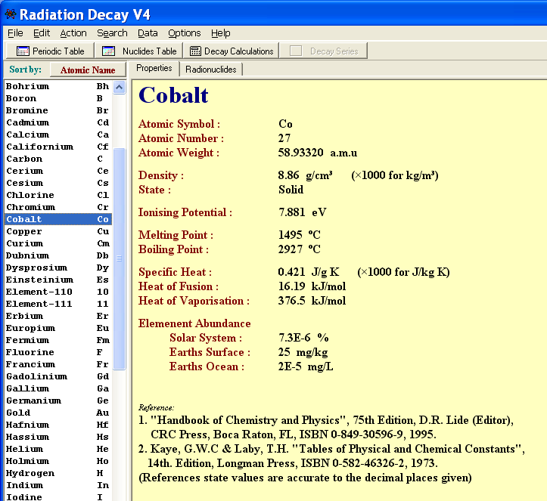
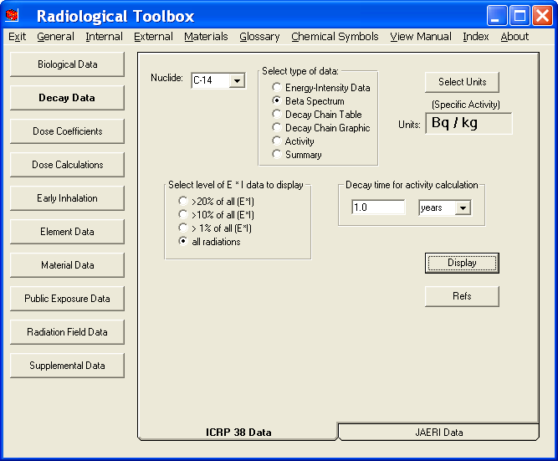



Multi-Purpose Software
RadDecay
RadToolbox

Slide 25








Dosimetry and Shielding
Microshield
IMBA
ICRP 68/72
MCNP

Slide 26
Guidance for Tool Selection
First, identify the type of guidance you need
Then, try some of the tools that fit the need
  Desktop scenario simulation
  Exercise
Next, integrate tool into response plans
  Have tool current and available
  Exercise
Ensure appropriate people can use the tool
Ensure recommended treatments are available
  FDA, off-label
Periodically re-evaluate the effectiveness of tool

Slide 27
Links
REMM tool/general guidance (US HHS)
http://www.remm.nlm.gov/
BAT/FRAT/worksheets (AFRRI)
http://www.usuhs.mil/afrri/outreach/biodostools.htm
Radiological Terrorism Toolkits (CDC)
http://www.bt.cdc.gov/radiation/publichealthtoolkit.asp
REAC/TS (ORAU)
http://orise.orau.gov/reacts/
NCRP Report No. 161 (Management of Persons Contaminated with Radionuclides
http://www.ncrponline.org/Publications/161press.html
MEDECOR2 and/or RTM
Contact Ed Waller (ed.waller@uoit.ca )
TMT Handbook
http://www.tmthandbook.org/

Slide 28
Links (cont)
Rad Pro Calculator
http://www.radprocalculator.com/
RadToolbox
http://ordose.ornl.gov/downloads.html
Radiation Decay
http://www.griffith.edu.au/professional-page/charles-hacker/resources
IMBA
http://www.imbaprofessional.com/
ICRP68/72 CD Rom
http://www.icrp.org/publication.asp?id=ICRP%20CD1
Microshield
http://www.radiationsoftware.com/mshield.html
MCNP
http://rsicc.ornl.gov/Catalog.aspx?c=M

