Slide 1
Development of CDC’s 2011-2016
Public Health Emergency Preparedness (PHEP)
Cooperative Agreement
Christa-Marie Singleton, MD, MPH
Associate Director for Science
Division of State and Local Readiness
Public Health and Radiation Emergency Preparedness Conference
March 24, 2011
Office of Public Health Preparedness and Response
Division of State and Local Readiness

Slide 2
2011 to 2016 Program Direction
Public Health Emergency Preparedness
Public
Health
Emergency Preparedness
HHS 10 Essential Services of Public Health
CDC PHEP Program
DHS National Preparedness Guidelines (NPG) and Target Capabilities List (TCL)
2

Slide 3
PHEP Capabilities Model
DSLR developed a capabilities-based approach for the new PHEP cooperative agreement to address issues identified during the current 2005-2010 program cycle.
The capabilities model is intended to:
  Provide a more systematic process for subject matter expert engagement
  Prioritize preparedness capabilities most relevant to state and local public health
  Align with the DHS Target Capabilities List
  Align with the National Health Security Strategy
  Align with the CDC Strategic Preparedness Plan
  Focus more on awardee strategic planning
DSLR developed a capabilities-based approach for the new PHEP cooperative agreement to address issues identified during the current 2005-2010 program cycle.
The capabilities model is intended to:
  Provide a more systematic process for subject matter expert engagement
  Prioritize preparedness capabilities most relevant to state and local public health
  Align with the DHS Target Capabilities List
  Align with the National Health Security Strategy
  Align with the CDC Strategic Preparedness Plan
  Focus more on awardee strategic planning
3
Notes:
Determining a consistent set of priorities/objectives for PHEP awardees has been challenging. Goals and objectives sometimes have been loosely or inconsistently defined, with many changes from year to year.
We are attempting to address this with our new capabilities model, that prioritizes preparedness capabilities most applicable to OR within the control of state and local public health.
Together with CDC and partner SMEs, we’ve translated the capability into language that is more specific to state and local public health departments
The content of the capabilities does not represent new preparedness requirements. Rather, we have cross-walked a multitude of key preparedness documents to analyze, translate, and collect into one single document all the pertinent preparedness information most relevant to state and local public.
We have repackaged this existing content and put it all into one document to make it easier for awardees to find the most current thinking about each capability in one central location.
By connecting all the dots, awardees can better organize their work, plan their priorities, and determine whether they have the right resources to build or sustain the 15 capabilities.

Slide 4
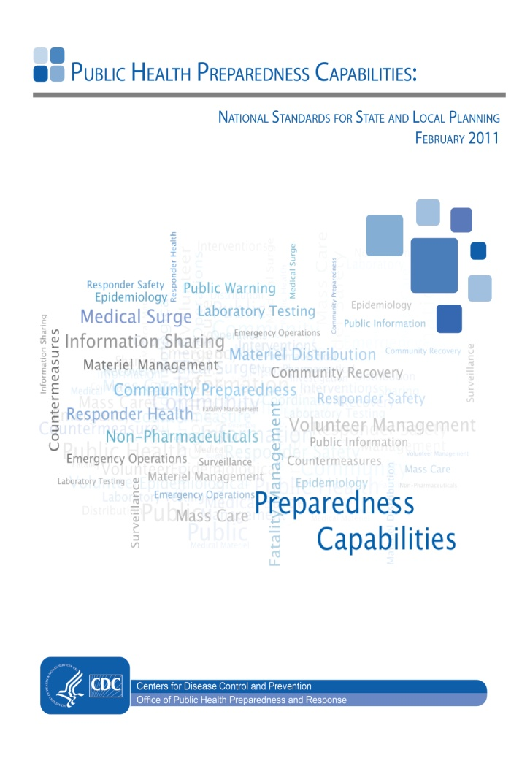
National Standards for State and Local Planning
Description of 15 capabilities and related functions, tasks, performance measures, and resources necessary for achieving each capability
Suggested activities for using the national standards to help public health departments organize work and identify most pressing needs

Slide 5











Determining PHEP Capabilities
Homeland Security Presidential Directives
(HSPD 5,8,21)
Pandemic and All-Hazards Preparedness Act
(PAHPA)
National Health Security Strategy
(NHSS)
National Preparedness Guidelines
Target Capability List
(TCL)
CDC Strategic Goals
Capability Selection Methodology
15 PHEP Capabilities
DSLR Capabilities Work Group
April - August 2009
Functions, Resource Elements, and Capability Planning Guide
CDC Capabilities Work groups
February 2010 - January 2011
Program Partner Review
June - November 2010
Vetting
Partner Vetting
September 2010 - January 2011
Clearance
CDC Clearance
February - March 2011
PHEP Guidance
PHEP Guidance
Released April 2011
5

Slide 6
Preparedness Capabilities
Capability Name
1 | Community Preparedness***
2 | Community Recovery***
3 | Emergency Operations Coordination
4 | Emergency Public Information and Warning
5 | Fatality Management ***
6 | Information Sharing
7 | Mass Care
8 | Medical Countermeasure Dispensing
9 | Medical Materiel Management and Distribution
10 | Medical Surge
11 | Non-Pharmaceutical Interventions***
12 | Public Health Laboratory Testing***
13 | Public Health Surveillance and Epidemiological Investigation
14 | Responder Safety and Health***
15 | Volunteer Management
Notes:
For alignment purposes, we utilized the DHS TCL capability names and definitions as a baseline for defining the public health contributions to these capabilities.
Some of the capability names were changed based on workgroup feedback after review of the content of the DHS TCL definitions.
The Biosurveillance aspects of Animal Disease and Emergency Support, Food and Agriculture Safety and Defense, and Environmental Health are included in Public Health Surveillance and Epidemiologic Investigation

Slide 7
Radiation preparedness: applicability to capabilities
2011-2016 PHEP Cooperative Agreement

Slide 8
Community Preparedness
Function 1: Determine risks to the health of the jurisdiction
(Priority) Written plans should include a jurisdictional risk assessment, utilizing an all-hazards approach with the input and assistance of public health/non–public health subject matter experts (e.g., emergency management, state radiation control programs/radiological
subject matter experts
.
8
Notes:
8

Slide 9
Community Recovery
Function 1: Identify and monitor public health, medical, and mental/behavioral health system recovery needs
(Priority) Written plans should include how the health agency and other partners will conduct a community assessment and follow-up monitoring of public health, medical, and mental/behavioral health system needs after an incident.
Environmental Example: CDC’s Community Assessment for Public Health Emergency Response Toolkit
Suggested resource for radiation incidents:
State Radiation Control Programs: http://www.crcpd.org/Map/RCPmap.htm
9
Notes:
9

Slide 10
Non-Pharmaceutical Interventions
Function 1: Determine role for public health in fatality management
Processes and protocols for jurisdictional all-hazards fatality management including addressing public health roles in fatality management
    Suggested resources:
    (1) Radiation Emergency Medical Management:
    Management of the Deceased
  (2) Radiological Terrorism: A Tool Kit for Public Health Officials
  (3) Guidelines for Handling Decedents Contaminated with Radioactive Materials Satellite Broadcast
10
Notes:
10

Slide 11
Non-Pharmaceutical Interventions
Function 3: Implement
non-pharmaceutical interventions
Protocols to support coordination of population monitoring and external decontamination of individuals
    Items for consideration:
    (1) screening based on incident-specific criteria levels determined by radiological/nuclear subject matter experts
(2) Registration of exposed and possibly exposed populations
11
Notes:
11

Slide 12
Non-Pharmaceutical Interventions
Training for public health personnel participating in or supporting operations at a radiological emergency community reception center should cover the following activities:
Location of community reception centers based on the amount of space needed, the anticipated magnitude of the radiation incident, and population needs
  Suggested Resources:
  (1) Virtual Community Reception Center
  (2) Population Monitoring in Radiation Emergencies: A Guide for State and Local Public Health Partners
  (3) Radiation Emergency Assistance Center Training/Training Site
12
Notes:
12

Slide 13
Laboratory Definition
Public Health Laboratory Testing
  Ability to conduct rapid detection, characterization, confirmatory testing, data reporting, investigative support, and laboratory networking to address actual or potential exposure to all-hazards which include chemical, radiological, and biological agents in all matrices including clinical samples, food, and environmental samples (e.g., water, air, soil).
LRN-R: if program funds become available:
  Radiation Safety and Security Plan
  Laboratory quality assurance, reporting
  Accreditation for clinical testing

Slide 14
Responder Safety and Health
Function 1: Identify responder safety and health risks
(Priority) Identify safety and health risk scenarios likely to be faced by public health responders, based on pre-identified jurisdictional incident risks, developed in consultation with partner agencies (e.g., environmental health, occupational health and safety, jurisdictional Local Emergency Planning Committee, risk-specific subject matter experts)
Areas for consideration:
(1) Limits of exposure or injury necessitating response
(2) Job-specific worker safety guides (e.g., radiation, heat, fire, and infrastructure damage resulting in other chemical release)
14
Notes:
14

Slide 15
Responder Safety and Health
Function 2: Identify safety and personal protective needs
(Priority) Identify recommendations for risk-related personal protective equipment for public health responders, developed in conjunction with partner agencies (e.g., environmental health, occupational health and safety, jurisdictional Local Emergency Planning Committee, risk-specific subject matter experts)
–
Suggested resources :
(1) CDC’s National Institute for Occupational Safety and Health, Pocket Guide to Chemical Hazards
(2) U.S. Health and Human Services, Radiation Emergency Medical Management Guide PPE Guidance
15
Notes:
15

Slide 16

Questions?
Office of Public Health Preparedness and Response
Division of State and Local Readiness

