Slide 1

Logistical Issues for Medical Response
MSB Consulting
Planz n-more Plans
www.msb-consulting.com “Public Health Preparedness Is Our Goal”
Receipt & Distribution of Radiological Assets
Leticia A. Mathis
CEO/Consultant
March 23, 2011

Slide 2
MSB Consulting
Planz n-more Plans
www.msb-consulting.com “Public Health Preparedness Is Our Goal”
Objectives
  Where radiation exposure emanates
  Locations of nuclear plants
  Possibilities for sudden radiation exposure
  Logistical issues of receiving and distributing assets

Slide 3
MSB Consulting
Planz n-more Plans
www.msb-consulting.com “Public Health Preparedness Is Our Goal”
Radiation exposure can come from:
  A nuclear power plant accident
  An atomic bomb explosion
  An accidental release from a medical or industrial device
  Nuclear weapons testing
  An intentional release of radioactive material as an act of terrorism

Slide 4
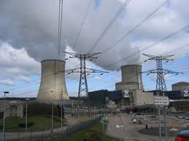
MSB Consulting
Planz n-more Plans
www.msb-consulting.com “Public Health Preparedness Is Our Goal”
A nuclear power plant accident:

Slide 5
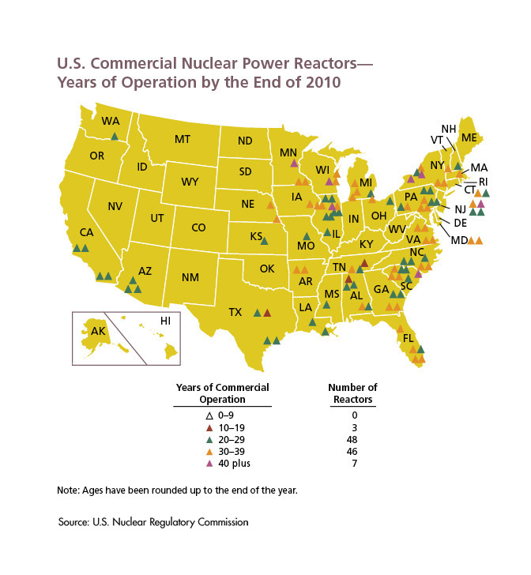
MSB Consulting
Planz n-more Plans
www.msb-consulting.com “Public Health Preparedness Is Our Goal”
Source: U.S. Nuclear Regulatory Commission (2011)
Notes:
104 nuclear power plants are currently operating in 32 states across the contiguous United States

Slide 6
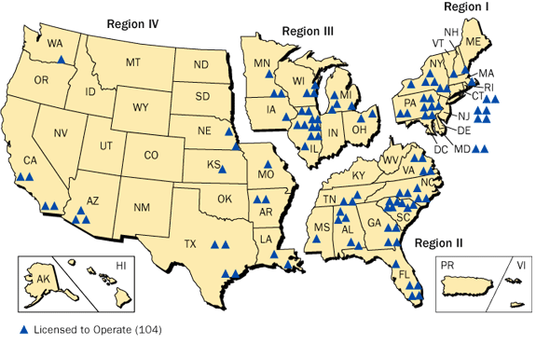
NRC REGIONS
MSB Consulting
Planz n-more Plans
www.msb-consulting.com “Public Health Preparedness Is Our Goal”
Source: U.S. Nuclear Regulatory Commission (2010)

Slide 7
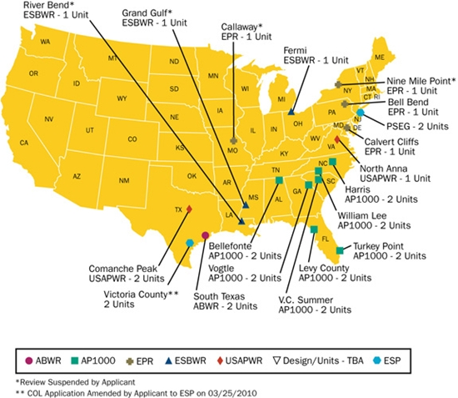
New Nuclear Reactor Plants
MSB Consulting
Planz n-more Plans
www.msb-consulting.com “Public Health Preparedness Is Our Goal”
Source: U.S. Nuclear Regulatory Commission (2011)
Notes:
30 New nuclear plants being built or have been built as of March 2010.

Slide 8
MSB Consulting
Planz n-more Plans
www.msb-consulting.com “Public Health Preparedness Is Our Goal”
Intentional release of radioactive material:
  Contamination of food or water
  Spreading radioactive material into the environment
    Dirty bombs
    Wind currents
  Bombing or destroying a nuclear reactor
  Railway/Highway spill
  Exploding a nuclear weapon

Slide 9
MSB Consulting
Planz n-more Plans
www.msb-consulting.com “Public Health Preparedness Is Our Goal”
Public health response issues:
  Limited availability of medications
    Potassium Iodide (KI)
    Prussian Blue
    Diethylene Triamine Pentaacetate (DTPA)
    Neupogen
Notes:
KI is a blocking agent – protects the thyroid gland against absorption of radioactive iodine
The Chernobyl disaster was a nuclear accident that occurred on 26 April 1986, at the Chernobyl Nuclear Power Plant in Ukraine (then in the Ukrainian Soviet Socialist Republic, part of the Soviet Union).
Prussian Blue – Used to treat internal contamination by radioactive cesium and thallium. Effective treatment to prevent absorption of thallium is available if therapy is begun within six hours following ingestion
Nuclear reactor waste and accidental releases such as the Chernobyl accident in the Ukraine release some cesium-137 to the environment.
Thallium is a soft, malleable gray metal that was previously widely used in rat poisons and insecticides.
DTPA – used to treat internal contamination by plutonium, americium, and curium. This provides a logistical challenge because it is only administered intravenously. Must be given within the first day.
Was stockpiled in state at one point but CDC did not rotate
Nuclear Weapons – americium
Nuclear Weapons – curium (alpha)
Neupogen – Is used only to treat the more serious adverse effect of acute radiation syndrome, bone marrow suppression.
Given intravenous
Has not been approved by the FDA, but would be administered as either an investigative new drug (IND) or under an Emergency Use Authorization from the FDA. CDC has both applications with the FDA.

Slide 10
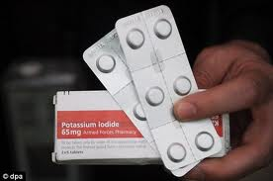
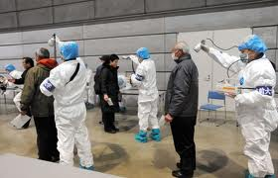
MSB Consulting
Planz n-more Plans
www.msb-consulting.com “Public Health Preparedness Is Our Goal”
Logistical Issues:
  Delivery
    Time is of the essence
  Transportation
    Public safety vehicles
    Courier
  Locations
    Hospitals
    Homes
    Community Reception Centers
Notes:
Only speaking from a state perspective:
Into the warehouse first
Transportation

Slide 11
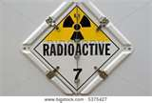
MSB Consulting
Planz n-more Plans
www.msb-consulting.com “Public Health Preparedness Is Our Goal”
Delivery issues:
  Progressive radiation exposure
  vs
  Sudden radiation exposure
Notes:
Managed Inventory – if this unfolds as it did in Japan we will have time to request and receive the appropriate assets to either the: Warehouse, Hospital, or Community Reception Centers
Sudden Radiation Exposure is a different story and provides more complications. If medication is given to those exposed within the initial 2-4 hours, and no later than 6 hours for the initial treatment then the medication may not do any good in saving these folks from developing cancer, or other ailments down the line.
Therefore should assets be direct shipped to facilities?

Slide 12

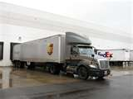
MSB Consulting
Planz n-more Plans
www.msb-consulting.com “Public Health Preparedness Is Our Goal”
Transportation issues:
  If transported by the State:
      Public safety vehicles
      Custom Critical Care Couriers
        UPS
        FedEX
Notes:
No this is a very real logistical issue. How do we transport if all public safety is responding, affected, exposed. Then what?
The areas are inundated with people, if you can use public safety vehicles, do it? If not, ever thought about utilizing one of the major couriers?

Slide 13
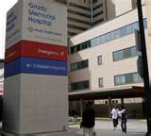
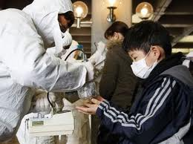
MSB Consulting
Planz n-more Plans
www.msb-consulting.com “Public Health Preparedness Is Our Goal”
Location issues:
  Hospitals
  Community Reception Centers
Notes:
Why would the location be a logistical issue?
People
Contaminated vs decontaminated

Slide 14
MSB Consulting
Planz n-more Plans
www.msb-consulting.com “Public Health Preparedness Is Our Goal”
        For planning assistance please contact:
        Leticia A. Mathis, CEO
        404-821-9864
        leticia.mathis@msb-consulting.com

