Slide 1
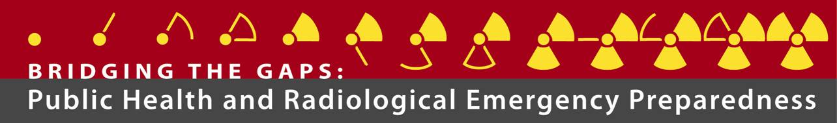
Keeping First Responders and Receivers Safe
Personal Protective Equipment for Responders
James S. Spahr, RS, MPH
Associate Director - Office for Emergency Preparedness & Response
National Institute for Occupational Safety and Health
Centers for Disease Control and Prevention

Slide 2
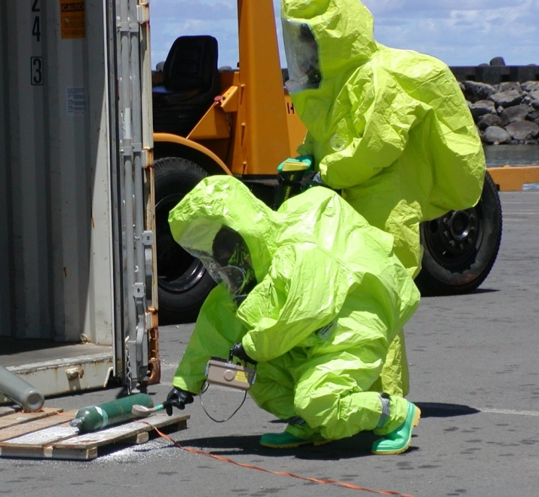
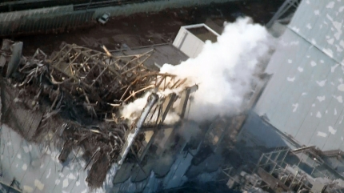
Background:
Why is Radiation a Concern?
Loss/misuse of radiation sources
Accident in radiation industry
  Nuclear Power Plant
Terrorism threat
  Radiological dispersal device (RDD)
  Improvised nuclear device (IND)
2
Notes:
2
Both real-life events and possible scenarios justify public health preparedness for radiological or nuclear events.
Sources of radiation used in health care or other industries can be lost or misused. The story of criminal use of Polonium 210 in London is a prominent example.
Accidents in the radiation industry, such Chernobyl and Three Mile Island, require public health response.
Radiological terrorism could involve the use of a radiological dispersal device or RDD – a device using conventional explosives to disperse radioactive materials. This could expose people to radiation and would contaminate the areas where they work and live.
The most devastating consequences would result from terrorist detonation of an improvised nuclear device or IND.

Slide 3
Background:
Public Health Functions in Preparedness and Response to Radiological Incidents
Pre-event
Early-phase
Intermediate-phase
Late-phase
Post-event
Early-phase: initial hours
Intermediate phase: hours to days
Late phase: days to months
Adapted from IOM, 2008, DHS, 2008, and RAND, 2009
Notes:
The public health sector will be essential in the response to radiological incidents, whether pre- or post-event.
[CLICK] The post event response has 3 phases: early, intermediate and late.
[CLICK] The early phase occurs in the initial hours.
[CLICK] The intermediate phase can last from hours to days.
[CLICK] The late phase can last months.
At all times, before and after events, public health authorities must provide a frightened public with information on how to protect themselves.

Slide 4
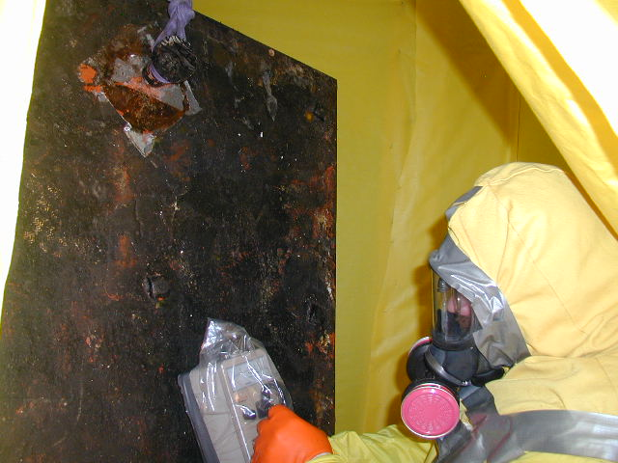
Roles for Responders
Pennsylvania Dept of Environmental Protection
Pre-event
dentify pre-existing radiation sources/baseline
Conduct training and exercises
Coordinate with response partners
Early-phase
Monitor indicators of a release
Identify likely areas of contamination
Provide public guidance
Identify agent and characterize contaminated area
Assess victim decontamination and medical needs
Ensure critical Infrastructure safety
Monitor responder exposures and health
Intermediate-phase
Conduct epidemiologic investigation
Provide emergency laboratory support
Establish victim registry
Monitor shelter and mass care conditions
Ensure food and water safety
Ensure animal safety (Veterinarians)
Late-phase
Manage contaminated fatalities
Define re-occupancy criteria
Decontaminate facilities and resources
Adapted from IOM, 2008, DHS, 2008, and RAND, 2009
Notes:
Pre-event responsibilities include identifying pre-existing radiation sources to have a baseline, conducting training and exercises, and developing partnerships and coordination with others such as state and local authorities, the Dept of Homeland Security, and the Dept of Energy.

Slide 5
Responsibilities
Employer:
Prior:
Establish & prioritized Admin controls, policies & procedures to control exposures
Provide health monitoring & surveillance program
Provide protective devices, PPE, monitoring equipment, & training/retraining
During:
Supervise hot zone to ensure implementation of P&P
Provide Just-In-Time training
Arrange for dosimetry services
Facilitate worker compliance
After:
Arrange for post-event health surveillance
Maintain & provide access to exposure records
Employee:
Accept S&H information & training
Follow regulations & procedures
Properly use monitoring equipment & devices
Cooperate with health surveillance and dose assessment programs
Report health/pregnancy status
Report circumstances that could affect the decision dose or safety compliance
Incident Command:
Determine pre-established exposure levels
Establish protective actions that produce more good than harm
Ensure that responder exposure is optimized to achieve the lowest exposure under the circumstances
NCRP does not recommend a dose limit for responders – exposure decisions should be made based on operational awareness and mission priorities

Slide 6
Acute Response
Determine that radioactivity/radiation is in the environment
  First responders
Determine the radionuclide(s) and amount(s)
  Radiation strike team
Estimate doses and geographic dose distribution
  Radiation strike team + state environment dept
Determine need for (and implement) evacuation
  Radiation strike team + health dept + fire/police
Determine additional incident needs
  Radiation strike team + Incident Commander
Notes:
In responding to a radiologic terror event, a step-wise approach needs to be taken. You first need to determine that radioactivity and radiation is in the environment. That is your job as first responders, using the detection equipment described earlier. Once you know you're dealing with a dirty bomb event, a radiation strike team should be called in with more sophisticated instrumentation to determine what radionuclides and what amount of those radionuclides are involved. That’s how you're going to estimate doses and the geographic dose distribution using computer models that will give you output data and images such as I showed in the previous slides. Ultimately, you’ll need to determine the need for and implement the evacuation.

Slide 7
Possible Radiation Scenarios:
Radiation-dispersal device (RDD) explodes at busy street corner: ~ 30 to 180 deaths.
Radiation-exposure device (RED) concealed at high-traffic area: ~ 60 to 250 deaths and ~ 130 cases of radiation sickness needing treatment for 30 years. Effect on public behavior. Decontamination efforts for people and objects. Community recovery timeline: Months to years.
Improvised nuclear device (IND), explosion 10 tons to 10 kilotons, in center of a city, few hundred to 100,000 deaths, number of hospitalizations not estimated. Economic costs: Trillions of dollars. Community recovery time: Years
Nuclear Device (ND) Nuclear power plant accident /smaller yield vs larger yield/ air vs land detonation – all have different outcomes, hundreds to 100,000 deaths, number of hospitalizations not estimated. Economic costs: Trillions of dollars. Community recovery time: Years.
Source: Tofani A, Bartolozzi M. Ranking nuclear and radiological terrorism scenarios: The Italian case. Risk Analysis 2008;28(Oct):1431-44.

Slide 8
Primary Occupational Hazards of IND
Prompt and Delayed Ionizing Radiation
  Initial prompt radiation from blast
  Nuclear Fallout
    Groundshine: gamma radiation exposure
    Nuclear contamination on skin and clothing: beta burns
    Inhalation of respirable fallout: radionuclide absorption
Numerous Physical/Chemical Hazards
  Collapsed structures/rubble
  Heat/Fire
  Broken glass/sharp objects
  Downed power lines/Ruptured gas lines
Impaired Communications (Secondary to EMP)

Slide 9
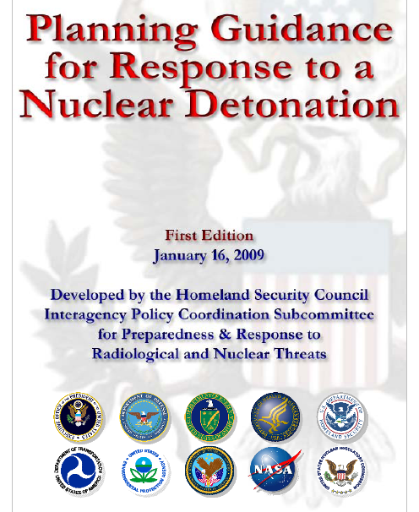
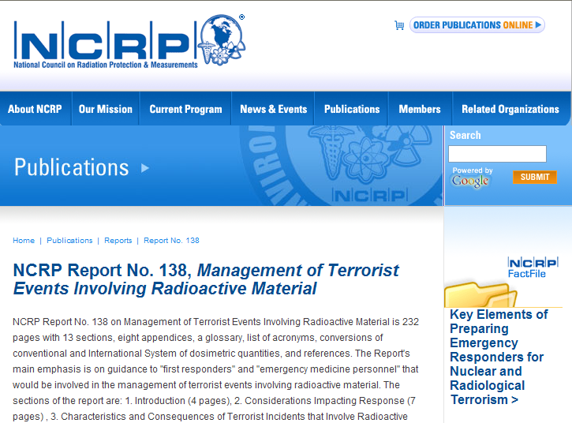
Existing Guidance

Slide 10
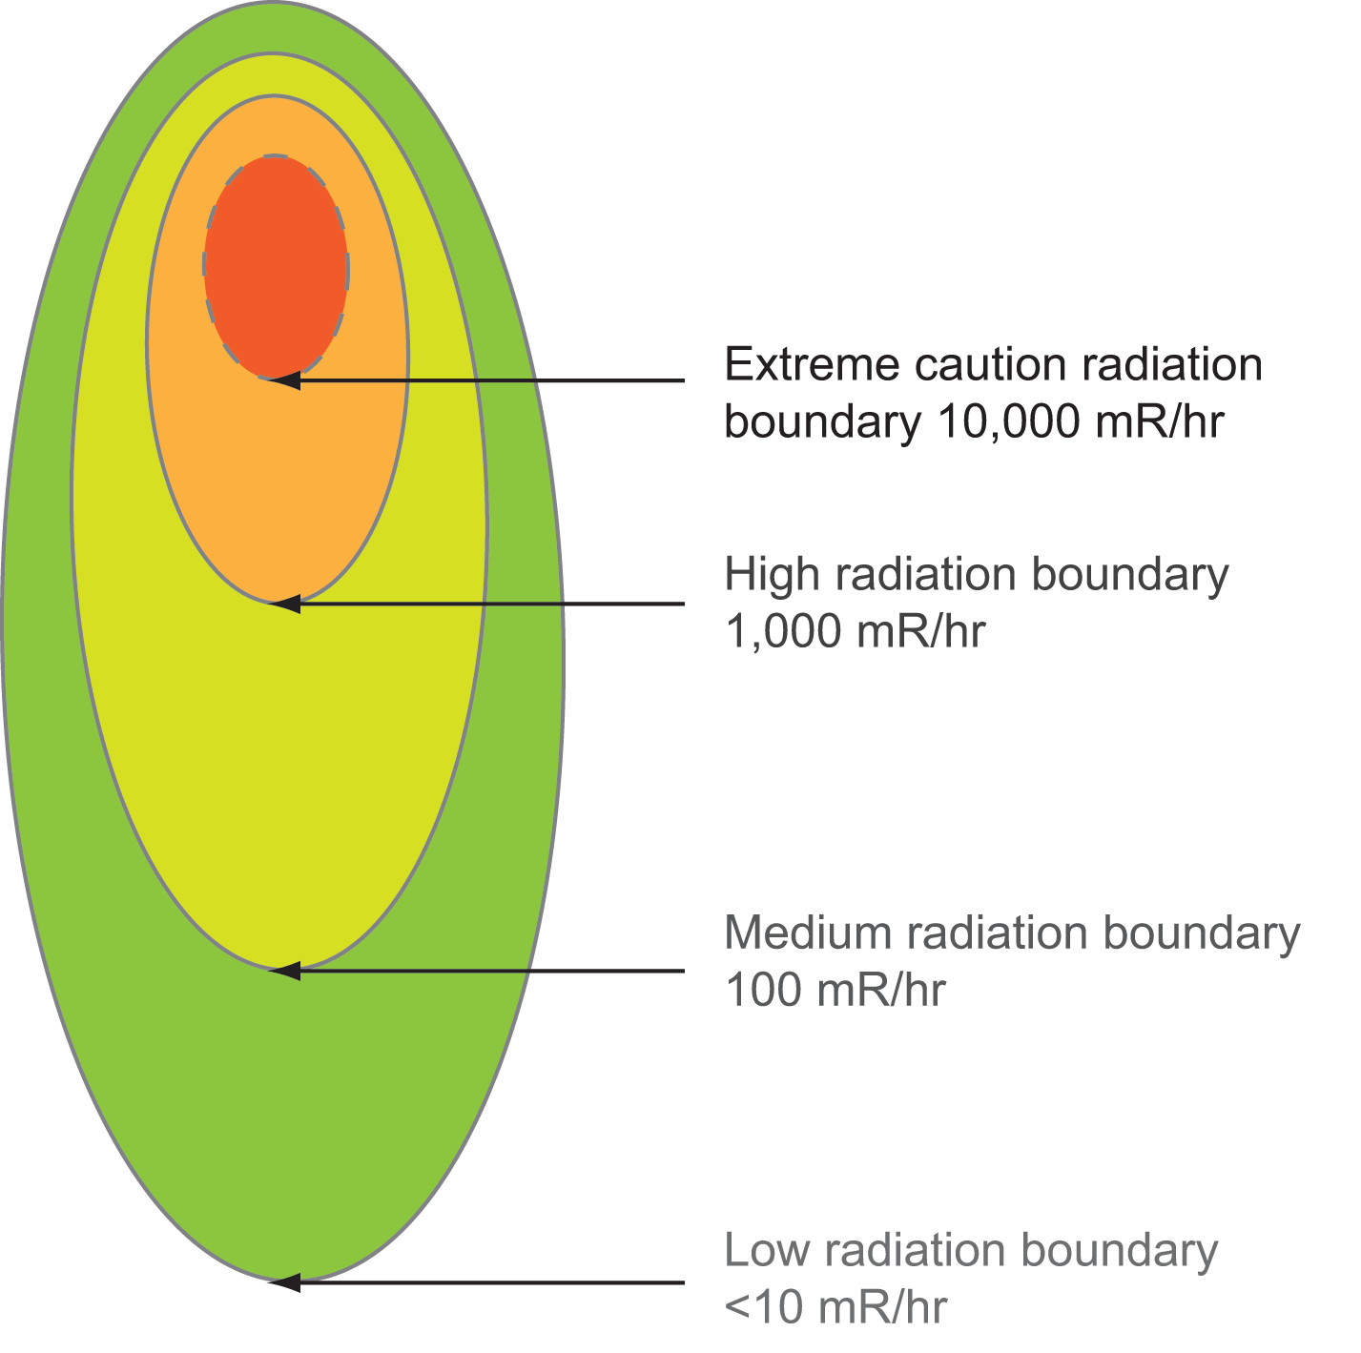
Education and Training
Workers should have a basic understanding of
Health risks:
  Acute vs. long-term effects of exposure
Radiation protection:
  Time, distance and shielding
Radiation response zones: Restrict responder access
Notes:
A radiological response has the potential to involve very large numbers of emergency responders, healthcare workers, and recovery workers, many of whom will have very little experience in radiological and nuclear response. Education and training will be crucial to ensuring their health and safety.
They will need to recognize the acute health effects of high dose radiation, and understand the long term risk of cancer which can result from low dose radiation.
They will also need to become versed in the protective principles of time, distance and shielding, and learn how to apply these principles in a safe and effective response strategy. Radiation safety zones, such as those illustrated here, are designed to guide the types of response activities which are reasonably permitted in each zone.
In this example, work conducted in the innermost Extreme Caution radiation zone, shown in red, should be restricted to lifesaving activities, with further less urgent activities being appropriate to areas further from the epicenter of the event.

Slide 11
Goals of Radiation Protection:
First Responders
Prevent acute (immediate) injuries and deaths due to short-term high-level radiation exposure (occurring over a few hours to a few days)
Keep long-term effects (cancer) associated with lower levels of radiation exposure as low as reasonably achievable
NCRP Commentary No. 19
Notes:
The goals of radiation protection with a focus on emergency or first responders, as delineated in NCRP Commentary Number Nineteen, are: To prevent the acute or immediate injuries and deaths due to short-term, high-level radiation exposure; that is, occurring over hours to days. And to keep the long-term effects, that is, cancer, associated with lower levels of radiation exposure, as low as reasonably achievable.

Slide 12
Radiation Exposure Limits
Safe response requires well defined limits for exposure to radiation
  OSHA: Sets occupational limit for radiation workers
    50 milliSievert/yr
    Enforceable by law
  Other U.S. organizations provide recommendations for emergency responders
    EPA recommendation: 250 milliSievert total exposure
    Balances risk of exposure with opportunity to perform life-saving activities or to maintain essential critical infrastructure
Notes:
Radiation monitoring equipment can only be effective if used within the context of well defined radiation exposure limits.
The Occupational Safety and Health Administration has set an enforceable legal limit of 50 mSv per year for radiation workers. This is approximately 10x higher than the dose that one can expect from background radiation alone, as was pointed out by Dr. Miller. This exposure limit will be most applicable to responders engaged in clean-up and recovery activities, or on the periphery of the acute response.
For those responders involved in lifesaving activities in the higher radiation zones, more liberal exposures limits have been recommended. The most commonly cited is that of the Environmental Protection Agency, which allows for up to 250 mSv total exposure for those responders specifically engaged in lifesaving activities.

Slide 14
Acute Exposure & Fatal Cancer Risk
10,000 mrem dose – extra 0.8%
1,000 survivors receive 10,000 mrem – estimated 8 extra cancer deaths
200 cancer deaths from other causes
208 total cancer deaths
Dose (mrem) | Percent
1,000 | 0.08
5,000 | 0.4
10,000 | 0.8
25,000* | 2.0 (ie: a 2% chance of dying from cancer)
50,000 | 4.0
EPA mrem dose limit for lifesaving actions
Notes:
_________________________________________________________
_________________________________________________________
_________________________________________________________
_________________________________________________________
_________________________________________________________
_________________________________________________________
_________________________________________________________
_________________________________________________________
Point out that this the chance due to an acute exposure (hours, or few days) to the whole body, and not the accumulated dose over years (chronic dose). This is the risk of a fatal cancer, not the just the risk that the person develops cancer.
The 25,000 mrem dose is highlighted because that is the emergency response dose limit for lifesaving actions recommended by the Environmental Protection Agency (EPA). (These dose limits are discussed later in this lesson.)
This estimate predicts that a responder who receives the emergency dose limit of 25-rem during a rescue operation, has about a 2% extra chance of dying of cancer. This person may get the cancer and die, for example 30 years from now and maybe not next year.
The rate of cancer deaths from all causes in the United States is about 20% of the deaths from all causes. So in the example of a responder with a 25-rem acute dose, that person has about a 22% chance of dying of cancer
(20% from all causes + 2% from 25-rem dose = 25%)
Point out that people who receive massive doses of radiation more than 500 rem, are likely to die from the short-term effects of the radiation and not live long enough to develop cancer.
From the Biological Effects of Ionizing Radiation (BEIR) V report, there is an estimated 0.8% risk of dying of cancer per 10 R (10 rem) of gamma-ray dose.

Slide 15
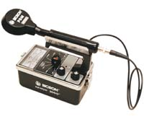
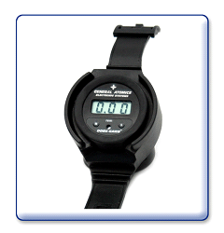
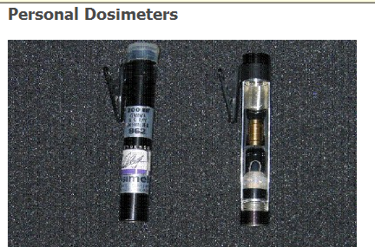
Essential
Personal Protective Equipment
  Personal dosimetry
  Radiation detection equipment
  PPE (ideally certified for CBRN purposes)
  Communication equipment effective after Electromagnetic Pulse
  Medical Countermeasures for radiation injury

Slide 16
Initial Radiation Detection:
Suspicious Incident
First emergency vehicles responding to a suspicious incident should be equipped with radiation-monitoring instruments
These instruments should alarm at 10 mR/h (corresponding to the outer perimeter)
NCRP Commentary No. 19
Notes:
In contrast to NCRP Report Number 138, the more recent NCRP Commentary Number Nineteen considers alarms and detectors from the point of view of a suspicious incident versus an incident with more certainty. If you have an incident that is suspicious but is not yet confirmed to be a radiologic incident, the first emergency vehicles responding to that suspicious incident should be equipped with radiation monitoring instruments. Those instruments should be able to alarm at ten milliroentgen per hour; which corresponds to the exposure rate at the outer perimeter.

Slide 17
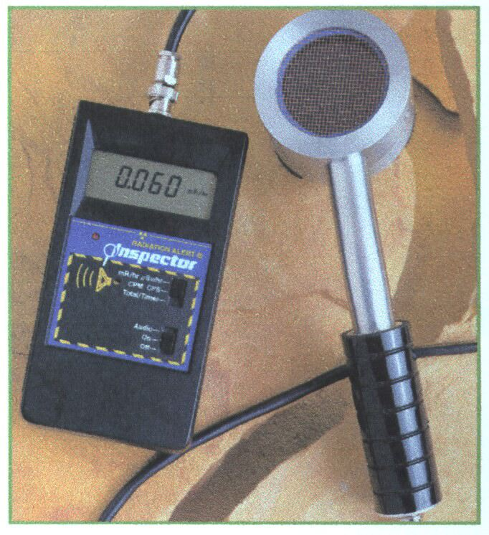
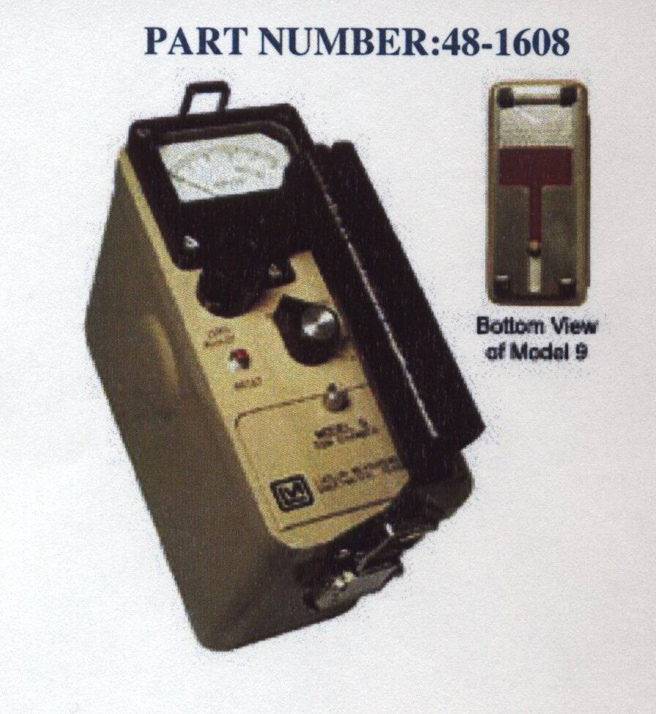
Contamination Detection
First responders should have simple tools to identify the presence of contamination (both ground surface and personnel)
  60,000 dpm/cm² beta and gamma
  6,000 dpm/cm² alpha
  Corresponding to the outer perimeter
Inner perimeter - risk of acute radiation injury to emergency responders
  10 R/h
NCRP Commentary No. 19
Notes:
I also said that the perimeters depend on surface contamination. NCRP Commentary Number Nineteen recommends that first responders have simple tools to identify the presence of contamination -- that’s both on a ground surface and on personnel. I've mentioned 60,000 dpm per square centimeter for beta and gamma and 6,000 dpm per square centimeter for alpha as the amount of contamination these detectors must be able to measure, because those levels correspond to the outer perimeter.

Slide 18
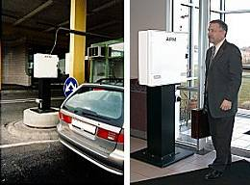
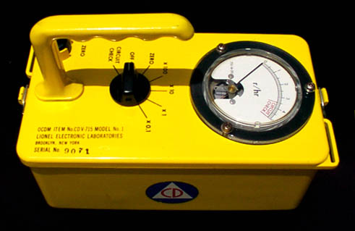
Portal Monitors & Survey Meters
A radiation survey meter is needed to:
Detect radioactive material
Measure radiation levels
Survey personnel
Notes:
Survey Meter - Purposes
Radiological instruments detect the interaction of radiation with matter. They do not measure radiation directly, but, in general, measure the electrical charges resulting from the ionization of atoms inside the detector.
A radiation survey meter is needed to:
Detect the presence of radioactive material
Measure the radiation levels (or dose rate)
Survey personnel to check them for radioactive contamination
Instructor note:
Mention that Awareness Level training does not qualify someone to perform these tasks with a radiation meter. These require additional training above the Awareness Level.
There are two main types of radiation detection instruments, survey meters and dosimeters.
Survey Meters
Survey meters, or rate meters, measure the intensity of the field, which is called the exposure rate.

Slide 19
Initial Radiation Detection
In a known radiological or nuclear incident
First emergency responders should be equipped with unambiguously alarming personal radiation detectors
  Alarm at 10 R/h (corresponding to the inner perimeter)
  Alarm at 50 rad cumulative absorbed dose (corresponding to the “decision dose”)
NCRP Commentary No. 19
Notes:
For the initial radiation detection and measurement in a known radiologic or nuclear incident; the first or emergency responders should be equipped with unambiguously alarming personal radiation detectors. These need to alarm at 10 roentgens per hour, which corresponds to the inner perimete. They also need to be able to alarm at 50 RADs cumulative absorbed dose, which corresponds to the decision dose we spoke about earlier.

Slide 20
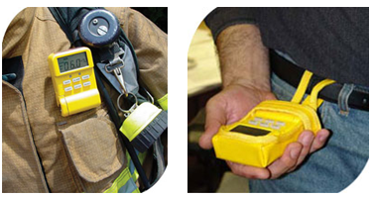
Personal Dosimetry
Newer technologies measure the radiation dose rate, total dose, and remaining “stay time” for the responder, and may provide flashing display, audible and vibration alarms and data logging capabilities
Pagers
Ruggedized design for field use
Canberra UltraRadiac-Plus
Notes:
Dosimeter
A dosimeter measures the radiation dose that a person received. These help emergency responders prevent overexposure to radiation, because you cannot rely on any biological symptoms to tell you that you are nearing the maximum dose allowed.
A dosimeter is like the odometer in a car, which measures the accumulated distance traveled in miles. A dosimeter measures the accumulated radiation dose in millirems.
Every responder who is working at a radiological or nuclear incident should request a dosimeter if they are available. Even the personnel who will only work in the cold zone (uncontaminated zone) should request one because they can be used to show that personnel did not receive a radiation dose during the incident.
Instructor note:
The three dosimeters shown (top to bottom) are the self-reading dosimeter (SRD) that you hold up to the light to read the scale, the thermoluminescent dosimeter (TLD) which is accurate but must be sent to a lab to be read, and an electronic dosimeter which can display the dose reading on the electronic display and can also alarm when a preset dose is reached.

Slide 21
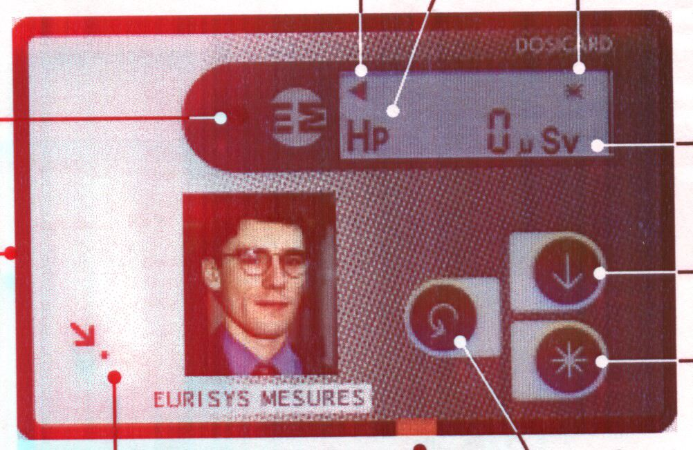
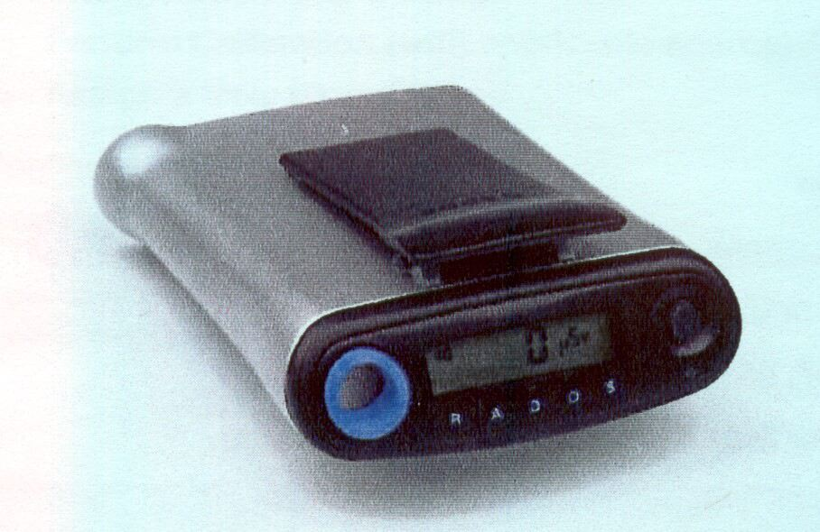
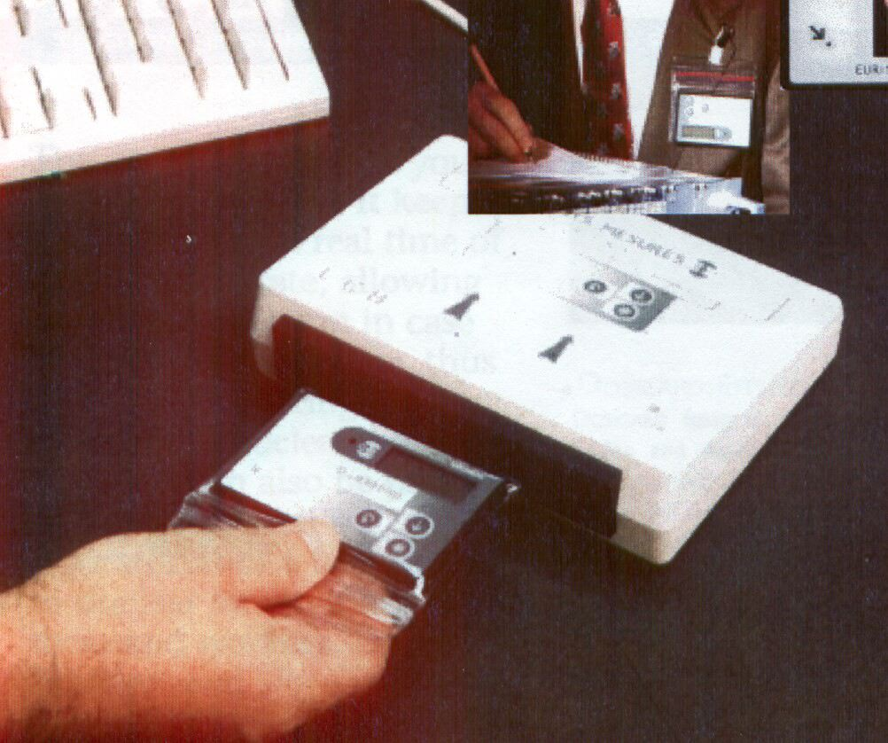
Radiation Detection
Notes:
Examples of instruments that could serve that purpose, and are also small enough to be carried on a emergency responders person, are shown here. This slide shows both credit card sized detectors and pager sized detectors. What's important here, is that they have a direct numerical read out. It's not just a light that turns on or turns a different color, but there's actually a numerical readout of exposure or dose or exposure rate or dose rate. These types of detectors are ideal for a suspicious incident.

Slide 22
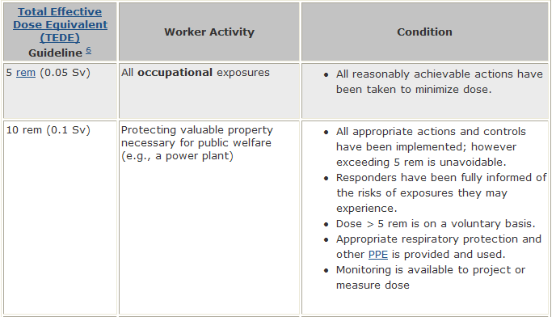
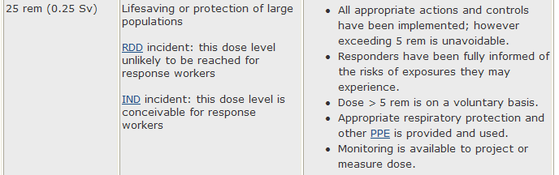
Key Challenges for Responder Safety and Health
Need for consensus on hazard exposure limits for emergency response
  EPA, DHS, NCRP, IAEA, CRCPD, ICRP
  OSHA limits not focused on emergency response
Will emergency response exposure limits be realistic and practical?

Slide 23
EPA Guidelines for Emergency Procedures*
(expected only once in a lifetime)
* Minors and pregnant females have much lower limits
Dose limit | Emergency Activity Performed | Condition
5,000 mrem | All activities | All activities during emergency
10,000 mrem | Protecting major property | Where lower dose not practicable
25,000 mrem | Lifesaving or protection of critical infrastructure | Where lower dose not practicable
More than 25,000 mrem | Lifesaving or protection of large populations | Only on a volunteer basis to persons fully aware of the risks involved.
Notes:
_________________________________________________________
_________________________________________________________
_________________________________________________________
_________________________________________________________
_________________________________________________________
_________________________________________________________
_________________________________________________________
_________________________________________________________

Slide 24
Acute Radiation Syndrome
Pre-determined Responder Exposure Levels will reduce the risk from unintentional higher exposures.
Earliest clinical signs = nausea and vomiting (at > 100 rad)
Remove victims (including first responders who become victims) from the inner perimeter
Notes:
For victims -- and first responders who we want to prevent from becoming victims, the earliest clinical signs of acute radiation syndrome, the prodromal syndrome, are nausea and vomiting. If you have victims or first responders who are nauseous and/or vomiting, that’s a bad sign -- and they need to be taken away from the site. They need to be especially removed from the inner perimeter.

Slide 25
Decision Dose
50 rad (500mSv) to emergency responders
Triggers decision on whether to withdraw an emergency responder from within or near (but outside) the inner perimeter during the early phase of response
Triggers decision on whether to withdraw an emergency responder from within the outer perimeter after prolonged activities
NCRP Commentary No. 19
(consistent with CRCPD HS-5 Task Force)
Notes:
Now, if I have an inner perimeter and an outer perimeter, and emergency or first responders are working within that inner perimeter to address the event and to aid victims, they will be accumulating radiation dose. Those outer and inner perimeters are based on an exposure rate. But the biologic effects we've discussed depend on total or cumulative exposure or dose. So, NCRP Commentary Number Nineteen recommends a decision dose. The recommendation is 50 RADs total to an emergency responder. We call it a decision dose because it triggers a decision on whether to withdraw a emergency responder from within or near the inner perimeter during the early phase of response. And it triggers a decision on whether to withdraw a emergency responder from within the outer perimeter after prolonged activities. So, the perimeters are based on an exposure rate, but the decision dose is based on a total or cumulative dose to any emergency or first responder.

Slide 26
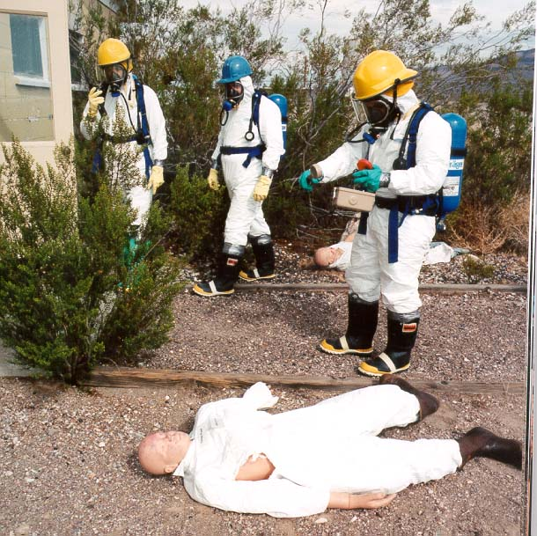
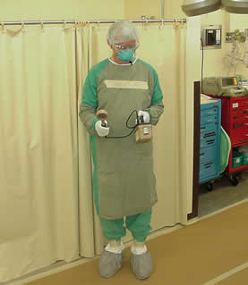
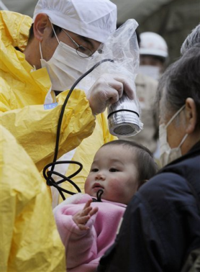
Personal Protective Equipment
  Affords protection from
    Internal contamination: radioactive material entering the body via inhalation, ingestion, or open wounds
    External contamination: radioactive dust deposited on ones body
Notes:
Personal Protective equipment, or PPE, is the third crucial component of worker safety and health. While this equipment can not protect against direct external radiation, it can serve to protect the responder from radiological contamination, which is both an internal and external hazard.
The need for such equipment will vary depending on the type of radiological or nuclear event. NIOSH, as well as other organizations, have prepared guidance documents to help in the selection of appropriate PPE for radioactive environments.

Slide 27
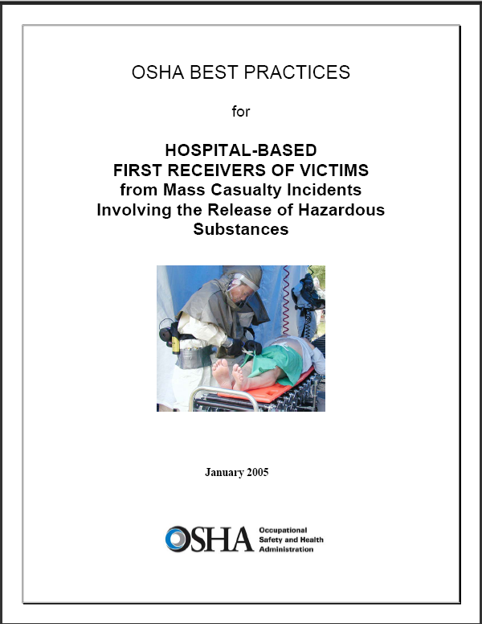
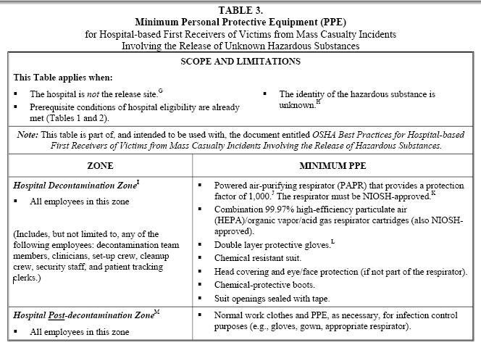
First Receiver ~ PPE

Slide 28
HEALTH THREAT
FROM A
NUCLEAR ACCIDENT
Contaminated Soil
Contaminated Air
Exposure
Burns to eyes/skin
Molds/Allergens
Inhalation
GI Tract
ARS
Thyroid
Cancer
Contaminated
Water
Environmental
Radiation
Contamination
Radiation
Exposure
Contaminated Food
Secondary Fires
Loss of
Communications
Delays/ Inability to Evacuate
Access to care prohibited
Trauma/Wounds
Burns
Radiation
Blast
Maternal & Neonatal
Chronic Disease
Burns/Smoke Inhalation
Exposure
Loss of Essential
Services
Nuclear
Accident
Infrastructure
Loss of Utilities
Fires and Explosions
Loss of Transportation
Networks
Loss of Assets
Displacement
Meningitis
Measles
Malnutrition
Dehydration
Diarrhea
Socio-Economic
Loss of Shelter
Loss of Employment
Loss of Access
To Food/Water

Slide 29
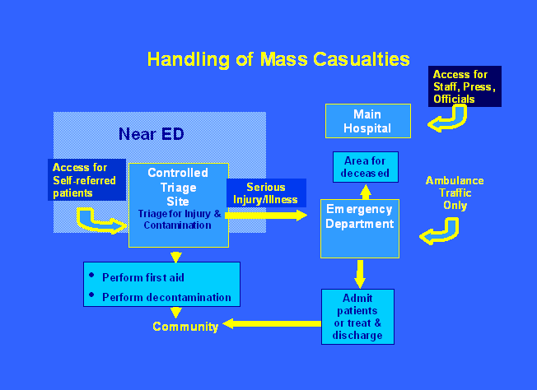
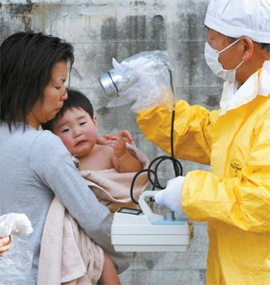
Prototype for Zones to Handle Patients in Medical Facility at Mass Casualty Incident
A baby is checked for radiation exposure after being decontaminated in Fukushima, Japan, Monday. [AP/YONHAP]

Slide 30
Treatment Area Layout
Separate Entrance
ED Staff
Radiation Survey
& Charting
CONTAMINATED
AREA
Contaminated
Waste
Trauma Room
HOT
LINE
STEP
OFF
PAD
Radiation
Survey
Waste
BUFFER
ZONE
CLEAN
AREA
Clean
Gloves, Masks,
Gowns, Booties
Notes:
20. Treatment Area Layout
The layout for the handling of a contaminated radiation accident victim should be established to control the spread of contamination by using universal precautions.
Control of individuals and materials going into the area.
Control and survey of materials and personnel coming out of the area.
Use appropriate steps to prevent the spread of contamination (e.g., monitor gloves and change as necessary, monitor shoes when leaving, etc.).
Monitoring of the patient and the trauma room to detect, control, and remove contamination.
Contaminated waste water need not be contained if it will unduly complicate the treatment of the patient or it is otherwise determined to be impractical. Release of wastewater can be justified in almost all situations.

Slide 31
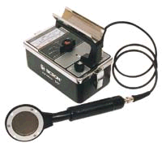
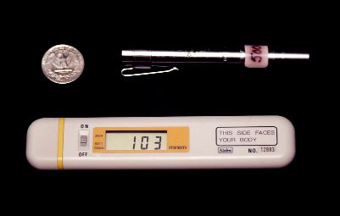
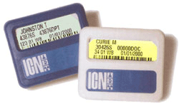
Detecting and Measuring Radiation
Instruments
  Locate contamination - GM Survey Meter (Geiger counter)
  Measure exposure rate - Ion Chamber
Personal Dosimeters - Measure doses to staff
  Radiation Badge - Film/TLD
  Self-reading dosimeter (analog and digital)
Notes:
21. Detecting and Measuring Radiation
You cannot see, smell, taste, feel, or hear radiation, but we have very sensitive instrumentation to detect it at very low levels. Radiation monitoring instruments detect the presence of radiation. The radiation measured is usually expressed as exposure per unit time, using various units of measure, milliroentgen per hour (mR/hr) and counts per minute (CPM). Anything with “milli” in front of it is SMALL! The most commonly used instruments to detect the presence of radiation include:
Geiger-Mueller Survey Meter. The Geiger-Mueller (GM) survey meter (also known as a Geiger counter) will detect low levels of gamma and most beta radiation. The instrument typically has the capability to distinguish between gamma and most beta radiation. This instrument is used to quickly determine if a person is contaminated. GM survey meters are very sensitive and other instruments may be needed to measure higher levels.
Ionization Chamber Survey Meter. This device can accurately measure radiation exposure. These meters measure from low levels (mR/hr) to higher levels (many R/hr). To find the dose an individual is receiving, multiply the dose rate by the time the person is exposed.
Personal Dosimeters. These devices measure the cumulative dose of radiation received by persons wearing them. Film and TLD badges must be analyzed by the company that supplies them, so the dose received is not typically known for several days. However, self-reading dosimeters allow the wearers to immediately see the total dose they have received.

Slide 32
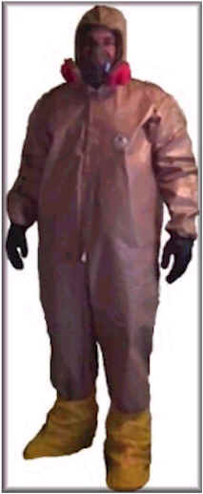
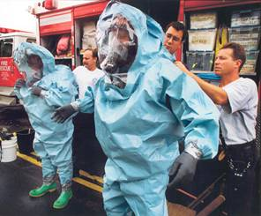
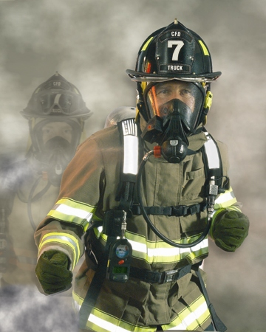
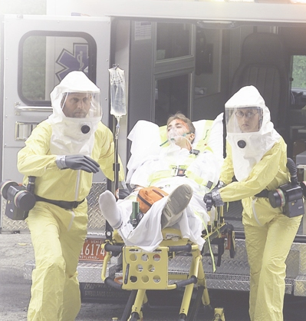
Personal Protective Equipment (PPE)
Notes:
_________________________________________________________
_________________________________________________________
_________________________________________________________
_________________________________________________________
_________________________________________________________
_________________________________________________________
_________________________________________________________
_________________________________________________________

Slide 33
Personal Protective Equipment
Civilian PPE
Two classification systems used in the US
  Occupational Safety and Health Administration (OSHA) /Environmental Protection Agency (EPA) PPE ensemble classification system
    Level A (most protective)
    Level B
    Level C
    Level D (least protective)
  National Fire Protection Association (NFPA) PPE ensemble classification system
    Class 1 (most protective)
    Class 2
    Class 3
    Class 4 (least protective)
US Military PPE
Mission Oriented Protective (MOPP) gear: six different readiness levels achieved by adding or removing individual MOPP gear ensemble components
MOPP Ready [lowest level of readiness (i.e., no ensemble elements are worn)]
  MOPP 0
  MOPP 1
  MOPP 2
  MOPP 3
  MOPP 4 [highest level of readiness (i.e., all ensemble elements are worn)]
Standard protective clothing
  Bunker/Turnout gear
  Level B
Respiratory protection
  APR
  PAPR
  SCBA
Notes:
I also want to mention personal protective equipment. For most RED and RDD events, standard protective clothing -- bunker gear or turnout gear -- is sufficient. Level B won't hurt of course, but there is some disagreement about whether or not Level B is necessary. NCRP Commentary Number Nineteen recommends bunker or turnout gear. What everyone agrees is important is respiratory protection, because first responders need to be protected from breathing in radioactive atoms that are likely to be present in the air at the site. Some level of respiratory protection -- N95, a PAPR, an SCBA, at least some level of half-face protection and ideally full-face respiratory protection -- is desirable.

Slide 34

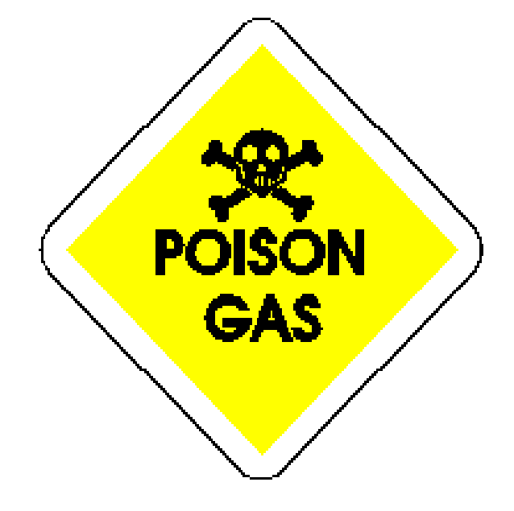
CBRN: An abbreviation for chemicals, biological agents and radiological particulates hazards.
CBRN Terrorism Agents: Chemicals, biological agents, radiological
particulates which could be potentially released as an act of terrorism.
(See Chemical Terrorism Agents, Biological Terrorism Agents, Radiological
Particulate Terrorism Agents)
Chemical Terrorism Agents: Liquid, solid, gaseous, and vapor chemical
warfare agents and dual-use industrial chemicals used to inflict lethal
or incapacitating casualties as a result of a terrorist attack.
Biological Terrorism Incident: Liquid or particulate agents that can
consist of biologically derived toxin or pathogen used to inflict lethal or
incapacitating causalities as a result of a terrorist attack
Radiological Particulate Terrorism Agents: Particles that emit ionizing
radiation in excess of normal background levels used to inflict lethal or
incapacitating casualties as a result of terrorist attack.

Slide 35
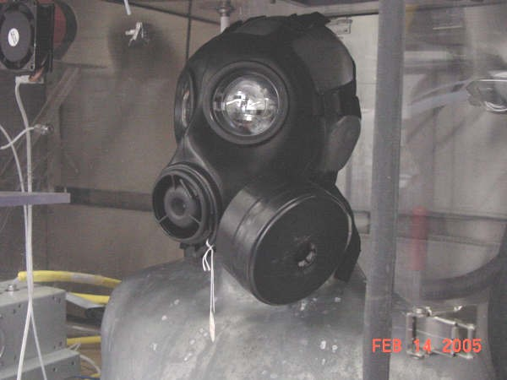
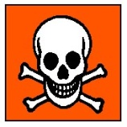
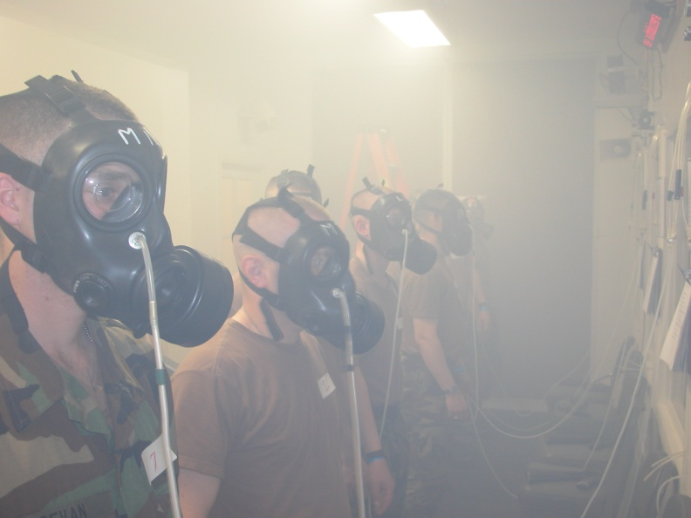

CBRN Agents Definitions: C & B
Chemical (gases, vapors, liquids, & particulates)
  Chemical warfare agents
  Toxic industrial chemicals/Toxic industrial materials
Biological (particulates)
  Micro organisms (disease-causing bacteria and viruses) and biological toxins
Notes:
The most important fissile materials for nuclear energy and nuclear weapons are an isotope of plutonium, plutonium-239, and an isotope of uranium, uranium-235. Uranium-235 occurs in nature.

Slide 36
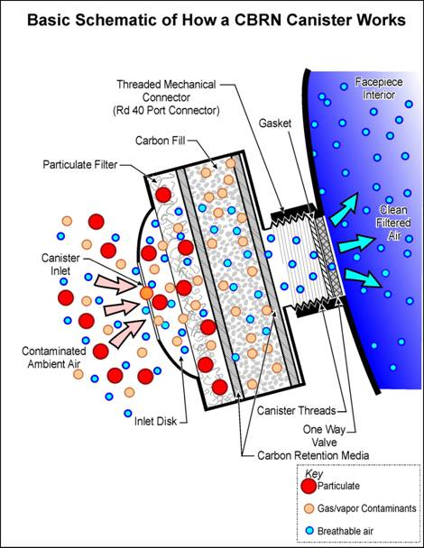
Test Representative Agents for Air-Purifying Respirators
  61 Organic vapor family
  (vapor pressures =<cyclohexane )
  32 Acid gas family
  (SO₂, H₂S, CNCL, COCl₂, HCN)
  4 Base gas family (ammonia)
  4 Hydride family (phosgene)
  5 Nitrogen oxide family (NO₂)
  1 Formaldehyde family
  32 Particulate family (DOP)

Slide 37
Select Agents/ WMD
Particulate Biological Agents
(USAMRIID and/or CDC Lists)
Anthrax
Brucellosis
Glanders
Pneumonic Plague
Tularemia
Q Fever
Smallpox
Venezuelan Equine Encephalitis
Viral Hemorrhagic Fevers
T-2 Mycotoxins
Botulism
Ricin
Staphylococcus Enterotoxin B
Notes:
1. Biological weapons primarily result from inhalation exposures.
2. Issues of concern are aerodynamic size and shape of organism, infectious dose, routes of infection, face seal leakage, and biological agent detectors. Portals of entry differ by disease! and include:
- Inhaled
- Mucous membrane (eye, nose, mouth)
- Break in skin (cut, wound, etc)

Slide 38
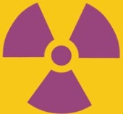

CBRN Agents Definitions: R & N
Radiological (particulates)
  Particulates carrying radiation dispersed by a radiological dispersive device (RDD) or “dirty bomb” IED
Nuclear (particulates)
  Particulates carrying radiation dispersed from a detonation involving nuclear fuel, a nuclear weapon, or a weapon’s component
Notes:
Nuclear – a nuclear detonation (traditionally uranium or plutonium) resulting from fission (splitting of nucleus)
The most important fissile materials for nuclear energy and nuclear weapons are an isotope of plutonium, plutonium-239, and an isotope of uranium, uranium-235. Uranium-235 occurs in nature.

Slide 39
Particulate Radiological\Nuclear Agents
(USAMRIID and/or DOE Lists)
Hydrogen 3
Carbon 14
Phosphorous 32
Cobalt 60
Nickel 63
Strontium 90
Technetium 99m
Iodine 131
Cesium 137
Promethium 147
Thallium 204
Radium 226
Thorium 232
Uranium 235 & 238
Plutonium 239
Americium 241
Notes:
1. All radiological agents are alpha, beta, gamma, x-rays, neutrons, high-speed electrons, high-speed protons, and other particles capable of producing ions. (approximately 2500 natural and artificial radionuclides have been identified).
2. The half-life for these radionuclides range from 6 hours (Technetium) to 1.4E10 years (Thorium). 13 of 18 are greater than 10 years creating enduring contamination of the local environments. Fallout from Chernobyl was measured around the world.
3. External radiation from external sources. Respirators can not protect against this. Internal radiation from sources taken into the body
Contaminated wounds
Ingested sources
Inhaled sources – respiratory protection

Slide 40
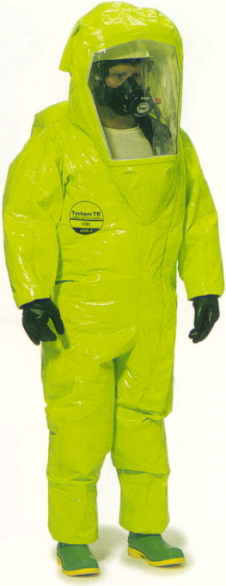
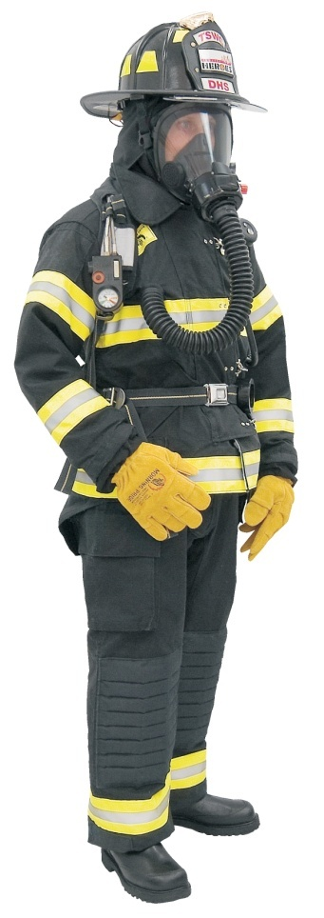
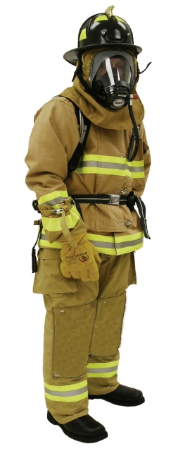
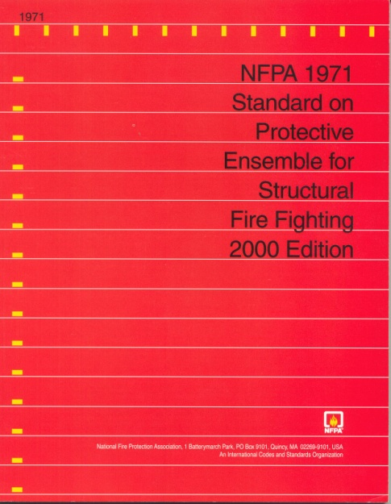
Technical Challenge
Provide CBRN protection in a structural fire fighting ensemble
Meet both NFPA 1971 (structural fire fighting) and NFPA 1994 (WMD/terrorism)
Tested & Certified as a System!

Slide 41
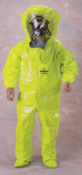
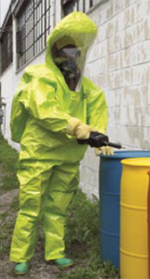
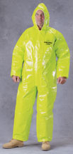
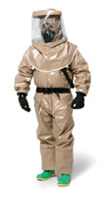
CBRN Protective Clothing Designations
“The Issue”
Encapsulating
NFPA 1994
Class 1
(Level A)
CBRN SCBA
Design & Tested to CBRN Hazard Based Performance
Requirements
Both
OSHA Level B
Ensembles
SCBA
NFPA 1994
Class 3
(Level C)
CBRN APR
Non-Encapsulating
Notes:
Now- scientific focus.

Slide 42
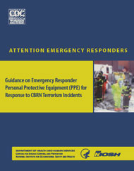
" Guidance on Emergency Responder Personal Protective Equipment (PPE) for Response to CBRN Terrorism Incidents”
NIOSH Publication No. 2008-132, June 2008
Compares OSHA/EPA Protection Levels A, B, and C to DHS adopted PPE performance based standards for response to terrorism incidents involving Chemical, Biological, Radiological, and Nuclear (CBRN) hazards

Slide 43
" Guidance on Emergency Responder Personal Protective Equipment (PPE) for Response to CBRN Terrorism Incidents”
Ensemble description using performance-based standard(s) OSHA/EPA level
NFPA 1991 (2005 Edition) worn with NIOSH CBRN SCBA A
NFPA 1994 (2007 Edition) Class 2 worn with NIOSH CBRN SCBA B
NFPA 1971 (2007 Edition) with CBRN option worn with NIOSH CBRN SCBA B
NFPA 1994 (2007 Edition) Class 3 worn with NIOSH CBRN APR/PAPR C
NFPA 1994 (2007 Edition) Class 4 worn with NIOSH CBRN APR/PAPR C
NFPA 1951 (2007 Edition) CBRN technical rescue ensemble worn with
NIOSH CBRN APR/PAPR C

Slide 44
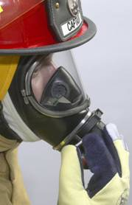
Respiratory Protection
The Department of Energy recommends full-face respiratory protection for entrance into a contaminated area. DOE/RW-0362 SR Office of Civilian Radiological Waste Management
The respiratory threat can be eliminated by employing High Efficiency Particulate Air (HEPA) or P100 filters. Domestic Preparedness Technician-HAZMAT Course
The U.S. Army specifies a M40 full-face gas mask with a two-element canister containing (HEPA) filtration and ASZM-T Cooperite carbon filtration media.
Notes:
The DOE recommendation is for HEPA filters with other chemical gas and vapor protections as needed.
2. The Domestic Preparedness training was provided to the 158 largest U.S. cities by the U.S. Army experts.
3. The U.S. joint services utilize the M40 mask with C2A1 cartridge to protect over 600,000 soldiers, marines, ground support airmen and sailors from RN exposures.

Slide 45

CBRN Air-Purifying Respirator
All of the following conditions must be met
Types of inhalation hazards and concentrations have been identified & Contaminant concentrations are non-IDLH
CBRN canister is capable of removing the hazard
Oxygen is known to be at least 19.5% by volume
Canister change schedule is required for gas/vapors
  Major responder needs:
  Create interchangeable conditions for canisters to use common threads
  Light weight, small size, left or right side can
  Canister interoperability
  Assembly with a canister other than specified in the approval assembly matrix is not in its NIOSH-approved configuration
  Decision to proceed with interoperability is the responsibility of the incident commander or other commanding authority under crisis conditions

Slide 46
GAPS & Challenges
First Responders and Receivers
Identifying Gaps in
      Strategy
      Leadership
      Priorities
      Accountability

Slide 47
Key Challenges for Responder Safety and Health
Training and Education
  Few responders receive adequate training in radiation safety, and have little experience with radiation response
  “Informed consent” from individual responders will be required for those entering the hot zones
  Research indicates potential reluctance of responders to respond to event involving significant radiation hazards

Slide 48
Key Challenges for Responder Safety and Health
Monitoring and Surveillance
  Area and Personal Monitoring
    Availability of dosimetry and radiation detection equipment
    Proper maintenance of existing equipment
    Blast-damaged equipment
  Long term surveillance and dose reconstruction
    Emergency Responders vs “Radiation Workers”
      Particularly in the Recovery phase

Slide 49
State and Local Public Health Capability and Capacity to Respond to a Radiological/Nuclear Incident
Response capability and capacity varies across state and local jurisdictions
  States with nuclear power plants: 31 states
  States with high risk metropolitan areas
Inconsistent integration of radiation control programs with public health agencies
  State radiation control programs reside in state public health agencies in 35 states
  Radiation control/expertise is found elsewhere with state government in remaining 15 states
Notes:
So, what is the current state and local capability to effectively respond to radiological or nuclear incidents?
The answer: It varies across state and local jurisdictions typically due to previous experience or perceived threat of such an incident in that region.
For example, 31 states with commercial nuclear power plants are required to have detailed response plans and drills, but only for the designated zones around their power plants.
Some major metropolitan areas are considered high probability terrorists targets, such as Los Angeles, California, and my own, NYC, and each of these localities have done extensive planning while other regions or states have modest or limited planning efforts.
Furthermore, each state has one or more radiation control programs that house tremendous assets in radiological expertise. In 35 states, these programs are located within the state public health department; in the other 15 states, this expertise and man power is found elsewhere in the state government, often in the state environmental departments. To insure adequate response and planning, it is critical that state and local public health agencies engage these programs.

Slide 50


Challenges to Planning & Response for
State, Local, Tribal, and Territorial Jurisdictions
Lack of awareness public health responsibilities in radiological/nuclear emergencies
Lack of funding
Lack of subject matter expertise
Lack of human resources for planning, exercises, and response
Notes:
Beyond the limitations of capacity and capabilities, state sand localities all face similar challenges including the following:
First, the lack of awareness of public health’s extensive role and responsibilities in radiological emergencies, especially in the role of communication, plays a significant challenge because without this awareness planning doesn’t take place.
Even if awareness exists, lack of funding, related to the lack of prioritization at the national, state and local levels, is probably the greatest obstacle we all face for emergency planning for any hazard, and this is particularly evident in radiation and nuclear response planning.
Thirdly, due to the lack of expertise, it is difficult for public health personnel who have little or no knowledge of radiological agents to be able to appropriately plan, drill and respond for these incidents; and,
Lastly, even if awareness, money, and expertise exist, there is a lack of human resources to complete plans and exercises with all the other competing priorities in public health.

Slide 51
Leadership brings it all together
Prioritize: Focus efforts on the most important, most fruitful work.
Synchronize: Get Departments, agencies, and partners working towards common goals.
Anticipate: Do as much in advance of an incident as possible.

Slide 52
Acknowledgements & Disclaimers
Many thanks for visual aids:
    Jonathan Links PhD, Johns Hopkins University
    RADM Scott Deitchman, MD, NCEH
    LCDR John Halpin, MD, NIOSH
    Jon Szalajda & Roland BerryAnn, NPPTL, NIOSH
    DHS - Office for Domestic Preparedness
Mention of the name of any company or product, or inclusion of any reference, does not constitute endorsement by the National Institute for Occupational Safety and Health.
The findings and conclusions in this presentation have not been formally disseminated by the National Institute for Occupational Safety and Health and should not be construed to represent any agency determination or policy

Slide 53
Questions
Happy Birthday:
Wilhelm Roentgen, German physicist who discovered X-Rays, born March 27, 1813
Notes:
_________________________________________________________
_________________________________________________________
_________________________________________________________
_________________________________________________________
_________________________________________________________
_________________________________________________________
_________________________________________________________
_________________________________________________________

