Slide 1
Nuclear Detonation Communications Activities at the Federal Level
Bridging the Gaps:
Public Health and Radiation Emergency Preparedness
March 23, 2011
Jessica Wieder
EPA
Center for Radiation Information and Outreach
202-343-9201
wieder.jessica@epa.gov
Notes:
Two Qs
-- What is right: leadership in understanding and communicating radiation issues. I think you will begin to see some examples of that leadership in this presentation.
One of the best things for me: embodied in the tag-line, Understanding Radiation in Your Life, Your World
-- Common purpose that individuals and the group returns to time again – resolve difference, prioritize work, guide action
Leisure-time reading: radiation past, radiation future
Today’s presentation will focus on the present
-- primarily a snapshot of what we have going on right now. However, we do see a lot of opportunities and look forward to moving ahead

Slide 2
Communicating to a Non-technical Audience
A brilliant scientific discourse is wasted if no one listens or understands it.
Journal of the American Medical Association

Slide 3
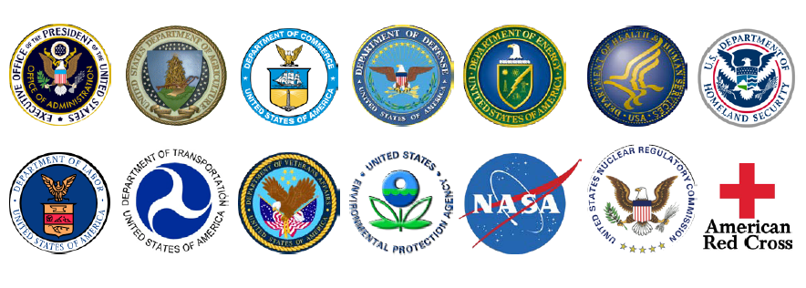
Interagency Collaboration

Slide 4
Overview
Nuclear Detonation Preparedness: Communicating in the Immediate Aftermath
Nuclear/Radiological Communications Working Group
  Post-Detonation Video Project
Public Message Testing
Pre-event Preparedness

Slide 5
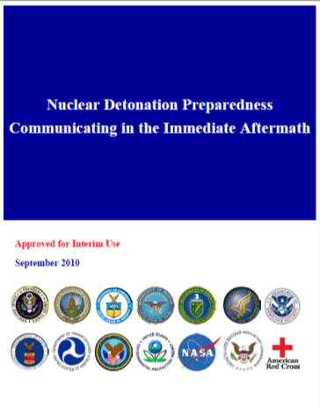
Post-Detonation Communications
The goal:
Provide technically-accurate, clear, consistent messages across all levels of government to the public as quickly as possible to save lives.
The document includes:
Key messages for the impacted community and the nation
98 anticipated questions and answers
Document update in progress

Slide 6
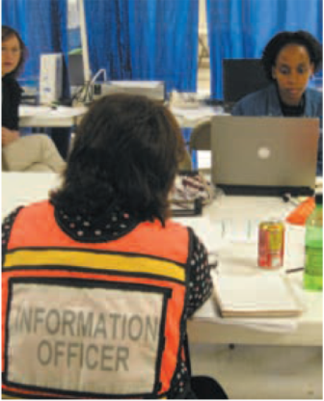
Nuc/Rad Communications Working Group
Under FEMA’s IND Response and Recovery Program
  Volunteers from federal, state and local governments and academic institutions
  Radiation communicators and technical specialist

Slide 7
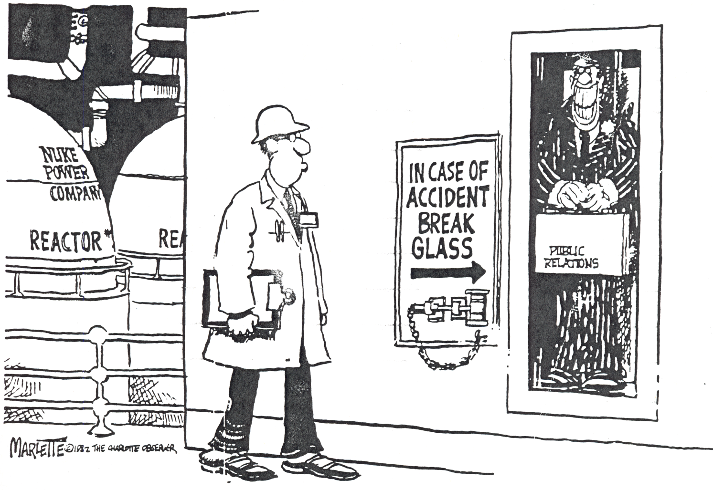
How not to do crisis communications

Slide 8
Post-Detonation Video Project
Post-Detonation Video Project
  Create 5 videos with associated media packages (background images (B-roll) and scripts)
  Identified potential video topics:
    Protective Actions (shelter, self-decon, food and water)
    Radiation Basics (time, distance, shielding; decay)
    Nuclear Detonation Basics (fallout, plumes, emp)
    Response to a Nuclear Detonation (what is the government doing and why)
    How to help (why to stay indoors, how to help within your organization, how to welcome people who may be contaminated into your home

Slide 9
Public Message Testing
Write short, concise and simple messages
Do not use contradicting statements
Use directive, authoritative language
Provide prioritized instructions
Modify “instructions will change” to “instruction will be updated”
Encourage people not to leave their homes
Tailor messages to various audiences

Slide 10
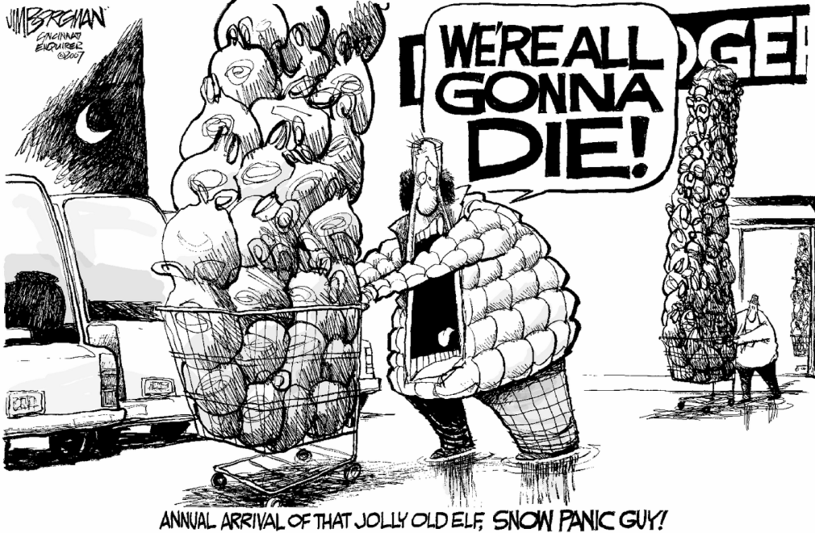
Pre-event Education

Slide 11





December 16, 2011

Slide 12


