Slide 1
Communicating About Radiation Emergencies: Lessons Learned from Audience Research
Katrina Pollard, Carol McCurley, Armin Ansari
Bridging the Gaps: Public Health and Radiation Emergency Preparedness
March 21-24, 2011

Slide 2
Key Communication Questions
Are we meeting audience needs for information?
How can we bridge the gap between technical information and risk perception?
How can we describe radiation in ways that promote responsible public action?

Slide 3
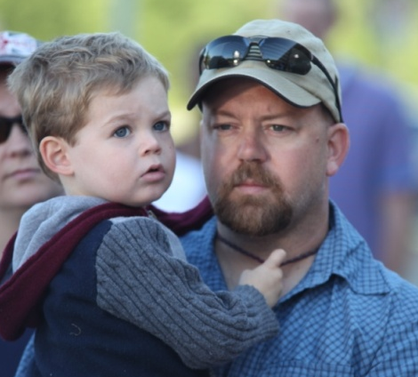
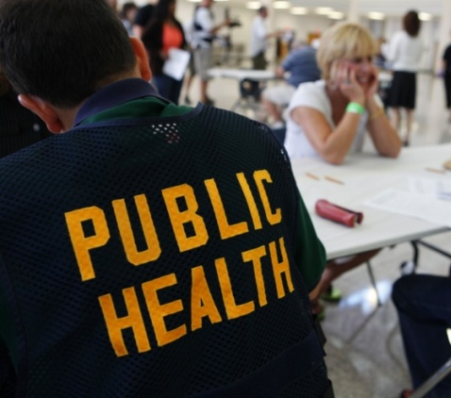
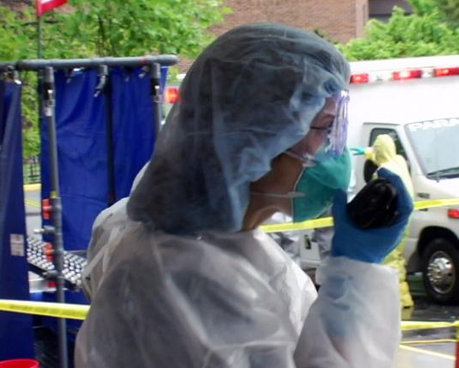
Key Audiences
Public
Public health professionals
Emergency services clinicians

Slide 4
CDC Research with Public Audiences
Focus group testing of knowledge, attitudes and behavior (2002-2003)
Cognitive interview message testing (2008
Focus group testing of messages (Spanish-2010)
Focus group testing of messages (English -2010)
Healthstyles® survey of knowledge/attitudes (2009)
Secondary research (lit search) (2008)
Message testing with public health professionals (2008)

Slide 5

Focus Groups for KAB
Analytical Sciences Inc. (ASI)
  3 focus groups—Philadelphia, Chicago, LA
  RDD scenario
ASPH/University of Alabama
(Birmingham)
  12 focus groups—region
  rural/urban, race/ethnicity

Slide 6
Focus Groups-ASI and UAB
ASI N=26: Philadelphia, Los Angeles and Chicago
3-part scenarios
News reports of an explosion at a nearby mall
Confirmation of a dirty bomb
Visit to pharmacy on the way home from work
UAB N= 131: 12 focus groups by race/ethnicity in SE, Midwest, West and SW
3-part scenarios
Elevated threat level
News reports of an explosion in the city
Confirmation of a small IND

Slide 7
Key Findings from ASI and UAB Focus Groups
The public’s most important concern during all stages of the focus group testing was:
What should I do to protect myself and my family?
Challenge
Based on these findings, the greatest challenge will be answering questions known only at the time of an emergency

Slide 8
Cognitive Interview Message Testing
ICF MACRO Inc: Individual interviews (N=60) to present context, message, and assess how individuals process the information
Cognitive interviews used to:
  Test initial responses to messages for clarity
  Assess understanding of terms and offer alternatives
  Determine if message motivated action

Slide 9
Cognitive Interview Message Testing
Atlanta, GA, and Rockville, MD
1 hour 15 mins
Audio-based and written
Scenarios included high (close) and low (distant) risk situations
Included pregnant women and nursing mothers as special populations

Slide 10
Focus Group Message Testing
Based on cognitive interview research, ICF MACRO pretested nine draft fact sheets with adults (N=47) ages 18-65
Seven focus groups were conducted to determine if:
  Fact sheets were clear and easy to understand
  Sufficient information was provided for persons on what to do before and after a radiation emergency
Audiences | Focus Groups
General Public | 4 groups with 4-6 participants
Pet Owners | 1 group with 8 participants
Pregnant Women | 1 group with 9 participants
Nursing Mothers | 1 group with 9 participants

Slide 11
Focus Group Message Testing/Spanish
N=31 Spanish speaking participants, pretested five Spanish language draft fact sheets, 6 groups,
ages 18-50
Atlanta, GA facility
1 hour 30 mins
Spanish speaking moderator used scripted moderator guide
Each group asked to review 3 fact sheets

Slide 12
Focus Group Message Testing/Spanish
Audience Segment Number per Group | Number of Focus Groups | Fact Sheets
General Public 5-7 total | 1 group-ages 18-30 yrs mix of gender, nation of origin, income, education ,one pet owner | What to Do Limiting Contamination Info for Pet Owners
General Public 5-7 total | 1 group-ages 35-50 yrs mix of gender, nation of origin, income, education ,one pet owner | What to Do Limiting Contamination Info for Pet Owners
Pregnant Women 4-5 (8-10 total) | 2 groups-mix of nation of origin, income and education | Info for Pregnant Women What to Do Limiting Contamination
Nursing Mothers 4-5 (8-10 total) | 2 groups-mix of nation of origin, income and education | Info for Nursing Mothers What to Do Limiting Contamination

Slide 13
Healthstyles® Survey
Population-based survey conducted by Ported Novelli (N=5,128)
Questions submitted by CDC on radiation-related knowledge and attitudes
Responses received from 5,128 participants
(73% response rate)

Slide 14
Secondary Research
ICF MACRO, Inc.
Literature search on public KAB concerning radiological emergencies
Environmental Scan (“gray” literature)
  Not peer-reviewed publications
  Professional organizations, government agencies, research organizations, other websites

Slide 15
Message Testing with Public Health Workers
Conducted by National Public Health Information Coalition (NPHIC)
Online survey (N=2700)
Focus groups (N=69 in 6 states)
Participants included MDs, nurses, techs, admin, managers, and epidemiologists
3 protective action messages and 1 workforce-specific message
Previous Research:
Lack of understanding about radiation
Would not come to work
Did not understand their roles

Slide 16
Key Findings
The public’s greatest concern is protecting themselves and family.
Radiation concepts, terms and risks are poorly understood, even among well-educated people and professionals.
People overestimate risks and resist reassuring messages.

Slide 17
Other Common Themes
People will more likely take protective actions if they understand why.
Many indicated they would not shelter in place, but would seek family/children.
Many do not understand basic terms such as “shelter in place.”
Some, especially African Americans, expressed fatalism about a radiation incident.
Few differences in responses from participants with higher vs. lower education.
ESOL have specific communication needs.
People do not like vague instructions, nor messages that convey uncertainly (use of “may”, “might” or “could”) considered less credible.

Slide 18
Communication Challenges
Professional responders will have the same concerns as members of the public.
Situational specifics will be difficult to communicate in a clear and timely way (e.g. plume modeling).
Inconsistency will cause confusion and discredit messages.
Pre-event education would be useful but how receptive would the public be?

Slide 19
Next Steps
Interagency collaboration to test IND messages
Incorporation of findings into materials development
Pre-event education through community-level efforts (schools, first responders, local organizations) and entertainment/media strategies
Review of innovative methods to get messages to audiences
Ongoing assessment/evaluation

Slide 20
Katrina Pollard
KPollard@cdc.gov
Carol McCurley
CMcCurley@cdc.gov
Radiation Emergencies Website
http://www.bt.cdc.gov/radiation/
The findings and conclusions in this report are those of the authors and do not necessarily represent the official position of the Centers for Disease Control and Prevention.

