Slide 1
Health Communicator’s
Social Media Toolkit Overview
Bridging the Gaps: Public Health and Radiation Emergency Preparedness
March 23, 2011
Diane Brodalski
Northrop Grumman Contractor
Social Media Specialist
Electronic Media Branch
Division of News and Electronic Media
Office of the Associate Director for Communication
Office of the Director
Office of the Associate Director for Communication

Slide 2
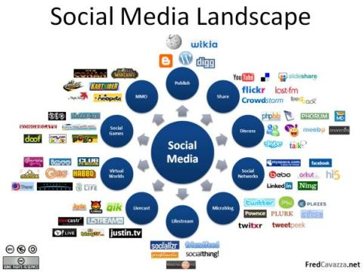
Social Media Definition
Internet-based tools for sharing and discussing information.
Refers to activities that integrate technology and social interaction.
Image source:
http://frenchguyonair.files.wordpress.com/2008/08/socialmedialandscape.jpg

Slide 3
Social Media Goals
Complement traditional communication
Share content in new spaces
Reach new audiences
Encourage engagement and interaction with the content

Slide 4
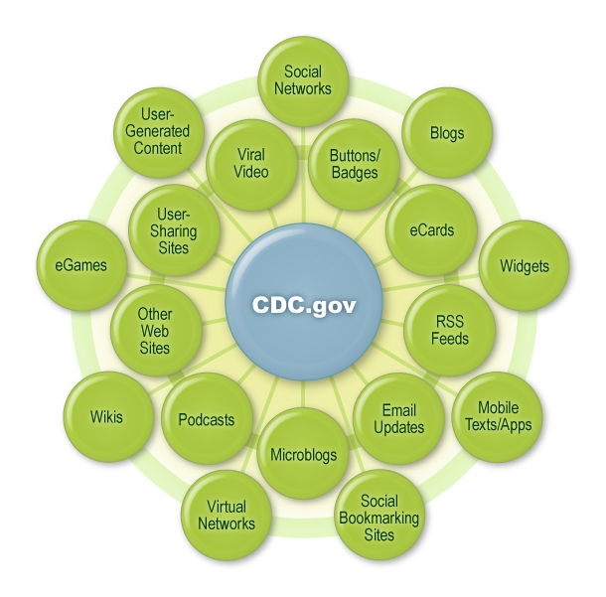
CDC Social Media Strategy

Slide 5
Social Media Tools

Slide 6
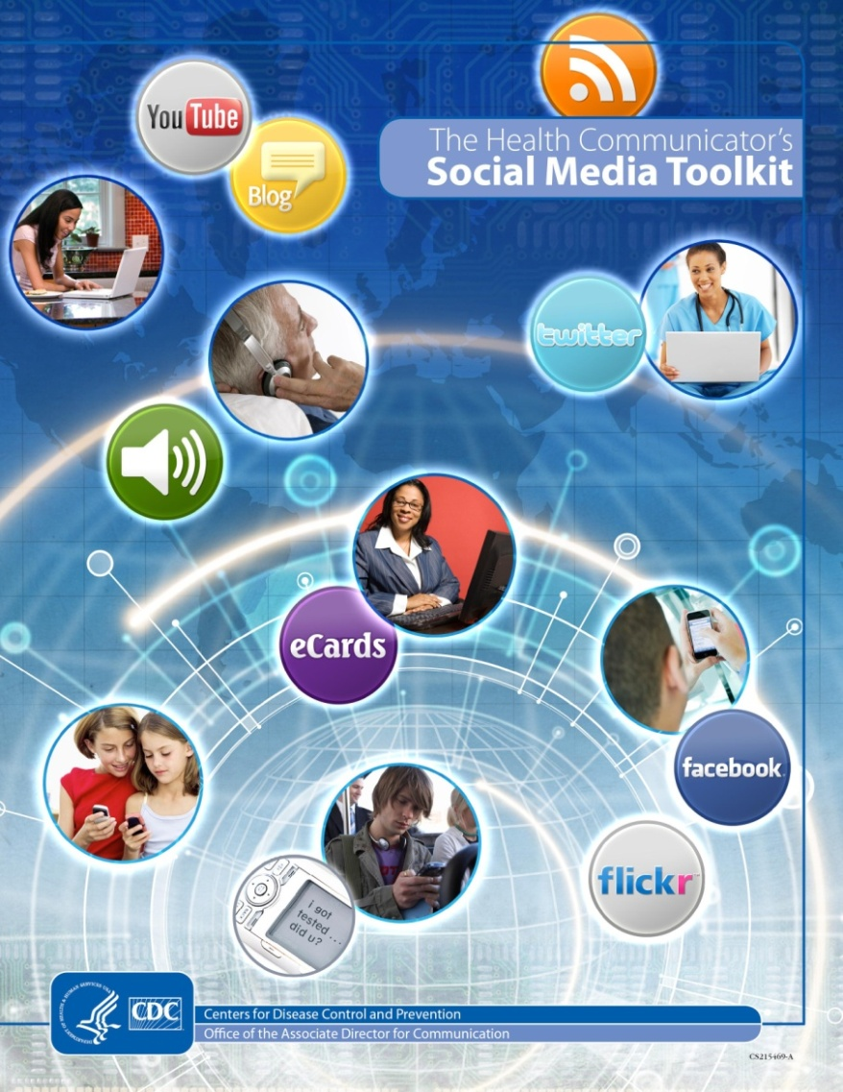
Social Media Toolkit
What’s covered:
Introduction
  Overview
  CDC’s Top Lessons Learned
Social media tools
  Overview of a variety of tools
    Buttons, widgets, mobile, technologies, social networks
Social Media Campaign Example
  2009 – 2010 H1N1 and Seasonal Flu
Found at cdc.gov

Slide 7
Social Media Toolkit
What’s covered:
Resources
  List of selected resources
Worksheets
  Communications Strategy
  Evaluation
Found at cdc.gov

Slide 8
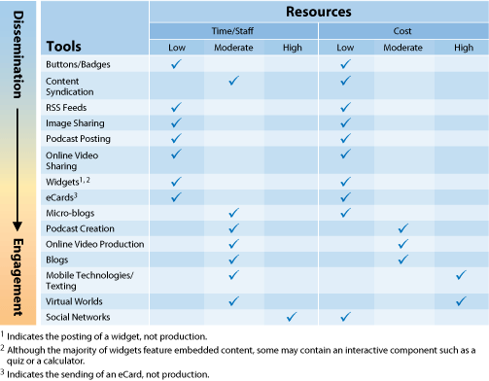
Another way to think about it…
Source: CDC. The Health Communicator's Social Media Toolkit. August 2010
Notes:
- Found in the CDC Toolkit

Slide 9

Buttons and badges
Graphics embedded in websites, blogs and social networking sites
Include a call-to-action message and a link for more information
Benefit:
  Share health information and link to resources, increase awareness about health topics

Slide 10
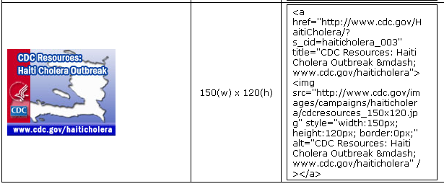
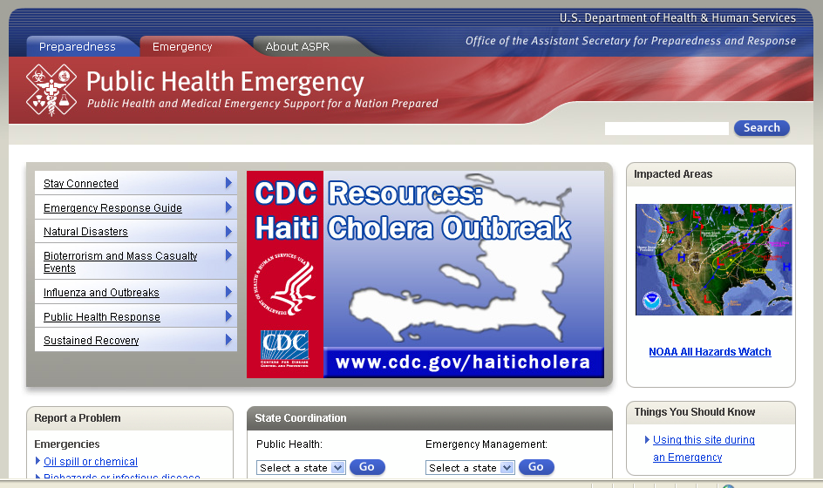
How to use
The HTML code can be copied and pasted into a webpage, blog, or some social network pages

Slide 11

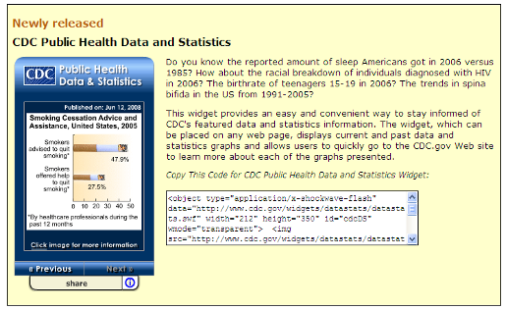
Widgets/Gadgets
Displays featured content directly on personalized home pages, blogs, and other sites
Benefits
  Interactive and fresh content
  No technical maintenance is required

Slide 12
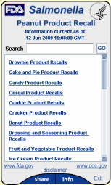
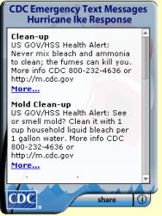
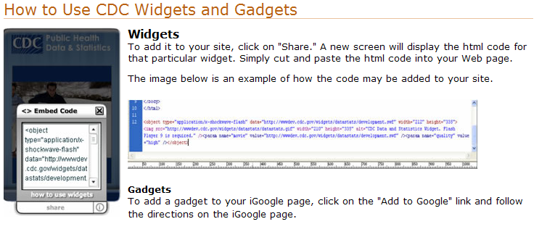
CDC Widgets
CDC’s complete gallery of widgets can be founds at cdc.gov/widgets

Slide 13
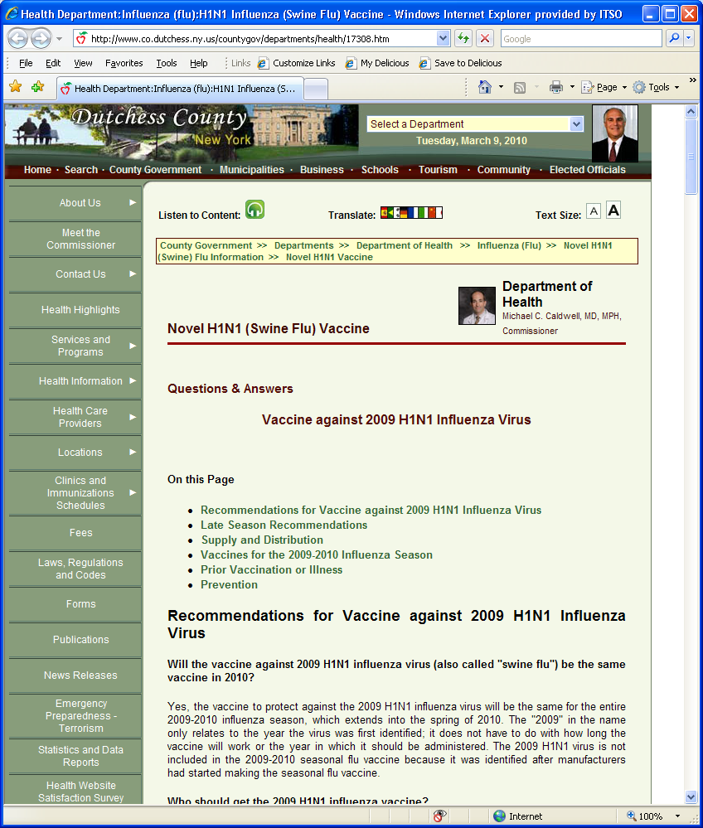
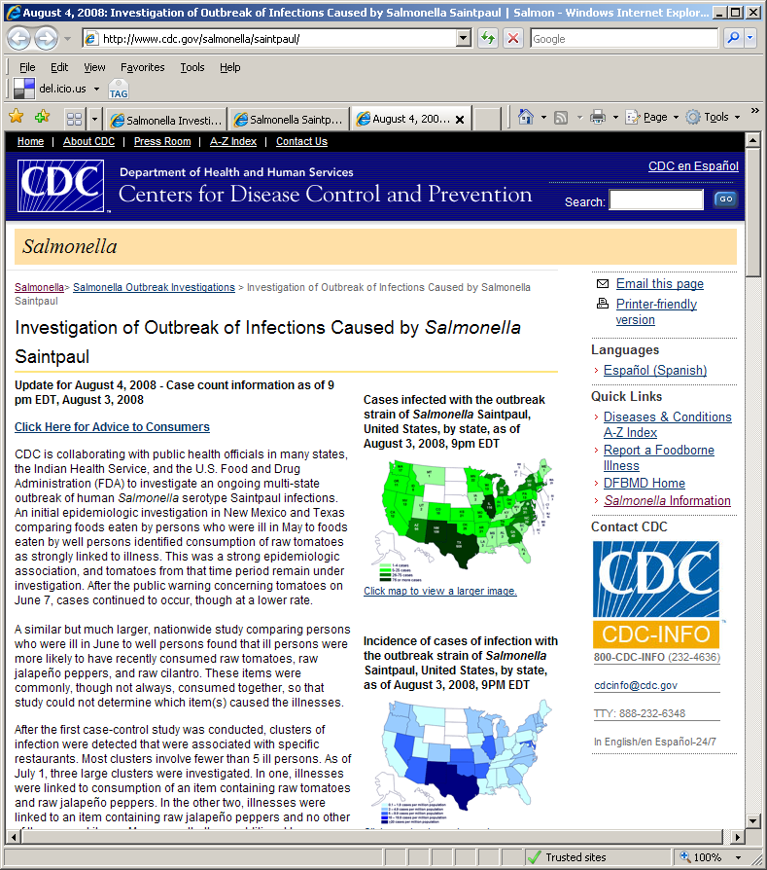
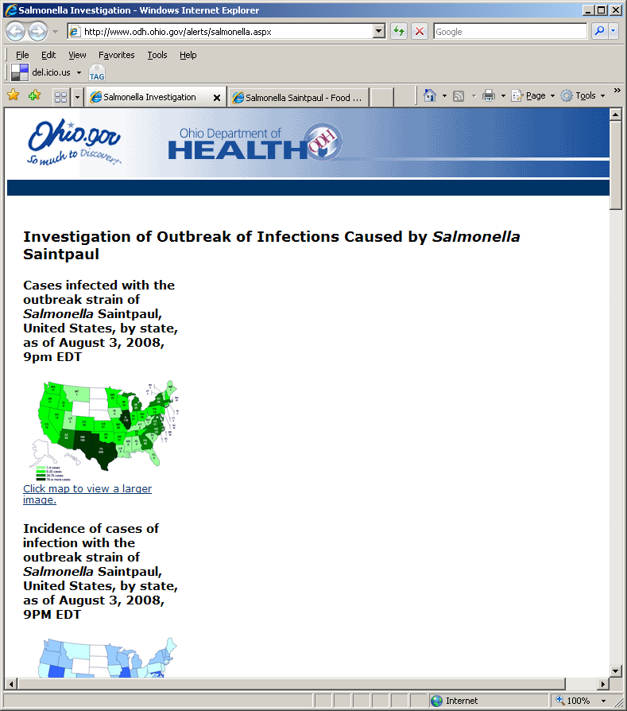
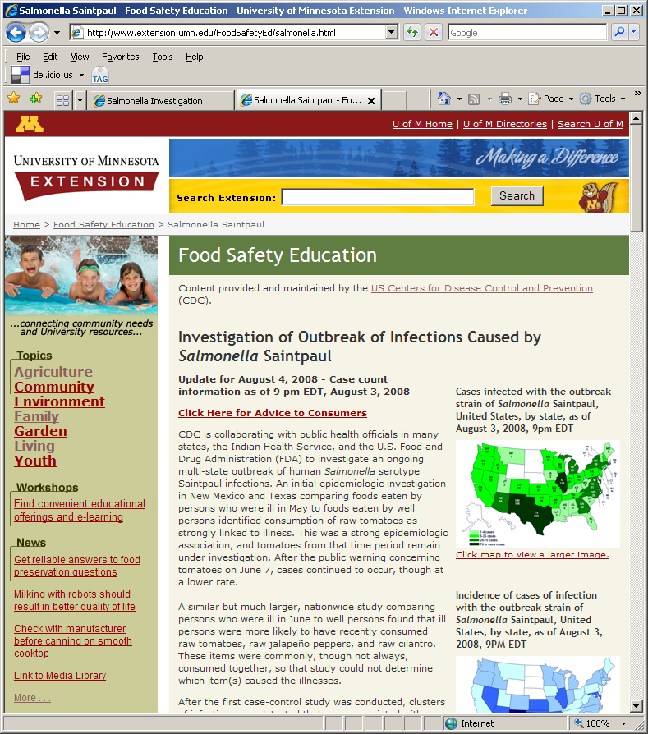
Content Syndication
Application that enables partner organizations to display current CDC health and safety information
Syndicated Content
Partner Web Sites
CDC.gov

Slide 14
Content Syndication Benefits
Top Users
State and Local Health Departments
Federal Agencies
Hospitals
Universities
No cost
Minimal maintenance solution to keep content up-to-date
Easy self registration process
More efficient use of critical resources
Variety of health topics available

Slide 15

Twitter
A real-time information network
Twitter users send updates, or “tweets,” that are 140 characters or less in length, and can follow other users’ posts
High level users:
  Young Adults 18 – 29
  African Americans and Latinos
  Urban residents
Source: Pew Internet & American Life Project, 8% of online Americans use Twitter, Accessed December 15, 2010
http://pewinternet.org/Reports/2010/Twitter-Update-2010/Findings/Overview.aspx

Slide 16

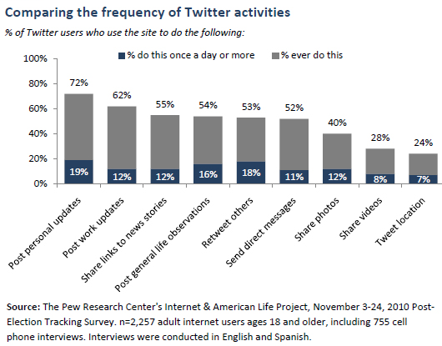
Twitter Activities

Slide 17
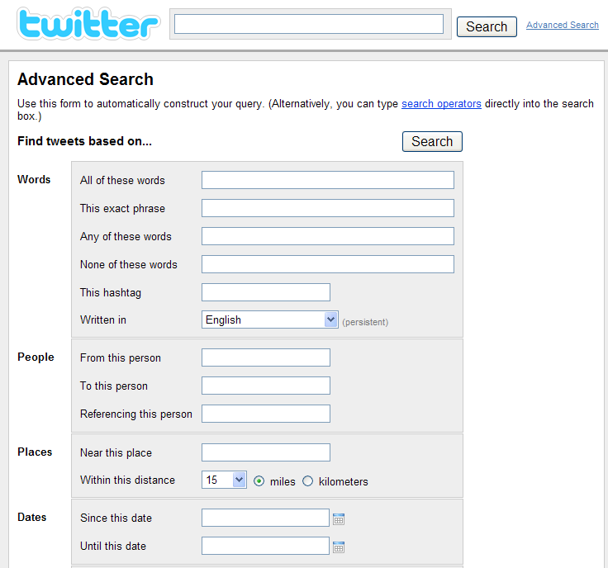
Why Use Twitter?
Immediate communication
Reaches engaged user networks
Fosters collaboration and partnership building
Expand research on the health impact of social media

Slide 18
Recommendations
Establish a posting schedule
Post frequently
Link back to resources for additional information
Promote your profile on both traditional and social media
Post (retweet) relevant content
Evaluate
  Track click-throughs
  Analyze influence
For detailed set-up and best practices information, refer to the CDC Microblog Guidelines and Best Practices on cdc.gov.

Slide 19
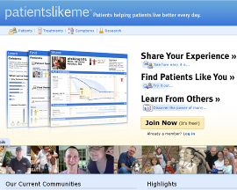



Social networking sites
Online communities where people can interact with friends, family, coworkers, acquaintances and others with similar interests.
Most sites provide multiple ways for their users to interact such as chat, email, video, voice chat, file-sharing, blogging, and discussion groups.

Slide 20
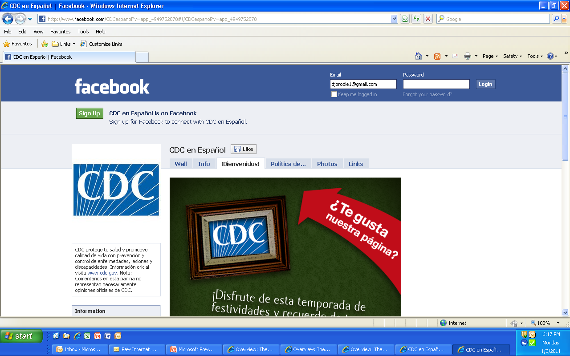
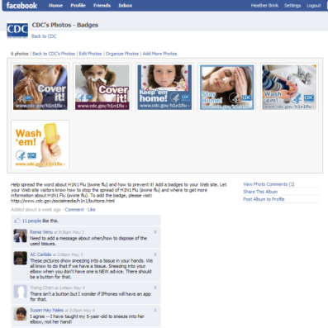
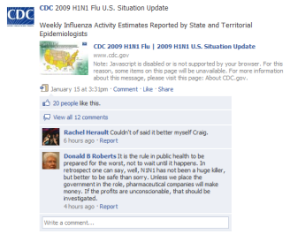
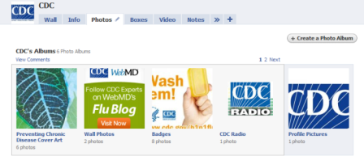
CDC Facebook Page
80,000+ Fans since launch
May 1, 2009

Slide 21
Recommendations
Allocate resources
Develop an posting calendar
Link back to resources for additional information
Promote your page on both traditional and social media
Create content worth sharing
Develop a comment policy

Slide 22

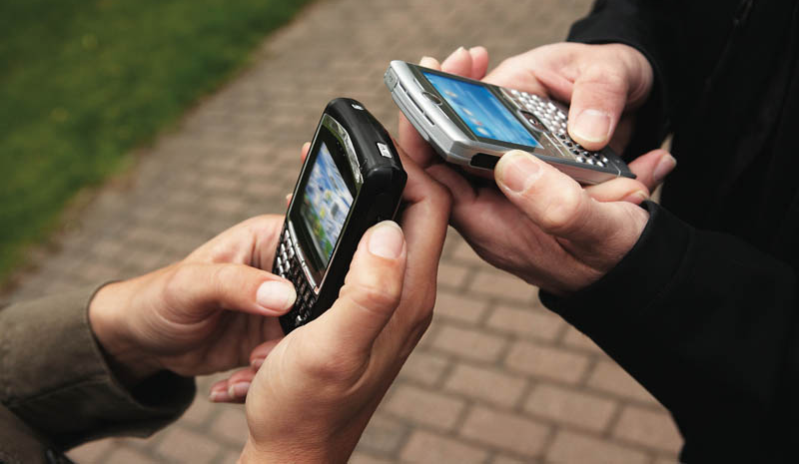
What is mHealth?
mHealth or mobile health is the use of mobile technologies – mobile phones, text messaging services, or applications – to support public health and medicine.
Personal and portable
Notes:
-

Slide 23
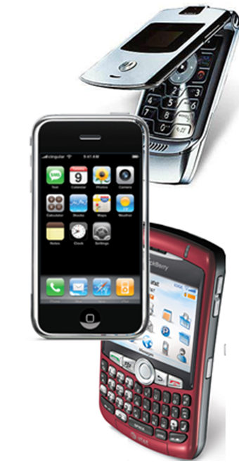
Why is Text Messaging Important?
Mobile usage on rise
  More than 292 million Americans have mobile devices, 93% of the American population ¹
Minorities lead mobile access
  Whites: 80%
  Hispanics: 87%
  African Americans: 87% ²
CTIA Wireless Association. Wireless Quick Facts. CTIA. [Online] October 2010. [Cited: January 2011.] http://www.ctia.org/media/industry_info/index.cfm/AID/10323.
Pew Internet & American Life Project. Mobile Access 2010 [Online] July 7, 2010: [Cited: January 2011] http://pewinternet.org/Reports/2010/Mobile-Access-2010/Summary-of-Findings.aspx

Slide 24

m.cdc.gov
vs.

Slide 25
Social Media Use for Emergency Communication
Consider the following:
Social media is a component of an integrated risk communication plan
  Used to support the existing message
  Message driven, not channel driven
Establish clear objectives and goals
Work collaboratively with partners
Identify resource needs

Slide 26
Resources

Slide 27
Health Communicator’s Social Media Toolkit
Available on CDC website: http://www.cdc.gov/healthcommunication/ToolsTemplates/SocialMediaToolkit_BM.pdf
Provides guidance and lessons learned.
Contents include information on developing communication objectives, overview of social media tools, resource section, and campaign examples.

Slide 28
More Information
Social Media Guidance: http://www.cdc.gov/SocialMedia/Tools/guidelines/
Social Media at CDC: http://www.cdc.gov/SocialMedia/
Metrics Dashboard: http://www.cdc.gov/metrics

Slide 29
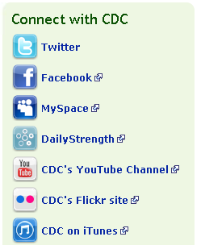
Thank You!
Diane Brodalski
Social Media Specialist
Dbrodalski@cdc.gov
@djdowski
Connect with CDC!
@CDCgov, @CDC_eHealth,
@CDCemergency, @CDCFlu
http://www.facebook.com/CDC
http://www.youtube.com/CDCstreaminghealth
Notes:
33

