Slide 1
Emergency Managers
& Social Networking:
Permission to engage
Nick Alexopulos
Media Relations Specialist
University of Maryland Center for Health & Homeland Security
BRIDGING THE GAPS:
Public Health & Radiation Emergency Preparedness Conference
March 23, 2011

Slide 2
About CHHS
The University of Maryland Center for Health & Homeland Security (CHHS) is a non-profit consulting group and academic center committed to developing plans, policies, and strategies for government, corporate, and institutional clients to ensure the safety of citizens in the event of natural or man-made catastrophes.

Slide 3
Outline
Facts & figures
The conversation
SN when there ISN’T a crisis
Social customer
Content
Interaction
Examples
Influence
The bottom line
Questions

Slide 4
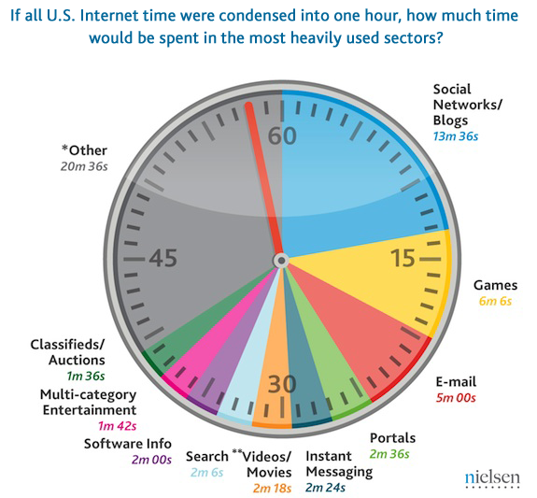
Facts & Figures: Social Media
Notes:
http://blog.nielsen.com/nielsenwire/online_mobile/what-americans-do-online-social-media-and-games-dominate-activity/print/

Slide 5
Facts & Figures: Social Media
8 of 10 U.S. adults have a cell phone
Mobile data traffic
Rise 40-fold by 2015
158 million mobile internet users in 2015
Now: social networking is 60% of mobile internet use
Notes:
Source:
Experian Simmons 2010 American Mobile Consumer Report
http://smrb.com/web/guest/2010-mobile-consumer-report
Coda Research Consultancy
http://techcrunch.com/2010/03/30/mobile-data-traffic-rise-40-fold/
Ground Truth
http://www.mobile-ent.biz/news/36854/60-of-US-mobile-internet-usage-is-social-networking
Portals, like AOL, MSN, Yahoo, only 13%

Slide 6
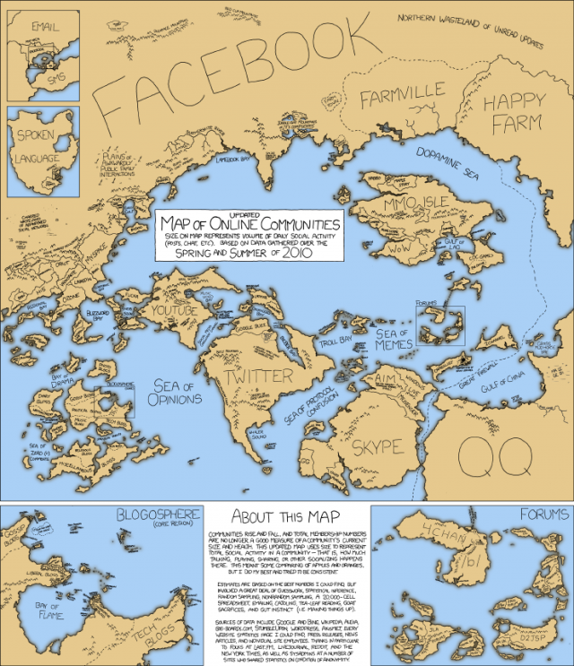
The conversation
Top three ways people share information:
Facebook
Email
Twitter
Notes:
http://socialmediatoday.com/tompick/176932/best-social-media-stats-and-market-research-2010-so-far Facebook is the #1 place where people get information, Twitter is #3 http://blog.hubspot.com/blog/tabid/6307/bid/5965/The-Ultimate-List-300-Social-Media-Statistics.aspx?source=Webbiquity

Slide 7
Social networking …
… when there isn’t an emergency

Slide 8
Social customer
Savvy, filter for relevant information
Wants curated information pushed to them
Expects engagement, interaction
Notes:
Social customer (http://mashable.com/2010/05/21/social-crm/)

Slide 9
Social customer
Bottom line: the social customer owns the relationship
Customers won’t be drawn to you just because you exist
The customer chooses to connect with you
You must engage social customers when they need you, not just when you need them
Zero engagement = severed connection

Slide 10
Social customer
How do you engage the social customer?
Compelling content
Consistent interaction

Slide 11
A doomed plan
“We should be on the Facebook and the Twitter, and maybe even that YouTube-thingy.”
- Misguided communications executive

Slide 12
Compelling Content
Original
Tailored to your audience
Engaging
Provides value
Encourages interaction
Notes:
Source for “Provide value”: http://www.brandopoliscentral.com/2010/04/5-social-media-pitfalls-to-avoid/

Slide 13
Interaction
Crux of social networking popularity
React
Repost
Respond
Social networking doesn’t move at the speed of bureaucracy

Slide 14
Interaction
“Focus on long term engagement, not short term goals.”
Stacy Cohen & Marina Molenda
Co-founders of Vitamin IMC

Slide 15
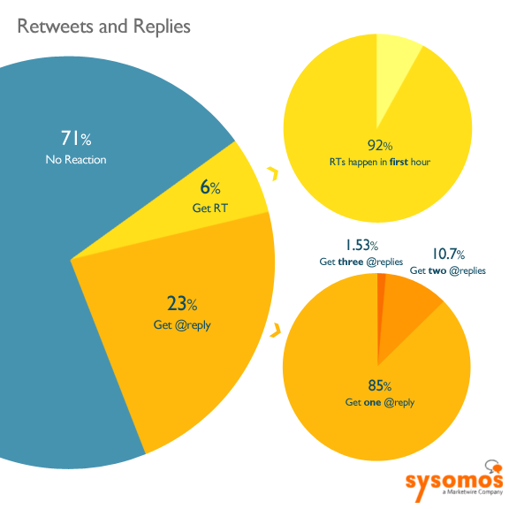
Interaction
Are you in the 71 percent?
Notes:
http://www.sysomos.com/insidetwitter/engagement/

Slide 16
Compelling Content/Interaction
‘How’ brand v. ‘What’ brand
Which describes your agency’s outreach?
“Vivid is more important than valid.”
Dr. Steven Feinberg
Decision Triggers
Notes:
“Our ability to shift perception, our willingness to focus on how we deliver what we deliver, our discipline to package our work and finish in a way that others would happily leave undone is what separates great brands from everyone and everything else.”
- Stephen Denny
The difference between How brands and What brands http://www.stephendenny.com/2010/10/the-difference-between-how-brands-and-what-brands/

Slide 17
CHHS blogs
Month of 7/11-8/11:
Total blogs posted: 9 (viewed 939 times)
Overall site visits: up 39% (1,921)
Blogs in top 10 landing pages: 7
Twitter followers: +20 (inclu. Emergency Mgm’t Mag)

Slide 18
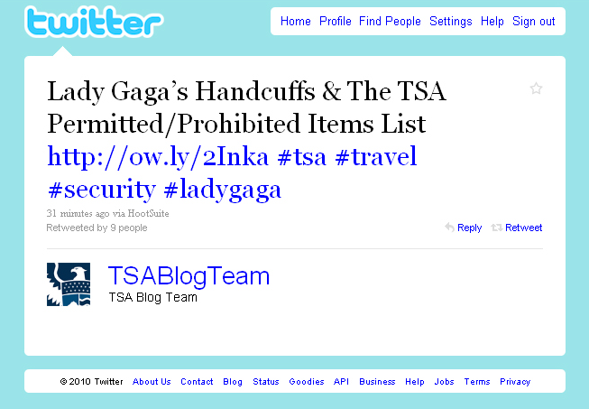
TSA blog

Slide 19
@AR_Emergencies

Slide 20
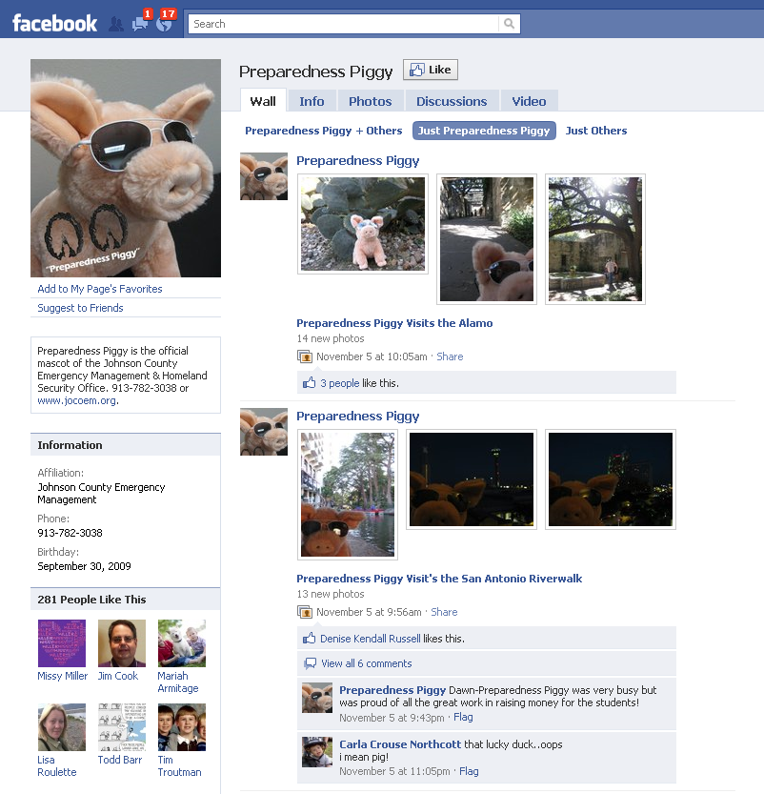
Notes:
http://www.facebook.com/preparednesspiggy#!/preparednesspiggy?v=wall

Slide 21
Influence
Ready Houston
http://www.readyhoustontx.gov/
Know What 2 Do (North Central Texas)
http://www.knowhat2do.com/
Notes:
20 tips for learning your audience http://ht.ly/2XFFd

Slide 22
Influence
Who should your organization connect with online?

Slide 23
Why bother?
“If we don’t practice the routine, how can we expect it to work in an emergency?”
Dr. Richard Gist
Kansas City Fire Dept.

Slide 24
Bottom line for EMs
Make compelling content and consistent interaction part of your routine
Incorporating content-rich social networking into your day-to-day operations is just as important as making it part of your plans, exercises, and emergency response
Practice real interaction
Build up your network
Establish credibility
Get plugged in

Slide 25
Bottom line for EMs
Don’t wait! Interact substantively with the public before a crisis happens
“I have a feeling if we ever get into a serious situation [our number of Twitter followers] will grow. Until we see a real life situation we won’t know what it can do.”
EM in area often threatened by hurricanes
(April 2010)

Slide 26
Bottom line for EMs
Don’t wait! Interact substantively with the public before a crisis happens
Avoid wasting valuable time getting the word out that you’re … getting the word out
Garner more immediate situational awareness
Be ready to flip the switch

Slide 27
Contact information
Nick Alexopulos
P: 410.706.0914
C: 410.845.9419
E: nalex001@umaryland.edu
@MDCHHS
http://facebook.com/mdchhs
http://youtube.com/mdchhs
Notes:
QUESTIONS?

