Slide 1
Radiation Preparedness
Regional Partnerships
National Alliance for Radiation Readiness
William F. Stephens MS,
Manager - Tarrant County Advanced Practice Center
Ft. Worth, TX

Slide 2
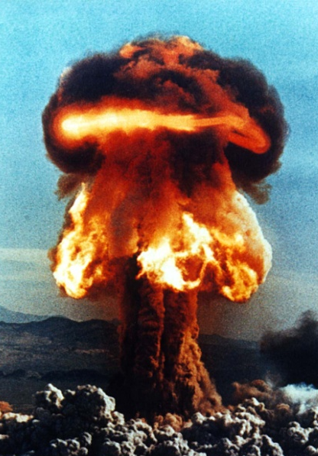
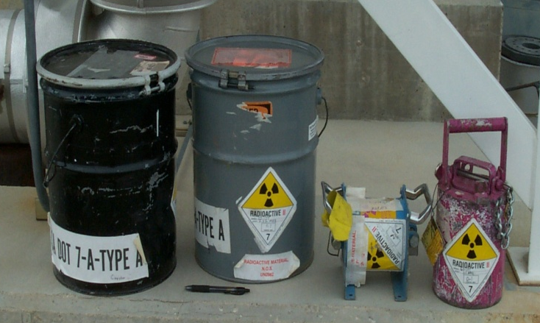
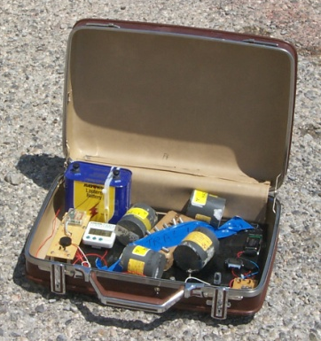
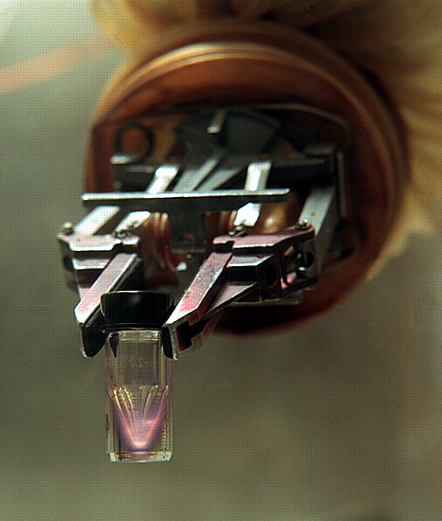
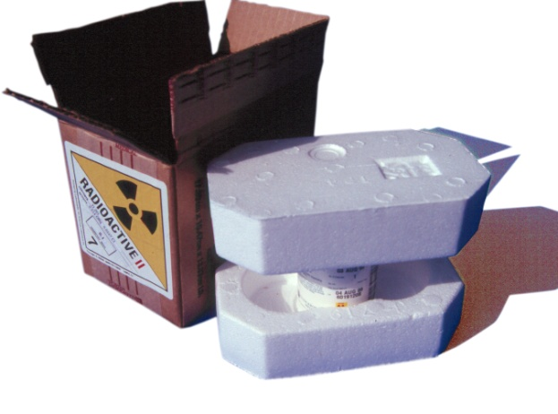
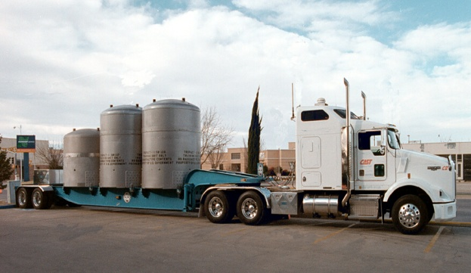
Why are regional partnerships important for radiological-nuclear disasters?

Slide 3
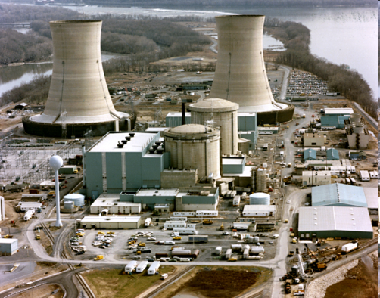

Diversity of Threats
Loss/misuse of radiation sources:
  Medical
  Geophysical
Accident in radiation industry:
  Power plants
  Food processing
  Inspection/testing sources
  Transportation
Terrorism threat:
  Radiological dispersal device (RDD)
  Improvised nuclear device (IND)
  Other intentional radiation exposure or contamination, even in outlying or rural areas

Slide 4
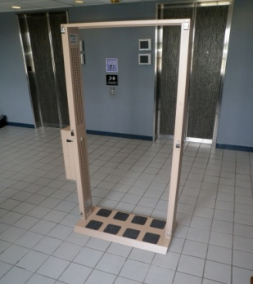
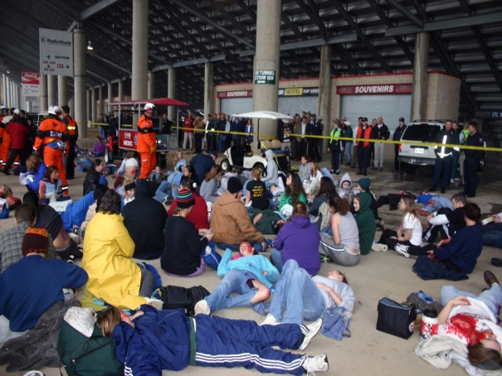
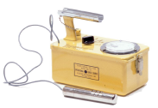
Expanded Resource Base
All-hazards response quickly overwhelms local response staff – mutual aid agreements; ICS, unified command, NIMS
Presence of radiation threats introduces new, often unfamiliar complexity
Radiation response equipment

Slide 5
Expanded Skills and Expertise
Healthcare
  Health physicists
  Radiation medical professionals
  Mental health professionals
Public health
  Epidemiologists
  Population screening, monitoring and tracking
  Long-term health assessment
  Risk communication
EMS, hazmat, mass fatality, law enforcement

Slide 6

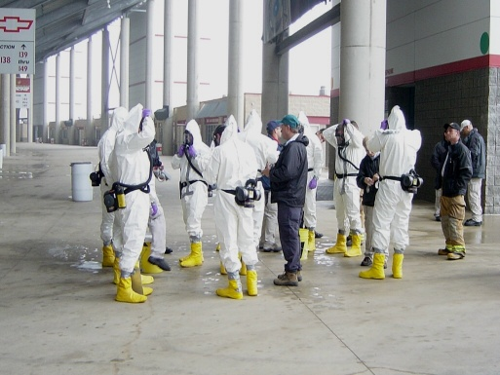
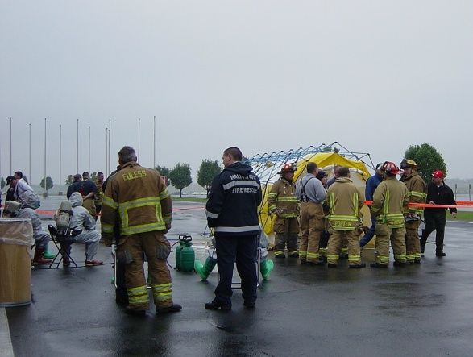
Examples of regional partners for radiological response
Dirty Bomb Exercise, Texas Motor Speedway
  30+ agencies, 5 jurisdictions, 30 hospitals, over 300 responders, 2500 victims, State and Federal partners (EM, Bureau of Radiation Control, CDC, FBI/JTTF)

Slide 7
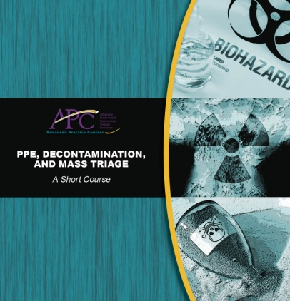
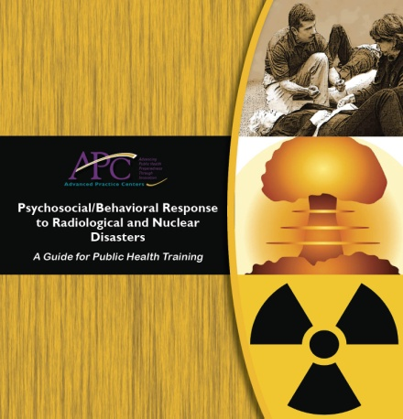
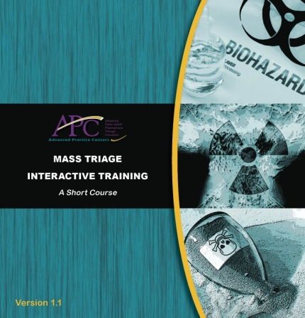
More regional partners for radiological response
Medical and mass care response
  UT Southwestern National Disaster Life Support Foundation (http://www.ndlsf.org/)
    Controller/evaluators for exercise
    Training/development for first receivers

Slide 8
Multi-jurisdiction regional partnerships
North Texas Radiation Response Group
  Formed in 2010
  Primary purpose to coordinate planning, training and equipment sharing for a radiation MCI
  Over 60 members representing 45 agencies and jurisdictions across the DFW 16 county area.

Slide 9
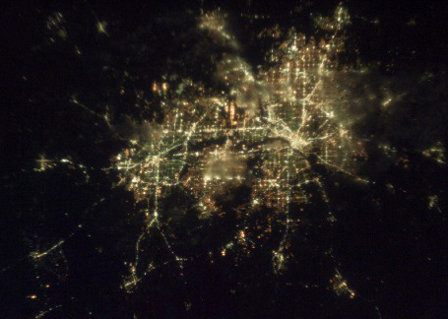
The North Texas Metropolitan Area As Seen from the
International Space Station
6.5+ Million
14,628 sq.mi
12+ Counties
$341+ Billion (2010)

Slide 10
PURPOSE
To BRING TOGETHER:
  Radiation Professionals
  Radiation-Trained Responders
    Fire/HazMat
    Police
  Scene Managers
  Response Planners
  Upper Management

Slide 11
WHY NTRRG
Rarity of Radiation Professionals
Technical Challenge of Radiation Environment
Public Fears and Misconceptions
Increasing Threat Environment
Limited Equipment and Resources
Management Resistance to New…

Slide 12
Meetings
1st: FBI HQ in Dallas: 86 people, 40 Agencies
  DHS, Training, Meet & Greet
2nd: TCPH in Ft. Worth: 65 People, 42 Agencies
  FBI, Training, Portal Monitors
3rd: NCTCOG in Arlington (Prior to SB XLV)
  65 People, 45 Agencies
  SWCAPC, Training, SB XLV prep

Slide 13
Questions ?
Bill Stephens
Manager – Tarrant County APC
Fort Worth, TX
wfstephens@tarrantcountytx.gov
817.321-4730
For more public health radiological preparedness tools go to: http://apc.naccho.org

