Slide 1
The National Alliance for Radiation Readiness (NARR)
Adela Salame-Alfie, Ph.D.
New York State Department of Health
Conference of Radiation Control Program Directors

Slide 2
Over the last two days:
We’ve set the stage…
We talked about current capacity and gaps…
Now, how do we bring it all together?

Slide 3
The National Alliance for Radiation Readiness (NARR)
Genesis
Key Concerns
Partners
Roundtable
Follow-up Workshop
Alliance Steering Committee
Path Forward

Slide 4
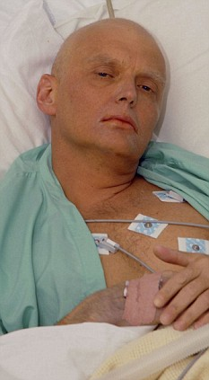
Genesis
The Polonium-210 Russian Spy poisoning incident in London in 2006.
International impact.
Recognition by the Centers for Disease Control and Prevention (CDC) of an opportunity to better prepare the nation for a public health threat involving nuclear/radiological incidents.
4

Slide 5
Key Issues
Identifying impacted U.S. travelers was challenging
State/local health departments not always aware of state/local radiation control agencies with responsibility for their jurisdictions
5

Slide 6
Response to this event highlighted the need to:
  Increase awareness of mutual responsibilities for preparing and responding to radiological incidents;
  Strengthen communication and working relationships among participating organizations;
  Share information on available resources; and
  Increase awareness of emerging roles and responsibilities regarding radiological events.

Slide 7

So how can we do that?
Well, one step at a time…

Slide 8
June 2008 CDC-CRCPD Sponsored the “Roundtable on Communication and Teamwork: Keys to Successful Radiological Emergency Response.”
April 2009 CDC-CRCPD Sponsored a follow-up Workshop “Alliance to Expand Radiological Emergency Preparedness in Public Health.”
May 2009 the first Steering Committee Meeting took place during the CRCPD Annual Meeting.
June 2009-May 2010 – An exploratory committee concluded that a National Alliance for Radiation Readiness was a necessary and viable undertaking.
The committee drafted a mission, vision, purpose, structure, governance, business and communications/marketing plans.

Slide 9

NAAR
Partners
Association of State and Territorial Health Officials (ASTHO)
Centers for Disease Control and Prevention (CDC)
Conference of Radiation Control Program Directors (CRCPD)
Council of State and Territorial Epidemiologists (CSTE)
National Association of County and City Health Officials (NACCHO)

Slide 10
Roundtable Participants
Over 30 experts in the broad fields of:
  Health physics,
  Hospital preparedness,
  Epidemiology,
  Public health preparedness,
  Risk communication,
  Psychology and
  Emergency medicine.
Representing federal agencies, state and local agencies, and professional organizations.
10

Slide 11
Roundtable Outcome
Identified:
  Gaps, capabilities and strategies to our mutual ability to respond to a radiological emergency.
  Need to coordinate and build relationships among participating agencies.
  Need for consistent radiological capabilities.
  Need for Multi-agency training and exercising, and
  Need for funding specifically allocated for radiological emergency preparedness.
11

Slide 12
Suggested Initiatives
Follow-up expanded roundtable, to include more medical and public health organizations, first receivers (EMTs, hospital staff).
Form an alliance of the partner organizations that participated in roundtable.
Create tools to raise awareness of local health agencies to their broader role in radiation and other emergencies.
Incorporate population monitoring in grants and other funding opportunities.
Tabletop exercises that focus on recovery, not just response.
12

Slide 13
Proposed Path Forward
13
Develop alliance of various organizations with shared objective of expanding radiological emergency preparedness capabilities nationwide.
Work within alliance to elevate recognition of the roles and responsibilities of public health agencies in a radiological emergency.

Slide 14
Action Plan
    Develop a plan that identifies actionable objectives (specific, measurable, achievable, relevant and timely) and provides a mechanism for monitoring progress, to enable the alliance partners to realize their central goal:
    To expand radiological preparedness in public health agencies, nationwide.
14

Slide 15
NARR Vision
To become a more protected, resilient nation through a comprehensive and integrated approach to radiological emergencies.
15

Slide 16
NARR Mission
Enhance radiological preparedness capability and capacity in public health and health care systems through a coalition of organizations committed to improving the nation’s ability to prepare, respond, and recover from radiological emergencies at the local, state, and national levels.
16

Slide 17
NARR Purpose
To build radiological emergency preparedness, response and recovery capacity and capabilities by supporting the:
  Development of mechanisms for sharing resources and tools, including technical methods and information.
  Identification and dissemination of best practices.
  Definition of and education on the roles and responsibilities of different levels of government and different governmental agencies in radiological emergencies.
  Establishment of performance measures and guidelines.
  Building and sustaining of long-term competencies.
17

Slide 18
NARR Purpose
To serve as the collective “voice of health” in radiological preparedness through the:
  Participation in national dialogues on radiological emergency issues.
  Provision of thoughtful feedback on documents, policies, and guidelines.
  Convening of partners to raise awareness of and resolve radiological emergency issues.
18

Slide 19
Charter Membership of Exploratory Committee
Association of Public Health Laboratories (APHL)
Association of State and Territorial Health Officials (ASTHO)
Conference of Radiation Control Program Directors (CRCPD)
Council of State and Territorial Epidemiologists (CSTE)
National Association of County and City Health Officials (NACCHO)
19

Slide 20

Current Governance & Leadership
For the 2010-2012 period, a steering committee will oversee the establishment of the NARR and the development of products and services.
The NARR Steering Committee:
Charter member organizations
American Medical Association (AMA)
National Emergency Management Association (NEMA)
The Steering Committee is governed by three chairpersons:
John Erickson, Washington State Department of Health (ASTHO)
Adela Salame-Alfie, Ph.D., New York State Department of Health (CRCPD)
William Stephens, Tarrant County Public Health, Texas (NACCHO)
20

Slide 21
Current NARR Administration
21
Administered by ASTHO.
Funding from:
CDC and Prevention, National Center for Environmental Health, Radiation Studies Branch.

Slide 22
New NARR Membership
The following organizations have been invited to participate in the Alliance:
Association of Schools of Public Health.
Environmental Council of States.
National Association of State Mental Health Program Directors.
National Governors Association Center for Best Practices.
National Voluntary Organizations Active in Disasters.
National Environmental Health Association.
  American Association of Poison Control Center.
  American Hospital Association.
  Health Physics Society.
  National Association of Counties.
  National Disaster Life Support Foundation.
  National Association of State Department of Agriculture.
  National Association of State EMS Officials.
The following organizations have accepted invitation:
  American Public Health Association.
22

Slide 23
2009-2010 Activities
CSTE follow-up assessment to 2004 report, “A National Assessment of the Status of Planning for Public Health Preparedness for Chemical and Radiological Contaminating Terrorism.”
Reviewed & commented on:
  Project Public Health Ready criteria.
  “Public Health Response to Radiological Accidents: A Guide for State and Local Public Health Departments,” a CDC-developed planning guide.
  Capabilities for the CDC 2011-2016 Public Health Emergency Preparedness Cooperative Agreement.
  FEMA’s “Nuclear Detonation Preparedness: Communicating in the Immediate Aftermath.”
23

Slide 24
2011 Activities
24
Development of:
  Population monitoring tool kit.
  Disaster epidemiology tracking tools.
  Model radiological preparedness plan.
  Online clearinghouse to disseminate and evaluate tools.

Slide 25
NARR Kick-off Meeting
March 24-25 - immediately following the “Bridging the Gaps: Public Health and Radiation Emergency Preparedness Conference”

Slide 26


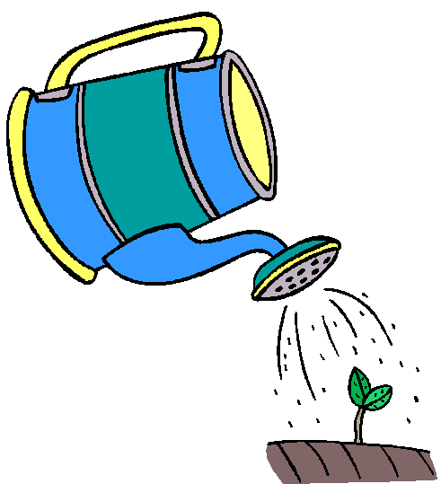
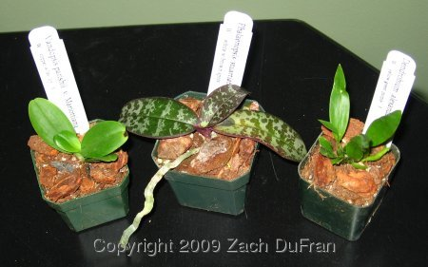

Started with the Roundtable – June 2008
“Official Launch” - March 2011
Continued with the Workshop – April 2009
Kick-off Steering Committee – May 2009
26

Slide 27
The Roundtable, Workshop and Action Plan were documented in a Report published by CRCPD and CDC
Available at http://www.crcpd.org
27

Slide 28
“It’s not what you know…it’s who you know.”

Slide 29
Questions
Questions
Questions

