Slide 1
State and Local Partnerships: Promoting the Use of Volunteer Radiation Professionals in Emergency Response Planning National Alliance for Radiation Readiness
Ruth E. McBurney, CHP
Executive Director
Conference of Radiation Control Program Directors

Slide 2
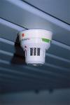
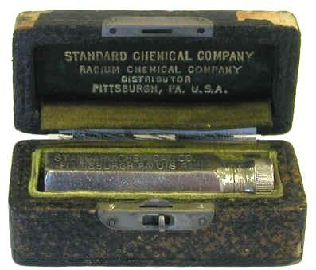
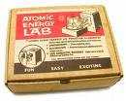
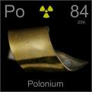
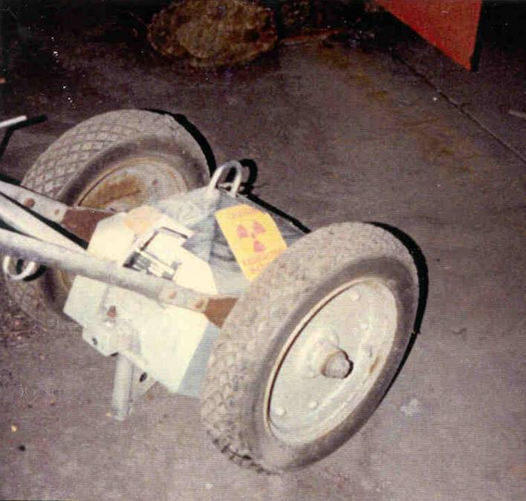
Radioactive Sources
157,000 licensed users in U.S.
2,000,000 devices containing
radioactive sources
Approximately 400 sources
lost or stolen in U.S. every
year

Slide 3
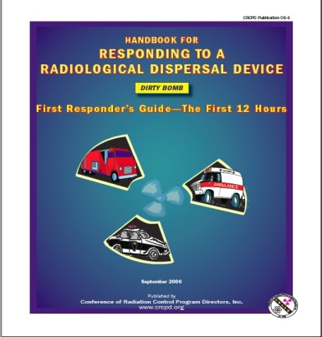
National Planning Scenario 11: Radiological Attack – Radiological Dispersal Devices
Casualties | 180 fatalities; 270 injuries; 20,000+ with detectable contamination (at each site)
Infrastructure Damage | Near the explosion
Evacuations/Displaced Persons | Yes
Contamination | 36 city blocks (at each site)
Economic Impact | Up to billions of dollars
Potential for Multiple Incidents | Yes
Recovery Timeline | Months to years

Slide 4
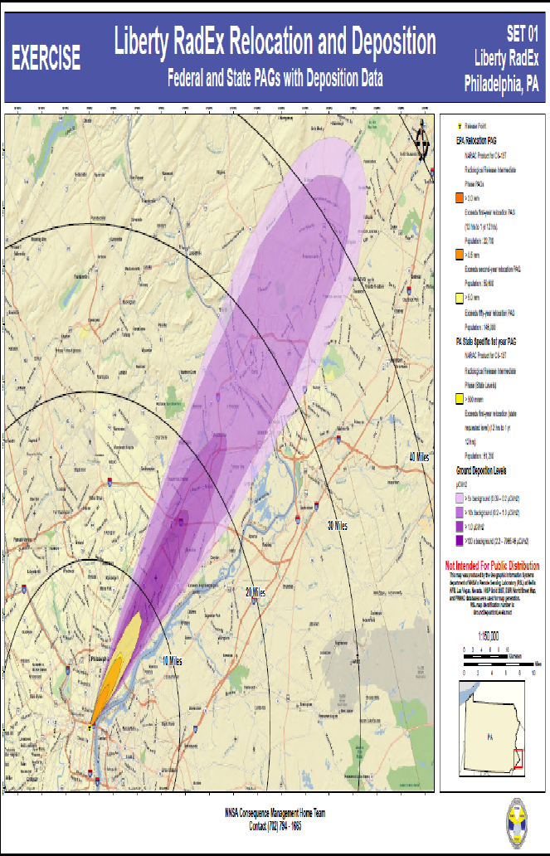
In total, the wind deposited significant radiation almost 50 miles through residential, commercial and industrial areas of Philadelphia and suburban and rural areas of Bucks County and New Jersey impacting major roadways, mass transit, hospitals, schools, and businesses.”
Notes:
In total, the wind deposited significant radiation almost 50 miles through residential,
commercial and industrial areas of Philadelphia and suburban and rural areas of Bucks County and
new Jersey impacting major roadways, mass transit, hospitals, schools, and businesses.”

Slide 5
Goiânia Morbidity
249 exposed; 54 hospitalized
Eight with radiation sickness
Four people died
112,000 people monitored (>10% of total population)—this took weeks to do
Photos courtesy of the International Atomic Energy Agency (IAEA)

Slide 6
Where Can a Radiological Event Occur?
May occur in a city without state resources
States without nuclear power plants have less expertise in emergency planning and response
Most state radiation control programs are located in capital cities, although some have regional staff as well
Host cities for displaced citizens with contamination

Slide 7
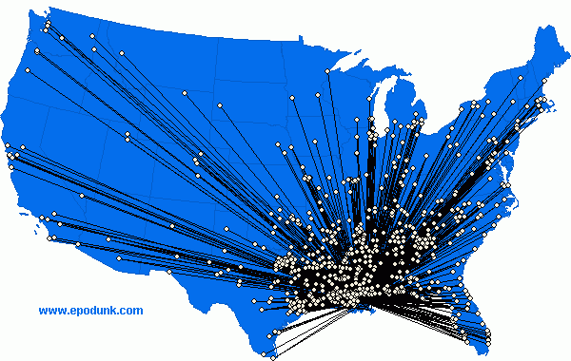
Local Response Considerations
Many communities around the country impacted
Millions potentially displaced, seeking assistance
Burden on local /state response authorities
Federal assistance may take time to arrive and may not be available to many
communities
Notes:
potentially millions of displaced population will seek assistance to address their health and medical needs, screen them for radioactive contamination, and provide them with adequate shelters and assistance for relocation.
Local and state authorities will need to address the needs of their own citizens as well as those of the displaced population.

Slide 8
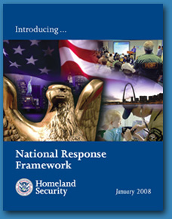
National Response Framework Nuclear/Radiological Incident Annex
Decontamination/Population Monitoring are:
“the responsibility of State, local, and tribal governments.”
http://www.fema.gov/emergency/nrf/
Notes:
YoYo-72 or longer

Slide 9
Radiation Professionals
Potential pool of tens of thousands who can volunteer in their local communities.
After a radiation emergency, many are likely to volunteer.
Spontaneous Unaffiliated Volunteers (SUVs)
We need trained affiliated volunteers
Notes:
American Society of Radiologic Technologists; American Registry of Radiologic Technologists (300,000).

Slide 10
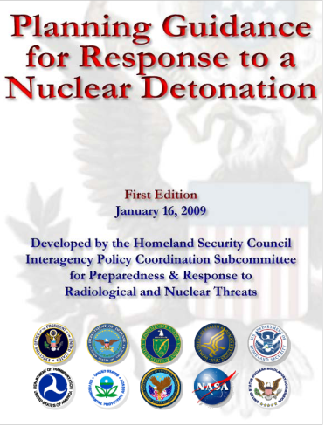
Call for Radiation Response Volunteers
“Planners should identify radiation protection professionals in their community and encourage them to volunteer and register in any one of the Citizen Corps or similar programs in their community.”
Chapter 5
http://www.afrri.usuhs.mil/outreach/pdf/planning-guidance.pdf

Slide 11
Volunteers in the Medical Reserve Corps
Notes:
Mention H1N1 clinics
11

Slide 12
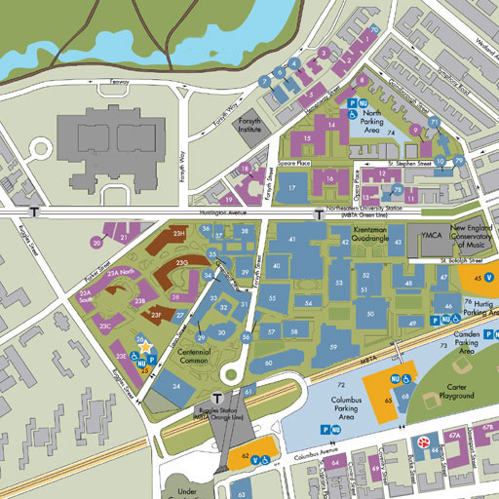
Medical Reserve Corps – Radiation Response Volunteers
State boundary
MRC coverage area
Radiation Volunteers
General/Public Health/Medical Volunteers
State Volunteer Registry
Radiation
Control
Program
MRC 2
MRC 3
MRC 4
MRC 1
Notes:
12

Slide 13
What is CRCPD?
The Conference of Radiation Control Program Directors is a national non-governmental nonprofit organization dedicated to radiation protection.
CRCPD’s membership is made up of directors and staff of state and local radiation control programs plus others interested in radiation protection issues.
CRCPD's mission is "to promote consistency in addressing and resolving radiation protection issues, to encourage high standards of quality in radiation protection programs, and to provide leadership in radiation safety and education."

Slide 14
What is CRCPD Doing to Address this Issue?
Developing a process for recruiting, managing and training volunteer radiation professionals
Promoting a volunteer registry of radiation professionals within existing registries and/or programs (e.g., Medical Reserve Corps)
Developing a publishable plan for effective deployment and use of volunteer radiation professionals that will align with existing radiation response plans and/or volunteer management plans
Developing a sustainable action plan for continued and expanded use of the program

Slide 15
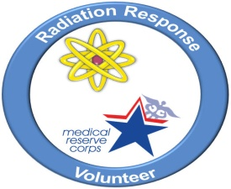
CRCPD, MRC, and CDC Partnership
Jan 2010: proposals accepted from six states and one metro area to recruit, train, and incorporate radiation professionals into their volunteer registries.
Feb-Mar 2011: Final reports from sub-contracting radiation control agencies accepted and CRCPD submitted final project report to CDC.
Funds also made available for interested local non-profits (e.g., local chapters of HPS, ANS, SNM)
Florida
Kansas
Mississippi
New York City
North Carolina
Ohio
Oregon

Slide 16
What did the state/local agencies do?
Incorporated radiation professionals into existing volunteer registries and/or programs
Oriented volunteer radiation professionals to the emergency response activities and requirements within existing volunteer response organizations
Promoted a volunteer registry of radiation professionals within existing registries and/or programs, such as:
regional/state/local HPS chapters; AAPM, SNM, ASTRO, NRRTP, ANS, CRCPD, etc.
Provided outreach to other radiation protection professionals in their state

Slide 17
Specialized Training through Workshops and Web Resources
National Response Framework, Nuclear/Radiological Incident Annex
Population monitoring of large groups of people
Walk-through monitors
Hot-line techniques
Effective communication to the public on monitoring results and remedial actions

Slide 18
Significant Accomplishments
Awareness of need to develop a system for population monitoring
Identified professionals and individuals with the existing skills to provide such services
Identified various methodologies for mobilization of volunteers
Conducted training of volunteers for to assist with population monitoring and shelter needs

Slide 19
Significant Accomplishments
Established a collection of training material and programs
Initiated a process to register trained volunteers who could be called upon to respond in a national radiological emergency
Performed outreach to radiation professional societies

Slide 20
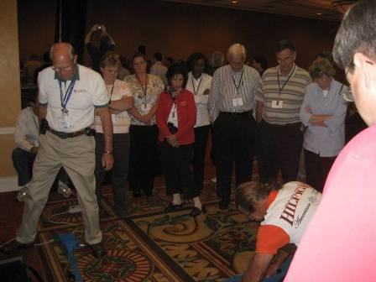
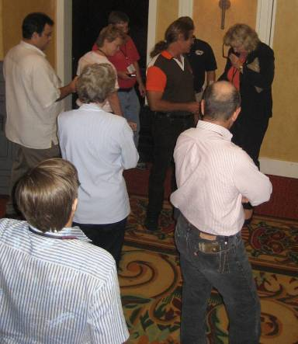
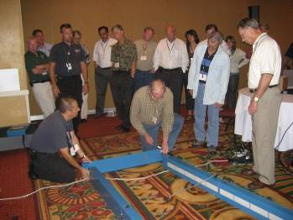
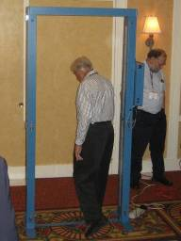
Training Session

Slide 21
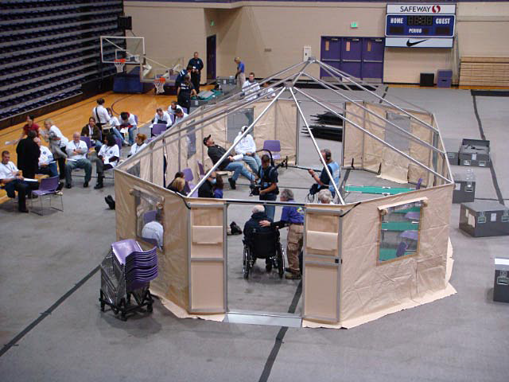
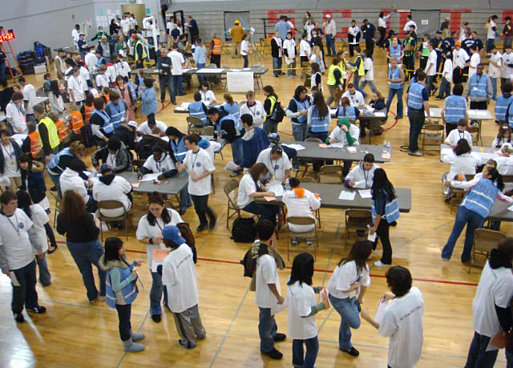
Exercising “Population Monitoring” at Community Reception Center
Population monitoring during a radiological exercise

Slide 22
Future Activities
Outreach and training to national organizations and their committees on preparedness and response
Outreach on the capabilities of radiation volunteers to emergency response organizations
Visibility of the need for mobilization of radiation professionals

Slide 23
Conclusion
CRCPD, in coordination with CDC and individual radiation control programs, has initiated a state and local partnership to incorporate the use of radiation volunteers.
Through the pilot project in several states, accomplishments and shared ideas have made the program expandable nationally.
Trained radiation volunteers can be used to supplement state and local resources in a major radiological emergency.

