Slide 1
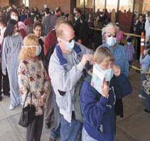
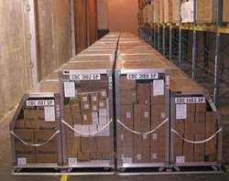
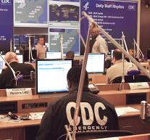
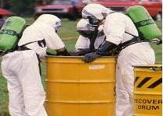
CDC’s Office of Public Health
Preparedness and Response
RADM Ali S. Khan, MD, MPH
Director, Office of Public Health Preparedness and Response
Bridging the Gaps: Public Health and Radiation Emergency Preparedness
March 22, 2011
Centers for Disease Control and Prevention
Office of Public Health Preparedness and Response

Slide 2
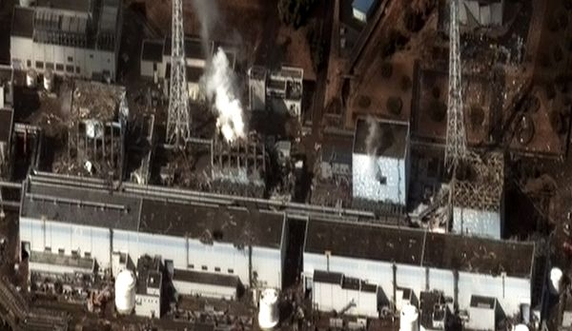
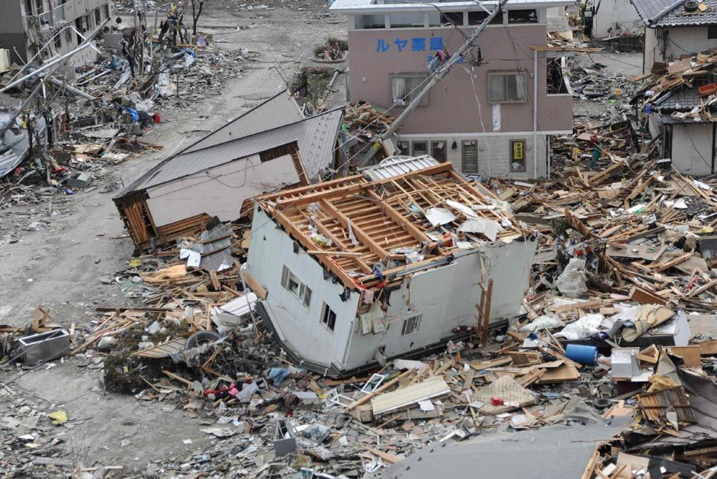
Japan Disasters: March 11, 2011
9.0 magnitude earthquake
Tsunami
Nuclear power plant damage and radiation release

Slide 3

CDC Response to Japan Disasters
CDC Emergency Operations Center activated
3 persons deployed by CDC
Travel health precaution posted on CDC website
Notes:
2 persons deployed to Japan and 1 to the Nuclear Regulatory Commission
CDC continues to closely monitor the effects of this disaster and is focused on making sure it is ready to support any requests that come in from Japanese colleagues related to public health.

Slide 4
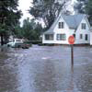
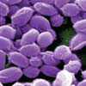

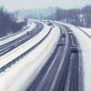
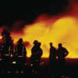
Public Health Preparedness is Dynamic
Not just major events
What we do every day
Public health threats always present

Slide 5
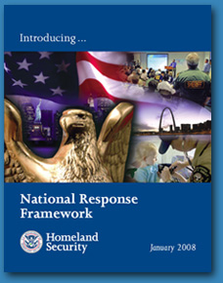
The National Response Framework
and CDC’s Role
The Department of Homeland Security has overall authority for emergency response activities as laid out in the National Response Framework (NRF)
The Department of Health and Human Services under the NRF has responsibility for public health and medical services (Emergency Support Function 8)
The Centers for Disease Control and Prevention executes public health response activities

Slide 6
CDC’s Office of Public Health Preparedness and Response
Strategy and Policy
Establishes strategy and policies to support federal, state, and local preparedness
Funding
Manages and monitors Preparedness and Emergency Response funding appropriated each year by Congress of approximately $1.5 billion to
support CDC and state and local activities
Operations
Manages key operational and regulatory public health preparedness programs

Slide 7
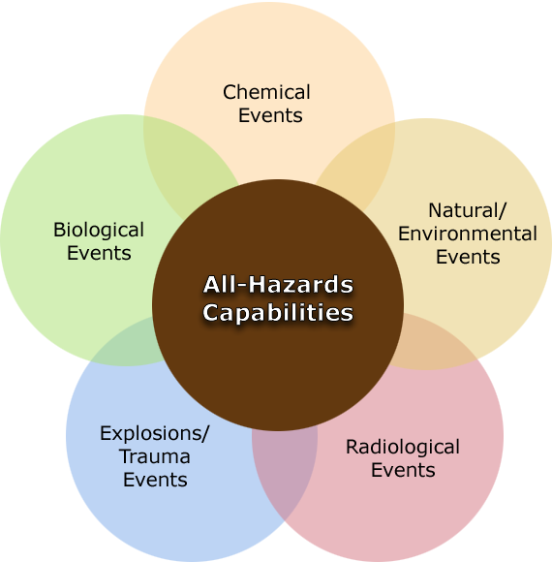
CDC Supports All Hazards Preparedness
Notes:
The all-hazards approach allows federal, state, and local partners to maximize the limited resources available for preparedness and response programs. It responds to the widest range of anticipated and unanticipated threats.
PHEP provides funding to states and localities for all hazards planning and testing.

Slide 8
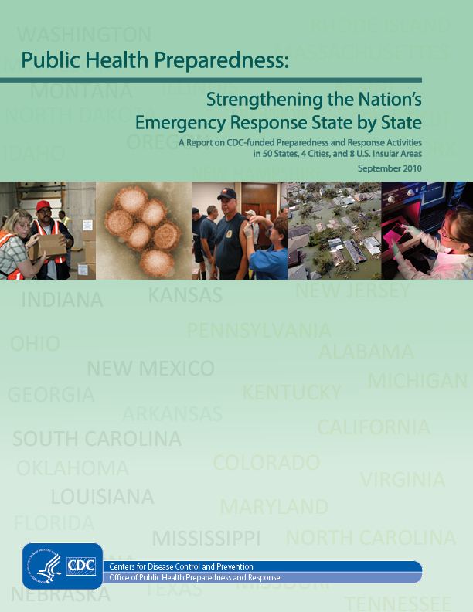
Much Progress Made –
But Much More to be Done

Slide 9
2010 CSTE Assessment of State-level Radiation Emergency Preparedness
Conclusion: In nearly every measure of public health capacity and capability, the nation is poorly prepared to respond to a major radiation event.
Average subjective preparedness score for a radiation emergency was 4.54 on a scale of 1 to 10.
Notes:
Council of State and Territorial Epidemiologists assessment
2010 CSTE assessment loosely based on 2003 survey and designed to assess the nation’s overall preparedness and response capabilities regarding radiation emergencies
38 states responded (76%)
Although not directly comparable, results for the 2010 assessment show that states seem to have the same or lower level of preparedness than when measured in 2003

Slide 10
Recommendations from the CSTE Survey
Explore with CDC how to incorporate radiation preparedness as a priority in all hazards capabilities development.
Promote strategic planning between state public health emergency preparedness and traditional radiation personnel to increase collaboration.
Notes:
This conference is designed to begin moving us together towards these and other ways to address the gaps that have been identified.

Slide 11
HHS Office of Inspector General Study
Radiological and Nuclear Preparedness: Assessing Selected State and Local Public Health Emergency Response Plans
Survey will determine the extent to which selected States and/or localities have developed and exercised radiological and nuclear public health emergency response plans.
Notes:
Some of you have already been contacted and asked to participate in this survey, and we look forward to the results of this study.

Slide 12
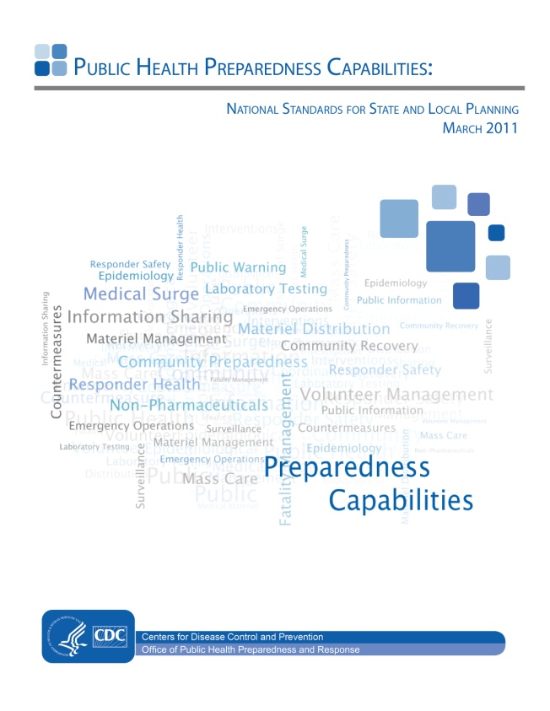
Challenges & Opportunities
Economy
Reauthorization of Pandemic and All Hazards Preparedness Act (2006)
Leverage funds from the Departments of Homeland Security and Defense
2011 National Standards for State and Local Planning
Notes:
PAHPA
Little to no language specific to radiologic/nuclear preparedness
DHS/DoD
Dr. Frieden is very interested in radiological preparedness and has held high level discussions with DHS Office of Science and Technology on possibly leveraging DHS funds to further develop this capacity. CDC also engaged in similar conversations with DoD.
New PHEP capabilities
PHPR’s Division of State and Local Readiness will include radiation/nuclear capabilities in the new cooperative agreement for states

Slide 13
CDC Focuses on Public Health Strengths
Laboratory and epidemiological detection and characterization of events
Clinical and self-help guidance
Countermeasures for medical and population response (where appropriate)
Linkage across the health system from the local to state, national, and even international levels
Notes:
Public health is just a part of the response for a radiologic event. We have many partners. Our focus in preparedness for a radiologic event is on our public health strengths (per above slide). All of these functions are dependent on a robust public health workforce.
Talking points on linkage across the health system (4th bullet in slide)
Whereas there is no national health system for medical care today, the public health system allows us to reach across the federal to state to local levels to ensure that the health system response is integrated with the broader national response. The Incident Command system provides a powerful structure for us to strengthen the linkage within the health system and across the three levels.
Wrap-up of CDC’s approach to preparedness:
By leveraging the all hazards public health infrastructure and focusing on strengths that public health brings to response, the resources available for public health preparedness and response will more readily flow toward the gaps that get identified.
With radiation disaster preparedness, public health plays a role as the caretakers of the public’s health. While we will continue to fight for the attention and resources needed to develop a deeper capacity and capability for this preparedness, the challenge of resources will mostly be addressed by our ability to collaborate.
State radiation programs are often not well integrated with state public health offices. To minimize these gaps, the federal government must enhance collaboration with state public health offices and ensure that the integration of these radiologic preparedness programs with other preparedness activities is effective.
It’s important to recognize that we’re not prepared to fully respond to this type of disaster. We will be figuring it out as we go, and incrementally increasing the capacity.

Slide 14
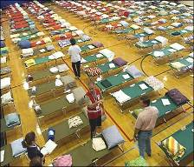
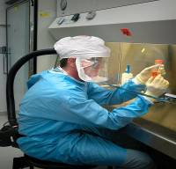
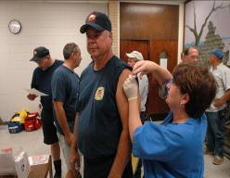

Thank You
Centers for Disease Control and Prevention
Office of Public Health Preparedness and Response

