Slide 1
Public Health Operations & Capabilities Los Angeles County
Kathleen Kaufman
Former Director, LA County Radiation Management

Slide 2
LA County Perspective
LA County is big- 10 million people, the largest population of any county in the nation.
Approximately 28 percent of California's residents live in Los Angeles County.
The County’s coastline is 81 miles long
It is 4,084 square miles, an area some 800 square miles larger than the combined area of Delaware and Rhode Island
There are 88 cities within the County, each with its own city council & mayor, & many with their own police &/or fire departments

Slide 3
Applicability
So many of our challenges are similar to both what locals confront, and to those that states confront.
And, many of our actions can be used by local, state, & federal agencies

Slide 4
Major Exercises
In 2004 we participated in three large exercises
Operation Synergy
Department of Energy Exercise
Determined Promise 04
Asymmetric Warfare Initiative Exercise
Operation Talavera
Los Angeles County Exercise

Slide 5
Issue/“Footprinting” a Plume
During our exercises, we used our radio system to try and “footprint” a plume
Staff drove around with meters, and called a central location with the results
The central location & the radio system was immediately overwhelmed
They had to mark the location of the reading on a map, with the measurements
Staff was frustrated because they couldn’t get through
Non-radiation staff’s measurements weren’t always correct

Slide 6
Response Issues
None of the agencies’ response actions were well integrated with each other.
We knew what we (Radiation Management) wanted to do, but we didn’t know what other agencies were doing! And they didn’t know what we were doing.
It was clear this wasn’t going to be effective

Slide 7
Issue/Population Monitoring
Population monitoring could stress existing systems, particularly relative to having subject matter experts available
Radiation volunteers will be helpful, but they can’t make decisions re what areas need evacuation
We could exponentially increase our capabilities if the data could be reviewed remotely, & include multiple jurisdictions’ and agencies’ measurements
We knew a “telemetry” system could solve many of these problems

Slide 8
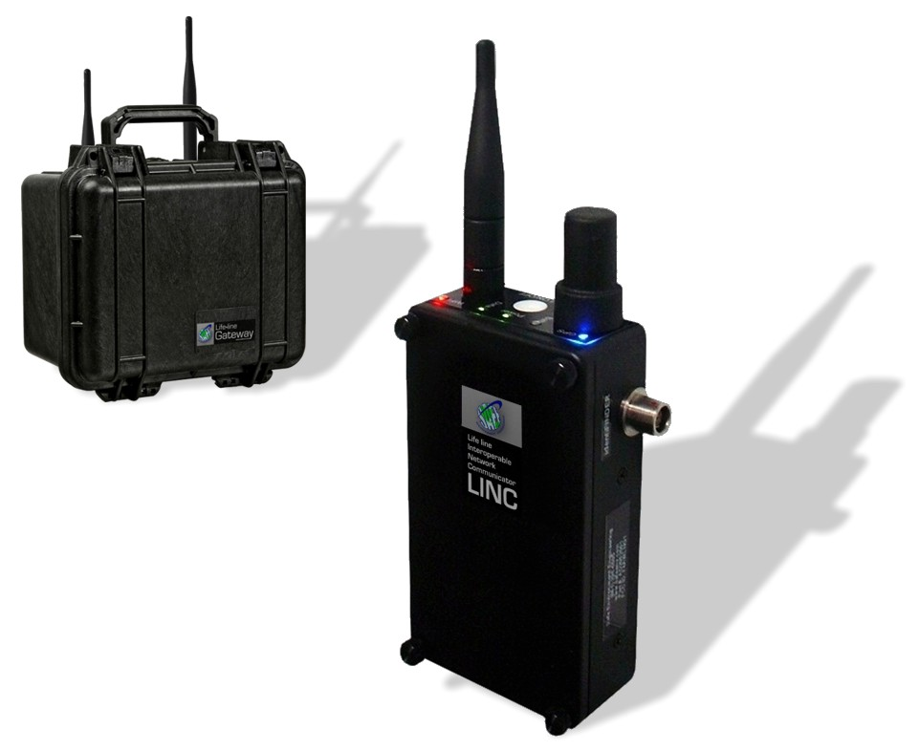
Field Components
MESH
WiFi
Cellular
Ethernet
Lifeline Gateway
LINC
Lifeline
Interoperability
Network
Communicator
LINC
8
Notes:
8

Slide 9
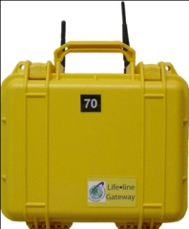
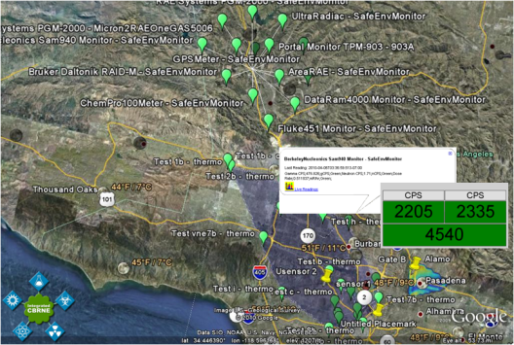
Telemetry System
Responder in the field uses wireless radiation sensor
Radiation sensor sends reading to Gateway
Gateway relay sends reading via data packet to a central server
PUBLIC
HEALTH DOC
SME is able to read and interpret data
OA EOC
Graphical data is sent to Emergency Managers
9

Slide 10
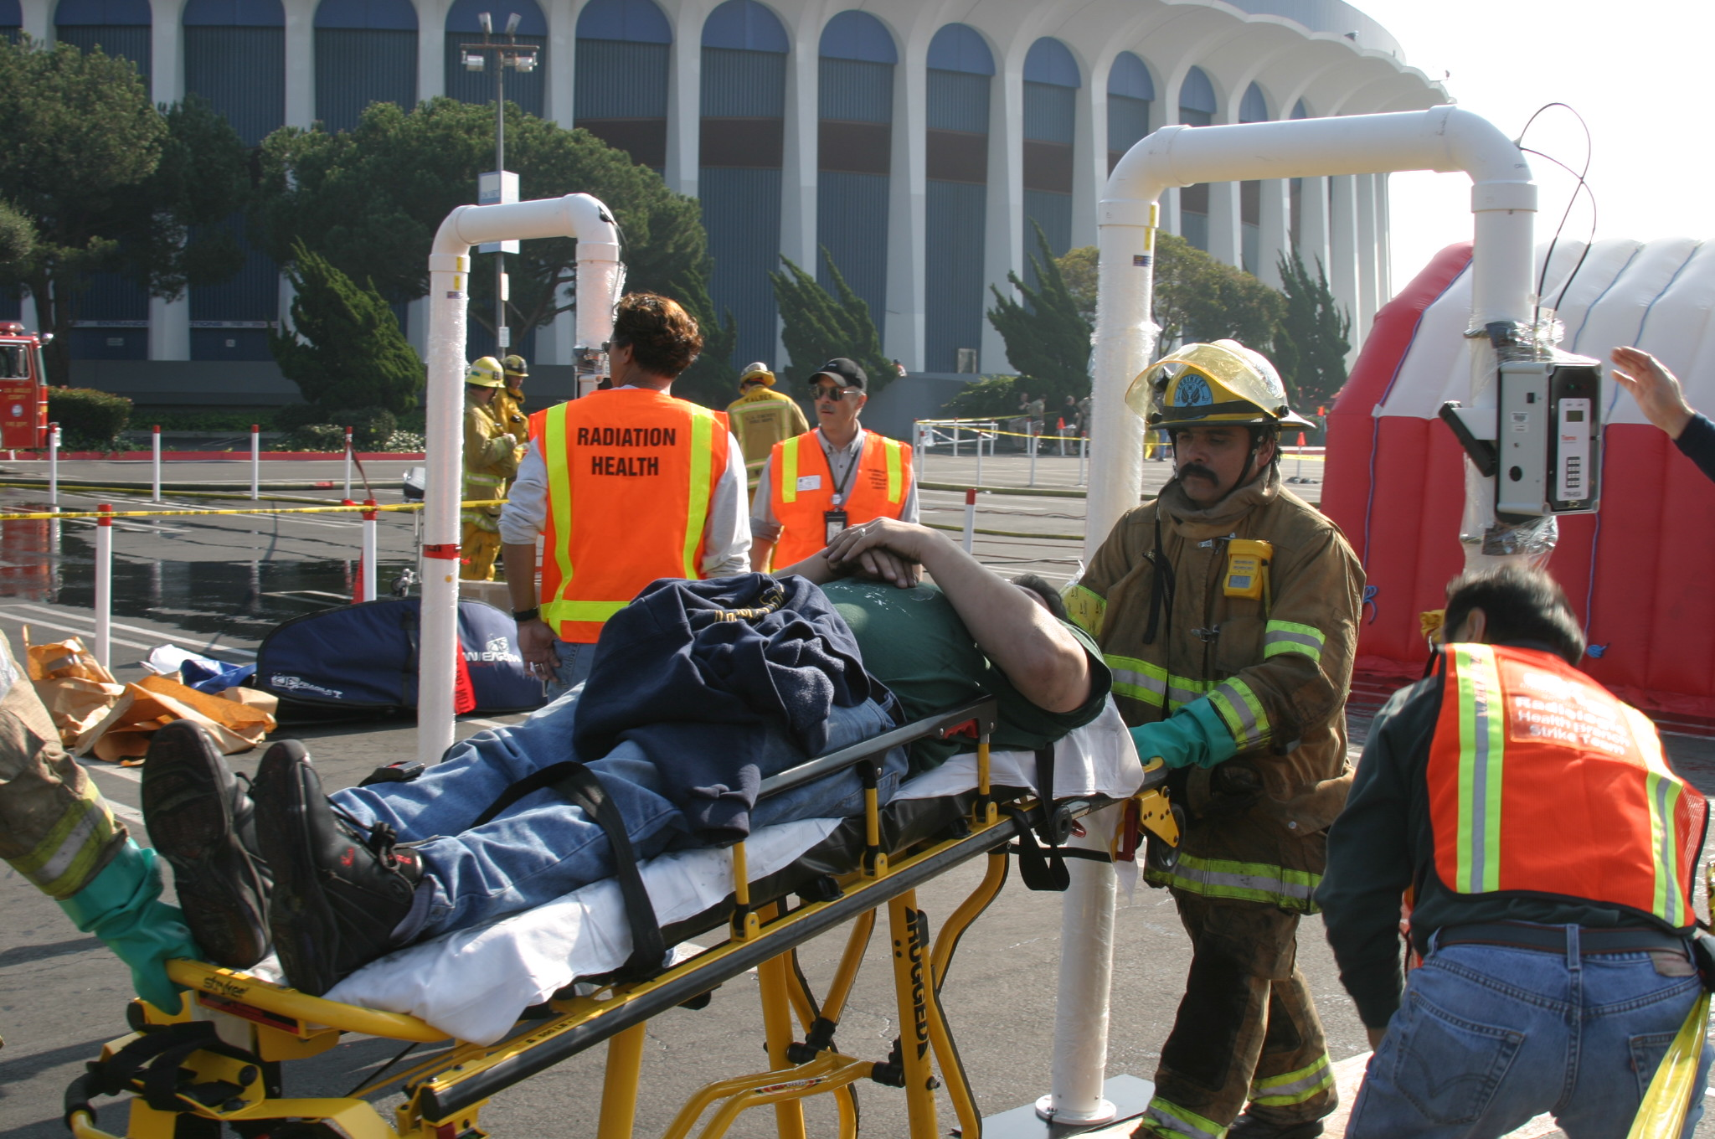
Population Monitoring
Notes:
10
Victim on a stretcher going thru monitor. The monitors also have a vehicle adapter, so that vehicles, including a fire engine, could go thru it.

Slide 11
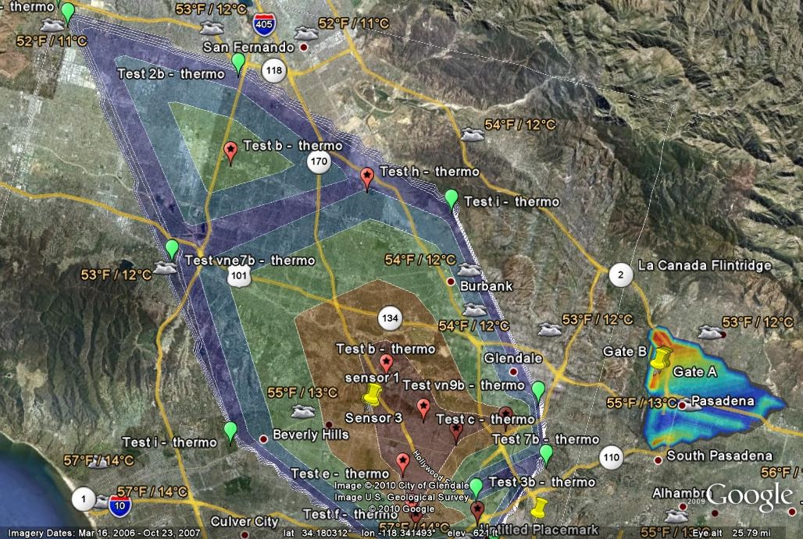
Radiation Energy Gradient

Slide 12
Integration
We started with just a few agencies involved
Conducted drills to make sure the system worked, and improve the system
Gradually the number of agencies increased
Radiation Management provided training to many of the responders
Ensured a basic knowledge of how to respond to a radiation event
Noted the many similarities & differences between their all-hazards training & a radiation event
Contamination not the priority for a radiation event, compared to a chemical event

Slide 13
Every Los Angeles Regional Hazmat Team Involved in the Telemetry System
L.A. City Fire | L.A. County Fire
L.A. County Sheriff | L.A. P.D.
L.A. County Rad Mgnt | L.A. County Health Hazmat
Glendale Fire | Santa Fe Springs Fire
LAX Airport | Long Beach Fire
Ontario Fire | Beverly Hills Fire
Riverside Fire | Joint Hazard Assessment Tm
County Coroner | Burbank Fire

Slide 14
In Process of Getting Telemetry
City of Torrance | City of Vernon
MTA (Transit Authority) | Port Police
Port of Los Angeles | Port of Long Beach

Slide 15
Outside Our Region
San Francisco Fire | San Luis Obispo Fire | US EPA ERT
NYPD Counter Terrorism | Air National Guard | Tinker AFB
Boston Fire | Seattle Fire | 1st, 9th, 10th CSTs
MA State Hazmat | Health Canada | Frontier Oil
Quanta Airlines | AClean | NEC

Slide 16
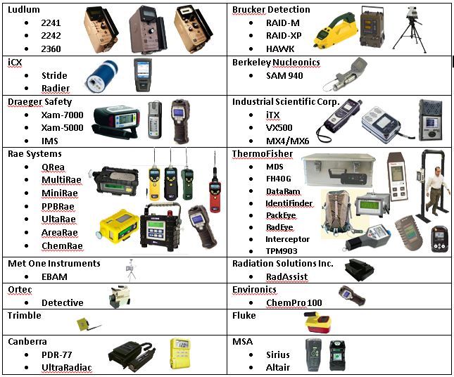
Integrated Sensors (and more)
16

Slide 17
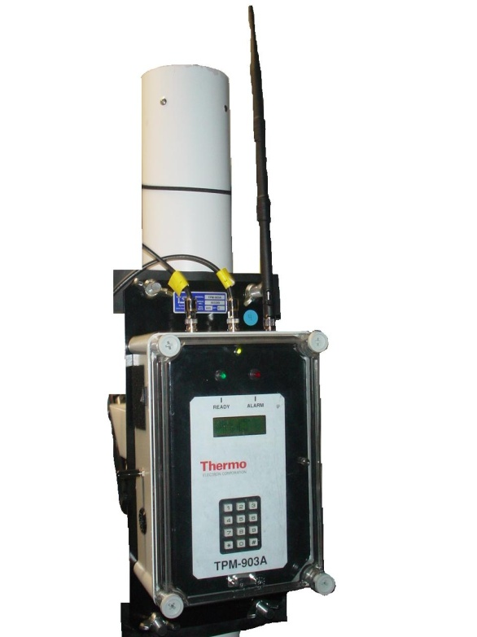
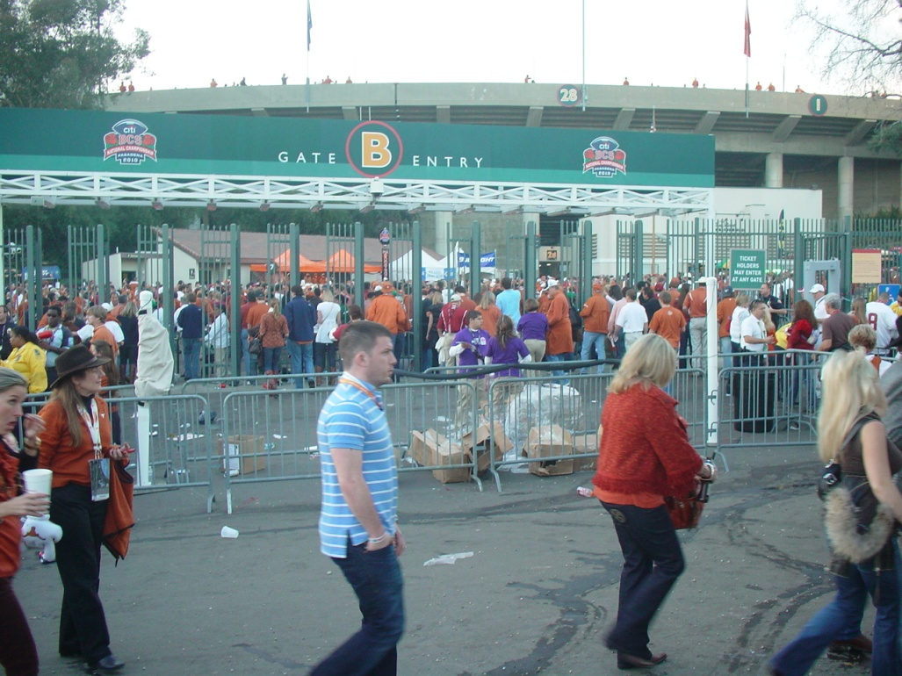
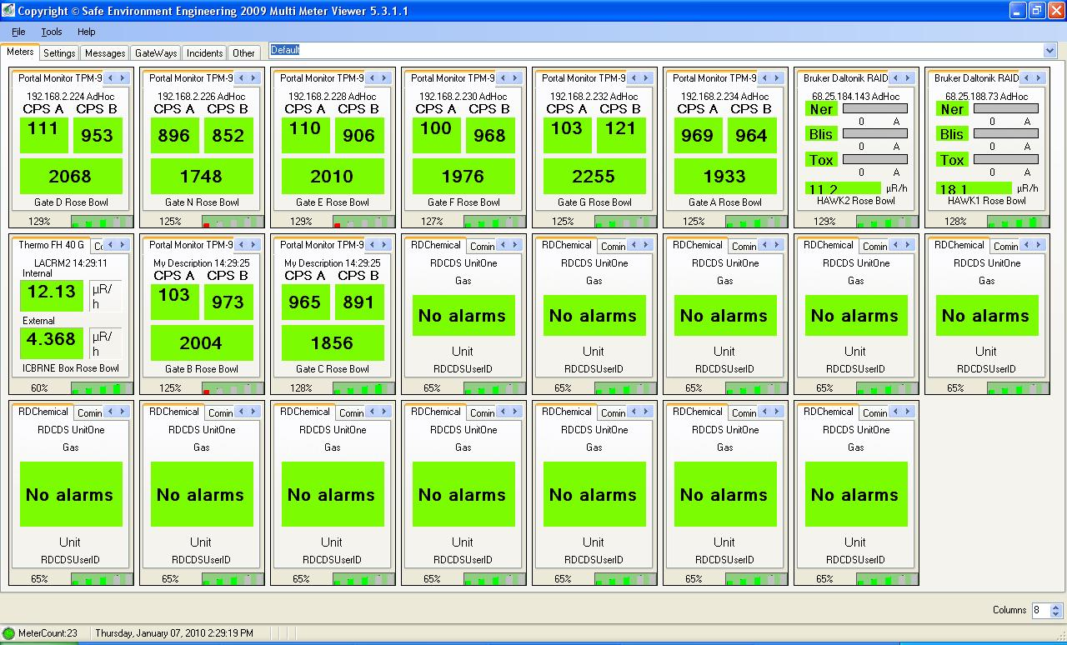
Example – Rose Bowl/BCS

Slide 18
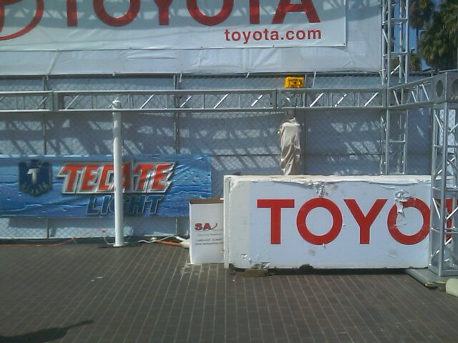
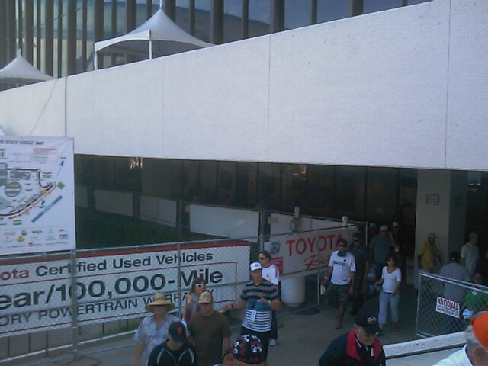
Example – Long Beach Grand Prix

Slide 19
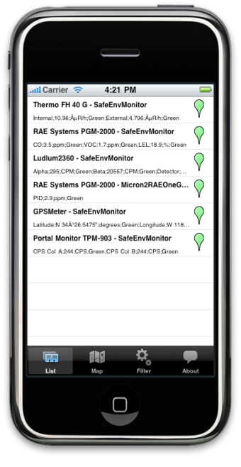
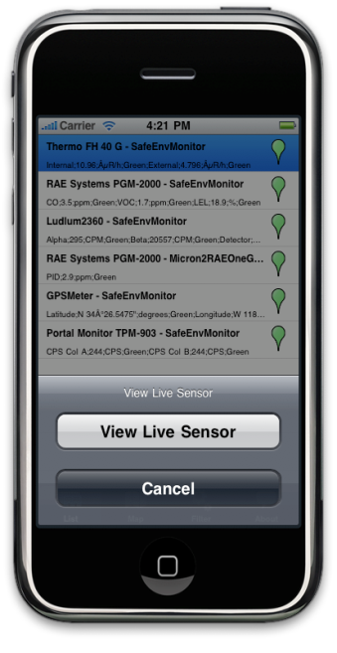
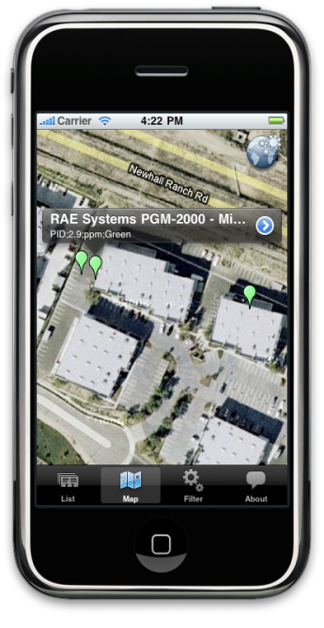
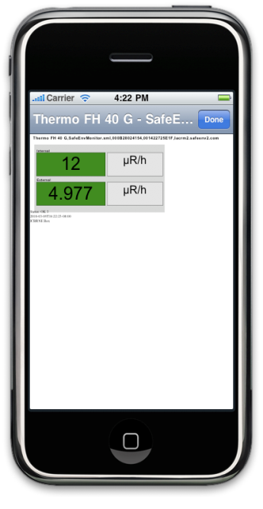
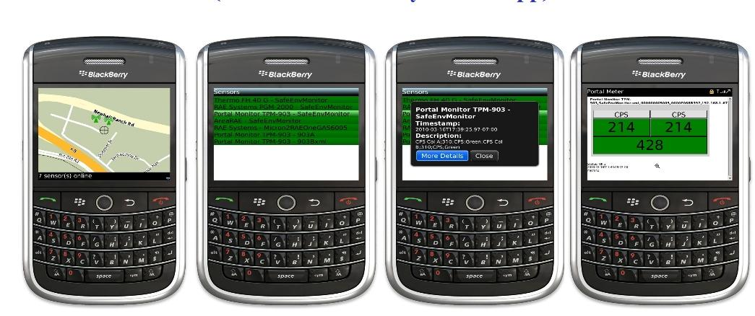
Mobile Apps Tool
Mobile Apps: iPHONE & Blackberry

Slide 20
Issue/Monitoring Responders’ Doses
Fear of radiation dose is of concern to those we’ll need after a radiation event
Public Health nurses
Ambulance drivers
Other County workers
Electronic dosimeters are expensive to provide to hundreds/thousands people
Will be helpful if we can provide quick and accurate information regarding their doses

Slide 21
microStar System
We have a system that allows us to measure personal doses ourselves
Both a manual and an automatic reader
4,000 personnel monitoring badges
We hope to “read” those every, or every-other, night
Badges can be sent to the company for “official” readings later
We can also use this system for making measurements that are otherwise difficult to measure
CT scanners, radiation therapy dose verification

Slide 22
Monitoring Doses
Can use partner system
Only one responder wears a dosimeter, & we assume everyone in his/her group got that same dose
One microSTAR system can be used for many agencies
A manual reader is about $16K, & each badge is about $5
We’re working with the FBI to supply them with badges

Slide 23
Thank you!

