Slide 1
A Perspective on Radiation Emergency Preparedness
Armin Ansari, PhD, CHP
Health Physicist, Radiation Studies Branch
National Center for Environmental Health
Division of Environmental Hazards and Health Effects

Slide 2
Key Planning Questions
Could your community be affected by a nuclear or radiological emergency?

Slide 3
Example: Displaced Population
Chernobyl (1986)
116,000 initially from the 30-km radius
210,000 additional from Ukraine, Belarus, and Russia
Fukushima (2011)
170,000 from the 20-km radius
450,000 people occupy 2600 evacuation centers
Our National Planning Scenarios
IND (scenario 1) – One million + self evacuate
RDD (scenario 11) – Hundreds of thousands self evacuate

Slide 4
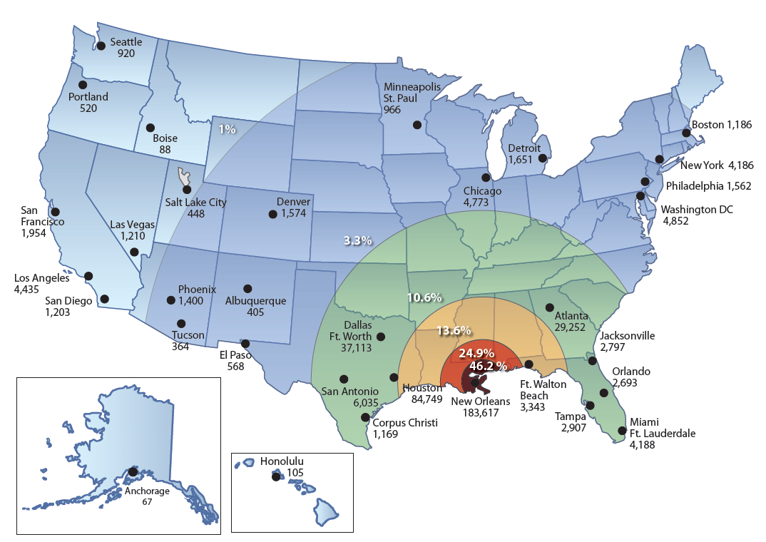
Displaced Population - Katrina (2005)
Sources: The Times-Picayune, October 13, 2005; FEMA, Census Bureau, Queens College Sociology Dept.
Notes:
Note that half are within 100 mile radius in this case – will be different in nuc/rad
Depending on how far from incident
Community most definitely impacted

Slide 5
Key Planning Questions
Could your community be affected by a nuclear or radiological emergency?
What are the public health roles in radiation emergencies?

Slide 6
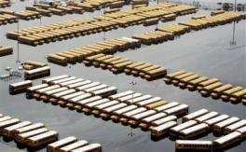
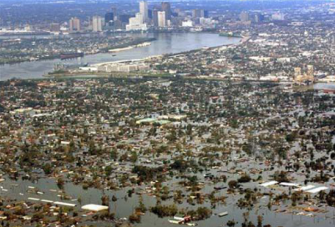
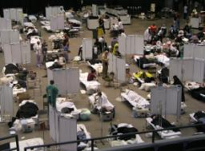
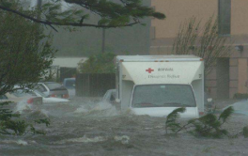
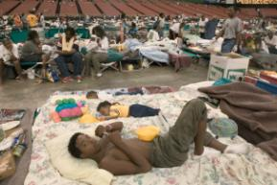
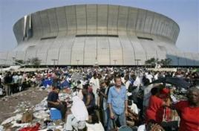
New Orleans 2005

Slide 7
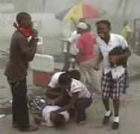
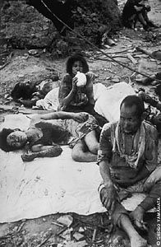
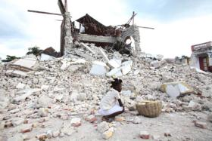
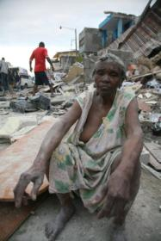
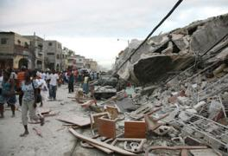
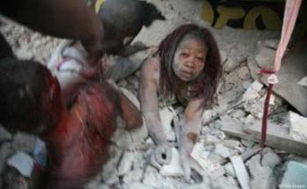
Haiti 2010

Slide 8
Fukushima 2011

Slide 9
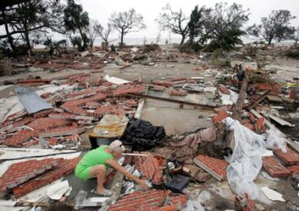
Public Health Functions After Any Disaster
Rapid assessment of health and medical needs
Sheltering and housing, mass care safety
Injury and illness surveillance
Potable water, safe food, sanitation and hygiene
Vector control
Solid waste, waste water management
Hazardous material disposal
Registry
Handling of the deceased
Rumor control
Public service announcements
Notes:
9
PH role in nuc/rad no mystery

Slide 10
In a radiation emergency:
Public health practitioners need to work closely with radiation safety professionals
Public
Health Physics
Notes:
Identify and work with local/state partners

Slide 11
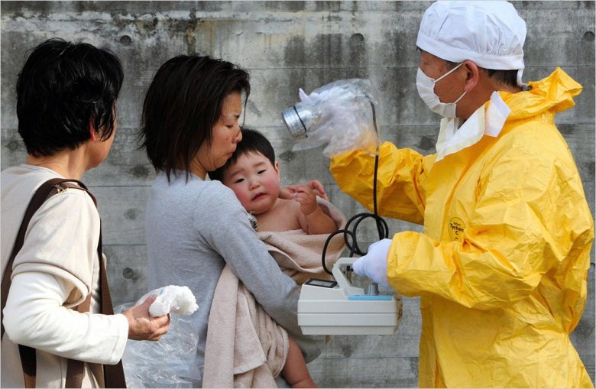
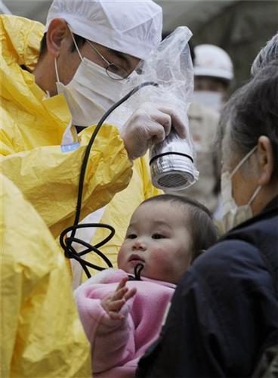
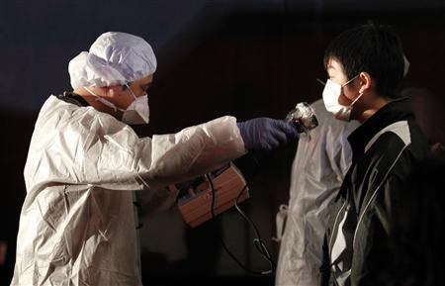
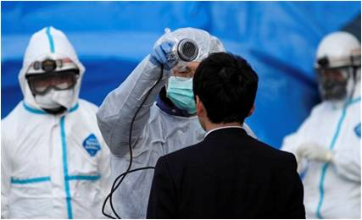
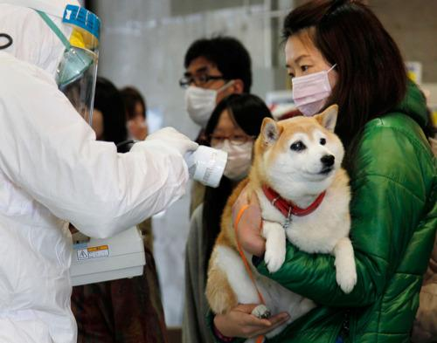
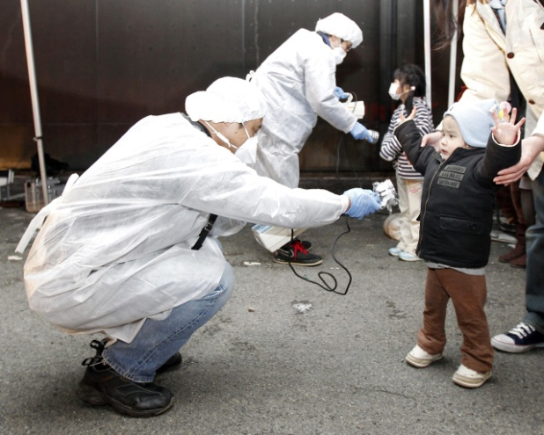
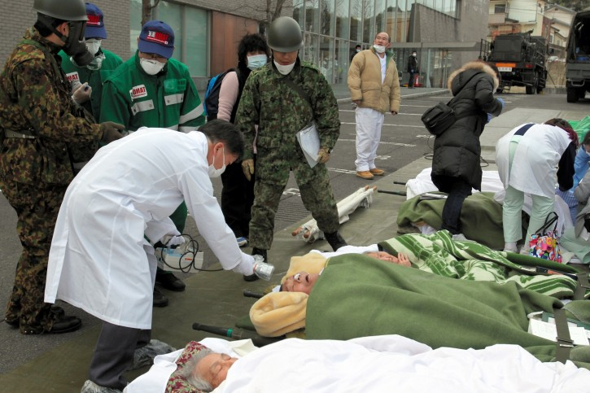
Population Monitoring

Slide 12
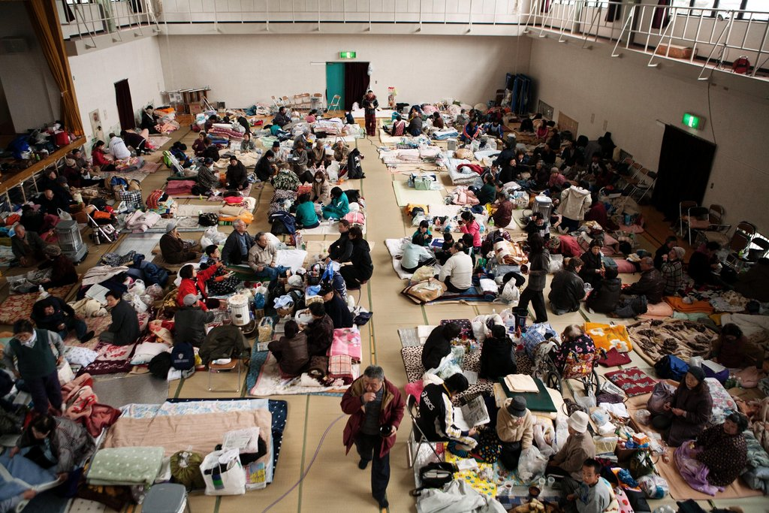
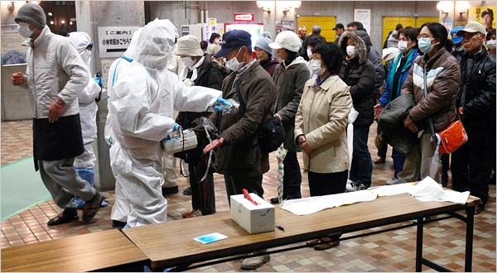
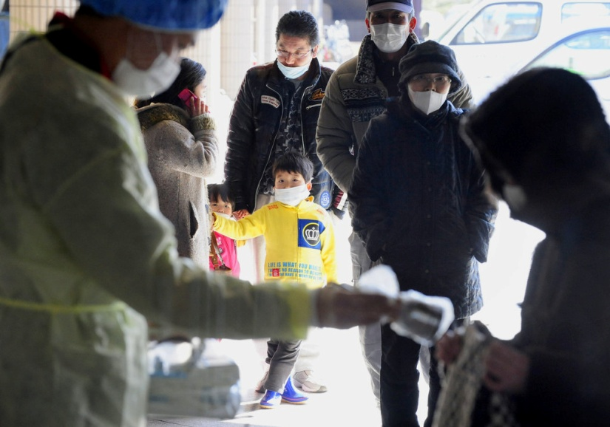
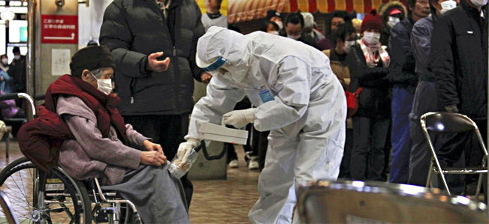
Public Shelters & Reception Centers
Notes:
Remember images as we come back to it

Slide 13
Key Planning Questions
Could your community be affected by a nuclear or radiological emergency?
What are the public health roles in radiation emergencies?
Is “radiation” included in your All-Hazards planning?

Slide 14
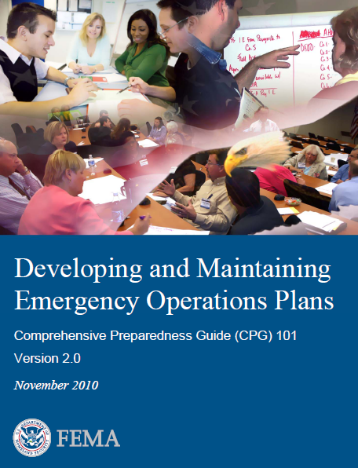
“Planning considers all hazards and threats”
“While the causes of emergencies can vary greatly, many of the effects do not.”
“For example, floods, wildfires, HAZMAT releases, and radiological dispersal devices may lead a jurisdiction to issue an evacuation order and open shelters. Even though each hazard’s characteristics (e.g., speed of onset, size of the affected area) are different, the general tasks for conducting an evacuation and shelter operations are the same.”
Notes:
General statement is true, but it can be easily misinterpreted and misapplied.
Are you prepared to open shelters for contaminated people.
“HazMat” is not the complete answer.

Slide 15
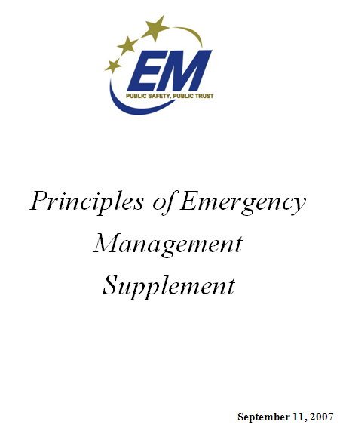
Generic vs. All Hazards Planning
“Treating all hazards the same in terms of planning resource allocation ultimately leads to failure.
There are “distinct differences between disaster agents that must be addressed in agent or hazard-specific plans.”
http://www.iaem.com/publications/documents/PrinciplesofEmergencyManagement.pdf
Notes:
Look in resource types for teams that can accommodate population radiation monitoring?
“Plans” if they are not exercised, and tested to the limits aren’t all that valuable. Doesn’t make a community prepared to just have a written plan on the shelf.
Comprehensive
All-Hazards
There are similarities in how one reacts to all disasters. These event-specific actions form the basis for most emergency plans. However,

Slide 16
Thank you!
Armin Ansari
770-488-3654
AAnsari@cdc.gov

