Slide 1
You are the Key to HPV Cancer Prevention
Understanding the Burden of HPV Disease and the Importance of the HPV Vaccine Recommendation
Speaker Name
Speaker Affiliation
Event
Date of Event

Slide 2
Disclosure Slide
Notes:
Note: Please have speaker add any financial disclosures or conflicts of interest to this slide.

Slide 3
Objectives
Express the importance of HPV vaccination for cancer prevention and the rationale for vaccinating at ages 11 or 12
Demonstrate concrete knowledge of all of the indications for HPV vaccine for girls and for boys
Provide useful and compelling information about HPV vaccine to parents to aid in making the decision to vaccinate

Slide 4
HPV Infection & Disease
Understanding the Burden

Slide 5
Personal story
In my practice, I…
Notes:
Note: Please add in a personal information aboput the burden of HPV-related cancer you see.

Slide 6
HPV Infection
Almost females and males will be infected with at least one type of HPV at some point in their lives
  Estimated 79 million Americans currently infected
  14 million new infections/year in the US
  HPV infection is most common in people in their teens and early 20s
Jemal A et al. J Natl Cancer Inst 2013;105:175-201
Notes:
HPV is the most common sexually transmitted infection
Most people never know that they have been infected unless a woman has an abnormal pap test with a positive HPV test
Most HPV infections happen during the teen and college-aged years

Slide 7
HPV Transmission
HPV exposure can occur with any type of intimate sexual contact
Intercourse is not necessary to become infected
Nearly 50% of high school students have already engaged in sexual (vaginal-penile) intercourse
  1/3 of 9th graders and 2/3 of 12th graders have engaged in sexual intercourse
  24% of high school seniors have had sexual intercourse with 4 or more partners
Jemal A et al. J Natl Cancer Inst 2013;105:175-201
Notes:
HPV is transmitted thorugh skin-to-skin contact through vaginal, anal, or oral intercourse. Condoms do not completely stop transmission of HPV.
This data demonstrates how young someone can be exposed to HPV

Slide 8
Rapid acquisition of HPV in following sexual debut
Study of 18-23 year-old males (n=240)
Notes:
8
This slide shows how quickly HPV infection occurs after first intercourse.
Genital HPV infection occurs frequently in women within 1 year of their first male sex partner.
Some women acquired genital HPV infection prior to having vaginal intercourse, suggesting that they may have had nonpenetrative sexual contact.
Young women are at high risk of acquiring HPV infection from her first male sex partner; the risk is increased by the partner’s prior sexual experience.

Slide 9
HPV is found in virgins
Study examined the frequency of vaginal HPV and the association with non-coital sexual behavior in longitudinally followed cohort of adolescent women without prior vaginal intercourse
HPV was detected in 46% of women prior to first vaginal sex
70% of these women reported non-coital behaviors that may in part explain genital transmission
Shew, J Infect Dis. 2012
Notes:
Even if a teen isn’t having sex, they may be engaging in behaviors that can expose them to HPV. Even girls who reported never having sexual intercourse still had HPV infection.

Slide 10
Cervical Cancer
Cervical cancer is the most common HPV-associated cancer among women
  500,000+ new cases and 275,000 attributable deaths world-wide in 2008
  12,000+ new cases and 4,000 attributable deaths in 2011 in the U.S.
  25.9% cervical cancers occur in women who are between the ages of 35 and 44
  14% between 20 and 34
  23.9% between 45 and 54
Notes:
Cervical cancer was once the leading cause of cancer death for women in the United States. Now it is the most preventable of all of the female cancers. The Pap test has helped decrease the number of women in the U.S. with cervical cancer by about 75% in the past 50 years. However even with an excellent cervical cancer screening program in the U.S., there are still around 12,000 case of cervical cancer each year in this country.
Many people think of gynecological cancers as just affecting older women, but cervical cancer affects 1 in 6 women who are in the prime of their reproductive years

Slide 11
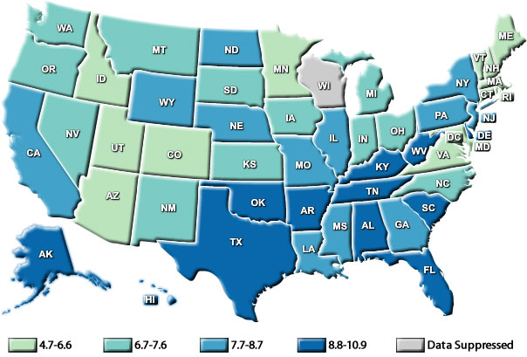
HPV-Associated Cervical Cancer Rates by State, United States, 2009
United States Cancer Statistics: 1999–2009 Incidence and Mortality Web-based Report. Atlanta (GA): DHHS, CDC, and NCI; 2013. Available at: http://www.cdc.gov/uscs.
Notes:
This map displays HPV-associated cervical cancer incidence rates by state. Highest rates are clustered in the Southeastern United States.

Slide 12
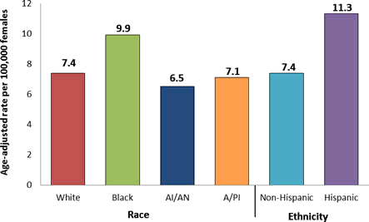
HPV-Associated Cervical Cancer Rates by Race and Ethnicity, United States, 2004–2008
Jemal A et al. J Natl Cancer Inst 2013;105:175-201
Notes:
Cervical cancer affects women of color and their communities more than their white counterparts. Women of color are often diagnosed with cervical cancer at a later stage than white women. Black women are more likely to die from cervical cancer than women of other races or ethnicities, possibly because of decreased access to Pap testing or follow-up treatment.
Hispanic women have the highest rates of cervical cancer in the United States. For example, for every 100,000 women living in the U.S., about 11 Hispanic women are diagnosed with cervical cancer, compared to only seven non-Hispanic women.

Slide 13
Annual Report to the Nation on the Status of Cancer: HPV-Associated Cancers
From 2000 to 2009, oral cancer rates increased
  4.9% for Native American men
  3.9% for white men
  1.7% for white women
  1% for Asian men
Anal cancer rates doubled from 1975 to 2009
Vulvar cancer rates rose for white and African-American women
Penile cancer rates increased among Asian men
Notes:
All types of HPV cancers are on the rise, some disproportionately affecting different racial/ethnic minorities

Slide 14
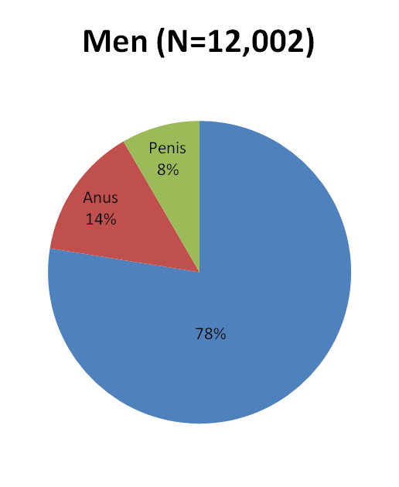
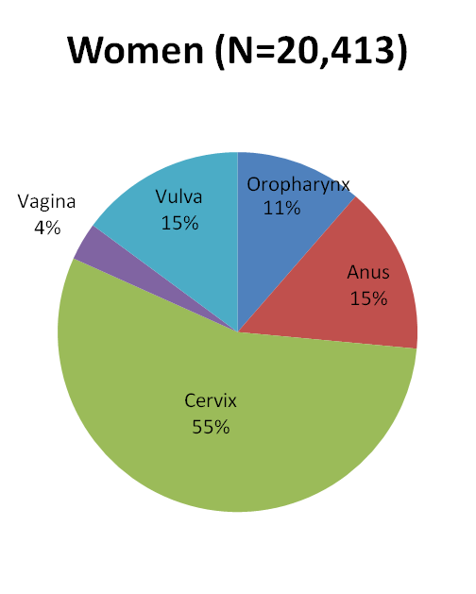
Average Number of New HPV-Associated Cancers by Sex, in the United States, 2005-2009
n=2317
n=1003
n=694
n=3039
n=1687
n=3084
Oropharynx
n=9312
n=11279
Jemal A et al. J Natl Cancer Inst 2013;105:175-201
Notes:
These data are from the Annual report to the Nation— published by 3 lead organizations on cancer surveillance –the American Cancer Society, the CDC, and the National Cancer Institute. This slide shows the average number of new human papillomavirus (HPV) –associated cancers overall, and by sex from 2005-2009.
Among women, the most common HPV cancer is cervical. Among males, the most common cancer was oropharyngeal.
An important point that isn’t shown on this slide: In addition to invasive cancers it is estimated that there are 1.4 million cervical disease or preinvasive cervical cancers and another 40,000 of the highest grade of anal, vulvar and vaginal precancers.

Slide 15
HPV-Associated Oropharyngeal Cancers
Prevalence increased from 16.3% (1984-89) to 71.7% (2000-04)
Population-level incidence of HPV-positive cancers increased by 225% while HPV-negative cancers declined by 50%
If trends continue, the annual number of HPV-positive oropharyngeal cancers is expected to surpass the annual number of cervical cancers by the year 2020
Chaturvedi, 2011, J Clin Oncol- data from SEER
Notes:
More oropharyngeal cancers that were previously thought to be caused by tobacco and/or alcohol use are now being identified as HPV-related cancers.
The number of oropharyngeal cancers diagnosed that are not caused by HPV have declined by half.

Slide 16
Economic Impact Related to HPV-Associated Disease, 2010
Event | Cost ($ billions)
Cervical cancer screening* | 6.6
Cervical cancer | 0.4
Other anogenital cancers | 0.2
Oropharyngeal cancer | 0.3
Anogenital warts | 0.3
RRP** | 0.2
TOTAL | 8.0
*Cervical cancer screening costs: ~ 80% routine screening, ~20% follow-up
**RRP costs: ~ 70% juvenile-onset, ~ 30% adult-onset
Chesson H et al. Vaccine 2012;30: 6016-19
RRP: recurrent respiratory papillomatosis
Notes:
This slide shows the cost of HPV associated disease in the US, taking into account the burden of the cancers and other HPV-associated diseases. Total costs of HPV-assocated diseases is 8 billion dollars, including 6.6 billion due to routine screening.
With new technologies, it is hoped that there can be more efficient screening, augmented by more organized screening systems, and vaccination leading to a reduction of the screening costs
Estimates of the direct medical costs attributable to human papillomavirus (HPV) can help to quantify the economic burden of HPV and to illustrate the economic benefits of HPV vaccination

Slide 17
Complications related to current methods of cervical cancer prevention
Infertility due to treatment of cervical cancer by hysterectomy
Cervical conization and loop electrosurgical excision procedure (LEEP) procedures associated with adverse obstetric morbidity
Subsequent pregnancies are at risk of
  Perinatal mortality
  Severe and extreme preterm delivery (<32/34 or <28/30 weeks)
  Severe and extreme low birth weight (< 2000g or 1500g)
These outcomes have a considerable impact—not only on the mothers and infants concerned—but also on the cost of neonatal intensive care
Notes:
Treatment of cervical precancer and cancer can lead to many complications for women of childbearing age:
Cervical cancer is often treated by hysterectomy, leaving many young women unable to have any or additional children
High-grade (or severe) precancerous lesions often require treatment that can cervical imcompetance or cervical stenosis
Cervical incompetance can lead to preterm delivery and cervical stenosis can lead to birth complications- both of which lead to tremendous burden on the mother, infant and their family

Slide 18
HPV Vaccine
Recommendations, Safety, Impact, & Coverage Rates
Notes:
This next section will focus on HPV vaccine and the impact on HPV-related disease and cancer

Slide 19
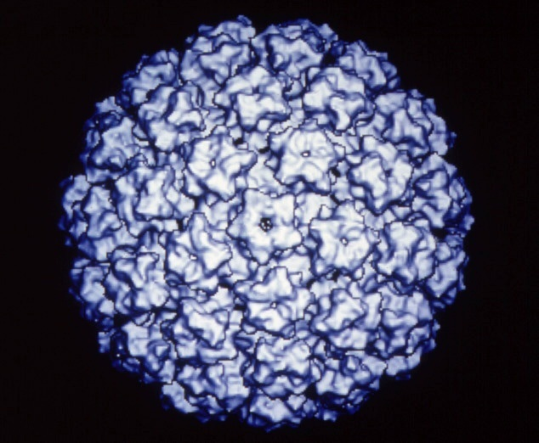
HPV Prophylactic Vaccines
Recombinant L1 capsid proteins that form “virus like” particles (VLP)
Non-infectious and non-oncogenic
Produce higher levels of neutralizing antibody than natural infection
HPV VLP
Notes:
HPV vaccines are made from virus-like particles that cannot cause infection with HPV or cause cancer. HPV vaccines produce a better immune response than an HPV infection.

Slide 20
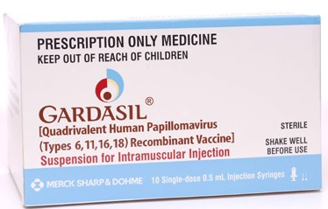
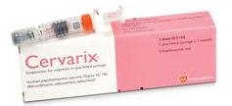
HPV Vaccine
Quadrivalent/HPV4 (Gardasil) | Name | Bivalent/HPV2 (Cervarix)
Merck | Manufacturer | GlaxoSmithKline
6, 11, 16, 18 | Types | 16, 18
Females: Anal, cervical, vaginal and vulvar precancer and cancer; Genital warts Males: Anal precancer and cancer; Genital warts | Indications | Females: Cervical precancer and cancer Males: Not approved for use in males
Pregnancy Hypersensitivity to yeast | Contraindications | Pregnancy Hypersensitivity to latex (latex only contained in pre-filled syringes, not single-dose vials)
3 dose series: 0, 2, 6 months | Schedule (IM) | 3 dose series: 0, 1, 6 months
Notes:
There are two brands of HPV vaccine on the market. Both protect against the types of HPV (16, 18) that cause most cervical cancer. Both vaccines have been shown to prevent cervical precancers in women. Both vaccines are very safe. Both vaccines are given as shots and require 3 doses.
Only one of the vaccines (Gardasil) protects against HPV types 6 and 11, the types that cause most genital warts in females and males. Only one of the vaccines (Gardasil) has been tested and licensed for use in males. While both vaccines protect against HPV16, which is the most common HPV type responsible for HPV associated cancers including cancers of cervix, vulva, vagina, penis, and anus and oropharynx, only one of the vaccines (Gardasil) has been tested and shown to protect against precancers of the vulva, vagina, and anus. The two vaccines have different adjuvants—a substance that is added to the vaccine to increase the body's immune response.

Slide 21
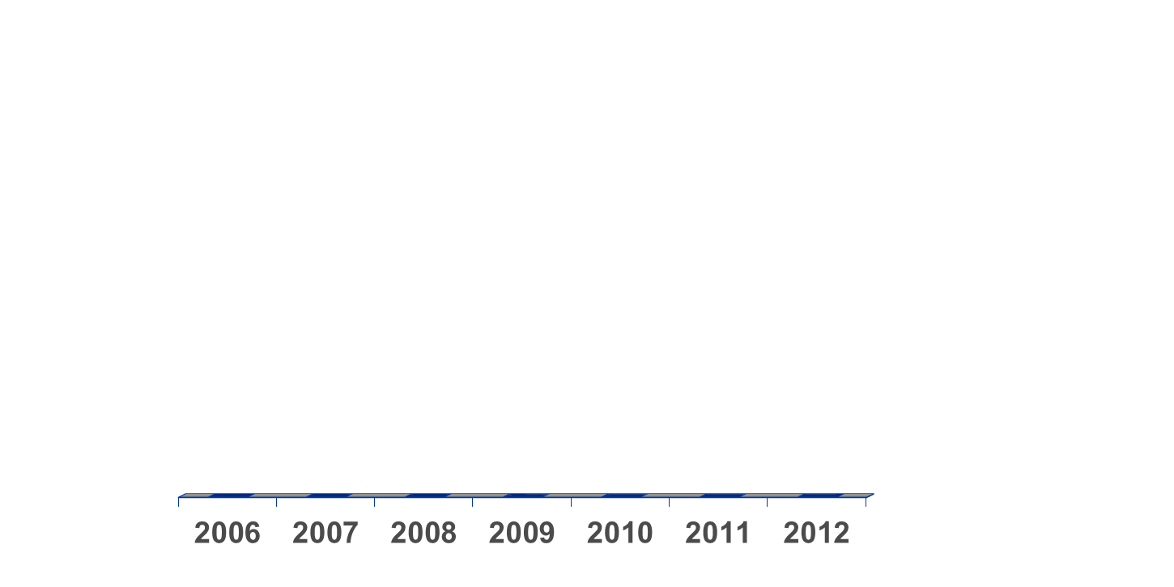
Evolution of recommendations for
HPV vaccination in the United States
Quadrivalent
Routine, females 11 or 12 yrs*
and 13-26 yrs not previously vaccinated
Quadrivalent or Bivalent
Routine, females 11 or 12 yrs*
and 13-26 yrs not previously vaccinated
Quadrivalent
May be given,
males 9-26 yrs*
Quadrivalent
Routine, males 11 or 12 yrs*
and 13-21 yrs not previously vaccinated
May be given, 22-26 yrs**
June
October
October
Quadrivalent (HPV 6,11,16,18) vaccine; Bivalent (HPV 16,18) vaccine
* Can be given starting at 9 years of age; ** For MSM and immunocompromised males, quadrivalent HPV vaccine through 26 years of age
Notes:
This slide shows the evolution of HPV vaccine recommendations in the US. In 2006, the quadrivalent vaccine was recommended for routine use in females 11 or 12 years of age…..

Slide 22
ACIP Recommendation and
AAP Guidelines for HPV Vaccine
Routine HPV vaccination recommended for both males and females ages 11-12 years
Catch-up ages 13-21 years for males; 13-26 for females
Permissive use ages 9-10 years for both males and females; 22-26 for males

Slide 23
Recommendation for Females
Either bivalent HPV vaccine (Cervarix) or quadrivalent HPV vaccine (Gardasil) recommended for girls at age 11 or 12 years for prevention of cervical cancer and precancer
  Also for girls 13 through 26 who haven’t started or completed series
  Only quadrivalent HPV vaccine (Gardasil) also for prevention of vaginal, vulvar, and anal cancers, as well as genital warts.

Slide 24
Recommendation for Males
Quadrivalent HPV vaccine (Gardasil) recommended for boys at age 11 or 12 years for prevention of anal cancer and genital warts
  Also for boys 13 through 21 who haven’t started or completed series
  Young men, 22 through 26 years of age, may get the vaccine
  Teen boys through age 26 who identify as gay or bisexual and haven’t started or completed series should be vaccinated
Notes:
Boys need HPV vaccine too. Many parents don’t understand that boys can get cancer and disease caused by HPV.

Slide 25
HPV Vaccine Safety
The most common adverse events reported were considered mild
For serious adverse events reported, no unusual pattern or clustering that would suggest that the events were caused by the HPV vaccine
These findings are similar to the safety reviews of MCV4 and Tdap vaccines
57 million doses of HPV vaccine distributed in US since 2006
Notes:
More than 175 million doses of HPV vaccine have been distributed worldwide and 57 million doses have been distributed in the United States. In the seven years of HPV vaccine safety studies and monitoring that have been conducted since the vaccine was licensed, no serious safety concerns have been identified. Reports to the Vaccine Adverse Event Reporting System (VAERS) have decreased each year since 2008.

Slide 26
HPV Vaccine Safety Data Sources
Post-licensure safety data (VAERS)¹
Post-licensure observational comparative studies (VSD)²
Ongoing monitoring by CDC and FDA
Post-licensure commitments from manufacturers
  Vaccine in pregnancy registries
  Long term follow-up in Nordic countries
Official reviews
  WHO’s Global Advisory Committee on Vaccine Safety ³
  Institute of Medicine’s report on adverse effects and vaccines, 2011⁴
¹Vaccine Adverse Events Reporting System, http://vaers.hhs.gov/index
²Vaccine Safety Datalink, http://www.cdc.gov/vaccinesafety/Activities/VSD.html
³http://www.who.int/vaccine_safety/Jun_2009/en/
⁴http://www.iom.edu/Reports/2011/Adverse-Effects-of-Vaccines-Evidence-and-Causality.aspx
Notes:
As with all vaccines, CDC and FDA continue to monitor the safety of these vaccines very carefully. These vaccine safety studies continue to show that HPV vaccines are safe.

Slide 27
HPV Vaccine Impact:
HPV Prevalence Studies
NHANES Study
  National Health and Nutrition Examination Survey (NHANES) data used to compare HPV prevalence before the start of the HPV vaccination program with prevalence from the first four years after vaccine introduction
  In 14-19 year olds, vaccine-type HPV prevalence decreased 56 percent, from 11.5 percent in 2003-2006 to 5.1 percent in 2007-2010
  Other age groups did not show a statistically significant difference over time
  The research showed that vaccine effectiveness for prevention of infection was an estimated 82 percent
Cummings T, Zimet GD, Brown D, et al. Reduction of HPV infections through vaccination among at-risk urban adolescents. Vaccine. 2012; 30:5496-5499.
Notes:
The CDC used data collected from the National Health and Nutrition Examination Survey (NHANES) to determine prevalence of HPV infection before and after HPV vaccine introduction. HPV prevalence declined by half after vaccine introduction in 14-19 year olds. This is the age group we’d expect to see an impact with. The study also showed that the vaccine is very effective which is what was seen during the prelicensure clinical trials.

Slide 28
HPV Vaccine Impact:
HPV Prevalence Studies, continued
Clinic-Based Studies
  Significant decrease from 24.0% to 5.3% in HPV vaccine type prevalence in at-risk sexually active females 14-17 years of age attending 3 urban primary care clinics from 1999-2005, compared to a similar group of women who attended the same 3 clinics in 2010
  Significant declines in vaccine type HPV prevalence in both vaccinated and unvaccinated women aged 13-26 years who attended primary care clinics from 2009-2010 compared to those from the pre-vaccine period (2006-2007)
Kahn JA, Brown DR, Ding L, et al. Vaccine-Type Human Papillomavirus and Evidence of Herd Protection After Vaccine Introduction. Pediatrics. 2012; 130:249-56.
Notes:
Similar declines in HPV prevalence have been demonstrated in smaller studies conducted in primary care clinics

Slide 29
HPV Vaccine Impact:
Genital Warts Studies
Ecologic analysis used health claims data to examine trends in anogenital warts from 2003-2010 among a large group of private health insurance enrollees
  The study found significant declines after 2007 in females aged 15-19 year (38% decrease from 2.9/1000 PY in 2006 to 1.8/1000 PY in 2010)
  Smaller declines were observed among those 21-30 years but not in those over 30 years
A similar study evaluated genital wart trends in males and females attending public family planning clinics and found
  Significant decrease of 35% (.94% to .61%) in females under 21 years of age and a 19% decrease in males less than 21 years
  No decreases were reported in the older males or females
Notes:
Prevalence of genital warts declined by more than one third in the same age group (15-19 yo) in two studies

Slide 30
HPV Vaccine Impact:
High HPV Vaccine Coverage in Australia
80% of school-age girls in Australia are fully vaccinated
High-grade cervical lesions have declined in women less than 18 years of age
For vaccine-eligible females, the proportion of genital warts cases declined dramatically by 93%
Genital warts have declined by 82% among males of the same age, indicating herd immunity
Garland et al, Prev Med 2011
Ali et al, BMJ 2013
Notes:
Australia has high HPV vaccine coverage and has seen declines prevalence of HPV infections, pre-cancerous lesions, and genital warts in young women
HPV vaccine is only recommended for girls in Australia, yet they have seen a decline in genital warts in young men, which shows that there has been a decrease in transmission of HPV

Slide 31
International uptake of 3 doses HPV vaccine
Australia UK Canada Netherlands USA
Brotherton, Lancet 2011; Cuzick BJC 2010; Ogilvie et al., 2010; Marc et al., 2010, NIS-Teen 2011
Notes:
The U.S. lags behind in vaccine coverge compared with other countries.
Not shown in this slide is HPV vaccine coverage for Rwanda. Before 2011, neither cervical cancer screening nor HPV vaccination was available in public health facilities in Rwanda. The First Lady of Rwanda worked with the public health system and with vaccine manufacturers to create a HPV vaccine program. On 26 and 27 April 2011, 93,888 Rwandan girls in primary grade six received their first shot of Gardasil with no out-of-pocket payment. This was done in a 2-day school-based vaccination program with 3rd day following up with grils not enrolled in school. This was repeated for the second two doses. The program’s first round achieved 95.04% coverage, the second 93.90% and the third, 93.23%. Currently HPV vaccine coverage for Rwanda is 93%.

Slide 32
National Estimated Vaccination Coverage Levels among Adolescents 13-17 Years,
National Immunization Survey-Teen, 2006-2012
Tdap: tetanus, diphtheria, acellular pertussis vaccine.
MCV4: meningococcal conjugate vaccine
HPV: human papillomavirus vaccine
Notes:
Data from the 2012 National Immunization Survey-Teen (NIS-Teen) show that no progress has been
made in HPV vaccination coverage in girls since last year. Between 2007 and 2011, vaccination coverage
significantly increased each year for all doses, though rates lagged behind those of other recommended
vaccines for teens. From 2011 and 2012, there were no statistically significant changes in coverage. The
percentage of girls initiating the HPV vaccine series did not improve. The number of girls receiving all
three recommended doses of HPV vaccine failed to improve as well.

Slide 33
Coverage of 1 of More Doses of HPV among Adolescent Girls 13-17 Years by State, NIS-Teen 2012
Washington
Montana
North
Minnesota
Maine
Dakota
Oregon
Idaho
Vermont
New
South
Wisconsin
Hampshire
Massachusetts
Dakota
New York
Wyoming
Michigan
Connecticut
Rhode Island
Nevada
Nebraska
Iowa
Pennsylvania
Ohio
New Jersey
Illinois
Indiana
Delaware
California
Utah
Colorado
West
Maryland
Kansas
Missouri
Virginia
Virginia
Kentucky
Tennessee
North Carolina
Arizona
Oklahoma
Arkansas
South
New Mexico
Carolina
Mississippi
Georgia
≤ 44% (8)
Alabama
Alaska
45-54% (19)
Alaska
Texas
Louisiana
55-64% (17)
Hawaii
Florida
≥65% (6)
Notes:
Shown in this slide are vaccination coverage levels for 1 or more doses of HPV vaccine by state. As you can see there is tremendous variation in coverage across the county. Coverage ranges from a low 32% in Mississippi to a high of 76% in Rhode Island.

Slide 34
HPV Vaccination Estimates among Adolescents 13-17 Years by Race/Ethnicity, NIS-Teen 2012
**
**
**
**
Girls
Boys
** Statistically different (P<0.05) from White-NH.

Slide 35
Why We Need to Do Better in HPV Vaccination of 12 year olds
Currently 26 million girls <13 yo in the US; If none of these girls are vaccinated then:
  168,400 will develop cervical cancer and
  54,100 will die from it
Vaccinating 30% would prevent 45,500 of these cases and 14,600 deaths
Vaccinating 80% would prevent 98,800 cases and 31,700 deaths
For each year we stay at 30% coverage instead of achieving 80%, 4,400 future cervical cancer cases and 1400 cervical cancer deaths will occur.
Notes:
Not vaccinating means leaving more girls and boys exposed to potential HPV cancers in the future

Slide 36
Actual and Achievable Vaccination Coverage if Missed Opportunities
Were Eliminated: Adolescents 13-17 Years, NIS-Teen 2012
Among girls unvaccinated for HPV, 84% had a missed opportunity
Missed opportunity: Encounter when some, but not all ACIP-recommended vaccines are given.
HPV-1: Receipt of at least one dose of HPV.

Slide 37
Avoid Missed Opportunities
HPV vaccine can safely be given at the same time as the other recommended adolescent vaccines
Provide HPV vaccine during routine sports, or camp physicals
Review immunization record even at acute care visits
Encourage parents to keep accurate vaccination records and to review the immunization schedule
Systems interventions depend on clinician commitment- determine what would work best for YOUR practice
Notes:
There are many ways to avoid these missed opportunities.

Slide 38
The Perfect Storm
Why is HPV vaccine different?
  HPV vaccine issues sensationalized by popular media
  Different reasons for why some girls and boys don’t get the first shot and why some don’t finish all 3 shots
  Parents think sexuality instead of cancer prevention
  Some clinicians aren’t giving strong recommendations
  Parents have questions that are seen as hesitation by some doctors
  Phased girls-then-boys recommendations initially confusing to parents
  Systems interventions to improve coverage rates depend on clinician commitment
Notes:
Plateau in HPV vaccine uptake in girls persisting
Series initiation vs. completion predictors differ
Provider “hesitancy” (weak recommendations)
Potential factors: risk assessment, resistant to 11-12 yr recommendations, vaccine cost, competing priorities, communication skills
Parental attitudes likely amenable to provider communication if clinicians are convinced & confident
System interventions depend on clinician commitment
E.g., Missed opportunities, AFIX, HEDIS (positive feedback loops) require clinicians to buy-in to purpose & targets

Slide 39
Framing the conversation
Talking about HPV vaccine

Slide 40
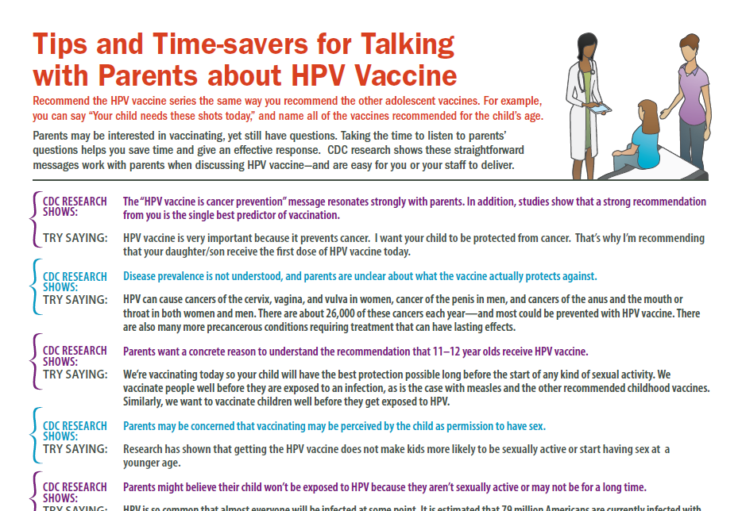
Notes:
This tips sheet provided by CDC offers suggestions for recommending HPV vaccine and answering questions parents may have. The following slides look at this in detail.

Slide 41
What’s in a recommendation?
  Studies consistently show that a strong recommendation from you is the single best predictor of vaccination
    In focus groups and surveys with moms, having a doctor recommend or not recommend the vaccine was an important factor in parents’ decision to vaccinate their child with the HPV vaccine
    Not receiving a recommendation for HPV vaccine was listed a barrier by mothers

Slide 42
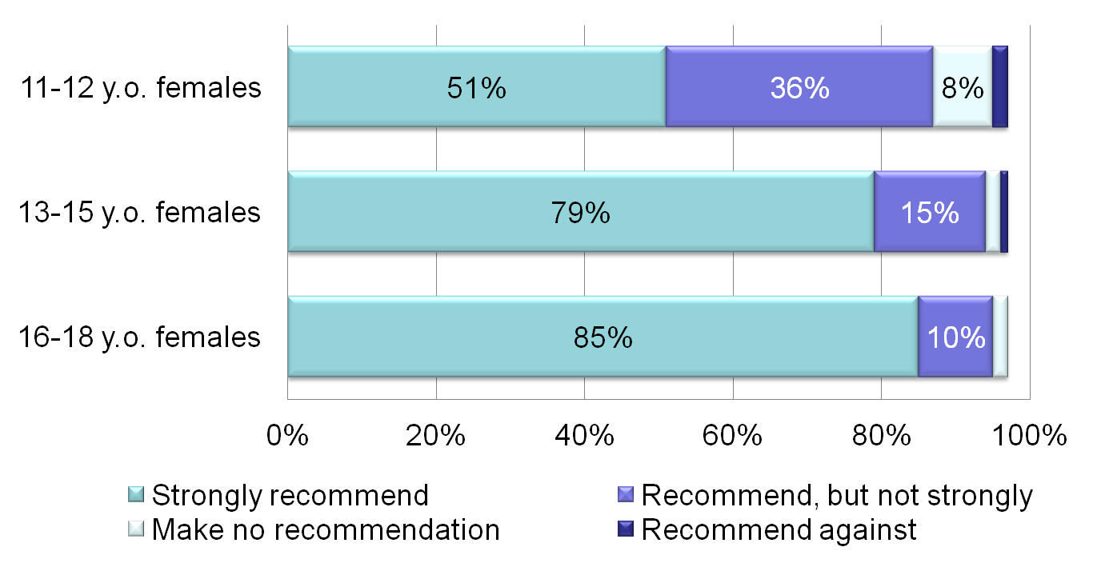
Strength of HPV Vaccine Recommendation for Female Patients, Pediatricians and
Family Physicians (N=609)
Allison et al. https://cdc.confex.com/cdc/nic2011/webprogram/Paper25181.html
Notes:
When we have studied HPV vaccination practices among physicians we see that providers are less likely to recommend the HPV vaccine to their younger adolescent patients. This slide shows results of a national survey of pediatricians and family physicians. Only 51% of providers strongly recommend HPV for their female patients 11 to 12 years old as shown by the top light blue bar. And the percent who strongly recommend the vaccine increases with patient age.

Slide 43
Just another adolescent vaccine
Successful recommendations group all of the adolescent vaccines
  Recommend the HPV vaccine series the same way you recommend the other adolescent vaccines
  Moms in focus groups who had not received a doctor’s recommendation stated that they questioned why they had not been told or if the vaccine was truly necessary
  Many parents responded that they trusted their child’s doctor and would get the vaccine for their child as long as they received a recommendation from the doctor

Slide 44
Top 5 reasons for not vaccinating daughter, among parents with no intention to vaccinate in the next 12 months, NIS-Teen 2012
* Not mutually exclusive.
** Did not know much about HPV or HPV vaccine.
Notes:
This slide shows the responses that parents gave when asked why they would not be getting the HPV vaccine for their daughter in the next year.
Three reasons that parents provided—lack of knowledge, not needed, and not sexually active—all demonstrate a lack of understanding on the part of the parent, especially why it is important to vaccinate at ages 11 or 12. Parents need to be told that HPV vaccine is cancer prevention and that it must be given prior to exposure.
Safety concerns can be allievated by sharing the tremendous amount of data before and after the vaccine was licensed that demonstrate that HPV vaccine is safe.

Slide 45
Try saying:
Your child needs three shots today: HPV vaccine, meningococcal vaccine and Tdap vaccine.
You child will get three shots today that will protect him/her from the cancers caused by HPV, as well as prevent tetanus, diphtheria, pertussis and meningitis.

Slide 46
A case of vaccine hesitancy?
Parents may be interested in vaccinating, yet still have questions
  Many parents didn’t have questions or concerns about HPV vaccine
  A question from a parents does not mean they are refusing or delaying
  Taking the time to listen to parents’ questions helps you save time and give an effective response
  CDC research shows these straightforward messages work with parents when discussing HPV vaccine—and are easy for you or your staff to deliver

Slide 47
An anti-cancer vaccine
The “HPV vaccine is cancer prevention” message resonates strongly with parents
  In focus groups and online panels, mothers wanted more information on the types of HPV cancers
  In focus groups mothers stated they were influenced to vaccinate their child because HPV vaccine prevents cancer, they had a family history of gynecological cancers (cervical, ovarian), and/or because they had a personal experience with cervical cancer

Slide 48
Try saying:
HPV vaccine is very important because it prevents cancer.
I want your child to be protected from cancer.
That’s why I’m recommending that your daughter/son receive the first dose of the HPV vaccine series today.

Slide 49
Tell me doctor, how bad is it?
Disease prevalence is not understood, and parents are unclear about what the vaccine actually protects against
  Parents in focus groups knew HPV vaccine can prevent cervical cancers, however they lacked knowledge about indications for HPV vaccine other than cervical cancer for girls, all HPV vaccine indications for boys, and the recommended ages to receive HPV vaccine

Slide 50
Try saying:
HPV can cause cancers of the cervix, vagina, and vulva in women, cancer of the penis in men, and cancers of the anus and the mouth or throat in both women and men.
There are about 26,000 of these cancers each year—and most could be prevented with HPV vaccine.
There are also many more precancerous conditions requiring treatment that can have lasting effects.

Slide 51
Why at 11 or 12 years old?
Parents want a concrete reason why 11-12 year olds should receive HPV vaccine
  In audience research with moms, almost all respondents were unaware of the correct age range the vaccine was recommended
  Respondents also missed the concept of vaccinating before sexual activity

Slide 52
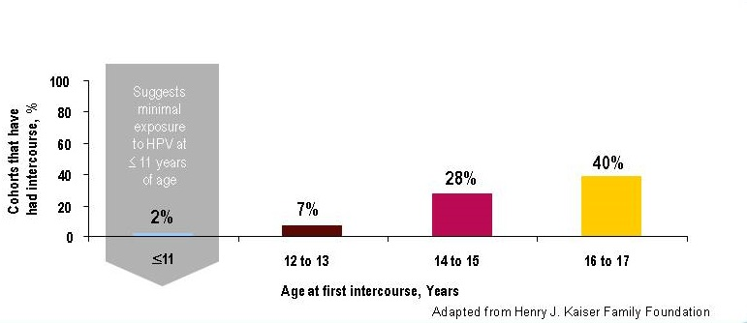
Rationale for vaccinating early:
Protection prior to exposure to HPV
82%
18 to 24
Markowitz MMWR 2007;
Holl Henry J Kaiser Found 2003;
Mosher Adv Data 2006
Notes:
HPV vaccines should be given prior to exposure to HPV. There is no reason to wait until a teen is having sex. We don’t wait until exposure occurs to give any other routinely recommended vaccine- we give the vaccine before we think exposure is likely to occur to ensure the best protection.

Slide 53
Try saying:
We're vaccinating today so your child will have the best protection possible long before the start of any kind of sexual activity.
We vaccinate people well before they are exposed to an infection, as is the case with measles and the other routinely recommended childhood vaccines.
Similarly, we want to vaccinate children long before they are exposed to HPV.

Slide 54
A green light for sexual activity?
Parents may be concerned that vaccinating may be perceived by the child as permission to have sex
  In focus groups, some parents expressed concern that in getting HPV vaccine for their child, they would be giving their child permission to have sex
  This was one of the top four reasons respondednts gave when asked why they would not vaccinate their daughter
  A few parents expressed that while they wanted their child to “wait to have sex” they understood that might not be the case

Slide 55
Receipt of HPV vaccine does not increase sexual activity or decrease age of sexual debut
Kaiser Permanente Center for Health Research
1,398 girls who were 11 or 12 in 2006, 30% of whom were vaccinated, followed through 2010
No difference in markers of sexual activity, including
  pregnancies
  counseling on contraceptives
  testing for, or diagnoses of, sexually transmitted infections
Bednarczyk Pediatrics Oct 2012
Notes:
Parents may be concerned that letting their chld receive HPV vaccine will be seen by the child as permission to have sex. However, multiple studies have demonstrated that girls who receive HPV vaccine do not engage in sexual intercourse sooner than their peers who did not receive HPV vaccine.

Slide 56
Try saying:
Multiple research studies have shown that getting the HPV vaccine does not make kids more likely to be sexually active.
These studies have also shown that getting the HPV vaccine does not make kids more likely to start having sex a younger age.

Slide 57
But she’s too young!
Parents might believe their child won't be exposed to HPV because they aren't sexually active or may not be for a long time
  In focus groups, some moms couldn’t understand how their child could become infected even if they waited until marriage to have sex
  Some moms stated that they didn’t think HPV infection was very common because they had never heard that it was or didn’t know anyone who had an HPV infection or HPV disease

Slide 58
Try saying:
Even if your child waits until marriage to have sex or only has one partner in the future, he/she could still be exposed if his/her future partner has engaged in any type of sexual activity with another person.
We don’t wait until exposure occurs to give any other routinely recommended vaccine. HPV vaccine is also given when kids are 11 or 12 years old because it produces a better immune response at that age. That’s why it is so important to start the shots now and finish them in the next 6 months.

Slide 59
Would you give it to your child?
Emphasizing your personal belief in the importance of HPV vaccine helps parents feel secure in their decision
  Some respondents in focus groups stated that they would feel more comfortable knowing that the doctor had vaccinated their own child or was planning to (if the child was <11)
  Respondents in an online survey stated that knowing that oncologists supported the recommendation made them more likely to get their child vaccinated

Slide 60
Try saying:
I strongly believe in the importance of this cancer-preventing vaccine.
I have given HPV vaccine to my son/daughter (or grandchild/niece/nephew/friend's children).
Experts, such as the American Academy of Pediatrics, cancer doctors, and the CDC, also agree that getting the HPV vaccine is very important for your child.

Slide 61
Scared of side effects
Understanding that the side effects are minor and emphasizing the extensive research that vaccines must undergo can help parents feel reassured
  Moms in focus groups stated concerns about both short term and long term vaccine safety as a reason that they would not vaccinate their child
  Respondents were not aware that HPV vaccine was tested in adolescents and adults and were concerned that their child’s fertility could be affected by the vaccine

Slide 62
Try saying:
HPV vaccine has been very carefully studied by scientific experts and it’s safety is continually monitored.
This is not a new vaccine and for years HPV vaccine has been shown to be very effective and very safe. HPV vaccine has a similar safety profile to the meningococcal and Tdap vaccines.
Like other shots, side effects can happen, but most are mild, primarily pain or redness in the arm. This should go away quickly, and HPV vaccine has not been associated with any long-term side effects.

Slide 63
Try saying:
Since 2006, about 57 million doses of HPV vaccine have been distributed in the U.S., and in the years of HPV vaccine safety studies and monitoring, no serious safety concerns have been identified.
There is no data to suggest that getting HPV vaccine will have an effect on future fertility. However, HPV can cause cervical cancer and the treatment of cervical cancer can leave women unable to have children.
Even treatment for cervical pre-cancer can put a woman at risk for problems with her cervix during pregnancy which could cause preterm delivery or problems.

Slide 64
When do we come back?
Many parents do not know that the full vaccine series requires 3 shots
Your reminder will help them to complete the series
  In focus groups, most respondents did not know the dosing schedule for HPV vaccine

Slide 65
Try saying:
I want to make sure that your son/daughter receives all 3 shots of HPV vaccine to give them the best possible protection from cancer caused by HPV.
Please make sure to make appointments for the second and third shots on the way out, and put those appointments on your calendar before you leave the office today!

Slide 66
How Can Clinicians Help?
Give a STRONG recommendation
  Ask yourself, how often do you get a chance to prevent cancer?
Start conversation early and focus on cancer prevention
  Vaccination given well before sexual experimentation begins
  Better antibody response in preteens
Offer a personal story
  Own children/Grandchildren/Close friends’ children
  HPV-related cancer case
Welcome questions from parents, especially about safety
  Remind parents that the HPV vaccine is safe and not associated with increased sexual activity
Notes:
Studies have consistently shown that provider recommendation is the most important when a parent is making the decision to vaccinate. Recommend the HPV vaccine series the exact same way you recommend the other adolescent vaccines. For example, you can say “Your child needs the HPV, Meningococcal, and Tdap vaccines today” or “Your child will be getting 3 vaccines today that protect against HPV cancers and disease, meningococcal meningitis, tentanus and pertussis”
Discuss HPV vaccine in the context of cancer prevention instead of sex
Let patients know that you support HPV vaccinaton personally
Answer questions confidently and give just the answer to the question they are asking- don’t give more information than the parents have asked for.

Slide 67
HPV Vaccine Conversations
Provider and Parent

Slide 68
Is she really too young? Take 1
(a conversation you may be familiar with)
Doctor: Meghan is due for some shots today: Tdap and the meningococcal vaccine. There is also the HPV vaccine…
Parent: Why does she need an HPV vaccine? She’s only 11!
Doctor: We want to make sure she gets the shots before she becomes sexually active.
Parent: Well I can assure you Meghan is not like other girls- she’s a long way off from that!
Doctor: We can certainly wait if that would make you feel more comfortable.
Notes:
Now we will discuss reframing the conversation about HPV vaccine.
This is the first of three vaccine recommendation scenarios that we will review. What concerns you about this scenario? How else could this have been handled?

Slide 69
A Strong Recommendation at 11
Doctor: Meghan is due for some shots today: HPV, meningococcal vaccine, and Tdap.
Parent: Why does she need an HPV vaccine? She’s only 11!
Doctor: HPV vaccine will help protect Meghan from cancer caused by HPV infection. And I want to make sure Meghan receives all 3 doses and develops protection long before she becomes sexually active.
Parent: But it just seems so young…
Doctor: We don’t wait until exposure occurs to give any other routinely recommended vaccine. HPV vaccine is also given when kids are 11 or 12 years old because it produces a better immune response at that age. That’s why it is so important to start the shots now and finish them in the next 6 months.
Notes:
Based on the previous slides, the scenario has been rewritten to reflect the clincians new knowledge. How does this feel to you? Would you do anything differently?

Slide 70
Questions Should Be Encouraged,
Not Interpreted as Refusal
Doctor: Olivia needs her Tdap and meningococcal vaccines today. We could also give her the HPV vaccine.
Parent: Do you think she needs all of those today? Can’t we just skip the HPV one? I’m not sure she really needs that anyway.
Doctor: Sure, we can wait until her next visit to give her that one.
Notes:
Many clinicians percieve questions as parents as vaccine hesitancy. But is this parents really hesitant? How could the parent’s questions been answered?

Slide 71
How to respond to Mom
Doctor: Olivia needs the HPV, meningococcal, and Tdap vaccines today.
Parent: Do you think she needs all of those today? Can’t we just skip the HPV one? I’m not sure she really needs that anyway.
Doctor: HPV vaccination is very important to help prevent cancer caused by HPV infection. I want to help protect Olivia from cancer and I know you want that too. That’s why I’m recommending that Olivia receive the first dose of HPV vaccine today.
Parent: I didn’t realize that.
Doctor: She’ll need to come back in for the next 2 doses of the HPV vaccine for full protection. Please make your appointments at the front desk for the 2nd and 3rd doses of the HPV vaccine.
Notes:
Any thoughts about this conversation? Anything you would add or say differently?

Slide 72
What about boys?
Take 1
Doctor: Henry is due for 3 vaccinations today: Tdap, MCV4 and HPV vaccine.
Parent: Why does he need HPV vaccine- isn’t that just for girls?
Doctor: It could help protect his partners in the future.
Parent: That seems like the girl’s responsibility. Henry is a nice boy—if nothing will happen to him, then why bother?
Doctor: It’s completely up to you.
Notes:
What concerns you about this conversation?

Slide 73
Get it for your son, take 2
Doctor: Henry is due for 3 vaccinations today: Tdap, MCV4 and HPV vaccines.
Parent: Why does he need HPV vaccine- isn’t it just for girls?
Doctor: Boys should also get HPV vaccine when they are 11 or 12 years old. HPV causes cancers in men too. Over 7000 men each year develop a cancer of the mouth, tongue or throat that is caused by HPV, and this number is rising. HPV also causes cancer of the penis and anus.
Parent: Wow, I had no idea. Yes, lets him that one too!
Doctor: Henry will need to come back for the second and third shots- make an appointment today for those visits.
Notes:
Do you have any thoughts about this conversation? Anything else that could have been said? What would you say?

Slide 74
For more information, including free resources for yourself and your patients, visit: cdc.gov/vaccines/teens
Email questions or comments to
CDC Vaccines for Preteens and Teens:
PreteenVaccines@cdc.gov

Slide 75
Tell parents that almost everyone gets HPV and HPV can cause a variety of cancers in women and men
Remind parents that HPV vaccine is for cancer prevention
Provide a strong recommendation for HPV vaccine when patients are 11 or 12 years old
Listen carefully to and welcome patient and parent questions especially about safety

