Slide 1
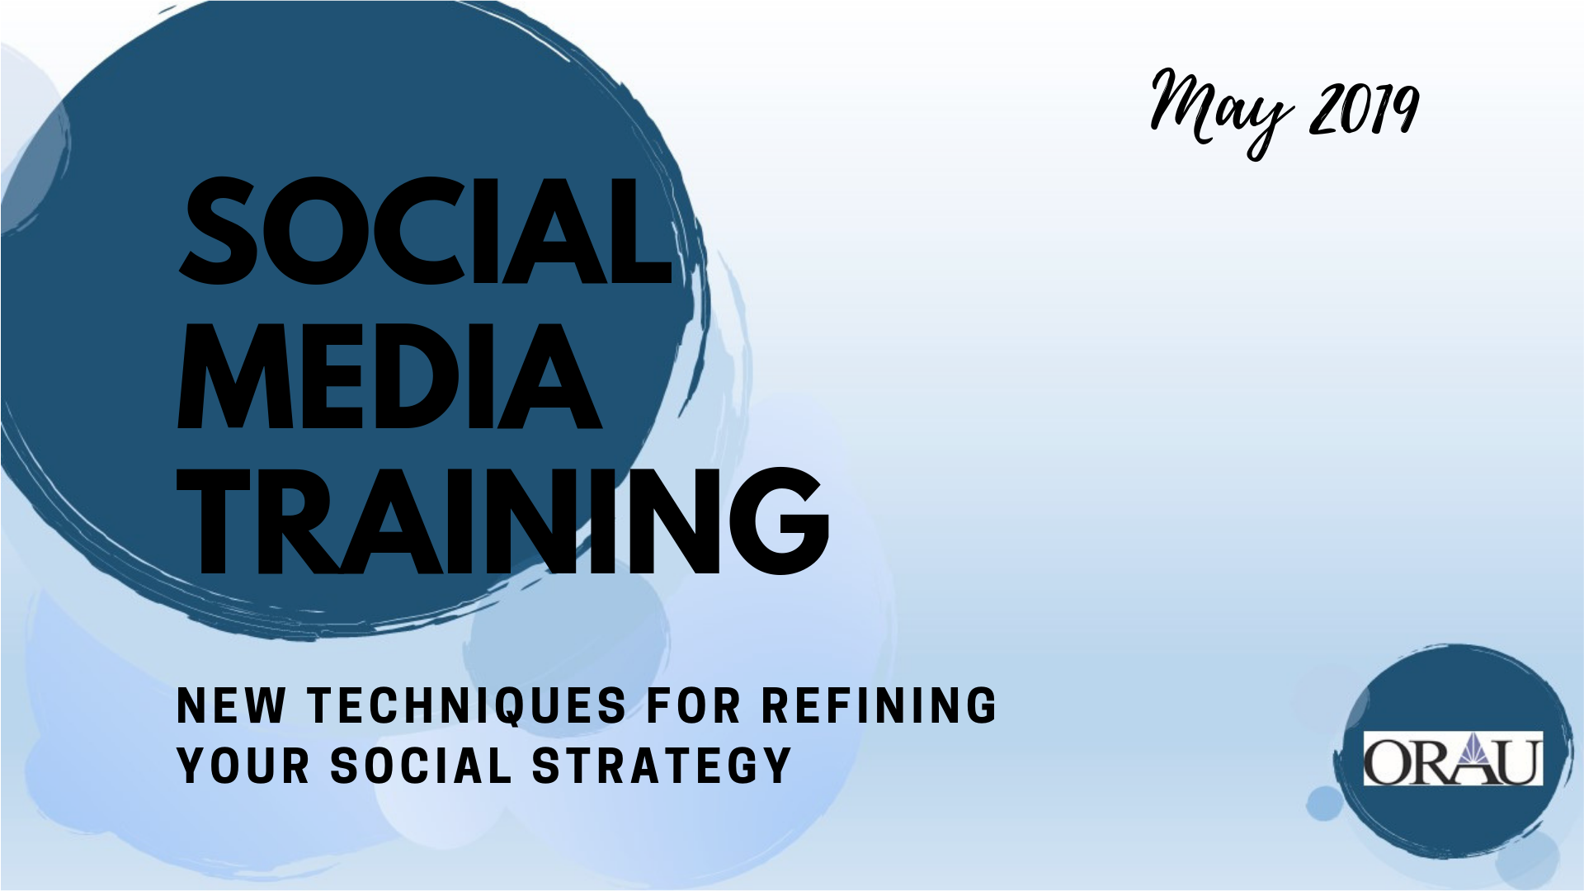

Slide 2
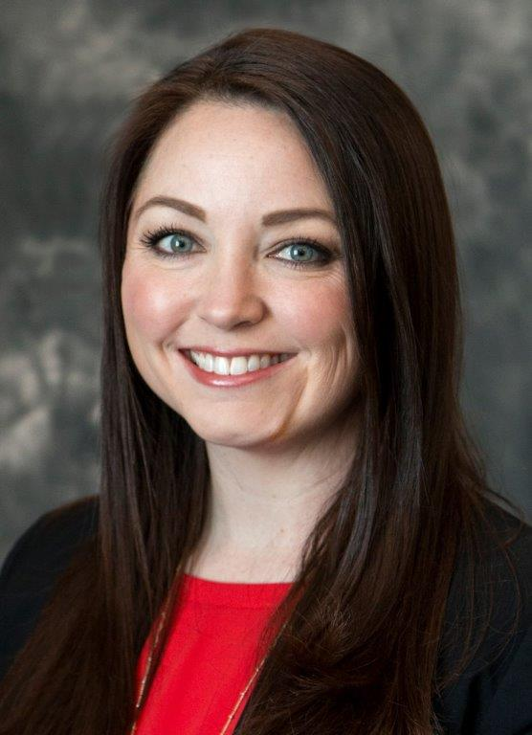


Kristin Mattson
MPH, MCHES
Jennifer Reynolds
MPH, CHES

Slide 3
Training Agenda
Welcome and Introductions | 9:00 – 9:30 am
Presentation: Social Media Strategy Review | 9:30 – 10:00 am
BREAK | 10:00 – 10:15 am
Activity: Overcoming Obstacles to Implementing a Social Media Strategy | 10:15 – 10:45 am
Presentation: Recent Updates to Social Media Platforms | 10:45 – 11:30 am
Presentation: New Strategies for your Toolbox | 11:30 am – 12:30 pm
LUNCH | 12:30 – 1:30 pm
Presentation: Implementing a Successful Social Media Campaign | 1:30 – 2:15 pm
BREAK | 2:15 – 2:30 pm
Activity: Practice Planning and Implementing a Social Media Campaign | 2:30 – 3:45 pm
Closing and Evaluation | 3:45 – 4:00 pm

Slide 4
Introductions
Name, organization, and job role
#1 thing you hope to learn today
[if you attended last year’s training] What changes have you made to your social media strategy this past year?

Slide 5
What does it take to be effective on social media?
Set realistic, achievable goals
Really know your audience
Develop content your audience will love and engage with
Post consistently
Engage in conversations
Promote others
Measure and adjust
Notes:
There are a lot of “social media experts” out there, but the truth is, social media is constantly changing.
The best, most successful social media strategists know that every organization and audience is different.
The key is to put in the effort to learn what resonates with your audience and do more of that.
In order to tell your nonprofit’s story effectively in the past, it required 30 second TV or radio spots, glossy brochures, and big, expensive galas. Now you can tell your story with every Facebook post, LinkedIn article and tweet.
Despite the difference social media can make for your organization, don’t expect your website, social media pages, and blog to be hits over night. Social media and content marketing take time and patience—so does building an audience.
Many digital thought leaders believe that it takes several months to see results from social media marketing.
Integrating social media into your overall communications and marketing strategy is a potentially powerful force, if you’re willing to put in the time and effort.

Slide 6

“Post and Pray”
The anti-strategy strategy
Notes:
One of the biggest mistakes you can make on social media. DO NOT DO THIS!

Slide 7
Social Media Strategy
Defines what success will look like
Helps measure impact
Gets everyone on the same page
Sets standards and expectations
Promotes continuity
You must write it down!

Slide 8
Strategy Components
Goals
SMART objectives
Resources (staff,
time, money)
Audience
Channels
Content
Engagement
Campaigns
Evaluation
Notes:
Goals should be aligned with the overall mission of the organization
Make sure goals and objectives are reasonable for your organization
How many hours are you willing to commit each week?
How much budget do you have for social media efforts?
Who from your organization is invested in your social media strategy?
Who will handle social media for your organization?
Can staff and volunteers share the responsibilities?
Which channels are you able to support now and in the future?
Content should always relate back to your goals and objectives. Be purposeful with your posting.
Evaluation is not just of your efforts, but also reviewing and revising strategy

Slide 9
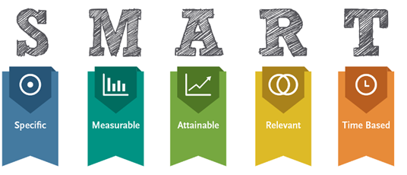
Building Your Strategy:
SMART Objectives
Notes:
SMART Objectives:
Specific
Measurable
Attainable/Audience-centered
Realistic
Time-oriented

Slide 10
Goal & Objective Example
Goal: Decrease stigma in XXX County toward those suffering from opioid use disorders
  Objective 1: Reach 10,000 people on Facebook with a campaign featuring video testimonials of individuals in long-term recovery (September 17-23).
  Objective 2: Develop two infographics (1 featuring the cost savings of investing in treatment and prevention, 1 featuring the success of opioid treatment) and work with the Health Department and Sheriff’s Office to disseminate monthly now through December 2017.

Slide 11
Goal & Objective Example
  Goal: Double our number of Facebook followers between July 2019 and July 2020.
    Objective 1: Continue to consistently post engaging content (minimum of 4 posts per week) each month
    Objective 2: Identify 3 partners with large social media followings who regularly posts engaging content. Develop agreements with these organizations to like and share each others posts (minimum 1-2 per month).
    Objective 3: On a weekly basis, gain new followers by “inviting” individuals who have reacted or commented on other posts to like your page.

Slide 12

Audience(s)
Demographics
Locations
  Social media channels - What activities do they participate in on these sites
  Where do they get news/updates
Who do they trust and/or respect
Psychographics
  Values
  Likes/Dislikes
  Interests/Hobbies
  Personality/Behavior
  Lifestyle
What content would be most interesting/appealing to them
  What are their day-to-day concerns
  How can you help
Notes:
“A lot of nonprofits say, “our audience is everyone,” but if you think you’re speaking to everyone, you’re probably speaking to no one”
Take a look at who your current audience is. Is that the audience you’re trying to reach? If not, what are you going to do to reach them?
Once you know your audience you can shape messages and communications to connect with these individuals’ wants, habits and values. What do they care about?

Slide 13
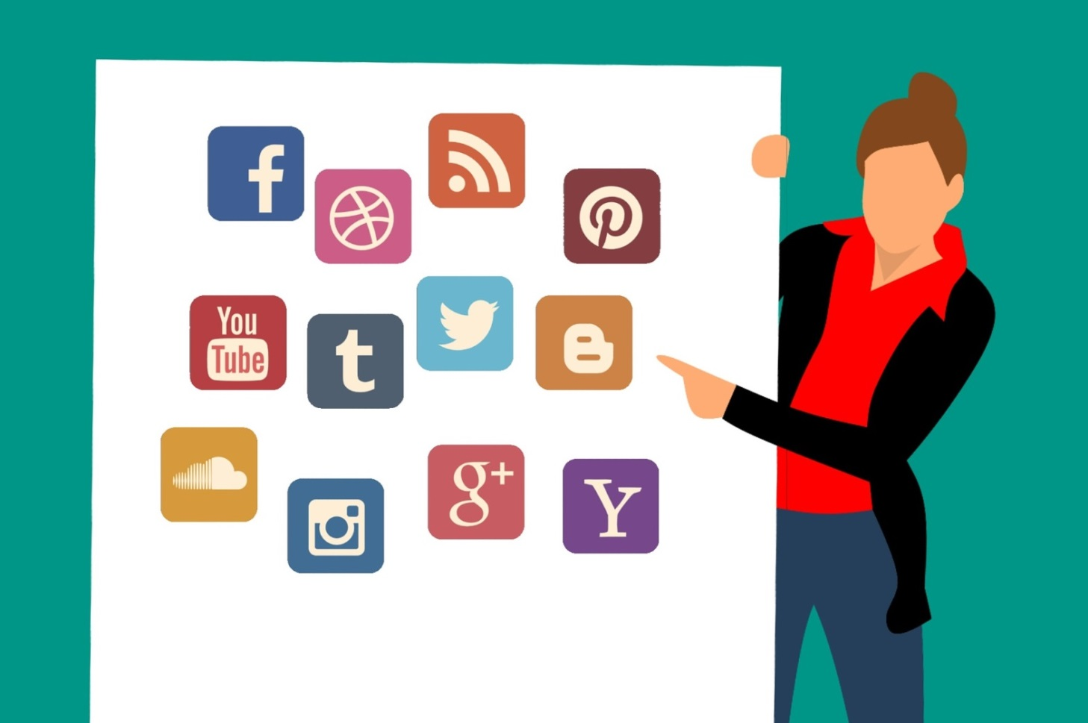
Social Media Channels
Notes:
Another big mistake people make on social media is being on the wrong channel for their audience or being on more channels than they can effectively manage.

Slide 14
What social media channels should I use?
The ones your audiences are on
  Review the national data on social media use
  Look at your own analytic data
  Ask people in your target audience or those that work
  closely with your target audience
The ones that best fit your objectives
and content
The ones your team has the resources to
support well

Slide 15
Content Strategy
Aim to post a variety of interesting, engaging,
VISUAL content
Remember: Quality Over Quantity
The best content adds value for your audience
and drives engagement (especially conversation)
  “What’s in it for me”
  “Why should I care”
  Tip: Tie national stories to what’s happening in
  your local jurisdiction
Notes:
We live in an increasingly visual-first world. People’s attention spans are getting shorter and a text-only post just isn’t going to cut it these days. Social media posts with visuals deliver 180 percent greater engagement. Try a mixture of stock photos, candid cell-phone pictures, graphics made with Canva or Adobe spark, infographics, memes and more.
Studies show that people only remember 10% of what they hear once 72 hours have passed. However, if you pair a relevant image with your material, people can remember 65% of the information after three days.
We know that local matters now more than ever because local = trustworthy which is what the algorithm focuses on.

Slide 16
Content strategy
Creating engaging content requires us to truly understand our audience on a deep level. Ask yourself (or better yet, your audience):
  What does your audience care about?
  What are your audience’s challenges?
  What are your audience’s motivations?
  What content does your audience love to interact with?
Each piece of content you post should serve a specific purpose.
  Aim to spark emotion.

Slide 17
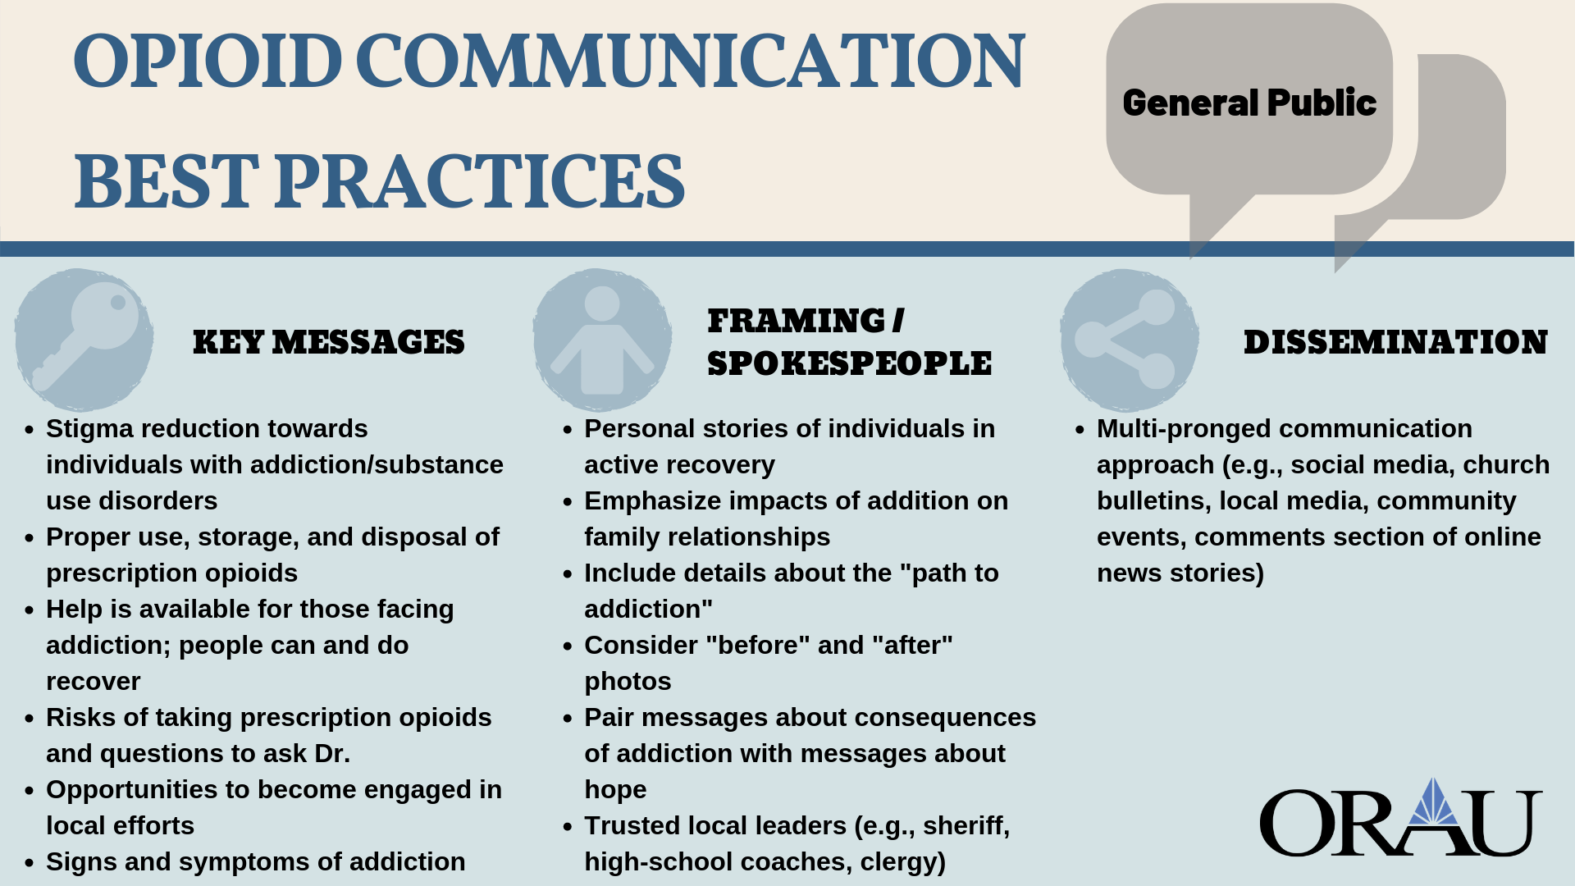

Slide 18
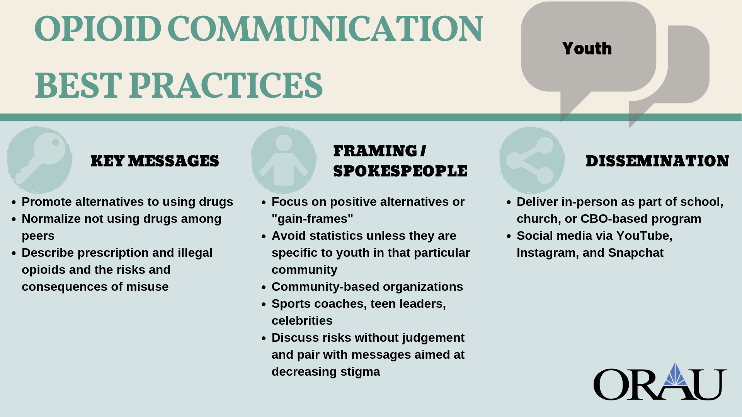

Slide 19
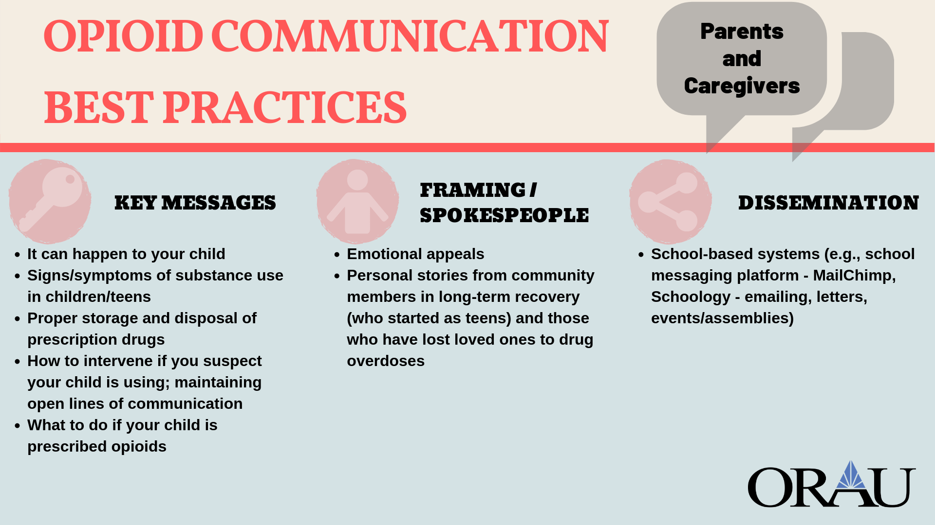

Slide 20
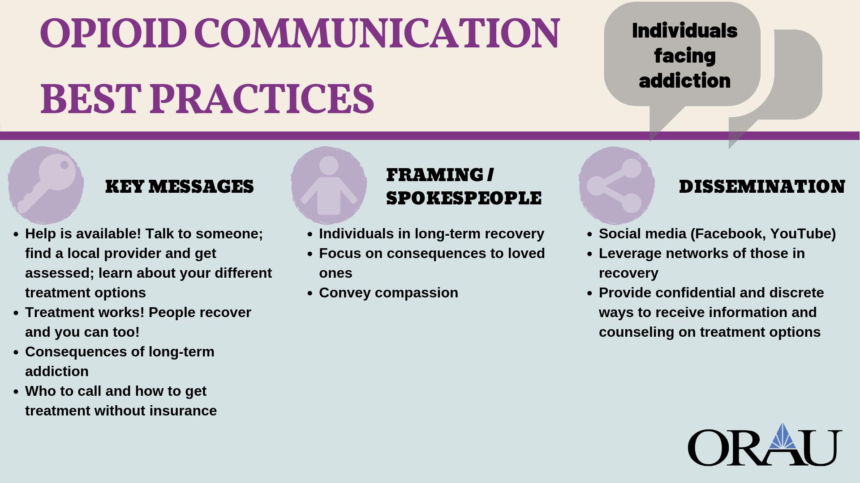

Slide 21
Objective: This study sought to examine if provider Twitter profiles with educational tweets were viewed as more professional than profiles with personal tweets or a mixture of the two, and to determine the impact of provider gender on perceptions of professionalism in an academic obstetrics and gynecology clinic.
Methods: This study randomized obstetrics and gynecology patients at the University of Michigan Von Voigtlander Clinic to view one of six medical provider Twitter profiles, which differed in provider gender and the nature of tweets. Each participant answered 10 questions about their perception of the provider’s professionalism based on the Twitter profile content.
Results: The provider profiles with educational tweets alone received higher mean professionalism scores than profiles with personal tweets. Specifically, the female and male provider profiles with exclusively educational tweets had the highest and second highest overall mean professionalism ratings at 4.24 and 3.85, respectively. In addition, the female provider profiles received higher mean professionalism ratings than male provider profiles with the same content. The female profile with mixed content received a mean professionalism rating of 3.38 compared to 3.24 for the male mixed-content profile, and the female profile with only personal content received a mean professionalism rating of 3.68 compared to 2.68 for the exclusively personal male provider profile.
Conclusions: This study showed that in our obstetrics and gynecology clinic, patients perceived providers with educational profiles as more professional than those with a mixture of educational and personal tweets or only personal tweets. It also showed that our patient population perceived the female provider with educational tweets to be the most professional. This study will help inform the development of evidence-based guidelines for social media use in medicine as it adds to the growing body of literature examining professionalism and social media.
J Med Internet Res 2018;20(3):e78 doi:10.2196/jmir.8056
Notes:
Lastly…importance of developing social media policies

Slide 22

Best Practices For Facebook
Create visual content that generates conversations – video if possible
Upload your videos directly into Facebook (add captions)
Add post copy with a call to action or question to prompt discussion
When posting links try to use local websites or other websites that your audience may frequent
Use Audience Insights to learn more about your audience https://www.facebook.com/ads/audience-insights
Go Live!
Connect with Facebook groups (more on this later)
Create Facebook Events
Notes:
Videos on Facebook see an average of 135% more organic reach than images. 85% of video is watched with the sound off so those captions are essential
When you upload directly into FB, it will be uploaded in a format that provides a bigger thumbnail, auto-plays, and is prioritized in the algorithm. Native gets 100% higher reach and 1055% more shares.
YouTube is one of Facebook’s biggest competitors so FB does not want you leaving FB to go watch videos on YouTube. These posts are treated as Link posts so are no good!
Facebook users spend 3x more time watching live videos than a video that’s no longer live.
They also comment more than 10x more during live videos.
80% of respondents said they would rather tune into a live video than read a blog post.
82% of respondents were more interested in watching live video from a brand than reading social media posts.

Slide 23
Best Practices For Facebook
Complete your page profile
  Appropriately sized cover/profile photos
  About
    Our Story
    Team Members
  “Call to Action” button
  Get verified (Settings – General – Page Verification) [Results may vary ☺]
Learn Facebook Advertising
  Previous webinar on Intro to FB ads
Notes:
Videos on Facebook see an average of 135% more organic reach than images. 85% of video is watched with the sound off so those captions are essential
When you upload directly into FB, it will be uploaded in a format that provides a bigger thumbnail, auto-plays, and is prioritized in the algorithm. Native gets 100% higher reach and 1055% more shares.
YouTube is one of Facebook’s biggest competitors so FB does not want you leaving FB to go watch videos on YouTube. These posts are treated as Link posts so are no good!
Facebook users spend 3x more time watching live videos than a video that’s no longer live.
They also comment more than 10x more during live videos.
80% of respondents said they would rather tune into a live video than read a blog post.
82% of respondents were more interested in watching live video from a brand than reading social media posts.

Slide 24
Best Practices For Facebook
Do NOT
  Overpost
  Ask for ‘likes,’ ‘comments,’ and ‘shares’
    Consider instead: “we’d love to know your thoughts”
Notes:
This is called engagement bait and you’ll actually result in a demotion of your posts in the newsfeed.

Slide 25

Best Practices for Instagram
Post consistently
Switch to a business profile
Include a keyword in your name
Consider including the following in your bio:
  Clickable link, branded hashtag, @mention(s)
Tag posts with locations and @mentions
Use emojis in captions and comments
Tell a story with your caption
Use hashtags strategically (more later)
Notes:
Switching to a business profile gives you access to analytics and a contact button
Include a keyword in your name to appear in search results
emojis in your captions and comments – they are searchable and hashtagable too)

Slide 26
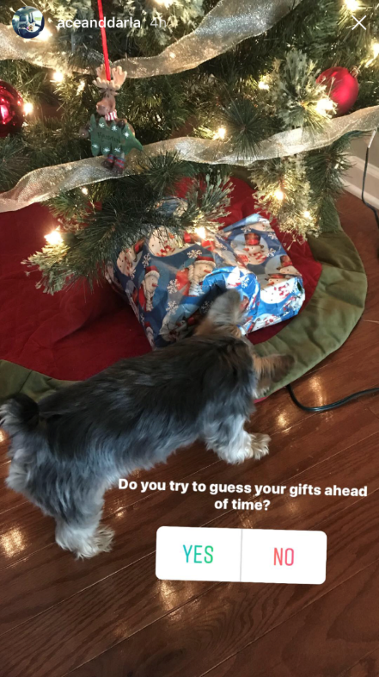
Best Practices for Instagram
Create stories and story highlights
  Use interactive features like poll and question stickers
Ask people to turn on post and story notifications for your content
Use new features
Go live!
Engage with others’ content and follow people in your target audience and with similar interests
Create an IGTV channel (more on this later)
Notes:
Story Highlights
Allows you to combine multiple stories into long-term content to show on your profile in albums
Create a unique highlight for each of your service areas to showcase stories pertaining to that content category
Highlights for events
Add from archive or from an active story
To add from archive click + button on profile screen
To add from active, open story and tap highlight icon with heart
Name your highlight album (max 16 characters, but will cut off after 11 or 12)
Create cover image (first image you uploaded to the highlight) TIP: create in Canva and upload them to stories via camera roll
Can have more than 20 albums – keep to 4 to 5
Most recently created will appear first
Follow at least 200 people to start

Slide 27
Best Practices for Instagram
HASHTAGS!
Determine your niche hashtags Super specific May even include your geographic area Think about what your target audience may be searching for Determine your super popular hashtags Related to your content, but have millions of posts on that hashtag Determine moderately popular hashtags Related to your content, but have tens to hundreds of thousands of posts on that hashtag | In each post, use: 2 to 5 niche hashtags 5 to 7 moderately popular hashtags 4 to 5 super popular hashtags
*Developed by Jenn Herman a top Instagram blogger.
Notes:
Follow these rules to greatly increase the odds of your posts appearing as a “top post” in searches
Tip: Search hashtags in the app to see how many posts are associated with it
The super popular hashtags should help give you some quick engagement, which will increase the likelihood of your content being a top post for your niche hashtags (less competition)

Slide 28

Best Practices for Twitter
Post content that adds value
  Native video
Engage with others’ content
Include links to a variety of sources
Use emojis
Respond if someone mentions you in a tweet
  Do not start off a retweet with @mention. Include a period or space
Use no more than 2 hashtags per tweet
Host and participate in Twitter chats (Tip: Use TweetChat)
Notes:
native video on Twitter tends to drive significantly more engagement than those from third party players (resulting in 2.5x more replies, 2.8x more retweets, and 1.9x more favorites).
Tweets with hashtags are 33% more likely to get retweeted than those without them.
However, less can also be more: tweets with only one hashtag are 69% more likely to get retweeted than those with two hashtags.
https://adespresso.com/academy/blog/23-strategies-increase-twitter-engagement/
A Twitter chat is a public Twitter conversation around one unique hashtag. This hashtag allows you to follow the discussion and participate in it. Twitter chats are usually recurring and on specific topics to regularly connect people with these interests. Twitter chats are a great way to gain exposure, grow your following and engage with your audience.

Slide 29
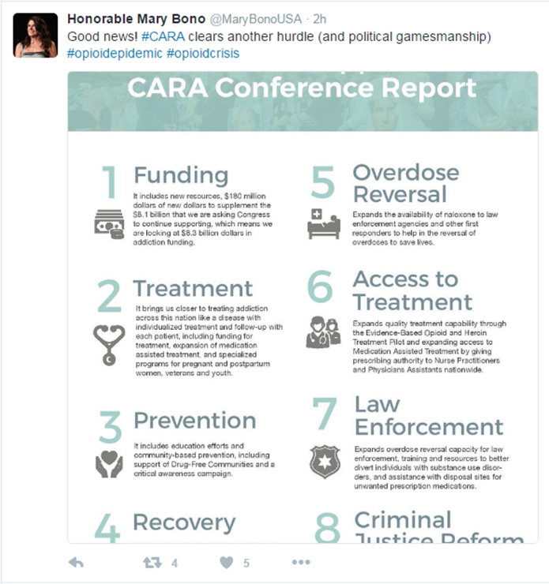
Best Practices for Twitter
Pin tweets to your page
Include quotes
Create a Twitter poll
Tag your location
Go live (mobile)
Size your images appropriately
  http://sproutsocial.com/landscape
Notes:
Although you can Tweet any sized image, Twitter automatically crops a section and displays it as 440 pixels wide and 220 pixels tall (2:1 ratio) in the Twitter stream; anything not meeting this ratio will be cut off in the newsfeed.
Pin your favorite, or most engaging tweets, or tweet to promote an upcoming event, blog post, or other.
https://adespresso.com/academy/blog/23-strategies-increase-twitter-engagement/
Public and Private lists-private lists will not notify people they’ve been added to a group.
Twitter polls allow you to have up to 4 options in your poll and set it for between 5 minutes and 7 days.

Slide 30
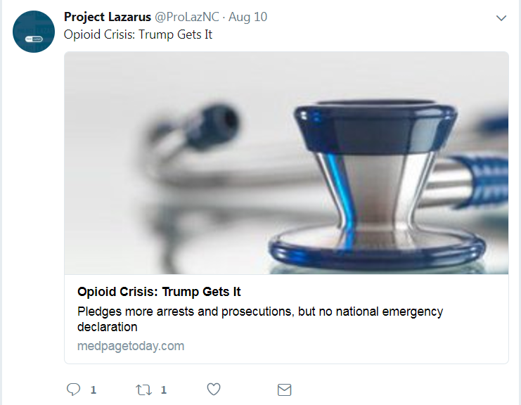
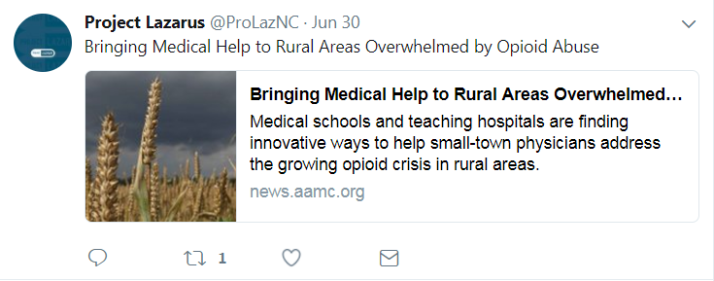
Best Practices for Twitter
Use your 280 characters wisely
DON’T simply repeat the headline when posting links
  Pull out quotes or statistics or tell the reader why they should click to read more
Notes:
“How young is too young to talk about underage drinking?”
E.g., Why you should be talking to your kids about underage drinking.

Slide 31

Notes:
15 minute break!

Slide 32

Activity: Overcoming Obstacles to Implementing a Social Media Strategy
  Identify challenges
  Discuss strategies

Slide 33

Recent Twitter Updates

Slide 34
Recent Updates
280 characters
Threads
Edit button
In app camera
Twttr
  New “chat like” display to threads
  Hidden metrics
Just kidding!
Notes:
In app camera similar to Instagram.
A new prototype version of Twitter debuted at SXSW in March highlighting potential changes. Twitter announced this prototype app would be where they would try out potential changes before rolling them all out to Twitter.
Hiding metrics to eliminate “the Ratio.” Generally speaking, the more replies a tweet gets over likes or retweets, there’s an increased perception that it’s a bad tweet. The Ratio or “getting ratio’d” has since become shorthand for obviously bad tweets—in 2017, Esquire published “How to Know If You’ve Sent a Horrible Tweet” explaining how The Ratio works. Twitter-famous Ratios have been logged against politicians, pundits and corporate social media accounts as a demonstration.

Slide 35
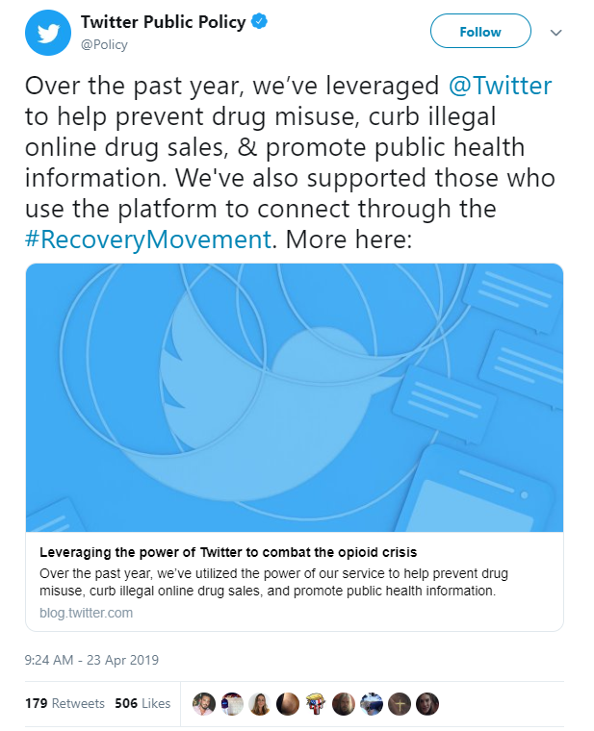
Recent Updates
Leveraging Twitter to help prevent drug misuse, curb illegal online drug sales, and promote public health information
  https://blog.twitter.com/en_us/topics/company/2019/leveraging-the-power-of-twitter-to-combat-the-opioid-crisis.html
Championing those working to build the #RecoveryMovement
Notes:
Removing tweets, banning certain content,
But also promoting public health information! HUGE FOR YOU! USE THIS HASHTAG!

Slide 36

Recent Instagram Updates

Slide 37
Recent Updates
Instagram FINALLY gave us insight into their algorithm
Ranking is very individualized and post popularity has little impact on placement
  3 major variables – Interest, Timeliness, Relationships
No preference for videos vs photos – user dependent
Interactions with stories has no impact on feed & vice versa
Notes:
Interest: Instagram looks at the type of content you interact with (e.g., home décor, dogs, photos, videos, food). What you interact most with will rank higher.
Timeliness: Recency of posts from those you follow is now a more important factor.
Relationships: Who do you interact with the most?
What does this mean for you?
Need to work harder to develop that relationship. Creating posts and stories that spark conversations and REPLYING thoughtfully when people comment.
Start posting more often, but only if you have quality content. And post when your followers are online.
Post more video – although video isn’t prioritized, video consumption on IG is increasing so more people prefer video than not.
if someone watches every single one of your Stories but never interacts with your regular content, your regular content will be buried lower in that person’s feed.
What does this mean for you? You should be cross promoting content between stories and feed (e.g., go check out my most recent post…)

Slide 38
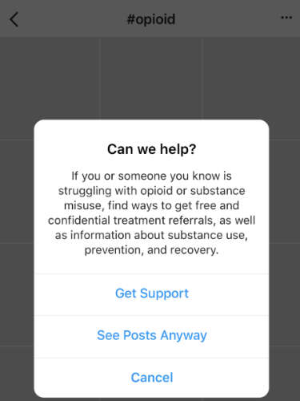
Recent Updates
Get Support feature
  Jennifer’s perspective: https://www.orau.org/news/perspectives/using-social-media-to-address-substance-misuse-and-abuse-an-analysis-of-instagrams-get-support-feature.html
Notes:
When users search for opioid related hashtags (#opioids, #uppers) a message appears asking if they would like to see information about substance use, prevention, treatment, and recovery.

Slide 39
Recent Updates
Posting from Facebook desktop to Instagram
  Must be posting a photo from your FB page
  BE CAREFUL of image ratios
New stickers for stories
  Questions
  Countdown
  Quiz
  Donate
Quick reactions on stories (heart eyes, laughing, sad, clapping)
Bulk story uploads
Close friends list
Alt Text to Posts
Notes:
Questions sticker – allows you to pose a question and get qualitative responses back from people in the form of a DM. You can then share the responses back as another sticker to your stories
Countdown – Released in December, allows you to put a countdown clock on stories and people can subscribe to be notified with the countdown expires. Countdown can be longer than 24 hour life of the story. This is great for contents, announcements, right before an event, etc.
Quiz – JUST announced at the end of April, this allows for multiple choice responses beyond the 2 option poll sticker. This would be a GREAT educational tool to have some interesting trivia and a way to increase engagement.
Donate- All of the money raised on the platform will go to the nonprofit a user chooses to support, an Instagram spokesman said, adding that Instagram’s owner, Facebook, will cover the credit-card processing fees and costs of operating the feature.
Bulk story uploads: select multiple photos and videos at once to add to stories, edit each one before doing the full upload. This allows you to post an entire story sequence at once without having delays in between posting each segment.
Close friends – allows you to choose a single segmented list of people to share content with. Perhaps you have content you just want to send to colleagues, a planning team, or volunteers, or some other audience segment. You can set this up in advance and update as often as you want.
Does anyone have to worry about 508 compliance? A lot of government grants are now requiring that content be made accessible to people with visual impairments. Alt Text allows people with a special screen reading tool to hear that text. Alt text can also help your content rank in Google searches. Instagram has capped the alt text description at 100 characters. Must explain in detail what is in the image.

Slide 40
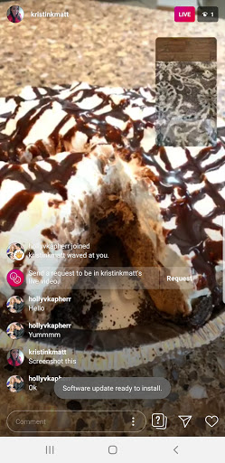
Recent Updates
Share your camera roll during live videos
Nametags
Better integration with 3rd party scheduling tools (Later, Iconosquare, Tailwind)
And of course…
IGTV (more to come)
Notes:
Think of how powerful this could be. You could create a slide deck in advance, save as a jpg and essentially give a presentation or provide other educational information to people.
Remember, you go live through the stories section of IG.
Nametags is a visual image that can be scanned (like a QR code) with the Instagram camera to be taken to or allow you to follow another Instagram account. These can be saved and printed on fliers, posters, etc. at events. Snapchat came up with this first…at a social media marketing conference someone was wearing their snap code printed on a t-shirt.
IGTV launched at the end of June

Slide 41
Recent Facebook Updates

Slide 42
Recent Updates
Facebook is being redesigned around Stories, Groups and Events (“FB5”)
  Stories are front and center
  New Groups and Events tabs
  Personalized feed from groups you’ve joined
  Group “discovery” emphasized throughout the app
  “Share to groups” added to create post
  “Ask admin to post” to protect privacy around sensitive topics
  New chat features for members to create threads and subthreads (like Reddit)
  More intuitive “events tab” makes it easier to find “events near you” and add them to your calendar
The Newsfeed era is over
Notes:
Arguably, FB has had a rough year with privacy breaches and bad press concerning its negative impacts on everything from individual mental health to its roles in influencing elections, inflaming hate speech, and more recently – influencing vaccination rates. They have paid out 3 Billion in fines for privacy violations.
Facebook says the mobile redesign will start rolling out immediately on iOS and Android around the world. It’s also working on a desktop redesign that will arrive in the coming months.
Facebook is making a concerted effort to ensure groups are visible in every part of the app, so it’ll start promoting groups in areas like Marketplace and Watch.
It’s also building specific tools tailored to group types, like a new listing format for groups focused on finding new jobs or buying buttons built into live broadcasts for groups that focus on selling used products. With the new design, the company says you’ll also be able to post to any group you’re a part of from the News Feed as if you were posting to your own profile.
The new events tab, which now sits next to the groups tab in the new menu bar layout, has a richer map view for seeing where the events you’re interested in are in proximity to one another. There’s also a much more intuitive look and feel to the design that makes it easy to find new events, organize your calendar, and quickly sift through events your friends are hosting and public ones, like concerts, that you may be interested in checking out.
Source: https://www.theverge.com/2019/4/30/18524068/facebook-f8-2019-keynote-highlights-summary-news-feed-messenger-instagram-oculus

Slide 43
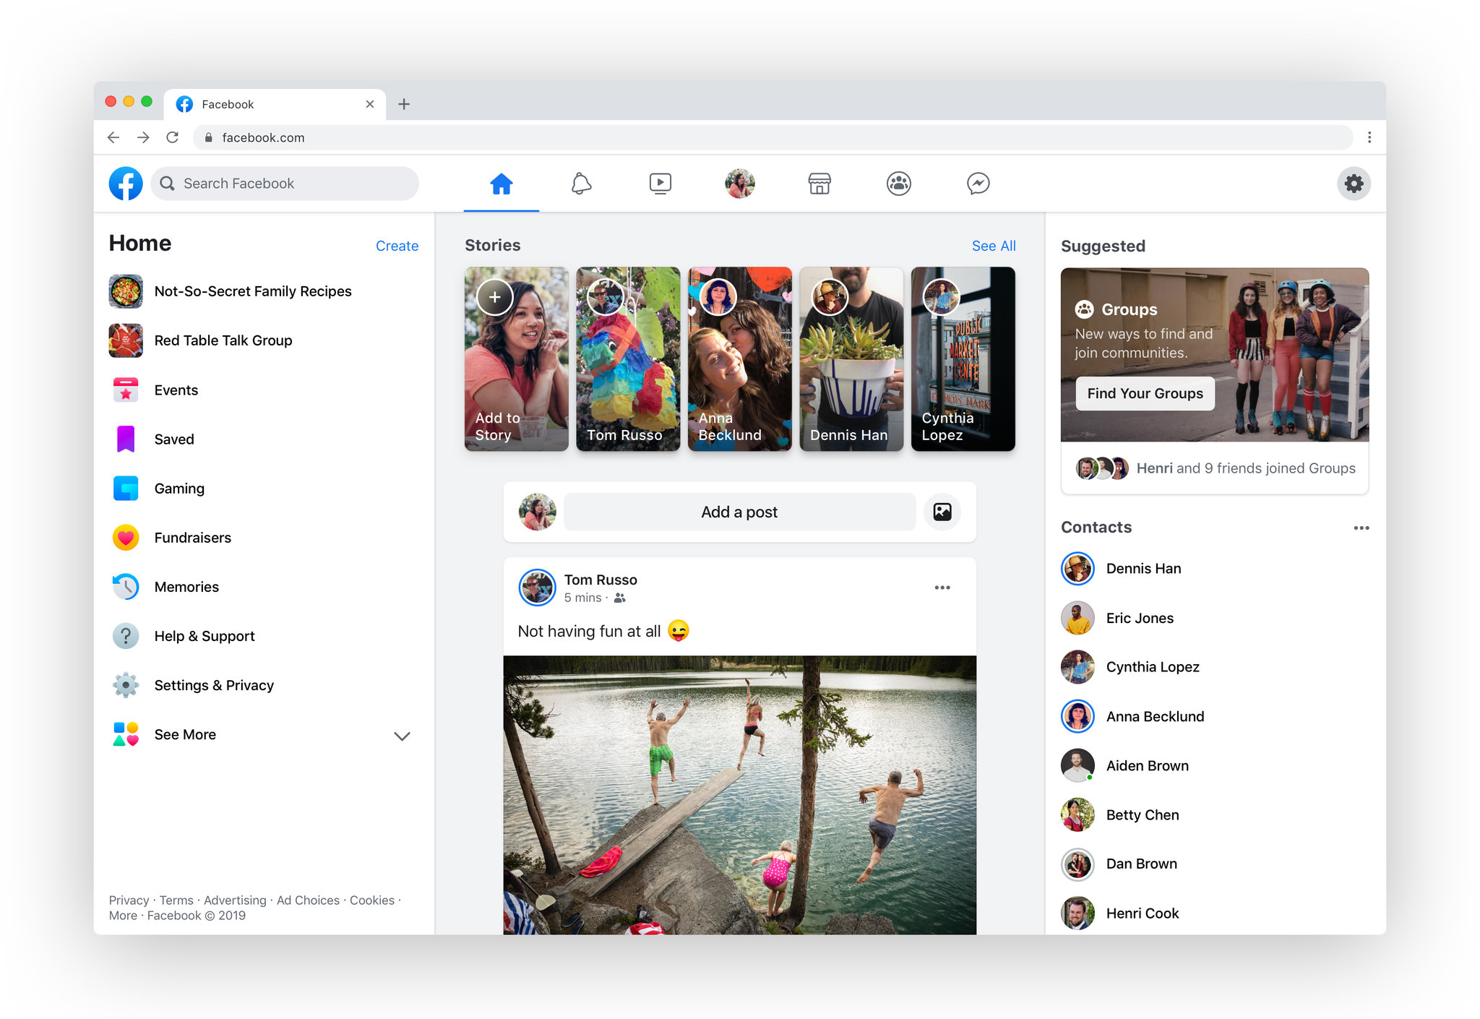
Notes:
Mobile changes rolled out last week, coming to desktop in the next few months

Slide 44
Recent Updates
FB Messenger overhaul
  “Fastest private communication app on the planet”
    Less battery, less storage (>30MB), faster (1.3 s start)
  End-to-end encryption by default (for text, shared locations, video)
  New features
    Dedicated tab for “close friends and family”
    Ability to message with FB, Instagram, and What’s App users
    Ability to unsend messages, augmented reality, “Watch Together”
  Desktop app
Notes:
End-to-end encryption means that conversations between two users on messenger are safe from hackers, government, and Facebook

Slide 45

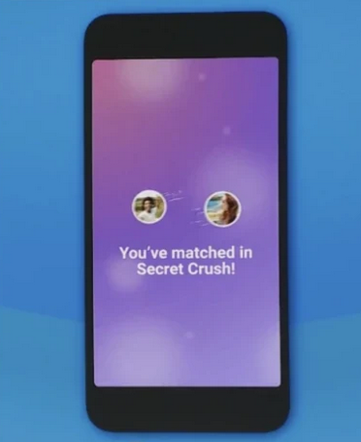
Recent Updates
New features
  Dark mode
  “Meet New Friends”
  Facebook Dating (Opt-in only)
  “Secret Crush”
Notes:
Facebook dating will launch in the US later this year. Same with “Secret Crush”

Slide 46
Strategy Recommendations
Focus on keeping your audience in Facebook
  Use fewer link posts
  Embed blogs and videos
  Never send users to YouTube
  Schedule posts ONLY in Facebook
Strategize around creating engagement
  Live video (6x more engagement)
  Focus on quality messaging versus quantity
Leverage the power of Stories, Groups and Events
Watch your metrics because it’s a brave new world …
Notes:
Source: https://www.facebook.com/brandmerrycoaching/photos/a.581249555244718/1667998093236520/?type=3&theater

Slide 47
Strategy Recommendations
Updates to Video Ranking (From 5/6/19!)
Loyalty and intent: Content that promotes repeat viewership will be considered when surfacing videos
  Promote videos and tease upcoming content
Video and viewing duration: Videos that are at least three minutes long and capture a viewers' attention until the end will have more weight.
  "plan your video’s opening, build-up, tension, pacing and payoff in ways that will catch a viewer’s attention and hold it until the end.“
Originality: Last year Facebook announced that they would limit distribution for unoriginal or repurposed content from other sources that don't add any extra value.
  "Videos that rely too heavily on static images can have their distribution reduced."
Notes:
Source: https://newsroom.fb.com/news/2019/05/updates-to-video-ranking/

Slide 48
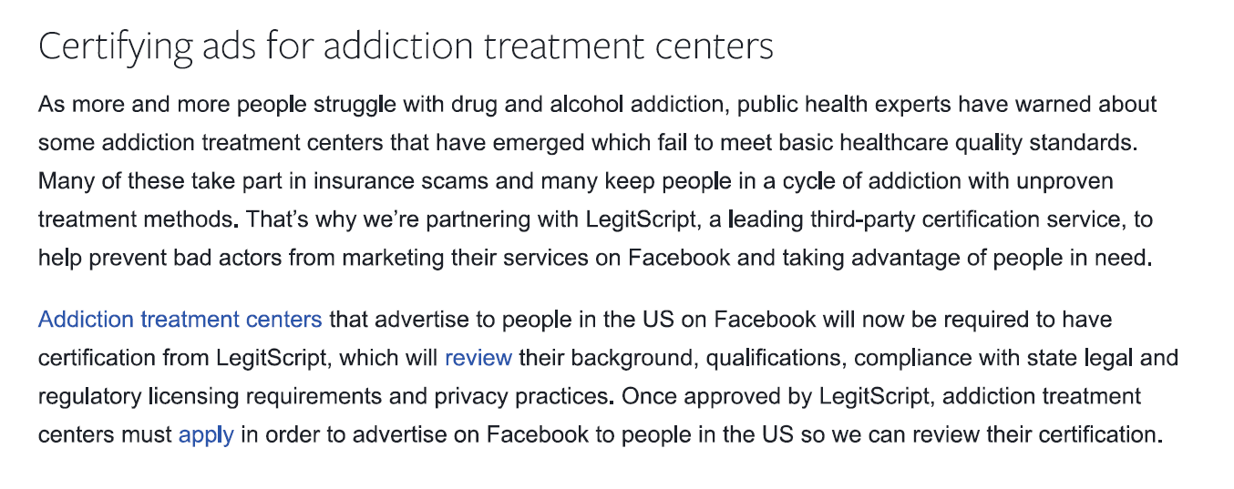

Slide 49
Pop Quiz
WHAT IS THE MOST POPULAR SOCIAL MEDIA PLATFORM ACROSS DIFFERENT AGE AND GENDER GROUPS?

Slide 50
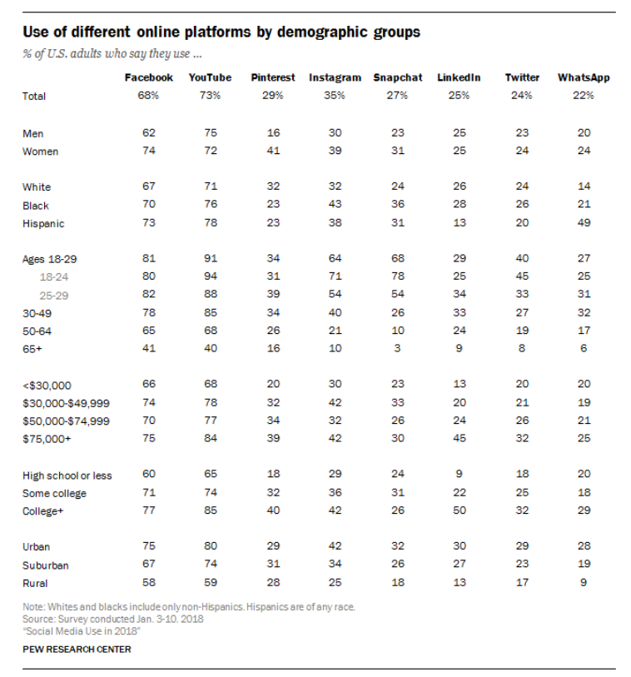

Slide 51

Intro to Basic YouTube Strategy

Slide 52

About YouTube
Owned by Google
2nd most popular search engine in the world
Most popular social media channel
  80 percent of American adults 18-49 watch at least one video a month
  YouTube has seen double digit growth, while traditional TV has seen double digit decline
98 different “localized” versions
More than 20 percent of videos are switched off within the first 10 seconds of playback
50 million content creators
  96.5% of channel owners won’t make enough advertising money to break the poverty line
Notes:
The most important thing to know about YouTube is that its parent company is Google. And that, behind Google, it is the most popular search engine. Which means that SEARCH ENGINE OPTIMIZATION IS KEY. Those keywords and descriptors really matter.
YouTube is the second largest search engine, right after Google. It's bigger than Bing, Yahoo!, and Ask combined.
Source: https://www.uscreen.tv/blog/how-to-make-a-good-youtube-video/; https://www.makeuseof.com/tag/21-amazingly-interesting-youtube-facts-2016/

Slide 53
YouTube Strategy Basics
Create a YouTube for Business Account (Do not create a channel using a regular Google account)
  https://blog.hootsuite.com/how-to-create-a-youtube-account-channel/
Complete your YouTube profile
  Keyword-rich bio
  Eye-catching Channel Art (2560 x 1440 pixels, 2MB max) and Icon (800 x 800 pixels)
  Links to your website and social media profiles
  Location and contact information
  Featured channels
Verification: www.youtube.com/verify
Notes:
Source: https://blog.hootsuite.com/youtube-marketing/
When you create your YouTube channel using a regular Google account, only one person—the Google Account holder—can log into that channel. By creating your YouTube channel using a Brand Account, multiple authorized Google Accounts can log in simultaneously.
When you upload a video you can choose a freeze-frame to use as the thumbnail. However, we strongly recommend making your own custom thumbnail, as it’ll help your content stand out.
A word on verification – when you first sign up for a channel, you will be limited to posting videos 15 mins or under. Once verified, you can post any length up to 20 MB.

Slide 54
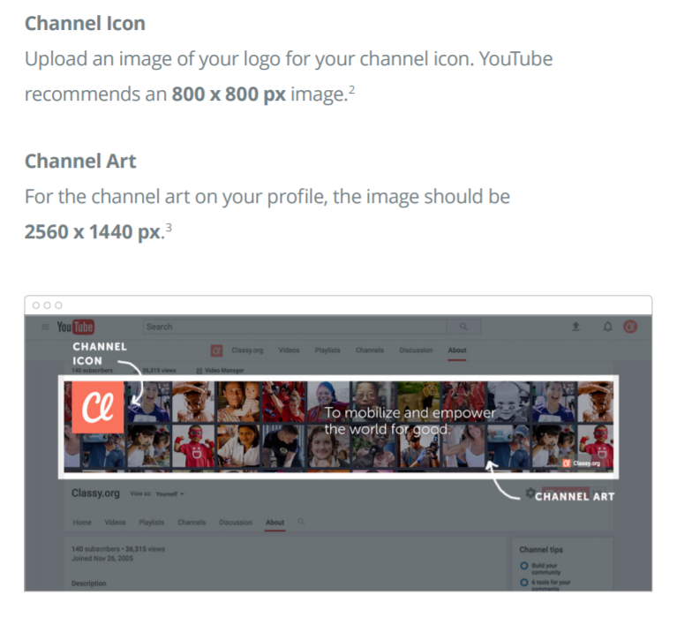
Notes:
Source: https://www.classy.org/blog/youtube-for-nonprofits-need-to-know/ - download YouTube Cheat Sheet for Non Profits

Slide 55
YouTube Strategy Basics
When creating video
  Try to incorporate different video formats and types
    How-to
    Question & Answer
    Live-stream events
    Testimonials and storytelling (Impact Stories)
    Guest or partner interviews
    Thank you messages to supporters
    Updates “from the field”
    Tours
    Fun videos to delight your community (“STAND man”)
Notes:
Source: https://blog.hootsuite.com/youtube-marketing/
When you create your YouTube channel using a regular Google account, only one person—the Google Account holder—can log into that channel. By creating your YouTube channel using a Brand Account, multiple authorized Google Accounts can log in simultaneously.
When you upload a video you can choose a freeze-frame to use as the thumbnail. However, we strongly recommend making your own custom thumbnail, as it’ll help your content stand out.

Slide 56
YouTube Strategy Basics
When creating video, cont.
  Aim to create videos that are 4 mins or less
  Start off energized and move quickly to the heart of your message
  Include a strong Call To Action (CTA) at the end of your video - tell viewers to like, subscribe, comment, or share
Notes:
Source:
https://cdn2.hubspot.net/hubfs/190333/_misc-resources/2017-01_youtube-cheat-sheet/classy-youtube-cheat-sheet.pdf?t=1485364428928
When you first sign up with YouTube, your account will be limited to videos under 15 minutes, until the account has been “verified.”

Slide 57
YouTube Strategy Basics
When uploading video
  Upload with a file name that includes a top key word
  Pick an appealing title containing relevant keywords
  Write a GREAT description –
    1000 characters max (only first 2-3 lines shown in line)
    Include keywords
  Use a custom thumbnail for your videos
  Add up to 15 hashtags https://support.google.com/youtube/answer/6390658?hl=en
  Under “Advanced Settings”
    Categorize your video
Notes:
Source: https://blog.hootsuite.com/youtube-marketing/; https://www.socialmediatoday.com/news/5-tips-for-effective-youtube-marketing-in-2019/546708/; https://blog.hubspot.com/marketing/youtube-seo
When you upload a video you can choose a freeze-frame to use as the thumbnail. However, we strongly recommend making your own custom thumbnail, as it’ll help your content stand out.
Instructions for great descriptions - https://creatoracademy.youtube.com/page/lesson/descriptions

Slide 58
YouTube Strategy Basics
Need help finding good keywords?
  https://ads.google.com/home/tools/keyword-planner/
Notes:
Source: https://blog.hootsuite.com/youtube-marketing/; https://www.socialmediatoday.com/news/5-tips-for-effective-youtube-marketing-in-2019/546708/
When you upload a video you can choose a freeze-frame to use as the thumbnail. However, we strongly recommend making your own custom thumbnail, as it’ll help your content stand out.

Slide 59

IGTV

Slide 60

IGTV
Instagram’s Answer to long-form video – Integrated within the IG app
2 ways to create channel: 1. desktop, 2. separate mobile app
Videos between 15 seconds and 1 hr
Videos must be in portrait orientation
IGTV channel shows up on your profile where story highlights live
Videos should have title and description
  Add hashtags to video description
IGTV previews in IG feed (one minute)
Ads coming
Notes:
Launched at the end of June
Desktop friendly, videos over 10 minutes can ONLY be uploaded via desktop site.
You’ll log in with your Instagram account, thereby connecting the two immediately, importing your Instagram bio and details into your IGTV channel.
Anyone who is following your Instagram account is automatically following your IGTV channel.
After posting, you can only edit title and description on desktop
IGTV allows you to put clickable links in your video description! Some people are even getting access to swipe up links in their videos (even without the 10k follower requirement of stories)
Insights are available for each video – you can like, comment, and send videos to friends in direct message
Instagram is really pouring a lot of energy into IGTV. Now is the time to get on board.
What will be your IGTV strategy? Content can’t be organized in categories and this is not meant to be a place to save all your stories. It’s meant for longer-form meaningful content. Think about television programming that adds VALUE. Teaching, how-to’s, talk-show-like segments with experts (think news interviews). A place to save your live videos? Think about how you can INSPIRE, EDUCATE, or ENTERTAIN

Slide 61
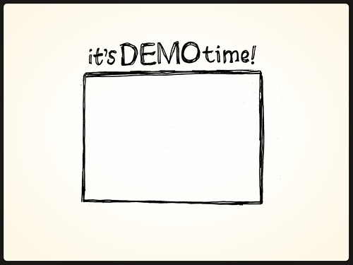


Slide 62

Facebook Groups

Slide 63
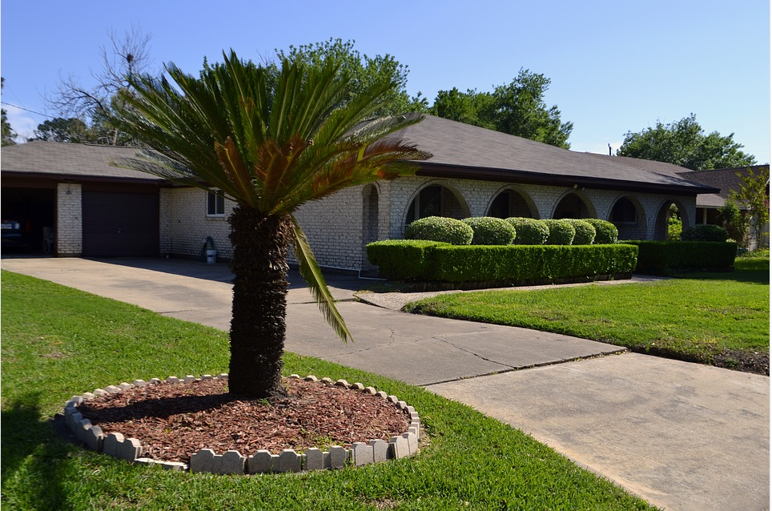

Pages versus Groups
Notes:
Would you host a BBQ or a pool party in your front yard for everyone in the world to see? No!
Pages are like your front yard – you keep them appealing and professional and open to anyone wandering by in the neighborhood.
But your backyard is the place where you invite people in that share a common interest. You provide an atmosphere and food/drinks to facilitate networking and conversation. But remember - you have to play the role of host when you invite people to your backyard! You would never invite people over and then go take a nap.
Analogy from Bella Vista during Casual Friday’s Podcast Episode 224: Facebook Groups for Business: A Secret Weapon for Facebook Marketing
From Facebook: While Pages were designed to be the official profiles for entities, such as celebrities, brands or businesses, Facebook Groups are the place for small group communication and for people to share their common interests and express their opinion. Groups allow people to come together around a common cause, issue or activity to organize, express objectives, discuss issues, post photos and share related content. https://www.facebook.com/notes/facebook/facebook-tips-whats-the-difference-between-a-facebook-page-and-group/324706977130/

Slide 64

Some BIG benefits to Facebook Groups
More organic reach
More options/tools for connecting with members
  Posts, polls (traditional), photos/albums, videos/live videos
  Instant chat, group message to all members, share documents
  “Watch Party”, “Get Together”, UNITS [social learning]
  Promote events
  “Admin to post” (anonymous to protect privacy)
  Chat features – threads and subthreads
Privacy options
Notifications
User-generated content
Notes:
Sources:
https://neilpatel.com/blog/an-eye-opening-guide-on-how-to-grow-a-facebook-group/
https://blog.hootsuite.com/facebook-secret-groups/
Casual Fridays Podcast Episode 224

Slide 65
3 Types of FB Groups
1. Public
Everyone can find your group
Everyone can join
Everyone can view your content
2. Closed
Everyone can find your group (name, description, member list)
Must be approved by an administrator or invited by a current member to join
Only members can view your content
3. Secret
No one can find your group
Only those invited by a current member can join
Only members can view your content
Notes:
Source: https://blog.hootsuite.com/facebook-secret-groups/
Our recommendation is to set your group up as ‘Closed’. If done correctly, people will want to join to be able to see your “exclusive content”. This allows you to collect information on members as they enter and keep more control over the audience. You want to protect people from trolls (especially when discussing controversial topics) and this is much harder to do in a public group.
You can still promote a ‘closed’ group which is useful for getting new members. I recommend only doing a secret group if you have a strong reason for doing so (e.g., private, internal conversations that you do not want others to be aware of).
One question we sometimes hear is – how private are closed and secret groups?
Answer: Following the fallout of the Cambridge Analytica data breach scandal, Facebook announced plans to restrict third-party data access to groups. Currently, third-party apps need permission from an administrator to access group content for secret groups.

Slide 66

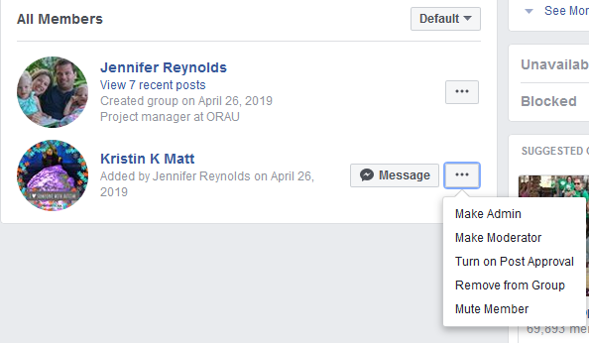

Best Practices for Groups
Have clear goals
  Be sure they are reflected in group name and description
Welcome new members
  Direct message a “hello”
  Public post welcoming new members
    Ask them to introduce themselves in the “comments”
Notes:
Advice on Setting Up Community Guidelines:
https://www.agorapulse.com/blog/facebook-group-community-management;
https://www.facebook.com/community/education/membership-and-rules/writing-great-group-rules/
https://www.facebook.com/community/education/blog/group-rules/
Sources:
http://fbadvance.com/15-smart-ways-to-run-a-successful-facebook-group/
https://neilpatel.com/blog/an-eye-opening-guide-on-how-to-grow-a-facebook-group/

Slide 67

Best Practices for Groups, cont.
Have strong community guidelines
  Under “Moderate Group” click “Create Rules”
  Put in post and pin to the top; periodic reminder post
  Enforce them and explain why
  Review and revise
Enlist trustworthy moderators
  Approve new members, moderate comments, create posts, participate in conversations
  Set up a schedule
Notes:
Advice on Setting Up Community Guidelines:
https://www.agorapulse.com/blog/facebook-group-community-management;
https://www.facebook.com/community/education/membership-and-rules/writing-great-group-rules/
https://www.facebook.com/community/education/blog/group-rules/
Sources:
http://fbadvance.com/15-smart-ways-to-run-a-successful-facebook-group/
https://neilpatel.com/blog/an-eye-opening-guide-on-how-to-grow-a-facebook-group/
m/facebook-secret-groups/
Source: https://blog.hootsuite.com/facebook-secret-groups/

Slide 68
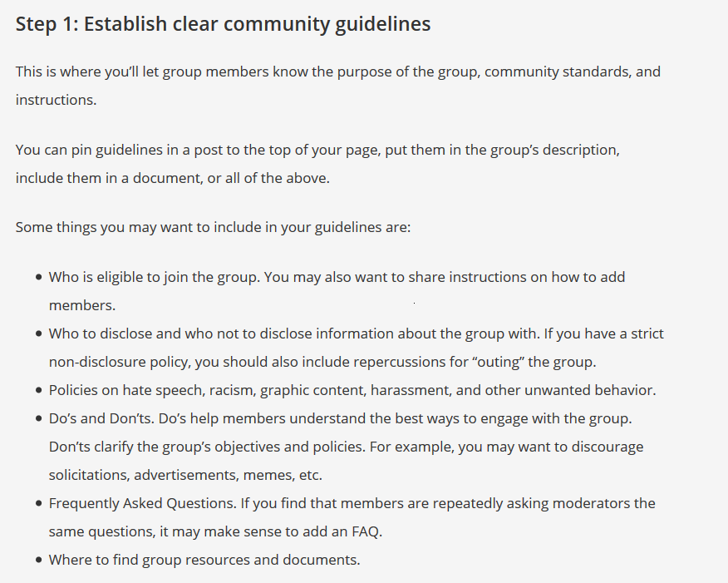
Notes:
Source: https://blog.hootsuite.com/facebook-secret-groups/

Slide 69
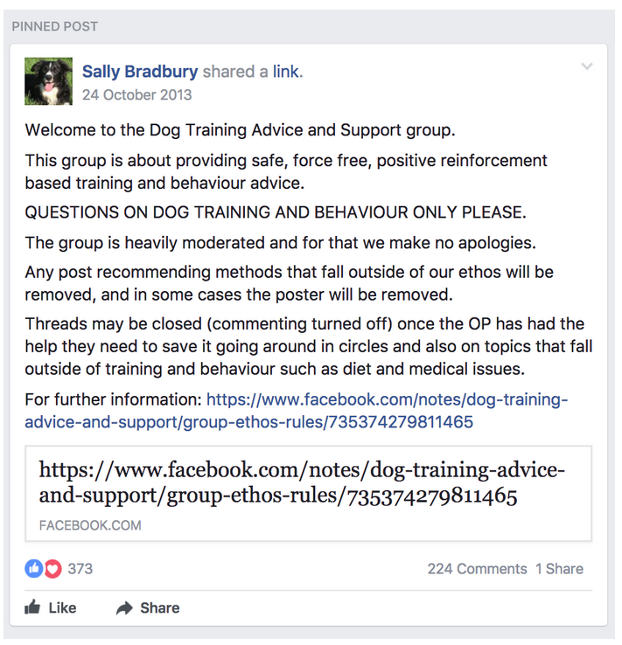
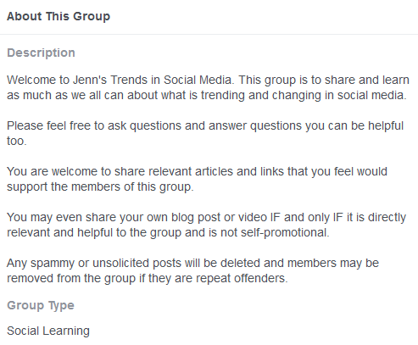
Notes:
Two examples of Community Guidelines = Dog Training Advice and Support Group and Jenn’s Trends in Social Media

Slide 70

Best Practices for Groups, cont.
Encourage engagement with diverse activities
  Pose questions (include graphic)
  “Tell us a story about …”
  Theme-Days
    “Facebook Page Friday”
  Live video
  3-4 minute instructional videos
  Polls
  Resources and tools posted in “Units” or “Files”
  Homework assignments
  Challenges
  Contests
Notes:
Advice on Setting Up Community Guidelines:
https://www.agorapulse.com/blog/facebook-group-community-management;
https://www.facebook.com/community/education/membership-and-rules/writing-great-group-rules/
https://www.facebook.com/community/education/blog/group-rules/
Sources:
http://fbadvance.com/15-smart-ways-to-run-a-successful-facebook-group/
https://neilpatel.com/blog/an-eye-opening-guide-on-how-to-grow-a-facebook-group/

Slide 71

Best Practices for Groups, cont.
Promote your Group
  Facebook “Engagement Ad” (Goal type – “Page Likes”)
  Boosted post
  “Grow this Group” Challenge
  Contest
  Join other groups and (carefully) promote yours
  Promote “exclusive” content available only in your FB group on your FB page
  Solicit influencers
  Ask current members to promote your group

Slide 72
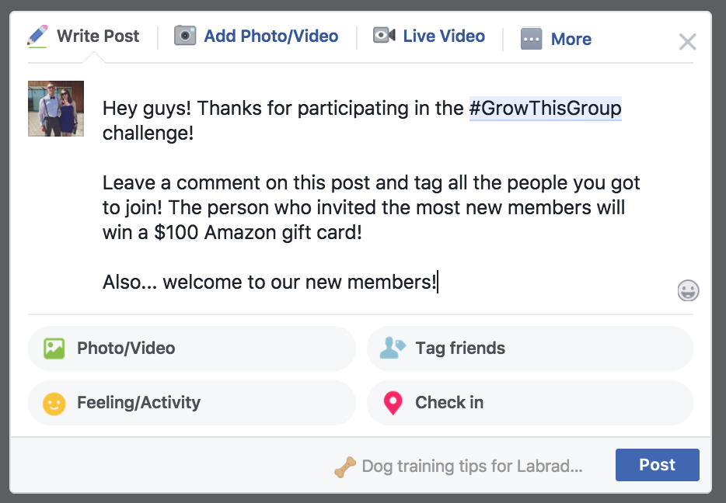
Your contest winner could be the person who gets the most new members to join the group. At the end of the contest, get everyone who invited others to tag who they brought into the group in the comments section of a post.
Notes:
Source: https://neilpatel.com/blog/an-eye-opening-guide-on-how-to-grow-a-facebook-group/

Slide 73
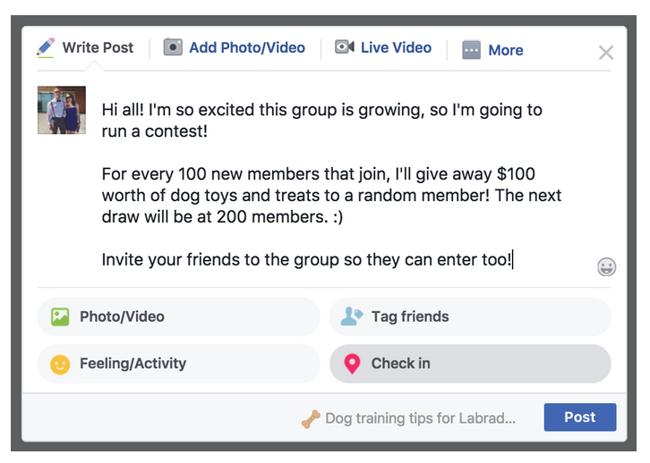
In these posts, I could also ask members to invite people they know to join and enter the giveaway too.
Notes:
Source: https://neilpatel.com/blog/an-eye-opening-guide-on-how-to-grow-a-facebook-group/

Slide 75
Notes:
1 hour lunch!

Slide 76

5 Steps to Implement a Social Media Campaign
Notes:
We’re going walk through our recommended steps for a successful social media campaign and then walk you through a series of fun examples.

Slide 77


Step 1. Make a Plan
Who are you trying to reach? (Target Audience)
What are you hoping the audience will know, feel, or do because of the campaign? (Campaign Goals)
What resources do you have to give to the campaign?
Budget
Donations
Staff time and skills
Volunteer time and skills
Notes:
The three biggest questions to ask before you begin a campaign are why are we doing this (what do we hope to accomplish), who are we doing this for, and what resources do we have to devote to this effort? There three questions are so important as they will determine much of what you want to do.
For example, if you have money to pay for ads or boosted posts, you likely want to focus on developing 2-3 high-quality eye catching graphic ads or videos. If you don’t have money, you may want to consider

Slide 78
Step 1. Make a Plan, cont.
What are the main messages we want to convey?
Campaign name
Campaign hashtag
Main messages
What social media channels will best deliver this message?
What tone will work best with the audience, message, and channel?
Notes:
Often it is best to have one key message:
You should start by promoting one message on multiple different platforms using content that fits the chosen platform. By consistently sharing the same message across your campaign, your followers will hear the same information over and over again, which will allow them to retain your message.
In fact, marketing campaigns in the past have proven that messages are most effective when repeated.
Source: https://blog.hubspot.com/marketing/social-media-campaigns
DON’T FORGET TO SEARCH YOUR HASHTAGS AND CAMPAIGN NAMES BEFORE YOU DECIDE!

Slide 79


Step 1. Make a Plan, cont.
What content and tactics will you use to convey messages on your channels?
What metrics will you monitor to assess progress and final performance?
Notes:
Tactics might include: video, live video, photos, infographics, graphics, memes, events, advertisements, question posts, GIFs, GIF videos, user-generated contests (photo, art, quotes, etc), social media landing pages, influencer marketing/promotion, volunteer promotion, no or low-cost traditional media, giveaways, quizzes

Slide 80
Example Campaign Goals | Possible Metrics to Track
Raise awareness of a specific substance use or health issue | Post/Ad Reach Post/Ad Engagement Rate Video views
Generate traffic to a web page or specific online resource | Post/Ad Reach Link clicks Unique page views Resource downloads
Get people to register for an event | Webpage registrations Facebook event page metrics (interested, going, shares, likes, comments) Post/Ad Reach Post/Ad Engagement Rate

Slide 81
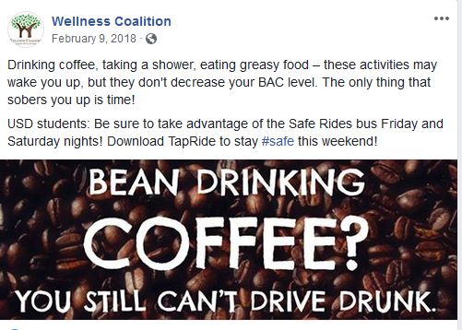
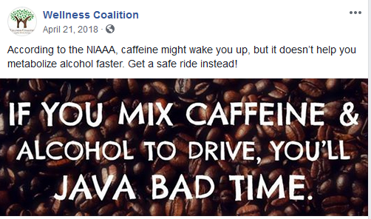
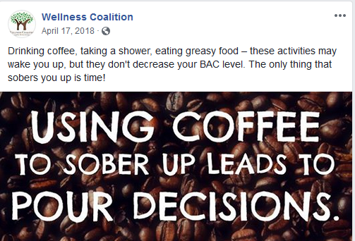
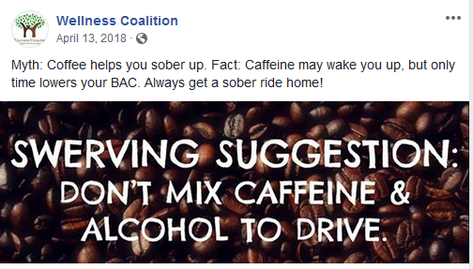
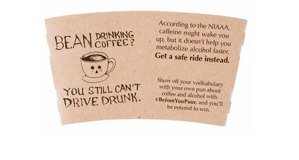
USD Wellness Coalition (Facebook)

Slide 82
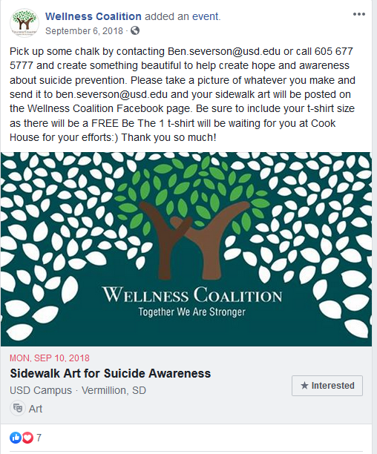
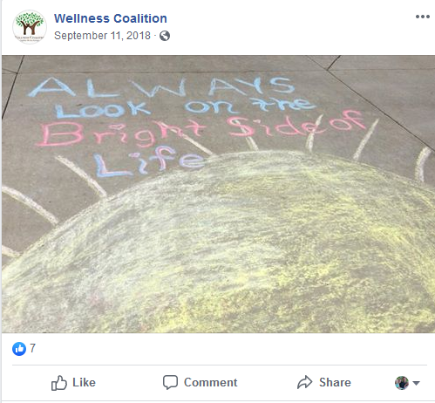
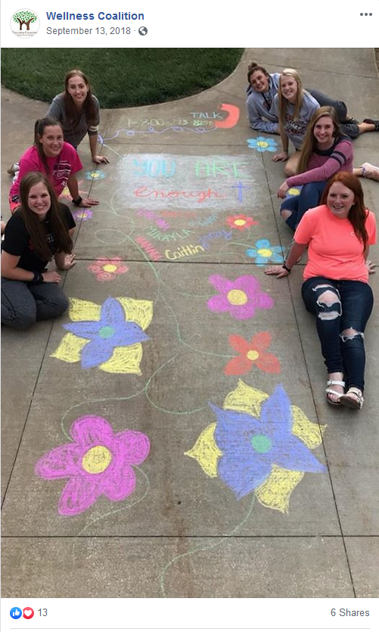
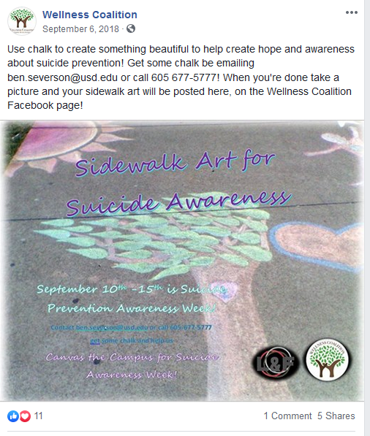
USD Wellness Coalition (Facebook)
Notes:
A related idea: Create a graphic providing words of encouragement or affirmation for someone in treatment for opioid abuse disorder and post on social media. Include a hashtag. #treatmentworks #Buncombcountystrong
And least we all forget #icebucketchallenge

Slide 83
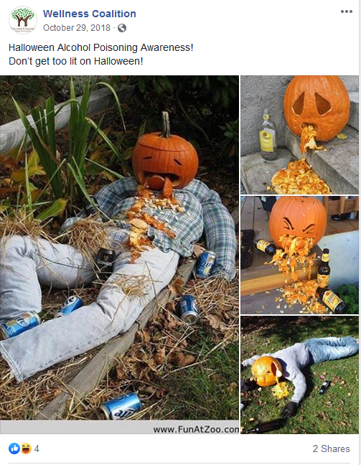
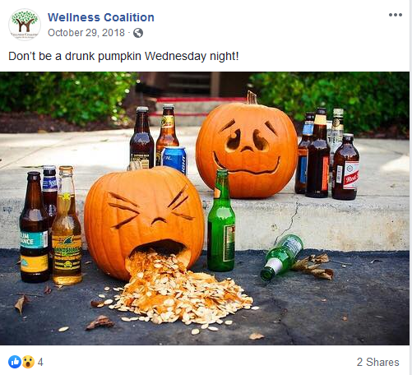
USD Wellness Coalition (Facebook)

Slide 84
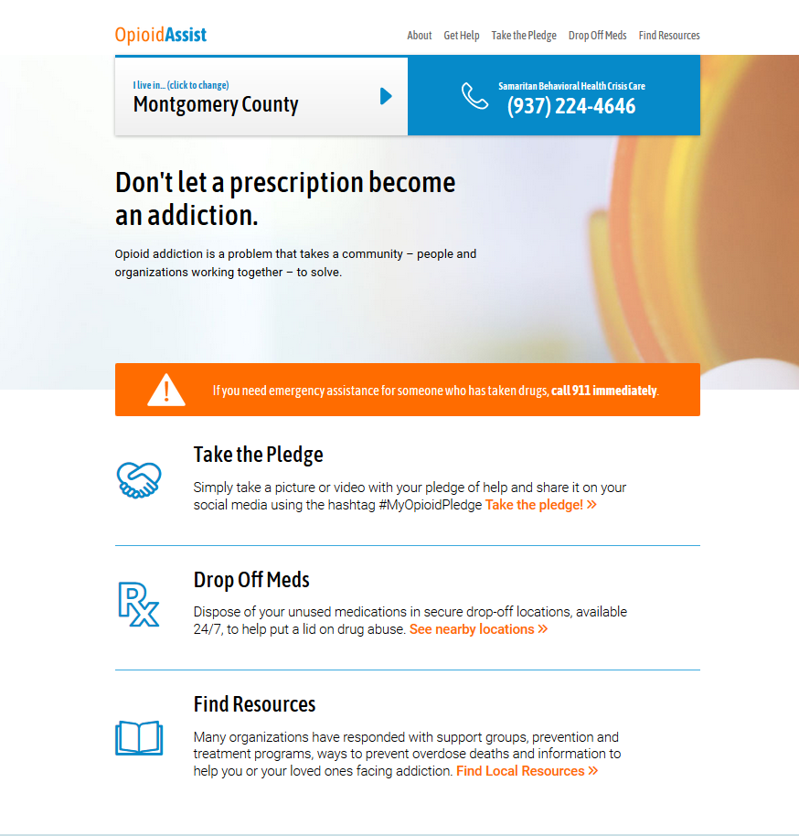
Premier Health - #MyOpioidPledge
Notes:
Built a simple landing page for their campaign
Want help building a social landing page?
(Social) Landing Page
https://unbounce.com/social-media/how-to-create-social-landing-pages/

Slide 85
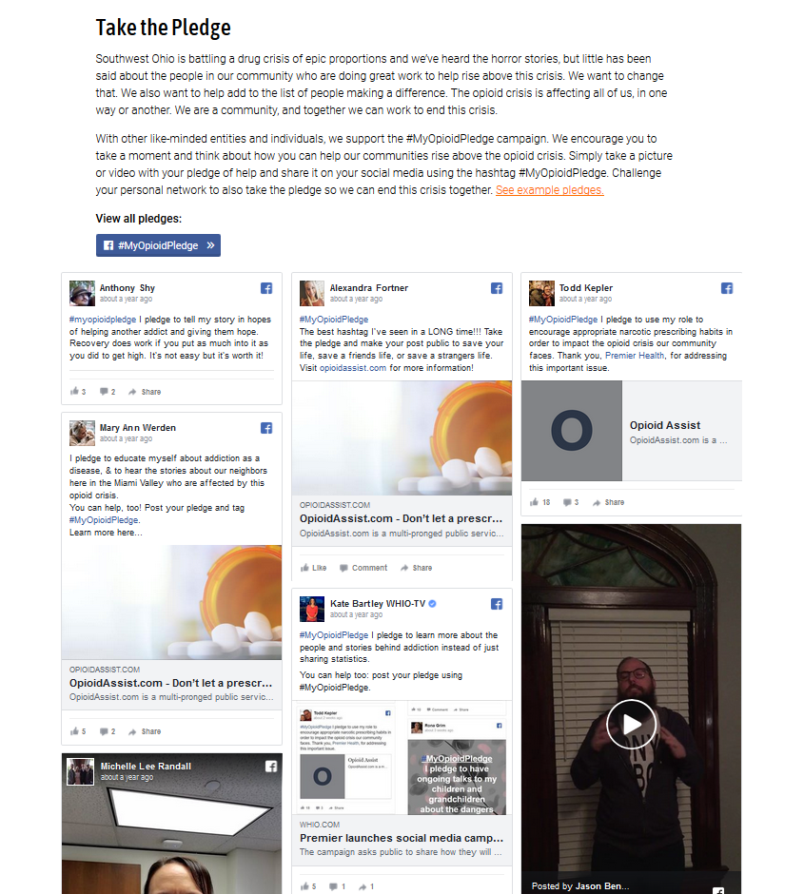
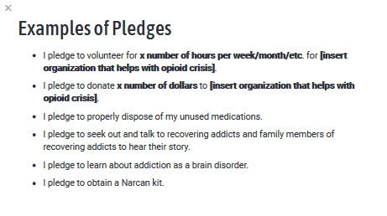
Premier Health - #MyOpioidPledge
Notes:
Built a simple landing page for their campaign
Want help building a social landing page?
(Social) Landing Page
https://unbounce.com/social-media/how-to-create-social-landing-pages/

Slide 86
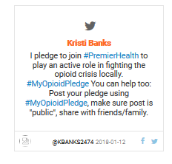
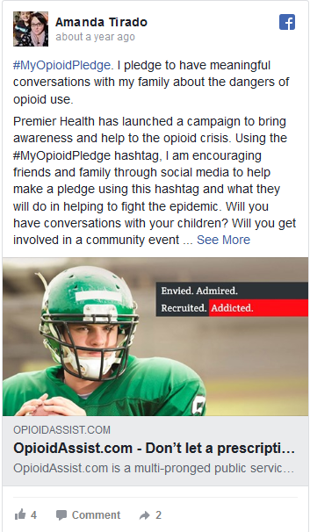
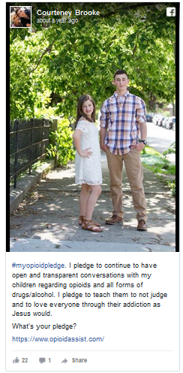
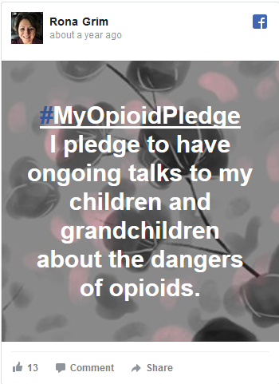

Premier Health - #MyOpioidPledge
Notes:
Built a simple landing page for their campaign
Want help building a social landing page?
(Social) Landing Page
https://unbounce.com/social-media/how-to-create-social-landing-pages/

Slide 87
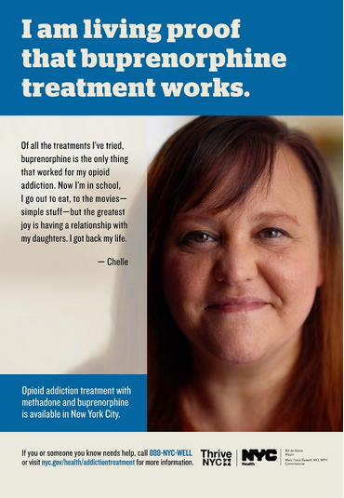
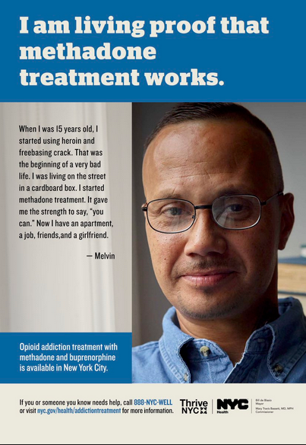
NYC Health Dept “Living Proof”

Slide 88
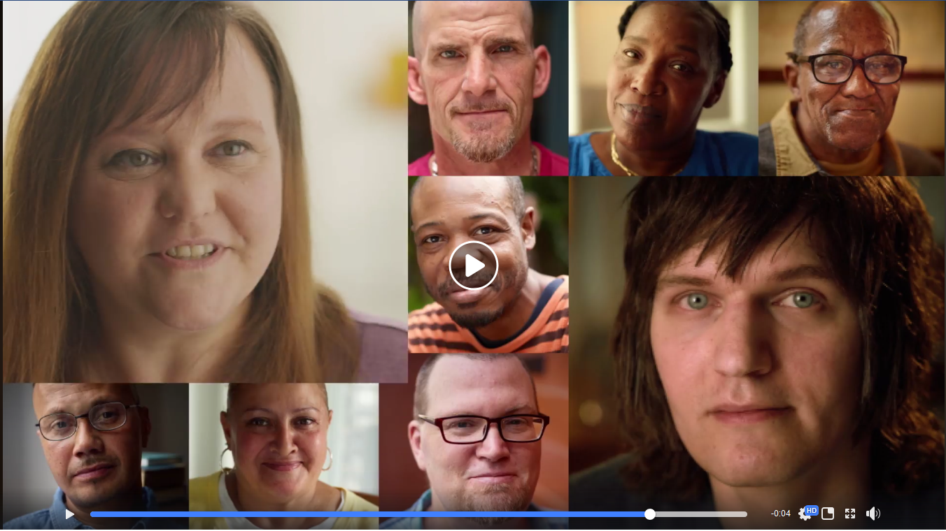
NYC Health Dept “Living Proof”

Slide 89
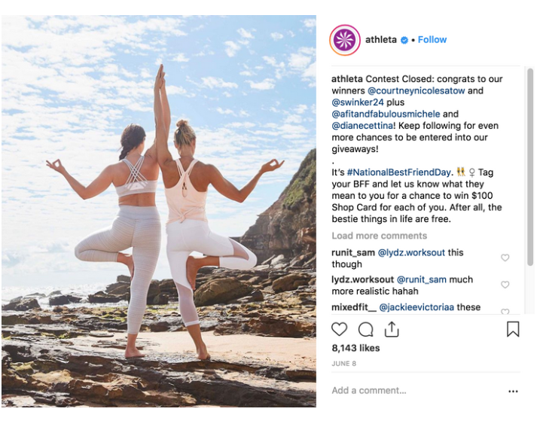
Athleta

Slide 90

ESPN

Slide 91


ASPCA

Slide 92
Step 2. Develop Your Campaign Content
Cheat-Sheets for Ad Types and Image Sizes
https://adespresso.com/blog/social-media-ads-image-sizes/
Facebook (and Instagram) Promotion Guidelines
https://www.facebook.com/policies/pages_groups_events/#
App to help run photo contests, create landing pages, and promote giveaways
https://www.shortstack.com/examples/
Tutorial for setting up a social landing page
https://unbounce.com/social-media/how-to-create-social-landing-pages/
Notes:
For example, Facebook has very strict rules on where you can run a promotion on your Timeline and how you select and contact a winner. Violating these rules could result in the termination of your entire business Timeline.
Source: https://www.nimble.com/blog/10-successful-social-media-campaign-tips/

Slide 93
Step 2. Develop Your Campaign Content
Remember
  Before you launch your campaign, come up with a list of keywords and use those keywords in your campaign posts
Notes:
Why? Each social network has its own search engine through which its users can search for interesting topics.
Source: https://www.nimble.com/blog/10-successful-social-media-campaign-tips/
According to Facebook, the best way to run campaigns is to activate all placements. This enables the Facebook Ad platform to optimize against which placements are achieving your desired objective at the most cost-effective rate.
Facebook calls this 'Placement Optimization'. The logic here is that the more placements you use, the more data the Facebook Ad platform has to learn from. The more it can learn, the better your campaigns can perform.
But even though this is one of Facebook’s own recommended best practices for Facebook Ads, it is important to consider where you, as the advertiser, want your ads to be shown.
For example, ad placements on Audience Network won’t generate engagements. If you care about that metric, you might want to omit Audience Network from your efforts. We recommend going to market utilizing Placement Optimization and nurturing what performs the best.
Source: https://www.socialmediatoday.com/news/5-best-practices-for-facebook-ads-from-facebook/550680/

Slide 94
Step 3. Prepare to Launch
Schedule your Posts
Identify and reach out to influencers
Who in your community would people love to see participate in your campaign?
Identify and reach out to local media outlets
Make it easy for them!
Notes:
Post Scheduling:
How to on FB: https://www.facebook.com/help/389849807718635
How to on Twitter: https://business.twitter.com/en/help/campaign-editing-and-optimization/scheduled-tweets.html
How to on Instagram: XXX
An influencer is a trusted, authoritative voice on a particular subject. Social media influencers are people in a particular industry who have build up large and loyal social followings. Before launching a social media campaign, create a list of influencers in your industry who may be able to help you spread the word about your campaign. The support of even one influencer can help you reach thousands or tens of thousands of new contacts. Before reaching out to the influencer, be sure to construct your best pitch on why your campaign will help his/her followers.
Source: https://www.nimble.com/blog/10-successful-social-media-campaign-tips/

Slide 95


Step 3. Prepare to Launch, cont.
Draft emails asking volunteers and board members to promote your posts
Prepare flyers for local businesses (and ask if they will support the campaign on social media)
Notes:
Local papers, in particular, are short staffed and often needing stories. Make it easy for reporters to feature your campaign by drafting a press release and accompanying photographs/images. For radio or TV, pitch a specific story around your campaign that may have broad interest (e.g., feature one of your story tellers).

Slide 96
Step 4. Monitor and Engage
Set aside time each day to monitor, answer questions, “like” comments, and respond to feedback
Don’t be afraid to “get personal”
Prepare a plan ahead of time for how your organization will respond to different kinds of comments
Notes:
These are the types of relationships and experiences that keep followers invested in your brand.
https://blog.hubspot.com/marketing/social-media-campaigns

Slide 97
Step 5. Evaluate and Learn
Analyze campaign metrics
Consider conducting interviews or focus groups
Debrief with staff and relevant stakeholders and record lessons learned
Notes:
These are the types of relationships and experiences that keep followers invested in your brand.
https://blog.hubspot.com/marketing/social-media-campaigns
Want to learn more about analytics? WE’RE HOSTING A WEBINAR!

Slide 98

Notes:
Walk through of some example tools to assist you in planning and implementing social media campaign:
Messaging worksheet
Content calendar
Canva, Pixabay, and Giphy
Scheduling on FB, Twitter, and Instagram

Slide 99
Notes:
15 Minute Break

Slide 100

Practice Planning and Implementing a Social Media Campaign
Step 1: Complete your plan.
  Target Audience
  Campaign Goals
  Resources
  Main messages
  Social media channels
  Tone
  Content and tactics
  Metrics
Step 2: Develop campaign content
Step 3: Prepare to launch (schedule some posts)
Need additional inspiration? www.preventmedabuse.org/facts-tools/doseofpreventionchallenge
Notes:
Activity (1 hour)
The goal: http://www.preventmedabuse.org/facts-tools/doseofpreventionchallenge/#.XMG722hKg2x [Slide with these elements]
As a group, fill out Step 1 – Planning for a one-week social media campaign that your organization would conduct.
Refer back to the examples from the slide deck for ideas
Use the tools Kristin introduced to develop at least 1 social media graphic/post, advertisement, video, infographic, GIFy video
Schedule at least one draft post for whatever platform they have chosen (you can delete this later)
Report-out (15 min)
Select one person to report out from your group – give us an overview of the campaign that they planned (e.g., audience, main messages, channels); read aloud a few of their posts or we can plug in their laptop to the projector and they can show up what they did; discuss any challenges and/or lessons learned going through that process

Slide 101
Campaign
Show & Tell!

Slide 102
Questions?
Don’t forget to complete your evaluation form!

