Slide 1
Engaging Experts on ACEs in Appalachia: Key Findings and Best Practices
Jennifer Reynolds, MPH, CHES
Manager of Health Communication, Research, and Evaluation
Oak Ridge Association Universities (ORAU)
2019 Rural Summit for Childhood Success
05.23.19 Abingdon, VA

Slide 2


Agenda
Background
Methods
Results
ACEs in Appalachia
Contributing factors
Gender differences
Buffering factors
Discussion

Slide 3

How We Started
ORAU research on behalf of the Appalachian Regional Commission (ARC) and CDC NCIPC
Engaged experts and community members to explore
Contributing and protecting factors for opioid misuse in Appalachia
Effective communication strategies including messages, spokespersons, channels, and delivery tactics
Parity across participant groups when describing the profound impacts of childhood trauma on substance abuse in the Region

Slide 4



Slide 5


Slide 6


Slide 7
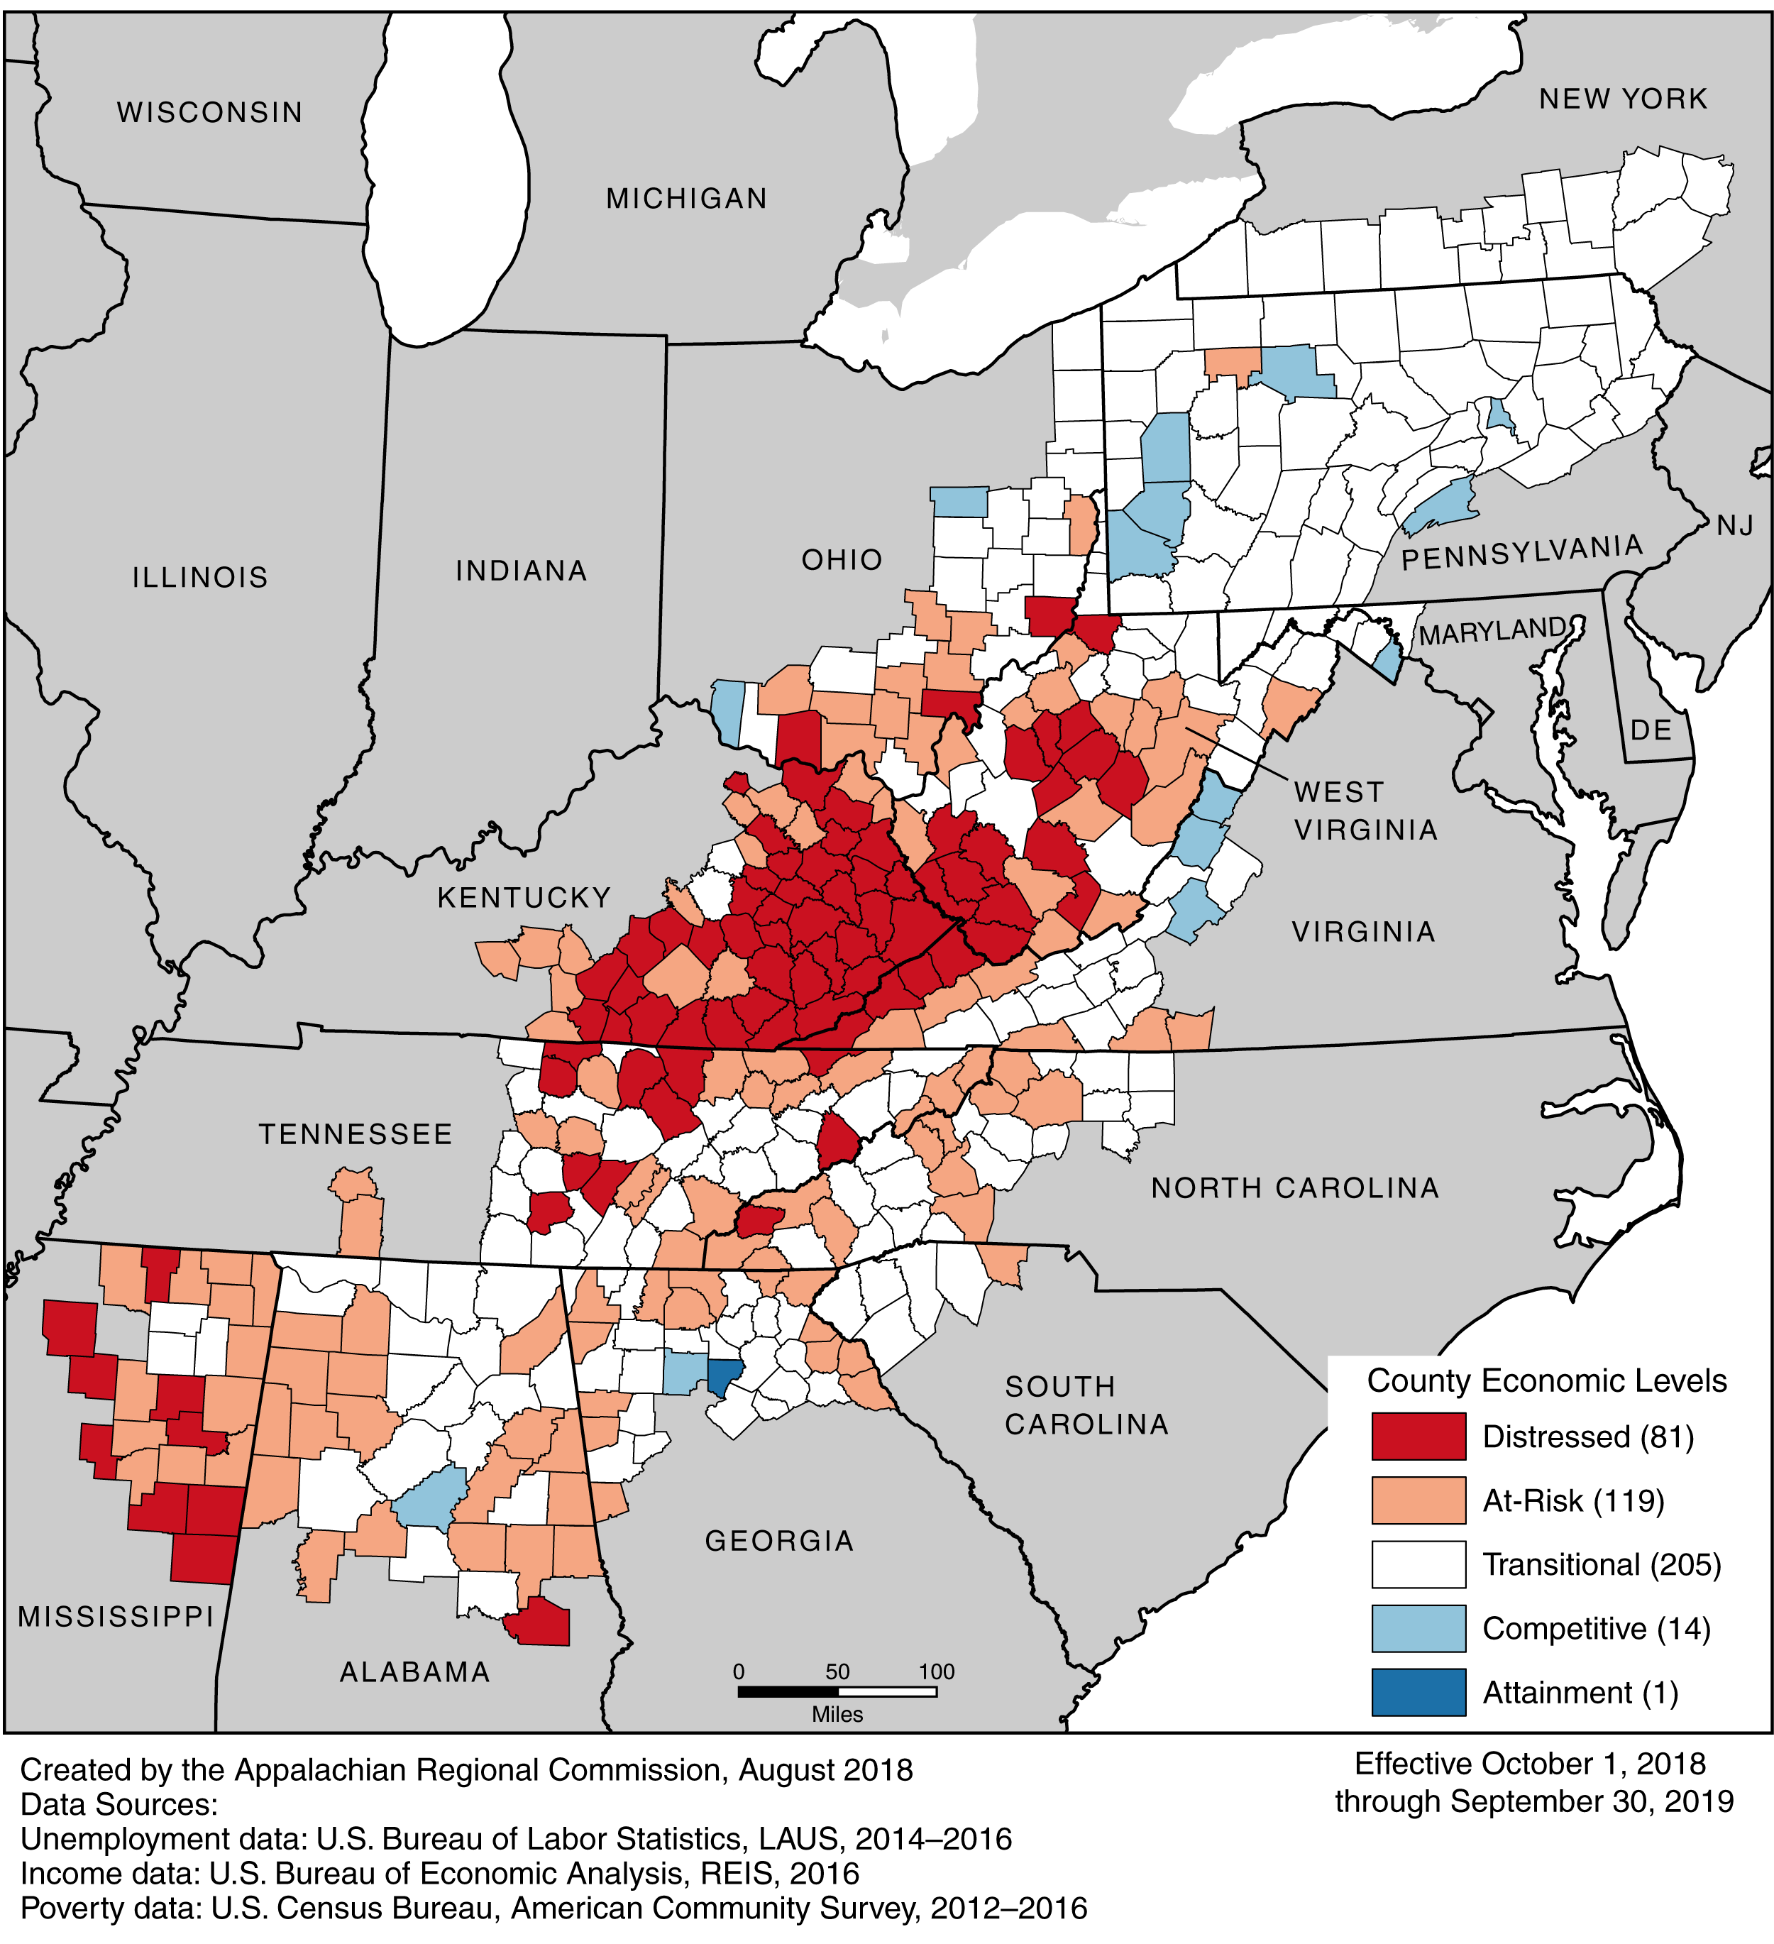
Appalachia
205,000 square miles
Encompasses all of West Virginia and part of 12 other states
81 distressed counties
Notes:
ARC defines Appalachia as a 205,000 – square mile region encompassing all of West Virginia and part of 12 other states.
We talk about Appalachia as a whole, but it’s really important to understand that regional differences exist. Appalachia contains large metro areas like Pittsburgh

Slide 8
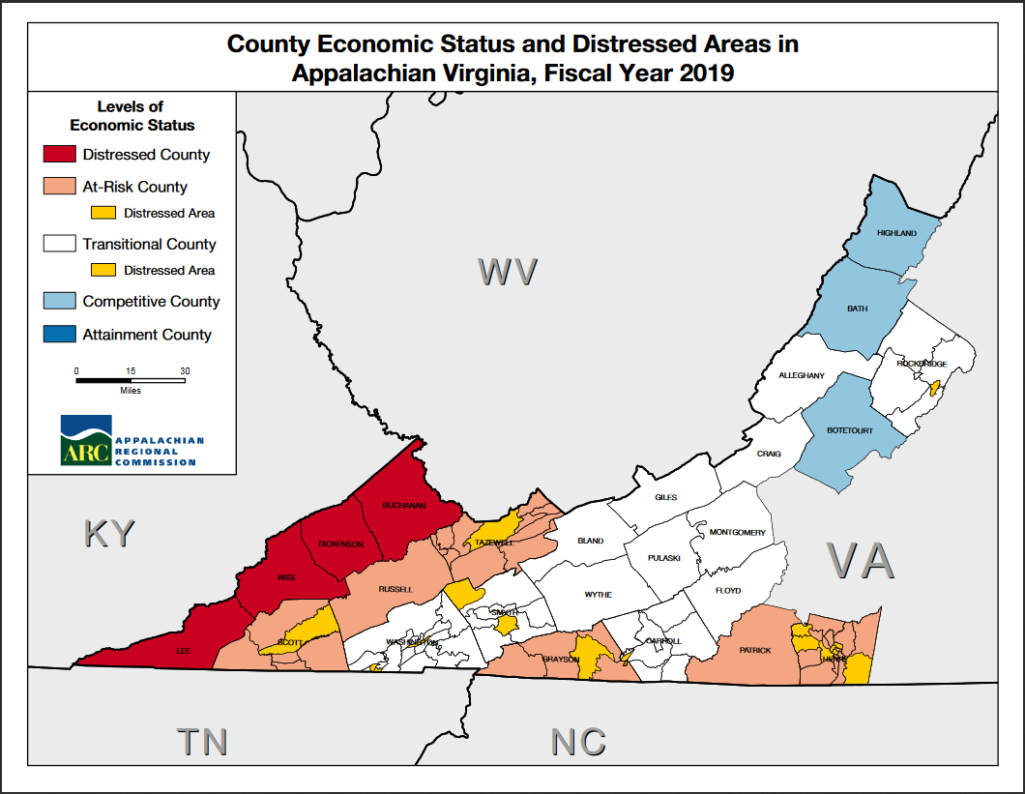
Notes:
Appalachian Virginia
Source: https://www.arc.gov/images/appregion/economic_statusFY2019/CountyEconomicStatusandDistressAreasFY2019Virginia.pdf
25 of your 95 counties are considered Appalachian
4 economically distressed counties – Buchanan, Dickenson, Lee, and Wise
6 counties designated as “at risk” – Scott, Russell, Tazwell, Grayson, Patrick, and Henry

Slide 9
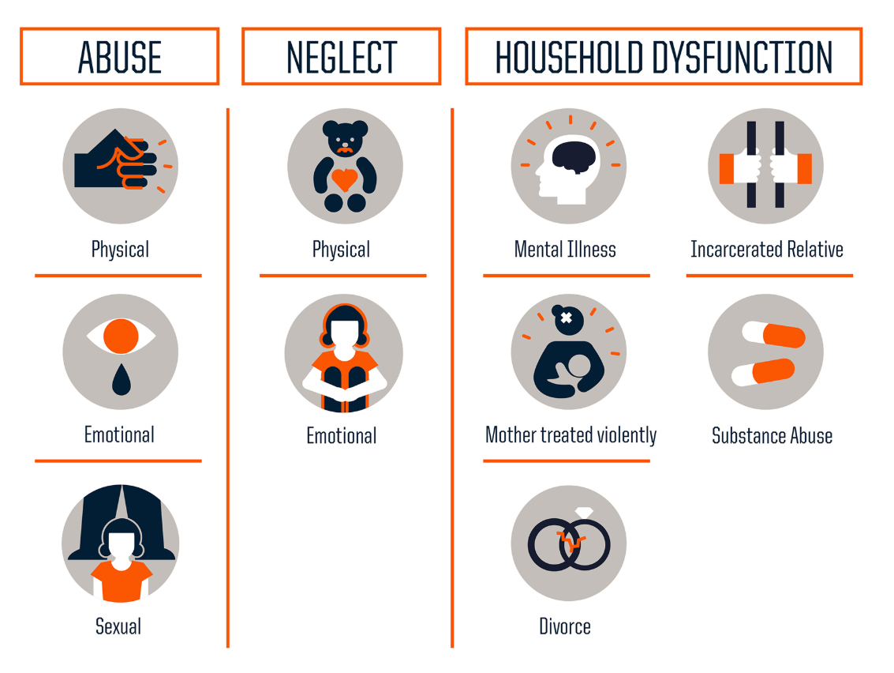
CDC-Kaiser ACE Study
Original ACE Study conducted from 1995-1997
ACEs categorized into three groups: abuse, neglect, and household dysfunction
Image Source: NPR - https://www.npr.org/sections/health-shots/2015/03/02/387007941/take-the-ace-quiz-and-learn-what-it-does-and-doesnt-mean
Notes:
The CDC-Kaiser Permanente ACE Study is one of the largest investigations of childhood abuse and neglect and later-life health and well-being
Adverse Childhood Experiences (ACEs) are categorized into three groups: abuse, neglect, and household challenges. Each category is further divided into multiple subcategories. Participant demographic information is available by gender, race, age, and education. The prevalence of ACEs is organized by category.

Slide 10
Prior to your 18th birthday:
Did a parent or other adult in the household often or very often… Swear at you, insult you, put you down, or humiliate you? Or act in a way that made you afraid that you might be physically hurt?
Did a parent or other adult in the household often or very often… Push, grab, slap, or throw something at you? Or ever hit you so hard that you had marks or were injured?
Did an adult or person at least 5 years older than you ever… Touch or fondle you or have you touch their body in a sexual way? Or attempt or actually have oral, anal, or vaginal intercourse with you?
Did you often or very often feel that … No one in your family loved you or thought you were important or special? Or your family didn’t look out for each other, feel close to each other, or support each other?
Did you often or very often feel that … You didn’t have enough to eat, had to wear dirty clothes, and had no one to protect you? Or your parents were too drunk or high to take care of you or take you to the doctor if you needed it?
Were your parents ever separated or divorced?
Was your mother or stepmother: Often or very often pushed, grabbed, slapped, or had something thrown at her? Or sometimes, often, or very often kicked, bitten, hit with a fist, or hit with something hard? Or ever repeatedly hit over at least a few minutes or threatened with a gun or knife?
Did you live with anyone who was a problem drinker or alcoholic, or who used street drugs?
Was a household member depressed or mentally ill, or did a household member attempt suicide?
Did a household member go to prison?
Notes:
Source: https://acestoohigh.com/got-your-ace-score/

Slide 11
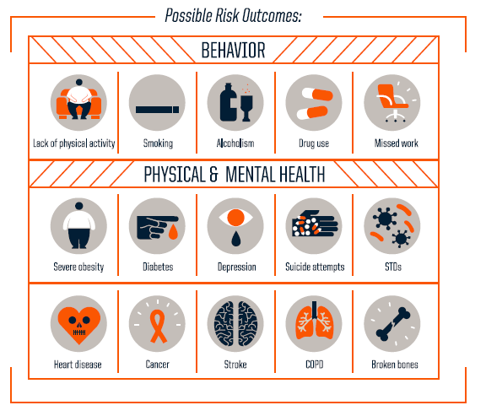
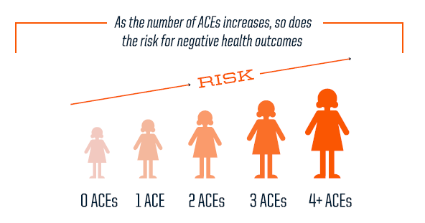
What impact do ACEs have?
Source: Robert Wood Johnson Foundation; www.rwjf.org/aces
Notes:
The ACE score is the total sum of the different categories of ACEs reported by participants. Study findings show a graded dose-response relationship between ACEs and negative health and well-being outcomes. In other words, as the number of ACEs increases so does the risk for negative outcomes.
Source: https://www.cdc.gov/violenceprevention/childabuseandneglect/acestudy/about.html

Slide 12
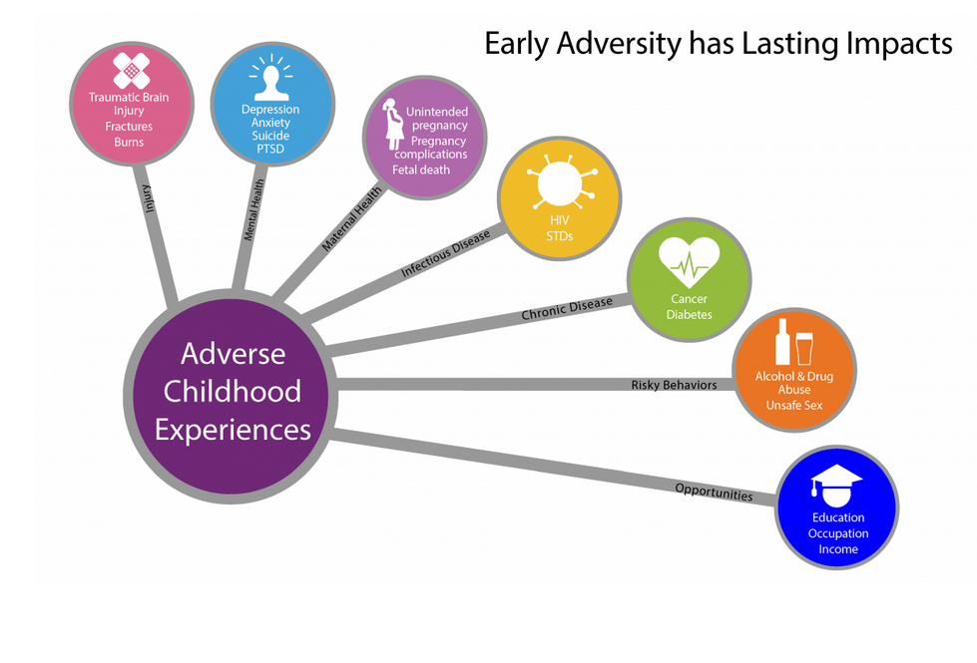
Source: National Center for Injury Prevention and Control, Division of Violence Prevention
Notes:
https://www.cdc.gov/violenceprevention/childabuseandneglect/acestudy/ace-brfss.html
Note: CDC’s Division of Violence Prevention notes impacts of ACEs on Injury, Mental Health, Maternal health, infection disease, chronic disease, risk behaviors, and opportunities (including education and income)

Slide 13

ACEs and Opioids
Individuals who reported five or more ACEs were three times more likely to misuse prescription pain medication and 5 times more likely to engage in injection drug use (Quinn et al., 2016)
Over 80% of the patients seeking treatment for opioid addiction had at least one form of childhood trauma, with almost two-thirds reporting having witnessed violence in childhood. (Sansone, Whitecard, & Wiederman, 2009)
Sexual abuse and parental separation (for women) and physical and emotional abuse (for men) appear to be particularly highly correlated with opioid abuse (Conroy et al., 2009)
Individuals who have experienced childhood trauma are more likely to report chronic pain symptoms that interfere with daily activities and are more likely to be prescribed multiple prescription medications making them more likely to seek opioids for pain relief in adulthood (Finestone et al., 2000)
Source: Campaign for Trauma-Informed Policy and Practice,
http://www.ctipp.org/wp-content/uploads/2019/02/CTIPP_OPB_No1.pdf
Notes:
http://www.ctipp.org/wp-content/uploads/2019/02/CTIPP_OPB_No1.pdf

Slide 14

‘Any strategy to address the opioid epidemic should recognize the role that trauma and ACEs play in addiction and incorporate trauma-informed prevention and treatment.’
- Campaign for Trauma Informed Policy and Practice
Notes:
http://www.ctipp.org/wp-content/uploads/2019/02/CTIPP_OPB_No1.pdf

Slide 15
ACEs Study Population
Over 17,000 HMO members from Southern California receiving physical exams
75.2% reported some college, college graduate, or higher
Average age was 55-57 years old
Approximately 25% were non-white
63% reported at least one ACE
22% reported three or more ACEs
Notes:
N=17,337
Source: https://www.cdc.gov/violenceprevention/childabuseandneglect/acestudy/about.html - Participant Demographics
Looking back at childhood trauma 40+ years ago may be unreliable

Slide 16
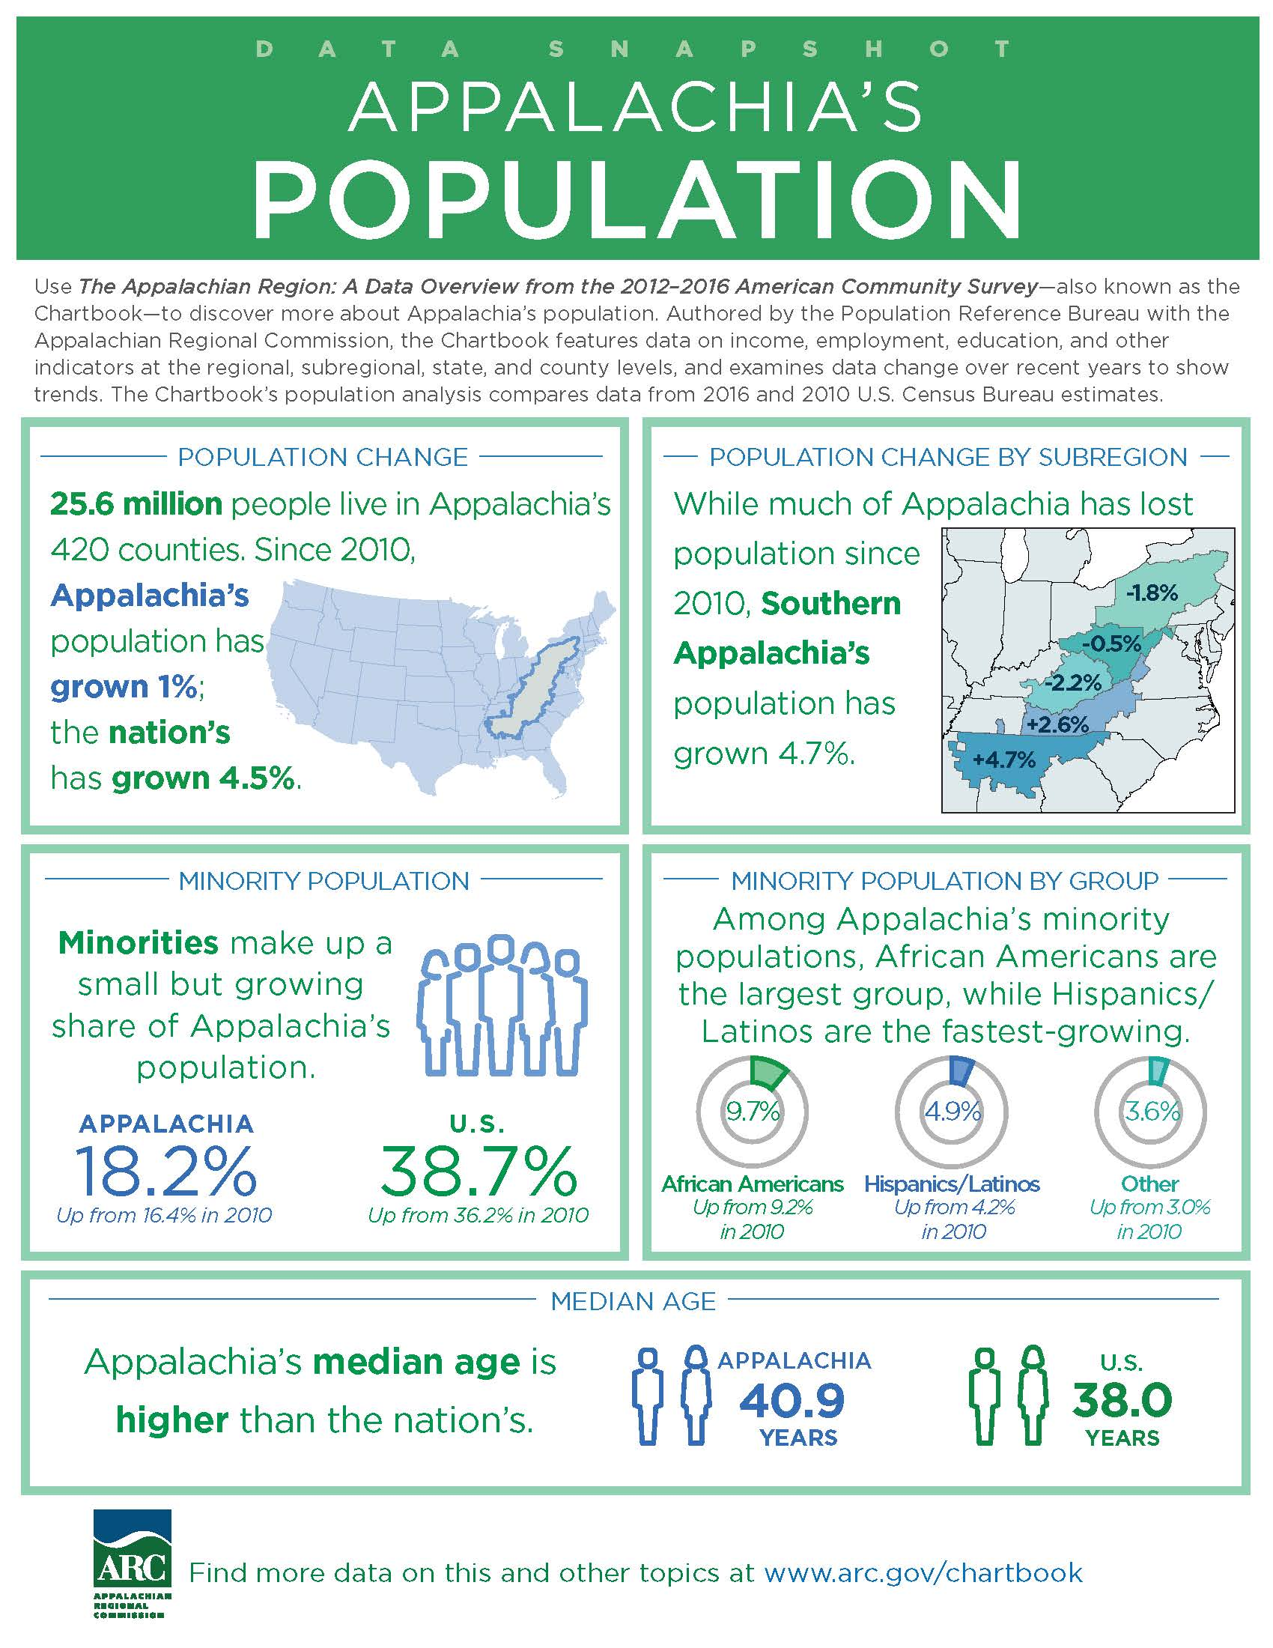

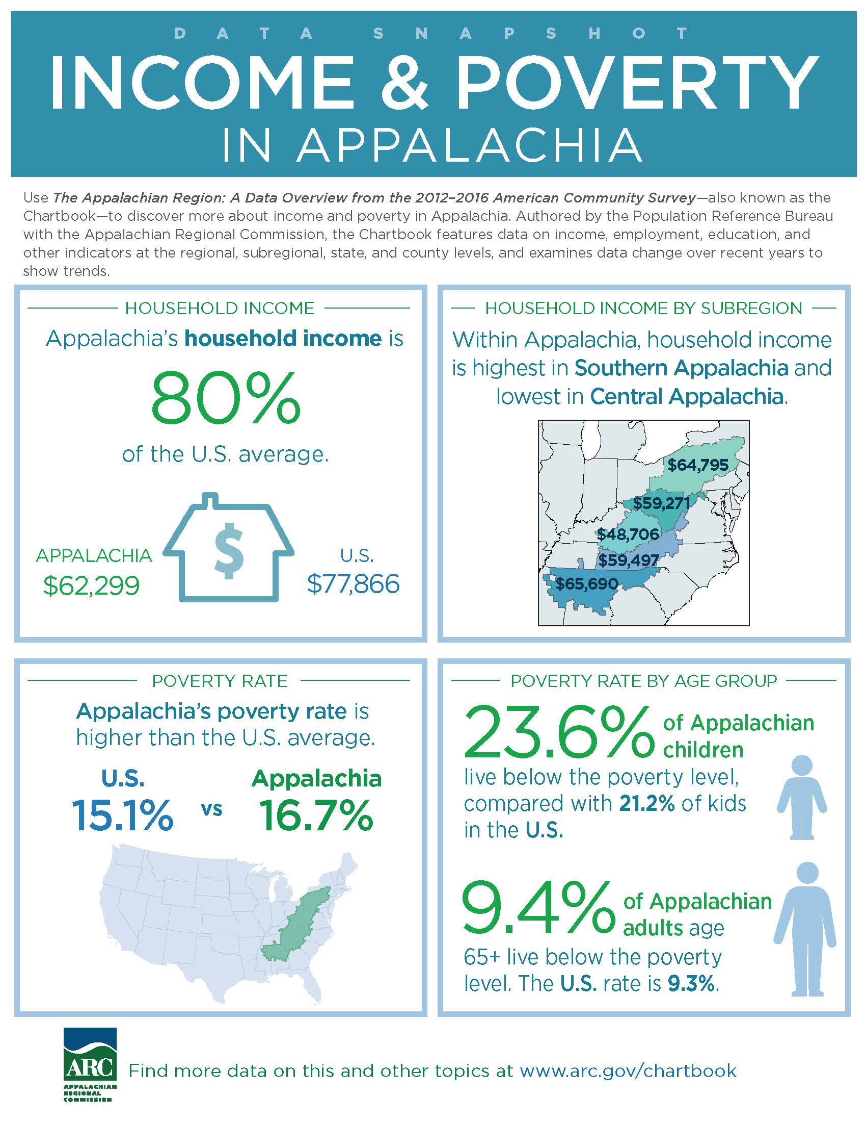
Appalachian Population
Overdose mortality rates among 25 to 44 year olds are more than 70% higher in Appalachia
Walsh Center for Rural Health Analysis, 2017
Notes:
ARC data overview – ACS 2016 data.
Smaller minority population
Lower educational attainment
14.1% of Appalachians aged 25 and older do not have a high school diploma. This figure is skewed by high educational attainment in Appalachian Pennsylvania and New York, where more than 90% of adults completed high school.
Higher rates of poverty
We also didn’t have the opioid epidemic raging in this country when the original study was done. We know there’s a correlation between ACEs and substance abuse, but do we really understand ACEs in a present-day Appalachian context?

Slide 17
ORAU Project steps
Create an Expert Working Group
Convene experts to create a plan for collecting feedback via a stakeholder engagement process.
Recruit multidisciplinary stakeholders to respond to project research questions via online collaboration sessions.
Expert Working Group members review and prioritize stakeholder input.
ORAU develops a summary findings report.

Slide 18
Project Questions
How might children in Appalachia experience ACEs differently?
What are the socioeconomic, cultural, and gender factors that increase likelihood of experiencing ACEs?
What factors can mitigate the impact of ACEs and enhance resiliency?
Notes:
The original project questions (1 and 2) were proposed by the Appalachian Regional Commission, CDC’s Division of Violence Prevention, and ORAU. The third question was added during the project by the Expert Working Group – they emphasized throughout our efforts the need to frame ACEs in Appalachia in positive terms, particularly emphasizing resilience.

Slide 19
ACEs Expert Working Group
Dr. Mike Brumage, West Virginia
Dr. Stephen Crane, North Carolina
Dr. Derek Ford, CDC
Dr. Scott Hambleton, Mississippi
Dr. Larke Huang, SAMHSA
Dr. David Mathews, Kentucky
Jim McKay, West Virginia
Kathy Szafran, West Virginia
Notes:
We worked with ARC and CDC to obtain recommendations for ACEs experts working in the region.
Experts acted as an advisory group by providing input on existing research and best practices, topics for additional exploration and a plan for additional stakeholder engagement, and evaluating data gathered.
Alphabetically by last name.

Slide 20
Methods – Online Stakeholder Meetings
Stakeholders sought from:
Behavioral health, hospitals and community health centers, schools, local government, social services, law enforcement, faith-based organizations, non-profit organizations, and other related fields
45 stakeholders participated in one of two online brainstorming sessions
33 from central Appalachia
12 from southern Appalachia
Notes:
Stakeholders had varying number of years of experience (anywhere from 1-25+) and were not required to have in-depth knowledge about the field of ACEs, although all but 2 were at least somewhat familiar with ACEs.

Slide 21
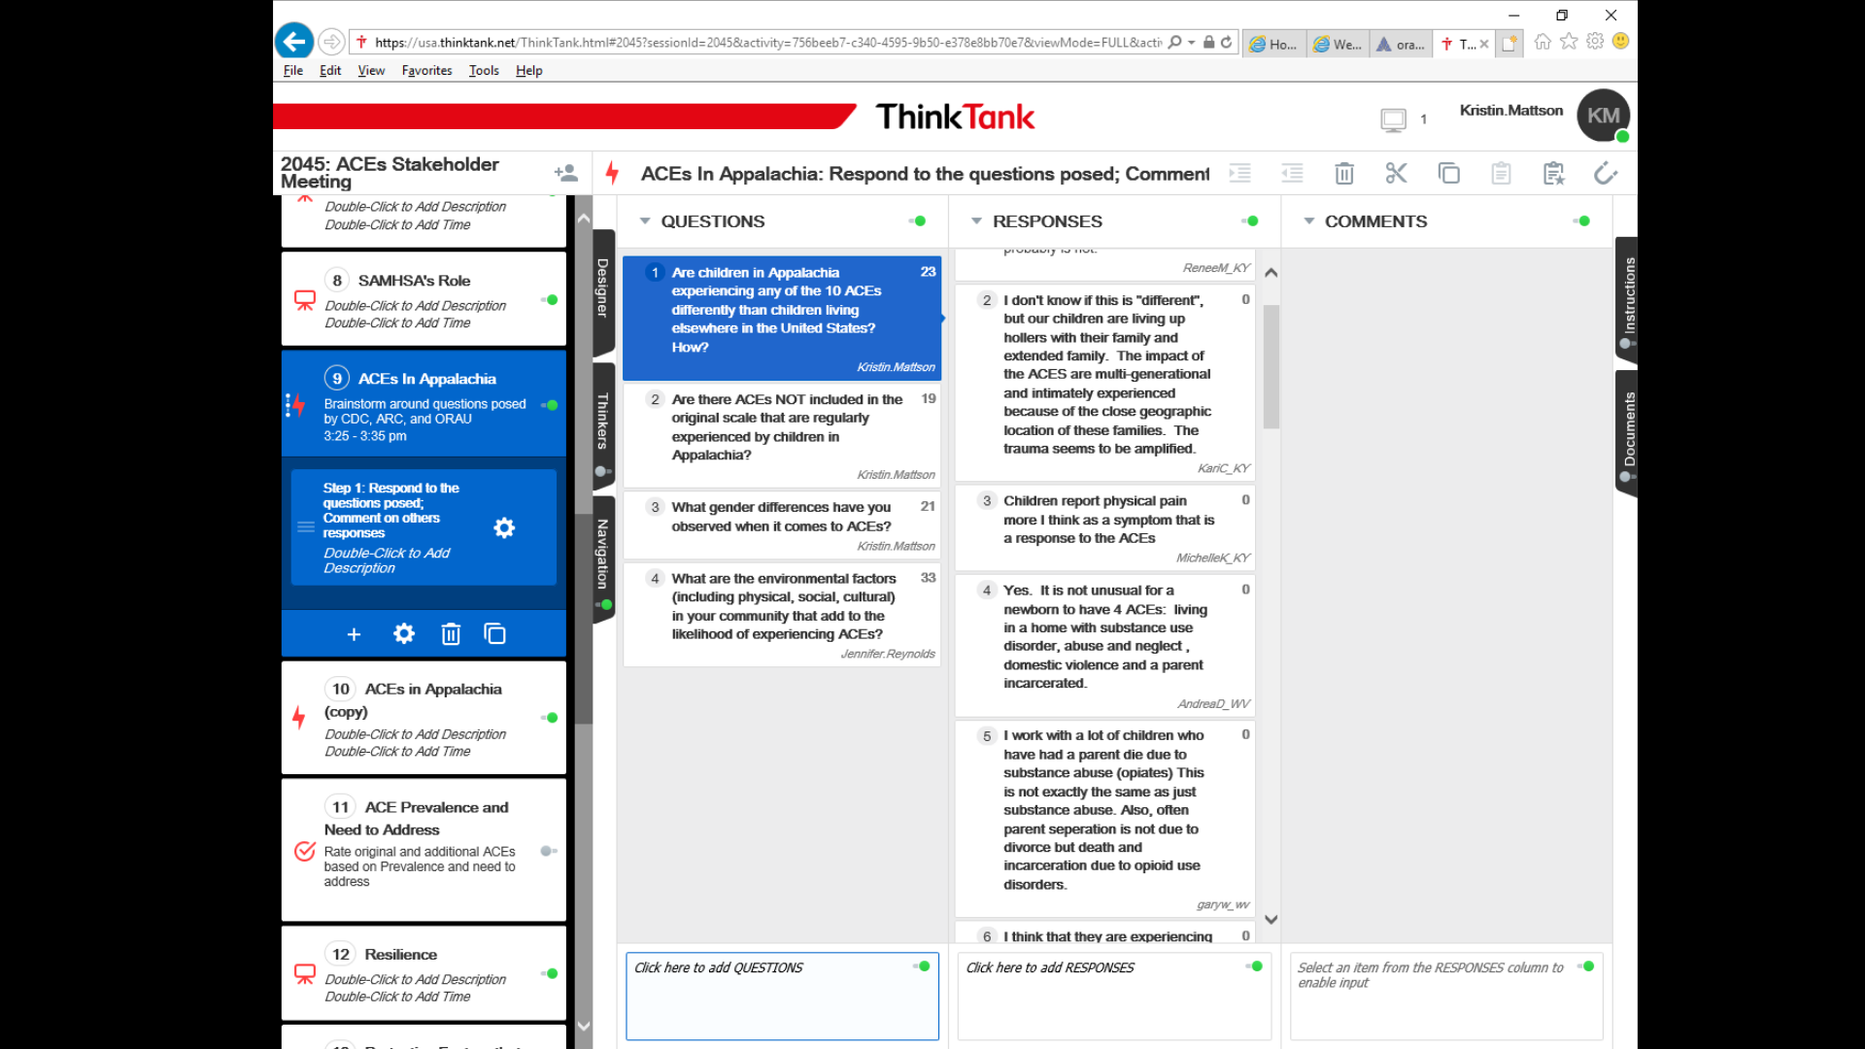
Notes:
ORAU used ThinkTank©, a browser-based software, to facilitate collaboration and build consensus among participants. ORAU facilitators designed activities in ThinkTank© to capture, synthesize, and prioritize ideas and directions. Using the tool made group work easier and more productive.
During the sessions, participants were asked to respond to a series of questions related to our objectives; they were able to see and comment on each other's feedback.

Slide 22
Methods - Expert Evaluation of Stakeholder Meeting Findings
The expert working group reviewed findings and participated in four assessment activities:
Rate the prevalence and severity of each of the additional ACEs
Rate the prevalence and impact of contributing factors
Rate the prevalence and impact of buffering factors
Prioritize the list of needs identified from greatest to least
Notes:
Following both ThinkTank sessions, we convened the expert working group again to provide feedback and assess the input from the stakeholders.
The experts felt that the additional ACEs identified by the stakeholders were mostly “dead on,” and recommended some additional information that was used to expand the list of ACEs and the list of contributing factors in the thematic summary

Slide 23
Additions to the ACE Scale
Most Prevalent
Death of an attachment figure
Bullying (in-person, online)
Food insecurity
Homelessness/transience/displacement
Witnessing overdose(s)
Parental/caregiver unemployment
Gang violence and shootings
Repeated ruptures in attachment (divorces, cohabitating relationships)

Slide 24
Additions to the ACE Scale
Most Impactful
Death of an attachment figure
Bullying (in-person, online)
Food insecurity
Homelessness/transience/displacement
Witnessing overdose(s)
Parental/caregiver unemployment
Gang violence and shootings
Repeated ruptures in attachment (divorces, cohabitating relationships)
Notes:
All of these items were unanimously rated as high prevalence/severity on a three-point Likert scale

Slide 25
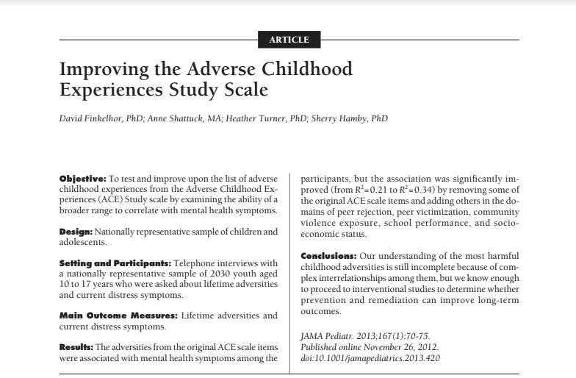
“The adversities from the original ACE scale items were associated with mental health symptoms among the participants, but the association was significantly improved (from R2=0.21 to R2=0.34) by removing some of the original ACE scale items and adding others in the domains of peer rejection, peer victimization, community violence exposure, school performance, and socioeconomic status.”
Notes:
A study published in JAMA in 2013 compared the original ACEs items versus an extended list of questions from a national study of victimization.
One of our expert workgroup members, Dr. David Matthews of Kentucky suggested “Some items such as peer victimization, parents arguing and SES showed up strong, so interventions (prevention curricula) targeting these factors should as well as physical, sexual and emotional abuse and neglect. One approach currently in vogue is teaching CBT coping skills to address triggers associated with ACEs. There is good evidence that when youth have a way to respond to triggers associated with prior trauma, turning to substance use is less frequent.”

Slide 26
Contributing Factors
Most Prevalent and Impactful
Poverty and economic decline
Hopelessness and increased stress
Multigenerational experiences
Cultural factors
Acceptability of violence (domestic violence, corporal punishment in schools)
Value of privacy
Influence of religion in the discipline of children
Geographic isolation
Lack of community resources – YMCA, transportation
Poor caregiver health
Lack of perceived value placed on education
Stigma given to Appalachian children
Notes:
One of the most pervasive themes that emerged from both ThinkTank© sessions was the role that poverty and economic decline play as a contributing factor to experiencing ACEs.
Stakeholders discussed economic decline as leading to a lack of job opportunities which can create a situation of hopelessness and increased stress.
Another theme that emerged in many of the activities was the concept of multigenerational experiences. This concept, which stakeholders defined as the passing of behaviors, values, and norms within and across generations in a family, was described as being particularly acute in some Appalachian communities.
For example, stakeholders described situations in which a child may live in close proximity to grandparents, parents, and siblings all of whom have issues with substance use or all of whom have experienced physical abuse in childhood as the behavior was passed from generation to generation.
Of note, a few stakeholders added that positive behaviors and values (e.g., an appreciation for the outdoors, strong family ties) can be passed down and may act as a buffering factor for ACEs.
Stakeholders explained that cultural factors, multigenerational experiences, and the frequency of ACEs in the Region have led many people to accept or normalize ACEs (e.g., “it’s just the way things are here”).

Slide 27
Gender Differences
Males:
More likely to present earlier with behavioral problems
Social/cultural expectation that males should resist showing emotion
Females:
Experience later onset of behavioral responses
More often experienced sexual abuse
Behavioral responses often include self-harm or becoming involved in abusive relationships
More likely to receive counseling or care
Notes:
When probed, stakeholders reported that males were more likely to present earlier with behavior problems resulting in suspension or expulsion from school or incarceration.
Social and cultural expectations that males should be tough and resist showing emotion can hinder males from wanting to openly discuss their experiences and seek out assistance.
Stakeholders indicated females more often experienced sexual abuse due to substance use in the family, and had a later onset of behavioral responses to ACEs as compared to males.
The behavioral responses for females often include self-harm or becoming involved in physically or sexually abusive relationships – most often beginning in middle school.
According to the stakeholders, females are also more likely to receive counseling or care in response to ACEs and
more intervention programs exist that are specifically geared towards females.

Slide 28
ACEs and Opioid Drug Use in Appalachian vs. Non-Appalachian Youth
UK Center of Drug and Alcohol Research BHOS (Jamie Miller and TK Logan)
Compared ACEs among adolescents admitted for drug treatment in Appalachian and non-Appalachian counties in Kentucky
Data showed significant differences between males and females on ACE scores regardless of Appalachian status
Inquiries:
333 Waller Ave. St. 480
Lexington, KY 40504
859-257-8248
tklogan@uky.edu
Notes:
Shared by Dr. David Matthews shared preliminary results from a study his colleagues conducted in Kentucky on youth involved in drug treatment

Slide 29
Resiliency/Buffering Factors
Strong, supportive family ties
Sense of community, social engagement
Religion (church, youth groups)
Sports
Outdoor and community activities/programs
Supportive schools
Counseling and support groups
Appalachian tenacity, self-reliance
Notes:
The expert working group emphasized the need to include resiliency in any discussions of ACEs in Appalachia. They believed that identifying factors that buffer the effects of ACEs and promote resiliency are key to helping those who have experienced ACEs and to preventing ACEs from occurring in subsequent generations.
When asked to describe factors that may buffer the effects of ACEs in Appalachia, stakeholders routinely mentioned…

Slide 30
Resiliency/Buffering Factors
Most Impactful
Strong, supportive family ties
Sense of community, social engagement
Religion (church, youth groups)
Sports
Outdoor and community activities/programs
Supportive schools
Counseling and support groups
Appalachian tenacity, self-reliance
Notes:
Experts concurred with the buffering factors listed by the stakeholders. They noted that presence of one caring adult may be a particularly important buffering factor – although there was some discussion that a caring adult could be an element of the buffering factors already listed (e.g., a particular coach in sports or pastor in a church youth group).
None of the buffering factors were rated as being highly prevalent in Appalachia.
Strong, supportive family ties, while rated as the least prevalent buffering factor, was unanimously rated as having a “high” impact – meaning if the prevalence of this factor were increased, it would have the strongest impact on ACEs in Appalachia.
Supportive schools was also unanimously rated as having a “high” impact.

Slide 31
Resource Needs
More trained behavioral health providers
Transportation
More school-based prevention and intervention programs
Community education on ACEs
Education and engagement of political representatives, the faith-based community, and other community leaders
Home visiting programs focused on intergenerational work
More substance abuse treatment options
Catalog of available community resources
Notes:
Stakeholders indicated that community education should address misunderstandings around how ACEs manifest in children, and promote engagement and utilization of resources.
Due to the geographic isolation and multigenerational experiences common in the Region, stakeholders reported a need for more home visiting programs focusing on intergenerational work.

Slide 32
Resource Needs Prioritized
Improved multi-sector engagement (politicians, faith-based, law-enforcement, community leaders)
School-based intervention programs
Education and communication to “general public”
Home-based intervention programs
Catalogue of available resources
Trained behavioral health providers
Improved transportation
Substance abuse treatment programs
Notes:
The experts proclaimed that the list of resources needed to address ACEs in Appalachia “hit the nail on the head,” and discussed the need to include some of these needs in state policies moving forward.
When asked to rank the list of needs in order of priority to address, all three experts were in agreement that improving multi-sector engagement to address ACEs was most critical.
Experts emphasized that ACE programs in Appalachia should recognize changing family dynamics resulting from the opioid crisis –most notably that many grandparents are raising grandchildren due to parental incarceration, overdose, and alternative custodial arrangements.

Slide 33
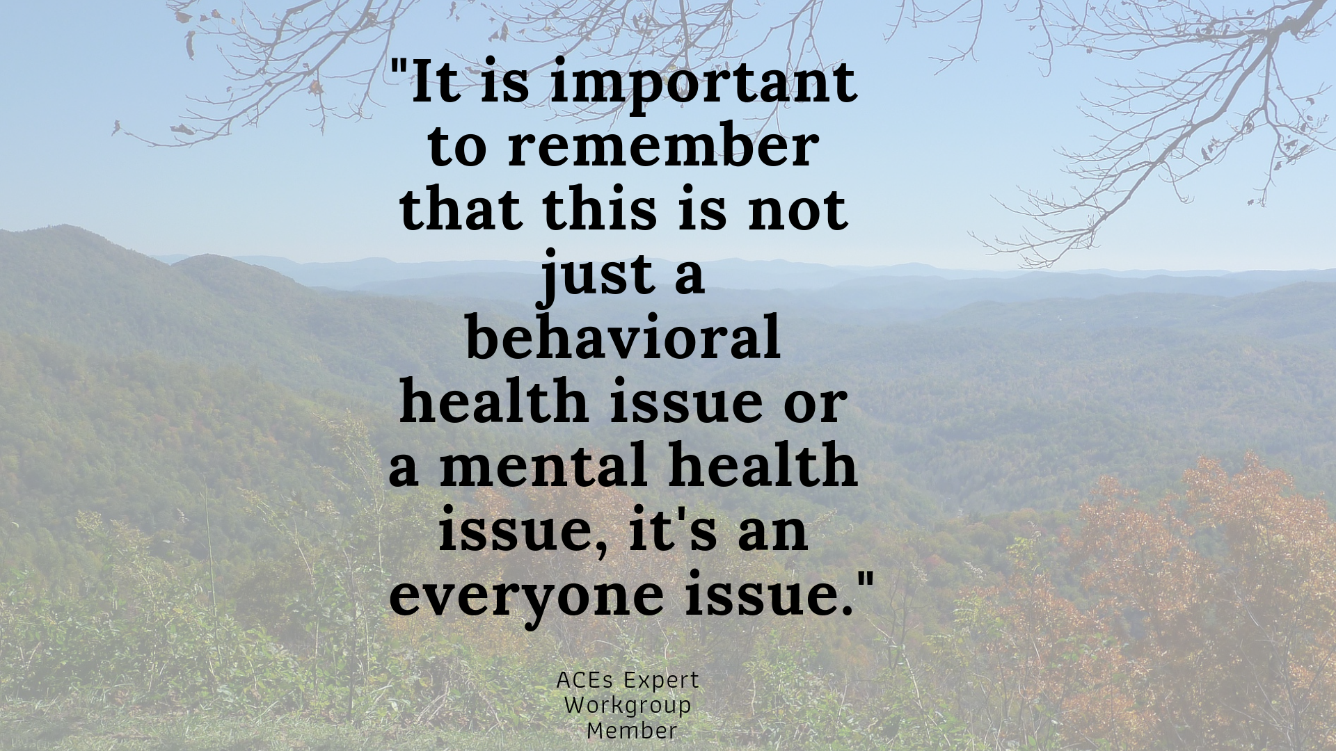
Notes:
The experts believed that improved awareness of the concept of ACEs and their impacts on children was necessary to garner needed support for grant programs for local organizations and engagement from community leaders throughout the Appalachian Region.
As a next step, they recommended that CDC issue an Appalachian report and plan for addressing ACEs and their contributing factors as a root cause for substance use issues – most importantly, opioids. They believed this would help pave the way for local organizations to develop their own plans and interventions. These plans and interventions should involve broad groups of stakeholders (e.g., physicians, schools, behavioral health) and encourage all service providers to include questions about ACEs and resilience together in their treatment and educational plans.
If you’re interested in receiving a copy of the full report with a list of programs and best practices recommended by stakeholders to address ACEs, please come see me.

Slide 34
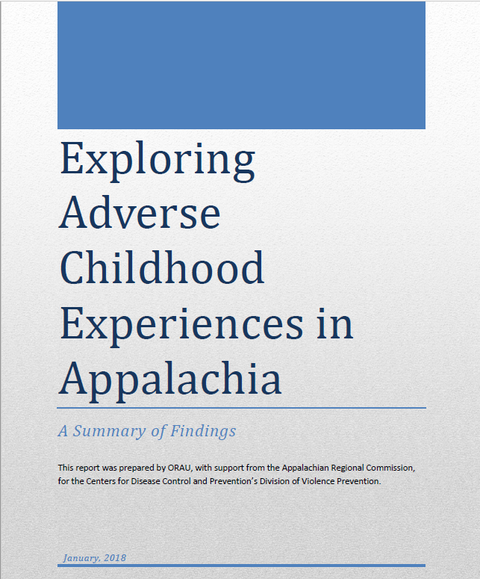
Summary Report
Summary of key findings
Stakeholder demographic information
Table of programs and best practices recommended by stakeholder to address ACEs

Slide 35

To download materials and reports from today’s presentation:
https://www.orau.gov/hsc/downloads/
RuralSummitForChildhoodSuccess/
Jennifer Reynolds, MPH CHES
Manager, Health Communication, Research, and Evaluation Jennifer.Reynolds@orau.org
https://www.orau.org/health-communication/

Slide 36
Discussion
Most Prevalent ACEs
Contributing Factors
Gender Differences
Buffering Factors

