Slide 1

Meltwater Platform: Overview & Use Cases
Interested in exploring Meltwater for your customer or project?
Contact Amparo Atencio
Amparo.Atencio@orau.org
Notes:
High level overview of the Meltwater platform and sample outputs that PHH has produced for customers.

Slide 2
Meltwater Platform Overview
 | Explore | Audiense
What does it do? | monitor online news and social media to answer 5 Ws (who, what, when, why, where) | generate actionable insights about a specified audience (e.g., key population segment, competitor, partner)
Where does it collect data? | news media, Twitter, blogs, forums, Reddit, product reviews, YouTube, Instagram, Facebook fan pages, comments (news & blogs), RFPs, Pinterest, Twitch, TikTok | Twitter
What information does it offer? | mention trends, top keywords, sentiment analysis, social engagement, emotional comparison, brand/content monitoring, consumer insights, social echo, anomaly detection, competitive monitoring | online habits, personality hallmarks, message and media recommendations, social media behavior and relevance, potential influencers, media affinity
How is it useful to me? | listen to conversations about a topic and identify emerging themes collect sentiment values about a topic and track how they change over time conduct needs assessment and landscape analysis activities identify misconceptions and misinformation about a topic | develop effective messages for specific audiences (utilizing a tone, style, and influence that is more likely to resonate with them identify relevant social media channels to support the development of a media monitoring and listening strategy
Notes:
The Meltwater platform consists of several different applications that are organized into different tools: Explore and Audiense

Slide 3
Case Study: Explore Tool
 | Explore | Audiense
What does it do? | monitor online news and social media to answer 5 Ws (who, what, when, why, where) | generate actionable insights about a specified audience (e.g., key population segment, competitor, partner)
Where does it collect data? | news media, Twitter, blogs, forums, Reddit, product reviews, YouTube, Instagram, Facebook fan pages, comments (news & blogs), RFPs, Pinterest, Twitch, TikTok | Twitter
What information does it offer? | mention trends, top keywords, sentiment analysis, social engagement, emotional comparison, brand/content monitoring, consumer insights, social echo, anomaly detection, competitive monitoring | online habits, personality hallmarks, message and media recommendations, social media behavior and relevance, potential influencers, media affinity
How is it useful to me? | listen to conversations about a topic and identify emerging themes collect sentiment values about a topic and track how they change over time conduct needs assessment and landscape analysis activities identify misconceptions and misinformation about a topic | develop effective messages for specific audiences (utilizing a tone, style, and influence that is more likely to resonate with them identify relevant social media channels to support the development of a media monitoring and listening strategy
Notes:
Next up: the Explore tool in action.
These are just a few of the outputs that Explore can offer

Slide 4
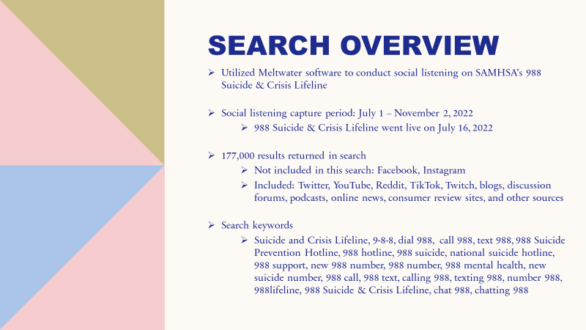
Case Study: Explore Tool
Notes:
I provided some background for the search like the capture period, how many results were returned, which media sources were included, and the keywords that were used.
Slide Notes Presented to the Customer:
How far back does media monitoring content go?
Social content from the last rolling 15 months is available
Editorial content from Jan 1, 2009 is available
Facebook
Meltwater only collects from fan pages.
Instagram
Accessing results for Instagram can be done after setting up the hashtag or competitor search. Results include posts, videos, reels, comments, and replies.

Slide 5
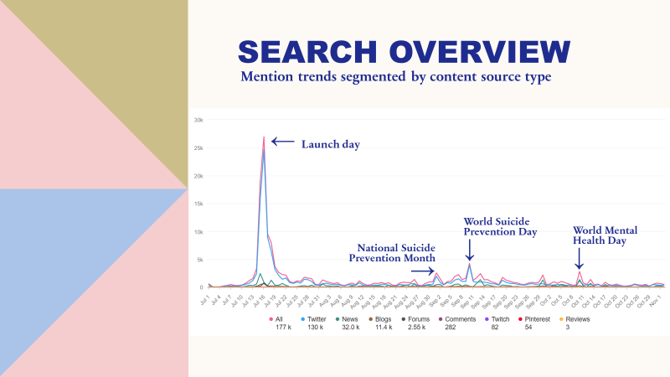
Case Study: Explore Tool
Notes:
The Explore tool illustrates keyword mentions in various ways. This graph illustrates mention trends segmented by content sources. We can take this Explore generated graph a step further and drill into why we might have seen a spike in those mentions over the course of the collection period.
Slide Notes Presented to the Customer:
There are many filter and sorting options within Explore (e.g., filter specific content source types, drill into a specific day to see content posted and understand why there was a spike in conversations). We can also see key metrics for Twitter including tweet type breakdowns (retweets, original tweets, quoted, replies). Meltwater’s Explore tool provides insights about the top emojis used, the authority level of the authors, top key words used, a sentiment breakdown, a sample of the most retweeted tweets and their key metrics, top hashtags, top Twitter authors, top locations, and gender breakdown. We can also collect insights about the authors of Twitter content such as the unique number of authors, gender breakdown, age breakdown, authors who have the highest number of followers, top author occupations, top Twitter bio keywords, and top interests among the authors.

Slide 6
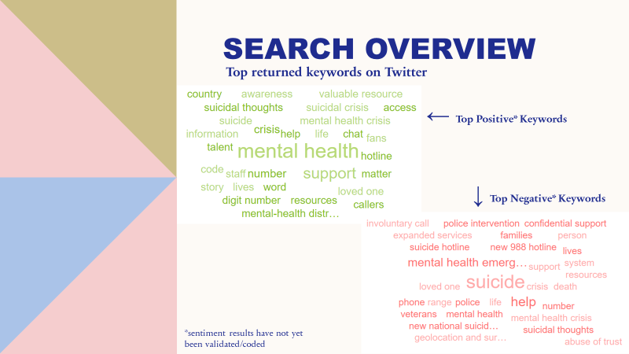
Case Study: Explore Tool
Notes:
The top keywords are also assigned a sentiment value that could be recoded.
Slide Notes Presented to the Customer:
Explore assigns a preliminary sentiment value to each individual piece of content. Sentiment values can be recoded by the ORAU team and over time Explore will learn the re-coding and incorporate those sentiment assignments into future searches.

Slide 7
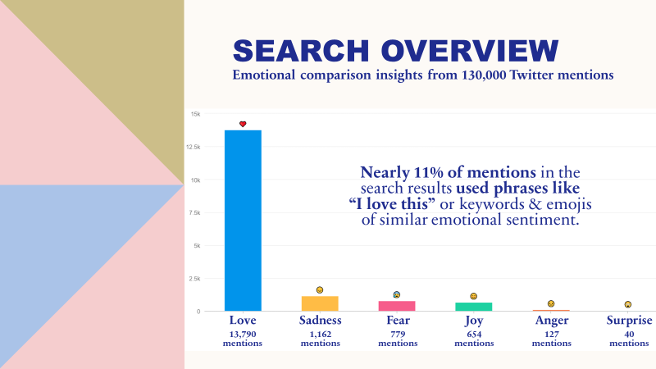
Case Study: Explore Tool
Notes:
Slide Notes Presented to the Customer:
This graph illustrates how many mentions in our search results expressed a specific emotion. This differs from a sentiment analysis (previous slide) because it is based on specific keywords, phrases, and emojis. This includes negation (keywords that won't be matched).
E.g. "I love this" vs "This made me sad".

Slide 8
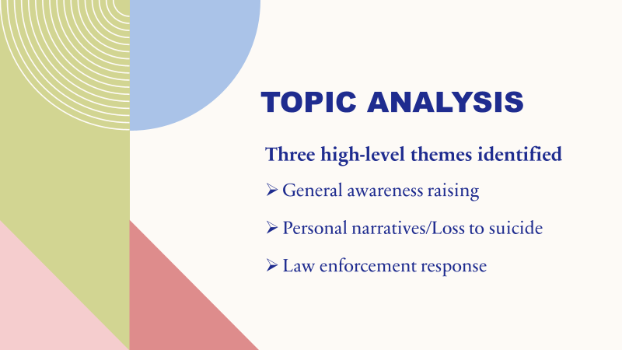
Case Study: Explore Tool
Notes:
Slide Notes Presented to the Customer:
Topic Analysis is an exploratory research tool designed to help understand the underlying meaning of the topics within the results. Go beyond the volume of results, or where conversations are taking place, and drill further into what the general topics and tenor are related to results. This provides you the ability to find deeper context to the results you see, and better understand how the results are being talked about within separate topics.
Three key themes were identified through this analysis.

Slide 9
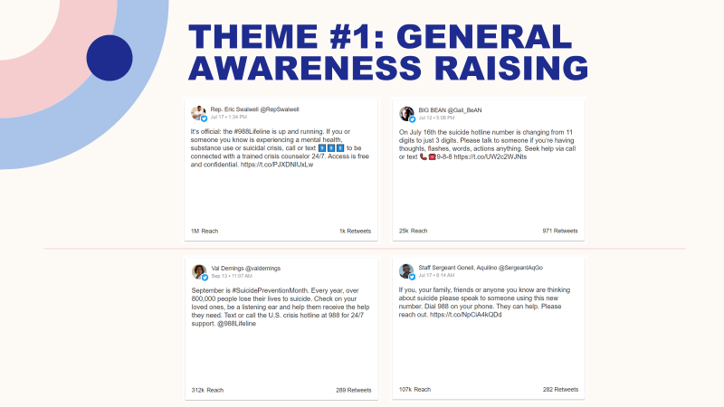
Case Study: Explore Tool
Notes:
Slide Notes Presented to the Customer:
Examples of content posted on Twitter during the social listening capture period. These four examples are categorized under Theme #1: General Awareness Raising.

Slide 10
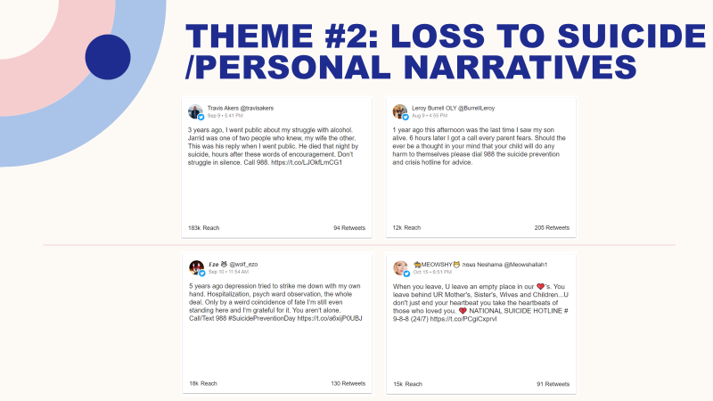
Case Study: Explore Tool
Notes:
Slide Notes Presented to the Customer:
Examples of content posted on Twitter during the social listening capture period. These four examples are categorized under Theme #2: Loss to Suicide/Personal Narratives.

Slide 11
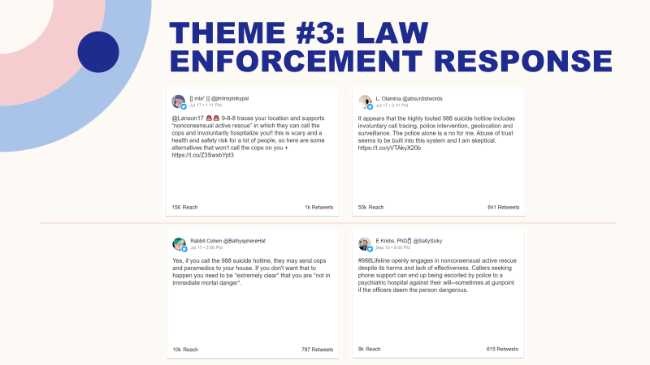
Case Study: Explore Tool
Notes:
Slide Notes Presented to the Customer:
Examples of content posted on Twitter during the social listening capture period. These four examples are categorized under Theme #3: Law Enforcement Response.

Slide 12
Case Study: Audiense Tool
 | Explore | Audiense
What does it do? | monitor online news and social media to answer 5 Ws (who, what, when, why, where) | generate actionable insights about a specified audience (e.g., key population segment, competitor, partner)
Where does it collect data? | news media, Twitter, blogs, forums, Reddit, product reviews, YouTube, Instagram, Facebook fan pages, comments (news & blogs), RFPs, Pinterest, Twitch, TikTok | Twitter
What information does it offer? | mention trends, top keywords, sentiment analysis, social engagement, emotional comparison, brand/content monitoring, consumer insights, social echo, anomaly detection, competitive monitoring | online habits, personality hallmarks, message and media recommendations, social media behavior and relevance, potential influencers, media affinity
How is it useful to me? | listen to conversations about a topic and identify emerging themes collect sentiment values about a topic and track how they change over time conduct needs assessment and landscape analysis activities identify misconceptions and misinformation about a topic | develop effective messages for specific audiences (utilizing a tone, style, and influence that is more likely to resonate with them identify relevant social media channels to support the development of a media monitoring and listening strategy
Notes:
Next up: the Audiense tool in action.
Some highlights of the presentation that was developed for a CDC client who wanted to learn more about school leaders.

Slide 13
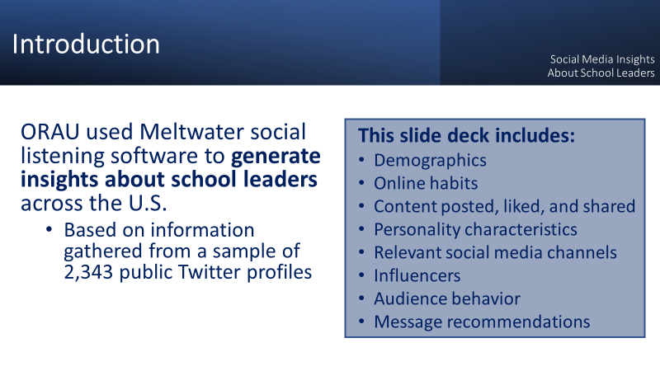
Case Study: Audiense Tool
Notes:
-We utilized the Audiense tool to generate actionable insights about school leaders from across the country.
-For this specific audience these insights are based on data gathered from over 2,000 unique social data profiles of self-identified school leaders
-Based on this analysis we were able to give the client an overview of who school leaders are, how they behave online, some hallmarks of their personality, what sort of media content or messaging is most likely to resonate with them, what social media platforms are most relevant to them, and who has the greatest potential to influence them.

Slide 14
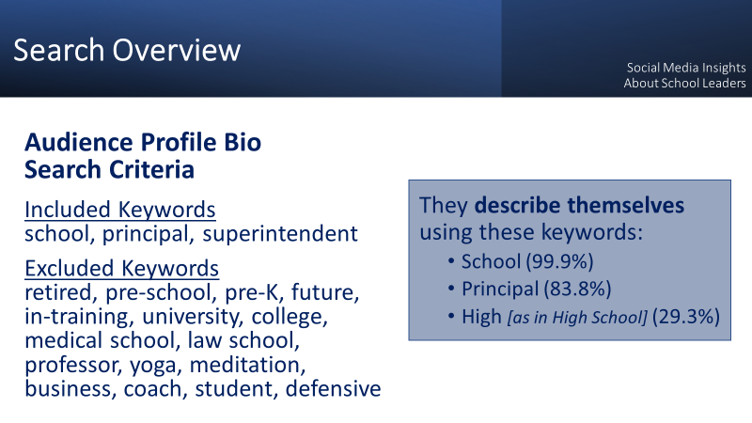
Case Study: Audiense Tool
Notes:
Next, we provided a little background on how we developed the audience search parameters using keywords and explained our search validation protocol.
Slide Notes Presented to the Customer:
crafted the search parameters based on a set of inclusionary and exclusionary keywords in order to identify this school leader audience.
excluded profiles that included words like retired, in-training, preschool, university – just to name a few
Of the 2,343 social media profiles pulled in this search, almost 100% of them used the word ‘school’ to described themselves in their Twitter bio. And about 84% used some variation of principal (e.g., high school principal, assistant principal, Oak Elementary School Principal) in their Twitter bio.
established face validity for this search through systematic testing of audience profiles

Slide 15
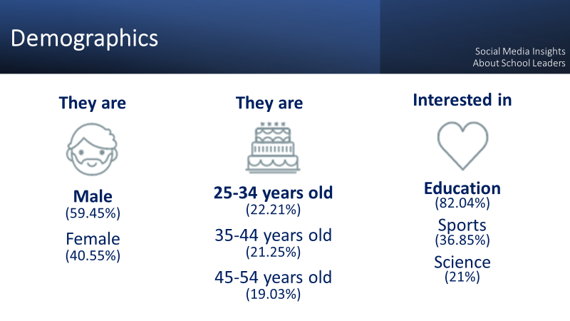
Case Study: Audiense Tool
Notes:
Slide Notes Presented to the Customer:
-nearly 60% are males and most are aged 25-34
-Audiense uses machine learning and a clustering process from the Interactive Advertising Bereau to generate audience interest categories. Not surprisingly the most relevant interest for this audience was education. When we drilled down into the education category some sub-interests include alumni and reunions, graduate school, teaching and classroom resources, homework and study tips, and distance learning.

Slide 16
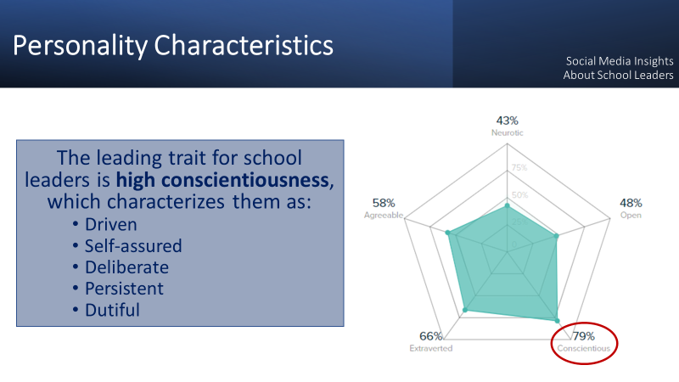
Case Study: Audiense Tool
Notes:
One of the first things we shared with the client were insights gathered about the personality characteristics of school leaders.
These insights were created through IBM Watson’s machine learning and are based on the psychology of language in combination with data analytics algorithms.
Some example of insights we shared were:
Our school leader audience believes the best in others and trusts people easily.
They have high goals for themselves and work hard to achieve them.
And they enjoy a fast-paced, busy schedule with many activities.

Slide 17
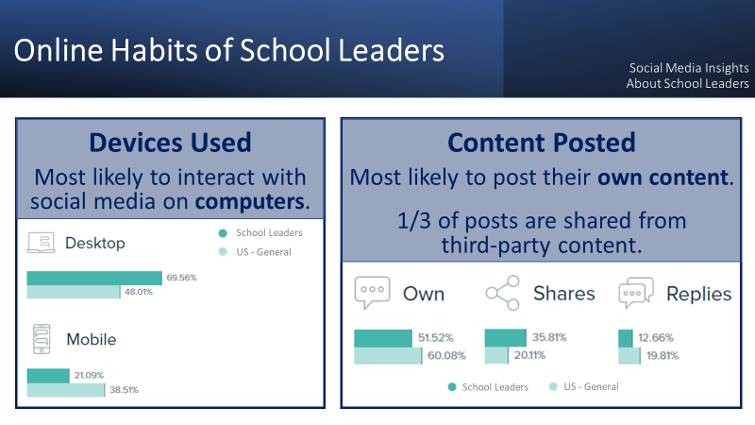
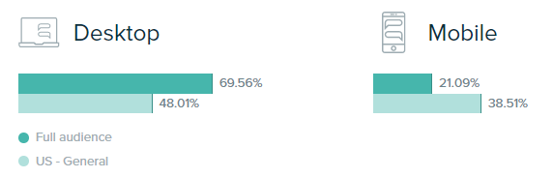
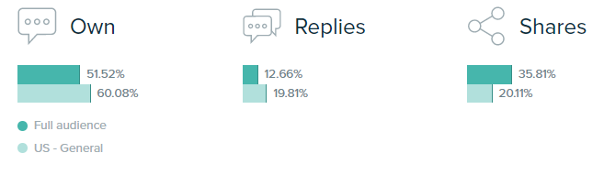
Case Study: School Health Branch
Case Study: Audiense Tool
Devices Used
Most likely to interact with social media on computers.
Content Posted
Most likely to post their own content.
1/3 of posts are shared from third-party content.
School Leaders
US - General
School Leaders
US - General
Notes:
Next, we provided insights into what kind of technology school leaders use and what type of content they are most likely to post on media.
Slide Notes Presented to the Customer:
- When school leaders interact with social media, they are most likely to do this on a computer. This is interesting bc they’re doing this about 20% more than the general US population.
- Also of note: they are less likely to engage with social on their mobile devices when compared to the general US population.
- When school leaders make posts on social media, they are most likely posting their own content.
- But really interestingly more than 1/3 of their posts are shared content from third party sources. There are several points of interest to note here:
U.S. general numbers are A LOT lower
Could be a window of opportunity to have school leaders share content with other relevant audiences because this is a behavior they’re already comfortable with

Slide 18
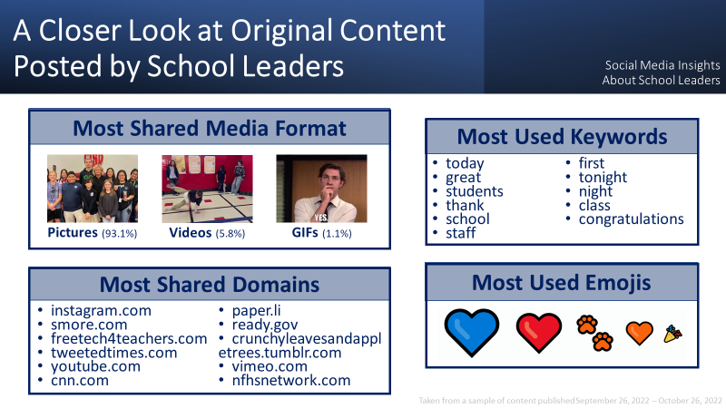
Case Study: Audiense Tool
Notes:
Then we took an even closer look at the original content posted by our school leader audience and provide actual examples of media posted by the school leaders audience.
Slide Notes Presented to the Customer:
When school leaders share posts with media content, 93% of that media are pictures. The media you see on the slide are actual examples of original content posted by our school leader audience. Pictures of students and staff were very popular.
The most shared domains highlights the sites that school leaders are spending most of their time on and sharing content from. Some of these sites are online newsletter templates or high school sports networks.

Slide 19
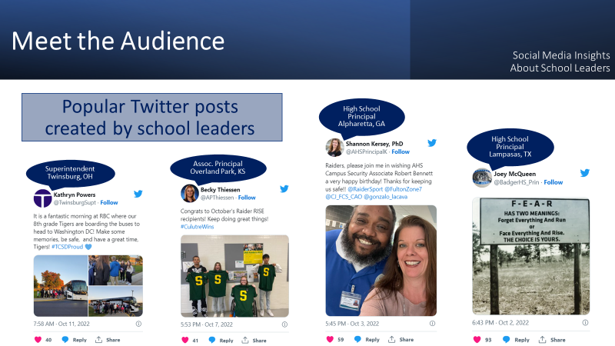
Case Study: Audiense Tool
Notes:
Next, we shared popular posts created by actual school leaders.
Slide Notes Presented to the Customer:
-Here we have a few samples of real school leaders whose personality characteristics and online behavior helped inform the insights being shared with you today.
-These posts were taken from a sample of the most popular tweets posted by school leaders from September 26 – October 26.
-We have a few HS principals represented here, an associate principal, and even a superintendent of a school district.
-The location of the schools are also varied across the country
-Some common threads = messages of encouragement, inspiration, appreciation, and excitement

Slide 20
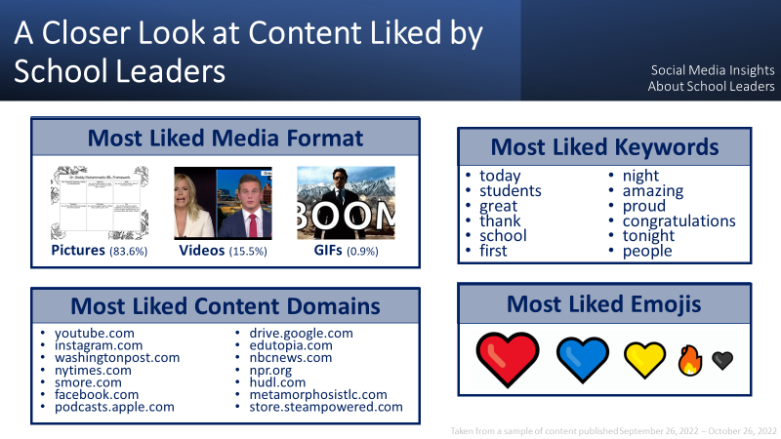
Case Study: Audiense Tool
Notes:
We provided insights on the type of content liked by school leaders. (so different from what they are posting themselves) so what they are liking and showing affinity towards
Slide Notes Presented to the Customer:
Note: more passive interaction and content can be liked by an audience that does not follow the account that originally posted the content.
When school leaders like a post that includes media, about 84% of those media are pictures and about 16% are videos.
When school leaders like posts containing content shared from domains outside of Twitter, the most found domain is YouTube. You can also see there are many news sources and educational resources. (Metamorphosis Teaching Learning Communities; Hudl is how the world sees sports; Smore online newsletter templates)

Slide 21
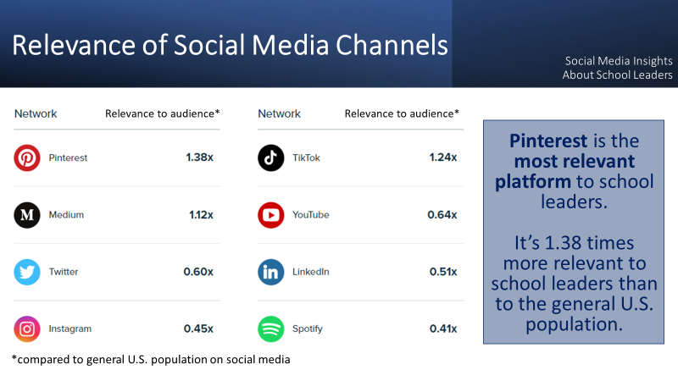
Case Study: Audiense Tool
Notes:
We identified which social media channels were most relevant to our school leader audience.
Slide Notes Presented to the Customer:
Note: Facebook is not included on this list. And it could have potentially been on the list per the software’s included networks.
_________________
Networks included are: Discord, Facebook, Instagram, LinkedIn, Medium, Pinterest, Reddit, Sinaweibo, Snapchat, SoundCloud, Spotify, Tiktok, Telegram, Twitch, Twitter, Wechat, Weibo, Whatsapp, Youtube
How relevance is calculated: Our algorithms are constantly evolving. Generally, through machine learning, Audiense infers the social media presence of the users within the audience according to the interactions (tweets, follows, likes, clicks, etc.), the information in the profiles of the users (name, profile picture, bio), other public information (demographic census) or combinations of these.

Slide 22
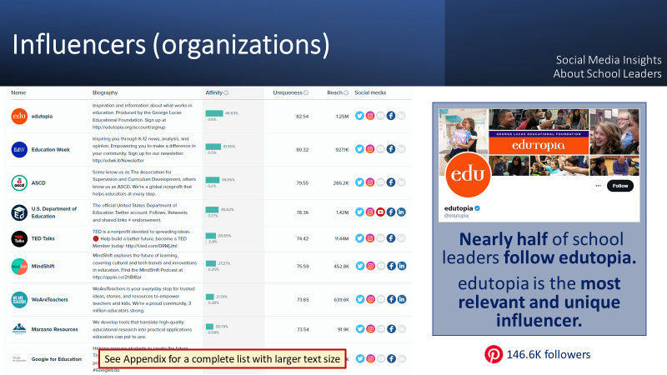
Case Study: Audiense Tool
Notes:
We provided a list of organizational and individual influencers for this audience. But we also took the list a step further and identified a significant organizational influencer worthy of further exploration.
Slide Notes Presented to the Customer:
Let’s explore an exciting organizational influencer. For those that don’t know, edutopia is a free source of information, inspiration, and practical strategies for learning and teaching in preK-12 education.
Nearly half of our school leader audience are followers of edutopia. And you may remember seeing their name on the list of ‘most liked content domains’ 2 slides back.
This information coupled with edutopia’s relevance to this distinct audience makes them a significant influencer amongst school leaders.
Since Pinterest is the most relevant channel to our audience, we wanted to include edutopia’s reach on that platform as well.
________
Affinity – The percentage of affinity the audience and the baseline have with the user
Uniqueness - How relevant and unique a person or a brand is for the members of the audience in comparison to the chosen baseline. This index takes into account how "mainstream" the accounts are for the public and penalizes accounts that are influential for the whole population versus those that are especially relevant for the audience we are analyzing.

Slide 23
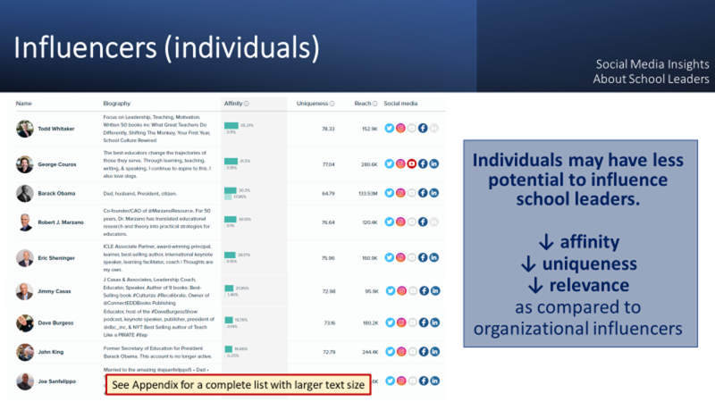
Case Study: Audiense Tool
Notes:
Slide Notes Presented to the Customer:
Individual influencers.
Based on our analysis of individuals with potential to influence school leaders, we found that the school leaders had less affinity for them as compared to organizations or brands and on the whole were less unique to this audience.
We concluded that individuals may have less potential to influence this group.
I also want to note that we’ve included an appendix at the end of this presentation where you can view these influencers lists with larger text size.

Slide 24
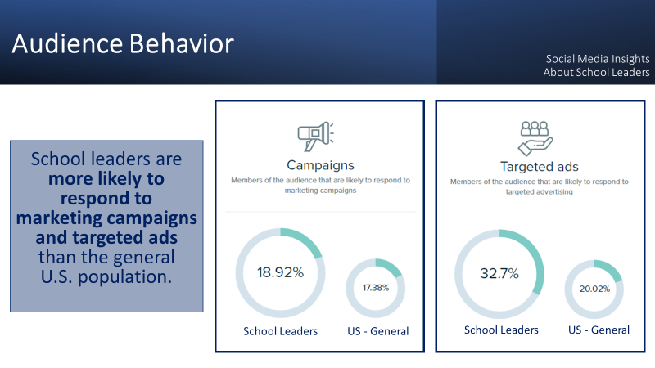
Case Study: Audiense Tool
Notes:
Next, we presented results of our consumer behavior analysis and were thrilled to report some exciting opportunities to reach our audience via marketing campaigns and targeted ads. And then based on these results, we included information about the media affinity of school leaders for both online and offline media.
Customer Question: How does this audience interact with ads? What type of ads are they interacting with?
ORAU Answer: Audiense provides insights into the media affinity for both online and offline communication channels. It makes recommendations for the best ways to reach our audience via offline channels (TV, radio, newspapers, magazines, events, and places) and online channels (social and display ads, web and digital content, online shows, and apps). Based on the school leader audience’s consumer behavior results, we’ve included information about the media affinity of school leaders where marketing campaigns and targeted ads could be used. (see next two slides)
Slide Notes Presented to the Customer:
Almost 19% of school leaders are likely to respond to a marketing campaign and almost 33% are likely to respond to targeted ads.
An interesting note here is that both of these response findings are above the general US population.

Slide 25
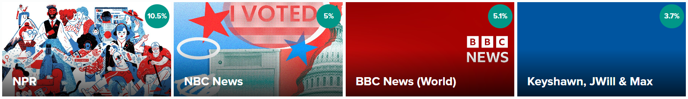
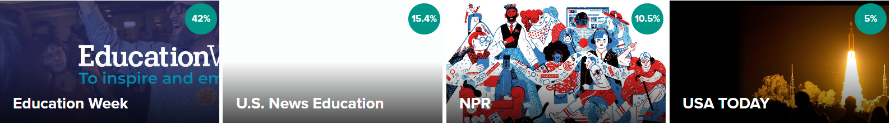
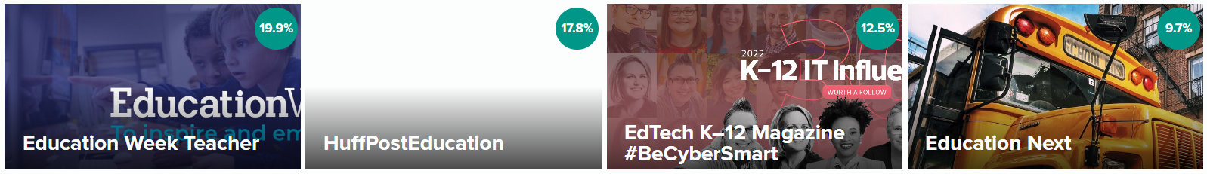
Offline Media Affinity
Case Study: Audiense Tool
Social Media Insights About School Leaders
Radio
Newspapers
Magazines
Notes:
We were able to provide our client with recommendations for the best ways to reach this specific audience.
These are the radio, newspapers, and magazines that school leaders are interested in.
Slide Notes Presented to the Customer:
These are the radio, newspapers, and magazines that school leaders are interested in.
Radio is a highly cost-effective and truly mobile advertising medium. Radio’s variety of formats allows you advertise with pinpoint accuracy on the station or show that best matches your audience’s lifestyle and interests.
Newspapers are read by influencers and newspaper ads are among the most trusted forms of advertising with high levels of media engagement. Newspapers require consumers to be engaged and active in order to consume the content and allow advertisers to reach more specific, niche audiences. Target a receptive audience with precision and influence them through a highly credible medium.
Magazine advertising is highly-targeted and relevant for those with a passion for the subject. It captures their focused attention and reaches readers with sufficient disposable income to buy your advertised brand. Magazines are a credible and trustworthy platform for your ads and allow quality advertising which is durable over time and allows readers to revisit ads and make considered decisions.
The percentages represent the affinity the audience has with the content in question (e.g., 10.5% of our school leader audience has an interest in the NPR radio station, 42% of our school leader audience has an interest in the Education Week newspaper)
These items are ordered by uniqueness from left to right. Uniqueness is a proprietary index used to determine how relevant and unique a person or a brand is for the members of a specific audience. This index takes into account how "mainstream" the accounts are for the public and penalizes accounts that are influential for the whole population versus those that are especially relevant for the audience we are analyzing. This index allows us to highlight brands or people that are unique for a concrete target audience or segment.

Slide 26
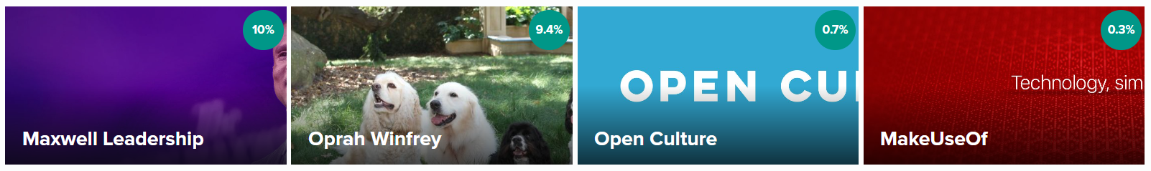
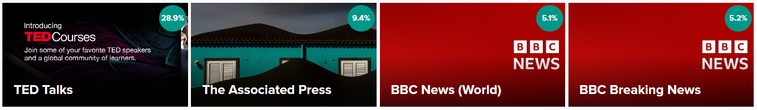
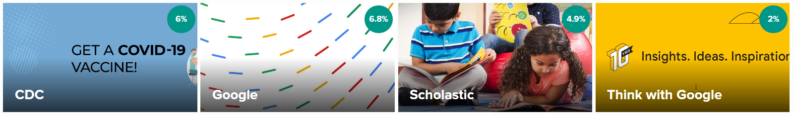
Online Media Affinity
Case Study: Audiense Tool
Social Media Insights About School Leaders
Blogs
Digital Magazines
Websites
Notes:
And these are the blogs, digital magazines and websites that school leaders are interested in.
Slide Notes Presented to the Customer:
These are the blogs, digital magazines and websites that school leaders are interested in.
Online advertising delivers targeted advertisements and brand messages to site visitors and is intended to attract traffic to the advertiser’s website. It can take the format of banners, pop-ups, etc., which may contain text, images, audio, video, etc. Results for display ads can be monitored in real-time.
The percentages represent the affinity the audience has with the content in question (e.g., 10% of our school leader audience has an interest in the Maxwell Leadership blog, 28.9% of our school leader audience has an interest in the TED Talks digital magazine)
These items are ordered by uniqueness from left to right. Uniqueness is a proprietary index used to determine how relevant and unique a person or a brand is for the members of a specific audience. This index takes into account how "mainstream" the accounts are for the public and penalizes accounts that are influential for the whole population versus those that are especially relevant for the audience we are analyzing. This index allows us to highlight brands or people that are unique for a concrete target audience or segment.

Slide 27
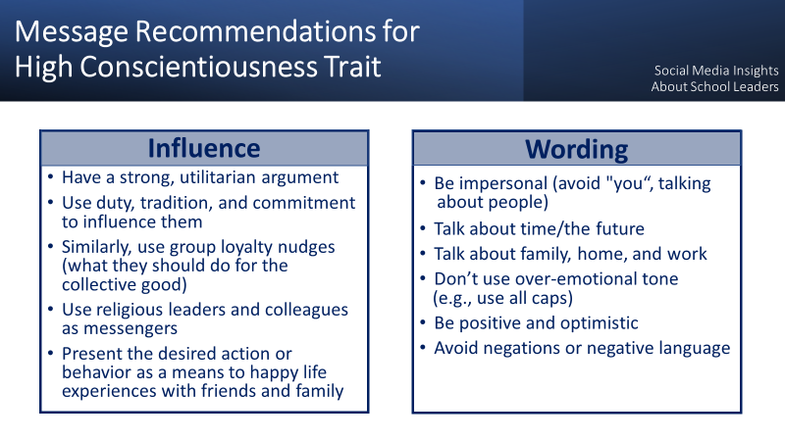
Case Study: Audiense Tool
Notes:
And lastly, we provided message recommendations developed by Audiense that were based on the personality traits associated with our school leader audience.
Slide Notes Presented to the Customer:
These Meltwater recommendations are based on the high conscientiousness personality trait that is associated with our school leader audience.
This audience is more likely to be influenced by messaging when you use group loyalty nudges or what they should do for the collective good.
Message content should avoid using the word YOU – be more impersonal with this group.
Message wording should be positive and optimistic and mention things such as family, home, and work

Slide 28
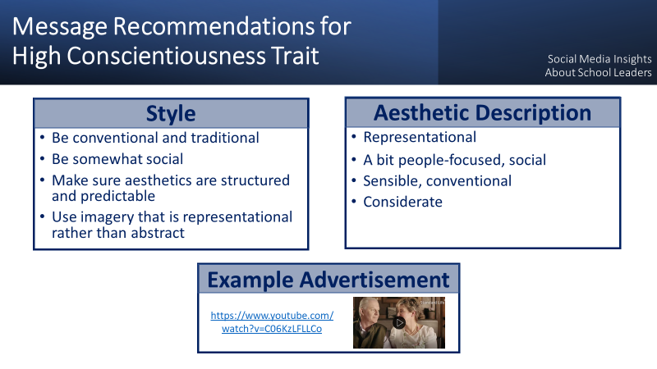
Case Study: Audiense Tool
Notes:
Here are a few more message recommendations we had.
Slide Notes Presented to the Customer:
Messages with structured and predictable aesthetics are more likely to be effective with school leaders.
The style should be balanced between traditional and social.
And imagery should be people-focused, sensible, and considerate.
This sample advertisement for ‘Standard Life – life assurance’ illustrates many of these recommendations: https://www.youtube.com/watch?v=C06KzLFLLCo

Slide 29
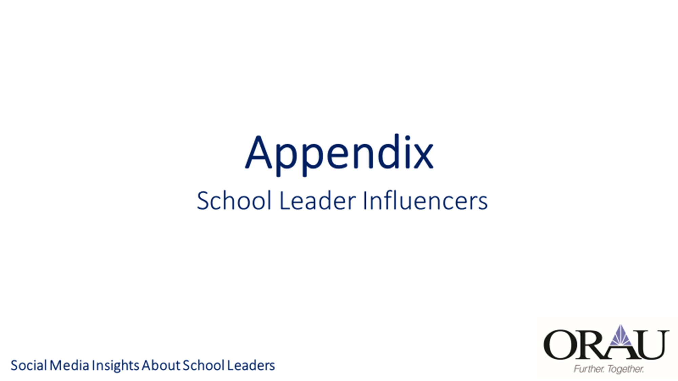
Case Study: Audiense Tool

Slide 30
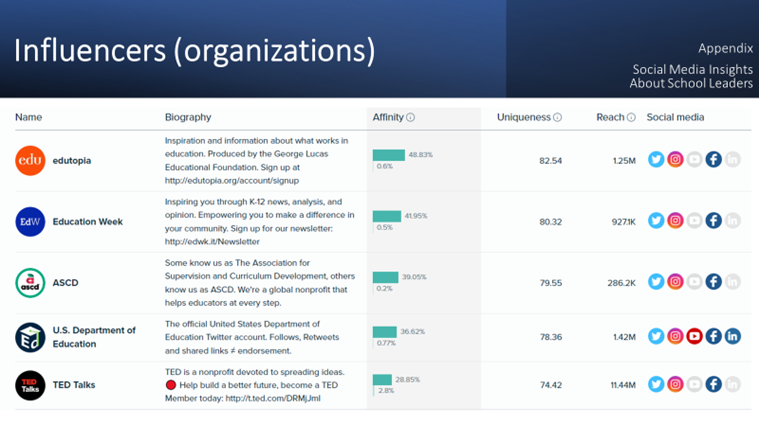
Case Study: Audiense Tool

Slide 31
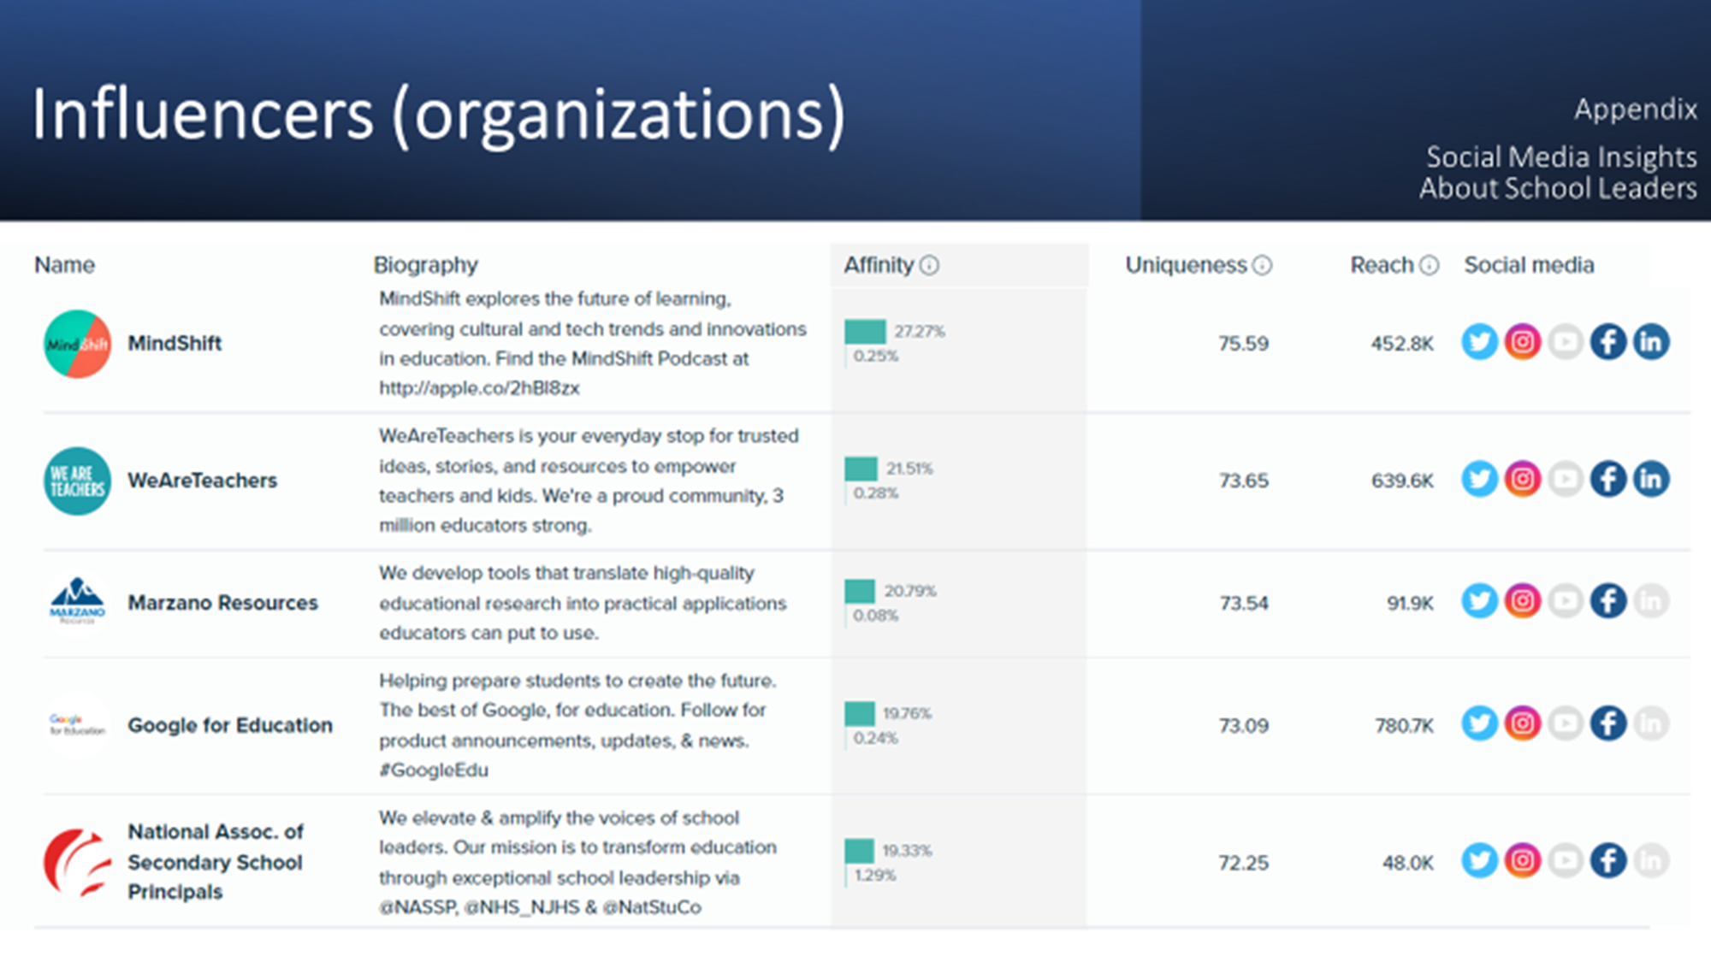
Case Study: Audiense Tool

Slide 32
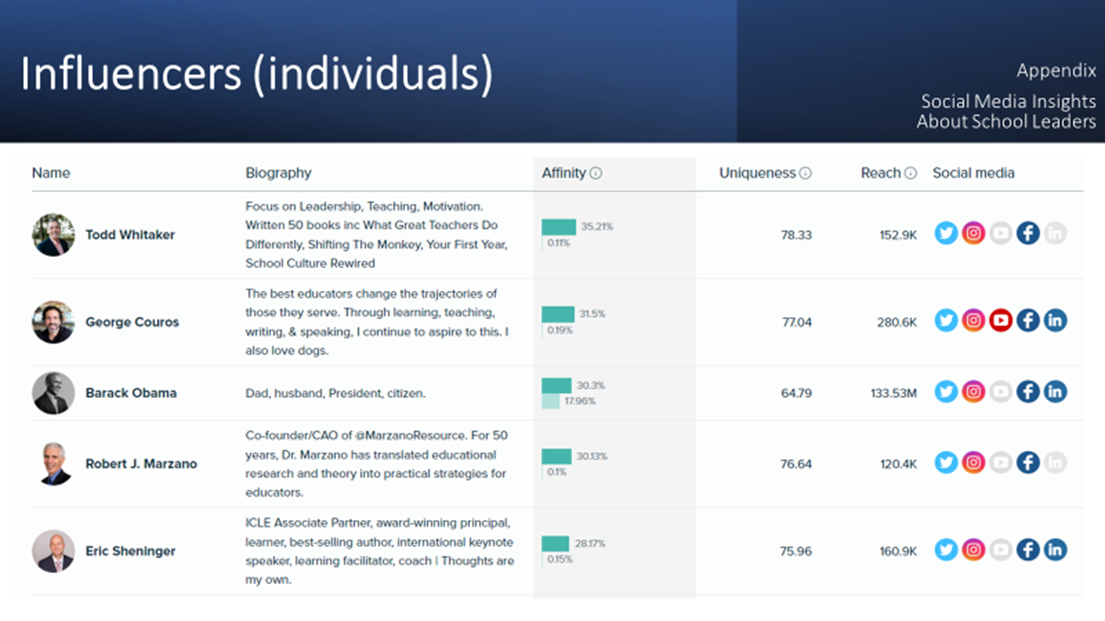
Case Study: Audiense Tool

Slide 33
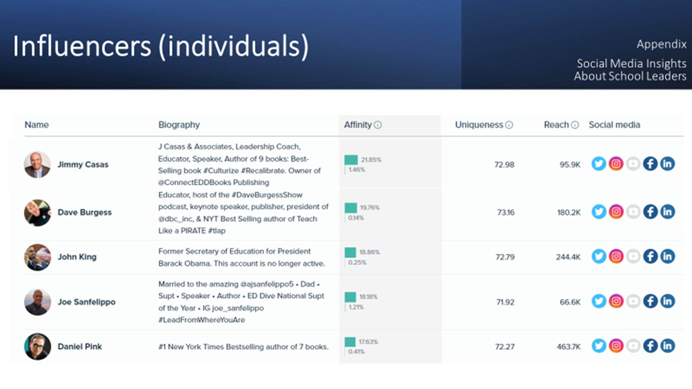
Case Study: Audiense Tool

Slide 34
Meltwater Platform Overview
Interested in utilizing Meltwater with your customer or writing it into a proposal for a future project?
Contact Amparo Atencio (Amparo.Atencio@orau.org)
to set up a meeting with the ORAU Meltwater Team and learn more!
Notes:
Contact Amparo Atencio (Amparo.Atencio@orau.org) to set up a meeting with the ORAU Meltwater Team and learn more!

