Slide 1

WRAP REPORT
ORAU – BMC
Massachusetts Digital

Slide 2

CAMPAIGN TARGETS
CAMPAIGN GOALS:
Address misunderstandings about and generate public support for HCS evidence-based interventions (i.e. naloxone, medication assisted treatment)
Encourage people with opioid use disorder to utilize treatment and recovery support services available in their communities.
TARGET AUDIENCES:
A 18+ Hispanic/Spanish language
A 18+ English language
GEOGRAPHY: ATHOL CLUSTER = Cities in Massachusetts (Athol, Greenfield, Montague, Orange). BERKLEY CLUSTER = Cities in Massachusetts (Berkley, Dighton, Freetown). BELCHERTOWN CLUSTER = Cities in Massachusetts
(Belchertown, Ware). Lawrence, MA, North Adams, Ma, Pittsfield, MA, Springfield, MA, Weymouth, MA
FLIGHT DATES: November 1 – December 18, 2023
CREATIVE:
Facebook Static Ads
Display Banners – 300x250, 728x90, 160x600, 300x600, 320x50
:15/:30 second video
TACTICS:
Cross Device Display: English
Facebook Traffic Ads: Spanish & English
Pre-Roll Video: Spanish & English

Slide 3
CAMPAIGN INFORMATION
NET SPEND BY COMMUNITY:
ATHOL CLUSTER = Cities in Massachusetts (Athol, Greenfield, Montague, Orange) - $4,375.00
BERKLEY CLUSTER = Cities in Massachusetts (Berkley, Dighton, Freetown) - $4,375.00
BELCHERTOWN CLUSTER = Cities in Massachusetts (Belchertown, Ware) - $4,375.00
Lawrence, MA - $5,875.00
North Adams, Ma - $4,375.00
Pittsfield, MA - $4,375.00
Springfield, MA - $5,875.00
Weymouth, MA - $5,375.00
NET SPEND BY LANGUAGE:
ENGLISH: $34,000
SPANISH: $3,000
PORTUGESE: $1,000
TOTAL BUDGET: $39,000.00 NET

Slide 4
POPULATION BY COMMUNITY
(U.S. CENSUS BUREAU DATA 2020):
ATHOL CLUSTER (Athol, Greenfield, Montague, Orange) – 45,364
BERKLEY CLUSTER (Berkley, Dighton, Freetown) – 24,088
BELCHERTOWN CLUSTER (Belchertown, Ware) – 24,945
Lawrence, MA – 88,508
North Adams, MA – 12,961
Pittsfield, MA – 43,927
Springfield, MA – 154,789
Weymouth, MA – 57,437

Slide 5
CAMPAIGN DELIVERY TOTALS
DISPLAY:
CROSS DEVICE DISPLAY – English
448,007 IMPRESSIONS
650 CLICKS
0.15% CLICK THROUGH RATE
CROSS DEVICE DISPLAY – Spanish
490,776 IMPRESSIONS
572 CLICKS
0.12% CLICK THROUGH RATE
CROSS DEVICE DISPLAY – Portuguese
161,028 IMPRESSIONS
231 CLICKS
0.14% CLICK THROUGH RATE

Slide 6
CAMPAIGN DELIVERY TOTALS
PRE-ROLL
Campaign | Impressions | Clicks | CTR | Completion Rate | Completions
2480849 - Pre-Roll - ATHOL Cluster AT1 | 82,650 | 90 | 0.11% | 63.41% | 50,567
2481113 - Pre-Roll - BERKLEY Cluster | 78,993 | 66 | 0.08% | 63.09% | 49,428
2481115 - Pre-Roll - BLECHERTOWN Cluster AT1 | 82,261 | 64 | 0.08% | 61.75% | 49,517
2481116 - Pre-Roll - Lawrence, MA AT1 | 82,084 | 100 | 0.12% | 59.90% | 48,081
2481117 - Pre-Roll - North Adams, MA AT1 | 84,994 | 78 | 0.09% | 66.19% | 53,909
2481118 - Pre-Roll - Pittsfield, MA AT1 | 81,066 | 111 | 0.14% | 66.29% | 53,116
2481120 - Pre-Roll - Springfield, MA AT1 | 80,764 | 121 | 0.15% | 60.97% | 48,686
2481612 - Pre-Roll - Weymouth, VA AT1 | 81,034 | 44 | 0.04% | 64.86% | 52,274
TOTAL | 653,846 | 674 | 0.10% | 62.02% | 405,578
SOCIAL:
Campaign | Impressions | Clicks | CTR
VDS | Kojoulka ORAU | North Adams, MA | Nov - Dec 2023 | 74,512 | 2,174 | 2.92%
VDS | Kojoulka ORAU | BERKLEY CLUSTER | Nov - Dec 2023 | 73,251 | 2,578 | 3.52%
VDS | Kojoulka ORAU | Weymouth, MA | Nov - Dec 2023 | 70,907 | 2,502 | 3.53%
VDS | Kojoulka ORAU | BELCHERTOWN CLUSTER | Nov - Dec 2023 | 69,680 | 1,853 | 2.66%
VDS | Kojoulka ORAU | Pittsfield, MA | Nov - Dec 2023 | 68,436 | 1,720 | 2.51%
VDS | Kojoulka ORAU | Lawrence, MA | Nov - Dec 2023 | 67,803 | 2,471 | 3.64%
VDS | Kojoulka ORAU | ATHOL CLUSTER | Nov - Dec 2023 | 64,310 | 1,657 | 2.58%
VDS | Kojoulka ORAU | Springfield, MA | Nov - Dec 2023 | 62,621 | 2,307 | 3.68%
TOTAL | 551,520 | 17,262 | 3.13%

Slide 7
DISPLAY PERFORMANCE
AUDIENCE TARGETING

Slide 8
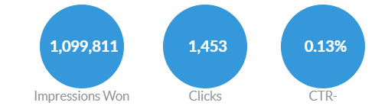
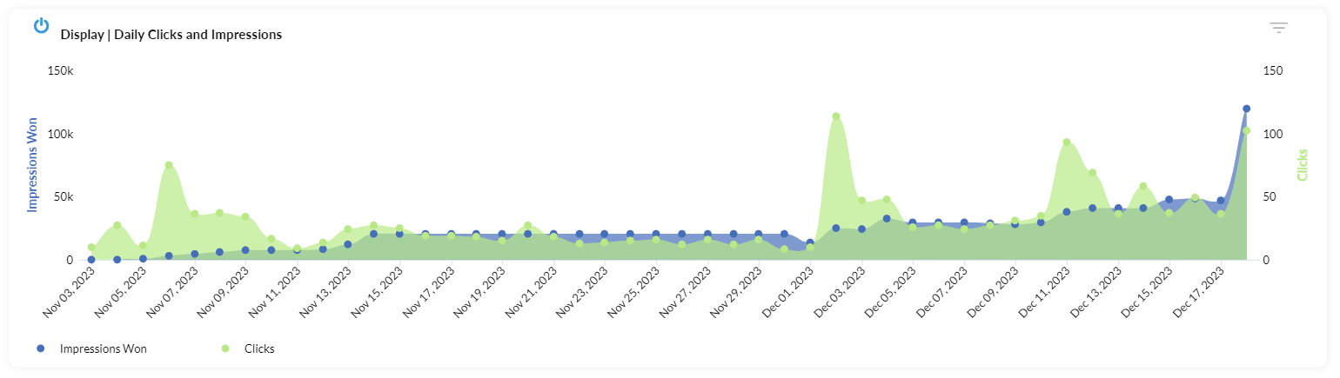
DISPLAY – OVERALL PERFORMANCE

Slide 9
DISPLAY – BY TOWN
City | Impressions | Clicks | CTR
Springfield | 297,664 | 391 | 0.13%
Lawrence | 290,624 | 360 | 0.12%
Weymouth | 219,857 | 305 | 0.14%
Athol | 59,031 | 77 | 0.13%
Pittsfield | 59,014 | 67 | 0.11%
North Adams | 58,985 | 101 | 0.17%
Belchertown | 58,932 | 69 | 0.12%
Berkley | 55,704 | 83 | 0.15%
TOTAL | 1,099,811 | 1453 | 0.13%

Slide 10
DISPLAY – CREATIVE
Creative | Campaign | Impressions | Clicks | CTR
W2C2-3 Media Buy_Digital Display_160x600 | ENGLISH | 24,297 | 89 | 0.37%
W2C2-3 Media Buy_Digital Display_300x600 | ENGLISH | 7,729 | 84 | 1.09%
W2C2-3 Media Buy_Digital Display_320 x 50 | ENGLISH | 451,037 | 463 | 0.10%
W2C2-3 Media Buy_Digital Display_320 x 250 px | ENGLISH | 483 | 8 | 1.66%
W2C2-3 Media Buy_Digital Display_728 x 90 | ENGLISH | 228,306 | 369 | 0.16%
TOTAL |  | 711,852 | 1,013 | 0.14%
Creative | Campaign | Impressions | Clicks | CTR
W2C2-3 Media Buy_Digital Display_300x600_PORT | PORT | 1,198 | 10 | 0.83%
W2C2-3 Media Buy_Digital Display_320 x 50_PORT | PORT | 56,056 | 61 | 0.11%
W2C2-3 Media Buy_Digital Display_320 x 250_PORT | PORT | 47 | 1 | 2.13%
W2C2-3 Media Buy_Digital Display_728 x 90_PORT | PORT | 22,690 | 41 | 0.18%
TOTAL | - | 79,991 | 113 | 0.14%
Creative | Campaign | Impressions | Clicks | CTR
W2C2-3 Media Buy_Digital Display_160x600_SPA | SPA | 9,748 | 29 | 0.30%
W2C2-3 Media Buy_Digital Display_300x600_SPA | SPA | 3,810 | 35 | 0.92%
W2C2-3 Media Buy_Digital Display_320 x 50_SPA | SPA | 207,742 | 139 | 0.07%
W2C2-3 Media Buy_Digital Display_320 x 250_SPA | SPA | 328 | 4 | 1.22%
W2C2-3 Media Buy_Digital Display_728 x 90_SPA | SPA | 110,581 | 139 | 0.13%
TOTAL | - | 332,209 | 346 | 0.10%

Slide 11
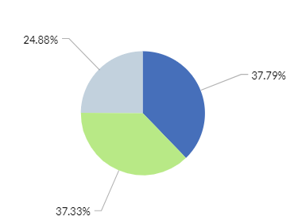

DISPLAY – BY DEVICE

Slide 12
TOP VIEWED SITES – DISPLAY
theScore
Crossword
USA
Audacy
AOL
Imgur
Zynga
Tune In
Yahoo
Worldstar Hip Hop
MyFitnessPal
Urban Dictionary
Barstool Sports
Plenty of Fish
theChive
Wheel of Fortune
New York Post
TMZ
OnDemandKorea
The Weather Channel
Trivia
National Review
CBS Sports
Rent.com
NBA
Merriam Webster
Dictionary
ESPN
Eat Well 101
FUTBIN
Bible
Cox
Paste Magazine
Match
Fox News
Daily Kos
AccuRadio
Weather Underground
Baseball Reference
Huffington Post
Stocktwits
Bored Panda
The Economic Times
CarGurus
Sallys Baking Addiction
The Hill
News Break
AccuWeather
Pro Football Reference
Realtor
The Daily Star
Apartment Guide
Law Insider
Britannica
Inside Lacrosse
Whitepages
WeatherBug
Ranker
Thesaurus
Page Six
Someecards
Find A Grave
Boston Herald
Universal Hub
Mass Live
NCAA
Podcast Addict
MLB
Casino Slot Machine
NewsTalk 1290 KWFS
The Onion
Hometalk
Washington Examiner
Rolling Stone
Washington Times
Mediotiempo
CNN
Tinybeans Family Photo Album
Politico
Wrestling Headlines
LetsRun.com
The Boston Globe
Legacy.com
Comics Kingdom
eBaum's World
Public School Review
Flickr
Florida Today
IndyStar
LiveScore
Rentals.com
Dot Esports
Horoscope
Half Baked Harvest
Law and Crime
12 Tomatoes
The American Spectator
The Nation
Slate
Forbes
Averie Cooks
Reason
Business Insider
AP News
The Daily Wire
Upworthy
Elle
Pro Football Network
Southern Living
PC Gamer
Parade
BladeForums
E!
Reader's Digest
NHL
Champion Daily
eNotes
Weather
LA Times
JCPenney
SFGATE
Oprah
Samsung TV Plus
MamÃ¡s Latinas
Classic Cars
US News
Good Housekeeping
El Nuevo DÃ­a
Footballscoop
Newsweek
Extra
NY Daily News
Tastes Better From Scratch
OK Magazine
Picture Cross
Sky Sports
Mail.com
SpanishDict
Boston
Boing Boing
Encyclopedia
Family Education
The Guardian
People
Barchart
Spotify
Variety
Minecraft
Cars.com
CBS
YourTango
Know Your Meme
Hollywood Life
The Sun
Dailymotion
Dexerto
Boat Trader
Zoosk
Sports Illustrated
NESN
Gizmodo
TV Guide
ABC
Entertainment Tonight
TV Insider
Bleacher Report
Rate My Professors
Gfinity Esports
WebMD
Racing Junk
Manta
WEBTOON
BabyCenter
Classmates
United Press International
GOLF.com
The Daily Beast
Entertainment Weekly
Esquire
MapQuest
Country Living
Mashable
Apartment Ratings
The Washington Post
Field & Stream
Baby Names
Prevention
MedicineNet
Popular Mechanics
Deadline
VICE
New York Magazine
The State
El Universal
NBC Sports
Fox Business
Woman's Day
Golf Monthly
HowStuffWorks
Times Union
The Week
InStyle
Spot the Difference
Family Handyman

Slide 13
PRE-ROLL PERFORMANCE
AUDIENCE TARGETING

Slide 14
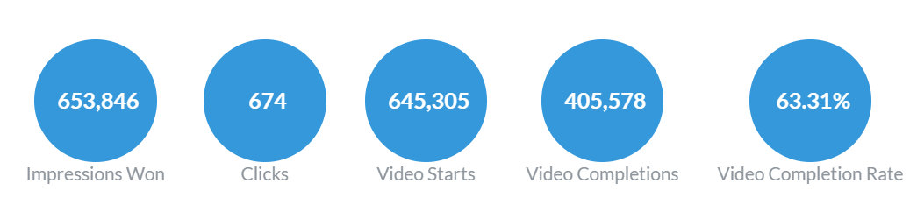
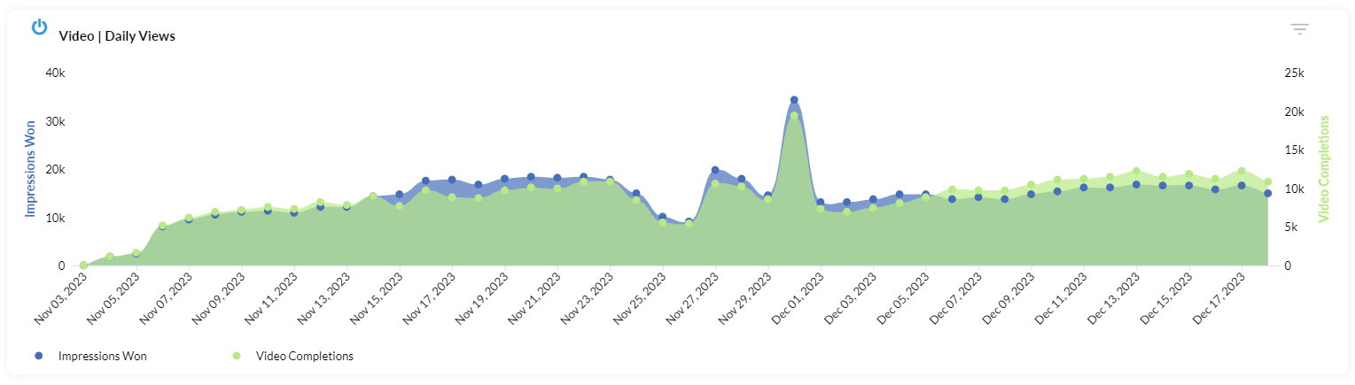
PRE-ROLL – OVERALL PERFORMANCE

Slide 15
PRE-ROLL – BY TOWN
Campaign | Impressions | Clicks | CTR | Completion Rate | Completions
2480849 - Pre-Roll - ATHOL Cluster AT1 | 82,650 | 90 | 0.11% | 63.41% | 50,567
2481113 - Pre-Roll - BERKLEY Cluster | 78,993 | 66 | 0.08% | 63.09% | 49,428
2481115 - Pre-Roll - BLECHERTOWN Cluster AT1 | 82,261 | 64 | 0.08% | 61.75% | 49,517
2481116 - Pre-Roll - Lawrence, MA AT1 | 82,084 | 100 | 0.12% | 59.90% | 48,081
2481117 - Pre-Roll - North Adams, MA AT1 | 84,994 | 78 | 0.09% | 66.19% | 53,909
2481118 - Pre-Roll - Pittsfield, MA AT1 | 81,066 | 111 | 0.14% | 66.29% | 53,116
2481120 - Pre-Roll - Springfield, MA AT1 | 80,764 | 121 | 0.15% | 60.97% | 48,686
2481612 - Pre-Roll - Weymouth, VA AT1 | 81,034 | 44 | 0.04% | 64.86% | 52,274
TOTAL | 653,846 | 674 | 0.10% | 62.02% | 405,578

Slide 16
PRE-ROLL – BY CREATIVE
Campaign | Impressions | Clicks | CTR | Completion Rate | Completions
W2C2-3 Media Buy_Pittsfield-NorthAdams.mp4 | 84,994 | 78 | 0.11% | 66.19% | 53,909
W2C2-3 Media Buy_FranklinNorthQuabbin_ATHOL Cluster.mp4 | 82,650 | 90 | 0.08% | 63.41% | 50,567
W2C2-3 Media Buy_Belchertown and Ware.mp4 | 82,261 | 64 | 0.08% | 61.75% | 49,517
W2C2-3 Media Buy_Lawrence.mp4 | 82,084 | 100 | 0.12% | 59.90% | 48,081
W2C2-3 Media Buy_Pittsfieldmp4 | 81,066 | 111 | 0.09% | 66.29% | 53,116
W2C2-3 Media Buy_Weymouth.mp4 | 81,034 | 44 | 0.14% | 64.86% | 52,274
W2C2-3 Media Buy_Springfield.mp4 | 80,764 | 121 | 0.15% | 60.97% | 48,686
W2C2-3 Media Buy_BerkleyDightonFreetown.mp4 | 78,993 | 66 | 0.04% | 63.09% | 49,428
TOTAL | 653,846 | 674 | 0.10% | 62.02% | 405,578

Slide 17
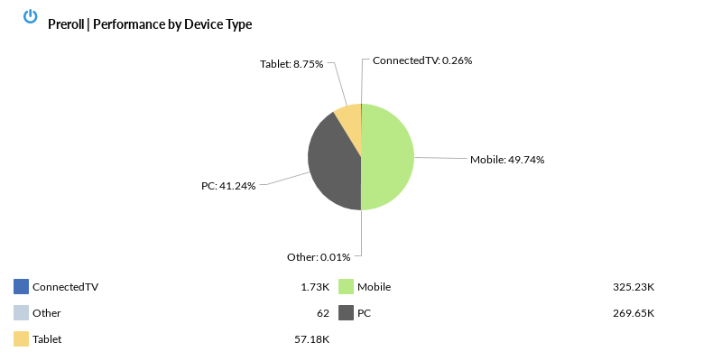
PRE-ROLL – BY DEVICE

Slide 18
TOP VIEWED SITES – SPANISH & ENGLISH
This measurement is not a full list of sites where your ads ran, as they follow the user, not the site, but it represents the sites where your ads were most viewable. Viewability is measured in terms of time on screen, time in view, total time spent by the user with your ads, and more.
SmartNews
New York Post
TMZ
Thesaurus
Yahoo
Daily Mail
Text Free
Fox News
Tune In
Bored Panda
AOL
Slate
Dictionary
Daily Kos
Huffington Post
Page Six
The Weather Channel
Family Handyman
Variety
ESPN
The Daily Beast
SpanishDict
Ranker
Brainly
Ultimate Guitar
The Hill
National Review
Stocktwits
Samsung TV Plus
theChive
Pluto TV
Rolling Stone
Buzzfeed
Mirror
USA
Sallys Baking Addiction
Taste of Home
The Daily Star
Mass Live
VICE
AccuWeather
LA Times
Political Wire
People
Tv Tropes
Fandom
The Guardian
Boston
FUTBIN
Gfinity Esports
The Independent
Far Out Magazine
Boston Herald
Newsweek
Soap Hub
Dinner then Dessert
League of Graphs
eBaum's World
Good Housekeeping
Fantrax
Miami Herald
The Hull Truth
The Direct
LiveXLive
Washington Times
Express
FINVIZ.com
La Nacion
Investing.com
TV Fanatic
theScore
Reader's Digest
Lifehacker
Timehop
RadarOnline
Parade
Epicstream
MSN
Horoscope
Reality Blurb
ABC
The Typical Mom
Bible
The Modern Proper
Court TV
ClutchPoints
Celebrating The Soaps
BabyCenter
Dot Esports
Times Union
The Hollywood Gossip
Pro Football Network
Monsters and Critics
Salon
Comic Book Movie
The Hollywood Reporter
Once Upon a Chef
Sports Illustrated
World Population Review
eNotes
Foodie Crush
Elder Scrolls
TIME
Rate My Professors
MetroPR
Merriam Webster
CBS
BBC
Cosmopolitan
SFGATE
New York Times
Al Jazeera
LiveScore
CBS Sports
Half Baked Harvest
Love and Lemons
The Nation
Britannica
Inspired Taste
Hollywood Life
Primera Hora
Law and Crime
The Boston Globe
TV Guide
MyFitnessPal
Country Living
Deadline
The Washington Post
All Kpop
Realtor
Forbes
Washington Examiner
Field & Stream
PCH
Upstyle
Scary Mommy
HotNewHipHop
Reuters
US Weekly Magazine
Men's Health
Politico
Opposing Views
Insider
Business Insider
Skinnytaste
El Nuevo DÃ­a
Apartment Therapy
Prevention
The Onion
Wrestling Headlines
Champion Daily
TV Insider
OK Magazine
Wheel of Fortune
Drugs.com
Chicago Tribune
Essence
Marie Claire
Bandsintown
Men's Journal
Univision
Oprah
Fox Business
Elle
Audacy
STIRR
What's on Netflix
Upworthy
NESN
Gizmodo
Redbook
NewsON
Food & Wine Magazine
The Babylon Bee
Popular Mechanics
GreaterGood
Popular Science
Billboard
Esquire
Women's Heath
Martha Stewart
El Diario NY
NDTV
MamÃ¡s Latinas
Muslim Pro
El Tiempo
Newsmax
Channel 3000
PC Gamer
HowStuffWorks
FuboTV
AccuRadio
Perez Hilton
The CW Network
La Prensa Honduras
US News
Daily Soap Dish
Pro Football Reference
Diario Deportivo Diez
Nasdaq
Farmers' Almanac
CNN
Entertainment Weekly
EatingWell
The Atlantic
Southern Living
Crunchyroll
Tripadvisor
The Advocate
Weather Underground
El Heraldo De MÃ©xico
WeatherBug
Bob Vila
Soap Opera Spy
Discovery
Fortune
Science
TitanTv
La OpiniÃ³n
Pinterest
AskMen
In Touch Weekly
Nj.com
GOLF.com
MLB
Cars.com

Slide 19
SOCIAL PERFORMANCE
FACEBOOK & INSTAGRAM

Slide 20
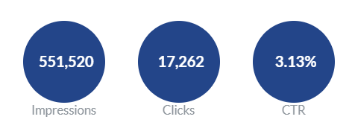
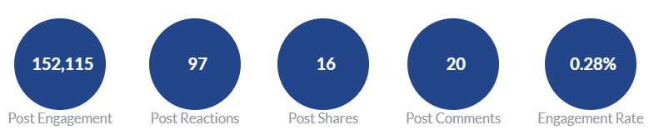
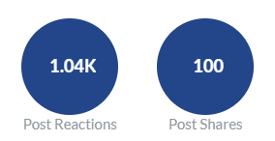
SOCIAL PEFORMANCE - OVERALL
#
#
Saves
Conversions

Slide 21
SOCIAL PEFORMANCE -
Campaign | Impressions | Clicks | CTR | Link Clicks | Engagements | Comments | Shares
VDS | Kojoulka ORAU | North Adams, MA | Nov - Dec 2023 | 74,512 | 2,174 | 2.92% | 1,741 | 19,568 | 4 | 9
VDS | Kojoulka ORAU | BERKLEY CLUSTER | Nov - Dec 2023 | 73,251 | 2,578 | 3.52% | 2,316 | 12,329 | 1 | 1
VDS | Kojoulka ORAU | Weymouth, MA | Nov - Dec 2023 | 70,907 | 2,502 | 3.53% | 2,256 | 9,092 | 1 | 1
VDS | Kojoulka ORAU | BELCHERTOWN CLUSTER | Nov - Dec 2023 | 69,680 | 1,853 | 2.66% | 1,600 | 29,541 | 9 | 2
VDS | Kojoulka ORAU | Pittsfield, MA | Nov - Dec 2023 | 68,436 | 1,720 | 2.51% | 1,566 | 28,047 | 3 | -
VDS | Kojoulka ORAU | Lawrence, MA | Nov - Dec 2023 | 67,803 | 2,471 | 3.64% | 2,236 | 9,845 | 1 | 1
VDS | Kojoulka ORAU | ATHOL CLUSTER | Nov - Dec 2023 | 64,310 | 1,657 | 2.58% | 1,568 | 26,542 | 1 | -
VDS | Kojoulka ORAU | Springfield, MA | Nov - Dec 2023 | 62,621 | 2,307 | 3.68% | 2,170 | 17,151 | - | 2
TOTAL | 300,386 | 9,603 | 3.20% | 9,495 | 152,115 | 20 | 16
AD TYPE: TRAFFIC (CLICK TO WEBSITE)
TOTAL IMPRESSIONS: 551,520
TOTAL CLICKS: 17,262
CTR: 3.13%
TOTAL REACH: 471,234
PREVIEW LINKS:
Lawrence: https://fb.me/1PKe8ezWI0XpZRI
Weymouth: https://fb.me/1UTRTgFK6STbt6g
Pittsfield: https://fb.me/1NjUBYbCMXFzfVu
Berkley Cluster: https://fb.me/225FUGSWZ1LZdcU
Belchertown Cluster: https://fb.me/24PoWkxyMVRHlyH
Springfield: https://fb.me/1OrgaWGdqthZPFa
North Adams: https://fb.me/1MXrXZubzoCWF4T
Athol Cluster: https://fb.me/22sQzUhJ5SW6BxO

Slide 22
SOCIAL - CLICKS BY AGE
Notes:
This is your top converting, lower funnel social media tactic. We are re-targeting people who have shown an interest based on engagement with other tactics with the remarketing. We are attributing a lot of sales, and as with all your facebook tactics seeing a high level of social media engagement from people interested in your brand. People are providing testimonials, sharing the ad, and tagging their friends.

Slide 23
SOCIAL – CLICKS BY GENDER
Notes:
This is your top converting, lower funnel social media tactic. We are re-targeting people who have shown an interest based on engagement with other tactics with the remarketing. We are attributing a lot of sales, and as with all your facebook tactics seeing a high level of social media engagement from people interested in your brand. People are providing testimonials, sharing the ad, and tagging their friends.

Slide 24
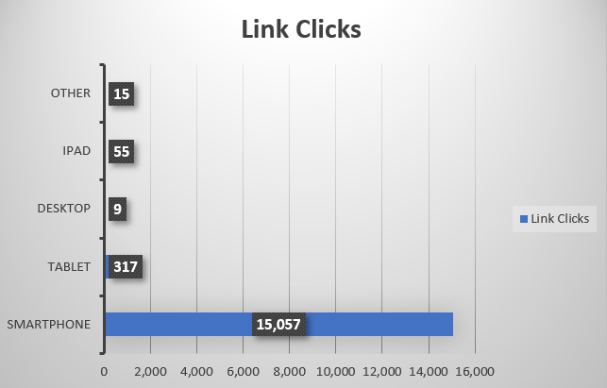
SOCIAL – CLICKS BY DEVICE
Notes:
UPDATE IMAGES and TEXT

