Slide 1
WRAP REPORT
ORAU – BMC
Massachusetts Digital

Slide 2

CAMPAIGN TARGETS
CAMPAIGN GOALS:
Address misunderstandings about and generate public support for HCS evidence-based interventions (i.e. naloxone, medication assisted treatment)
Encourage people with opioid use disorder to utilize treatment and recovery support services available in their communities.
TARGET AUDIENCES:
A 18+ Hispanic/Spanish language
A 18+ English language
GEOGRAPHY: ATHOL CLUSTER = Cities in Massachusetts (Athol, Greenfield, Montague, Orange). BERKLEY CLUSTER = Cities in Massachusetts (Berkley, Dighton, Freetown). BELCHERTOWN CLUSTER = Cities in Massachusetts
(Belchertown, Ware). Lawrence, MA, North Adams, Ma, Pittsfield, MA, Springfield, MA, Weymouth, MA
FLIGHT DATES: January 18 to March 21, 2023
CREATIVE:
Facebook Static Ads
Display Banners – 300x250, 728x90, 160x600, 300x600, 320x50
:15/:30 second video
TACTICS:
Cross Device Display: English
Facebook Traffic Ads: Spanish & English
Pre-Roll Video: Spanish & English

Slide 3
CAMPAIGN INFORMATION
NET SPEND BY COMMUNITY:
ATHOL CLUSTER = Cities in Massachusetts (Athol, Greenfield, Montague, Orange) - $3,750.00
BERKLEY CLUSTER = Cities in Massachusetts (Berkley, Dighton, Freetown) - $3,750.00
BELCHERTOWN CLUSTER = Cities in Massachusetts (Belchertown, Ware) - $3,750.00
Lawrence, MA - $3,750.00
North Adams, Ma - $3,750.00
Pittsfield, MA - $3,750.00
Springfield, MA - $3,750.00
Weymouth, MA - $3,750.00
NET SPEND BY LANGUAGE:
ENGLISH: $18,000
SPANISH: $12,000
TOTAL BUDGET: $30,000 NET

Slide 4
POPULATION BY COMMUNITY
(U.S. CENSUS BUREAU DATA 2020):
ATHOL CLUSTER (Athol, Greenfield, Montague, Orange) – 45,364
BERKLEY CLUSTER (Berkley, Dighton, Freetown) – 24,088
BELCHERTOWN CLUSTER (Belchertown, Ware) – 24,945
Lawrence, MA – 88,508
North Adams, MA – 12,961
Pittsfield, MA – 43,927
Springfield, MA – 154,789
Weymouth, MA – 57,437

Slide 5
CAMPAIGN DELIVERY TOTALS
DISPLAY:
CROSS DEVICE DISPLAY – English
52,304 IMPRESSIONS
118 CLICKS
0.23% CLICK THROUGH RATE
CROSS DEVICE DISPLAY – Spanish
27,328 IMPRESSIONS
106 CLICKS
0.39% CLICK THROUGH RATE
SOCIAL:
Campaign | Impressions | Clicks | CTR
VDS | Konjolka | Athol Cluster | English | 2023 | 37,775 | 1,173 | 3.11%
VDS | Konjolka | Belchertown Cluster | English | 2023 | 38,623 | 1,237 | 3.20%
VDS | Konjolka | Berkley Cluster | English | 2023 | 40,308 | 1,322 | 3.28%
VDS | Konjolka | Lawrence | English | 2023 | 39,069 | 1,227 | 3.14%
VDS | Konjolka | North Adams | English | 2023 | 35,666 | 1,119 | 3.14%
VDS | Konjolka | Pittsfield | English | 2023 | 35,440 | 1,041 | 2.94%
VDS | Konjolka | Springfield | English | 2023 | 35,664 | 1,223 | 3.43%
VDS | Konjolka | Weymouth | English | 2023 | 37,841 | 1,261 | 3.33%
TOTAL | 300,386 | 9,603 | 3.20%
Campaign | Impressions | Clicks | CTR
VDS | Konjolka | Athol Cluster | Spanish | 2023 | 54,907 | 1,042 | 1.90%
VDS | Konjolka | Belchertown Cluster | Spanish | 2023 | 48,249 | 1,114 | 2.31%
VDS | Konjolka | Berkley Cluster | Spanish | 2023 | 56,140 | 1,170 | 2.08%
VDS | Konjolka | Lawrence | Spanish | 2023 | 49,042 | 1,113 | 2.27%
VDS | Konjolka | North Adams | Spanish | 2023 | 31,236 | 712 | 2.28%
VDS | Konjolka | Pittsfield | Spanish | 2023 | 28,767 | 779 | 2.71%
VDS | Konjolka | Springfield | Spanish | 2023 | 41,417 | 1,023 | 2.47%
VDS | Konjolka | Weymouth | Spanish | 2023 | 45,485 | 1,093 | 2.40%
TOTAL | 355,243 | 8,046 | 2.26%

Slide 6
CAMPAIGN DELIVERY TOTALS
PRE-ROLL
Campaign | Impressions | Clicks | CTR | Completion Rate | Completions
182304 - PRE-ROLL - ATHOL CLUSTER - ENGLISH | 47,297 | 39 | 0.08% | 56.82% | 25,629
182304 - PRE-ROLL - BELCHERTOWN CLUSTER - ENGLISH | 47,361 | 28 | 0.06% | 66.91% | 30,998
182304 - PRE-ROLL - BERKLEY CLUSTER - ENGLISH | 47,441 | 32 | 0.07% | 56.84% | 26,820
182304 - PRE-ROLL - Lawrence - English | 48,185 | 37 | 0.08% | 73.15% | 33,889
182304 - PRE-ROLL - North Adams - English | 48,272 | 33 | 0.07% | 63.54% | 29,910
182304 - PRE-ROLL - Pittsfield - English | 47,283 | 42 | 0.09% | 63.92% | 29,074
182304 - PRE-ROLL - Springfield - English | 48,495 | 45 | 0.09% | 65.67% | 30,903
182304 - PRE-ROLL - Weymouth - English | 47,609 | 48 | 0.10% | 62.26% | 29,340
TOTAL | 381,943 | 304 | 0.08% | 61.94% | 236,563
Campaign | Impressions | Clicks | CTR | Completion Rate | Completions
182304 - PRE-ROLL - ATHOL CLUSTER - SPANISH | 23,710 | 18 | 0.08% | 57.62% | 12,314
182304 - PRE-ROLL - BELCHERTOWN CLUSTER - SPANISH | 23,723 | 18 | 0.08% | 60.95% | 14,282
182304 - PRE-ROLL - BERKLEY CLUSTER - SPANISH | 22,626 | 24 | 0.11% | 48.11% | 11,182
182304 - PRE-ROLL - Lawrence - Spanish | 23,697 | 34 | 0.14% | 65.33% | 14,839
182304 - PRE-ROLL - North Adams - Spanish | 23,706 | 16 | 0.07% | 63.19% | 14,525
182304 - PRE-ROLL - Pittsfield - Spanish | 23,719 | 16 | 0.07% | 62.55% | 14,225
182304 - PRE-ROLL - Springfield - Spanish | 23,698 | 31 | 0.13% | 55.56% | 12,496
182304 - PRE-ROLL - Weymouth - Spanish | 23,733 | 20 | 0.08% | 63.76% | 15,186
TOTAL | 188,612 | 177 | 0.09% | 57.82% | 109,049

Slide 7
DISPLAY PERFORMANCE
AUDIENCE TARGETING

Slide 8
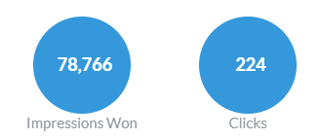
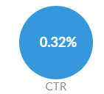
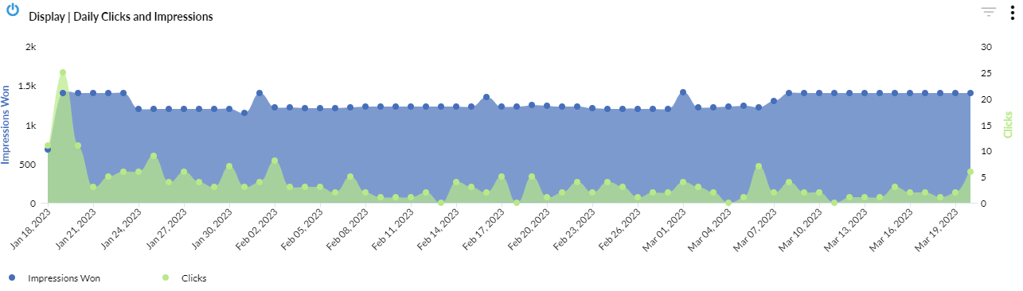
DISPLAY – OVERALL PERFORMANCE

Slide 9
DISPLAY – BY TOWN
City | Impressions | Clicks | CTR
Springfield | 32,939 | 86 | 0.30%
Lawrence | 10,515 | 31 | 0.39%
Pittsfield | 8,753 | 27 | 0.30%
Greenfield | 6,639 | 22 | 0.44%
Weymouth | 4,631 | 15 | 0.48%
Athol | 4,616 | 10 | 0.21%
North Adams | 4,189 | 16 | 0.44%
Ware | 4,041 | 9 | 0.23%
Belchertown | 1,853 | 7 | 0.26%
Berkley | 211 | 0 | 0.00%
Orange | 191 | 1 | 0.27%
East Freetown | 84 | 0 | 0.00%
Dighton | 66 | 0 | 0.00%
Montague | 38 | 0 | 0.00%
TOTAL | 78,766 | 224 | 0.25%

Slide 10
DISPLAY – CREATIVE
Creative | Campaign | Impressions | Clicks | CTR
HEALing MA_web banners-2023_320x50.png | 182304 - DISPLAY - ENGLISH | 31,171 | 44 | 0.15%
HEALing MA_web banners-2023_728x90.png | 182304 - DISPLAY - ENGLISH | 17,685 | 31 | 0.18%
HEALing MA_web banners-2023_320x250.png | 182304 - DISPLAY - ENGLISH | 1,983 | 22 | 1.13%
HEALing MA_web banners-2023_160x600.png | 182304 - DISPLAY - ENGLISH | 683 | 14 | 1.48%
HEALing MA_web banners-2023_300x600.png | 182304 - DISPLAY - ENGLISH | 222 | 7 | 3.66%
TOTAL | - | 51,744 | 118 | 0.23%
Creative | Campaign | Impressions | Clicks | CTR
HEALing MA_web banners-2023_320x50 sp.png | 182304 - DISPLAY - SPANISH | 16,337 | 41 | 0.27%
HEALing MA_web banners-2023_728x90 sp.png | 182304 - DISPLAY - SPANISH | 9,127 | 27 | 0.31%
HEALing MA_web banners-2023_320x250 sp.png | 182304 - DISPLAY - SPANISH | 1,195 | 22 | 1.92%
HEALing MA_web banners-2023_160x600 sp.png | 182304 - DISPLAY - SPANISH | 263 | 10 | 4.04%
HEALing MA_web banners-2023_300x600 sp.png | 182304 - DISPLAY - SPANISH | 100 | 6 | 6.85%
TOTAL | - | 27,022 | 106 | 0.39%

Slide 11
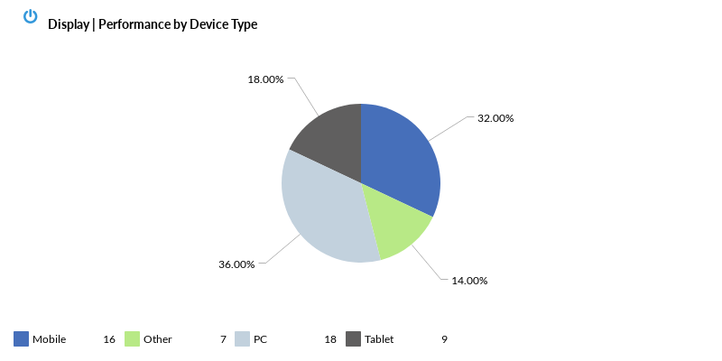
DISPLAY – BY DEVICE

Slide 12
TOP VIEWED SITES – DISPLAY
2KMTCentral
3 Tiles
911 Emergency Dispatcher App
9Gag
AccuWeather
All Kpop
Allrecipes
Amino
AOL
Arkadium Games
Ask a Manager
Aternos
Auction Zip
Audacy
Audiomack
Baby Tracker
Backgammon
Badoo
Ball Blast
Ball Sort Puzzle
Ballz
Barstool Sports
Baseball Reference
Bazooka Boy
Bejeweled Classic
Bible
Bingo
BitLife
Blackjack
Bleeding Cool
Block Puzzle
Blockscapes
Bored Panda
Boston
Bowmasters
BoxRec
Bricks Ball Crusher
Bricks Breaker Quest
Bricks n Balls
Bridge Base Online
Britannica
Broadcastify
BroBible
Bubble Pop!
Bubble Shooter
Bulbapedia
Buzzfeed
Calculator
Call Recorder Automatic
CallApp
Canasta
Card Games
Cars.com
Casino Slot Machine
Cat Escape!
CCM
Checkers
Chegg
Chess
China Times
City Takeover
Classmates
ClutchPoints
Color by Number
Color Island
Comic Book
Comic Book Movie
Comic Sands
Comics Kingdom
Cookie and Kate
Cox
Crazy Games
Cribbage
Crossword
CurseForge
d20PFSRD
Daily Kos
Daily Mail
DatPiff
Dazzly
Detik
Detroit Free Press
dfndr security
Diario Deportivo Diez
Dictionary
Differences
Dig This!
Discogs
Dominoes
Douban
Drag n Merge
Drop The Number
Drugs.com
EarthLink
Easy Game
eBaum's World
eBay
EDHREC
Eenadu
Elder Scrolls
Encyclopedia
Entertainment Weekly
Equibase
ESPN
Euchre
Evermatch
Fanatics
Fantrax
Fark.com
Find A Grave
FiveThirtyEight
Flow Free
Fortnite
Fox News
FUTBIN
Game8
GameFAQs
GamePress
Gateway Classic Cars
Go Escape!
GoComics
Going Balls
Greek Rank
GSN
Guitar
Happy Canvas
Happy Color
Haru Cats
Hearts
Heavy.com
Helix Jump
hi5
High Heels
Hometalk
IAA
Imgur
IMLeagues
IMVU
IndyStar
Issuu
ITM
Javatpoint
Jewel Hunter
Jigsaw Puzzle
KDVR & FOX31
KenKen Puzzle
Kinetic
Know Your Meme
Kotaku
Kryss- The Battle of the Words
Law Insider
League of Graphs
LetsRun.com
Letter Soup
Letterboxd
LEVVVEL
Listen On Repeat
LiveScore
LiveXLive
lohud
Ludo King
MacRumors
Magic Jigsaw Puzzles
MamÃ¡s Latinas
Manta
MapQuest
Martha Stewart
Match
Match 3D
Match Master!
Match Tile
Match To Win
Math Aids
Mathway
Mediaite
Merriam Webster
Messenger
Microsoft
Milwaukee Journal Sentinel
Minecraft
MLB
Moco Space
MSN
Musi
MyAnimeList
MyHughesNet
NameMC
NETR Online
New York Post
New York Times
NewsTalk 1290 KWFS
Nexus Mods
Nonogram
Nookazon
Not Always Right
Notepad
Numberzilla
NY Daily News
On TV Tonight
OnDemandKorea
OneFootball
Onet 3D
Onnect
Oprah
Other
Page Six
Paint by Number
Paltalk
Paper.io
Parking Jam 3D

Slide 13
TOP VIEWED SITES – DISPLAY
Paste Magazine
Perfect365
Philly Voice
PicsArt
Picture Cross
Pixiv
Plenty of Fish
Podcast Addict
Pogo
Poke Genie
Police Scanner
Political Flare
Political Wire
Prank Master 3D
Public School Review
Pull the Pin
Puzzle Page
Quizlet
Raider.io
Reason
Reddit
REDSPOT.TV
Rocket League
Roku
RotoWire
Salary.com
Sallys Baking Addiction
Satisfying ASMR
Scrabble GO
Scrabble Word Finder
Showbiz Cheat Sheet
Skinnytaste
Slate
Sleep Sounds
SmartNews
Soda Sort Puzzle
SofaScore
Software Testing Help
Solitaire
Sort It 3D
Spades
SpanishDict
Spot the Difference
Spotify
Sudoku
Talkatone
Tapatalk
Terraria
Tetris
Text Free
TextNow
The A.V. Club
The Boston Globe
The CW Network
The Daily Beast
The Daily Star
The Detroit News
The Economic Times
The Hill
The Indian Express
The Sun
The Tennessean
The Times of India
The Weather Channel
The World Journal
theChive
TheLayoff.com
Thesaurus
TierMaker
Tile Connect
Tile Master
Time.is
TipHero
TitanTv
TMZ
Tomb of the Mask
Toofab
Traderie
Traffic Run
Trivia
Tune In
Tutorials Point
Tv Tropes
TypeRacer
U GG
Ultimate Guitar
Universal Hub
UnscrambleX
Urban Dictionary
USA
Variety
Water Sort Puzzle
WAVY
Weather Underground
WeatherBug
Well Plated
What The Forecast?!!
Wheel of Fortune
Whitepages
WildTangent Games
WNYT
Woodoku
Woody Block Games
Word Card: Fun Collect Game
Word Cash
Word Chums!
Word Collect
Word Connect
Word Mansion
Word Search
Word Stacks
Word Swipe
Word Trip
Word Wars
Wordplays
WordReference
Words With Friends
Wordscapes
Wordtips
Worldstar Hip Hop
Wowhead
Wrestling Headlines
WTNH News 8
X Blocks
X2 Blocks
Xfinity
Yahoo
Yahtzee
Zacks
ZiMAD
Zoosk
Zynga

Slide 14
PRE-ROLL PERFORMANCE
AUDIENCE TARGETING

Slide 15
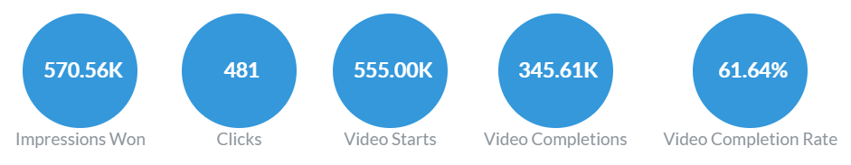
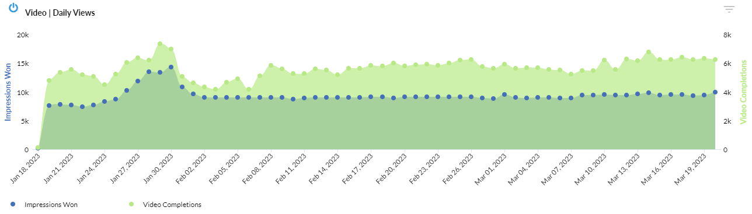
PRE-ROLL – OVERALL PERFORMANCE

Slide 16
PRE-ROLL – BY TOWN
Campaign | Impressions | Clicks | CTR | Completion Rate | Completions
182304 - PRE-ROLL - ATHOL CLUSTER - ENGLISH | 47,297 | 39 | 0.08% | 56.82% | 25,629
182304 - PRE-ROLL - BELCHERTOWN CLUSTER - ENGLISH | 47,361 | 28 | 0.06% | 66.91% | 30,998
182304 - PRE-ROLL - BERKLEY CLUSTER - ENGLISH | 47,441 | 32 | 0.07% | 56.84% | 26,820
182304 - PRE-ROLL - Lawrence - English | 48,185 | 37 | 0.08% | 73.15% | 33,889
182304 - PRE-ROLL - North Adams - English | 48,272 | 33 | 0.07% | 63.54% | 29,910
182304 - PRE-ROLL - Pittsfield - English | 47,283 | 42 | 0.09% | 63.92% | 29,074
182304 - PRE-ROLL - Springfield - English | 48,495 | 45 | 0.09% | 65.67% | 30,903
182304 - PRE-ROLL - Weymouth - English | 47,609 | 48 | 0.10% | 62.26% | 29,340
TOTAL | 381,943 | 304 | 0.08% | 61.94% | 236,563
Campaign | Impressions | Clicks | CTR | Completion Rate | Completions
182304 - PRE-ROLL - ATHOL CLUSTER - SPANISH | 23,710 | 18 | 0.08% | 57.62% | 12,314
182304 - PRE-ROLL - BELCHERTOWN CLUSTER - SPANISH | 23,723 | 18 | 0.08% | 60.95% | 14,282
182304 - PRE-ROLL - BERKLEY CLUSTER - SPANISH | 22,626 | 24 | 0.11% | 48.11% | 11,182
182304 - PRE-ROLL - Lawrence - Spanish | 23,697 | 34 | 0.14% | 65.33% | 14,839
182304 - PRE-ROLL - North Adams - Spanish | 23,706 | 16 | 0.07% | 63.19% | 14,525
182304 - PRE-ROLL - Pittsfield - Spanish | 23,719 | 16 | 0.07% | 62.55% | 14,225
182304 - PRE-ROLL - Springfield - Spanish | 23,698 | 31 | 0.13% | 55.56% | 12,496
182304 - PRE-ROLL - Weymouth - Spanish | 23,733 | 20 | 0.08% | 63.76% | 15,186
TOTAL | 188,612 | 177 | 0.09% | 57.82% | 109,049

Slide 17
PRE-ROLL – BY CREATIVE
Campaign | Impressions | Clicks | Completion Rate | 25% Completions | 50% Completions | 75% Completions | Completions
Springfield – English | 48,495 | 45 | 65.67% | 38,359 | 35,577 | 33,339 | 30,903
North Adams - English | 48,272 | 33 | 63.54% | 38,601 | 35,336 | 32,704 | 29,910
Lawrence - English | 48,185 | 37 | 73.15% | 40,253 | 38,193 | 36,362 | 33,889
Weymouth - English | 47,609 | 48 | 62.26% | 38,739 | 35,664 | 33,345 | 29,340
BERKLEY CLUSTER - ENGLISH | 47,441 | 32 | 56.84% | 37,735 | 34,219 | 30,476 | 26,820
BELCHERTOWN CLUSTER - ENGLISH | 47,361 | 28 | 66.91% | 39,564 | 37,167 | 34,303 | 30,998
ATHOL CLUSTER - ENGLISH | 47,297 | 39 | 56.82% | 34,555 | 31,281 | 28,595 | 25,629
Pittsfield - English | 47,283 | 42 | 63.92% | 37,513 | 34,546 | 32,039 | 29,074
Campaign | Impressions | Clicks | Completion Rate | 25% Completions | 50% Completions | 75% Completions | Completions
Weymouth - Spanish | 23,733 | 20 | 63.76% | 19,164 | 17,800 | 16,772 | 15,186
BELCHERTOWN CLUSTER - SPANISH | 23,723 | 18 | 60.95% | 18,544 | 17,282 | 16,036 | 14,282
Pittsfield - Spanish | 23,719 | 16 | 62.55% | 18,352 | 17,067 | 16,020 | 14,225
ATHOL CLUSTER - SPANISH | 23,710 | 18 | 57.62% | 16,331 | 14,995 | 13,982 | 12,314
North Adams - Spanish | 23,706 | 16 | 63.19% | 18,695 | 17,461 | 16,322 | 14,525
Springfield - Spanish | 23,698 | 31 | 55.56% | 16,961 | 15,407 | 14,190 | 12,496
Lawrence - Spanish | 23,697 | 34 | 65.33% | 18,844 | 17,653 | 16,590 | 14,839
BERKLEY CLUSTER - SPANISH | 22,626 | 24 | 48.11% | 16,806 | 14,997 | 12,912 | 11,182

Slide 18
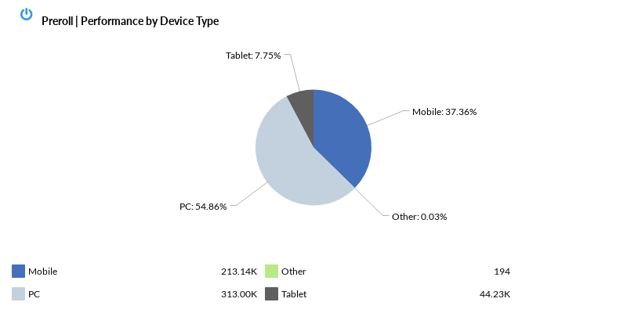
PRE-ROLL – BY DEVICE

Slide 19
TOP VIEWED SITES – SPANISH & ENGLISH
This measurement is not a full list of sites where your ads ran, as they follow the user, not the site, but it represents the sites where your ads were most viewable. Viewability is measured in terms of time on screen, time in view, total time spent by the user with your ads, and more.
9Gag
A Family Feast
ABC
ABC13 KTRK Houston
AccuWeather
ActiveBeat
Add a Pinch
All Kpop
Animal Crossing
AOL
Apartment Therapy
Ark IDs
Arkadium Games
AS USA
Ask a Manager
Astrostyle
Aternos
Atlanta Black Star
Audacy
Audiomack
Averie Cooks
AZLyrics
Baby Names
Barstool Sports
Baseball Reference
Belly Full
BeSoccer
BGR
Bible
Big Think
Binding of Isaac: Rebirth Wiki
Bingo
Bleeding Cool
BleepingComputer
Bob Vila
Bored Panda
Boston
Boston Herald
Brainly
Britannica
Broadcastify
BroBible
Bubble Pop!
Bubble Shooter
Bubble Witch 3 Saga
Budget Bytes
Bulbapedia
Business Insider
Bustle
Buzzfeed
Cafe Delites
Calamity Mod
Calculator
Candy Crush Saga
CarBuzz
Casino Slot Machine
Castbox
CBS
Celebrating The Soaps
Chicago Sun-Times
Chicago Tribune
Chocolate Covered Katie
Chron
ClutchPoints
CNN
Color by Number
Comic Book
Comic Book Movie
Comic Sands
Comics Kingdom
Complex
Cookie and Kate
Cooking Classy
Cosmopolitan
Country Living
Court TV
Crossword
Crunchyroll
CurseForge
d20PFSRD
Daily Kos
Daily Mail
Daily Soap Dish
Daily Voice
Damn Delicious
Deadline
Delish
Den of Geek
Denver Post
Detroit Free Press
Dexerto
dfndr security
Dictionary
Diethood
Dinner At The Zoo
Dinner then Dessert
Discogs
Distractify
DMV
Dominoes
Doodle
Dot Esports
Drugs.com
eBaum's World
EDHREC
Eenadu
El Heraldo De MÃ©xico
El Nuevo DÃ­a
El Tiempo
Elder Scrolls
Encyclopedia
eNotes
Entertainment Tonight
Epicstream
Escape from Tarkov
ESPN
Esquire
Euchre
Extra
Family Education
Family Handyman
Fantrax
Far Out Magazine
Fark.com
Farm Heroes Saga
Farmers' Almanac
Field & Stream
FINVIZ.com
FiveThirtyEight
FlightAware
Flipboard
Foodie Crush
Forbes
Fortnite
Fox Business
Fox News
FUTBIN
Game Rant
Game8
GameFAQs
GamePigeon
GamePress
GamesRadar+
GameWith
Gimme Some Oven
Gin Rummy
Gizmodo
GoComics
Good Housekeeping
GreaterGood
Guitar
Half Baked Harvest
Harper's Bazaar
Hearts
Heavy.com
Hemmings
Hindustan Times
Hollywood Life
Home Stratosphere
Hometalk
Horoscope
HotNewHipHop
IGN
Imgur
IMVU
In The Know
IndieWire
Infoplease
Insider
Issuu
ITM
Jagran
Jalopnik
Jezebel
Jigsaw Puzzle
Joy Food Sunshine
June's Journey
KenKen Puzzle
KIRO 7
Know Your Meme
Kotaku
KSL
La Nacion
LA Times
LaPatilla
Law and Crime
League of Graphs
LetsRun.com
Letterboxd
Lifehacker
Lil' Luna
Liquidpedia
LiveXLive
Love and Lemons
Love to Know
Macrotrends
Magic Jigsaw Puzzles
Mail.com
MamÃ¡s Latinas
Manta
MapQuest
Marca
MarketWatch
Mass Live
Mathway
Maxroll.gg
MEAWW
Men's Health
Mercury News
Merriam Webster
MetroPR
MetroUS
Miami Herald
Minecraft
Minimalist Baker
Mobafire
Moco Space
Movieweb
MSN
Mundo Deportivo
MUO
Nasdaq
NDTV
NESN
New York Post
News Break
Newsweek
Nexus Mods
NY Daily News
OK Magazine
Once Upon a Chef
One Good Thing
Orange County Register
Other
Outdoor Life
Outsider
Page Six
Paint by Number
Pandora: Music & Podcasts
Parade
Paste Magazine
PC Gamer
PCGamesN
People
Perez Hilton
PetaPixel
Pinch of Yum
Plex
PokÃ©mon
Political Flare
Political Wire
Popular Mechanics

Slide 20
TOP VIEWED SITES – SPANISH & ENGLISH
This measurement is not a full list of sites where your ads ran, as they follow the user, not the site, but it represents the sites where your ads were most viewable. Viewability is measured in terms of time on screen, time in view, total time spent by the user with your ads, and more.
Popular Science
Prevention
Primera Hora
Pro Football Network
Pro Game Guides
ProProfs
Public School Review
Quartz
RadarOnline
Raider.io
Rate My Professors
Reader's Digest
Reality Blurb
Reality Tea
Realtor
Reason
RecipeTin Eats
Rocket League
Rolling Stone
RotoWire
Sallys Baking Addiction
Salon
Salt and Lavender
Scrabble GO
Scrambled Chefs
Screen Rant
Second Nexus
SFGATE
SheKnows
Showbiz Cheat Sheet
Skinnytaste
Small Joys
SmartNews
Snopes
Soap Hub
Soap Opera Spy
Software Testing Help
Solitaire
Spades
SpanishDict
Spend with Pennies
Sports Illustrated
Stocktwits
Stylecaster
Sudoku
Sun Sentinel
Tapatalk
Taste of Country
Taste of Home
Tastes Better From Scratch
Techwalla
Terraria
Text Free
TextNow
The A.V. Club
The Blast
The Charlotte Observer
The Daily Beast
The Daily Dot
The Daily Star
The Detroit News
The Direct
The Drive
The Droid Guy
The Gazette
The Hill
The Hockey Writers
The Hollywood Gossip
The Hollywood Reporter
The Independent
The Kansas City Star
The Kitchn
The Modern Proper
The Morning Call
The Nation
The Onion
The Philadelphia Inquirer
The Pioneer Woman
The Political Insider
The Recipe Critic
The Sacramento Bee
The Sims Resource
The Source
The State
The Sun
The Times of Israel
The Typical Mom
The Weather Channel
The World Journal
TheGamer
theScore
TheThings
TierMaker
Tiles Hop: EDM! Rush
TIME
Timehop
Times Union
Tinybeans Family Photo Album
TMZ
Tom's Guide
Toofab
Town and Country
Traderie
Tripadvisor
Trivia
Trump Excel
Tune In
Tutorials Point
TV Fanatic
TV Insider
Tv Tropes
TVLine
two peas & their pod
U GG
Ultimate Classic Rock
Ultimate Guitar
Univision
UnscrambleX
Uproxx
Upworthy
US Weekly Magazine
USA
Variety
Wealthy Gorilla
WebMD
WEBTOON
Well Plated
Whitepages
WildTangent Games
WJAR NBC 10
Women's Heath
Woodoku
Word Chums!
Word Connect
Wordplays
Wordscapes
Wordtips
World Population Review
Worldstar Hip Hop
Wowhead
WXYZ Detroit News
Xbox
Yahoo
Yahtzee
Zelda Dungeon
Zoosk
Zynga

Slide 21
SOCIAL PERFORMANCE
FACEBOOK & INSTAGRAM

Slide 22
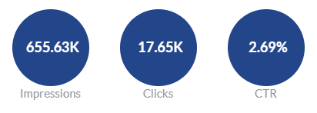
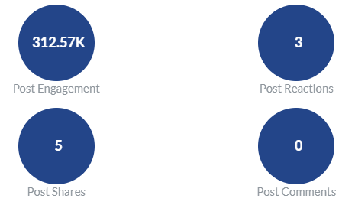
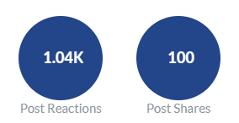
SOCIAL PEFORMANCE - OVERALL
#
#
Saves
Conversions

Slide 23
SOCIAL PEFORMANCE - ENGLISH
Campaign | Impressions | Clicks | CTR | Link Clicks | Engagements | Shares
VDS | Konjolka | Athol Cluster | English | 2023 | 37,775 | 1,173 | 3.11% | 1,157 | 21,142 | -
VDS | Konjolka | Belchertown Cluster | English | 2023 | 38,623 | 1,237 | 3.20% | 1,215 | 21,718 | -
VDS | Konjolka | Berkley Cluster | English | 2023 | 40,308 | 1,322 | 3.28% | 1,312 | 22,478 | -
VDS | Konjolka | Lawrence | English | 2023 | 39,069 | 1,227 | 3.14% | 1,213 | 21,566 | -
VDS | Konjolka | North Adams | English | 2023 | 35,666 | 1,119 | 3.14% | 1,115 | 19,451 | -
VDS | Konjolka | Pittsfield | English | 2023 | 35,440 | 1,041 | 2.94% | 1,026 | 19,179 | 1
VDS | Konjolka | Springfield | English | 2023 | 35,664 | 1,223 | 3.43% | 1,207 | 20,770 | -
VDS | Konjolka | Weymouth | English | 2023 | 37,841 | 1,261 | 3.33% | 1,250 | 21,522 | -
TOTAL | 300,386 | 9,603 | 3.20% | 9,495 | 167,826 | 1
PREVIEW LINK: https://fb.me/2zBGgTumK6bYah2
AD TYPE: TRAFFIC (CLICK TO WEBSITE)
TOTAL IMPRESSIONS: 300,386
TOTAL CLICKS: 9,603
CTR: 3.20%
TOTAL REACH: 284,980

Slide 24
SOCIAL PEFORMANCE - SPANISH
Campaign | Impressions | Clicks | CTR | Link Clicks | Engagements | Shares
VDS | Konjolka | Athol Cluster | Spanish | 2023 | 54,907 | 1,042 | 1.90% | 1,029 | 18,689 | -
VDS | Konjolka | Belchertown Cluster | Spanish | 2023 | 48,249 | 1,114 | 2.31% | 1,104 | 19,427 | -
VDS | Konjolka | Berkley Cluster | Spanish | 2023 | 56,140 | 1,170 | 2.08% | 1,162 | 21,717 | -
VDS | Konjolka | Lawrence | Spanish | 2023 | 49,042 | 1,113 | 2.27% | 1,105 | 20,473 | -
VDS | Konjolka | North Adams | Spanish | 2023 | 31,236 | 712 | 2.28% | 679 | 12,659 | 3
VDS | Konjolka | Pittsfield | Spanish | 2023 | 28,767 | 779 | 2.71% | 752 | 13,069 | 1
VDS | Konjolka | Springfield | Spanish | 2023 | 41,417 | 1,023 | 2.47% | 1,008 | 18,866 | -
VDS | Konjolka | Weymouth | Spanish | 2023 | 45,485 | 1,093 | 2.40% | 1,074 | 19,848 | -
TOTAL | 355,243 | 8,046 | 2.26% | 7,913 | 144,748 | 4
PREVIEW LINK: https://fb.me/2hlmOJJuU7JQZnB
AD TYPE: TRAFFIC (CLICK TO WEBSITE)
TOTAL IMPRESSIONS: 355,243
TOTAL CLICKS: 8,046
CTR: 2.26%
TOTAL REACH: 299,187

Slide 25
SOCIAL - CLICKS BY AGE
Notes:
This is your top converting, lower funnel social media tactic. We are re-targeting people who have shown an interest based on engagement with other tactics with the remarketing. We are attributing a lot of sales, and as with all your facebook tactics seeing a high level of social media engagement from people interested in your brand. People are providing testimonials, sharing the ad, and tagging their friends.

Slide 26
SOCIAL – CLICKS BY GENDER
Notes:
This is your top converting, lower funnel social media tactic. We are re-targeting people who have shown an interest based on engagement with other tactics with the remarketing. We are attributing a lot of sales, and as with all your facebook tactics seeing a high level of social media engagement from people interested in your brand. People are providing testimonials, sharing the ad, and tagging their friends.

Slide 27
SOCIAL – CLICKS BY DEVICE
Notes:
UPDATE IMAGES and TEXT

