Slide 1

WRAP REPORT
ORAU – BMC
Campaign 5 – NALOXONE Digital

Slide 2
CAMPAIGN TARGETS
CAMPAIGN GOALS:
Encourage people with opioid use disorder to utilize treatment and recovery support services available in their communities.
TARGET AUDIENCES: A 18+ with interests in News OR Health & Wellness OR Gambling/gamblers OR PWLE OR People in Recovery OR Family/friends of opioid addicts in Spanish and English languages
GEOGRAPHY: MASSACHUSETTS regions
BROCKTON REGION: Abington, Bridgewater, Brockton, Carver, Duxbury, East Bridgewater, Halifax, Hanover, Hanson, Hingham, Hull, Kingston, Lakeville, Marion, Marshfield, Mattapoisett, Middleborough, Norwell, Pembroke, Plymouth, Plympton, Rochester, Rockland, Scituate, Wareham, West Bridgewater, Whitman
SALEM REGION: Amesbury, Andover, Beverly, Boxford, Byfield, Danvers, Essex, Georgetown, Gloucester, Groveland, Hamilton, Hathorne, Haverhill, Ipswich, Lynn, Lynnfield, Manchester, Marblehead, Merrimac, Methuen, Middleton, Nahant, Newbury, Newburyport, North Andover, Peabody
LOWELL REGION: Lowell, Chelmsford, North Chelmsford, Dracut, Tewksbury, North Billerica, Billerica, Tyngsboro, Andover, Nutting Lake, Westford, Carlisle
FLIGHT DATES: May 22 – July 16, 2022
CREATIVE:
Facebook Static Ads
Display Banners – 300x250, 728x90, 160x600, 300x600, 320x50
TACTICS:
Cross Device Display: English
Facebook Traffic Ads: Spanish & English

Slide 3
CAMPAIGN INFORMATION
NET SPEND BY COMMUNITY:
BOURNE: $5,500
SALEM: $5,500
LOWELL: $5,500
NET SPEND BY LANGUAGE:
ENGLISH: $12,000
SPANISH: $4,500
TOTAL BUDGET: $16,500 NET

Slide 4
CAMPAIGN INFORMATION
FLIGHT DATES BY COMMUNITY:
All communities = 5/22 -7/16/2022
FLIGHT DATES BY LANGUAGE:
English: 5/22 -7/16/2022
Spanish: 5/22 -7/16/2022
FLIGHT DATES BY TACTIC:
Facebook/Instagram: 5/25 -7/16/2022
Display: 5/22 -7/16/2022

Slide 5
POPULATION BY REGION (U.S. CENSUS BUREAU DATA 2020):
BROCKTON REGION: 437,296
SALEM REGION: 707,016
LOWELL REGION: 351,591

Slide 6
CAMPAIGN DELIVERY TOTALS
DISPLAY
SOCIAL
FACEBOOK TRAFFIC ADS - English
832,616 impressions
187,431 total reach
12,646 clicks
1.52% CTR
244 Post Reactions (likes, loves, etc)
81 Comments
157 Shares
FACEBOOK TRAFFIC ADS - Spanish
140,146 impressions
27,294 total reach
1,533 clicks
1.09% CTR
30 Post Reactions (likes, loves, etc)
4 Comments
9 Shares
CROSS DEVICE DISPLAY – English
485,033 IMPRESSIONS
582 CLICKS
0.12% CLICK THROUGH RATE
CROSS DEVICE DISPLAY – Spanish
236,742 IMPRESSIONS
330 CLICKS
0.14% CLICK THROUGH RATE

Slide 7
DISPLAY PERFORMANCE
AUDIENCE TARGETING

Slide 8
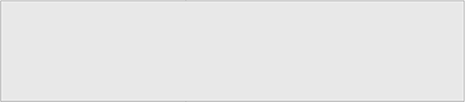
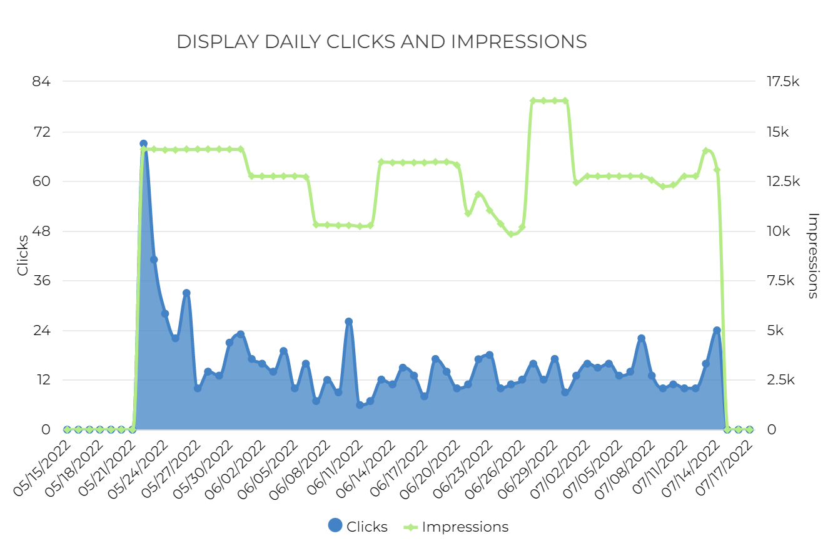
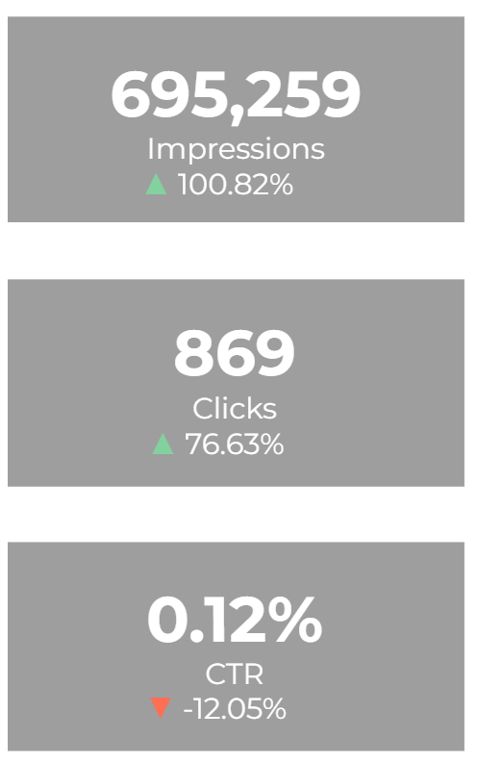
DISPLAY – OVERALL PERFORMANCE

Slide 9
DISPLAY – BY REGION
Region | Impressions | Clicks | CTR
149014 - DISPLAY ENGLISH BROCKTON | 152,277 | 187 | 0.24%
149014 - DISPLAY ENGLISH LOWELL | 158,628 | 187 | 0.28%
149014 - DISPLAY ENGLISH SALEM | 158,432 | 184 | 0.30%
Total | 469,337 | 558 | 0.12%
Region | Impressions | Clicks | CTR
149014 - DISPLAY SPANISH BROCKTON | 74,405 | 104 | 0.28%
149014 - DISPLAY SPANISH LOWELL | 75,763 | 107 | 0.24%
149014 - DISPLAY SPANISH SALEM | 75,754 | 100 | 0.26%
Total | 225,922 | 311 | 0.14%

Slide 10
DISPLAY – BY ZIP CODE
Zip Codes | Location | Impressions | Clicks
02301 | Brockton, Massachusetts | 83,528 | 130
01810 | Andover, Massachusetts | 39,617 | 30
01852 | Lowell, Massachusetts | 38,434 | 55
01902 | Lynn, Massachusetts | 31,453 | 43
02302 | Brockton, Massachusetts | 30,713 | 40
01844 | Methuen, Massachusetts | 29,902 | 23
01876 | Tewksbury, Massachusetts | 29,619 | 40
01824 | Chelmsford, Massachusetts | 28,885 | 32
01821 | Billerica, Massachusetts | 26,150 | 35
01826 | Dracut, Massachusetts | 25,303 | 31
01851 | Lowell, Massachusetts | 25,115 | 30
02360 | Plymouth, Massachusetts | 22,444 | 34
01960 | Peabody, Massachusetts | 19,811 | 23
01913 | Amesbury, Massachusetts | 15,464 | 8
01930 | Gloucester, Massachusetts | 15,038 | 20
01923 | Danvers, Massachusetts | 14,997 | 28
01886 | Westford, Massachusetts | 14,962 | 17
01915 | Beverly, Massachusetts | 14,235 | 16
02043 | Hingham, Massachusetts | 12,931 | 18
01832 | Haverhill, Massachusetts | 12,348 | 9
01950 | Newburyport, Massachusetts | 12,299 | 13
01854 | Lowell, Massachusetts | 11,592 | 23
02346 | Middleboro, Massachusetts | 11,555 | 10
02050 | Marshfield, Massachusetts | 10,368 | 7
02359 | Pembroke, Massachusetts | 9,923 | 10
01835 | Haverhill, Massachusetts | 9,025 | 8
02324 | Bridgewater, Massachusetts | 8,702 | 5
01845 | North Andover, Massachusetts | 8,038 | 11
02571 | Wareham, Massachusetts | 7,664 | 7
01945 | Marblehead, Massachusetts | 7,077 | 9
01830 | Haverhill, Massachusetts | 6,872 | 7
01850 | Lowell, Massachusetts | 6,337 | 8
01834 | Groveland, Massachusetts | 5,816 | 10
02351 | Abington, Massachusetts | 5,534 | 7

Slide 11
DISPLAY – BY ZIP CODE
Zip Codes | Location | Impressions | Clicks
02370 | Rockland, Massachusetts | 5,486 | 7
01879 | Tyngsboro, Massachusetts | 5,476 | 4
01940 | Lynnfield, Massachusetts | 5,460 | 4
02066 | Scituate, Massachusetts | 4,351 | 5
01905 | Lynn, Massachusetts | 4,335 | 4
01741 | Carlisle, Massachusetts | 3,210 | 4
01904 | Lynn, Massachusetts | 3,130 | 28
02339 | Hanover, Massachusetts | 3,065 | 2
02332 | Duxbury, Massachusetts | 3,063 | 3
01949 | Middleton, Massachusetts | 2,722 | 5
02333 | East Bridgewater, Massachusetts | 2,702 | 3
02364 | Kingston, Massachusetts | 2,480 | 1
01938 | Ipswich, Massachusetts | 2,402 | 3
01833 | Georgetown, Massachusetts | 2,393 | 8
02738 | Marion, Massachusetts | 2,299 | 3
01921 | Boxford, Massachusetts | 2,185 | 7
02061 | Norwell, Massachusetts | 1,926 | 3
02739 | Mattapoisett, Massachusetts | 1,799 | 5
02382 | Whitman, Massachusetts | 1,470 | 3
02770 | Rochester, Massachusetts | 1,448 | 1
02330 | Carver, Massachusetts | 1,318 | 2
01862 | North Billerica, Massachusetts | 1,209 | 3
02347 | Lakeville, Massachusetts | 1,008 | 1
01929 | Essex, Massachusetts | 919 | 2
02379 | West Bridgewater, Massachusetts | 782 | 1
02341 | Hanson, Massachusetts | 234 | 0
01860 | Merrimac, Massachusetts | 220 | 2
02338 | Halifax, Massachusetts | 192 | 0
01863 | North Chelmsford, Massachusetts | 172 | 0
02045 | Hull, Massachusetts | 74 | 0
01901 | Lynn, Massachusetts | 61 | 0
01922 | Byfield, Massachusetts | 32 | 0
01831 | Haverhill, Massachusetts | 15 | 0
01853 | Lowell, Massachusetts | 15 | 0

Slide 12
DISPLAY – BY ZIP CODE
Zip Codes | Location | Impressions | Clicks
01908 | Nahant, Massachusetts | 15 | 0
02362 | Plymouth, Massachusetts | 15 | 0
01822 | Billerica, Massachusetts | 7 | 0
01903 | Lynn, Massachusetts | 7 | 0
01865 | Nutting Lake, Massachusetts | 7 | 0
02367 | Plympton, Massachusetts | 6 | 0
02044 | Hingham, Massachusetts | 3 | 0
02359 | Hanson, Massachusetts | 1 | 0
01910 | Lynn, Massachusetts | 1 | 0

Slide 13
DISPLAY – CREATIVE
Name | Impressions | Clicks | CTR
Lowell Naloxone 320x50.png | 139,000 | 103 | 0.07%
Salem Naloxone_320x50.png | 137,939 | 114 | 0.08%
320x50Brockton Naloxone.png | 132,158 | 129 | 0.10%
Salem Naloxone_320x50 SPA_SPANISH.png | 61,639 | 58 | 0.09%
Lowell Naloxone 320x50 SPA_SPANISH.png | 60,790 | 68 | 0.11%
320x50 SPABrockton Naloxone_SPANISH.png | 59,535 | 76 | 0.13%
728x90Brockton Naloxone.png | 19,034 | 41 | 0.22%
Lowell Naloxone 728x90.png | 17,712 | 55 | 0.31%
Salem Naloxone_728x90.png | 17,573 | 41 | 0.23%
728x90 SPABrockton Naloxone_SPANISH.png | 16,658 | 26 | 0.16%
Lowell Naloxone 728x90 SPA_SPANISH.png | 15,663 | 27 | 0.17%
Salem Naloxone_728x90 SPA_SPANISH.png | 13,012 | 29 | 0.22%
Lowell Naloxone 300x250.png | 7,393 | 28 | 0.38%
Salem Naxolone 300x250.png | 6,931 | 31 | 0.45%
Brockton Naloxone 300x250.png | 6,805 | 22 | 0.32%
Salem Naxolone 300x250 SPA_SPANISH.png | 3,199 | 15 | 0.47%
Lowell Naloxone 300x250 SPA_SPANISH.png | 3,129 | 15 | 0.48%
Brockton Naloxone SPA 300x250_SPANISH.png | 2,877 | 10 | 0.35%
Lowell Naloxone 300x600.png | 164 | 3 | 1.83%
Lowell Naloxone 160x600.png | 160 | 4 | 2.50%
Lowell Naloxone 160x600 SPA_SPANISH.png | 92 | 0 | 0.00%
Lowell Naloxone 300x600 SPA_SPANISH.png | 86 | 1 | 1.16%
Salem Naloxone_300x600.png | 64 | 5 | 7.81%
300x600Brockton Naloxone.png | 48 | 2 | 4.17%
160x600Brockton Naloxone.png | 29 | 1 | 3.45%
Salem Naloxone_160x600.png | 23 | 3 | 13.04%
Salem Naloxone_300x600 SPA_SPANISH.png | 23 | 4 | 17.39%
160x600 SPABrockton Naloxone_SPANISH.png | 16 | 1 | 6.25%
300x600 SPABrockton Naloxone_SPANISH.png | 15 | 0 | 0.00%
Salem Naloxone_160x600 SPA_SPANISH.png | 8 | 0 | 0.00%

Slide 14
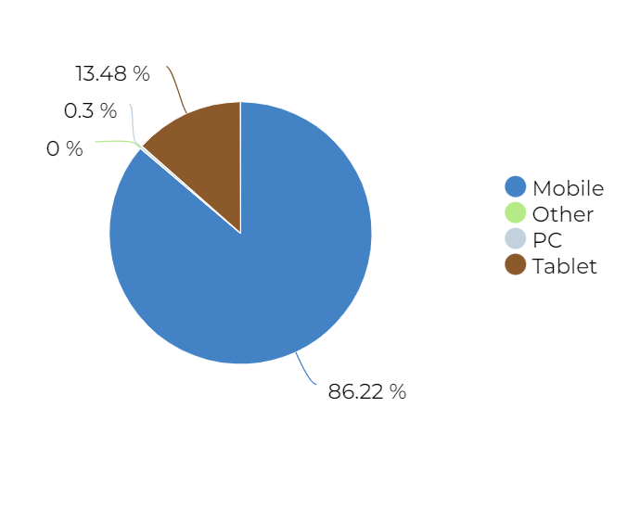
DISPLAY – BY DEVICE

Slide 15
TOP VIEWED SITES – DISPLAY
1Weather
6pm
AARP
ABC
ABPV
AccuWeather
ActiveBeat
Al Jazeera
All Kpop
Allrecipes
AOL
AP News
AskMen
Atlanta Black Star
Audiomack
Baby Names
Baby Tracker
Barstool Sports
Baseball Reference
BET
Better Homes and Gardens
Bible
Billboard
Bingo
Biography
BitLife
Blackjack
Bleacher Report
Bleeding Cool
Boat Trader
Boggle With Friends
Bon Appetit
BoostMobile
Bored Panda
Boston
Boston Herald
Bowling
Bowmasters
BoxRec
Broadcastify
BroBible
Business Insider
Buzzfeed
Cageside Seats
Calamity Mod
CallApp
Canasta
Card Games
Casino Slot Machine
CBS
CBS Sports
Celeb Dirty Laundry
Celebrating The Soaps
Chicago Sun-Times
China Times
Classmates
CNBC
CNN
Collider
Cosmopolitan
Country Living
Cox
Craft Island
Crooks and Liars
Crossword
CTPost
Daily Caller
Daily Choices
Daily Kos
Daily Mail
Daily Soap Dish
Daily Voice
DatPiff
Delish
Diario Deportivo Diez
Dictionary
Digital Spy
Dilbert
DMV
Dominoes
Drudge Report
E!
Easy Game
Eat This, Not That
Eat Well 101
eBaum's World
eBay
Eighties Kids
El Diario NY
El Nuevo Dia
Elite Daily
Elle
eNotes
Entertainment Weekly
Epicstream
Equibase
ESPN
Esquire
Extra
Facty Health
Family Handyman
Fandango
Fandom
Fantrax
Field & Stream
Find A Grave
FiveThirtyEight
FlightAware
Flipboard
FloSports
Flow Free
Fodors
Forbes
Ford
Fortnite
Fox News
FUTBIN
Gaana Music
GamesRadar+
GasBuddy
Genius
George Takei
Gizmodo
Glamour
Glassdoor
Good Housekeeping
GreaterGood
GSN
Guitar
Harper's Bazaar
Healthgrades
Heavy.com
Hello Magazine
Herald Weekly
HGTV
History
Hollywood Life
Horoscope
HOT 97
HotNewHipHop
HowStuffWorks
Huffington Post
IGN
iHeartRadio
In Touch Weekly
Inked
Insider
InStyle
JCPenney
Jezebel
Jigsaw Puzzle
Know Your Meme
Kpop Profiles
La Nacion
La Opinion
La Prensa Honduras
LA Times
LaPatilla
Larry Brown Sports
Law and Crime
Letter Soup
Letterboxd
Life & Style
Lifehacker
LiveScore
Looper
Loudwire
Love to Know
Mail.com
Manorama Online
Manta
Martha Stewart
Mashed
Mass Live
Match
Mediotiempo
Men's Health
Merriam Webster
Messenger
metroPCS
Miami Herald
Miami New Times
Mirror
MissyUSA
MLB
Monsters and Critics
MSN
Mundo Deportivo
Musi
Music Tube
My Mixtapez Music
MyFitnessPal
MyRadar
MyRecipes
National Review
NBA
NBC
NBC Sports
NDTV
NetZero
New York Post
New York Times
Newsmax
Newsweek
Nicki Swift
NY Daily News
OilPrice
OnDemandKorea
OurTime
Page Six
Pandora: Music & Podcasts
Parade
Paste Magazine
PC Gamer
PC Mag
People
Percolately
Perez Hilton
Plenty of Fish
Police Scanner
Politico
PolitiFact
Popular Science
Primera Hora
Pro Football Reference
Quizlet
Racing Junk
RadarOnline
Ranker
Raw Story
RealClearPolitics
Realtor
Reddit
Reuters
Roku
Rolling Stone
Salary.com
Scary Mommy
Sky Sports
Soap Hub
Someecards
Southern Living
Spades
SpanishDict
Sports Illustrated
Spotify
Stock Master
Stylecaster
Tarot
Telemundo
Text Free
TextNow
The Advocate
The American Spectator
The Boston Globe
The CW Network
The Daily Beast
The Daily Conservative
The Daily Dot
The Daily Star
The Daily Wire
The Delite
The Discoverer
The Drive
The Economic Times
The Gazette
The Guardian
The Hill
The Hockey Writers
The Hull Truth
The Independent
The Nation
The Onion
The Political Insider
The Verge
The Washington Post
The Weather Channel
The Western Journal
The World Journal
The Wrap
theChive
TheGamer
theScore
TMZ
Tom's Guide
Town and Country
Tripadvisor
Trivia
Tune In
Tv Tropes
Ultimate Classic Rock
Uproxx
Urban Dictionary
US News
US Weekly Magazine
USA
Vanity Fair
Variety
Washington Examiner
Washington Times
Weather
Weather Underground
WeatherBug
WebMD
What The Forecast?!!
Whitepages
wikiHow
Women's Heath
Worldstar Hip Hop
Wrestling Headlines
WSBTV
WTNH News 8
Xbox
Xfinity
YachtWorld
Yahoo
YourBump
YourTango
Zimbio
Zynga

Slide 16
SOCIAL PERFORMANCE
FACEBOOK & INSTAGRAM

Slide 17
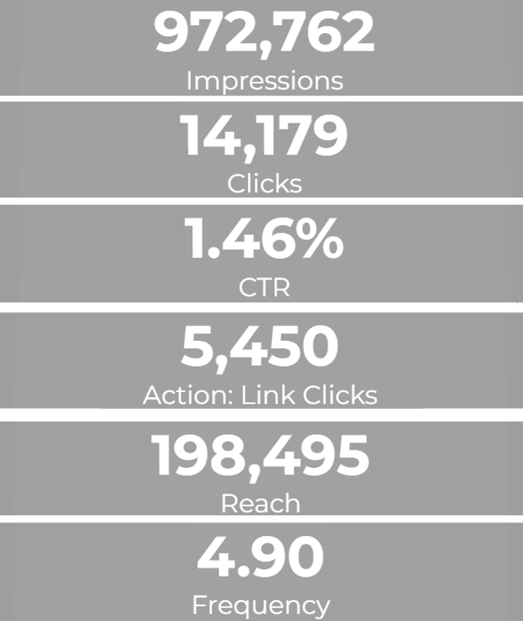
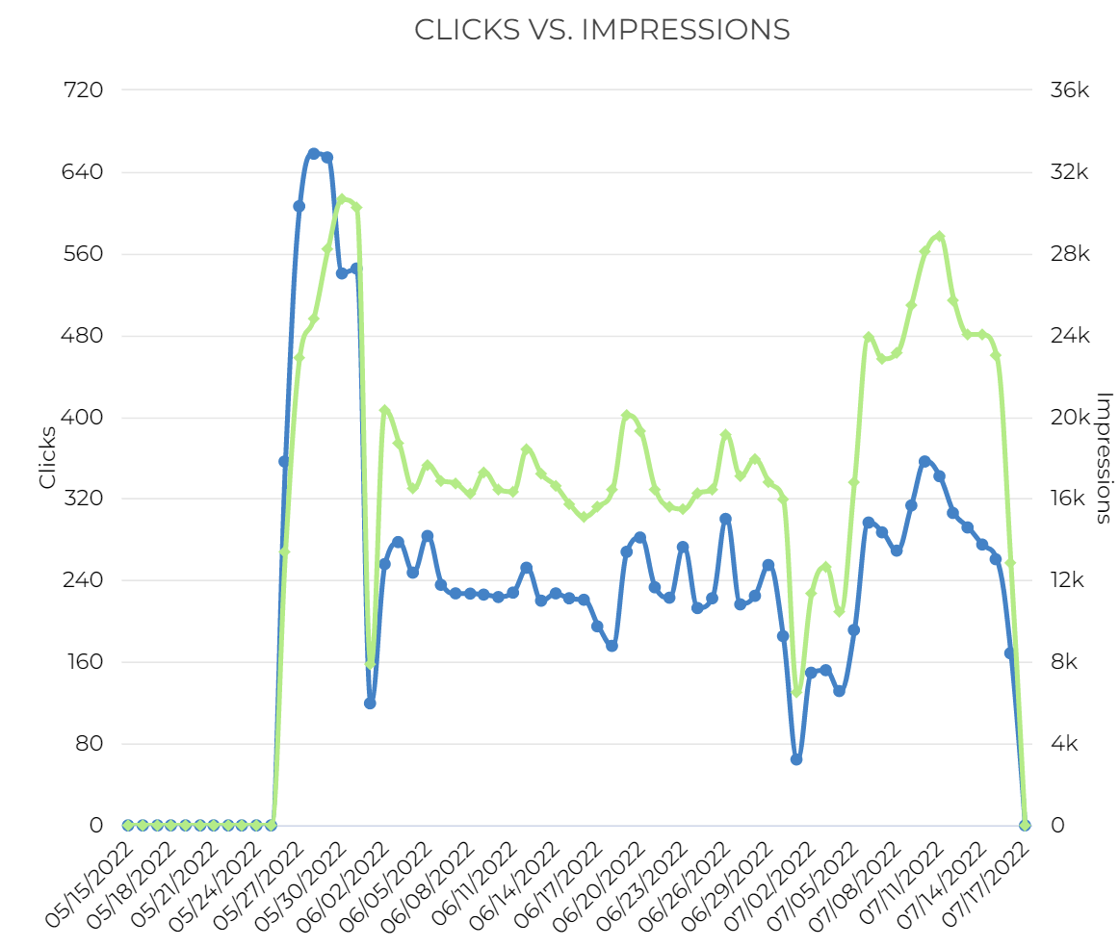
SOCIAL PERFORMANCE - OVERALL

Slide 18
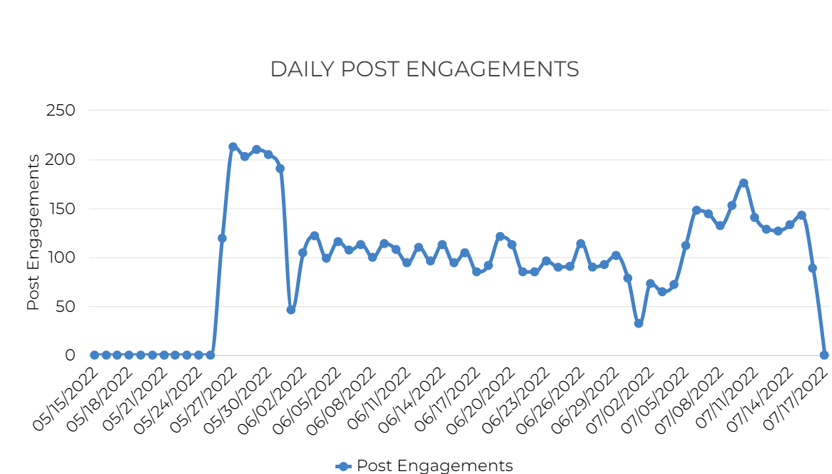

SOCIAL PERFORMANCE - OVERALL

Slide 19
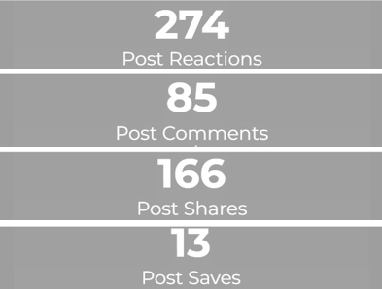
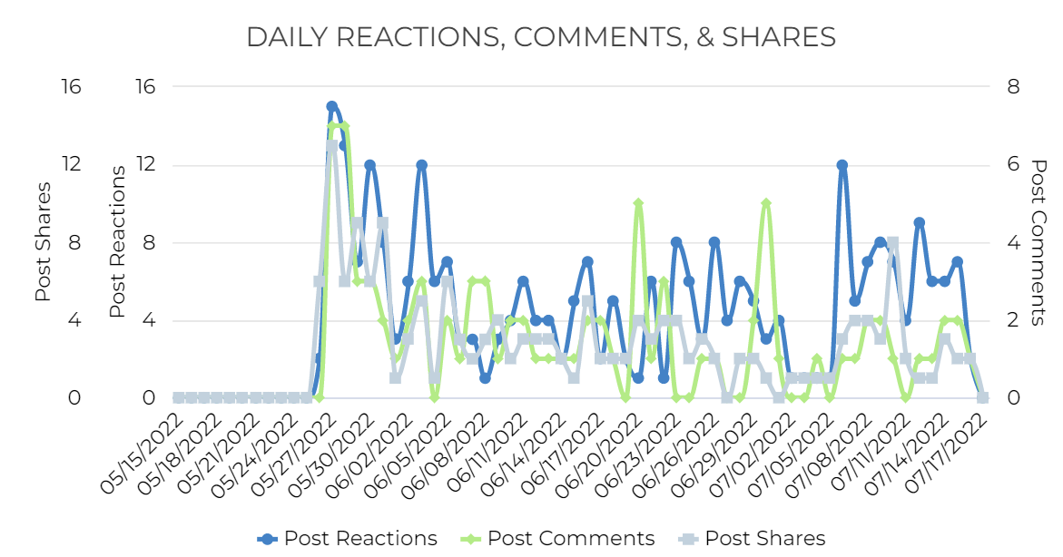
SOCIAL PERFORMANCE - OVERALL

Slide 20
SOCIAL PERFORMANCE: CREATIVE
Adset Name | Impressions | Clicks | CTR | Link Clicks | Reach | Frequency
Brockton Naloxone - English | 303,731 | 5,168 | 1.70% | 1,696 | 73,472 | 4.13
Brockton Naloxone - Spanish | 32,974 | 324 | 0.98% | 231 | 5,592 | 5.90
Lowell Naloxone - English | 264,049 | 2,610 | 0.99% | 1,268 | 45,623 | 5.79
Lowell Naloxone - Spanish | 53,478 | 489 | 0.91% | 275 | 8,096 | 6.61
Salem Naloxone - English | 264,836 | 4,868 | 1.84% | 1,664 | 68,336 | 3.88
Salem Naloxone - Spanish | 53,694 | 720 | 1.34% | 316 | 14,236 | 3.77

Slide 21
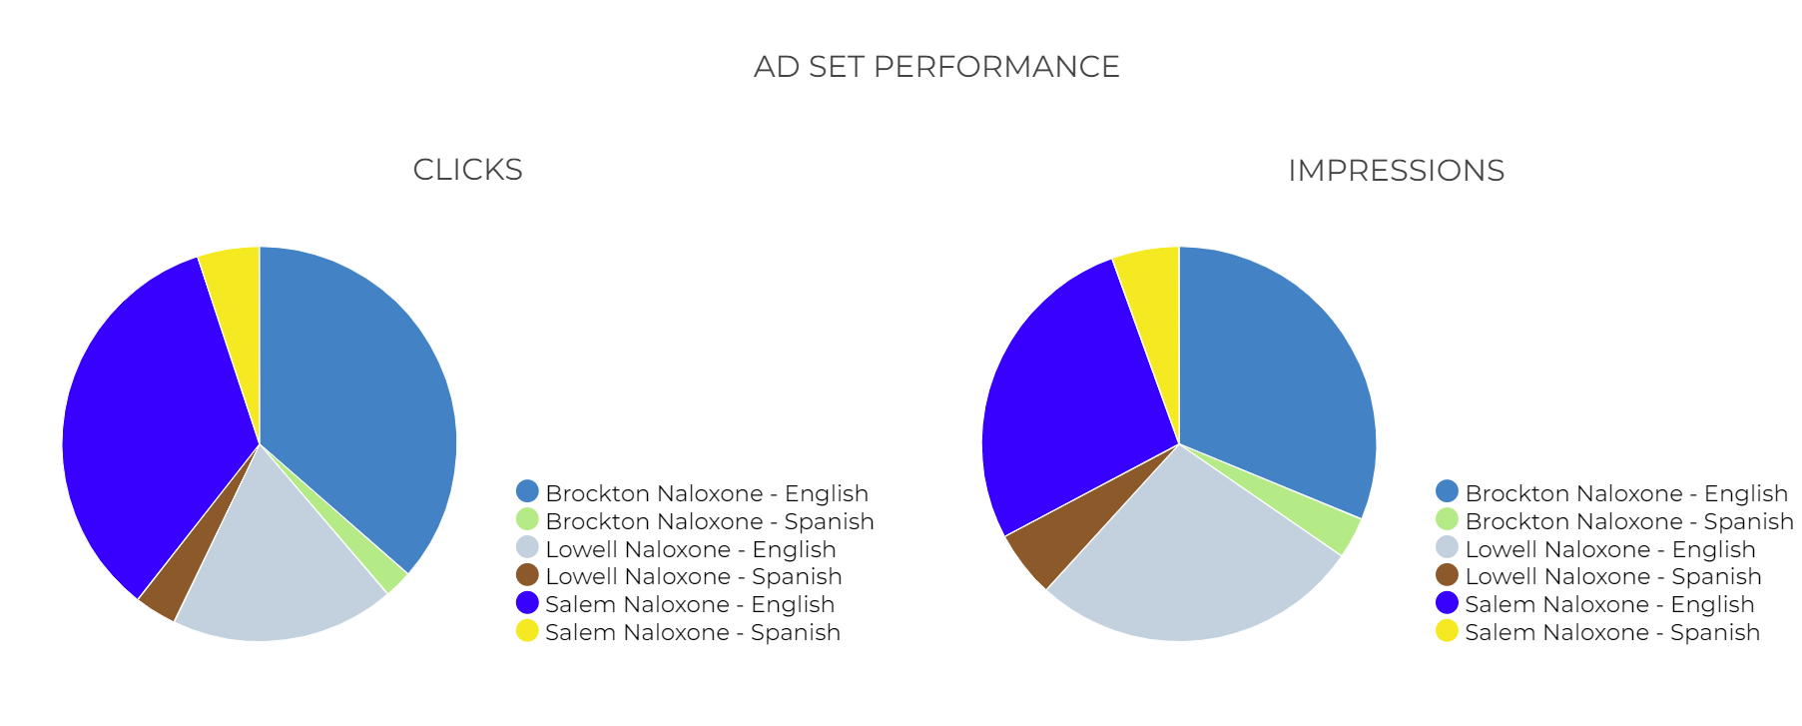
SOCIAL PERFORMANCE: CREATIVE

Slide 22
SOCIAL PERFORMANCE: CREATIVE
Ad Name | AdPreviewURL | Impressions | Clicks | CTR | Link Clicks | Engagements | Comments | Shares | Reactions
Facebook Brockton Naloxone | https://www.facebook.com/102650498106646_541696727535352 | 303,731 | 5,168 | 1.70% | 1,696 | 1,907 | 45 | 65 | 100
Salem Naloxone Facebook | https://www.facebook.com/102650498106646_541704737534551 | 264,836 | 4,868 | 1.84% | 1,664 | 1,845 | 29 | 55 | 89
Lowell Naloxone Facebook | https://www.facebook.com/102650498106646_541687777536247 | 264,049 | 2,610 | 0.99% | 1,268 | 1,369 | 7 | 37 | 55
Lowell Naloxone Facebook SPA | https://www.facebook.com/102650498106646_541690470869311 | 53,478 | 489 | 0.91% | 275 | 295 | 0 | 4 | 15
Salem Naloxone Facebook SPA | https://www.facebook.com/102650498106646_541704730867885 | 53,694 | 720 | 1.34% | 316 | 336 | 4 | 5 | 10
Facebook SPABrockton Naloxone | https://www.facebook.com/102650498106646_541696737535351 | 32,974 | 324 | 0.98% | 231 | 236 | 0 | 0 | 5

Slide 23
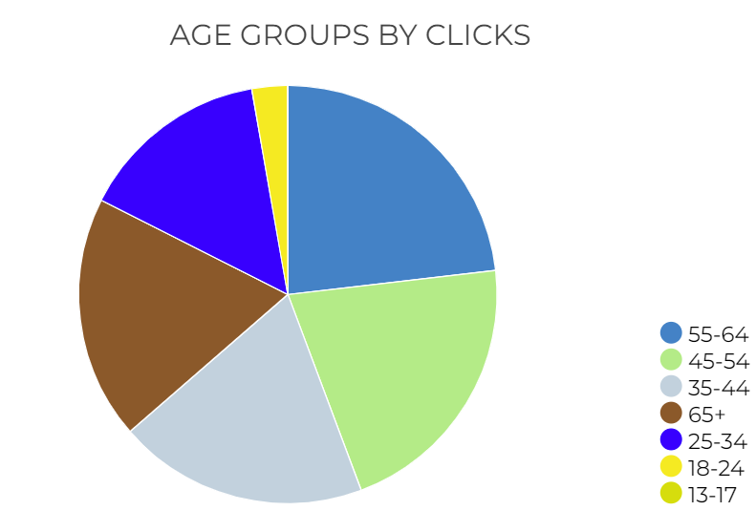
SOCIAL - AUDIENCE INSIGHTS
Notes:
This is your top converting, lower funnel social media tactic. We are re-targeting people who have shown an interest based on engagement with other tactics with the remarketing. We are attributing a lot of sales, and as with all your facebook tactics seeing a high level of social media engagement from people interested in your brand. People are providing testimonials, sharing the ad, and tagging their friends.

Slide 24
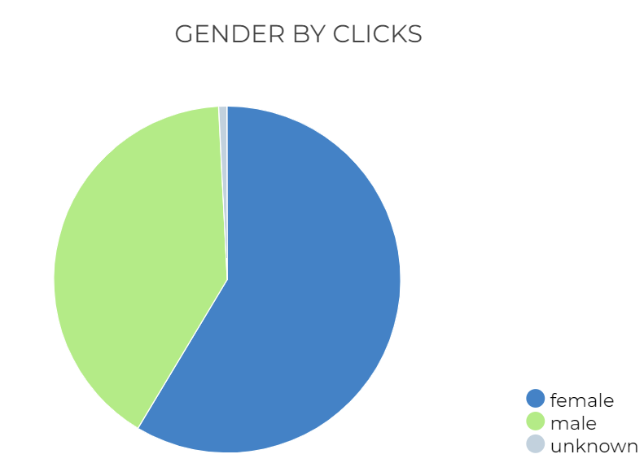
SOCIAL - AUDIENCE INSIGHTS
Notes:
This is your top converting, lower funnel social media tactic. We are re-targeting people who have shown an interest based on engagement with other tactics with the remarketing. We are attributing a lot of sales, and as with all your facebook tactics seeing a high level of social media engagement from people interested in your brand. People are providing testimonials, sharing the ad, and tagging their friends.

Slide 25
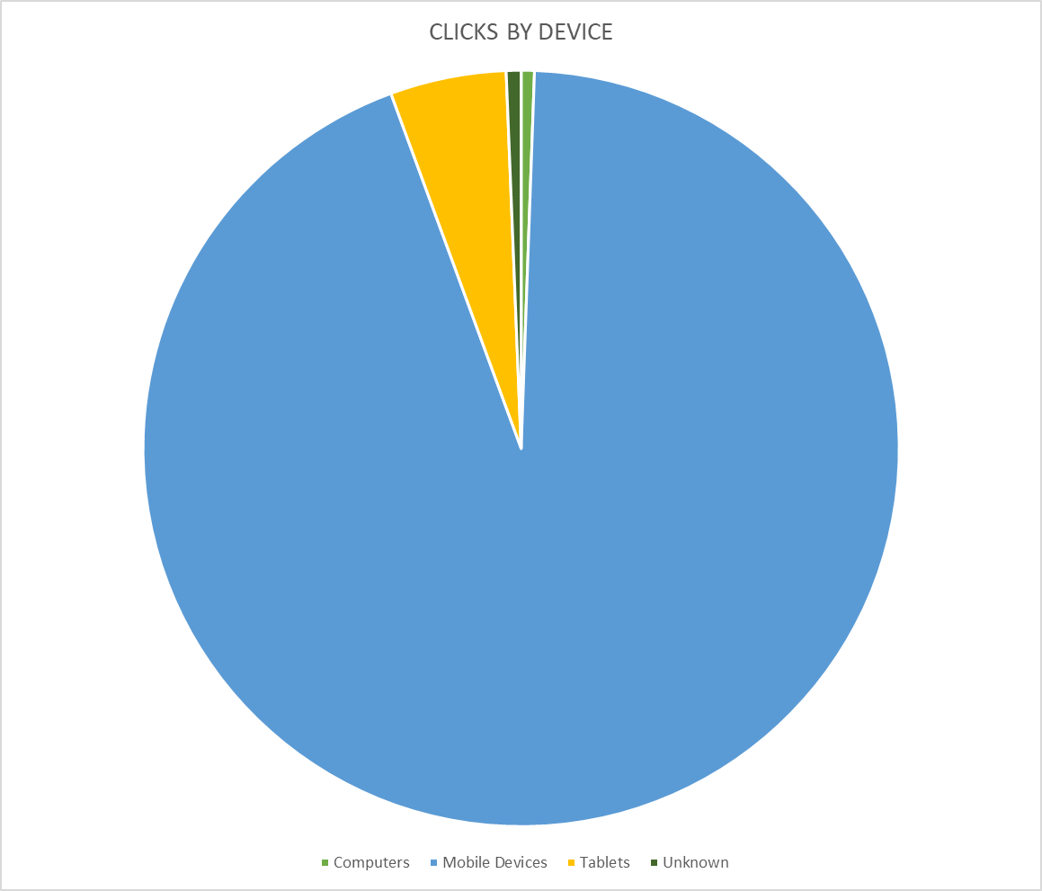
SOCIAL – CLICKS BY DEVICE
Notes:
UPDATE IMAGES and TEXT

