Slide 1

WRAP REPORT
ORAU – BMC
Campaign 5 – MOUD Digital

Slide 2
CAMPAIGN TARGETS
CAMPAIGN GOALS:
Encourage people with opioid use disorder to utilize treatment and recovery support services available in their communities.
TARGET AUDIENCES: A 18+ with interests in News OR Health & Wellness OR Gambling/gamblers OR PWLE OR People in Recovery OR Family/friends of opioid addicts in Spanish and English languages
GEOGRAPHY: MASSACHUSETTS regions
BROCKTON REGION: Abington, Bridgewater, Brockton, Carver, Duxbury, East Bridgewater, Halifax, Hanover, Hanson, Hingham, Hull, Kingston, Lakeville, Marion, Marshfield, Mattapoisett, Middleborough, Norwell, Pembroke, Plymouth, Plympton, Rochester, Rockland, Scituate, Wareham, West Bridgewater, Whitman
SALEM REGION: Amesbury, Andover, Beverly, Boxford, Byfield, Danvers, Essex, Georgetown, Gloucester, Groveland, Hamilton, Hathorne, Haverhill, Ipswich, Lynn, Lynnfield, Manchester, Marblehead, Merrimac, Methuen, Middleton, Nahant, Newbury, Newburyport, North Andover, Peabody
LOWELL REGION: Lowell, Chelmsford, North Chelmsford, Dracut, Tewksbury, North Billerica, Billerica, Tyngsboro, Andover, Nutting Lake, Westford, Carlisle
FLIGHT DATES: May 22 – July 16, 2022
CREATIVE:
Facebook Static Ads
Display Banners – 300x250, 728x90, 160x600, 300x600, 320x50
TACTICS:
Cross Device Display: English
Facebook Traffic Ads: Spanish & English

Slide 3
CAMPAIGN INFORMATION
NET SPEND BY COMMUNITY:
BOURNE: $5,500
SALEM: $5,500
LOWELL: $5,500
NET SPEND BY LANGUAGE:
ENGLISH: $12,000
SPANISH: $4,500
TOTAL BUDGET: $16,500 NET

Slide 4
CAMPAIGN INFORMATION
FLIGHT DATES BY COMMUNITY:
All communities = 5/22 -7/16/2022
FLIGHT DATES BY LANGUAGE:
English: 5/22 -7/16/2022
Spanish: 5/22 -7/16/2022
FLIGHT DATES BY TACTIC:
Facebook/Instagram: 5/25 -7/16/2022
Display: 5/22 -7/16/2022

Slide 5
POPULATION BY REGION (U.S. CENSUS BUREAU DATA 2020):
BROCKTON REGION: 437,296
SALEM REGION: 707,016
LOWELL REGION: 351,591

Slide 6
CAMPAIGN DELIVERY TOTALS
DISPLAY
SOCIAL
FACEBOOK TRAFFIC ADS - English
938,239 impressions
210,352 total reach
5,472 clicks
0.58% CTR
85 Post Reactions (likes, loves, etc)
12 Comments
16 Shares
FACEBOOK TRAFFIC ADS - Spanish
194,294 impressions
49,037 total reach
1,506 clicks
0.78% CTR
16 Post Reactions (likes, loves, etc)
0 Comments
2 Shares
CROSS DEVICE DISPLAY – English
465,452 IMPRESSIONS
820 CLICKS
0.18% CLICK THROUGH RATE
CROSS DEVICE DISPLAY – Spanish
235,397 IMPRESSIONS
508 CLICKS
0.22% CLICK THROUGH RATE

Slide 7
DISPLAY PERFORMANCE
AUDIENCE TARGETING

Slide 8

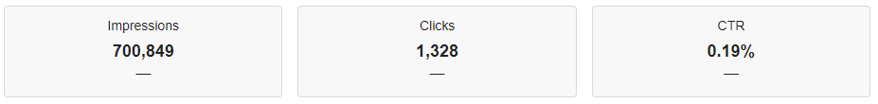
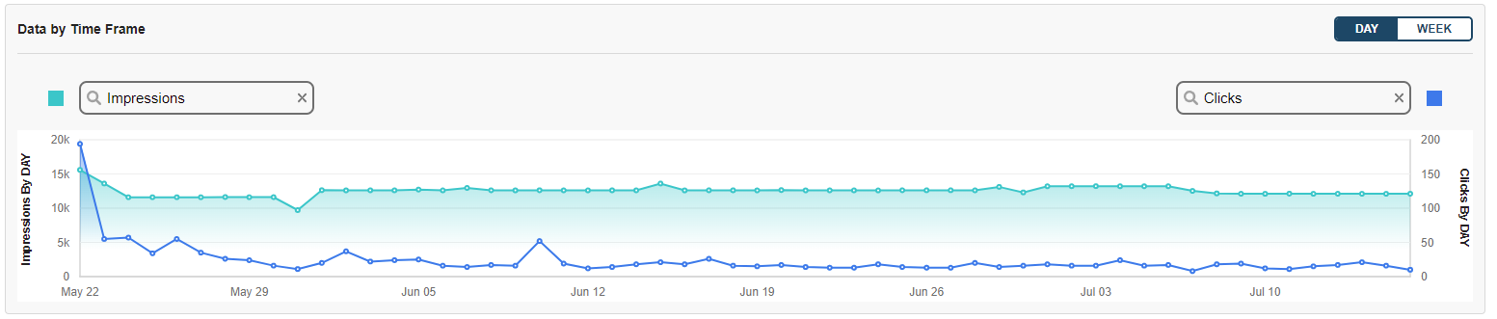
DISPLAY – OVERALL PERFORMANCE

Slide 9
DISPLAY – BY REGION
Name | Impressions | Clicks | CTR
149019 - Display - LOWELL - English | 155445 | 298 | 0.19%
149019 - Display - BROCKTON - English | 155034 | 251 | 0.16%
149019 - Display - SALEM - English | 154973 | 271 | 0.17%
TOTAL ENGLISH | 465452 | 820 | 0.18%
Name | Impressions | Clicks | CTR
149019 - Display - LOWELL - Spanish | 78904 | 158 | 0.20%
149019 - Display - BROCKTON - Spanish | 78725 | 178 | 0.23%
149019 - Display - SALEM - Spanish | 77768 | 172 | 0.22%
TOTAL SPANISH | 235397 | 508 | 0.22%

Slide 10
DISPLAY – BY ZIP CODE
Zip Codes | Location | Impressions | Clicks
02301 | Brockton, Massachusetts | 60,882 | 92
01810 | Andover, Massachusetts | 39,884 | 93
02360 | Plymouth, Massachusetts | 33,728 | 68
01852 | Lowell, Massachusetts | 32,331 | 54
01876 | Tewksbury, Massachusetts | 27,935 | 52
01821 | Billerica, Massachusetts | 27,914 | 52
01826 | Dracut, Massachusetts | 27,400 | 47
01844 | Methuen, Massachusetts | 27,126 | 51
01824 | Chelmsford, Massachusetts | 26,062 | 54
01902 | Lynn, Massachusetts | 25,475 | 49
01851 | Lowell, Massachusetts | 22,938 | 42
01960 | Peabody, Massachusetts | 19,666 | 42
02302 | Brockton, Massachusetts | 19,659 | 36
02043 | Hingham, Massachusetts | 18,175 | 50
01930 | Gloucester, Massachusetts | 17,612 | 33
01915 | Beverly, Massachusetts | 17,571 | 23
01950 | Newburyport, Massachusetts | 16,082 | 29
01886 | Westford, Massachusetts | 15,964 | 28
01913 | Amesbury, Massachusetts | 15,058 | 22
02050 | Marshfield, Massachusetts | 12,661 | 24
01832 | Haverhill, Massachusetts | 12,191 | 21
02571 | Wareham, Massachusetts | 12,126 | 19
02359 | Pembroke, Massachusetts | 11,681 | 23
01854 | Lowell, Massachusetts | 10,741 | 26
02324 | Bridgewater, Massachusetts | 9,860 | 20
01945 | Marblehead, Massachusetts | 9,110 | 11
01845 | North Andover, Massachusetts | 8,945 | 22
01835 | Haverhill, Massachusetts | 8,897 | 15
01830 | Haverhill, Massachusetts | 7,912 | 10
02370 | Rockland, Massachusetts | 7,568 | 6
02351 | Abington, Massachusetts | 7,465 | 11
02066 | Scituate, Massachusetts | 7,161 | 10

Slide 11
DISPLAY – BY ZIP CODE
Zip Codes | Location | Impressions | Clicks
01879 | Tyngsboro, Massachusetts | 6,784 | 14
01834 | Groveland, Massachusetts | 5,649 | 12
01940 | Lynnfield, Massachusetts | 5,304 | 10
01850 | Lowell, Massachusetts | 4,722 | 13
01905 | Lynn, Massachusetts | 4,647 | 2
02364 | Kingston, Massachusetts | 3,812 | 10
02332 | Duxbury, Massachusetts | 3,786 | 4
01938 | Ipswich, Massachusetts | 3,664 | 5
02738 | Marion, Massachusetts | 3,642 | 10
02333 | East Bridgewater, Massachusetts | 3,346 | 4
01741 | Carlisle, Massachusetts | 3,243 | 10
01904 | Lynn, Massachusetts | 3,205 | 42
02339 | Hanover, Massachusetts | 3,144 | 4
02061 | Norwell, Massachusetts | 3,072 | 11
02739 | Mattapoisett, Massachusetts | 3,034 | 7
01949 | Middleton, Massachusetts | 2,546 | 4
01833 | Georgetown, Massachusetts | 2,441 | 2
01921 | Boxford, Massachusetts | 2,216 | 3
02382 | Whitman, Massachusetts | 2,070 | 7
02770 | Rochester, Massachusetts | 1,939 | 2
02330 | Carver, Massachusetts | 1,836 | 2
02347 | Lakeville, Massachusetts | 1,105 | 1
01944 | Manchester-by-the-Sea, Massachusetts | 1,009 | 2
01862 | North Billerica, Massachusetts | 848 | 0
01929 | Essex, Massachusetts | 845 | 1
02362 | Plymouth, Massachusetts | 561 | 7
02379 | West Bridgewater, Massachusetts | 537 | 0
02338 | Halifax, Massachusetts | 433 | 0
02341 | Hanson, Massachusetts | 224 | 0
01903 | Lynn, Massachusetts | 177 | 0
01863 | North Chelmsford, Massachusetts | 172 | 0
02045 | Hull, Massachusetts | 153 | 1

Slide 12
DISPLAY – BY ZIP CODE
Zip Codes | Location | Impressions | Clicks
01922 | Byfield, Massachusetts | 108 | 1
01908 | Nahant, Massachusetts | 28 | 0
01901 | Lynn, Massachusetts | 25 | 0
01853 | Lowell, Massachusetts | 23 | 0
02331 | Duxbury, Massachusetts | 14 | 0
01822 | Billerica, Massachusetts | 13 | 0
01831 | Haverhill, Massachusetts | 8 | 0
02767 | Bridgewater, Massachusetts | 6 | 0
02367 | Plympton, Massachusetts | 6 | 0
02044 | Hingham, Massachusetts | 2 | 0
01812 | Andover, Massachusetts | 1 | 0
02304 | Brockton, Massachusetts | 1 | 0
02359 | Hanson, Massachusetts | 1 | 0

Slide 13
DISPLAY – CREATIVE
Creative Name | Impressions | Clicks | CTR
Brockton Bupe 160x600_052022.png | 88 | 4 | 4.55%
Brockton Bupe 300x250_052022.png | 6,111 | 21 | 0.34%
Brockton Bupe 300x600 copy_052022.png | 182 | 7 | 3.85%
Brockton Bupe 320x50_052022.png | 60,192 | 63 | 0.10%
Brockton Bupe 728x90_052022.png | 19,602 | 28 | 0.14%
Brockton Bupe SPA 160x600_052022.png | 30 | 2 | 6.67%
Brockton Bupe SPA 300x250_052022.png | 2,344 | 18 | 0.77%
Brockton Bupe SPA 300x600_052022.png | 70 | 4 | 5.71%
Brockton Bupe SPA 320x50_052022.png | 30,816 | 52 | 0.17%
Brockton Bupe SPA 728x90_052022.png | 11,196 | 25 | 0.22%
Brockton Methadone 160x600_052022.png | 43 | 3 | 6.98%
Brockton Methadone 300x250_052022.png | 6,273 | 22 | 0.35%
Brockton Methadone 300x600_052022.png | 189 | 10 | 5.29%
Brockton Methadone 320x50_052022.png | 47,782 | 54 | 0.11%
Brockton Methadone 728x90_052022.png | 14,572 | 39 | 0.27%
Brockton Methadone SPA 160x600_052022.png | 16 | 1 | 6.25%
Brockton Methadone SPA 300x250_052022.png | 2,227 | 19 | 0.85%
Brockton Methadone SPA 300x600_052022.png | 59 | 6 | 10.17%
Brockton Methadone SPA 320x50_052022.png | 23,370 | 31 | 0.13%

Slide 14
DISPLAY – CREATIVE
Creative Name | Impressions | Clicks | CTR
Lowell Bupe 160x600_052022.png | 135 | 5 | 3.70%
Lowell Bupe 300x250_052022.png | 6,475 | 26 | 0.40%
Lowell Bupe 300x600_052022.png | 212 | 8 | 3.77%
Lowell Bupe 320x50_052022.png | 70,746 | 83 | 0.12%
Lowell Bupe 728x90_052022.png | 21,054 | 49 | 0.23%
Lowell Bupe SPA 160x600_052022.png | 21 | 1 | 4.76%
Lowell Bupe SPA 300x250_052022.png | 2,723 | 17 | 0.62%
Lowell Bupe SPA 300x600_052022.png | 44 | 4 | 9.09%
Lowell Bupe SPA 320x50_052022.png | 28,294 | 32 | 0.11%
Lowell Bupe SPA 728x90_052022.png | 11,115 | 27 | 0.24%
Lowell Methadone 300x250_052022.png | 5,776 | 26 | 0.45%
Lowell Methadone 300x600_052022.png | 214 | 9 | 4.21%
Lowell Methadone 320x50_052022.png | 34,935 | 47 | 0.13%
Lowell Methadone 728x90_052022.png | 15,898 | 45 | 0.28%
Lowell Methadone SPA 160x600_052022.png | 38 | 2 | 5.26%
Lowell Methadone SPA 300x250_052022.png | 2,610 | 19 | 0.73%
Lowell Methadone SPA 300x600_052022.png | 90 | 5 | 5.56%
Lowell Methadone SPA 320x50_052022.png | 24,157 | 29 | 0.12%
Lowell Methadone SPA 728x90_052022.png | 9,812 | 22 | 0.22%

Slide 15
DISPLAY – CREATIVE
Creative Name | Impressions | Clicks | CTR
Salem Bupe 160x600_052022.png | 86 | 2 | 2.33%
Salem Bupe 300x600_052022.png | 197 | 8 | 4.06%
Salem Bupe 320x50_052022.png | 63,051 | 75 | 0.12%
Salem Bupe 728x90_052022.png | 21,945 | 51 | 0.23%
Salem Bupe SPA 160x600_052022.png | 27 | 2 | 7.41%
Salem Bupe SPA 300x250_052022.png | 2,913 | 19 | 0.65%
Salem Bupe SPA 300x600_052022.png | 72 | 5 | 6.94%
Salem Bupe SPA 320x50_052022.png | 31,768 | 44 | 0.14%
Salem Methadone 160x600_052022.png | 57 | 3 | 5.26%
Salem Methadone 300x250_052022.png | 11,928 | 30 | 0.25%
Salem Methadone 300x600_052022.png | 198 | 8 | 4.04%
Salem Methadone 320x50_052022.png | 42,129 | 60 | 0.14%
Salem Methadone 728x90_052022.png | 15,382 | 34 | 0.22%
Salem Methadone SPA 160x600_052022.png | 16 | 2 | 12.50%
Salem Methadone SPA 300x250_052022.png | 2,570 | 21 | 0.82%
Salem Methadone SPA 300x600_052022.png | 65 | 7 | 10.77%
Salem Methadone SPA 320x50_052022.png | 25,135 | 35 | 0.14%
Salem Methadone SPA 728x90_052022.png | 15,202 | 37 | 0.24%

Slide 16
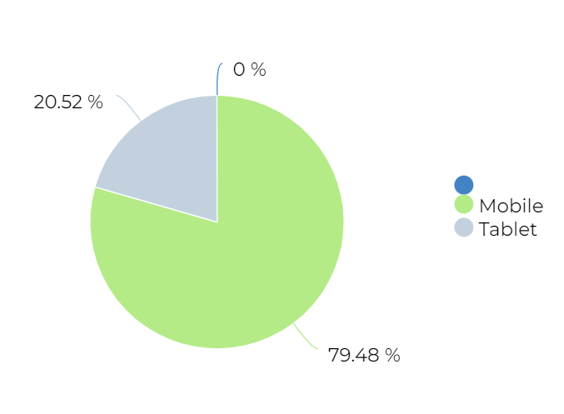
DISPLAY – BY DEVICE

Slide 17
TOP VIEWED SITES – DISPLAY
107.5 WBLS
11Alive
12 Tomatoes
13 WTHR
1Weather
247Sports
2KMTCentral
3 Tiles
6pm
911 Emergency Dispatcher App
A Family Feast
ABC
AccuWeather
ActiveBeat
Add a Pinch
Adult Swim
AL.com
All Kpop
Allrecipes
Alternative Press Magazine
Amino
Animal Crossing
AOL
AP News
Apartment Therapy
Apple Insider
Architectural Digest
Arkadium Games
Astrostyle
Atlas Obscura
Audacy
Audiomack
Autoblog
AutoTrader
Averie Cooks
AZ Central
Baby Names
Baby Tracker
Backgammon
Barchart
Barstool Sports
Baseball Reference
Bazooka Boy
BBC
Belly Full
Best Life
Best Products
BET
Better Homes and Gardens
Bible
Bingo
Biography
BitLife
Black Enterprise
Blackjack
BladeForums
Bleacher Report
Bleeding Cool
Block Puzzle
Blockscapes
Bloomberg: Business News
Boat Trader
Bob Vila
Boggle With Friends
Bon Appetit
BoostMobile
Bored Panda
Bossip
Boston
Boston Herald
Bowmasters
BoxRec
Bravo
Bristol Live
Britannica
Broadcastify
BroBible
Budget Bytes
Business Insider
Business Today
Bustle
Buzzfeed
Cafe Delites
Calamity Mod
CallApp
Canasta
Card Games
Career Sidekick
CarGurus
Cars.com
Casino Slot Machine
Castbox
CBS
CBS Sports
Celeb Dirty Laundry
Celebrating The Soaps
Celebuzz
Checkers
Chegg
Chess
Chicago Tribune
Chip and Company
Chocolate Covered Katie
Choice Hotels
City Takeover
Classic Cars
Classmates
Closer Weekly
ClutchPoints
CNN
Collider
Comics Kingdom
Complex
Conde Nast
Conserve Energy Future
Convert Units
Cookie and Kate
Cooking Classy
Copy Kat
Cosmopolitan
Country Living
Coupons
Cox
Craft Island
Crazy Games
Creaders
Creative Bloq
Cribbage
Crooks and Liars
Crossword
CurseForge
Daily Caller
Daily Choices
Daily Freeman
Daily Kos
Daily Mail
Daily Soap Dish
Daily Voice
Dailyhunt
Damn Delicious
DatPiff
Dazzly
DCUM
Deadline
Deal News
Dealmoon
Delightful E Made
Delish
Den of Geek
Diario Deportivo Diez
Dictionary
Diethood
Disney Food Blog
Distractify
DMV
Dominoes
Donga
Doodle
Dot Esports
Douban
Drudge Report
Drugs.com
E!
Eat Well 101
EatingWell
eBaum's World
eBay
Eighties Kids
El Diario NY
El Nuevo
Elite Daily
Elle
Empire
Encyclopedia
eNotes
Entertainment Tonight
Entertainment Weekly
Epicstream
Equibase
ESPN
Esquire
Eurosport
Evermatch
Express
Extra
Facty Health
Fadeaway World
Family Education
Family Handyman
Famous Birthdays
Fandango
Fandom
FanGraphs
Fantrax
FAQtoids
Far Out Magazine
Fark.com
Fatherly
Field & Stream
Find A Grave
FiveThirtyEight
Flickr
FlightAware
Flightradar24
Flixster - Showtimes + Tickets
Fodors
Food & Wine Magazine
Food Network
Food52
Foodie Crush
Footwear News
Forbes
Ford
Fortnite
Fortune
FotMob
Fox Business
Fox News
FUTBIN
Gaana Music
Game Rant
Game8
Gameknot
GamePress
Gamepur
GamesRadar+
GameWith
GasBuddy
Geared to You
Genius
George Takei
Gfinity Esports
Gimme Some Oven
Gin Rummy
Gizmodo
Glamour
Glassdoor
Go Escape!
Goal.com
Gold Price
Golf Monthly
Good Housekeeping
GreaterGood
GreatSchools
Greek Rank
Groupon
GSN
Guitar
Harper's Bazaar
Heavy.com
Hello Magazine
Herald Weekly
HGTV
HipHopDX
History
Hollywood Life
Hometalk
Horoscope
HOT 97
HotNewHipHop
House Beautiful
HowStuffWorks
How-To Geek
Huffington Post
Imgur
In Touch Weekly
IndieWire
Infinite Connections
Infoplease
Inforum
Inked
Inside Lacrosse
Insider
InStyle
Interesting Engineering
Inverse
Investor Place
JCPenney
Jezebel
Kik
Kiplinger
Kmart
Know Your Meme
Kpop Profiles
La Opinion
LA Times
Larry Brown Sports
Latest Hairstyles
Law and Crime
League Athletics
League of Graphs
Legacy.com
Life & Style
LiveScore
LiveXLive
Livingly
Looper
Louder
Mail.com
Manta
MapQuest
Marie Claire
Martha Stewart
Mashable
Mashed
Mass Live
Match
McCormick
Mediaite
Medical News Today
MedicineNet
Mediotiempo
Men's Health
Men's Journal
Mental Floss
Mercury News
Merriam Webster
MetroUS
Miami Herald
Miami New Times
MLB
MMA Fighting
MMA Mania
Moms.com
Motherly
Movieweb
Mr Gun
MSN
Mundo Deportivo
Muscle and Fitness
MyAnimeList
MyFitnessPal
MyRadar
MyRecipes
National Review
NBA
NBC
NBC News
NBC Sports
NCAA
NDTV
New York Post
New York Times
Newsday
Newser
Newsmax
NewsTalk 1290 KWFS
Newsweek
NHL
Nicki Swift
Nintendo
Nj.com
NOLA.com
NY Daily News
OK Magazine
On TV Tonight
Once Upon a Chef
OnDemandKorea
Oprah
OurTime
Outdoor Life
Page Six
Parade
Paste Magazine
Pats Pulpit
PC Gamer
PC Mag
People
Perez Hilton
Pet Finder
Pinch of Yum

Slide 18
TOP VIEWED SITES – DISPLAY
Plenty of Fish
Podcast Addict
Police Scanner
Political Flare
Political Wire
PolitiFact
Popular Mechanics
Popular Science
Prevention
Primera Hora
Pro Football Network
Pro Football Reference
Pro Game Guides
RadarOnline
Ranker
Rate My Professors
Raw Story
Real Simple
RealClearPolitics
Redbook
Reddit
Refinery29
RetailMeNot
Reuters
Rolling Stone
Rotten Tomatoes
Salary.com
Sallys Baking Addiction
San Francisco Chronicle
Scary Mommy
Science
SELF Magazine
SFGATE
Shape Magazine
Skinnytaste
Sky Sports
Slate
SmartNews
Snopes
Soap Hub
Soap Opera Spy
Someecards
Southern Living
SpanishDict
Sporting News
Sports Illustrated
Spotify
Stocktwits
Taste of Country
Text Free
TextNow
The American Digest
The American Spectator
The Boston Globe
The Daily Beast
The Daily Conservative
The Daily Dot
The Daily Star
The Daily Wire
The Drive
The Economic Times
The Escapist
The Gazette
The Guardian
The Hill
The Hockey Writers
The Hollywood Gossip
The Hollywood Reporter
The Hull Truth
The Onion
The Political Insider
The Source
The Spruce Eats
The Spun
The Washington Post
The Weather Channel
The World Journal
theChive
Thesaurus
theScore
This Old House
TIME
TLC
TMZ
Town and Country
Travel and Leisure
Tripadvisor
Trivia
Univision
Upworthy
Urban Dictionary
US News
US Weekly Magazine
USA
Vanity Fair
Variety
VICE
Vox
Washington Examiner
Washington Times
Weather Underground
WeatherBug
WebMD
Wheel of Fortune
Whitepages
wikiHow
Woman's Day
Women's Heath
Wrestling Headlines
Wrestling INC
WTNH News 8
YachtWorld
Yahoo
YourBump
YourTango
Zimbio
Zoosk

Slide 19
TOP VIEWED SITES – DISPLAY
tmz.com
topgear.es
toppoptoday.com
travel.usnews.com
travelandleisure.com
travelerdoor.com
trendencias.com
tribuna.com
tripadvisor.com
tripadvisor.es
tripstodiscover.com
trivia.com
triviatoday.com
trome.pe
TUDN: TU Deportes Network
TuneInRadio: Music & Sports
tunoticiapr.com
tuotromedico.com
turnto10.com
tuvideopr.com
tvguide.com
tvinsider.com
tvpacifico.mx
tvynovelas.com
Univision Noticias
Univision Puerto Rico
univision.com
urbandictionary.com
usatoday.com
usmagazine.com
usnews.com
vaccines.procon.org
vandal.elespanol.com
vanguardia.com
vanguardia.com.mx
vanityfair.com
variety.com
venezuelaaldia.com
vertele.eldiario.es
video.foxnews.com
videos.elmundo.es
vox.com
washington.cbslocal.com
washingtonexaminer.com
washingtonpost.com
washingtontimes.com
wcvb.com
weather.com
weatherbug.com
webmd.com
webosfritos.es
whdh.com
wickedlocal.com
wikihow.com
wired.com
woman.es
womansday.com
women.com
womenshealthmag.com
WPRI 12 News - Providence, RI
wpri.com
wsj.com
wtnh.com
yachtworld.com
yahoo.com

Slide 20
SOCIAL PERFORMANCE
FACEBOOK & INSTAGRAM

Slide 21
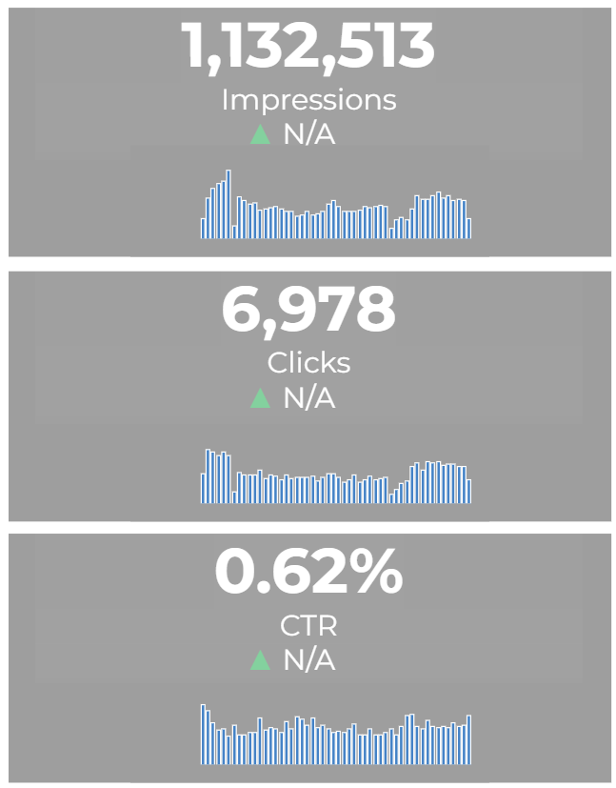
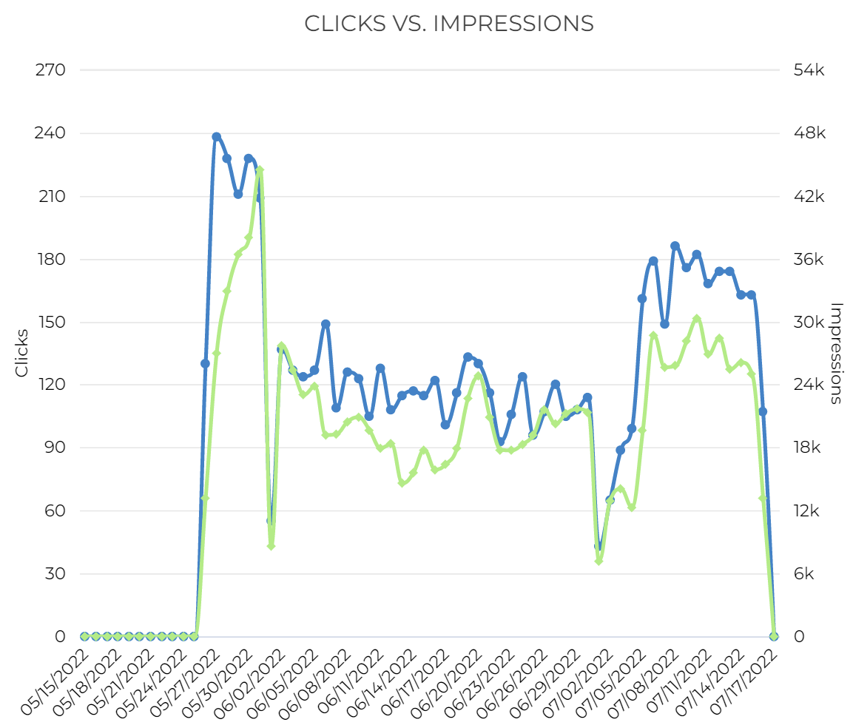
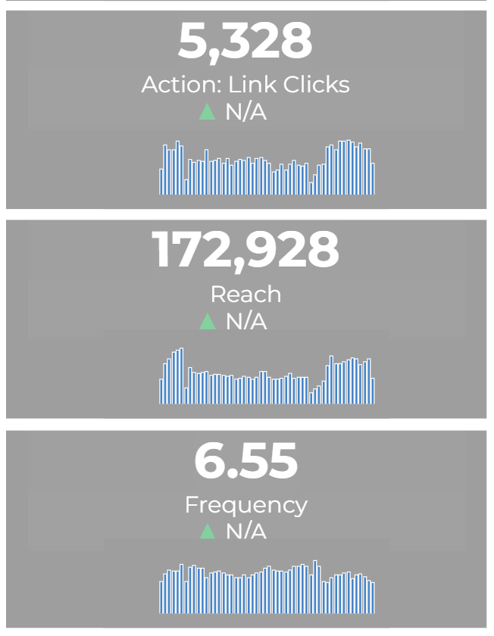
SOCIAL PERFORMANCE - OVERALL

Slide 22
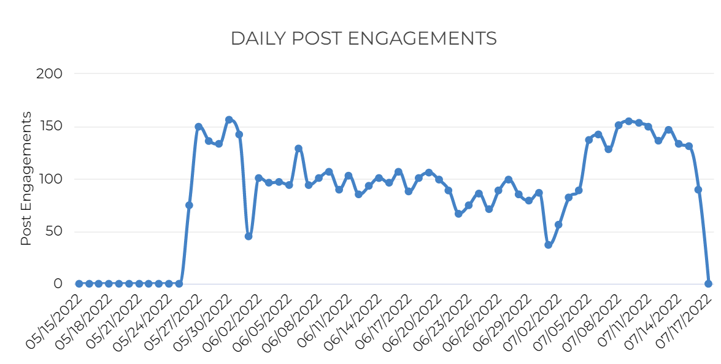
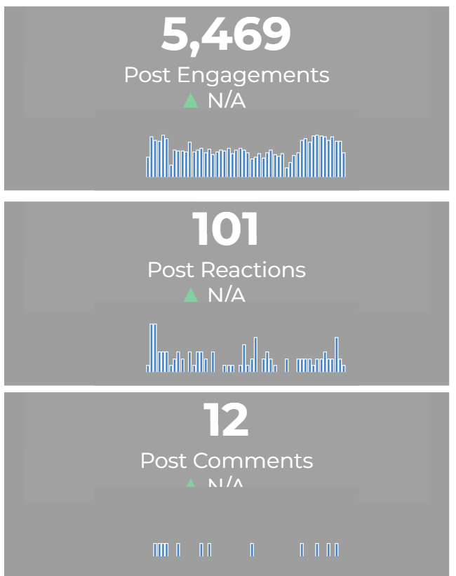
SOCIAL PERFORMANCE - OVERALL

Slide 23
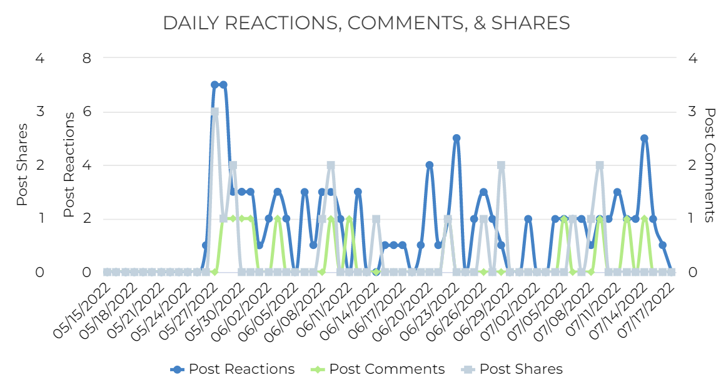
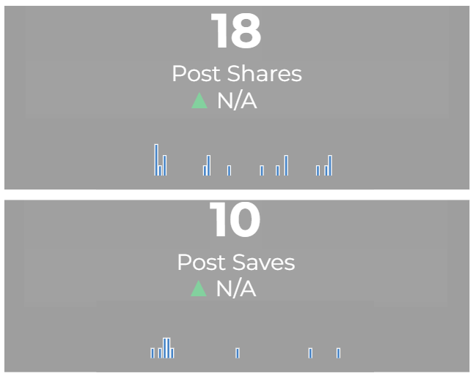
SOCIAL PERFORMANCE - OVERALL

Slide 24
SOCIAL PERFORMANCE: CREATIVE
Creative | Impressions | Clicks | CTR | Link Clicks | Reach | Frequency
ORAU | BMC Wave 5 MOUD - Brockton | 367,540 | 2,327 | 0.63% | 1,723 | 57,712 | 6.37
ORAU | BMC Wave 5 MOUD - Lowell | 376,588 | 2,255 | 0.60% | 1,786 | 51,056 | 7.38
ORAU | BMC Wave 5 MOUD - Salem | 388,385 | 2,396 | 0.62% | 1,819 | 65,873 | 5.90
AD TYPE: TRAFFIC (CLICK TO WEBSITE)
TOTAL IMPRESSIONS: 1,132,513
TOTAL CLICKS: 6,978
CTR: 0.62%
TOTAL REACH: 174,641

Slide 25
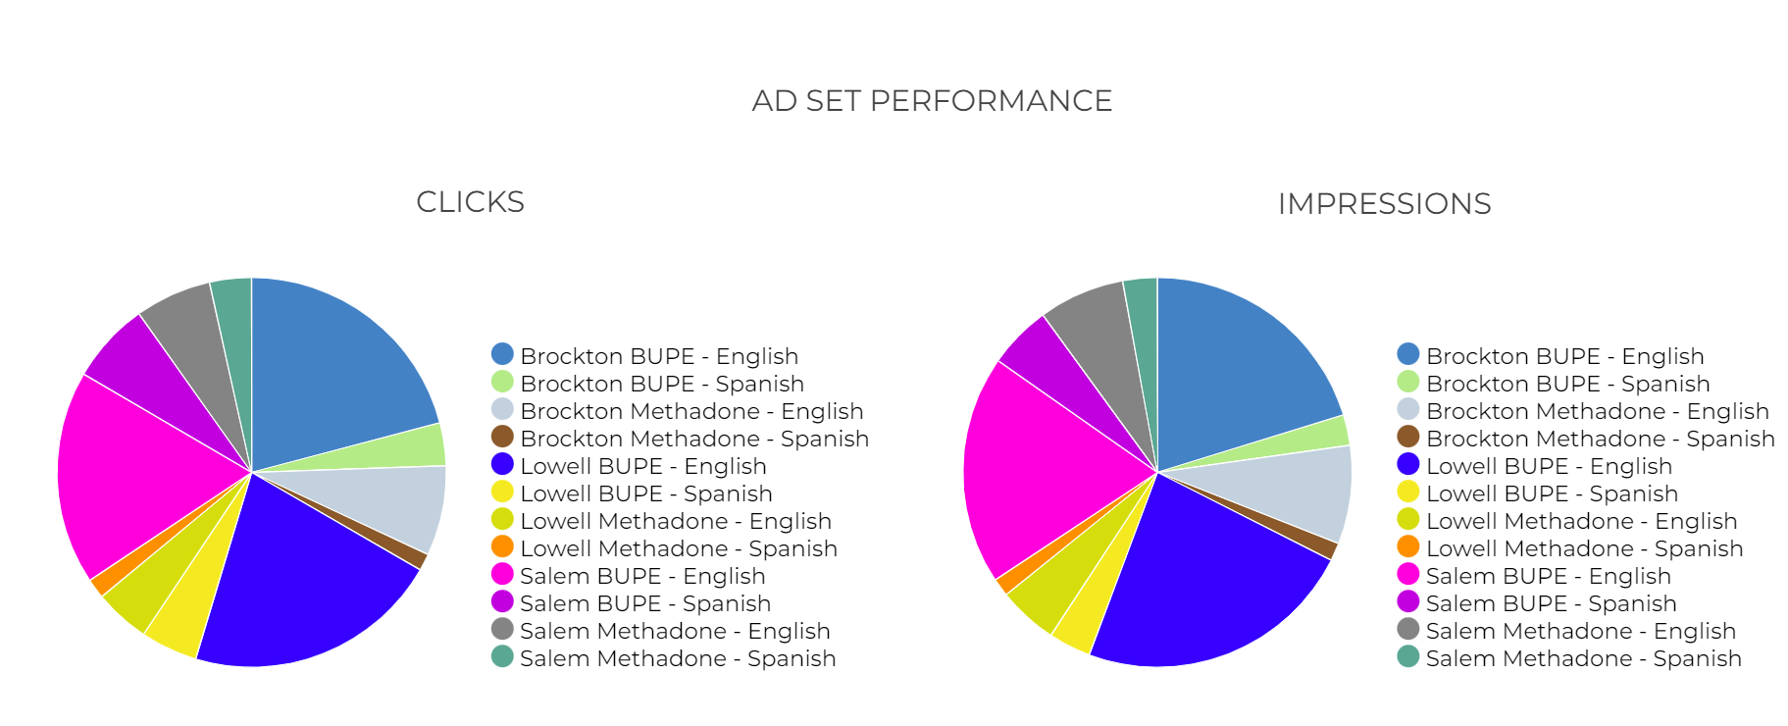
SOCIAL PERFORMANCE: CREATIVE

Slide 26
SOCIAL PERFORMANCE: CREATIVE
Ad Name | AdPreviewURL | Impressions | Clicks | CTR | Link Clicks | Engagement | Commemts | Shares | Reactions
BUPE English | https://www.facebook.com/102650498106646_541478880890470 | 222,091 | 1,194 | 0.54% | 933 | 960 | 1 | 7 | 18
BUPE English | https://www.facebook.com/102650498106646_541561997548825 | 136,202 | 815 | 0.60% | 571 | 595 | 2 | 3 | 19
Methadone English | https://www.facebook.com/102650498106646_541570330881325 | 105,030 | 681 | 0.65% | 527 | 540 | 1 | 2 | 9
Methadone English | https://www.facebook.com/102650498106646_541564900881868 | 93,014 | 644 | 0.69% | 446 | 463 | 6 | 0 | 11
BUPE English | https://www.facebook.com/102650498106646_541534317551593 | 110,520 | 559 | 0.51% | 397 | 417 | 0 | 3 | 12
Methadone English | https://www.facebook.com/102650498106646_541564900881868 | 92,837 | 521 | 0.56% | 422 | 430 | 1 | 0 | 7
Methadone English | https://www.facebook.com/102650498106646_541570330881325 | 80,857 | 443 | 0.55% | 406 | 409 | 1 | 1 | 1
Methadone English | https://www.facebook.com/102650498106646_541560707548954 | 56,244 | 322 | 0.57% | 297 | 302 | 0 | 0 | 4
Methadone English | https://www.facebook.com/102650498106646_541560707548954 | 41,444 | 293 | 0.71% | 256 | 260 | 0 | 0 | 4
Methadone Spanish | https://www.facebook.com/102650498106646_541574304214261 | 32,535 | 243 | 0.75% | 171 | 175 | 0 | 0 | 4
Methadone Spanish | https://www.facebook.com/102650498106646_541574304214261 | 29,888 | 259 | 0.87% | 176 | 180 | 0 | 0 | 3
BUPE Spanish | https://www.facebook.com/102650498106646_541559914215700 | 26,959 | 217 | 0.80% | 127 | 129 | 0 | 0 | 2
BUPE Spanish | https://www.facebook.com/102650498106646_541536567551368 | 29,555 | 211 | 0.71% | 142 | 144 | 0 | 0 | 1
BUPE Spanish | https://www.facebook.com/102650498106646_541510464220645 | 14,933 | 125 | 0.84% | 95 | 97 | 0 | 0 | 2
Methadone Spanish | https://www.facebook.com/102650498106646_541558784215813 | 17,131 | 115 | 0.67% | 99 | 99 | 0 | 0 | 0
Methadone Spanish | https://www.facebook.com/102650498106646_541567487548276 | 13,800 | 124 | 0.90% | 99 | 103 | 0 | 2 | 2
Methadone Spanish | https://www.facebook.com/102650498106646_541567487548276 | 16,754 | 98 | 0.58% | 90 | 90 | 0 | 0 | 0
Methadone Spanish | https://www.facebook.com/102650498106646_541558784215813 | 12,719 | 114 | 0.90% | 74 | 76 | 0 | 0 | 2

Slide 27
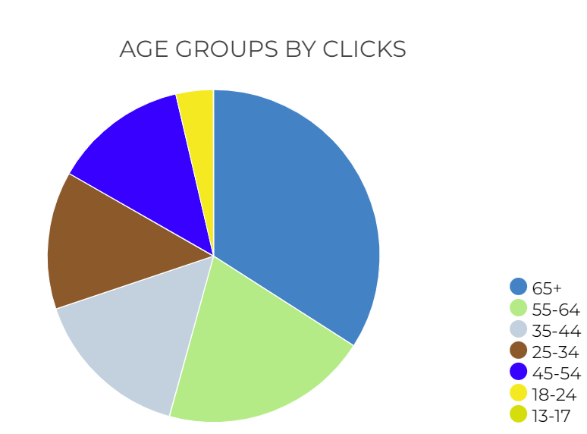
SOCIAL - AUDIENCE INSIGHTS
Notes:
This is your top converting, lower funnel social media tactic. We are re-targeting people who have shown an interest based on engagement with other tactics with the remarketing. We are attributing a lot of sales, and as with all your facebook tactics seeing a high level of social media engagement from people interested in your brand. People are providing testimonials, sharing the ad, and tagging their friends.

Slide 28
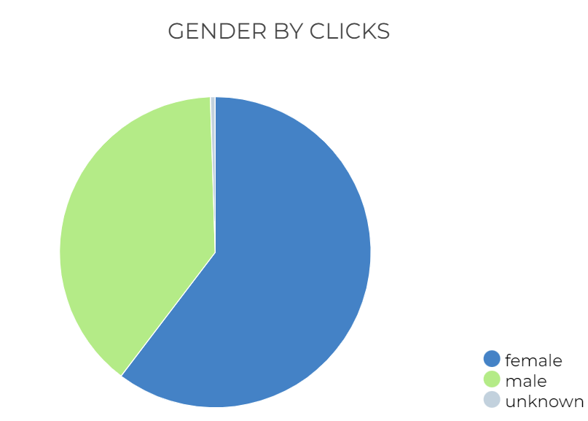
SOCIAL - AUDIENCE INSIGHTS
Notes:
This is your top converting, lower funnel social media tactic. We are re-targeting people who have shown an interest based on engagement with other tactics with the remarketing. We are attributing a lot of sales, and as with all your facebook tactics seeing a high level of social media engagement from people interested in your brand. People are providing testimonials, sharing the ad, and tagging their friends.

Slide 29
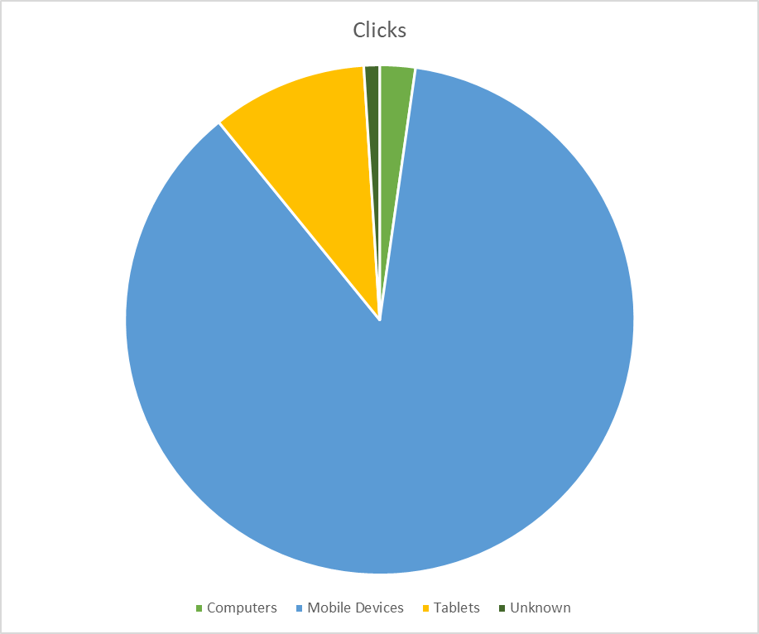
SOCIAL – CLICKS BY DEVICE
Notes:
UPDATE IMAGES and TEXT

