Slide 1

WRAP REPORT
ORAU – BMC
Campaign 3 – Massachusetts Digital

Slide 2
CAMPAIGN TARGETS
CAMPAIGN GOALS:
Combat stigma toward people with opioid use disorder (POUD)
Address misunderstandings about and generate public support for HCS evidence-based interventions (i.e. naloxone, medication assisted treatment)
Encourage people with opioid use disorder to utilize treatment and recovery support services available in their communities.
TARGET AUDIENCES:
A 18+ Hispanic/Spanish language
A 18+ English language
GEOGRAPHY: MASSACHUSETTS - Bourne, Sandwich, Brockton, Gloucester, Holyoke, Lowell, Plymouth, Salem, Shirley, Townsend
FLIGHT DATES: December 2020 – February 2021
CREATIVE:
Facebook Static Ads
Display Banners – 300x250, 728x90, 160x600, 300x600, 320x50
TACTICS:
Cross Device Display: Spanish & English
Audience Targeting (Spanish)
Search Retargeting (English)
Facebook Traffic Ads: Spanish & English

Slide 3
CAMPAIGN INFORMATION
NET SPEND BY COMMUNITY:
BOURNE: $1812.17
BROCKTON: $4,722.70
GLOUCESTER: $2,698.52
HOLYOKE: $3,580.74
LOWELL: $5,737.80
PLYMOUTH: $2,836.83
SALEM: $3,584.98
SANDWICH: $2,039.91
SHIRLEY: $1,451.94
TOWNSEND: $1,534.40
NET SPEND BY AUDIENCE:
PROVIDERS: $12,000
COMMUNITY LEADERS: $6,000
PWLE: $12,000
NET SPEND BY LANGUAGE:
ENGLISH: $24,312.50
SPANISH: $5,687.50
TOTAL BUDGET: $30,000 NET

Slide 4
CAMPAIGN INFORMATION
FLIGHT DATES BY COMMUNITY:
All communities = 12/3/2020 – 2/3/2021
FLIGHT DATES BY LANGUAGE:
English: 12/3/2021 – 1/28/2021
Spanish: 12/7/2020 – 2/3/2021
FLIGHT DATES BY AUDIENCE:
PROVIDERS:12/3/2020 -1/28/2021
COMMUNITY LEADERS: 12/3/2020 - 1/7/2021
PWLE: 12/3/2020 - 2/3/2021

Slide 5
POPULATION BY COMMUNITY (U.S. CENSUS BUREAU DATA):
BOURNE: 19,872
BROCKTON: 95,594
GLOUCESTER: 30,162
HOLYOKE: 40,241
LOWELL: 111,306
PLYMOUTH: 60,803
SALEM: 43,252
SANDWICH: 20,226
SHIRLEY: 7,649
TOWNSEND: 9,547

Slide 6
CAMPAIGN DELIVERY TOTALS
DISPLAY
SOCIAL
FACEBOOK TRAFFIC ADS - English
2,218,197 impressions
2,152,664 total reach
2415 clicks
0.11% CTR
117 Post Reactions (likes, loves, etc)
6 Comments
4 Shares
FACEBOOK TRAFFIC ADS - Spanish
246,804 impressions
242,582 total reach
341 clicks
0.14% CTR
6 Post Reactions (likes, loves, etc)
0 Comments
5 Shares
CROSS DEVICE DISPLAY – English
3,366,576 IMPRESSIONS
2884 CLICKS
0.09% CLICK THROUGH RATE
CROSS DEVICE DISPLAY – Spanish
492,182 IMPRESSIONS
481 CLICKS
0.10% CLICK THROUGH RATE

Slide 7
DISPLAY PERFORMANCE
AUDIENCE TARGETING & SEARCH RETARGETING

Slide 8

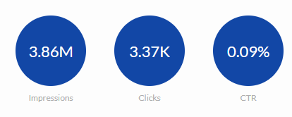
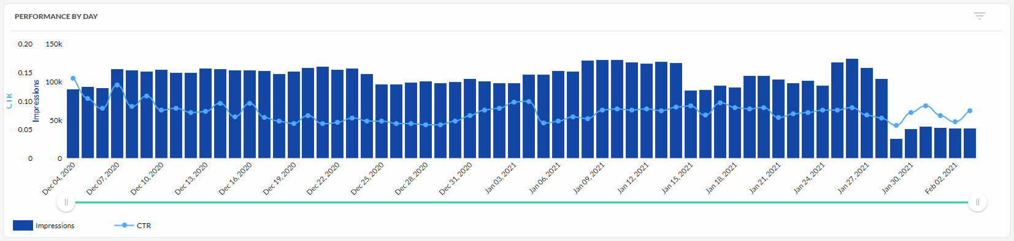
DISPLAY – OVERALL PERFORMANCE
CROSS DEVICE DISPLAY – Spanish
492,182 IMPRESSIONS
481 CLICKS
0.10% CTR
CROSS DEVICE DISPLAY – English
3,366,576 IMPRESSIONS
2884 CLICKS
0.09% CTR

Slide 9
DISPLAY – BY AUDIENCE
Audience | Language | Impressions | Clicks | CTR
Community Leader | English | 593,013 | 461 | 0.08%
 | Spanish | 259,106 | 169 | 0.07%
Community Leader Total |  | 852,119 | 630 | 0.07%
Provider | English | 1,762,526 | 1,431 | 0.08%
Provider Total |  | 1,762,526 | 1,431 | 0.08%
PWLE | English | 1,011,037 | 992 | 0.10%
 | Spanish | 233,076 | 312 | 0.13%
PWLE Total |  | 1,244,113 | 1,304 | 0.10%

Slide 10
DISPLAY – BY TOWN & AUDIENCE
ENGLISH LANGUAGE
Town | Audience | Impressions | Clicks | CTR
Bourne | Community Leader | 61,255 | 66 | 0.11%
 | Provider | 140,916 | 118 | 0.08%
 | PWLE | 100,967 | 96 | 0.10%
Bourne Total |  | 303,138 | 280 | 0.09%
Brockton | Community Leader | 59,215 | 50 | 0.08%
 | Provider | 247,637 | 258 | 0.10%
 | PWLE | 103,967 | 109 | 0.10%
Brockton Total |  | 410,819 | 417 | 0.10%
Gloucester | Community Leader | 63,342 | 50 | 0.08%
 | Provider | 179,523 | 143 | 0.08%
 | PWLE | 101,280 | 117 | 0.12%
Gloucester Total |  | 344,145 | 310 | 0.09%
Holyoke | Community Leader | 60,449 | 51 | 0.08%
 | Provider | 198,868 | 196 | 0.10%
 | PWLE | 101,536 | 128 | 0.13%
Holyoke Total |  | 360,853 | 375 | 0.10%
Lowell | Community Leader | 60,009 | 52 | 0.09%
 | Provider | 240,619 | 169 | 0.07%
 | PWLE | 100,980 | 109 | 0.11%
Lowell Total |  | 401,608 | 330 | 0.08%
Plymouth | Community Leader | 58,292 | 43 | 0.07%
 | Provider | 185,938 | 174 | 0.09%
 | PWLE | 104,896 | 95 | 0.09%
Plymouth Total |  | 349,126 | 312 | 0.09%
Salem | Community Leader | 61,760 | 38 | 0.06%
 | Provider | 188,817 | 156 | 0.08%
 | PWLE | 101,688 | 97 | 0.10%
Salem Total |  | 352,265 | 291 | 0.08%
Sandwich | Community Leader | 60,445 | 49 | 0.08%
 | Provider | 176,953 | 133 | 0.08%
 | PWLE | 101,707 | 97 | 0.10%
Sandwich Total |  | 339,105 | 279 | 0.08%
Shirley | Community Leader | 53,071 | 30 | 0.06%
 | Provider | 102,623 | 43 | 0.04%
 | PWLE | 94,776 | 59 | 0.06%
Shirley Total |  | 250,470 | 132 | 0.05%
Townsend | Community Leader | 55,175 | 32 | 0.06%
 | Provider | 100,632 | 41 | 0.04%
 | PWLE | 99,240 | 85 | 0.09%
Townsend Total |  | 255,047 | 158 | 0.06%

Slide 11
DISPLAY – BY TOWN & AUDIENCE
SPANISH LANGUAGE
Town | Audience | Impressions | Clicks | CTR
Bourne | Community Leader | 26,721 | 14 | 0.05%
 | PWLE | 23,592 | 31 | 0.13%
Bourne Total |  | 50,313 | 45 | 0.09%
Brockton | Community Leader | 41,319 | 30 | 0.07%
 | PWLE | 24,275 | 32 | 0.13%
Brockton Total |  | 65,594 | 62 | 0.09%
Gloucester | Community Leader | 31,085 | 20 | 0.06%
 | PWLE | 24,024 | 35 | 0.15%
Gloucester Total |  | 55,109 | 55 | 0.10%
Holyoke | Community Leader | 25,345 | 22 | 0.09%
 | PWLE | 23,849 | 29 | 0.12%
Holyoke Total |  | 49,194 | 51 | 0.10%
Lowell | Community Leader | 39,291 | 22 | 0.06%
 | PWLE | 23,840 | 33 | 0.14%
Lowell Total |  | 63,131 | 55 | 0.09%
Plymouth | Community Leader | 18,117 | 20 | 0.11%
 | PWLE | 22,375 | 36 | 0.16%
Plymouth Total |  | 40,492 | 56 | 0.14%
Salem | Community Leader | 37,465 | 24 | 0.06%
 | PWLE | 24,337 | 37 | 0.15%
Salem Total |  | 61,802 | 61 | 0.10%
Sandwich | Community Leader | 20,854 | 9 | 0.04%
 | PWLE | 23,525 | 26 | 0.11%
Sandwich Total |  | 44,379 | 35 | 0.08%
Shirley | Community Leader | 5,858 | 0 | 0.00%
 | PWLE | 22,796 | 34 | 0.15%
Shirley Total |  | 28,654 | 34 | 0.12%
Townsend | Community Leader | 13,051 | 8 | 0.06%
 | PWLE | 20,463 | 19 | 0.09%
Townsend Total |  | 33,514 | 27 | 0.08%

Slide 12
DISPLAY – ENGLISH CREATIVE
Creative Name | Impressions | Clicks | CTR
BOURNE_KOL_160 x 600_11.30.jpg | 5,745 | 3 | 0.05%
BOURNE_KOL_300 x 600_11.30.jpg | 3,414 | 3 | 0.09%
BOURNE_KOL_320 x 250_11.30.jpg | 65 | 1 | 1.54%
BOURNE_KOL_320 x 50_11.30.jpg | 31,902 | 33 | 0.10%
BOURNE_KOL_728 x 90_11.30.jpg | 20,129 | 26 | 0.13%
BOURNE_Provider_160 x 600_11.30.jpg | 15,430 | 8 | 0.05%
BOURNE_Provider_300 x 600_11.30.jpg | 10,193 | 6 | 0.06%
BOURNE_Provider_320 x 250_11.30.jpg | 608 | 0 | 0.00%
BOURNE_Provider_320 x 50_11.30.jpg | 68,591 | 62 | 0.09%
BOURNE_Provider_728 x 90_11.30.jpg | 46,094 | 42 | 0.09%
BOURNE_PWLE 160 x 600_11.30.jpg | 6,935 | 4 | 0.06%
BOURNE_PWLE 300 x 600_11.30.jpg | 5,770 | 3 | 0.05%
BOURNE_PWLE 320 x 250_11.30.jpg | 130 | 1 | 0.77%
BOURNE_PWLE 320 x 50_11.30.jpg | 66,388 | 66 | 0.10%
BOURNE_PWLE 728 x 90_11.30.jpg | 21,744 | 22 | 0.10%
BROCKTON_KOL_160 x 600_11.30.jpg | 3,659 | 1 | 0.03%
BROCKTON_KOL_300 x 600_11.30.jpg | 2,080 | 4 | 0.19%
BROCKTON_KOL_320 x 250_11.30.jpg | 63 | 0 | 0.00%
BROCKTON_KOL_320 x 50_11.30.jpg | 39,196 | 34 | 0.09%
BROCKTON_KOL_728 x 90_11.30.jpg | 14,217 | 11 | 0.08%
BROCKTON_Provider_160 x 600_11.30.jpg | 19,081 | 12 | 0.06%
BROCKTON_Provider_300 x 600_11.30.jpg | 11,884 | 8 | 0.07%
BROCKTON_Provider_320 x 250_11.30.jpg | 610 | 3 | 0.49%
BROCKTON_Provider_320 x 50_11.30.jpg | 141,874 | 149 | 0.11%
BROCKTON_Provider_728 x 90_11.30.jpg | 74,188 | 86 | 0.12%
BROCKTON_PWLE 160 x 600_11.30.jpg | 4,958 | 5 | 0.10%
BROCKTON_PWLE 300 x 600_11.30.jpg | 3,642 | 9 | 0.25%
BROCKTON_PWLE 320 x 250_11.30.jpg | 60 | 0 | 0.00%
BROCKTON_PWLE 320 x 50_11.30.jpg | 78,331 | 76 | 0.10%
BROCKTON_PWLE 728 x 90_11.30.jpg | 16,976 | 19 | 0.11%
GLOUCESTER_KOL_160 x 600_11.30.jpg | 5,811 | 2 | 0.03%
GLOUCESTER_KOL_300 x 600_11.30.jpg | 3,737 | 2 | 0.05%
GLOUCESTER_KOL_320 x 250_11.30.jpg | 69 | 0 | 0.00%
GLOUCESTER_KOL_320 x 50_11.30.jpg | 33,481 | 28 | 0.08%
GLOUCESTER_KOL_728 x 90_11.30.jpg | 20,244 | 18 | 0.09%
GLOUCESTER_Provider_160 x 600_11.30.jpg | 17,821 | 4 | 0.02%
GLOUCESTER_Provider_300 x 600_11.30.jpg | 12,394 | 9 | 0.07%
GLOUCESTER_Provider_320 x 50_11.30.jpg | 91,528 | 63 | 0.07%
GLOUCESTER_Provider_320 x250_11.30.jpg | 494 | 1 | 0.20%
GLOUCESTER_Provider_728 x 90_11.30.jpg | 57,286 | 66 | 0.12%
GLOUCESTER_PWLE 160 x 600_11.30.jpg | 7,133 | 5 | 0.07%
GLOUCESTER_PWLE 300 x 600_11.30.jpg | 5,869 | 5 | 0.09%
GLOUCESTER_PWLE 320 x 250_11.30.jpg | 84 | 0 | 0.00%
GLOUCESTER_PWLE 320 x 50_11.30.jpg | 65,896 | 87 | 0.13%
GLOUCESTER_PWLE 728 x 90_11.30.jpg | 22,298 | 20 | 0.09%

Slide 13
DISPLAY – ENGLISH CREATIVE
Creative Name | Impressions | Clicks | CTR
HOLYOKE_KOL 320 x 250_11.30.jpg | 26 | 0 | 0.00%
HOLYOKE_KOL_160 x 600_11.30.jpg | 4,226 | 2 | 0.05%
HOLYOKE_KOL_300 x 600_11.30.jpg | 2,724 | 3 | 0.11%
HOLYOKE_KOL_320 x 50_11.30.jpg | 34,597 | 29 | 0.08%
HOLYOKE_KOL_728 x 90_11.30.jpg | 18,876 | 17 | 0.09%
HOLYOKE_Provider_160 x 600_11.30.jpg | 15,590 | 6 | 0.04%
HOLYOKE_Provider_300 x 600_11.30.jpg | 11,268 | 5 | 0.04%
HOLYOKE_Provider_320 x 250_11.30.jpg | 417 | 0 | 0.00%
HOLYOKE_Provider_320 x 50_11.30.jpg | 107,635 | 116 | 0.11%
HOLYOKE_Provider_728 x 90_11.30.jpg | 63,958 | 69 | 0.11%
HOLYOKE_PWLE 160 x 600_11.30.jpg | 5,427 | 5 | 0.09%
HOLYOKE_PWLE 300 x 600_11.30.jpg | 4,532 | 4 | 0.09%
HOLYOKE_PWLE 320 x 250_11.30.jpg | 51 | 0 | 0.00%
HOLYOKE_PWLE 320 x 50_11.30.jpg | 71,016 | 90 | 0.13%
HOLYOKE_PWLE 728 x 90_11.30.jpg | 20,510 | 29 | 0.14%
LOWELL_KOL_160 x 600-100_11.30.jpg | 4,155 | 1 | 0.02%
LOWELL_KOL_300 x 600-100_11.30.jpg | 2,901 | 3 | 0.10%
LOWELL_KOL_320 x 250-100_11.30.jpg | 54 | 0 | 0.00%
LOWELL_KOL_320 x 50-100_11.30.jpg | 36,539 | 28 | 0.08%
LOWELL_KOL_728 x 90-100_11.30.jpg | 16,360 | 20 | 0.12%
LOWELL_Provider_160 x 600-100_11.30.jpg | 18,241 | 8 | 0.04%
LOWELL_Provider_300 x 600-100_11.30.jpg | 14,413 | 7 | 0.05%
LOWELL_Provider_320 x 250 -100_11.30.jpg | 438 | 0 | 0.00%
LOWELL_Provider_320 x 50-100_11.30.jpg | 135,142 | 104 | 0.08%
LOWELL_Provider_728 x 90-100_11.30.jpg | 72,385 | 50 | 0.07%
LOWELL_PWLE 160 x 600-100_11.30.jpg | 5,409 | 4 | 0.07%
LOWELL_PWLE 300 x 600-100_11.30.jpg | 4,832 | 3 | 0.06%
LOWELL_PWLE 320 x 250-100_11.30.jpg | 76 | 1 | 1.32%
LOWELL_PWLE 320 x 50-100_11.30.jpg | 71,675 | 79 | 0.11%
LOWELL_PWLE 728 x 90-100_11.30.jpg | 18,988 | 22 | 0.12%
PLYMOUTH_KOL_160 x 600_11.30.jpg | 4,925 | 1 | 0.02%
PLYMOUTH_KOL_300 x 600_11.30.jpg | 2,600 | 3 | 0.12%
PLYMOUTH_KOL_320 x 250_11.30.jpg | 62 | 0 | 0.00%
PLYMOUTH_KOL_320 x 50_11.30.jpg | 30,376 | 22 | 0.07%
PLYMOUTH_KOL_728 x 90_11.30.jpg | 20,329 | 17 | 0.08%
PLYMOUTH_Provider_160 x 600_11.30.jpg | 15,633 | 3 | 0.02%
PLYMOUTH_Provider_300 x 600_11.30.jpg | 10,038 | 9 | 0.09%
PLYMOUTH_Provider_320 x 250_11.30.jpg | 887 | 0 | 0.00%
PLYMOUTH_Provider_320 x 50_11.30.jpg | 97,757 | 88 | 0.09%
PLYMOUTH_Provider_728 x 90_11.30.jpg | 61,623 | 74 | 0.12%
PLYMOUTH_PWLE 160 x 600_11.30.jpg | 6,144 | 4 | 0.07%
PLYMOUTH_PWLE 300 x 600_11.30.jpg | 5,119 | 3 | 0.06%
PLYMOUTH_PWLE 320 x 250_11.30.jpg | 64 | 0 | 0.00%
PLYMOUTH_PWLE 320 x 50_11.30.jpg | 70,732 | 69 | 0.10%
PLYMOUTH_PWLE 728 x 90_11.30.jpg | 22,837 | 19 | 0.08%

Slide 14
DISPLAY – ENGLISH CREATIVE
Creative Name | Impressions | Clicks | CTR
SALEM_KOL_160 x 600_11.30.jpg | 5,571 | 1 | 0.02%
SALEM_KOL_300 x 600_11.30.jpg | 3,552 | 3 | 0.08%
SALEM_KOL_320 x 250_11.30.jpg | 35 | 0 | 0.00%
SALEM_KOL_320 x 50_11.30.jpg | 33,452 | 20 | 0.06%
SALEM_KOL_728 x 90_11.30.jpg | 19,150 | 14 | 0.07%
SALEM_Provider_160 x 600_11.30.jpg | 17,852 | 4 | 0.02%
SALEM_Provider_300 x 600_11.30.jpg | 13,280 | 2 | 0.02%
SALEM_Provider_320 x 50_11.30.jpg | 96,319 | 74 | 0.08%
SALEM_Provider_320x250_11.30.jpg | 613 | 0 | 0.00%
SALEM_Provider_728 x 90_11.30.jpg | 60,753 | 76 | 0.13%
SALEM_PWLE 160 x 600_11.30.jpg | 7,027 | 3 | 0.04%
SALEM_PWLE 300 x 600_11.30.jpg | 5,924 | 4 | 0.07%
SALEM_PWLE 320 x 250_11.30.jpg | 83 | 1 | 1.20%
SALEM_PWLE 320 x 50_11.30.jpg | 66,912 | 73 | 0.11%
SALEM_PWLE 728 x 90_11.30.jpg | 21,742 | 16 | 0.07%
SANDWICH_KOL_160 x 600_11.30.jpg | 5,834 | 0 | 0.00%
SANDWICH_KOL_300 x 600_11.30.jpg | 3,277 | 0 | 0.00%
SANDWICH_KOL_320 x 250_11.30.jpg | 72 | 0 | 0.00%
SANDWICH_KOL_320 x 50_11.30.jpg | 30,365 | 27 | 0.09%
SANDWICH_KOL_728 x 90_11.30.jpg | 20,897 | 22 | 0.11%
SANDWICH_Provider_160 x 600_11.30.jpg | 19,665 | 13 | 0.07%
SANDWICH_Provider_300 x 600_11.30.jpg | 11,807 | 3 | 0.03%
SANDWICH_Provider_320 x 250_11.30.jpg | 420 | 0 | 0.00%
SANDWICH_Provider_320 x 50_11.30.jpg | 74,201 | 70 | 0.09%
SANDWICH_Provider_728 x 90_11.30.jpg | 70,860 | 47 | 0.07%
SANDWICH_PWLE 160 x 600_11.30.jpg | 6,802 | 3 | 0.04%
SANDWICH_PWLE 300 x 600_11.30.jpg | 6,001 | 7 | 0.12%
SANDWICH_PWLE 320 x 250_11.30.jpg | 106 | 1 | 0.94%
SANDWICH_PWLE 320 x 50_11.30.jpg | 64,971 | 66 | 0.10%
SANDWICH_PWLE 728 x 90_11.30.jpg | 23,827 | 20 | 0.08%
SHIRLEY_KOL_160 x 600_11.30.jpg | 7,343 | 3 | 0.04%
SHIRLEY_KOL_300 x 600_11.30.jpg | 2,266 | 0 | 0.00%
SHIRLEY_KOL_320 x 250_11.30.jpg | 48 | 0 | 0.00%
SHIRLEY_KOL_320 x 50_11.30.jpg | 27,244 | 14 | 0.05%
SHIRLEY_KOL_728 x 90_11.30.jpg | 16,170 | 13 | 0.08%
SHIRLEY_Provider_160 x 600_11.30.jpg | 13,799 | 3 | 0.02%
SHIRLEY_Provider_300 x 600_11.30.jpg | 6,118 | 2 | 0.03%
SHIRLEY_Provider_320 x 250_11.30.jpg | 488 | 0 | 0.00%
SHIRLEY_Provider_320 x 50_11.30.jpg | 49,776 | 28 | 0.06%
SHIRLEY_Provider_728 x 90_11.30.jpg | 32,442 | 10 | 0.03%
SHIRLEY_PWLE 160 x 600_11.30.jpg | 7,859 | 5 | 0.06%
SHIRLEY_PWLE 320 x 250_11.30.jpg | 166 | 0 | 0.00%
SHIRLEY_PWLE 320 x 50_11.30.jpg | 60,260 | 34 | 0.06%
SHIRLEY_PWLE_ 728x90_11.30.jpg | 21,209 | 17 | 0.08%
SHIRLEY_PWLE_300_x_600__1__11.30.jpg | 5,282 | 3 | 0.06%

Slide 15
DISPLAY – ENGLISH CREATIVE
Creative Name | Impressions | Clicks | CTR
TOWNSEND_KOL_160 x 600_11.30.jpg | 4,521 | 3 | 0.07%
TOWNSEND_KOL_300 x 600_11.30.jpg | 3,057 | 2 | 0.07%
TOWNSEND_KOL_320 x 250_11.30.jpg | 6 | 0 | 0.00%
TOWNSEND_KOL_320 x 50_11.30.jpg | 29,171 | 19 | 0.07%
TOWNSEND_KOL_728 x 90_11.30.jpg | 18,420 | 8 | 0.04%
TOWNSEND_Provider_160 x 600_11.30.jpg | 10,925 | 4 | 0.04%
TOWNSEND_Provider_300 x 600_11.30.jpg | 5,151 | 5 | 0.10%
TOWNSEND_Provider_320 x 250_11.30.jpg | 223 | 0 | 0.00%
TOWNSEND_Provider_320 x 50_11.30.jpg | 51,565 | 18 | 0.03%
TOWNSEND_Provider_728 x 90_11.30.jpg | 32,768 | 14 | 0.04%
TOWNSEND_PWLE 160 x 600_11.30.jpg | 6,257 | 12 | 0.19%
TOWNSEND_PWLE 320 x 250_11.30.jpg | 234 | 1 | 0.43%
TOWNSEND_PWLE 320 x 50_11.30.jpg | 67,459 | 50 | 0.07%
TOWNSEND_PWLE_ 728x90_11.30.jpg | 20,441 | 16 | 0.08%
TOWNSEND_PWLE_300_x_600__1__11.30.jpg | 4,849 | 6 | 0.12%

Slide 16
DISPLAY – SPANISH CREATIVE
Creative Name | Impressions | Clicks | CTR
Bourne Spanish_KOL_160 x 600 SPANISH_12.2.jpg | 7298 | 0 | 0.00%
Bourne Spanish_KOL_300 x 600 SPANISH_12.2.jpg | 1503 | 3 | 0.20%
Bourne Spanish_KOL_320 x 250 SPANISH_12.2.jpg | 36 | 0 | 0.00%
Bourne Spanish_KOL_320 x 50 SPANISH_12.2.jpg | 7901 | 4 | 0.05%
Bourne Spanish_KOL_728 x 90 SPANISH_12.2.jpg | 9983 | 7 | 0.07%
Bourne Spanish_PWLE 160 x 600 SPANISH_12.2.jpg | 2240 | 4 | 0.18%
Bourne Spanish_PWLE 320 x 250 SPANISH_12.2.jpg | 27 | 0 | 0.00%
Bourne Spanish_PWLE 320 x 50 SPANISH_12.2.jpg | 10632 | 10 | 0.09%
Bourne Spanish_PWLE 728 x 90 SPANISH_12.2.jpg | 9298 | 16 | 0.17%
Bourne Spanish_PWLE_300_x_600__SPANISH_12.2.jpg | 1395 | 1 | 0.07%
Brockton Spanish_KOL_160 x 600 SPANISH_12.2.jpg | 3989 | 2 | 0.05%
Brockton Spanish_KOL_300 x 600 SPANISH_12.2.jpg | 1590 | 2 | 0.13%
Brockton Spanish_KOL_320 x 250 SPANISH_12.2.jpg | 313 | 0 | 0.00%
Brockton Spanish_KOL_320 x 50 SPANISH_12.2.jpg | 25335 | 20 | 0.08%
Brockton Spanish_KOL_728 x 90 SPANISH_12.2.jpg | 10092 | 6 | 0.06%
Brockton Spanish_PWLE 160 x 600 SPANISH_12.2.jpg | 1466 | 5 | 0.34%
Brockton Spanish_PWLE 320 x 250 SPANISH_12.2.jpg | 18 | 0 | 0.00%
Brockton Spanish_PWLE 320 x 50 SPANISH_12.2.jpg | 16702 | 17 | 0.10%
Brockton Spanish_PWLE 728 x 90 SPANISH_12.2.jpg | 5414 | 6 | 0.11%
Brockton Spanish_PWLE_300_x_600__SPANISH_12.2.jpg | 675 | 4 | 0.59%
Gloucester Spanish_KOL_160 x 600 SPANISH_12.2.jpg | 3972 | 2 | 0.05%
Gloucester Spanish_KOL_300 x 600 SPANISH_12.2.jpg | 2880 | 2 | 0.07%
Gloucester Spanish_KOL_320 x 250 SPANISH_12.2.jpg | 167 | 0 | 0.00%
Gloucester Spanish_KOL_320 x 50 SPANISH_12.2.jpg | 12778 | 10 | 0.08%
Gloucester Spanish_KOL_728 x 90 SPANISH_12.2.jpg | 11288 | 6 | 0.05%
Gloucester Spanish_PWLE 160 x 600 SPANISH_12.2.jpg | 2448 | 4 | 0.16%
Gloucester Spanish_PWLE 320 x 250 SPANISH_12.2.jpg | 18 | 0 | 0.00%
Gloucester Spanish_PWLE 320 x 50 SPANISH_12.2.jpg | 12695 | 17 | 0.13%
Gloucester Spanish_PWLE 728 x 90 SPANISH_12.2.jpg | 7241 | 10 | 0.14%
Gloucester Spanish_PWLE_300_x_600__SPANISH_12.2.jpg | 1622 | 4 | 0.25%
Holyoke Spanish_KOL_160 x 600 SPANISH_12.2.jpg | 2027 | 0 | 0.00%
Holyoke Spanish_KOL_300 x 600 SPANISH_12.2.jpg | 1222 | 2 | 0.16%
Holyoke Spanish_KOL_320 x 250 SPANISH_12.2.jpg | 33 | 0 | 0.00%
Holyoke Spanish_KOL_320 x 50 SPANISH_12.2.jpg | 14060 | 17 | 0.12%
Holyoke Spanish_KOL_728 x 90 SPANISH_12.2.jpg | 8003 | 3 | 0.04%
Holyoke Spanish_PWLE 160 x 600 SPANISH_12.2.jpg | 1218 | 1 | 0.08%
Holyoke Spanish_PWLE 320 x 250 SPANISH_12.2.jpg | 12 | 0 | 0.00%
Holyoke Spanish_PWLE 320 x 50 SPANISH_12.2.jpg | 15607 | 18 | 0.12%
Holyoke Spanish_PWLE 728 x 90 SPANISH_12.2.jpg | 6007 | 6 | 0.10%
Holyoke Spanish_PWLE_300_x_600__SPANISH_12.2.jpg | 1005 | 4 | 0.40%

Slide 17
DISPLAY – SPANISH CREATIVE
Creative Name | Impressions | Clicks | CTR
Lowell Spanish_KOL_160 x 600 SPANISH_12.2.jpg | 3725 | 2 | 0.05%
Lowell Spanish_KOL_300 x 600 SPANISH_12.2.jpg | 2755 | 2 | 0.07%
Lowell Spanish_KOL_320 x 250 SPANISH_12.2.jpg | 16 | 0 | 0.00%
Lowell Spanish_KOL_320 x 50 SPANISH_12.2.jpg | 21762 | 11 | 0.05%
Lowell Spanish_KOL_728 x 90 SPANISH_12.2.jpg | 11033 | 7 | 0.06%
Lowell Spanish_PWLE 160 x 600 SPANISH_12.2.jpg | 1525 | 2 | 0.13%
Lowell Spanish_PWLE 320 x 250 SPANISH_12.2.jpg | 16 | 0 | 0.00%
Lowell Spanish_PWLE 320 x 50 SPANISH_12.2.jpg | 15523 | 18 | 0.12%
Lowell Spanish_PWLE 728 x 90 SPANISH_12.2.jpg | 5761 | 12 | 0.21%
Lowell Spanish_PWLE_300_x_600__SPANISH_12.2.jpg | 1015 | 1 | 0.10%
Plymouth Spanish_KOL_160 x 600 SPANISH_12.2.jpg | 1610 | 1 | 0.06%
Plymouth Spanish_KOL_300 x 600 SPANISH_12.2.jpg | 967 | 1 | 0.10%
Plymouth Spanish_KOL_320 x 250 SPANISH_12.2.jpg | 29 | 0 | 0.00%
Plymouth Spanish_KOL_320 x 50 SPANISH_12.2.jpg | 9662 | 11 | 0.11%
Plymouth Spanish_KOL_728 x 90 SPANISH_12.2.jpg | 5849 | 7 | 0.12%
Plymouth Spanish_PWLE 160 x 600 SPANISH_12.2.jpg | 1763 | 3 | 0.17%
Plymouth Spanish_PWLE 320 x 250 SPANISH_12.2.jpg | 4 | 0 | 0.00%
Plymouth Spanish_PWLE 320 x 50 SPANISH_12.2.jpg | 12225 | 16 | 0.13%
Plymouth Spanish_PWLE 728 x 90 SPANISH_12.2.jpg | 7357 | 16 | 0.22%
Plymouth Spanish_PWLE_300_x_600__SPANISH_12.2.jpg | 1026 | 1 | 0.10%
Salem Spanish_KOL_160 x 600 SPANISH_12.2.jpg | 7432 | 3 | 0.04%
Salem Spanish_KOL_300 x 600 SPANISH_12.2.jpg | 2605 | 1 | 0.04%
Salem Spanish_KOL_320 x 250 SPANISH_12.2.jpg | 27 | 0 | 0.00%
Salem Spanish_KOL_320 x 50 SPANISH_12.2.jpg | 14798 | 17 | 0.11%
Salem Spanish_KOL_728 x 90 SPANISH_12.2.jpg | 12603 | 3 | 0.02%
Salem Spanish_PWLE 160 x 600 SPANISH_12.2.jpg | 2598 | 3 | 0.12%
Salem Spanish_PWLE 320 x 250 SPANISH_12.2.jpg | 13 | 0 | 0.00%
Salem Spanish_PWLE 320 x 50 SPANISH_12.2.jpg | 12269 | 21 | 0.17%
Salem Spanish_PWLE 728 x 90 SPANISH_12.2.jpg | 7737 | 10 | 0.13%
Salem Spanish_PWLE_300_x_600__SPANISH_12.2.jpg | 1720 | 3 | 0.17%
Sandwich Spanish_KOL_160 x 600 SPANISH_12.2.jpg | 6078 | 1 | 0.02%
Sandwich Spanish_KOL_300 x 600 SPANISH_12.2.jpg | 1053 | 3 | 0.28%
Sandwich Spanish_KOL_320 x 250 SPANISH_12.2.jpg | 44 | 0 | 0.00%
Sandwich Spanish_KOL_320 x 50 SPANISH_12.2.jpg | 5631 | 4 | 0.07%
Sandwich Spanish_KOL_728 x 90 SPANISH_12.2.jpg | 8048 | 1 | 0.01%
Sandwich Spanish_PWLE 160 x 600 SPANISH_12.2.jpg | 1616 | 4 | 0.25%
Sandwich Spanish_PWLE 320 x 250 SPANISH_12.2.jpg | 5 | 0 | 0.00%
Sandwich Spanish_PWLE 320 x 50 SPANISH_12.2.jpg | 11114 | 14 | 0.13%
Sandwich Spanish_PWLE 728 x 90 SPANISH_12.2.jpg | 9611 | 5 | 0.05%
Sandwich Spanish_PWLE_300_x_600__SPANISH_12.2.jpg | 1179 | 3 | 0.25%

Slide 18
DISPLAY – SPANISH CREATIVE
Creative Name | Impressions | Clicks | CTR
Shirley Spanish_KOL_160 x 600 SPANISH_12.2.jpg | 1354 | 0 | 0.00%
Shirley Spanish_KOL_300 x 600 SPANISH_12.2.jpg | 327 | 0 | 0.00%
Shirley Spanish_KOL_320 x 250 SPANISH_12.2.jpg | 17 | 0 | 0.00%
Shirley Spanish_KOL_320 x 50 SPANISH_12.2.jpg | 2536 | 0 | 0.00%
Shirley Spanish_KOL_728 x 90 SPANISH_12.2.jpg | 1624 | 0 | 0.00%
Shirley Spanish_PWLE 160 x 600 SPANISH_12.2.jpg | 1689 | 3 | 0.18%
Shirley Spanish_PWLE 320 x 250 SPANISH_12.2.jpg | 43 | 0 | 0.00%
Shirley Spanish_PWLE 320 x 50 SPANISH_12.2.jpg | 12439 | 22 | 0.18%
Shirley Spanish_PWLE 728 x 90 SPANISH_12.2.jpg | 7390 | 7 | 0.09%
Shirley Spanish_PWLE_300_x_600__SPANISH_12.2.jpg | 1235 | 2 | 0.16%
Townsend Spanish_KOL_160 x 600 SPANISH_12.2.jpg | 1845 | 2 | 0.11%
Townsend Spanish_KOL_300 x 600 SPANISH_12.2.jpg | 1916 | 1 | 0.05%
Townsend Spanish_KOL_320 x 250 SPANISH_12.2.jpg | 4 | 0 | 0.00%
Townsend Spanish_KOL_320 x 50 SPANISH_12.2.jpg | 4342 | 3 | 0.07%
Townsend Spanish_KOL_728 x 90 SPANISH_12.2.jpg | 4944 | 2 | 0.04%
Townsend Spanish_PWLE 160 x 600 SPANISH_12.2.jpg | 2216 | 2 | 0.09%
Townsend Spanish_PWLE 320 x 250 SPANISH_12.2.jpg | 34 | 0 | 0.00%
Townsend Spanish_PWLE 320 x 50 SPANISH_12.2.jpg | 7788 | 8 | 0.10%
Townsend Spanish_PWLE 728 x 90 SPANISH_12.2.jpg | 8079 | 6 | 0.07%
Townsend Spanish_PWLE_300_x_600__SPANISH_12.2.jpg | 2346 | 3 | 0.13%

Slide 19
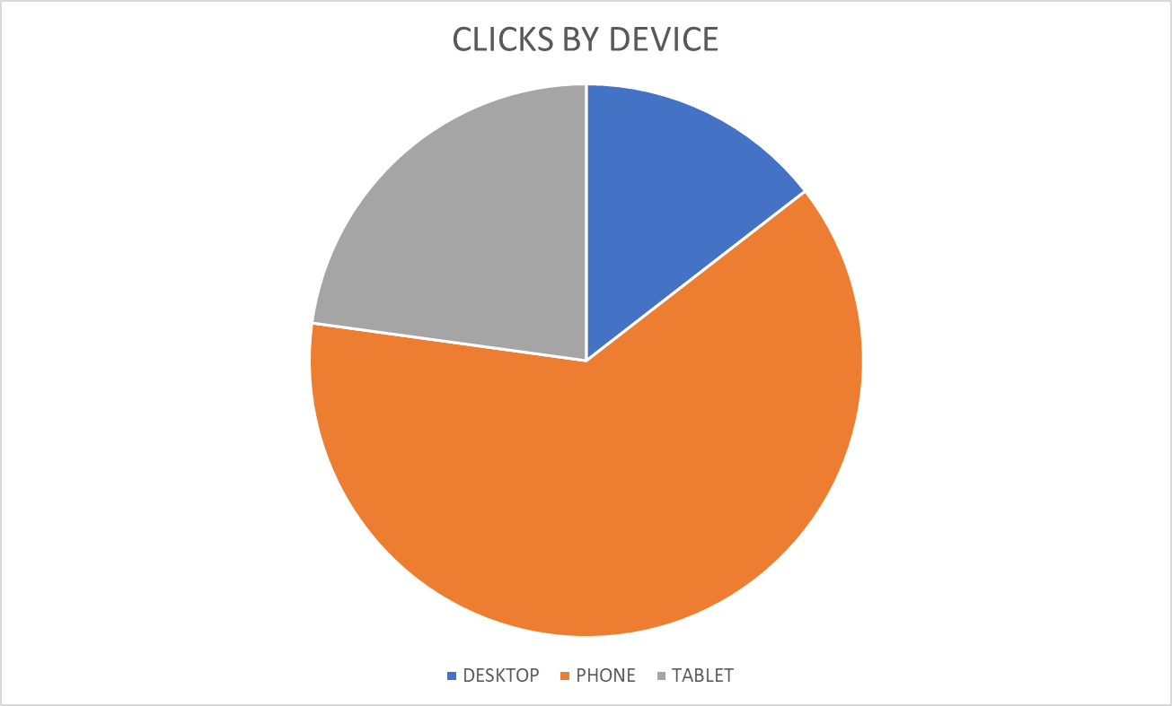
DISPLAY – BY DEVICE

Slide 20
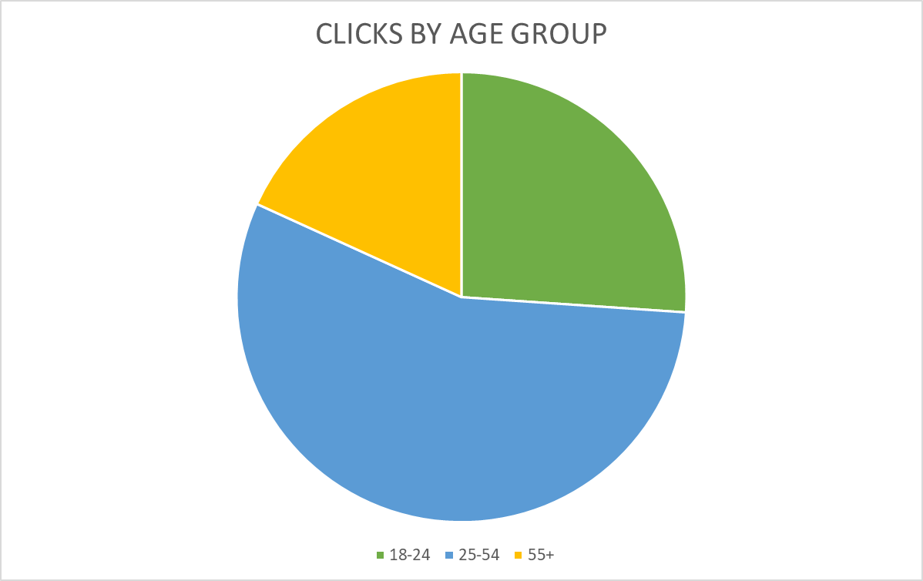
DISPLAY – BY DEVICE

Slide 21
TOP VIEWED SITES – SPANISH & ENGLISH
This measurement is not a full list of sites where your ads ran, as they follow the user, not the site, but it represents the sites where your ads were most viewable. Viewability is measured in terms of time on screen, time in view, total time spent by the user with your ads, and more.
abcnews.go.com
absolutehistory.com
accuradio.com
accuweather.com
acurazine.com
addictedcheats.com
affordablehousingonline.com
afrobasket.com
aljazeera.com
allhiphop.com
allkpop.com
allmusic.com
allrecipes.com
amc.com
americandigest.com
andovertownsman.com
animalchannel.co
aol.com
apartmenttherapy.com
apnews.com
appleinsider.com
ask.com
astrology.com
astrology-daily.com
atlanticmirror.com
autos.yahoo.com
autosport.com
autotrader.com
babycenter.com
babylonbee.com
babynamewizard.com
baltimoresun.com
barnstablepatriot.com
barstoolsports.com
baseball-almanac.com
bbc.com
bbcamerica.com
bbcgoodfood.com
beachraider.com
bellinghamherald.com
belmont.wickedlocal.com
berkley.wickedlocal.com
berkshireeagle.com
bet.com
betterhealthpost.com
bgr.com
bhg.com
bible.org
biblegateway.com
bibletrivia.com
billboard.com
billerica.wickedlocal.com
biography.com
blackamericaweb.com
blackenterprise.com
bleacherbreaker.com
bleacherreport.com
bloomberg.com
boats.com
boattrader.com
bobshideout.com
bobvila.com
bonappetit.com
boredomtherapy.com
boredpanda.com
bossip.com
Boston 25 News | Live TV Video
Boston Herald
boston.cbslocal.com
boston.com
boston25news.com
bostoncentral.com
bostonglobe.com
bostonherald.com
bostonhockeynow.com
bostonmagazine.com
bostonrealestatetimes.com
bostonsportsmedia.com
bourne.wickedlocal.com
bridgewater.wickedlocal.com
britannica.com
broadwayworld.com
brobible.com
brockton.wickedlocal.com
burlingtonfreepress.com
businessinsider.com
bustle.com
buzzfeed.com
buzzfeednews.com
cafedelites.com
canoodlesoup.com
capecodtimes.com
cars.com
carsandyachts.com
CBS Sports App Scores & News
CBS Sports Fantasy
cbsnews.com
cbssports.com
celebdirtylaundry.com
celebsfacts.com
celebuzz.com
celticsblog.com
celticslife.com
chess.com
chicagotribune.com
chocolate.com
classmates.com
cnbc.com
cnet.com
cnn.com
cnnespanol.cnn.com
cnsnews.com
cocinadominicana.com
cohasset.wickedlocal.com
collegehockeynews.com
collider.com
comedy.com
comicbook.com
concord.wickedlocal.com
convertunits.com
cookingclassy.com
cosmopolitan.com
couchpotato.football.cbssports.com
countryliving.com
courant.com
courier-journal.com
courttv.com
cracked.com
c-span.org
ctpost.com
curbed.com
cwtv.com
cyclingnews.com
dadpatrol.com
dailyhoroscope.com
dailykos.com
dailymail.com
deadline.com
definition.org
delish.com
democraticunderground.com
diario.elmundo.sv
diarioaovivo.com
diariocidade.com
diariodoaco.br
diariolasamericas.com
diariolibre.com
dictionary.com
discoverlifestyle.com
discovermagazine.com
dominicancupid.com
dominicantoday.com
draftkings.com
drugs.com
easton.wickedlocal.com
eatingwell.com
ebaumsworld.com
ebay.com
ebony.com
eightieskids.com
elcaribe.do
elcivics.com
elcomercio.pe
eldia.do
eldiariolatinoamericano.com
eldiariony.com
eleconomista.mx
elespanol.com
eliteherald.com
elle.com
elledecor.com
elmundo.es
elnacional.com
elnacional.do
elnuevodiario.do
elnuevoherald.com
elperiodico.com
elpregonerord.com
elsalvador.com
elsiglodetorreon.mx
elsoldemexico.mx
eltiempo.com
eluniversal.mx
elvocero.com
ensegundos.do
enterprisenews.com
epicurious.com
espanol.yahoo.com
espn.com
espndeportes.espn.com
esquire.com
essence.com

Slide 22
TOP VIEWED SITES – SPANISH & ENGLISH
This measurement is not a full list of sites where your ads ran, as they follow the user, not the site, but it represents the sites where your ads were most viewable. Viewability is measured in terms of time on screen, time in view, total time spent by the user with your ads, and more.
estudios.biblicos.diario
etonline.com
everydayhealth.com
ew.com
fandom.com
fantasy.espn.com
fantasy.nfl.com
finance.yahoo.com
finewoodworking.com
flickr.com
fodors.com
food.com
foodandwine.com
foodnetwork.com
football.cbssports.com
football.fantasysports.yahoo.com
forbes.com
fortune.com
fosters.com
foxnews.com
fun107.com
futbin.com
gardenloversclub.com
gazette.com
genius.com
gizmodo.com
glamour.com
glassdoor.com
globoesporte.globo.com
gloucesterdailytimes.com
gloucestertimes.com
goal.com
goodhousekeeping.com
goodnewsnetwork.org
grunge.com
gsn.com
guatevision.com
guitar.com
hannity.com
headlinehealth.com
health.com
health.usnews.com
healthandwellnesnews.com
healthline.com
healthyhabits.care
hearst.android.wcvb
hearst.android.wmtw
hearst.android.wmur
hellomagazine.com
heraldbulletin.com
heraldnews.com
hermoments.com
hgtv.com
hiddenboston.com
history.com
hockeybuzz.com
hollywoodlife.com
homebrewtalk.com
homes.com
housebeautiful.com
housecoast.com
huffpost.com
inquirer.com
instyle.com
intouchweekly.com
investing.com
ireland-calling.com
irishamericanmom.com
irishcentral.com
irishmirror.ie
irishpost.com
irishsportsdaily.com
jamaica-star.com
jerusalemonline.com
jezebel.com
kingsofbostonsports.com
kingston.wickedlocal.com
knowyourmeme.com
ladbible.com
laprensa.hn
latimes.com
latimescrosswordanswers.com
latina.com
latinamericancupid.com
latindictionary.wikidot.com
lawandcrime.com
lawinsider.com
legacy.com
lifeandstylemag.com
literock105fm.com
livestrong.com
looper.com
lostmediaarchive.fandom.com
loteriasdominicanas.com
loteriasdominicanas.do
lotterypost.com
lotteryusa.com
lotto.massachusetts
lotto.pch.com
lovemoney.com
lowellsun.com
lyrics.com
magiquiz.com
mansfield.wickedlocal.com
marieclaire.com
marthastewart.com
mashed.com
massachusetts.hometownlocator.com
masscops.com
masslive.com
massrealty.com
match.com
maxim.com
medicaldaily.com
medicalnewstoday.com
menshealth.com
mensjournal.com
mentalfloss.com
merriam-webster.com
metrotimes.com
metrowestdailynews.com
metv.com
mexiconewsdaily.com
miami.cbslocal.com
miamidiario.com
miamiherald.com
milfordmirror.com
mix1041.radio.com
mlb.com
mlive.com
moms.com
money.cnn.com
money.usnews.com
money.yahoo.com
moneypop.com
moneywise.com
motor-junkie.com
motorsport.com
mrfood.com
msn.com
mundodeportivo.com
myfitnesspal.com
myrecipes.com
narcoticnews.com
nationalreview.com
nbaanalysis.net
nbadraft.net
nbadraftroom.com
nbcboston.com
nbcnews.com
nbcnewyork.com
nbcsports.com
ncaa.com
necn.com
nesn.com
newbedfordguide.com
newenglandfacts.com
newenglandtrailconditions.com
newenglandwithlove.com
newsandguts.com
newsweek.com
newyorker.com
newyorkpost.com
nfl.com
nhlrumors.com
nj.com
noticiasaominuto.com
noticiasporelmundo.com
noticieros.televisa.com
nydailynews.com
nymag.com
nypost.com
nytcrosswordanswers.com
nytimes.com
nytimesanswers.com
nytimescrosswordsolver.com
oann.com
occupydemocrats.com
okcupid.com
okmagazine.com
onceuponachef.com
oprahmag.com
palmbeachpost.com
palmerreport.com
parentinfluence.com
parentingteensandtweens.com
parents.com
patch.com
patriotledger.com
patriotsfans.freeforums.net
patriotsplanet.net
patriotswire.usatoday.com

Slide 23
TOP VIEWED SITES – SPANISH & ENGLISH
This measurement is not a full list of sites where your ads ran, as they follow the user, not the site, but it represents the sites where your ads were most viewable. Viewability is measured in terms of time on screen, time in view, total time spent by the user with your ads, and more.
patsfans.com
pauladeen.com
pch.com
people.com
peopleenespanol.com
pof.com
politicalwire.com
politico.com
politifact.com
popcrush.com
popculture.com
popularmechanics.com
priceline.com
pro-football-reference.com
profootballrumors.com
propublica.org
psychnewsdaily.com
publicpolicerecord.com
puppyfinder.com
queerty.com
radaronline.com
radio.com
ranker.com
ratemyprofessors.com
rawstory.com
realtor.com
redbookmag.com
reddit.com
redfin.com
reference.com
religionnews.com
restablecidos.com
reuters.com
rogerebert.com
rollingstone.com
runnersworld.com
salary.com
salem.wickedlocal.com
salemnews.com
salon.com
scarymommy.com
scientificmirror.com
scribol.com
seacoastonline.com
self.com
seventeen.com
sfgate.com
simplypsychology.org
simplyrecipes.com
skinnytaste.com
slate.com
snopes.com
soapdirt.com
soaphub.com
someecards.com
southcoasttoday.com
southernliving.com
space.com
spanishdict.com
spin.com
sportbible.com
sports.theonion.com
sports.yahoo.com
tarot.com
tasteofhome.com
teachervision.com
teenvogue.com
tennis.com
theatlantic.com
thehill.com
thisoldhouse.com
thrillist.com
time.com
tmz.com
townandcountrymag.com
tribuna.com
trivia.com
tunoticiapr.com
univision.com
urbandictionary.com
us.soccerway.com
usatoday.com
usmagazine.com
usnews.com
valleynewslive.com
vanityfair.com
variety.com
vibe.com
vox.com
wareham.wickedlocal.com
washingtonpost.com
washingtontimes.com
wcvb.com
weather.com
weatherbug.com
webmd.com
westernmassnews.com
wfsb.com
whdh.com
wickedlocal.com
wikihow.com
wired.com
wmur.com
womansday.com
womansworld.com
women.com
womenshealthmag.com
wordfind.com
wunderground.com
wwe.com
yahoo.com
yellowpages.com
zimbio.com
zoosk.com
zulily.com
zynga.com

Slide 24
SOCIAL PERFORMANCE
FACEBOOK & INSTAGRAM

Slide 25
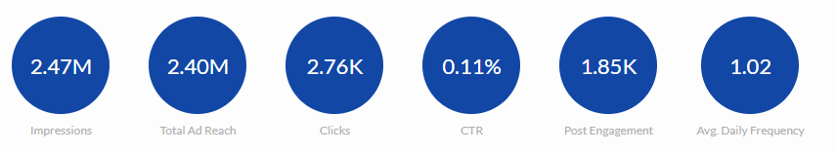
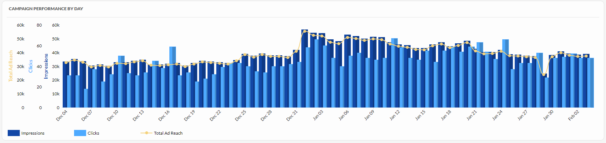
SOCIAL PERFORMANCE - OVERALL

Slide 26
SOCIAL PERFORMANCE: ENGLISH CREATIVE
Ad | Impressions | Total Ad Reach | Clicks | CTR
ENG - BOURNE - PROVIDER | 9480 | 9200 | 11 | 0.12%
ENG - BOURNE - KOL | 1904 | 1829 | 0 | 0.00%
ENG - BOURNE - PWLE | 3740 | 3518 | 1 | 0.03%
ENG - BROCKTON - KOL | 64644 | 63512 | 63 | 0.10%
ENG - BROCKTON - PROVIDER | 378511 | 371983 | 465 | 0.12%
ENG - BROCKTON - PWLE | 79820 | 75944 | 69 | 0.09%
ENG - GLOUCESTER - KOL | 11138 | 10769 | 13 | 0.12%
ENG - GLOUCESTER - PROVIDER | 70604 | 69146 | 89 | 0.13%
ENG - GLOUCESTER - PWLE | 26990 | 25281 | 21 | 0.08%
ENG - HOLYOKE - KOL | 21530 | 20747 | 20 | 0.09%
ENG - HOLYOKE - PROVIDER | 218569 | 215219 | 266 | 0.12%
ENG - HOLYOKE - PWLE | 44251 | 42029 | 48 | 0.11%
ENG - LOWELL - KOL | 59207 | 55519 | 67 | 0.11%
ENG - LOWELL - PROVIDER | 522906 | 507402 | 594 | 0.11%
ENG - LOWELL - PWLE | 104828 | 99586 | 81 | 0.08%
ENG - PLYMOUTH - KOL | 26049 | 24785 | 26 | 0.10%
ENG - PLYMOUTH - PROVIDER | 161961 | 159273 | 171 | 0.11%
ENG - PLYMOUTH - PWLE | 34444 | 32091 | 31 | 0.09%
ENG - SALEM - KOL | 24514 | 23120 | 26 | 0.11%
ENG - SALEM - PROVIDER | 184801 | 180882 | 182 | 0.10%
ENG - SALEM - PWLE | 78386 | 74592 | 66 | 0.08%
ENG - SANDWICH - KOL | 6449 | 6115 | 5 | 0.08%
ENG - SANDWICH - PROVIDER | 23340 | 22704 | 28 | 0.12%
ENG - SANDWICH - PWLE | 8601 | 8155 | 6 | 0.07%
ENG - SHIRLEY - KOL | 1892 | 1799 | 3 | 0.16%
ENG - SHIRLEY - PROVIDER | 13227 | 12830 | 18 | 0.14%
ENG - SHIRLEY - PWLE | 4462 | 4022 | 1 | 0.02%
ENG - TOWNSEND - KOL | 2767 | 2646 | 4 | 0.14%
ENG - TOWNSEND - PROVIDER | 21506 | 20918 | 34 | 0.16%
ENG - TOWNSEND - PWLE | 7676 | 7048 | 6 | 0.08%
AD TYPE: TRAFFIC (CLICK TO WEBSITE)
TOTAL IMPRESSIONS: 2,218,197
TOTAL CLICKS: 2,415
CTR: 0.11%
TOTAL REACH: 2,152,664

Slide 27
SOCIAL PERFORMANCE: SPANISH CREATIVE
Ad | Impressions | Total Ad Reach | Clicks | CTR
Phase 3 - SPAN - BOURNE - KOL | 953 | 940 | 2 | 0.21%
Phase 3 - SPAN - BOURNE - PWLE | 2106 | 2065 | 5 | 0.24%
Phase 3 - SPAN - BROCKTON - KOL | 12876 | 12737 | 17 | 0.13%
Phase 3 - SPAN - BROCKTON - PWLE | 27688 | 27212 | 40 | 0.14%
Phase 3 - SPAN - GLOUCESTER - KOL | 1827 | 1802 | 0 | 0.00%
Phase 3 - SPAN - GLOUCESTER - PWLE | 3162 | 3108 | 4 | 0.13%
Phase 3 - SPAN - HOLYOKE - KOL | 28885 | 28460 | 55 | 0.19%
Phase 3 - SPAN - HOLYOKE - PWLE | 56568 | 55586 | 78 | 0.14%
Phase 3 - SPAN - LOWELL - KOL | 28512 | 28007 | 40 | 0.14%
Phase 3 - SPAN - LOWELL - PWLE | 51356 | 50382 | 67 | 0.13%
Phase 3 - SPAN - PLYMOUTH - KOL | 679 | 671 | 1 | 0.15%
Phase 3 - SPAN - PLYMOUTH - PWLE | 1792 | 1765 | 3 | 0.17%
Phase 3 - SPAN - SALEM - KOL | 8306 | 8189 | 8 | 0.10%
Phase 3 - SPAN - SALEM - PWLE | 20750 | 20335 | 21 | 0.10%
Phase 3 - SPAN - SANDWICH - KOL | 107 | 106 | 0 | 0.00%
Phase 3 - SPAN - SANDWICH - PWLE | 170 | 169 | 0 | 0.00%
Phase 3 - SPAN - SHIRLEY - KOL | 222 | 220 | 0 | 0.00%
Phase 3 - SPAN - SHIRLEY - PWLE | 379 | 367 | 0 | 0.00%
Phase 3 - SPAN - TOWNSEND - KOL | 161 | 159 | 0 | 0.00%
Phase 3 - SPAN - TOWNSEND - PWLE | 305 | 302 | 0 | 0.00%
AD TYPE: TRAFFIC (CLICK TO WEBSITE)
TOTAL IMPRESSIONS: 246,804
TOTAL CLICKS: 341
CTR: 0.14%
TOTAL REACH: 242,582

Slide 28
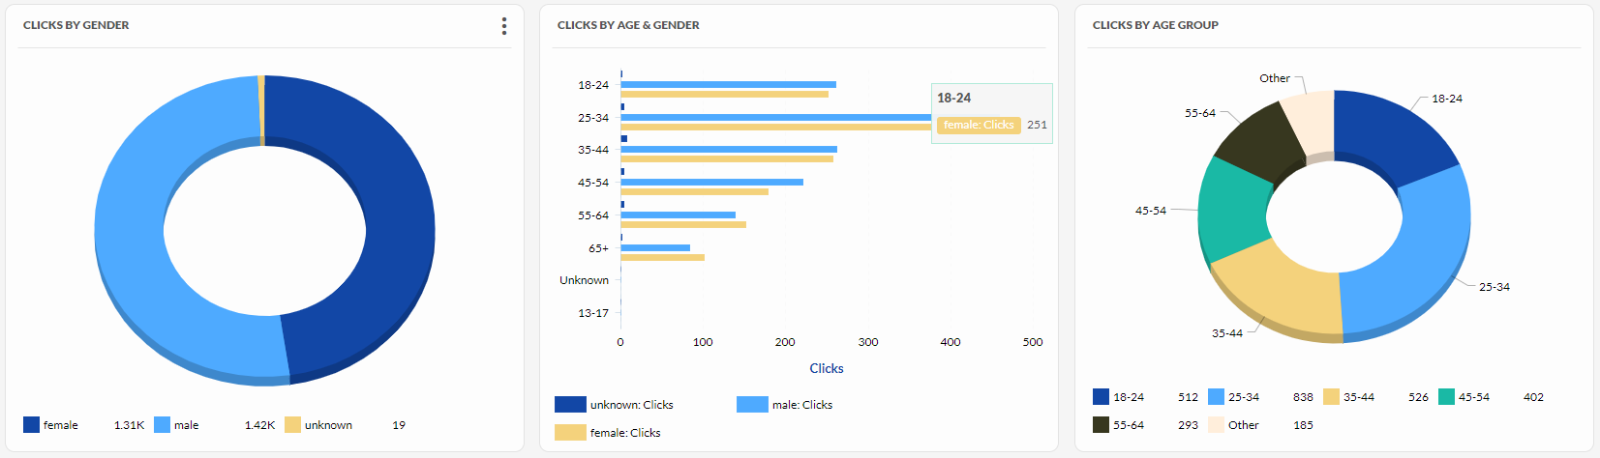
SOCIAL - AUDIENCE INSIGHTS
Notes:
This is your top converting, lower funnel social media tactic. We are re-targeting people who have shown an interest based on engagement with other tactics with the remarketing. We are attributing a lot of sales, and as with all your facebook tactics seeing a high level of social media engagement from people interested in your brand. People are providing testimonials, sharing the ad, and tagging their friends.

Slide 29
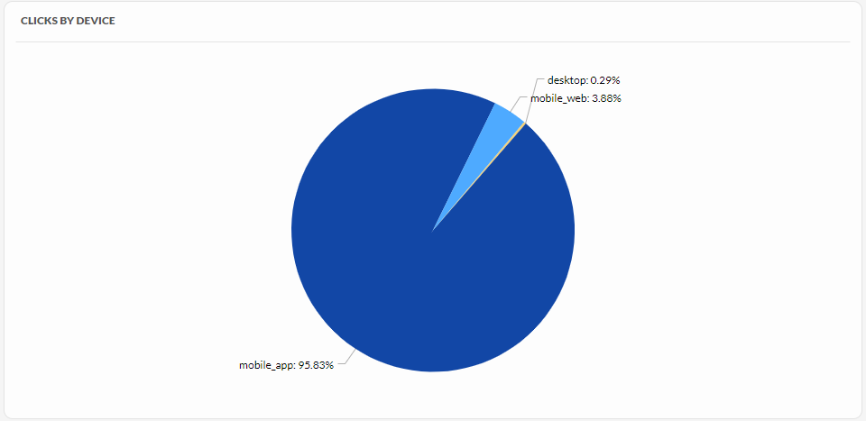
SOCIAL – CLICKS BY DEVICE
Notes:
UPDATE IMAGES and TEXT

Slide 30
SOCIAL MEDIA AD LINKS: ENGLISH
Creative | Preview Link
ENG - BOURNE - PROVIDER | https://www.facebook.com/?feed_demo_ad=23846450329880386&h=AQD79pXNP6ZGwMRN6wg
ENG - BOURNE - KOL | https://www.facebook.com/?feed_demo_ad=23846450329870386&h=AQDJhCtQCO0b5xbPiWs
ENG - BOURNE - PWLE | https://www.facebook.com/?feed_demo_ad=23846450329890386&h=AQC5n3bqEGielVQ9FqE
ENG - BROCKTON - KOL | https://www.facebook.com/?feed_demo_ad=23846450378140386&h=AQD3v8K6VVBXRjyz2NA
ENG - BROCKTON - PROVIDER | https://www.facebook.com/?feed_demo_ad=23846450378130386&h=AQD281F_IGlGrGdu4Eg
ENG - BROCKTON - PWLE | https://www.facebook.com/?feed_demo_ad=23846450378120386&h=AQBuiZCoI5HOEPGwJKw
ENG - GLOUCESTER - KOL | https://www.facebook.com/?feed_demo_ad=23846450372660386&h=AQDDXWUDANZ5n13vxcc
ENG - GLOUCESTER - PROVIDER | https://www.facebook.com/?feed_demo_ad=23846450372670386&h=AQAkN0_h0X2nOR7m3rE
ENG - GLOUCESTER - PWLE | https://www.facebook.com/?feed_demo_ad=23846450372680386&h=AQDWlQWXxsE-bzRA8XU
ENG - HOLYOKE - KOL | https://www.facebook.com/?feed_demo_ad=23846450368950386&h=AQCM0LWcC-EJjoJqw-k
ENG - HOLYOKE - PROVIDER | https://www.facebook.com/?feed_demo_ad=23846450368930386&h=AQAAw51hIGFeqjNCFeM
ENG - HOLYOKE - PWLE | https://www.facebook.com/?feed_demo_ad=23846450368940386&h=AQB7MPbLvHd96VPY168
ENG - LOWELL - KOL | https://www.facebook.com/?feed_demo_ad=23846450364600386&h=AQCPzRSyIwUrcxYHJR8
ENG - LOWELL - PROVIDER | https://www.facebook.com/?feed_demo_ad=23846450364590386&h=AQBmSj19mcb2ehSAkKw
ENG - LOWELL - PWLE | https://www.facebook.com/?feed_demo_ad=23846450364580386&h=AQDfgvohjTIQDILhjOc
ENG - PLYMOUTH - KOL | https://www.facebook.com/?feed_demo_ad=23846450360150386&h=AQDTGDodKrRZLe45_Pw
ENG - PLYMOUTH - PROVIDER | https://www.facebook.com/?feed_demo_ad=23846450360140386&h=AQDhT8tg8D9Eo1JoK0E
ENG - PLYMOUTH - PWLE | https://www.facebook.com/?feed_demo_ad=23846450360130386&h=AQDsQ3p_xXDGEoyCx8s
ENG - SALEM - KOL | https://www.facebook.com/?feed_demo_ad=23846450352270386&h=AQBqV0EAC-es-HMFyUQ
ENG - SALEM - PROVIDER | https://www.facebook.com/?feed_demo_ad=23846450352290386&h=AQA8-z1rl_fQZx2Br-E
ENG - SALEM - PWLE | https://www.facebook.com/?feed_demo_ad=23846450352280386&h=AQAuNAKuyTNYl-Y6fhk
ENG - SANDWICH - KOL | https://www.facebook.com/?feed_demo_ad=23846450345170386&h=AQDM0Ue4P5xEwpvE540
ENG - SANDWICH - PROVIDER | https://www.facebook.com/?feed_demo_ad=23846450345190386&h=AQALA2hoeLOEDzCrLzY
ENG - SANDWICH - PWLE | https://www.facebook.com/?feed_demo_ad=23846450345180386&h=AQD1S5f60cxd5K4URLc
ENG - SHIRLEY - KOL | https://www.facebook.com/?feed_demo_ad=23846450340570386&h=AQDyKDYdfOsKK3LjODs
ENG - SHIRLEY - PROVIDER | https://www.facebook.com/?feed_demo_ad=23846450340560386&h=AQBoRnHl5KvF49BKtnk
ENG - SHIRLEY - PWLE | https://www.facebook.com/?feed_demo_ad=23846450340550386&h=AQBcucilY9hLtJ3RUww
ENG - TOWNSEND - KOL | https://www.facebook.com/?feed_demo_ad=23846450337480386&h=AQD4TpUjmQsblveGSpU
ENG - TOWNSEND - PROVIDER | https://www.facebook.com/?feed_demo_ad=23846450337470386&h=AQA9-cw64VdRGV2g6IU
ENG - TOWNSEND - PWLE | https://www.facebook.com/?feed_demo_ad=23846450337460386&h=AQCESdNIRi9Vf_vzL_c

Slide 31
SOCIAL MEDIA AD LINKS: SPANISH
Creative | Preview Link
Phase 3 - SPAN - BOURNE - KOL | https://www.facebook.com/?feed_demo_ad=23846486996050386&h=AQDopLy4VEk7cqqoE7A
Phase 3 - SPAN - BOURNE - PWLE | https://www.facebook.com/?feed_demo_ad=23846487006360386&h=AQAljZl3Uz1uVIe5mgQ
Phase 3 - SPAN - BROCKTON - KOL | https://www.facebook.com/?feed_demo_ad=23846487015170386&h=AQDOwXwAPoYCicaN9iw
Phase 3 - SPAN - BROCKTON - PWLE | https://www.facebook.com/?feed_demo_ad=23846487006370386&h=AQCnxw5DUjI03ycqi_Y
Phase 3 - SPAN - GLOUCESTER - KOL | https://www.facebook.com/?feed_demo_ad=23846487015230386&h=AQDgNLfYkkN9BbSoRkA
Phase 3 - SPAN - GLOUCESTER - PWLE | https://www.facebook.com/?feed_demo_ad=23846487006340386&h=AQDfrhc6CNmJMs_SV5Q
Phase 3 - SPAN - HOLYOKE - KOL | https://www.facebook.com/?feed_demo_ad=23846487015190386&h=AQDQzwDFwEnk0KAt10A
Phase 3 - SPAN - HOLYOKE - PWLE | https://www.facebook.com/?feed_demo_ad=23846487006530386&h=AQDcDL0gDojyCADCfro
Phase 3 - SPAN - LOWELL - KOL | https://www.facebook.com/?feed_demo_ad=23846487015200386&h=AQBlNnv7ml64boUQ9KU
Phase 3 - SPAN - LOWELL - PWLE | https://www.facebook.com/?feed_demo_ad=23846487006350386&h=AQA4TF310Fhe_znEFCQ
Phase 3 - SPAN - PLYMOUTH - KOL | https://www.facebook.com/?feed_demo_ad=23846487015150386&h=AQCUtesQD7Hea1v8UY4
Phase 3 - SPAN - PLYMOUTH - PWLE | https://www.facebook.com/?feed_demo_ad=23846487006380386&h=AQB1jWp4Q1zrcmibJHs
Phase 3 - SPAN - SALEM - KOL | https://www.facebook.com/?feed_demo_ad=23846487015160386&h=AQDZlXBJDczRa_Pltyw
Phase 3 - SPAN - SALEM - PWLE | https://www.facebook.com/?feed_demo_ad=23846487006310386&h=AQBZDvoaZRcE8lxTzO4
Phase 3 - SPAN - SANDWICH - KOL | https://www.facebook.com/?feed_demo_ad=23846487015130386&h=AQCyeDEDrSphq4pyz9w
Phase 3 - SPAN - SANDWICH - PWLE | https://www.facebook.com/?feed_demo_ad=23846487006320386&h=AQCERz2Q3wFGFt9Hz3A
Phase 3 - SPAN - SHIRLEY - KOL | https://www.facebook.com/?feed_demo_ad=23846487015140386&h=AQA9jdv9etPUng6tG-8
Phase 3 - SPAN - SHIRLEY - PWLE | https://www.facebook.com/?feed_demo_ad=23846487006390386&h=AQCa5ccs8QIPX2sWfCA
Phase 3 - SPAN - TOWNSEND - KOL | https://www.facebook.com/?feed_demo_ad=23846487015180386&h=AQCe5PdvkqXz4ENzDEs
Phase 3 - SPAN - TOWNSEND - PWLE | https://www.facebook.com/?feed_demo_ad=23846487006330386&h=AQDLV_8JTv3_OV5HO9U

