Slide 1

WRAP REPORT
ORAU – BMC
Wave 1 – Massachusetts Digital 2020

Slide 2
CAMPAIGN TARGETS
CAMPAIGN GOALS:
Combat stigma toward people with opioid use disorder (POUD)
Address misunderstandings about and generate public support for HCS evidence-based interventions (i.e. naloxone, medication assisted treatment)
Encourage people with opioid use disorder to utilize treatment and recovery support services available in their communities.
TARGET AUDIENCES:
A 18+ Hispanic/Spanish language
A 18+ English language
GEOGRAPHY: MASSACHUSETTS - Barnstable (Bourne & Sandwich), Brockton, Gloucester, Holyoke, Lowell, Plymouth, Salem
FLIGHT DATES: May 4 – July 19, 2020
CREATIVE:
Facebook Static Ads
Display Banners – 300x250, 728x90, 160x600, 300x600, 320x50
TACTICS:
Cross Device Display: Spanish & English
  Audience Targeting (Spanish)
  Search Retargeting (English)
Facebook Traffic Ads: Spanish & English

Slide 3

CAMPAIGN DELIVERY TOTALS
DISPLAY
SOCIAL
FACEBOOK TRAFFIC ADS - English
1,371,037 impressions
7,931 clicks (5,715 link clicks)
0.58% CTR
203 Post Reactions (likes, loves, etc)
42 Comments
38 Shares
FACEBOOK TRAFFIC ADS - Spanish
713,816 impressions
3,669 clicks (2944 link clicks)
0.51% CTR
108 Post Reactions (likes, loves, etc)
5 Comments
9 Shares
CROSS DEVICE DISPLAY – English
769,167 IMPRESSIONS
2861 CLICKS
0.37% CLICK THROUGH RATE
CROSS DEVICE DISPLAY – Spanish
832,476 IMPRESSIONS
3016 CLICKS
0.36% CTR
Total Exposure Time: 293 Hours
In-View Time: 57.97%
In-View Time (s): 17.96

Slide 4
DISPLAY PERFORMANCE
AUDIENCE TARGETING & SEARCH RETARGETING

Slide 5

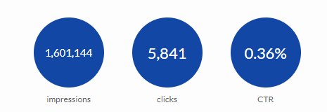
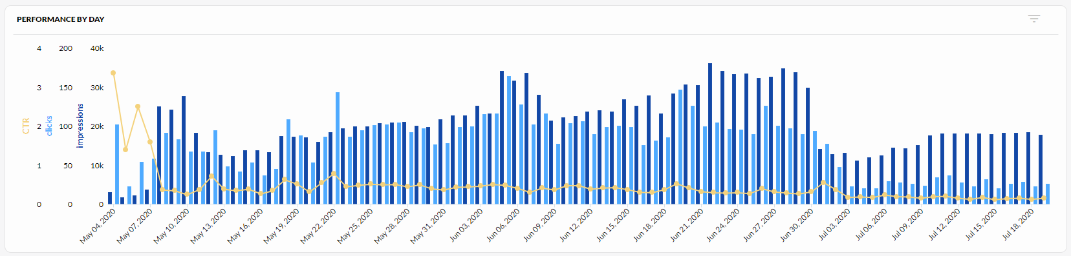
DISPLAY – OVERALL PERFORMANCE
CROSS DEVICE DISPLAY: English
768,668 IMPRESSIONS
2,825 CLICKS
0.37% CTR
CROSS DEVICE DISPLAY: Spanish
832,476 IMPRESSIONS
3,016 CLICKS
0.36% CTR

Slide 6
DISPLAY – ENGLISH CREATIVE

Slide 7
DISPLAY – SPANISH CREATIVE

Slide 8
DISPLAY – BY TOWN
City | Language | Impressions | Clicks
Bourne-Sandwich | English | 104384 | 298
 | Spanish | 47320 | 166
Brockton | English | 110834 | 500
 | Spanish | 178015 | 658
Gloucester | English | 102104 | 364
 | Spanish | 42197 | 211
Holyoke | English | 109491 | 431
 | Spanish | 151060 | 513
Lowell | English | 114470 | 391
 | Spanish | 199758 | 615
Plymouth | English | 112452 | 436
 | Spanish | 63791 | 240
Salem | English | 115432 | 441
 | Spanish | 150335 | 613

Slide 9
DISPLAY – BY DEVICE
ENGLISH
Device Type | Towns
 | Barnstable | Brockton | Gloucester | Holyoke | Lowell | Plymouth | Salem
Desktop | 133 | 375 | 154 | 171 | 147 | 141 | 145
Smartphone | 15 | 1073 | 12 | 14 | 14 | 18 | 14
Tablet | 6 | 397 | 7 | 6 | 8 | 4 | 7
SPANISH
Device Type | Towns
 | Barnstable | Brockton | Gloucester | Holyoke | Lowell | Plymouth | Salem
Desktop | 86 | 239 | 107 | 232 | 275 | 127 | 306
Smartphone | 65 | 381 | 87 | 260 | 313 | 86 | 265
Tablet | 15 | 38 | 17 | 21 | 27 | 27 | 42

Slide 10
DISPLAY – CLICKS BY AGE ENGLISH & SPANISH

Slide 11
TOP VIEWED SITES – SPANISH & ENGLISH
This measurement is not a full list of sites where your ads ran, as they follow the user, not the site, but it represents the sites where your ads were most viewable. Viewability is measured in terms of time on screen, time in view, total time spent by the user with your ads, and more.
abc.es
accuradio.com
accuweather.com
allhiphop.com
americanpregnancy.org
amnews.com
amomama.es
aol.com
ask.com
astrology.com
astrologyanswers.com
astrology-zodiac-signs.com
autotrader.com
babycenter.com
bbpeoplemeet.com
bet.com
bhg.com
bible.org
biblegateway.com
blacksportsonline.com
bodybuilding.com
boredpanda.es
boston.com
boston25news.com
bostoncentral.com
bostonglobe.com
bostonherald.com
bostonmagazine.com
capecodtimes.com
com.loop.match3d
com.peoplefun.wordcross
dailymail.co.uk
easybrain.jigsaw.puzzles
eldiario.es
eldiariony.com
eleconomista.com.mx
elespanol.com
elespectador.com
elfutbolero.com.mx
elheraldo.co
eliteherald.com
elle.com
elledecor.com
elmundo.es
eluniversal.com
enterprisenews.com
eresmama.com
flickr.com
forbes.com
ford-trucks.com
fotor.com
foxnews.com
frugalcouponliving.com
futbolcentroamerica.com
gardenersworld.com
gazette.com
gazettenet.com
germs.io
gloucestertimes.com
gm-trucks.com
golficity.com
gq.com
gsn.com
health.com
healthline.com
kik.android
legacy.com
mail.aol.com
mail.yahoo.com
masslive.com
match.com
metv.com
mexicanfoodjournal.com
miamiherald.com
military.com
moms.com
mtv.com
mujerhoy.com
mundodeportivo.com
mundohispanico.com
nascar.com
nationalenquirer.com
people.com
reddit.com
tmz
tunein.player
weather.com
wwlp.com
yahoo.com

Slide 12
SOCIAL PERFORMANCE
FACEBOOK & INSTAGRAM

Slide 13
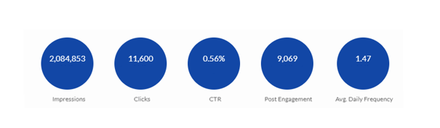
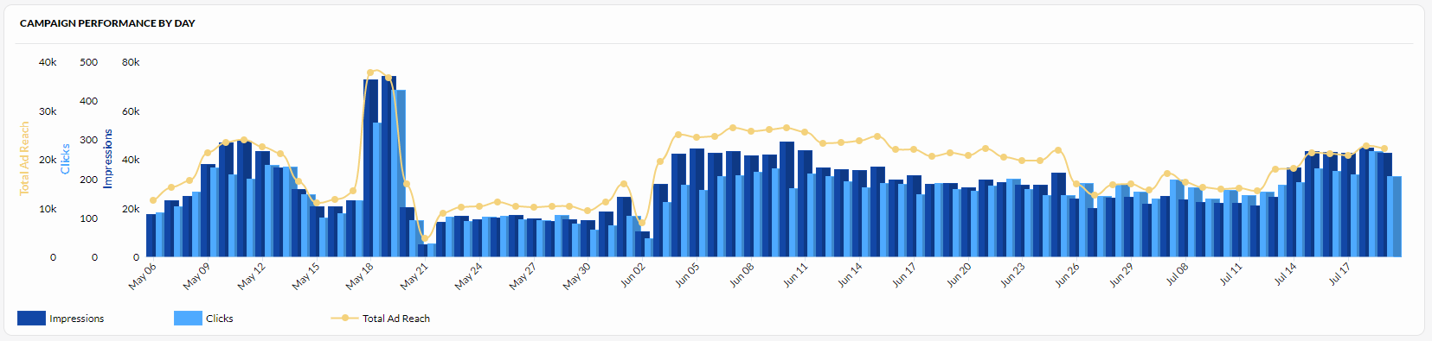
SOCIAL PERFORMANCE - OVERALL

Slide 14
SOCIAL PERFORMANCE: ENGLISH CREATIVE
English Ad Set | Impressions | Total Ad Reach | Clicks | CTR
153811_Auto_Bourne-Sandwich_Zips_A18+_English | 208999 | 111625 | 999 | 0.48%
153811_Auto_Brockton_Zips_A18+_English | 164556 | 118004 | 1024 | 0.62%
153811_Auto_Gloucester_Zips_A18+_English | 204638 | 100917 | 1127 | 0.55%
153811_Auto_Holyoke_Zips_A18+_English | 186079 | 131498 | 1212 | 0.65%
153811_Auto_Lowell_Zips_A18+_English | 205981 | 127912 | 955 | 0.46%
153811_Auto_Plymouth_Zips_A18+_English | 184438 | 117263 | 1410 | 0.76%
153811_Auto_Salem_Zips_A18+_English | 216346 | 131848 | 1204 | 0.56%
AD TYPE: TRAFFIC (CLICK TO WEBSITE)
TOTAL IMPRESSIONS: 1,371,037
TOTAL CLICKS: 7391
CTR: 0.54%
TOTAL REACH: 193,757
LIKES/LOVES: 203
COMMENTS: 42
SHARES: 38

Slide 15
SOCIAL PERFORMANCE: SPANISH CREATIVE
Spanish Ad Set | Impressions | Total Ad Reach | Clicks | CTR
153811_Auto_Bourne-Sandwich_Zips_A18+_Spanish | 47287 | 25812 | 186 | 0.39%
153811_Auto_Brockton_Zips_A18+_Spanish | 124197 | 75045 | 691 | 0.56%
153811_Auto_Gloucester_Zips_A18+_Spanish | 72321 | 33289 | 287 | 0.40%
153811_Auto_Holyoke_Zips_A18+_Spanish | 145421 | 88602 | 823 | 0.57%
153811_Auto_Lowell_Zips_A18+_Spanish | 140415 | 87612 | 831 | 0.59%
153811_Auto_Plymouth_Zips_A18+_Spanish | 63937 | 29823 | 232 | 0.36%
153811_Auto_Salem_Zips_A18+_Spanish | 120238 | 71931 | 619 | 0.51%
AD TYPE: TRAFFIC (CLICK TO WEBSITE)
TOTAL IMPRESSIONS: 713,816
TOTAL CLICKS: 3,669
CTR: 0.51%
TOTAL REACH: 85,684
LIKES/LOVES: 108
COMMENTS: 5
SHARES: 9

Slide 16
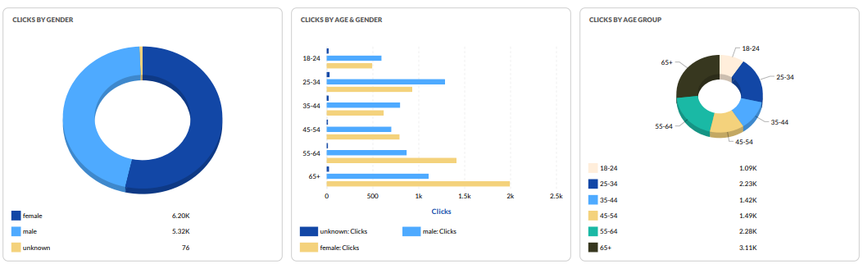
SOCIAL - AUDIENCE INSIGHTS
Notes:
This is your top converting, lower funnel social media tactic. We are re-targeting people who have shown an interest based on engagement with other tactics with the remarketing. We are attributing a lot of sales, and as with all your facebook tactics seeing a high level of social media engagement from people interested in your brand. People are providing testimonials, sharing the ad, and tagging their friends.

Slide 17
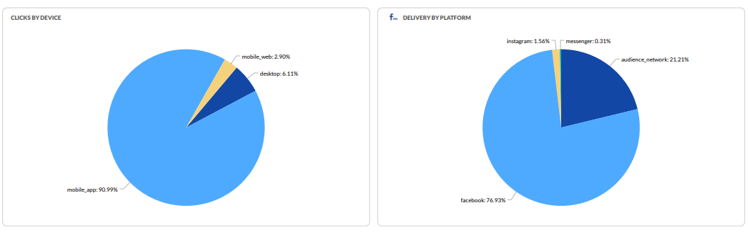
SOCIAL – DEVICE & PLATFORM
Notes:
UPDATE IMAGES and TEXT

