Slide 1
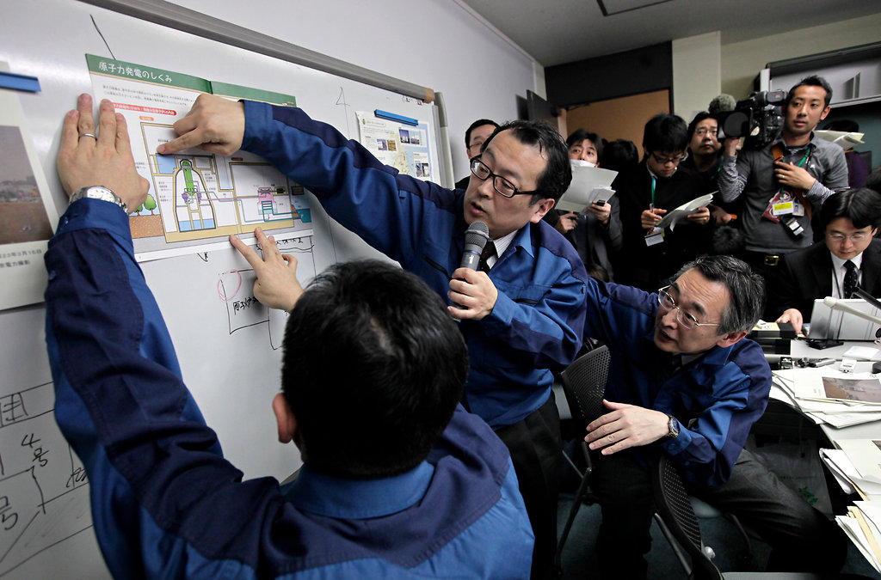
Communication and Psychological Needs in Radiation Emergencies
Leeanna Allen, MPH, MCHES
Oak Ridge Institute for Science and Education
August 27, 2012
National Center for Environmental Health
Division of Environmental Hazards and Health Effects

Slide 2
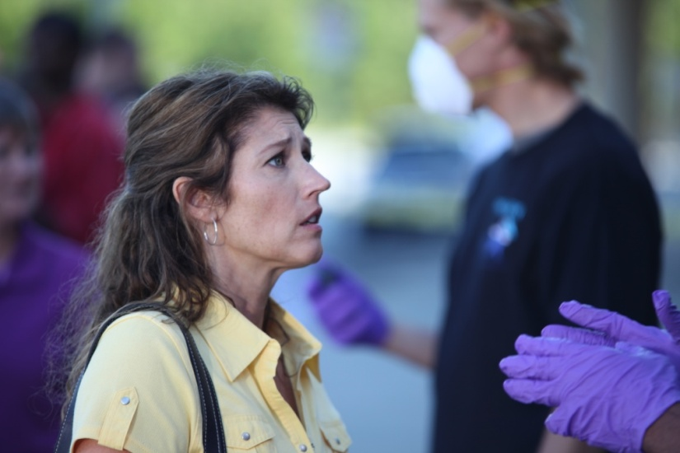
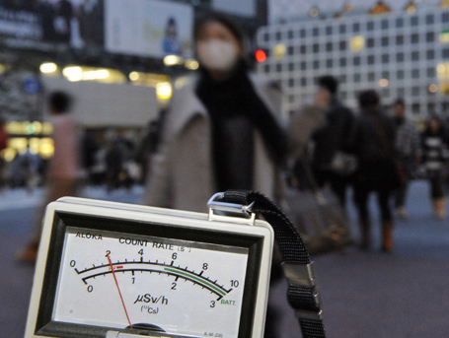
Radiation Disasters are Different
Radiation is:
Invisible
Silent
Odorless
Can only be detected with specialized equipment
Radiation concepts, terms, and risks are poorly understood by the public
Fear
Fatalism
Notes:
Radiation disasters are unique in large part because of the public’s intense fear of radiation. Unlike many other threats, radiation is invisible, silent, and odorless, and can only be detected with specialized equipment. It is also unfamiliar to, and not well understood by, the general public. Even common radiological medical procedures are often referred to in terms that mask any reference to radiation. There is also a strong sense of fatalism regarding radiation disasters. People do not believe that radiation disasters are survivable. Even those who may survive the initial disaster fear possible long-term and delayed health effects, primarily cancers, many of which can only be diagnosed years after the exposure.
Unlike other types of health emergencies, people generally don’t have the background knowledge on radiation that they may have with other subject areas. For example, and this is somewhat of an oversimplication, if you are communicating information for flu prevention, more people will have a general sense of what the flu is. You have a larger percentage of the population who have had the flu, or know someone who has, and more people know symptoms, how it spreads, etc. With radiation, the knowledge base isn’t there as much. Many times in asking people what they know about radiation we hear people mention superheroes (or supervillians!), we hear people talk about three-eyed fish, mutations, or disasters so horrible, there’s no hope for survival. This has an impact on how receptive people are to information, and what hurdles communicators must overcome to get the messages out.
The psychological effects of radiation emergencies will be huge. For example, following a 1987 radiation disaster in Brazil, only 249 people were found to have some level of contamination of cesium-137, however, over 120,000 people showed up at monitoring sites to be surveyed. Addressing psychological issues will also be a major element of the communications plan.

Slide 3
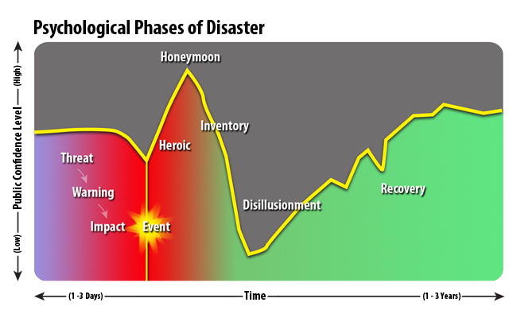

Slide 4
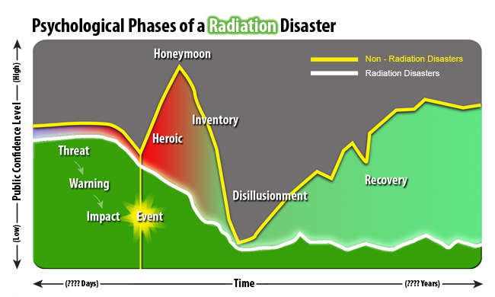

Slide 5
Social Stigma
Can be experienced by those contaminated or potentially contaminated
People may choose not to assist victims of radiation disasters
Lack of social support hinders resilience and recovery efforts
Stigma can also be associated with receiving mental health services

Slide 6
Japan-2011
"I still have no idea what the numbers they are giving about radiation levels mean. It's all so confusing. And I wonder if they aren't playing down the dangers to keep us from panicking. I don't know who to trust.“
Tsugumi Hasegawa, age 29, living with her young daughter in a shelter with 1,400 other people on the outskirts of Fukushima city, 80 km (50 miles) away from the plant
From “Japan’s efforts to ease nuke crisis hit setback”, Mary Yamaguchi, AP 3/20/2011
Notes:
Certainly the tragic events in Japan triggered by the earthquake and tsunami gave us some firsthand knowledge of the difficulties in communicating in a radiation emergency. Americans living in Japan, or those traveling to and from the country had concerns and questions about the radiation levels. At the same time, radiation monitors in the United States began detecting small amounts of radiation from the reactors, causing alarm among people here at home.

Slide 7
Japan-2012
"I had kind of a scary image of radiation because it’s invisible. But after I’ve learned about it, I know what to avoid and where not to go. Also, I now understand the news about the nuclear crisis. I understand (radioactive materials) better than my mother. When we go to a supermarket together, I tell her which produce to avoid.“
Teppei Sato, a Fukushima fourth-grader, on the benefits of radiation education
From “Children Taught Radiation Studies: Nuke Education Now Compulsory Subject in Schools in Fukushima”, Mizuho Aoki, The Japan Times, 2/21/2012
Notes:
Effective communication can go a long way in relieving fears and anxieties. One fourth-grade teacher in Fukushima worked with an illustrator he found through Twitter to produce a leaflet for children about radiation, and has concentrated 30-40 hours of general studies time for radiation classes. The subject of radiation will become mandatory in science classes for third year students at junior high schools.

Slide 8
Communication Goals
Effective communication in radiation emergencies can:
Decrease illness, injury, and death
Facilitate response and recovery efforts
Avoid misallocation of limited resources
Reduce rumors
Minimize medically unnecessary self-referrals to hospitals and other critical facilities
Notes:
Effective communication in radiation disasters can go a long way in aiding response efforts. For instance, in the case of an Improvised Nuclear Device (or IND) event, we can save lives if we can communicate to the affected populations to stay inside for 24 hours. Communicating factual information about radiation and health effects can reduce rumors and provide reassurance. I saw an article during the Japan incident that was talking about the way China dealt a blogger who was spreading a rumor that encouraged people to stockpile and consume vast quantities of iodized salt to combat the adverse effects of Iodine-131…he was jailed for 10 days and fined the equivalent of about $75. I know for many of us seeing rumors like this is incredibly frustrating, but as we know, good crisis and risk communication messages, particularly if they come from multiple trusted sources can go a long way in reducing rumors.
Communications can direct people to a community reception center to be surveyed for radioactive contamination, rather than to an overcrowded and overwhelmed emergency room. Much of the United States response to the events in Japan was a communications response to public concern and explaining the risks and the radiation levels that were detected.

Slide 9
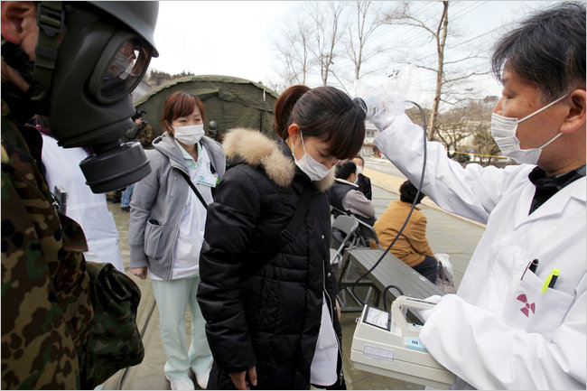
Key Communications Questions
Are we meeting audience needs for information?
How can we bridge the gap between technical information and risk perception?
How can we describe radiation in ways that promote responsible public action?
Notes:
Many times, especially in radiation emergencies, the main concern of the public is “am I safe?” . If I am, how do you know I am, and if I’m not, what can I do, or what are you doing, to make me safe. This question doesn’t always have an easy answer, particularly when we’re talking about radiation. How much of the technical content is necessary to provide for people to make informed decisions about their risk? And how can we talk about radiation in ways that promote responsible public actions, such as reporting to a community reception center to be surveyed for contamination, like in the picture on the left, verses buying up mass quantities of ground kelp for protection against radioactive Iodine, like in the picture on the right?

Slide 10
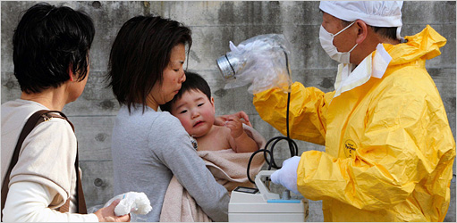
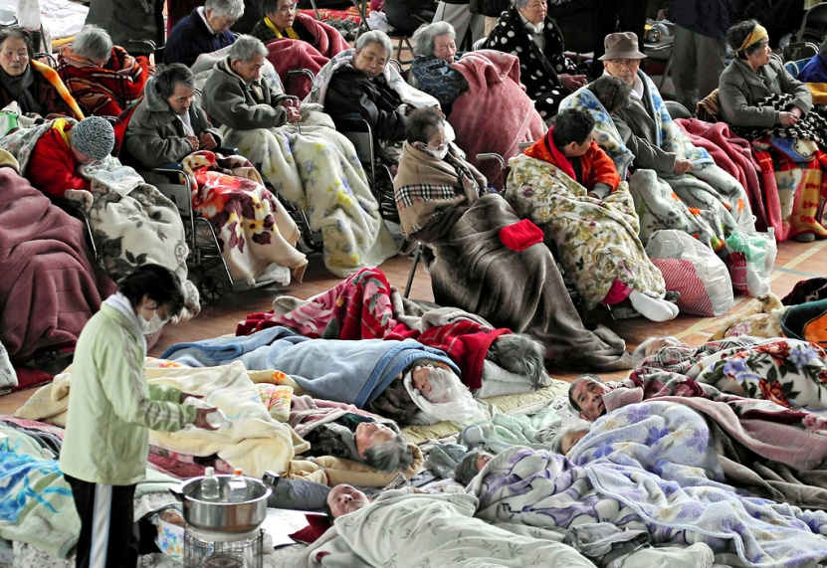
Message Development
Few differences in higher vs. lower education level
Professional responders will have the same concerns as members of the public
Non-English speakers and other special populations will have specific communication needs
Notes:
One of the “silver linings” of radiation communication, is that you don’t really have to worry as much about making the information too basic. What we saw in Japan, was that professional responders and clinicians were asking many of the same questions as members of the public, so many of the messages were appropriate for multiple audiences.
As in all communications, it is important to consider the needs of special populations, including non-English speakers. For example, explaining that radioactive contamination is like dust or mud, and if you think you have been contaminated, treat yourself as if you are covered in dust or mud has been an analogy that seems to work well with helping people understand contamination. One of the interesting things that CDC found in conducting some focus groups among Spanish speaking audiences was that there are so many different words for dust or mud in the Spanish language, and that these words have different connotations depending on the country of origin. So just because a message is effective in English, doesn’t mean that it will have the same success once translated.

Slide 11
Communication Best Practices
Give prioritized action items in each message.
Use plain, non-technical, relatable language
Tailor messages by
Time
Distance
Delivery method
Environment

Slide 12
More Communication Best Practices
Use an urgent and serious tone, but provide a sense of hope
Communicate authoritatively and directly
Make messages concise
Avoid contradictions (real or perceived)
Steer clear of words like “could”, “may”, “might”, “possibly”

Slide 13
Commonly Misunderstood Terms
Background radiation
Contamination/Contaminant
Detrimental health effects
Dose
Hereditary genetic damage
In the path/Downwind
Internal/external contamination
Low/high radiation levels
Potassium Iodide
Protective actions
Protective measures
Radiation particles
Radiation protection standards and practices
Radioactive material
Rem/Sievert
Responders
Risk of exposure
Sheltering

Slide 14
Sources of Information During an Emergency
People want to hear from radiation scientists
People want a live voice, not a recording
When uncertain, people base their actions on familiar situations, both real and fictional.

Slide 15
Resources
CDC Emergency Preparedness and Response Social Media: 2011 Japan Earthquake and Tsunami Response
http://www.emergency.cdc.gov/socialmedia/japan.asp
CDC Radiation Emergency Communications Research
http://www.emergency.cdc.gov/radiation/audience.asp
NRC: Guidance on Developing Effective Radiological Risk Communication Messages: Effective Message Mapping and Risk Communication with the Public in Nuclear Plant Emergency Planning Zones
http://pbadupws.nrc.gov/docs/ML1104/ML110490120.pdf
EPA booklet Communicating Radiation Risks: Crisis Communications for Emergency Responders
(CDC Public Health Toolkit)
Notes:
More information on the use of social media during the Japan Earthquake and Tsunami can be found at http://www.emergency.cdc.gov/socialmedia/japan.asp. There is also a huge amount of additional information and resources on CDC’s use of social media. Technology is moving fast, so this information is updated quite often.
Reports on radiation emergency communications can be found at http://www.emergency.cdc.gov/radiation/audience.asp. In addition, I encourage you to download the Federal Planning Guidance for Response to a Nuclear Detonation. Make sure it is the second edition, as the information on communications is not in the first edition. If you google the title, it comes up in several different sites, but I’ve included the link on the HHS Radiation Emergency Medical Management site, which has a lot of great information for clinicians and health care providers. The EPA’s booklet, on Communicating Radiation Risks: Crisis Communications for Emergency Responders is another good resource, and can be obtained from the CDC Public Health Radiation Toolkit.
I would also encourage you if you haven’t already, to get in touch with your state radiation control program. They are great resources to help you on any technical issues or questions you may have.

Slide 16
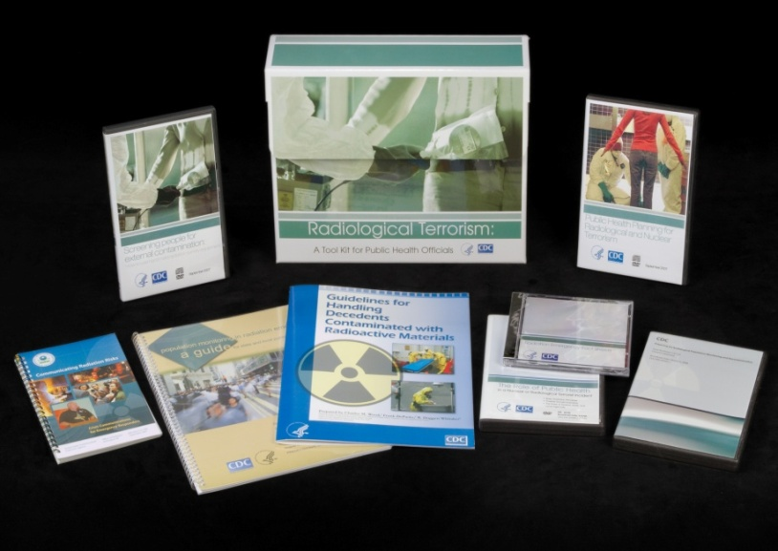
Radiological Terrorism: A Toolkit for Public Health Professionals
Resources for Public Health
Virtual Community Reception Center
Population Monitoring Guide
EPA Risk Communication Guide
Contaminated Decedents Guide
Radiation Survey DVD
Webcasts
Fact Sheets
Psychological First Aid Self-Study
Notes:
CDC has developed two radiation emergency toolkits, one geared towards public health professionals, the other towards clinicians. Both toolkits have all sorts of resources: videos, brochures, guidance documents, trainings, fact sheets, etc.
If you already have a toolkit, we have added a few new pieces this year. In the public health kit we have a joint law-enforcement/public health radiation emergency investigation guide, an interactive training tool that creates a virtual community reception center, as well as a self-study training on psychological first aid in radiation disasters.

Slide 17
Radiological Terrorism: A Toolkit for Emergency Services Clinicians
Resources for Clinicians:
JIT Training
Pocket Guides
Radiation Triage Chart
Fact Sheets
Webcasts
Self-study Trainings
Notes:
The clinician toolkit also has some resources that might be useful, especially if you communicate with the health care providers in your area.

Slide 18
To order complimentary toolkits:
Email: cdcinfo@cdc.gov or
Call: 1-800-CDC-INFO (1-800-232-4636);
TTY: (888) 232-6348
Selected material available online:
http://www.emergency.cdc.gov/radiation
Notes:
Both toolkits are absolutely free of charge, and you can order as many as you like. To place an order, send an email to cdcinfo@cdc.gov with your name, mailing address, and contact information. Be sure to specify how many of each toolkit (clinician or public health) you are requesting. You can also place an order over the phone by calling 1-800-CDC-INFO. In addition, many of the toolkit resources, especially the multimedia resources, can be obtained directly from our website, at emergency.cdc.gov/radiation.

Slide 19
Questions?
National Center for Environmental Health
Division of Environmental Hazards and Health Effects
Notes:
Thank you so much for your interest and attention to this important topic. I hope that the information provided will be helpful to you in your planning efforts. I’d be happy to take any questions if we have time?

