Slide 1
Surveillance Using NPDS and Radiation-related Coding
Royal Law, MPH
Health Studies Branch
Division of Environmental Hazards and Health Effects National Center for Environmental Health
Centers for Disease Control and Prevention (Atlanta, GA)
National Center for Environmental Health
Environmental Hazards and Health Effects/ Health Studies Branch

Slide 2
Disclaimer
The findings and conclusions in this presentation are those of the author(s) and do not necessarily represent the official position of the Centers for Disease Control and Prevention/the Agency for Toxic Substances and Disease Registry .

Slide 3
Agenda
HSB radiation program
New coding scheme
Example use of NPDS during an incident
Questions/Comments

Slide 4
Background
Problem
Limited capacity for radiation exposure/event surveillance
Goal of the HSB radiation program
To enhance national surveillance for radiation exposures
HSB Actions
Partnered with AAPCC to create a national surveillance program for radiation exposures using NPDS
Funded 4 poison centers to develop radiation-specific case-based definitions for NPDS
Implemented case-based definitions for radiation exposure surveillance

Slide 5
NPDS Surveillance
Human exposure calls to radiation and associated substances - Definition 801 and 803
425 radiation-related anomalies were analyzed in NPDS from August 2010 to June 2012
None required urgent intervention

Slide 6
NPDS Surveillance
Human exposure calls with symptoms of acute radiation syndrome - Definition 802
205 anomalies were analyzed in NPDS from August 2010 to June 2012
None required urgent intervention

Slide 7
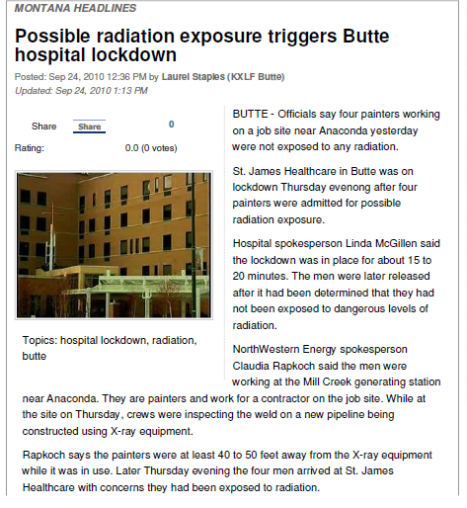
NPDS Surveillance
NPDS anomalies
3 painters presented to hospital with nausea and vomiting after exposure to radiation
Hospital shut down for 30 minutes
Dose reconstruction revealed low radiation exposure (0.002mSv)

Slide 8
NPDS Radiation Code Changes
CDC and AAPCC found that current NPDS product and generic codes are not specific enough for optimal surveillance
Majority of cases are reported as “ionizing radiation”
In a radiation event, potential delay until a temp code is defined and released
CDC, AAPCC, Micromedex Joint Coding Group, Micromedex Poisindex and Lexicon teams enhanced the radiation coding system
New codes designed to provide more detail about radiation exposures
Incorporate current radiation codes

Slide 9
NPDS Radiation Code Changes
Weapons of Mass Destruction
Non-ionizing radiation
Ionizing radiation
Radiopharmaceuticals

Slide 10
Weapons of Mass Destruction
Radiological and nuclear weapon codes expanded to include other possible radiological or nuclear scenarios
Radiological weapons (generic)
Radiological Dispersal Device (explosive)
Radiological Dispersal Device (non-explosive)
Radiological Exposure Device
Radiological Weapon (not otherwise specified)
Nuclear weapons
Improvised Nuclear Device
Nuclear Weapon (not otherwise specified)

Slide 11
Non-Ionizing Radiation
Additional generic codes separated by radiation type
Radiofrequency radiation (generic)
Radio waves
Non X-ray emitting airport scanners
Visible light radiation
Microwave radiation
Infrared radiation
Ultraviolet radiation
Unknown type of non-ionizing radiation

Slide 12
Ionizing Radiation
Additional generic codes for types of radiation (if specific radionuclide is unknown)
X-ray radiation (Generic)
Industrial radiography X-rays
Medical X-rays
Airport portal X-ray screening
Alpha radiation
Beta radiation
Gamma radiation
Neutron radiation

Slide 13
Ionizing Radiation
Additional product codes for specific radionuclides
Specific non-pharmaceutical radionuclides (generic)
Americium-241
Polonium-210
Cesium-137
Naturally Occurring Radioactive Materials (NORM)
Extensive list of radionuclides added as product codes
Ionizing radiation: Type Unknown (generic)

Slide 14
Radiopharmaceuticals
Commonly used pharmaceutical radionuclides now have product codes
Pharmaceutical radionuclides (generic)
Nitrogen-13 ammonia
Rubidium-82 chloride
Carbon-14
Iodine-131 (pharmaceutical)

Slide 15
Summary of Radiation Code Changes
Expansion of the Weapons of Mass Destruction category to include radiological and nuclear scenarios
Non-ionizing radiation codes expanded based on the type of radiation (microwave, ultraviolet, etc.)
Ionizing radiation codes can be coded by either the type of radiation emitted or by the specific radionuclide
Most changes appear in V150 in September 2011

Slide 16
Coding Suggestions
Code all available information
Example: Radiological Dispersal Device and Cs-137
Include specific radionuclides if available
Example: I-131 (if unknown) -> gamma radiation (if unknown) -> Ionizing radiation: Type Unknown
Obtain and add the following information into the “comments/notes” (if known)
Any radiation assessment performed (counts, detector type)
External or internal contamination detected or decontamination performed
Time, distance, shielding from the source

Slide 17
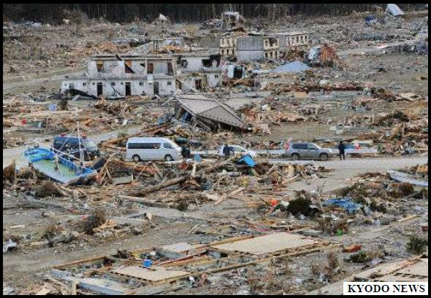
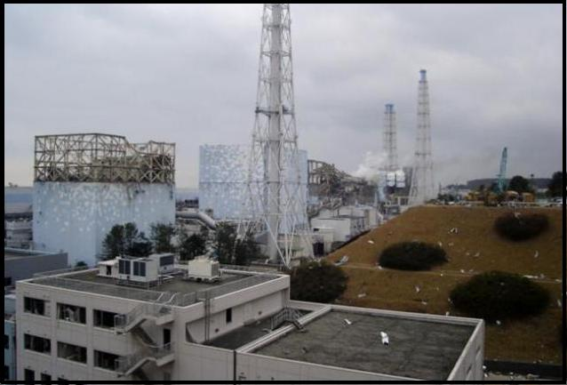
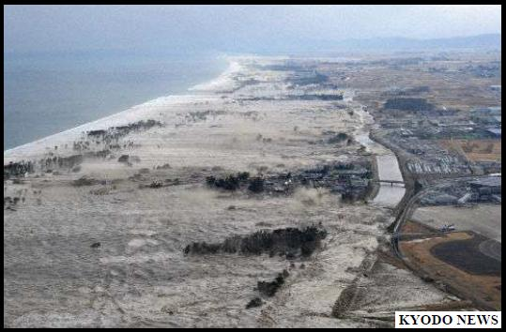
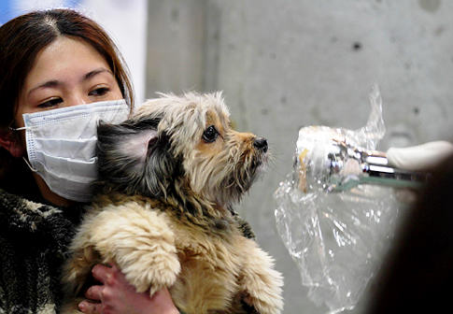
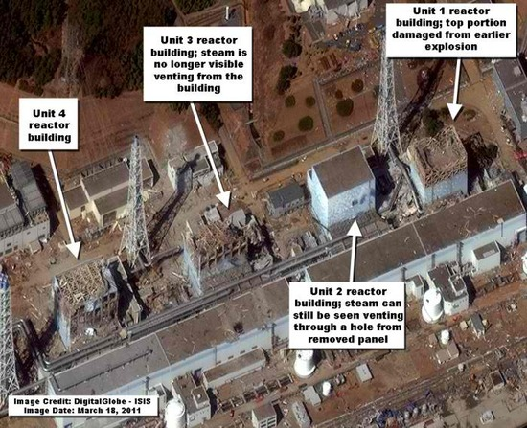
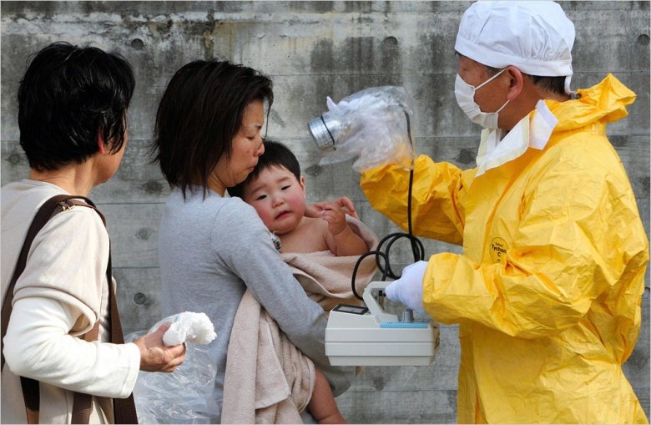
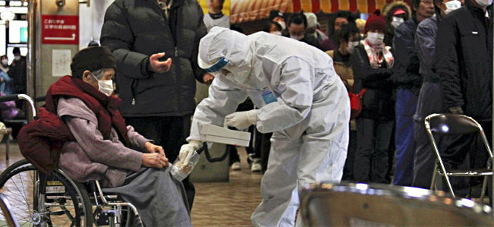
Japan Earthquake and Radiological Incident

Slide 18
CDC NPDS Response
Tracking reported ingestions of countermeasures and perceived risk from radiation
Identifying health communication needs
Potassium Iodide (KI)
Other iodide-containing products
Radiation

Slide 19
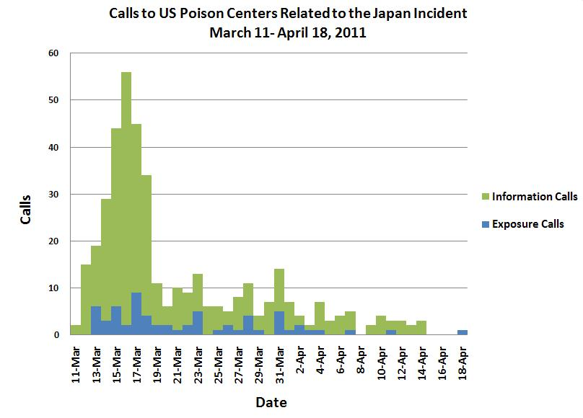

Slide 20
Summary
Poison center calls are important for national surveillance of radiation exposures
CDC and AAPCC members of the NPDS Surveillance Team use NPDS to track radiation calls
New enhanced radiation codes in NPDS will add more detail to radiation calls

Slide 21
Questions?
Royal Law MPH
Rlaw@cdc.gov
770-488-3416
Art Chang MD MS
ctn7@cdc.gov
770-488-1470

