Slide 2
Vision
Mission
To become a more protected, resilient nation through a comprehensive and integrated approach to radiological emergencies
Enhancing radiological preparedness capability and capacity in public health and health care systems through a coalition of organizations committed to improving the nation’s ability to prepare, respond, and recover from radiological emergencies at the local, state, and national levels,

Slide 3
NARR Purpose
To serve as the collective “voice of health” in radiological preparedness through the:
Participation in national dialogues on radiological emergency issues
Provision of thoughtful feedback on documents, policies, and guidelines
Convening of partners to raise awareness of and resolve radiological emergency issues
To build radiological emergency preparedness, response and recovery capacity and capabilities by supporting the:
Development of mechanisms for sharing resources and tools, including technical methods and information
Identification and dissemination of best practices
Definition of and education on the roles and responsibilities of different levels of government and different governmental agencies in radiological emergencies
Establishment of performance measures and guidelines
Building and sustaining of long-term competencies

Slide 4
NARR Membership
• American Association of Poison Control Centers (AAPCC)
• American Hospital Association (AHA)
• American Medical Association (AMA)
• American Public Health Association (APHA)
• Association of Public Health Laboratories (APHL)
• Association of Schools of Public Health (ASPH)
• Association of State and Territorial Health Officials (ASTHO)
• Conference of Radiation Control Program Directors (CRCPD)
• Council of State and Territorial Epidemiologists (CSTE)
• Council of State and Territorial Epidemiologists (CSTE)
• Health Physics Society (HPS)
• International Association of Emergency Managers (IAEM)
• National Association of County and City Health Officials (NACCHO)
• National Association of State EMS Officials (NASEMSO)
• National Disaster Life Support Foundation (NDSLF)
• National Emergency Management Association (NEMA)
• National Public Health Information Coalition (NPHIC)

Slide 5
Federal Partner Agencies
Centers for Disease Control and Prevention (CDC)
Office of the Assistant Secretary for Preparedness and Response/US Department of Health and Human Services (ASPR/HHS)
US Department of Homeland Security (DHS)
Environmental Protection Agency (EPA)
US Department of Energy (DOE)
US Department of Agriculture (USDA)
Food and Drug Administration (FDA)
US Nuclear Regulatory Commission (NRC)
Federal Emergency Management Agency (FEMA)

Slide 6
History
June 2008: CDC-CRCPD sponsored “Roundtable on Communication and Teamwork: Keys to Successful Radiological Emergency Response”
April 2009: CDC-CRCPD sponsored follow-up Workshop “Alliance to Expand Radiological Emergency Preparedness in Public Health”
May 2009: the first Steering Committee Meeting
May 2010: final report of exploratory phase submitted to CDC
March 2011: Official Kick-off meeting following Bridging the Gaps conference

Slide 7
Governance
Chairs
John Erickson, Washington State Department of Health (ASTHO)
Adela Salame-Alfie, New York State Department of Health (CRCPD)
William Stephens, Tarrant County Public Health, Texas (NACCHO)
Executive Committee
Subgroups
Membership
Editorial Board
Laboratory taskforce
Administered by the Association of State and Territorial Health Officials through a cooperative agreement with the Centers for Disease Control and Prevention (CDC) , National Center for Environmental Health, Radiation Studies Branch

Slide 8
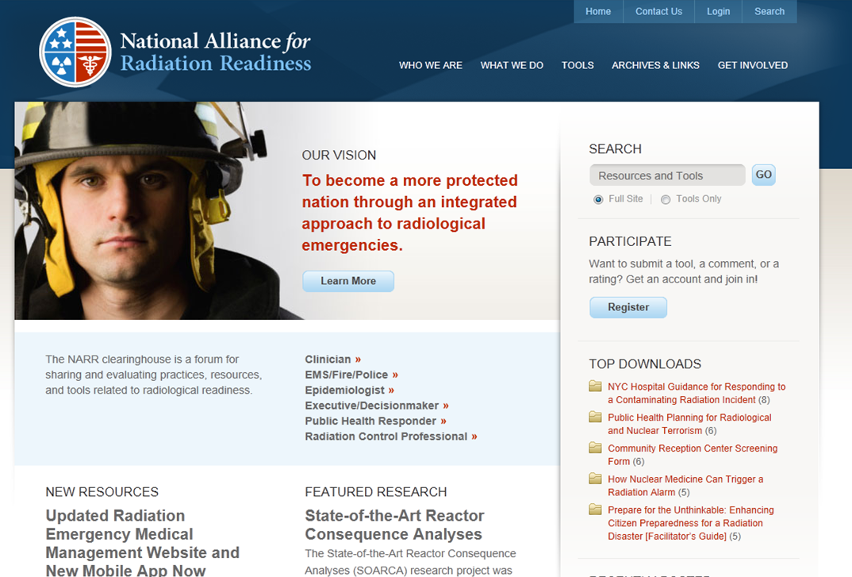
NARR Clearinghouse www.radiationready.org

Slide 9
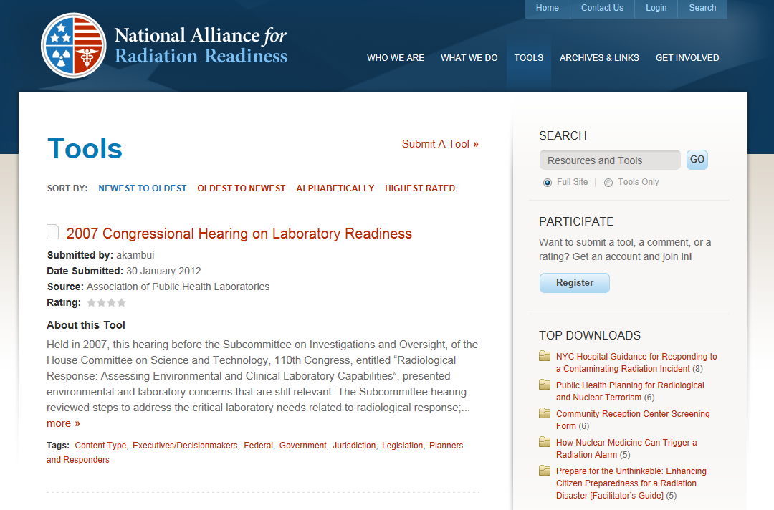
NARR Clearinghouse Tools

Slide 10
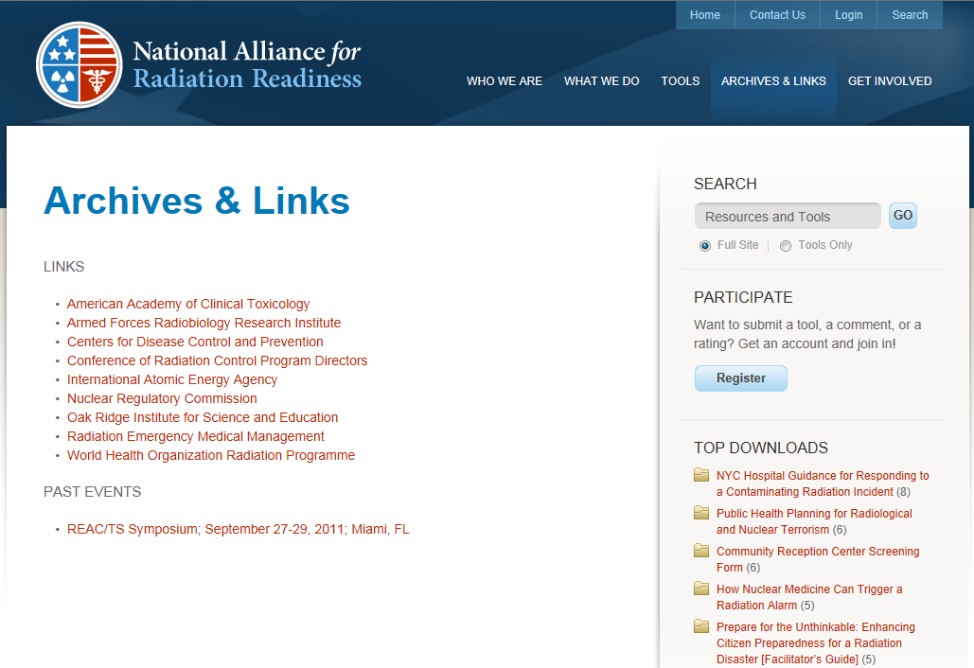
Important Links and Events

Slide 11
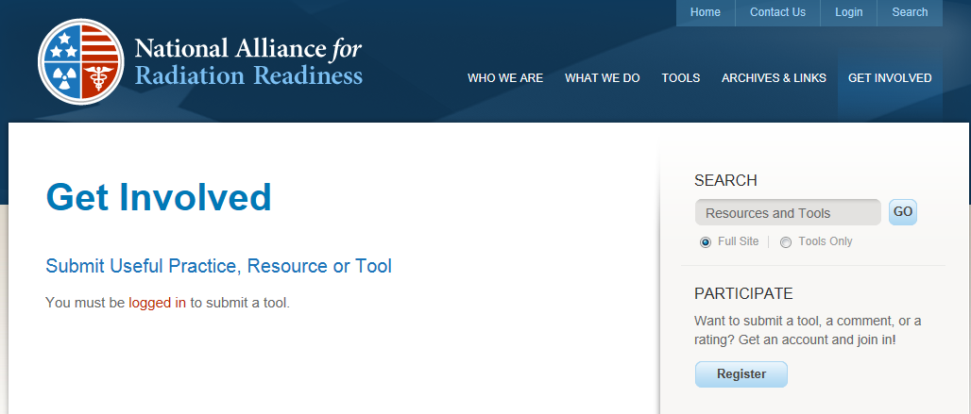
We Would Like to Hear from YOU!

