Slide 1
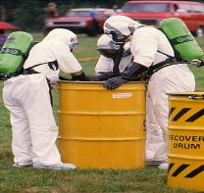
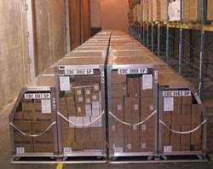
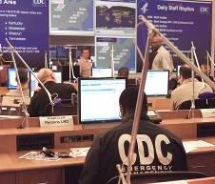
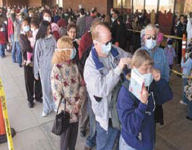
Strategic National Stockpile
Susan Gorman, Pharm.D., M.S., DABAT, FAACT
Associate Director for Science , Division of Strategic National Stockpile
Office of Public Health Preparedness and Response

Slide 2
The
Strategic National Stockpile
The nation’s repository of antibiotics, chemical antidotes, antitoxins, vaccines, antiviral drugs and other life-saving medical materiel designed to supplement and re-supply state and local public health agencies in the event of an emergency.
Managed by Office of Public Health Preparedness and Response’s (OPHPR) Division of Strategic National Stockpile (DSNS)
  Mission: Prepare and support partners and provide the right resources at the right time to secure the nation’s health.

Slide 3
Rationale for Stockpiling Material
Stockpiled material is normally held for one or more of the following reasons:
  A product required is not commercially viable and thus is not commercially available.
  The US pharmaceutical supply chain runs under a just in time model, consequently:
    A product may be commercially available but not in projected quantities required.
    A product may be commercially available but cannot reach affected populations in adequate timeframes and/or in adequate quantities
  Normal supply chain cannot dispense to the population at the level required (time or volume)

Slide 4
Strategic National Stockpile
Background
Program created in 1999
  Limited available material and formulary governance
Push packages and limited SMI/VMI material held in a network of strategically located repositories
Adopted Shelf Life Extension Program (SLEP)
Commercial partnerships for storage, maintenance, and rapid transport
Federal partnerships for purchasing and security
Technical assistance to states/locals for management and utilization of deployed material
Non-scored reviews of SLTT plans

Slide 5
Today’s Strategic National Stockpile
Supporting National Health Security
It’s more than the stuff!
Acquire and manage countermeasures and medical devices to meet PHEMCE created requirements in a manner that assures regulatory compliance, viability and safe effective use
Develop and support federal/state/local and private sector partners to effectively use SNS material
Create guidance and policy for safe and effective implementation of a countermeasure response
  Scientific research
  Clinical guidance and support
  Regulatory management
Deploy support teams to assist state and local officials during a public health emergency
Scored SLTT reviews that show return on preparedness investment

Slide 6
Partnerships
Federal
  VA
  DoD
  DHS
  DoJ
  FDA
  USDA
Private Sector
  Commercial vendors
  Commercial carriers
State and Local Planners

Slide 7

Formulary Development
Based on Category A Biological Threat Agents
  Smallpox
  Anthrax
  Botulism
  Viral Hemorrhagic Fevers
  Plague
  Tularemia
Chemical
Radiation
Pandemic Influenza

Slide 8
Formulary Development:
Requirements Setting
Set by Interagency Public Health Emergency Medical Countermeasures Enterprise (PHEMCE)
  Define and prioritize requirements for public health emergency medical countermeasures
  Integrate and coordinate research, early and late stage product development, and procurement activities addressing the requirements
  Set deployment and use strategies for medical countermeasures held in the Strategic National Stockpile (SNS).
Annual Review
Phase I
SNS Content Review
Phase II
Integrated Gap Analysis
Phase III
Gap Prioritization
Phase IV
Corrective Action Planning

Slide 9
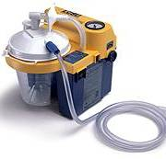
Formulary Contents
Pharmaceuticals
  Antibiotics (Oral and Intravenous)
  Chemical (nerve agent) Antidotes
  Vaccines, Antivirals and Antitoxins
  Other Emergency Medications
IV Administration Supplies
Airway Management Supplies (Pediatric and Adult)
Items for Radiation, Burn and Blast, Wound Care
Pandemic Influenza

Slide 10
Radiation Specific Countermeasures
Neupogen (filgrastim)
Radiogardase (Prussian blue)
Calcium & Zinc DTPA
Other Related Countermeasures
Anti-emetics
Antimicrobials, antifungals, antivirals
Seizure control, pain control
Vasopressors
Sedatives/paralytics for intubation/ventilator support
Notes:
Human granulocyte-colony stimulating factor
For treatment of acute radiation sickness
Not FDA approved for this indication
Given by IV or subcutaneous route
PB: Radiogardase (Prussian blue) – Heyl
FDA approved
Treat internal contamination
Oral administration
Enhance fecal excretion of isotopes by ion exchange
Radioactive cesium
Radioactive or nonradioactive thallium
DTPA: FDA approved
Treat internal contamination
Chelator for absorbed multivalent radioisotopes such as plutonium, americium, others
Product manufactured by Hameln and distributed in US by Akorn
200mg/ml; 5ml ampule
Kytril (granisetron) - Roche
Antiemetic
IV administration
1mg/ml vial
Selective inhibitor of type 3 serotonergic receptors
Promethazine
Antiemetic/sedative
IV or IM administration
25mg/ml ampule

Slide 11
Burn/Blast/Trauma Countermeasures
Bandages, sterile dressings
Silvadene cream, bacitracin ointment
Sutures/needles
Sterile laceration repair kits
Sterile skin staplers
Fluoroscein dye strips
1% lidocaine with and without epinephrine
Opthalmic antibiotic ointment

Slide 12
IV Administration Supplies
Alcohol pads
Gloves
IV administration sets
IV fluids
Syringes/needles
Intermittent injection sites
Sodium chloride flushes

Slide 13
Airway Maintenance Supplies
Manual pulmonary resuscitators/CO2 detectors
Laryngoscopes
Oropharyngeal airways
Endotracheal tubes/stylettes
Oxygen masks/tubing/nasal cannulas
Suction catheters/units
Ventilators and ancillary supplies

Slide 14

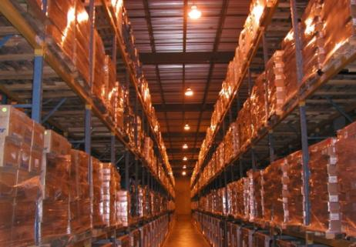
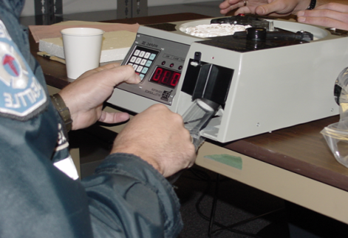
Formulary Development:
Acquisition Considerations
R = rotation capabilities-can drugs be rotated?
E = effectiveness of drugs for a particular disease
A = availability of items
S = storage considerations
O = operational considerations
N = need for ancillary supplies

Slide 15

Emergency Response Concept
Provide threat-appropriate delivery mechanism
Provide rapid delivery of a broad spectrum of support for an ill-defined threat in the early hours of an event
Provide specific materiel when a threat is known
Provide technical assistance to receive and effectively distribute Strategic National Stockpile materiel

Slide 16
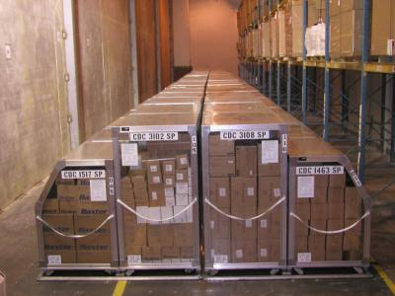
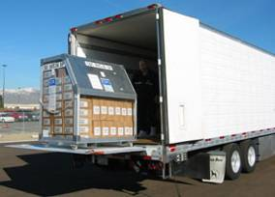
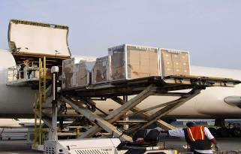
Broad Spectrum Support:
12-hour Push Packages
Pre-packed and configured materiel assembled in transport-ready containers (50 tons)
Pre-positioned in secure facilities near major transportation hubs
Delivered rapidly by commercial transport partners
Color coded and numbered containers for rapid identification by state and local authorities

Slide 17
Strategic National Stockpile
Managed Inventory
Stockpile Managed Inventory
  Held in a 3PL (third party logistics) model
  Appropriate where rapid response or quantities of commercially available material exceeds supply chain capability
  Appropriate where countermeasures are not commercially available
Vendor Managed Inventory
  Appropriate where supply chain capability is not exceeded by time or quantity required

Slide 18
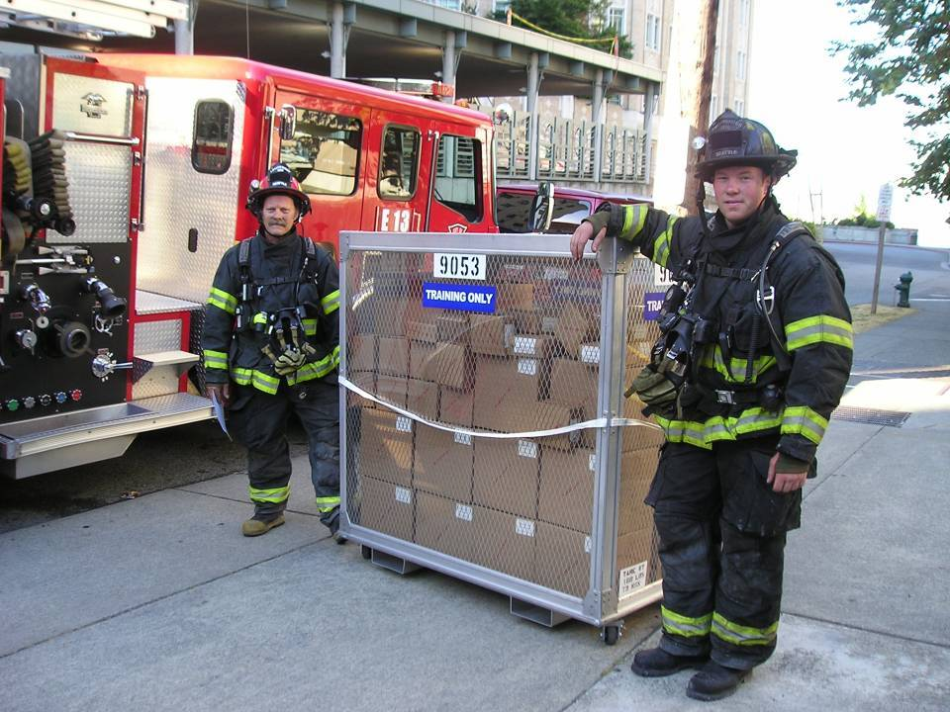
Forward Placed Caches:
CHEMPACK
Chemical nerve agent antidotes require administration too rapidly to centrally manage and move as needed
Nationwide “joint venture” program
Forward placement of nerve agent antidotes
Integrated into local
Hazardous Material response
Containerized storage
Remote monitoring
Uniform Formulary
Two configurations

Slide 19
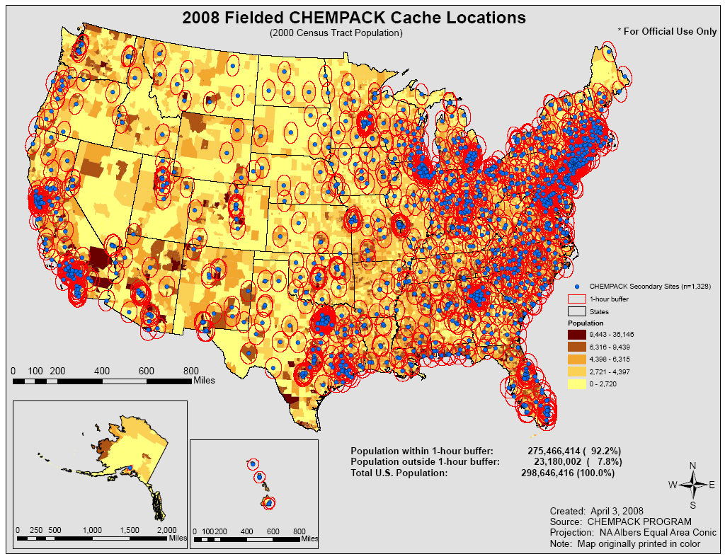
>1,900 CHEMPACK containers in >1,300 cache sites
>90% of US Population within a 1 hour response

Slide 20
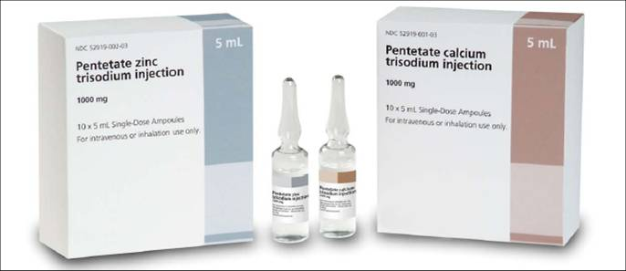
DTPA Forward Placement Project
Voluntary program to protect major US cities
Integrated into local RDD response
Local storage and control
Calcium & Zinc DTPA
Permits rapid chelation of internal contamination with plutonium, americium, or curium.

Slide 21
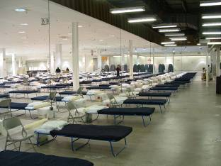
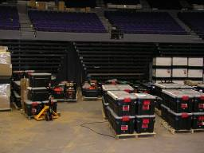
Federal Medical Stations (FMS)
Modular deployable medical surge support caches
250 Beds per “station”
Medical supplies, pharmaceuticals and equipment for 3 days
Designed for non-acute care
Configured for rapid movement

Slide 22
DSNS Deployable Teams
Stockpile Services Advance Group (SSAG)
  Experts on SNS response and state/local capability
  Provides short-term technical assistance
  Members represent DSNS at Emergency Operations Center (EOC), IRCT, etc.
Receiving, Staging and Storing (RSS) Task Force
  Assists with receipt, staging, onward movement and re-supply
Federal Medical Station (FMS) Strike Team
  Helps state/local officials set up, re-supply and recover

Slide 23
DSNS Provides Technical Assistance
Pre Event
  Version 10.02: Receiving, Distributing and Dispensing Strategic National Stockpile Assets
  Cities Readiness Initiative (CRI)
  Technical assistance to the 62 state, locality, and U.S. insular area public health departments funded by CDC’s Public Health Emergency Preparedness cooperative agreement
  State and local exercise support and evaluations
  Classroom instruction
  Satellite Educational Broadcasts
  Pilot program for Strategic National Stockpile field staff
Post Event
  DSNS Deployable Teams (SSAG, RSS Task Force, FMS Strike Team)

Slide 24
SNS Asset Request Flow
1.
Need for Drugs and Medical Supplies Exceeds Local & State Resources
2.
State Requests Federal Assistance
Discussion with key officials: (i.e. HHS, DHS, CDC, State, etc)
4.
Augments Federal, State, Local Medical Materiel Resources
3.
Federal Officials Deploy SNS Assets
Division of Strategic National Stockpile

Slide 25
Request Procedure
National Response Plan does not have to be activated
Presidential Disaster Declaration does not have to be in effect

Slide 26
Summary of Response
Request for assets is made and approved
DSNS delivers medical countermeasures (MCM) to predesignated Receive/Store/Stage (RSS) locations
State/city further distributes MCM to points of dispensing (PODs) or other designated locations (i.e. hospitals)
PODs are opened/staffed
  Open/closed PODs
  Non medical vs medical model
  Use of MCM under IND or EUA
    Information materials

Slide 27
EUA vs. IND
Regulatory Requirement | Emergency Use Authorization | Investigational Protocols (IND/IDE)
Investigational Review Board | Not Required | Required 21 CFR part 56
Written/Witnessed Informed Consent | Not Required | Required 21 CFR part 50
Protocol Training | Not Required | Required
Adverse Event Monitoring/Reporting | May be required | Required
Recordkeeping/Access | May be required | Required
Duration | Up to one year | Length of clinical trial

Slide 28
EUA Sequence
****EVENT****
Declaration and Determination
EUA Request and Authorization
Countermeasure Distribution
EUA Conditions
EUA Termination

Slide 29
EUA Conditions
Information for Health Care Providers/Authorized Dispensers*
Information for Recipients*
Adverse Event Reporting/Monitoring*
Recordkeeping/Access*
Compliance with Good Manufacturing Practices
Advertising
Restricted Distribution
Data Collection/Analysis

Slide 30
Questions? http://www.cdc.gov/phpr/stockpile/stockpile.htm

