Slide 1
Things You Should Know About Radiation Exposure...But Were Afraid to Ask
Jeffrey B. Nemhauser, MD
Deputy Associate Director for Science
Office of Public Health Preparedness and Response
August 27, 2012
Centers for Disease Control and Prevention
Office of Public Health Preparedness and Response

Slide 2
Use of trade names or commercial sources is for informational purposes only and does not constitute an endorsement by the
United States Department of Health and Human Services or the US Public Health Service.
Views and opinions expressed by Dr. Nemhauser are not necessarily those of the Centers for Disease Control and Prevention.

Slide 3
Radiation is a Toxicant…Sort of
Photons pass directly through the body; particles must be ingested/inhaled
No volume of distribution
Not metabolized by biological processes
Cannot be excreted
Time/distance/shielding are the means of limiting radiation exposure
Have to be ingested/inhaled to exert an effect
Have a volume of distribution
Are metabolized or undergo detoxification
Excretion can be facilitated
Uptake can be blocked
Metabolism may depend on genetic polymorphisms
RADIATION
TOXINS & TOXICANTS

Slide 4
Radiation is a Toxicant…Sort of
“The dose makes the poison…”
RADIATION
TOXINS & TOXICANTS

Slide 5
Where Physics and Biology Collide
Relative Biological Effectiveness (RBE)
  The effect of radiation on a test system as compared to a fixed dose of x-rays
  Is a function of
    Radiation quality: radiation type (electromagnetic or particle) and its energy
    Radiation dose
    Number of dose fractions
    Dose rate
    Biological system or endpoint
* Citations, references, and credits – Myriad Pro, 11pt

Slide 6
Where Physics and Biology Collide
Linear Energy Transfer (LET)
  Energy transferred per unit length of the distance traveled by a charged particle (e.g., alpha or beta)
  Simple way of indicating the quality of different types of ionizing radiation (sparsely ionizing – low LET vs. densely ionizing – high LET)
  The higher the energy, the lower the LET
* Citations, references, and credits – Myriad Pro, 11pt

Slide 7
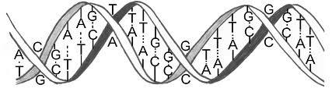
Where Physics and Biology Collide
100 keV/μm
200 keV/μm
Equally as effective per track, but less effective per unit dose (i.e., energy is “wasted”)
RBE
x-ray
* Hall, Giaccia: Radiobiology for the Radiologist, 2006.
LET

Slide 8
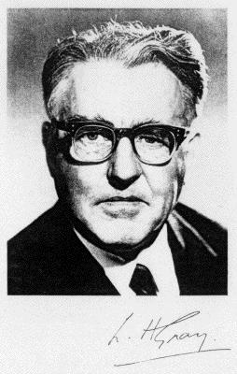
Where Physics and Biology Collide
Absorbed dose
  Energy actually deposited from any kind of radiation in any kind of material as the radiation passes through it
  rad = 100 ergs per gram of tissue
  SI Unit: gray (Gy)
    1 joule per kilogram of tissue
  1 Gy = 100 rad
Louis Harold Gray
“Father of Radiobiology”

Slide 9
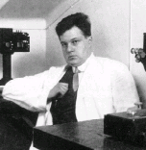
Where Physics and Biology Collide
Dose equivalent
  Allows for different biological effectiveness of different kinds of radiation
  rem is used when absorbed dose calculated in rad
  SI unit: sievert (Sv) used when absorbed dose calculated in Gy
  1 Sv = 100 rem
Rolf Sievert

Slide 10
Where Physics and Biology Collide
rad: radiation absorbed dose
  Amount of energy absorbed by a given mass of tissue (ergs/gram)
rem: roentgen equivalent in man
  Takes into account the biological effect of various types of radiation

Slide 11
Where Physics and Biology Collide
rem = rad x RBE*
  Relative Biological Effectiveness
  RBE ≈ 1.0 for β, γ, and x-radiation
  RBE ≈ 2.0 for neutrons
  RBE ≈ 20 for alpha particles

Slide 12
The Law of Bergonié and Tribondeau (1906)
Actively proliferating cells are the most sensitive to the effects of radiation
The degree of differentiation of cells is inversely related to their radiosensitivity
Radiosensitivity of cells is proportional to the duration of mitotic and developmental activity they must pass through

Slide 13
Cellular Radiosensitivity
Most
  Lymphocytes
  Immature hematopoietic cells
  Intestinal epithelium
  Spermatogonia & ovarian follicular cells
Least
  Mature red cells
  Muscle cells
  Mature connective tissue, bone, cartilage
  Ganglion cells

Slide 14
Acute Radiation Syndrome (ARS)
Radiation dose must be high
Radiation must be penetrating (i.e., able to reach internal organs)
Radiation must be delivered over a short period of time (usually minutes)
Exposure area: whole body or significant partial body
Most dire acute outcome of whole body, high dose, radiation exposure

Slide 15
The Four Stages of ARS
Prodrome
  Begins after exposure
  Lasts 24–48 hours
  More rapid symptom onset implies greater absorbed dose
  Onset of prodromal adverse health effects occurs more rapidly with more severe ARS than with more mild ARS
Latency Period (quiescent phase)
  Variable length depending on absorbed dose
Manifest Illness
Recovery or Death

Slide 16
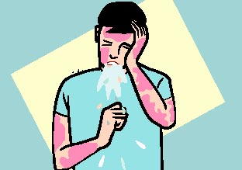
ARS Prodrome – Signs and Symptoms
Nausea/vomiting
  Hallmark finding but not always present
  Time to vomiting may be used as rough estimate of exposure and ultimate outcome
Fever
Fatigue
Headache
Salivary gland inflammation (hyperamylasemia)
Diarrhea (indicator of poor prognosis)
Skin erythema

Slide 17
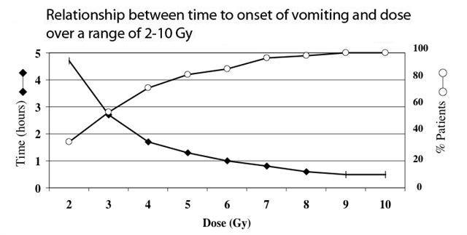
ARS Prodrome – Signs and Symptoms
* Nicholas Dainiak, Course: Response to and Management of a Radiological Crisis, Figure 2, New York School of Medicine Courses Online. (Site registration required.)

Slide 18
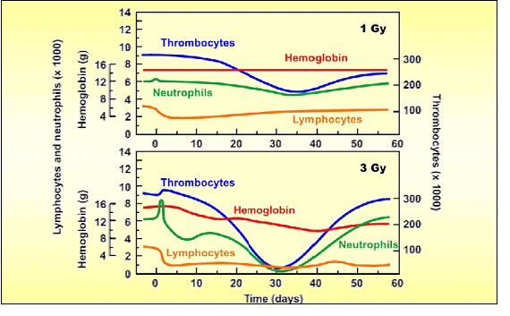
ARS Prodrome – Early Markers
* Adapted from lecture by Col. William Dickerson, AFRRI.

Slide 19
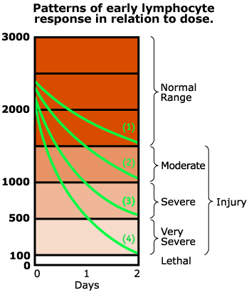
ARS Prodrome – Early Markers
Lymphocytes
  Highly radiosensitive
  Progressive decline in absolute lymphocyte count provides early estimate of injury and outcome
Absolute Lymphocyte Count

Slide 20
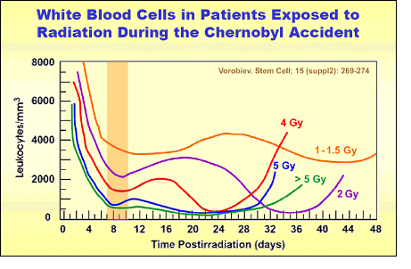
The Three Subsyndromes of ARS
Hematopoietic (Bone Marrow): 250-500 rad/2.5-5 Gy
* Dr. William Dickerson, (AFRRI) based on Figure 6 from Vorobiev AI. Acute Radiation Disease and Biologic Dosimetry in 1993. Stem Cells 1997;15(Suppl 2):269-274

Slide 21
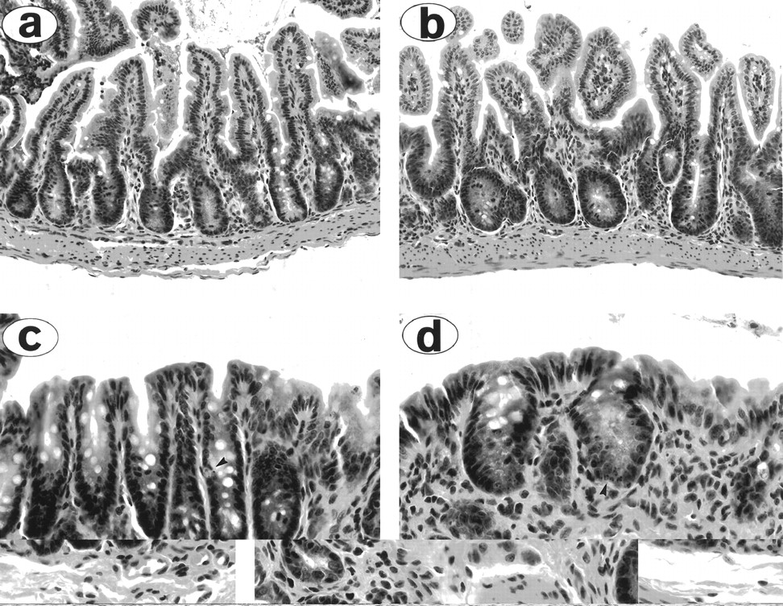
The Three Subsyndromes of ARS
GI: 1000 rad/10 Gy
* Hill G R et al. Blood 1997;90:3204-3213

Slide 22
The Subsyndromes of ARS
Neurovascular: 10,000 rad/100 Gy
  Death within 24-48 hours
  Exact and immediate cause of death unknown
  Endothelial destruction resulting in profound capillary leak

Slide 23
Treatment of ARS
Largely limited to BM subsyndrome
Supportive Care
Colony Stimulating Factors (Neupogen®/filgrastim)
Antibiotics/antifungals
Reverse isolation
Bone Marrow Transplant
* Citations, references, and credits – Myriad Pro, 11pt

Slide 24
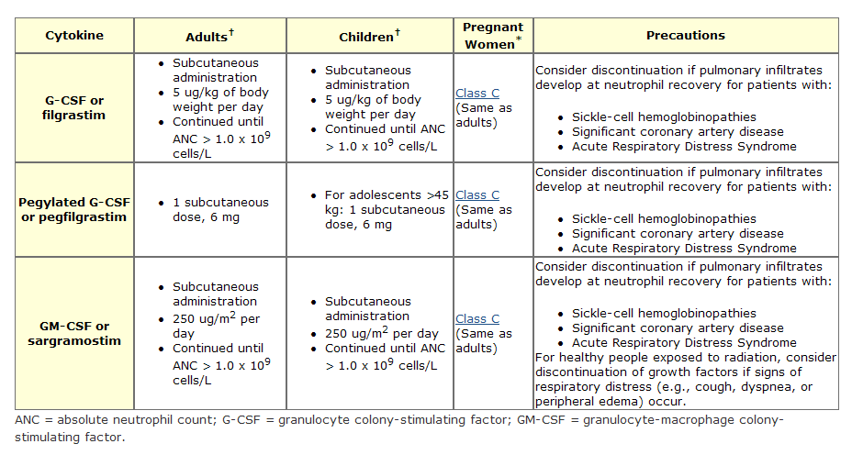
http://remm.nlm.gov

