Slide 1
A Radiation Primer
radiation … radioactive material
What are they?
exposure … contamination
Are they the same?

Slide 2
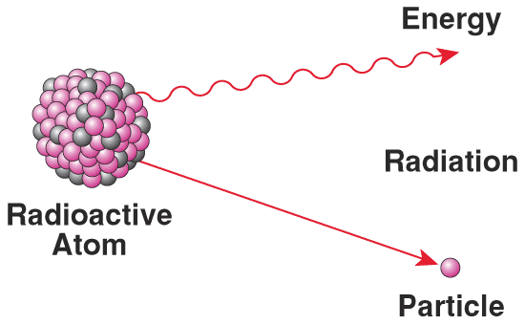
Radioactivity
Spontaneous emission of radiation from the nucleus of an unstable isotope
Disintegration Decay

Slide 3
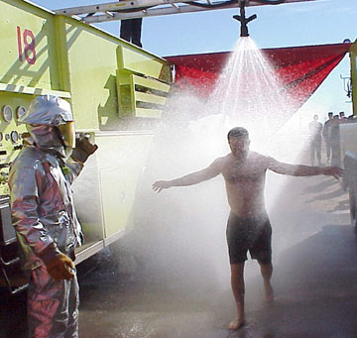
Demonstrate Decontamination
Any Volunteers?

Slide 4
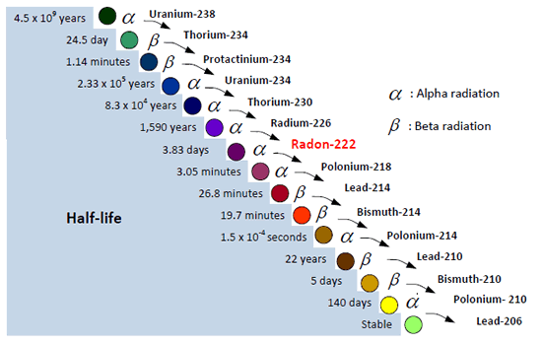
Notes:
http://radonmd.com/

Slide 5
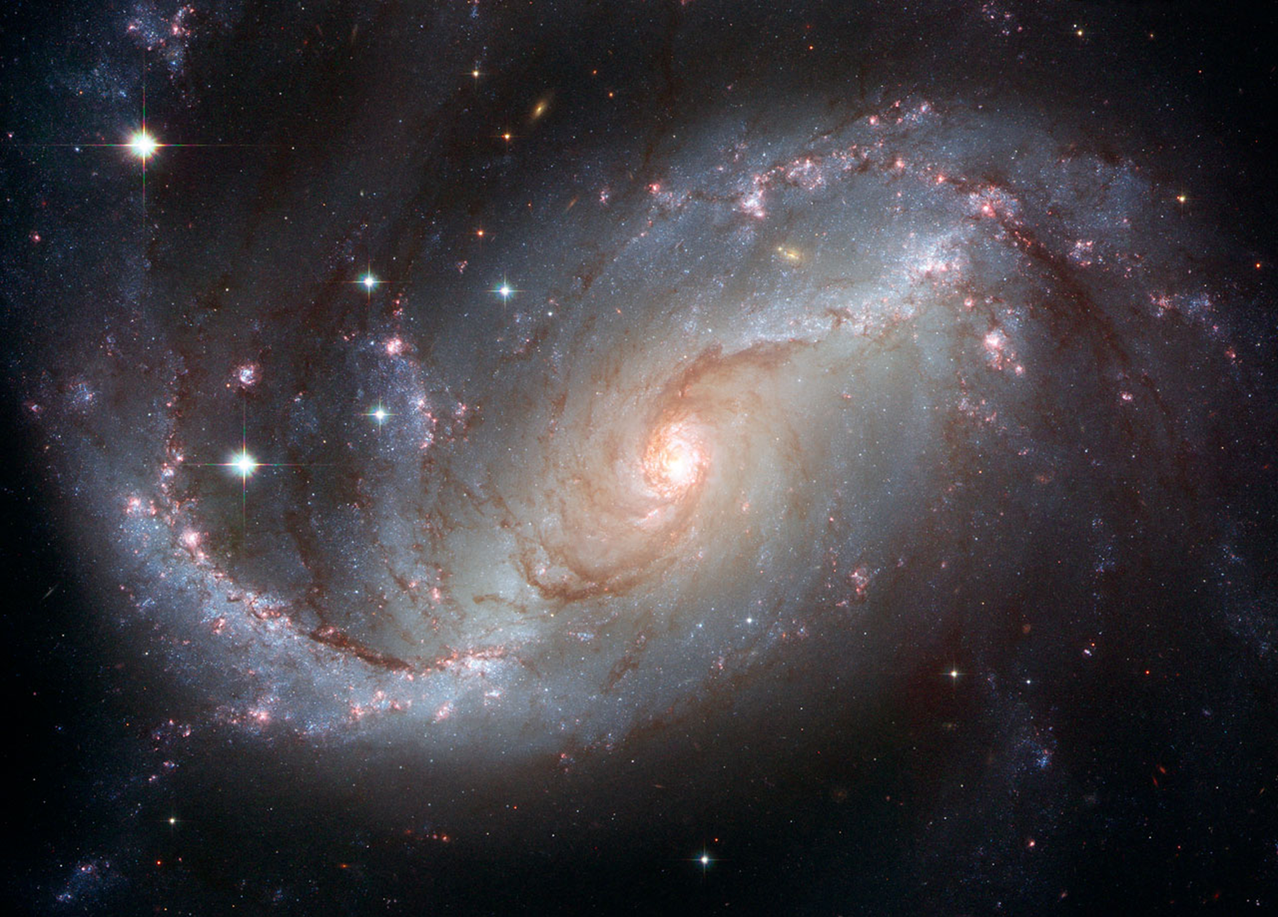

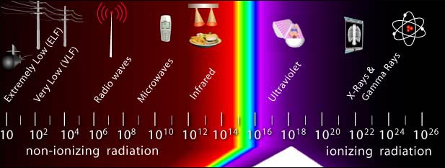
Energy
Notes:
5

Slide 6
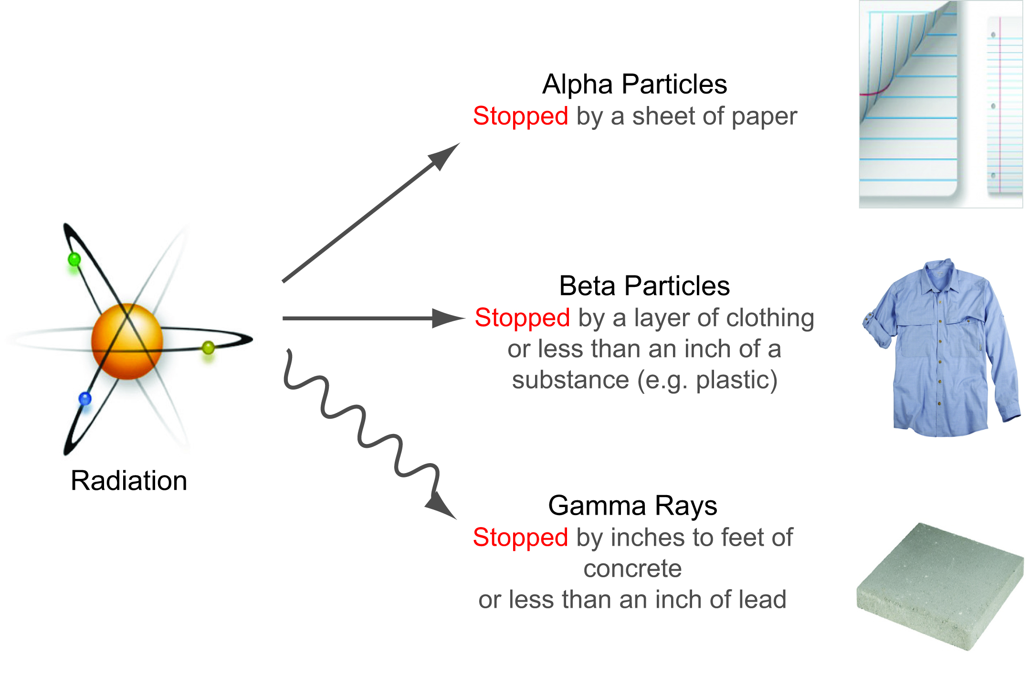
Penetration Abilities
Especially damaging to internal tissues if inhaled or swallowed
Damaging to internal tissues if inhaled or swallowed and can cause external skin burns
Damaging to tissues externally and internally

Slide 7
Common Radioactive Nuclides
Nuclear medicine: Iodine-131
Radiotherapy: cobalt-60
Satellite power: plutonium-238
Nuclear power: uranium-235
Our body: potassium-40
Our water: radium-226

Slide 8
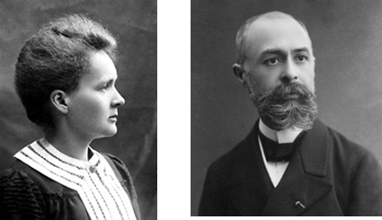
Radiation Units
Unit prefixes from Tera (10¹²) to pico (10⁻¹²)
Amount of radioactivity
  Curie (Ci), Becquerel (Bq)
Ambient radiation levels
  Roentgen per hour (R/h, rem per hour (rem/h)
Radiation Dose
  Rad, rem, Gray (Gy), Sievert (Sv)

Slide 9


Radioactive Contamination
What if you ingested
  12 Bq (disintegrations per second)?
  5500 Bq?
The point is not to trivialize radioactivity, but to put it in perspective.

Slide 10
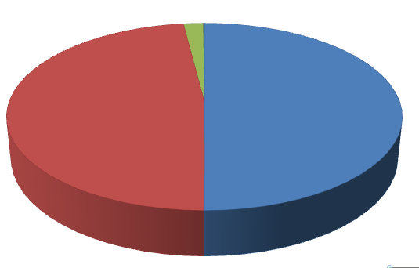
Average Annual Radiation Exposures:
6.2 mSv = 620 mrem
Consumer products, occupational
2%
Natural background
50%
Medical
48%
?
Source: NCRP Report No. 160, Ionizing Radiation Exposure of the Population of the United States (2009)

Slide 11
Typical Doses (mSv)
Airport Screening 0.0001
NY to London by air 0.05
Chest X-Ray 0.1
Natural bkgd. (annual) 3
CT Scan -Abdomen 10
Occupational annual limit 50
50% survival (whole body) 4,000
Radiotherapy (tumor, partial) 80,000
1 mSv = 100 mrem

Slide 12
Radiation Protection
Time
Distance
Shielding
Evacuation
Sheltering
Medical countermeasures
Guiding principle for controlling exposures:
ALARA
As Low As Reasonably Achievable

Slide 13
Review Fundamentals
Difference between:
– Radioactive material
– Radiation
Difference between being:
– Contaminated
– Irradiated (exposed)
External &
Internal

Slide 14
Summary: Key Points
Radiation types: alpha, beta, gamma
Radiation and radioactivity are part of our natural environment
Radioactive contamination is not immediately life threatening.
Decontamination is relatively simple.
Radiation can be readily detected.

Slide 15
Summary: Key Points
Dose Units:
    Rem – in the U.S.
    Sievert (Sv) - rest of the world
Radiation can:
    kill in short term
    cause cancer in long term, or
    have NO EFFECT
It is all about dose!

Slide 16
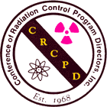
Important Contact!
Know the contact information for your state radiation control program. This office is vital in both planning for and responding to a nuclear or radiological incident.
www.crcpd.org/Map/map.html

Slide 17
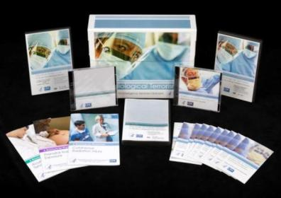
Radiological Terrorism: A Toolkit for Emergency Services Clinicians
Resources for Clinicians
  JIT Training
  Pocket Guides
  Radiation Triage Chart
  Fact Sheets
  Webcasts
  Self-study Programs
  Psychological First Aid in Radiation Disasters
http://www.emergency.cdc.gov/radiation/

Slide 18
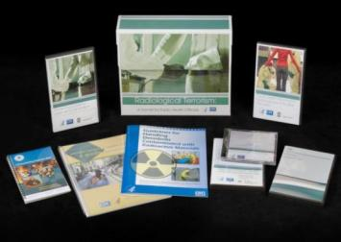
Radiological Terrorism: A Toolkit for Public Health Professionals
Resources for Public Health
  vCRC
  Population Monitoring Guide
  EPA Risk Communication Guide
  Contaminated Decedents Guide
  Radiation Survey DVD
  Webcasts
  Fact Sheets
  Self-study Programs
  Psychological First Aid in Radiation Disasters
http://www.emergency.cdc.gov/radiation/

Slide 19
Questions?
Armin Ansari
770-488-3654
AAnsari@cdc.gov

