Slide 1
Epidemiologic Issues in Radiation Response
Colleen Martin, MSPH
National Center for Environmental Health
Division of Environmental Hazards and Health Effects
Health Studies Branch
National Center for Envrionmental Health
Division of Environmental Hazards and Health Effects

Slide 2
Disclaimer
The findings and conclusions in this presentation are those of the author(s) and do not necessarily represent the official position of the Centers for Disease Control and Prevention/the Agency for Toxic Substances and Disease Registry .

Slide 3
Objectives
Define and describe role of epidemiology in radiation response
Discuss examples of recent radiation responses

Slide 4
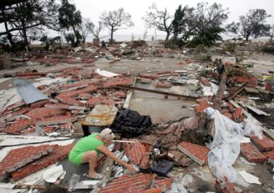
Public Health Functions After Any Disaster
Rapid assessment of health and medical needs
Sheltering and housing, mass care safety
Injury and illness surveillance
Potable water, safe food, sanitation and hygiene
Vector control
Solid waste, waste water management
Hazardous material disposal
Registry
Handling of the deceased
Rumor control
Public service announcements
Notes:
4
Large displaced population
Potential for contamination
Potential for injuries
Some may need immediate medical care
Most may need shelter/temporary housing
All would be stressed
People need to be screened and triaged, preferably at locations other than area hospitals
Decontamination will need to be provided
Response and recovery from detection to site decontamination could extend for weeks, months, or years
Biomonitoring might be performed for years

Slide 5
Epidemiology
Study of the distribution and determinants of health-related states in specified populations, and the application of this study to control health problems
Disaster epidemiology
Assesses the short- and long-term adverse health effects of disasters and to predict consequences of future disasters
Includes acute and communicable disease, environmental health, occupational health, chronic disease, injury, mental health, and behavioral health epidemiology
Provides situational awareness
Information to describe immediate needs, plan the response, and gather the appropriate resources.

Slide 6
Role of Epidemiology in Radiation Response
Surveillance
Ongoing to detect covert incident (challenging!)
Post-incident to track population health impact
At-risk populations (young, pregnant)
Standardized data collection to
Inform immediate interventions to protect health
Prioritize limited resources (e.g., urine radiobioassay)
Long-term health effects studies

Slide 7
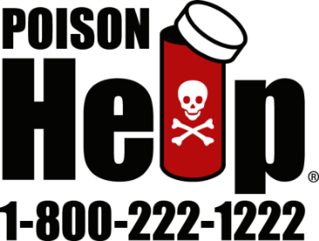
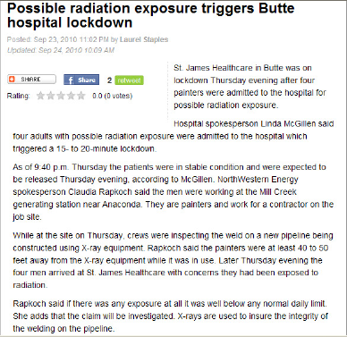
Surveillance
National Poison Data System (NPDS)
Near real-time, electronic, web-based surveillance system
Exposures and health effects reported from healthcare facilities and community members to 57 regional US Poison Centers

Slide 8
Population Monitoring
Public health function that involves monitoring and evaluating all potentially affected people for
Needed medical treatment
Presence of radioactive contamination on the body or clothing
Intake of radioactive materials into the body
Removal of external or internal contamination (decontamination)
Radiation dose received and the resulting health risk from the exposure (including long term)

Slide 9
Community Reception Center (CRC)
Modular, scalable structure
Radiation assessment station
Decontamination station
Registration station
Laboratory collection station
First aid and medical station
Mental health and social services station
VCRC link: http://www.emergency.cdc.gov/radiation

Slide 10
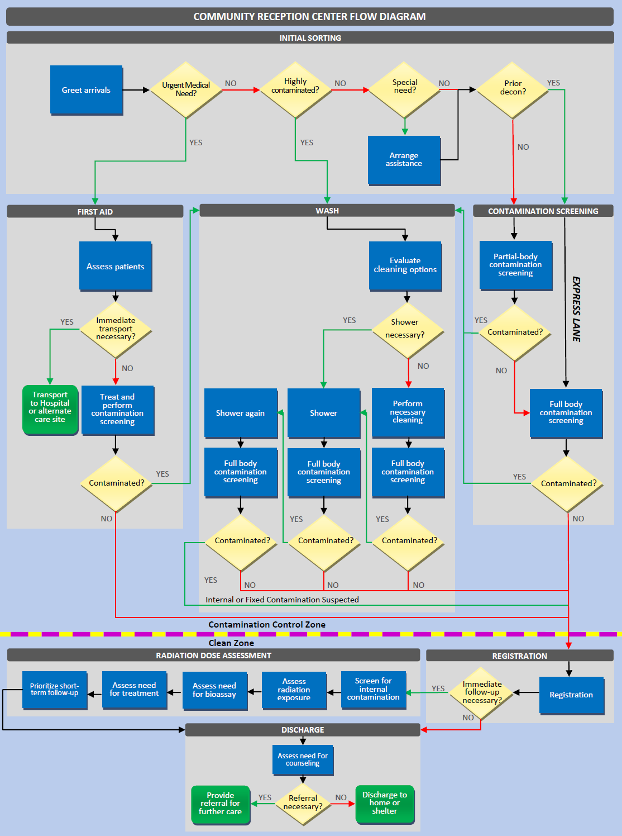

Slide 11
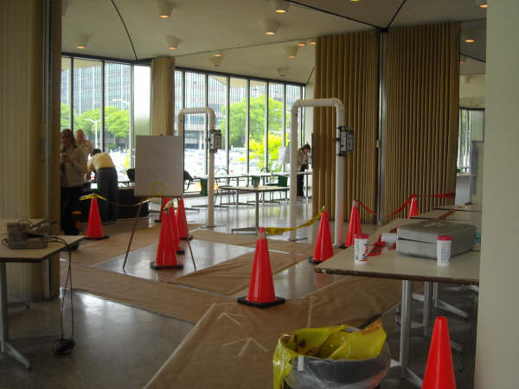
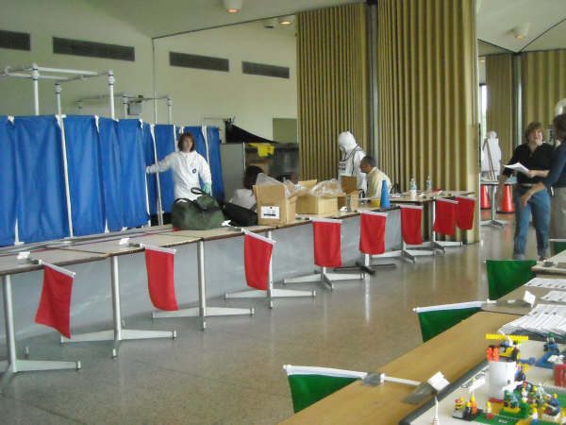
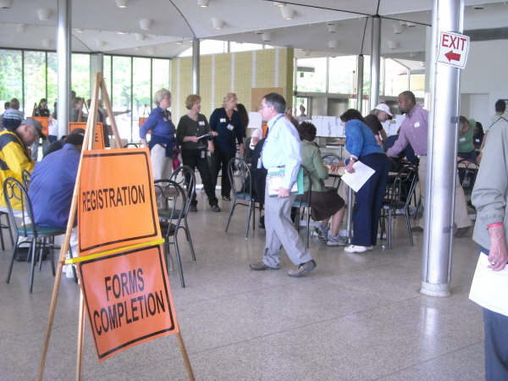
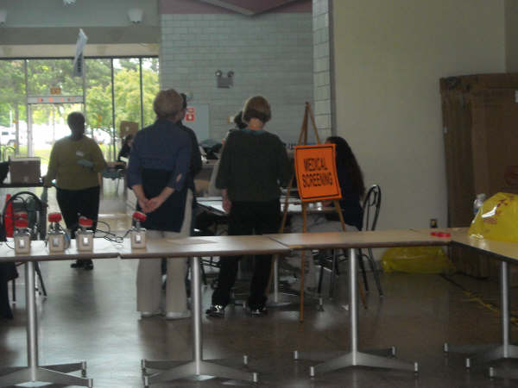
Community Reception Center

Slide 12
Urine Radiobioassay
Technique for measuring internal contamination with radionuclides using a urine sample
Urine radioactivity used, along with other variables, to estimate dose
Variables that improve dose estimation model precision
Age
Time of last urinary void
Time of sample collection
Height and weight
Limited capacity for rapid analysis of large number of samples

Slide 13
Example CRC Standardized Data Collection
Data Element | Reason for Collecting
Contact information | Enable short and long-term follow-up
Demographics | Describe affected populations, including vulnerable populations
Radiation contamination in face or chest area | Identify those at increased risk of internal contamination
Open wounds
Location at time of and following incident | Assess time, distance, and shielding factors
Inside building at time of and following incident
Time spent at or near incident site following incident
Signs and symptoms of acute radiation syndrome (ARS) | Identify those who may need immediate medical care
Height and weight | Improve dose estimation associated with bioassay result

Slide 14
Example Urine Radiobioassay Prioritization Criteria
Explosive RDD (Complex Engineering) | IND Detonation (10kT)
Age < 18 or pregnant female | Age < 18 or Pregnant female
Outdoors at time of explosion | Outdoors at time of explosion
Within 1 mile of explosion | Within 20 miles of explosion
External contamination detected around face and chest or known internal contamination | External contamination detected around face and chest or known internal contamination
Wounds or embedded foreign bodies from the explosion | Wounds or embedded foreign bodies from the explosion
First responder that worked at the scene of the explosion without PPE | First responder that worked at the scene of the explosion
Clinical co-morbidities/Injuries | Signs/symptoms of ARS
Receiving decorporation therapy | Receiving decorporation therapy

Slide 15
Long Term Health Studies
Monitor affected populations for health effects
Integrate data collected during the response phase into a health registry
Contact information
Epidemiology
Dose estimation
Timely public health response will improve ability to capture these data
Notes:
Finally, in the recovery phase a long term monitoring program will be likely established. If we collect accurate information during the event, it will improve dose reconstruction and risk assessment. While we need to balance the amount of information collected, we don’t want to collect information twice or throw away information that later will need to be recollected. Many of our tools can be simply interfaced with a long term registry thus saving work in the future.

Slide 16
Where Do PCs Fit In?
Surveillance
“Concerned citizens”
Exposed/possibly contaminated
Health effects
Countermeasures
Improper use of related products
Adverse events
Collection of data for epidemiologic investigations and studies
Dissemination of standard health communication messages

Slide 17
examples

Slide 18
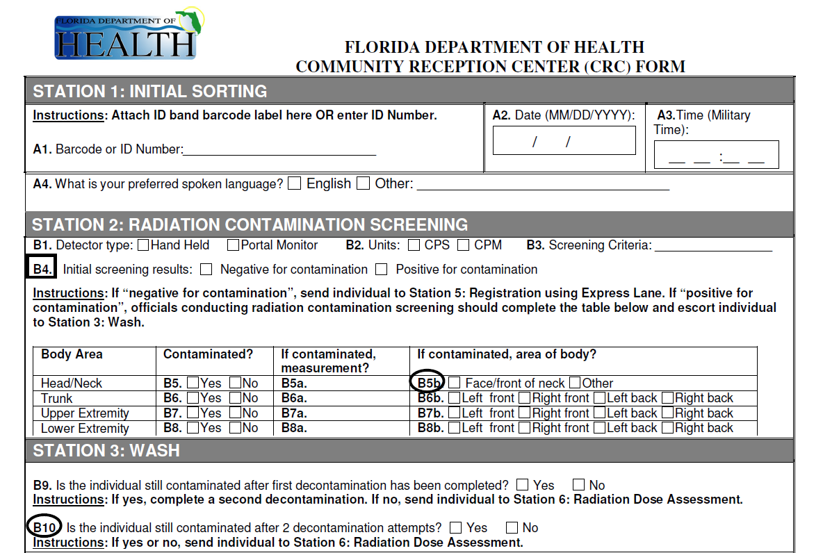
Exercise: Florida CRC

Slide 19
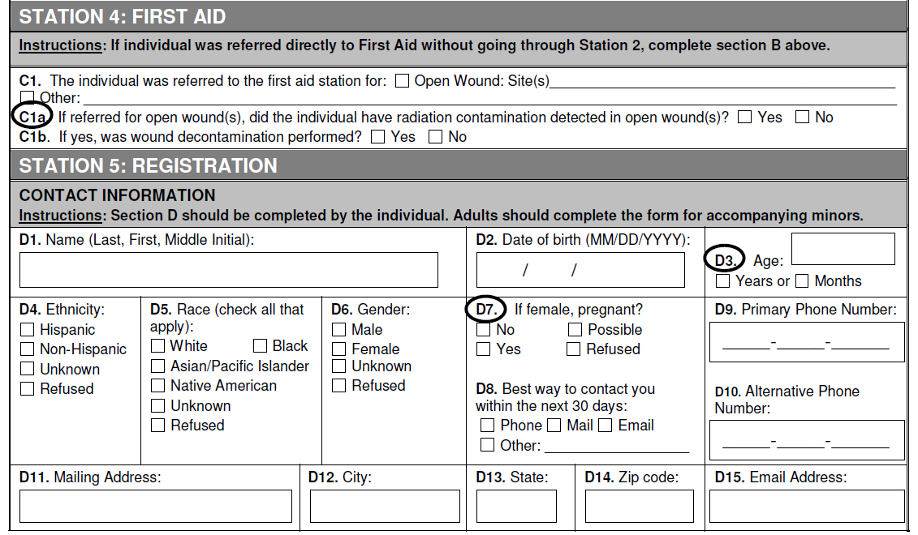
Exercise: Florida CRC

Slide 20
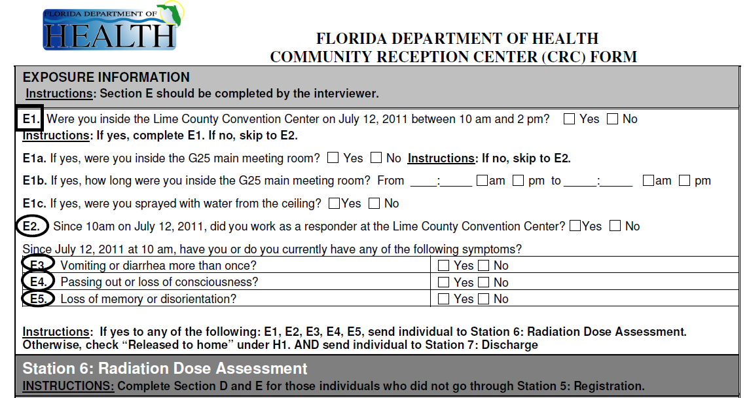
Exercise: Florida CRC

Slide 21
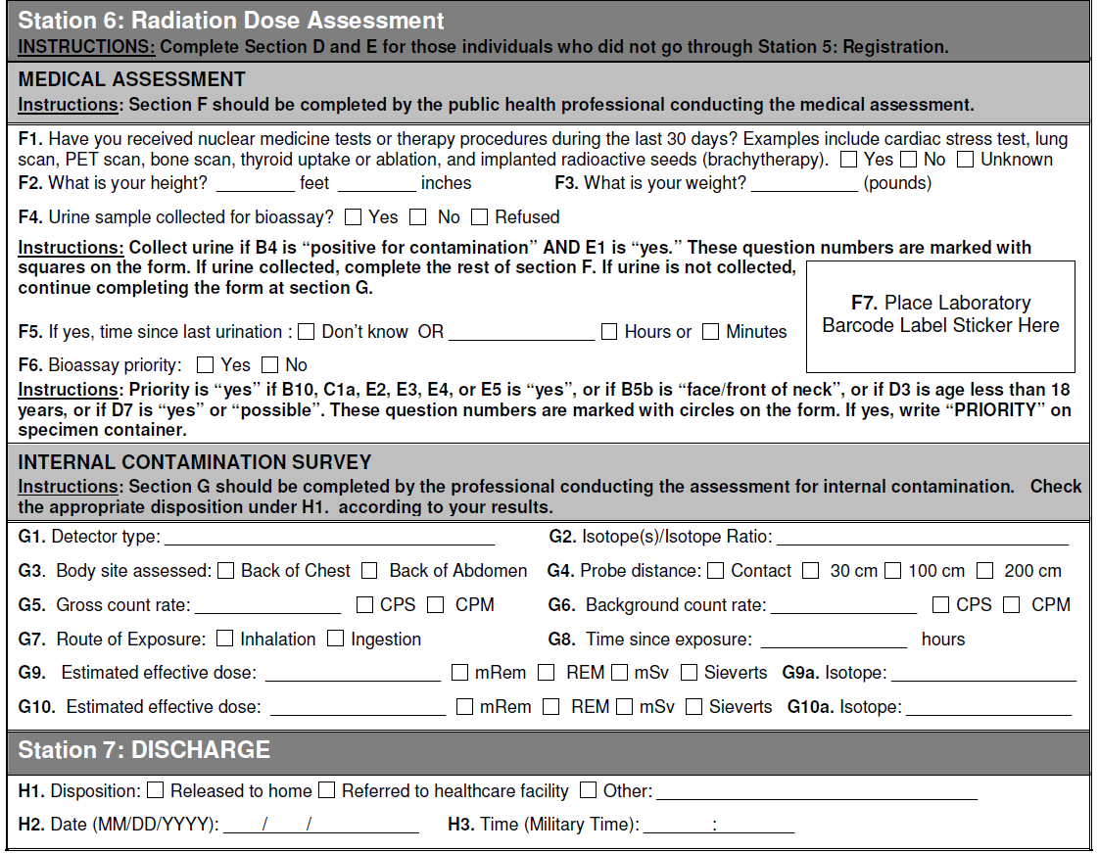
Exercise: Florida CRC

Slide 22
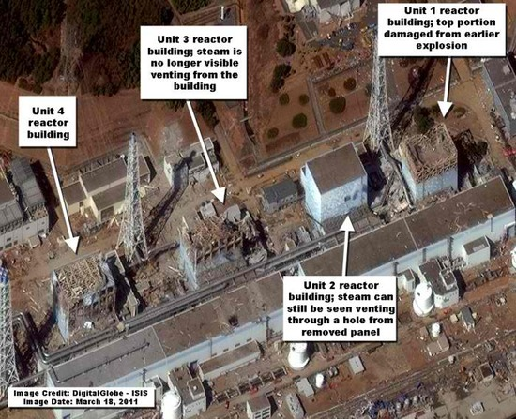
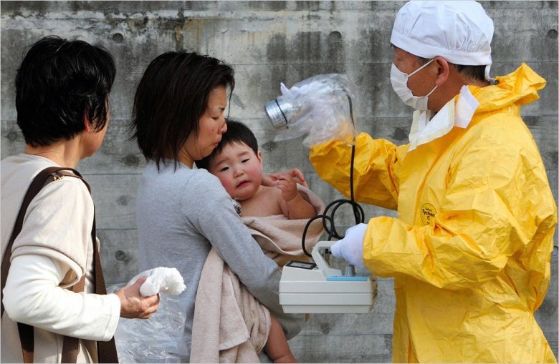
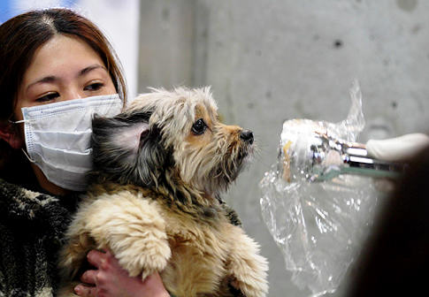
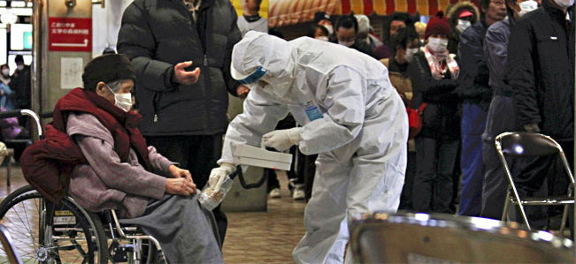
Response: Fukushima Disaster
170,000 evacuated from the 20-km radius
450,000 people in 2600 evacuation centers
Significant environmental and agricultural impact
Concern for contaminated travelers entering the US

Slide 23
Response: Fukushima Disaster
CBP Screening
Intervention and rescreen (if needed)
Public Health Follow up
Potential follow-up activities:
Radiation rescreening including thyroid count
Epidemiologic data collection
Urine collection for CDC bioassay, if necessary
Notes:
The CDC EOC was activated shortly after March 11, and one of the tasks was to design a traveler screening protocol by partnering with Customs and Border Protection. Turns out that CBP had been screening all travelers since 9/11 to detect radiological and nuclear terrorists. CBP’s existing protocols could deal with such terrorist as well as other potential medical radiation sources. They needed guidance for what to do in case many travelers came in contaminated. So our plan (this is the enhanced protocol) was to have CBP carry on screening and if anyone was above a certain threshold they would need to have an intervention (ie change of clothing, wipe) and go through rescreening. Then after the traveler arrived to their final destination, state radiation control and/or the state health department would follow up to obtain more information about their exposure and potentially perform additional radiation screening, epi data collection and urine collection if deemed necessary.

Slide 24
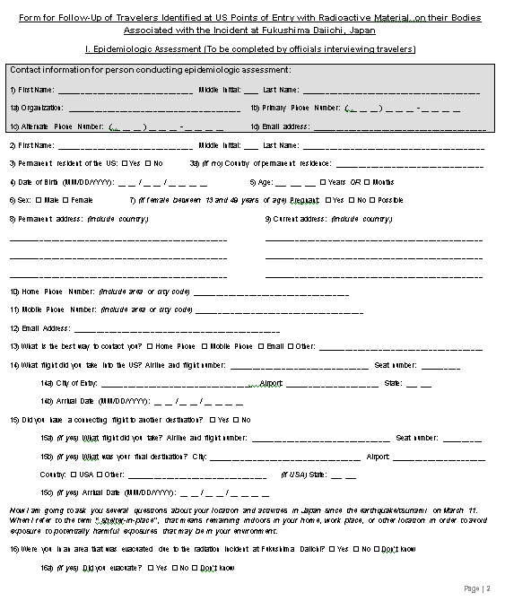
Response: Fukushima Disaster
Identify risk factors (e.g., proximity to incident, not sheltering in place, working in the affected area)
Context for rad assessment data
Improve accuracy of dose assessment if urine bioassay is collected
Contact info for further follow-up
Pending Traveler Consent
Notes:
We also developed an epi questionnaire that was released to states for use. A lot of the questions from this questionnaire were field tested during past radiation exercises.

Slide 25
Response: Fukushima Disaster
Using existing protocols, CBP detected 3 passengers with external radiological contamination (3/12/11, 3/16/11)
On 3/23/11, enhanced radiation screening protocol implemented at all U.S. POE
Approximately 543,000 passengers screened entering US from Japan at 25 US airports until 4/30/11
No additional passengers were detected to have radiological contamination
Notes:
What was the end result?: only 3 passengers were detected with external radiological contamination and they came through a few days before the enhanced protocol was implemented. The main protocol screened 543,00 passengers until May 2011 with no other contamination detected. Despite this, it was a good “dry run” for a national response to an international radiological incident.

Slide 26
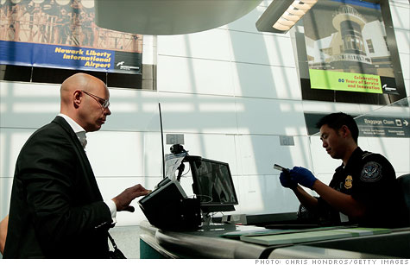
Response: Cardiogen Recall
In May 2011, CBP identified two passengers with internal contamination with radioactive strontium
Strontium-82 and strontium-85 are radionuclides contained in the Cardiogen infusion system
FDA and manufacturer trace-back revealed that individuals received the Cardiogen cardiac PET scans during recent months
Notes:
Cardiogen was recalled because in May 2011, 2 passengers were identified by CBP to have elevated levels of strontium internally and both had the cardiogen nuclear stress tests in February and March. This was not expected because residual radiation of radionuclides used in stress tests should not be present for this long.

Slide 27
Response: Cardiogen Recall
Multi-state, multi-clinic investigation
Convenience sample of states and clinics
Random selection of participants
Participant and Procedure Data Collection
Radiation Screening
Urine Collection
Whole Body Counting (subset of participants only)
Notes:
Working with our state partners, we conducted a multi state, multi clinic investigation. This was a convenience sample of states that had the radiation capacity and capability to perform this investigation rapidly and clinics that had enough patients that underwent this procedure. The participants were randomly selected from the pool of eligible patients.
After consent was obtained each participant had radiation screening using an isotope identifier, a short epi questionnaire, and a urine specimen. Based on their radiation screening results, a subset roughly 10%, were then flown to Oak Ridge National Lab in TN for whole body screening voluntarily.

Slide 28
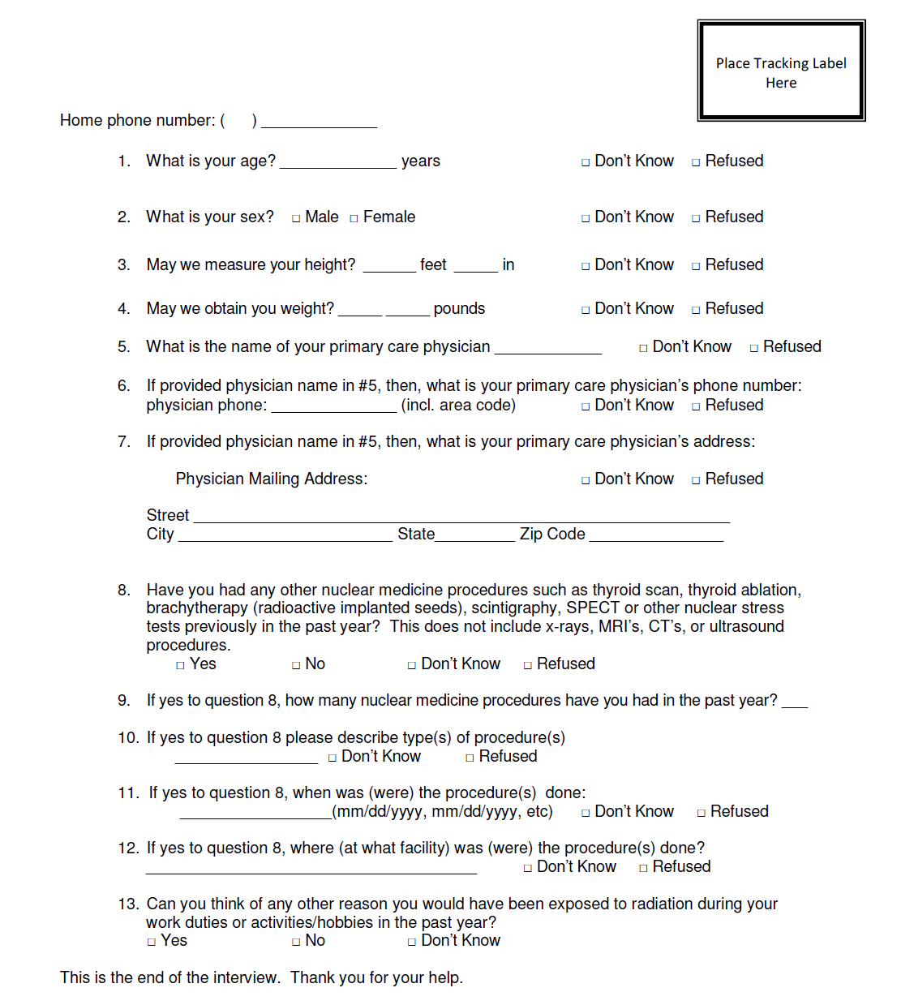
Response: Cardiogen Recall
Questionnaire provides context about possible radiation exposures
Data variables needed for dose reconstruction using radiation screening modalities
Notes:
This was the questionnaire that was used. It asked specific information about when the nuclear stress test was performed and whether they had other radiological procedures. Heigh, weight, age were also collected for dose reconstruction modeling.

Slide 29
Response: Cardiogen Recall
Radiation screening showed 5% > 2 times background
Urine radiobioassay 1 % had detectable activity
Whole body counting results
No detectable Sr-82 activity, but majority had Sr-85
None above NRC regulatory limits
Sr-85 doses did not add significantly to expected doses for procedure
Participant with highest dose had the highest result for all 3 tests!
Notes:
The radiation screening detected 16 participants above 2x background while the urine bioassay only detected 4 that were above background out of those. Out of the 23 participants that were sent for whole body counting, not one had detectable Sr-82 activity (because the half life is shorter), and virtually everyone had some level of Sr-85 activity but no one above the NRC regulatory limit. The interesting finding was that all 3 modalities consistently picked up the highest person. This means that radiation screening and urine bioassay may be used to determine who needs to be sent for whole body counting. WBC is still the most accurate modality that can give you dose reconstruction information.

Slide 30
Public Health Impact
Fukushima Japan Nuclear Disaster Response
Federal, state and local public health involvement
Negative radiation screening at POE reassured general public
Provided valuable lessons learned for a coordinated public health response to a national radiation emergency
Cardiogen Recall Investigation
Provided reassurance for patients that had procedure performed
FDA and manufacturer investigation revealed that “user error” was involved in index patients
Cardiogen-82 reintroduced with stricter use instructions and guidelines
Notes:
Both radiation responses had public health impact. The Fukushima disaster involved all levels of public health. Negative radiation screening provided reassurance to the general public. For the Cardiogen investigation, we did not find evidence of widespread internal contamination of strontium. The FDA and manufacturer investigations revealed that only those index sites were involved. This reassured all the other patients that had this procedure. Also, this led FDA and the manufacturer to re-introduce this product with better administration and monitoring guidelines.

Slide 31
Summary: Radiation Disaster Epidemiology
Epidemiology should be operationalized and integrated into emergency preparedness and response plans and processes
Epidemiologic principles can be used to prioritize limited resources
Epidemiologic tools need to be flexible and scalable based on the incident and available resources
Data collection should drive near-term decision-making
Pre-developed tools enable rapid implementation
Notes:
Epidemiology is useful during response and recovery after a radiological/nuclear event. A successful epi response will have tools develop prior to the event with input from state and local personnel. Tools need to be flexible, scalable and customizable to the individual event and site. They need to be succinct and capture only useful information.

Slide 32
Summary: Radiation Public Health Response
Public health functions and response activities are common with other disaster types
Population monitoring is a process to assess all potentially affected persons
CRCs can perform essential functions of population monitoring
Collaboration between public health and state radiation control personnel is essential

Slide 33
Radiation Public Health Resources
CDC Radiation Emergencies Website
http://www.bt.cdc.gov/radiation/
Forms, toolkits, Virtual CRC
National Alliance for Radiation Readiness
http://www.radiationready.org/
Forms, processes, sharing forums for best practices

Slide 34
Contact Information
Art Chang: ctn7@cdc.gov or (770) 488-1470
Colleen Martin: auq4@cdc.gov or (770) 488-1468
National Center for Environmental Health
Division of Environmental Hazards and Health Effects

Slide 35
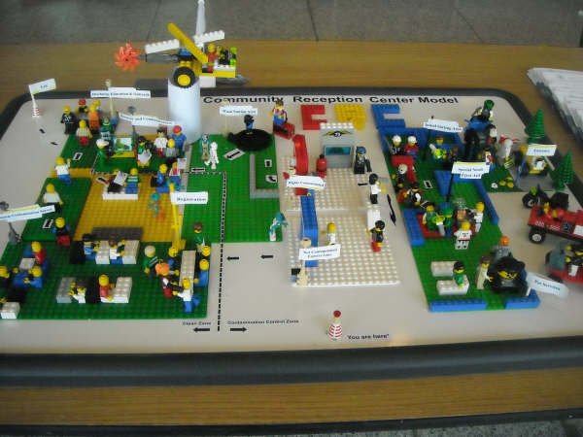
Thank you! Questions?
National Center for Environmental Health
Division of Environmental Hazards and Health Effects

Slide 36
Extra slides

Slide 37
Challenges
Limited capacity and resources: clinical laboratory, countermeasures, public health, healthcare
Fear/lack of familiarity
Complexities and scale

Slide 38
Council of State and Territorial Epidemiologists State-Level Radiation Preparedness Survey, 2012
Strengths
Majority of states had a written radiation response plan, and most plans include a detailed section for communications issues during a radiation emergency
More than half of the states indicated that their relationship with federal partners is sufficient to provide resources for radiation emergencies, indicating the importance states placed on federal resources and expertise

Slide 39
Council of State and Territorial Epidemiologists State-Level Radiation Preparedness Survey, 2012
Challenges
70%-84% of responding states had completed little to no planning for public health surveillance
Less than half had written plans to address exposure assessment, environmental sampling, human specimen collection and analysis, and human health assessment
11% reported having sufficient resources to do public health surveillance and no more than 24% had sufficient resources for radiation exposure assessment
Average overall subjective radiation emergency preparedness “score” was 4.54 on a scale of 1 to 10 among the 37 states that provided a score.

Slide 40
Emergency Support Functions
ESF #1 - Transportation
ESF #2 - Communications
ESF #3 - Public Works and Engineering
ESF #4 - Firefighting
ESF #5 - Emergency Management
ESF #6 - Mass Care, Emergency Assistance, Housing and Human Services
ESF #7 - Logistics Management and Resource Support
ESF #8 - Public Health and Medical Services
ESF #9 - Search and Rescue
ESF #10 - Oil and Hazardous Materials Response
ESF #11 - Agriculture and Natural Resources
ESF #12 - Energy
ESF #13 - Public Safety and Security
ESF #14 - Long-Term Community Recovery
ESF #15 - External Affairs
www.fema.gov/emergency/nrf/

Slide 41
Incident Annexes
Biological Incident
Catastrophic Incident
Cyber Incident
Food and Agriculture Incident
Mass Evacuation Incident
Nuclear/Radiological Incident
Terrorism Incident Law Enforcement and Investigation
www.fema.gov/emergency/nrf/

Slide 42
CASPER
Potential CASPER applications
Community knowledge, attitudes, and practices associated with preparedness for a radiological public health emergency
Nuclear power plant-specific community preparedness in the 10-mile protection zone
Community needs among households returning to the relocation zone after a radiological public health emergency
Radiation CASPER module in development

