Slide 1
Health Effects after Radioactive Contamination
Art Chang MD MS
National Center for Environmental Health
Division of Environmental Hazards and Health Effects
Health Studies Branch
National Center for Environmental Health
Division of Environmental Hazards and Health Effects
Notes:
Good morning.

Slide 2
Disclaimer
The findings and conclusions in this presentation are those of the author(s) and do not necessarily represent the official position of the Centers for Disease Control and Prevention/the Agency for Toxic Substances and Disease Registry

Slide 3
Outline
Differences between Radioactive Exposure and Contamination
Health Effects after External Contamination
Assessment of external contamination
Decontamination procedures
Health Effects after Internal Contamination
Assessment of internal contamination
Medical countermeasures for internal contamination

Slide 4
Radiation Emergencies
Exposure
RED
Contamination
NPP Accident
RDD
IND
RED= Radiological Exposure Device
IND= Improvised Nuclear Device
RDD= Radiological Dispersal Device
NPP= Nuclear Power Plant

Slide 5
External Contamination

Slide 6
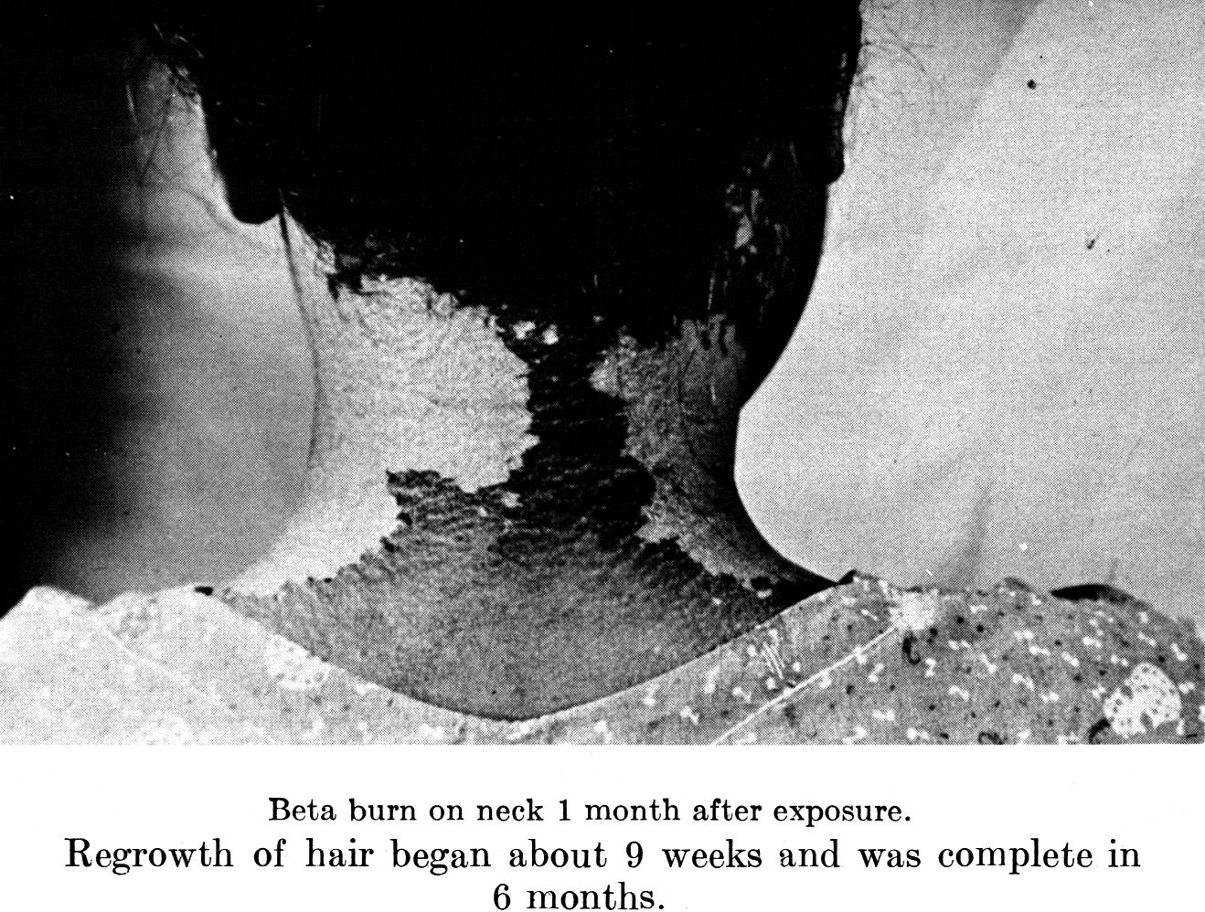
External Contamination
Health effect is local radiation injury from beta and gamma emitters
Initially, there may be no symptoms
Dose continues until contamination is removed
Source: Dunning, US AEC 1957

Slide 7
External Contamination
External contamination increases risk of internal contamination
Alpha particles cannot penetrate the skin, but they can be internalized
Personal protective equipment (N95 mask and gown/gloves) should be worn by personnel at medical facilities
Treat critical medical conditions first! (even before decontamination)

Slide 8
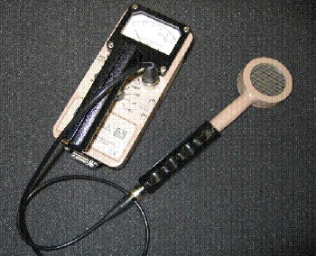
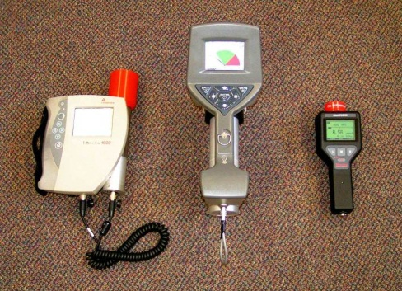
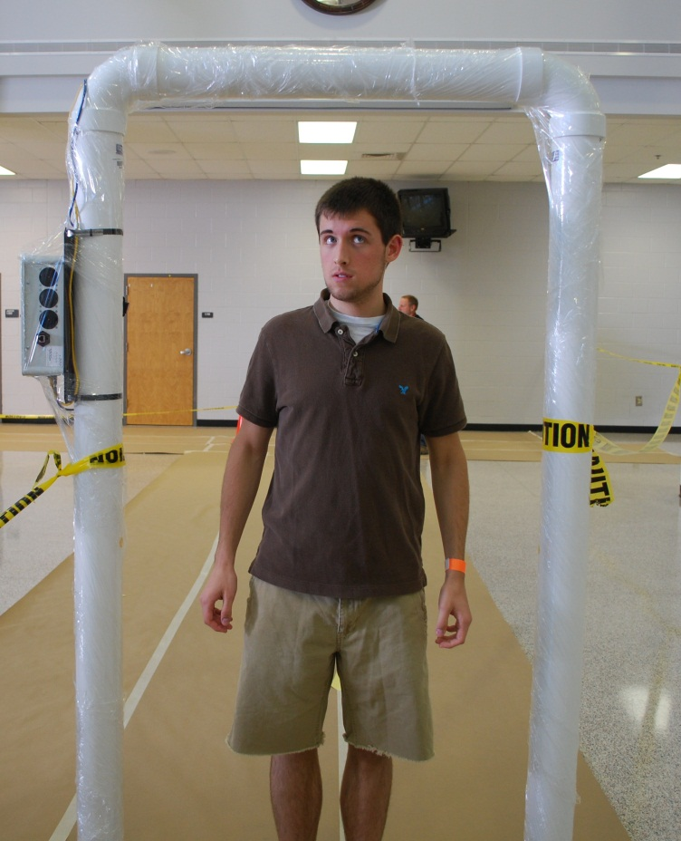
Measuring External Contamination
Geiger-Muller
Portal Monitor
Isotope identifier
Source: http://www.remm.nlm.gov/

Slide 9
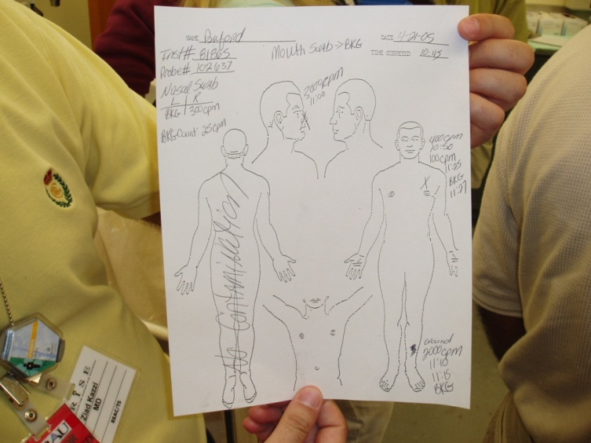
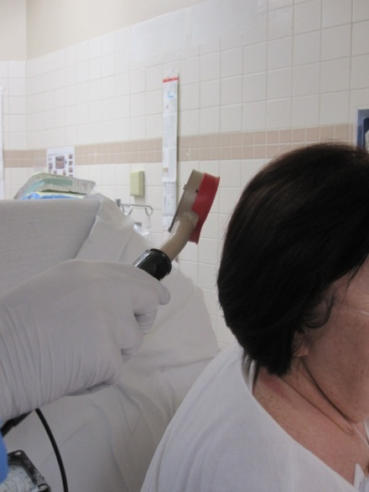
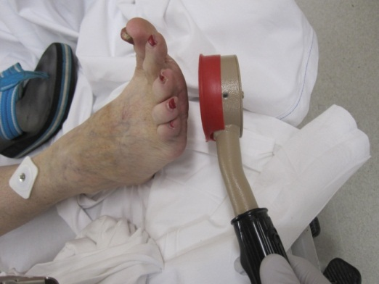
Contamination Survey

Slide 10
Decontamination
Skin contamination intervention levels for beta/gamma in low background area (NCRP/EPA):
Decontamination advisable (2-3 times background)
Decontamination required (20-30 times background)
Intervention levels may be set higher during emergency evacuation
Notes:
According to guidance from the National Council on Radiation Measurement and Protection and the EPA, skin decontamination is advisable when skin contamination measures 2-3 times above background radiation. Decontamination is required when measurements reach 20-30 times background radiatoin. These intervention levels may be increased depending on the situation. For example, in Fukushima, their decontamination threshold was even higher because the risks of dying from the tsunami was greater than the risk of any health effects due to the contamination.

Slide 11
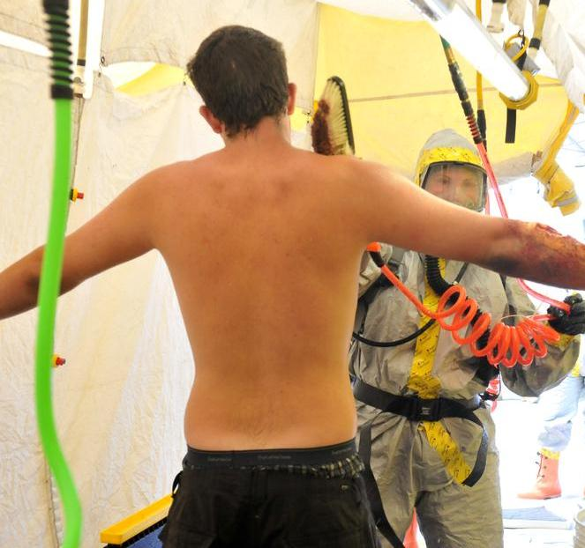
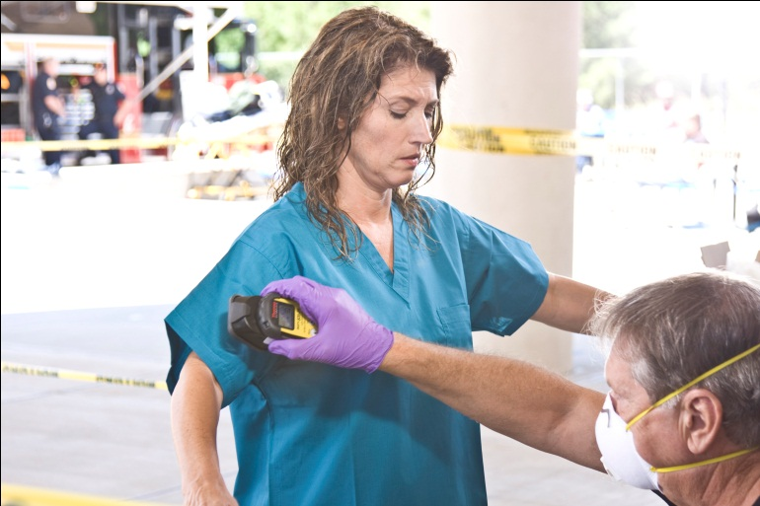
Decontamination
Goal is to remove radioactive material minimizing internal contamination
Goal is < 2 times background or 2 decontamination attempts
Repeat radiation survey after each attempt

Slide 12
Internal Contamination
External
Routes of Internalization
Inhalation
Ingestion
Injection or Wounds

Slide 13
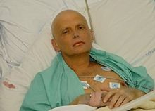
Health Effects after Internal Contamination
Internal contamination increases risk of developing cancer years later
Acute symptoms are very rare and usually due to ARS
Cesium-137 (Goiania)
Polonium-210 (London)
Source: Public media

Slide 14
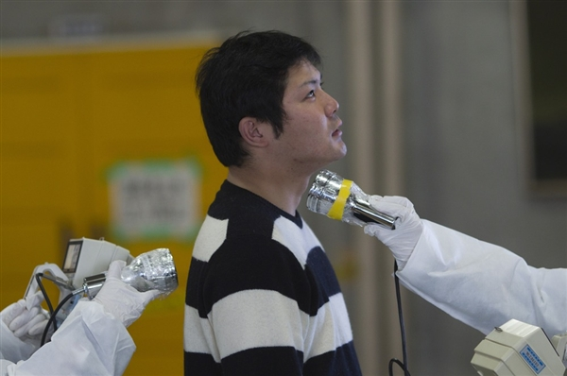
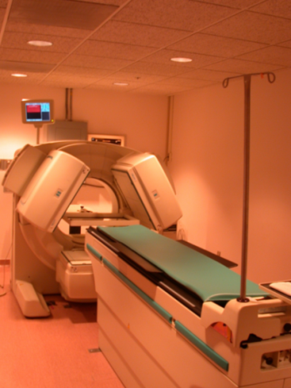
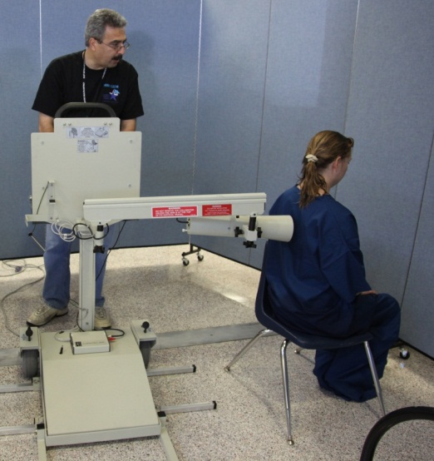
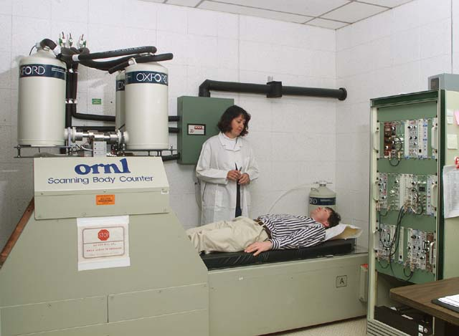
Measuring Internal Contamination (Direct)
Field Instruments
Medical Facility Diagnostics

Slide 15
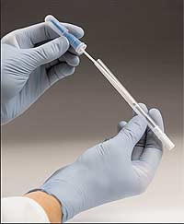
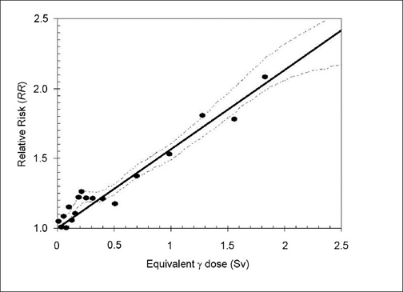
Measuring Internal Contamination (Indirect)
Nasal swab detects presence of radionuclides in nostrils as inhaled dose
Urine and feces bioassays measure excreted radionuclides
All require calculations and modeling for dose assessment interpretation

Slide 16
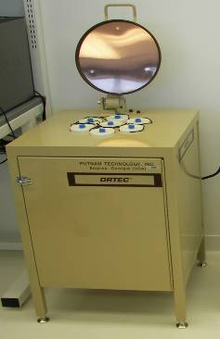
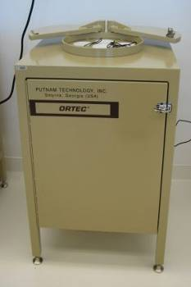
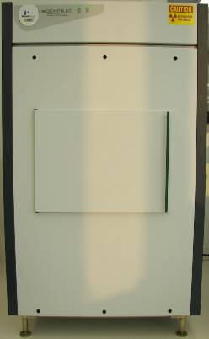
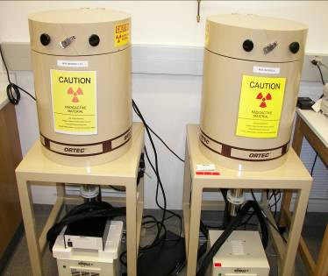
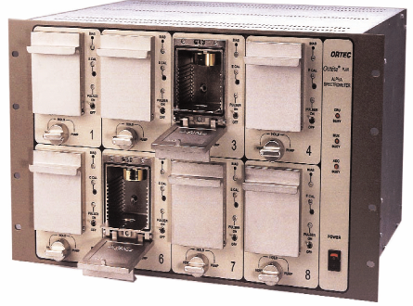
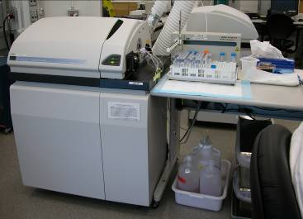
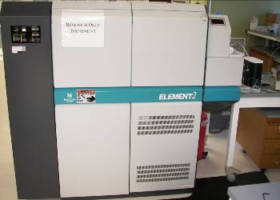
CDC Urine Bioassay
Urine Sample “Spot”
Gamma Radionuclide Screen
Alpha/Beta Radionuclide Screen/Quantification
Alpha (Long Lived) ICP-MS Screen
Gamma Radionuclide
Quantification
Alpha Spectroscopy
Quantification
Mass Spectroscopy
Quantification
High Resolution
Mass Spectroscopy
Quantification
Notes:
16

Slide 17
Why Screen for Internal Contamination?
Identify people who could most benefit from medical intervention (e.g., decorporation therapy)
Identify people whose health need long-term monitoring
Provide reassurance to people who suspect internal contamination
Smaller Population
Larger Population

Slide 18
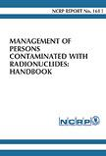
Countermeasures
Countermeasures are medications used to treat internal contamination
Increased efficacy when administered sooner after intake
Countermeasures should be administered if intake exceeds Clinical Decision Guide (CDG)
New operational quantity that takes into account acute and latent health effects

Slide 19
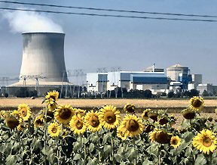
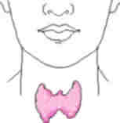
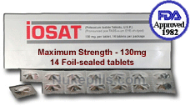
Potassium Iodide (KI)
Radionuclide: Iodine-131
Setting: Nuclear reactor accident, IND
Half-life: 8 days
Health effect: Thyroid cancer and hypothyroidism
Mode of Action:
Blocks uptake of I-131 into thyroid

Slide 20
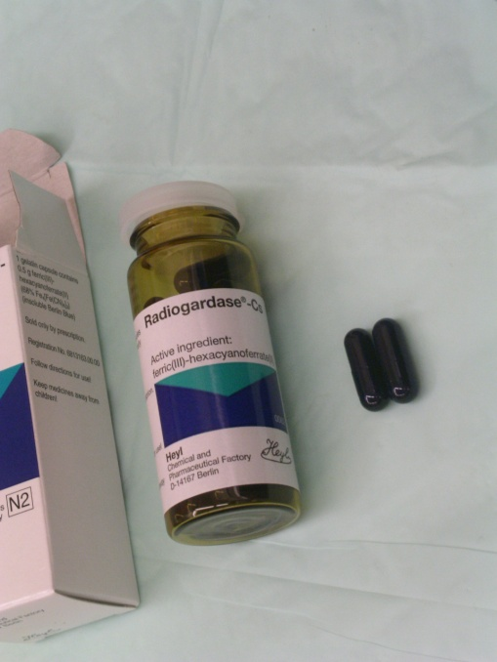
Prussian Blue
Radionuclide: Cesium-137
Setting: Nuclear reactor accident, IND, RDD
Half-life: 30 years
Target organ: whole body
Health effect: Cancer, ARS
Mode of Action:
Enhances GI elimination of Cesium

Slide 21
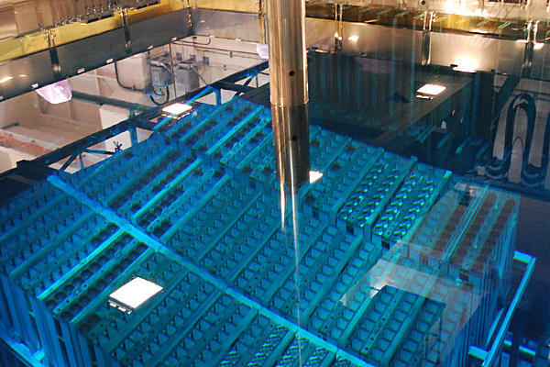
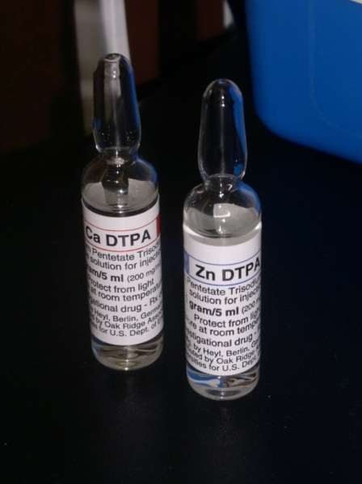
Calcium and Zinc DTPA
Radionuclides: Plutonium, Americium, Curium and other actinides
Setting: Nuclear spent fuel, IND
Half-life: Days to years
Target organs: Bone, lung, liver
Health effect: Cancer
Mode of Action:
Enhances renal elimination
Notes:
Calcium given first day 1g iv or neb. Calcium DTPA has 10 times more efficacy in the first 24 hours. Then switch to zinc DTPA which has less side effects. All actinides except for thorium, neptunium and uranium. Highest efficacy within 1 to first 24 hours.
DTPA-diethyl entriamine penta acetate

Slide 22
Long-Term Registry
Exposed populations will require long-term follow up
Some important information to collect
Contact info, demographics, medical history
Exposure factors (distance, time, shielding)
Presence/type of contamination
Radionuclide involved and dose estimate
Countermeasures administered

Slide 23
Radiation Emergencies Handbooks
National Council on Radiation Protection and Measurements (NCRP) Report 161: Management of Persons Contaminated with Radionuclides
Guidance on CDG, diagnosis, medical therapy
http://www.ncrponline.org
TMT Handbook: Triage, Monitoring and Treatment of people exposed to ionizing radiation following a malevolent act
Emergency response planning, field manual
http://www.tmthandbook.org

Slide 24
Radiation Emergency Resources
CDC Radiation Emergencies Website
http://www.bt.cdc.gov/radiation/
Guidance/Recommendations, Resources
Radiation Emergencies Assistance/ Training Center (DOE)
http://orise.orau.gov/reacts/
Consultations, training requests
Radiation Emergency Medical Management (DHHS)
http://www.remm.nlm.gov/index.html
Guidance/Recommendations, Resources

Slide 25
Questions?
Contact Information
Art Chang: ctn7@cdc.gov or (770) 488-1470
National Center for Environmental Health
Division of Environmental Hazards and Health Effects

